Slide 1
MP4 To HLS Cloudfront Distribution

Slide 2
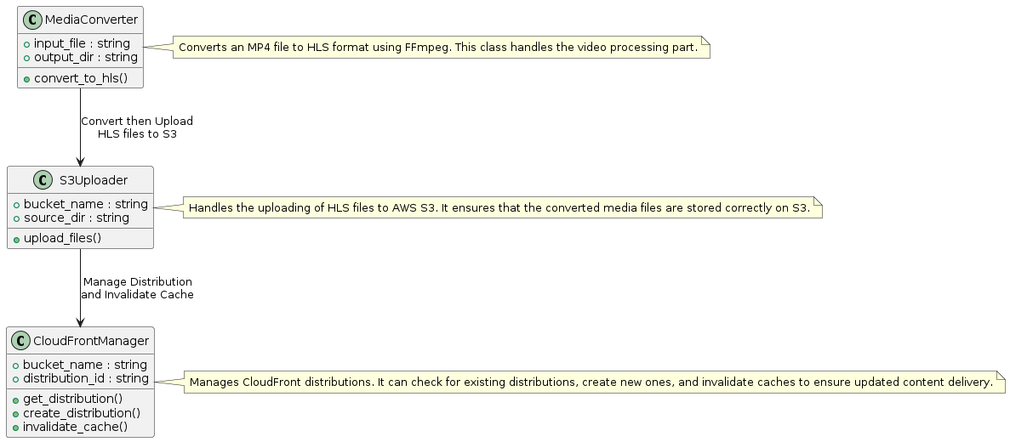
Overview

Slide 3
Steps

Slide 4
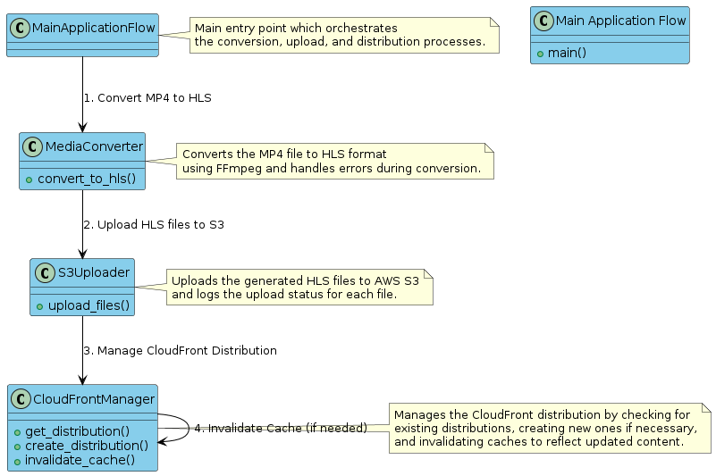
Process Diagram

Slide 5
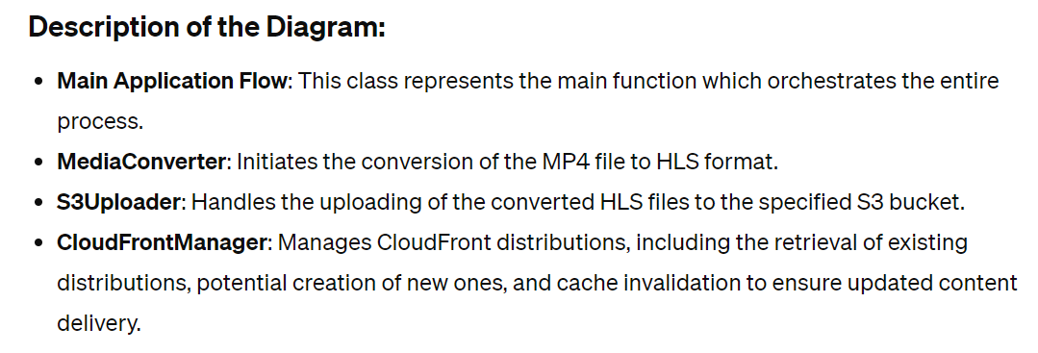

Slide 6
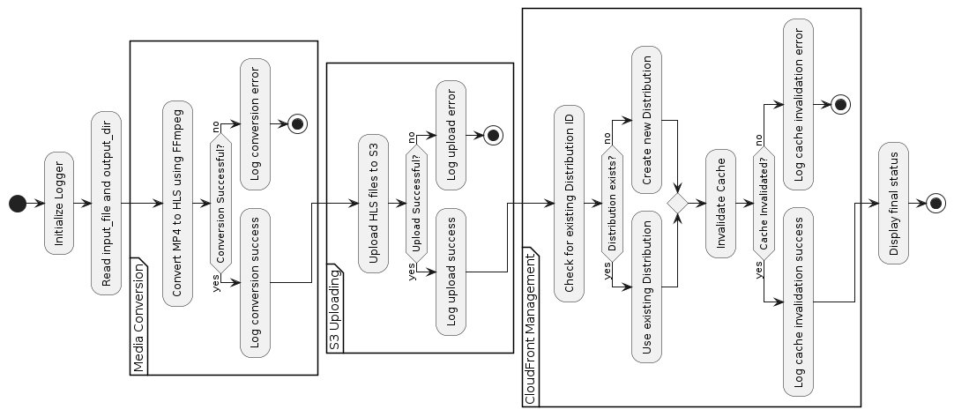
Flow-diagram

