Slide 1
MP4 To HLS Cloudfront Distribution

Slide 2
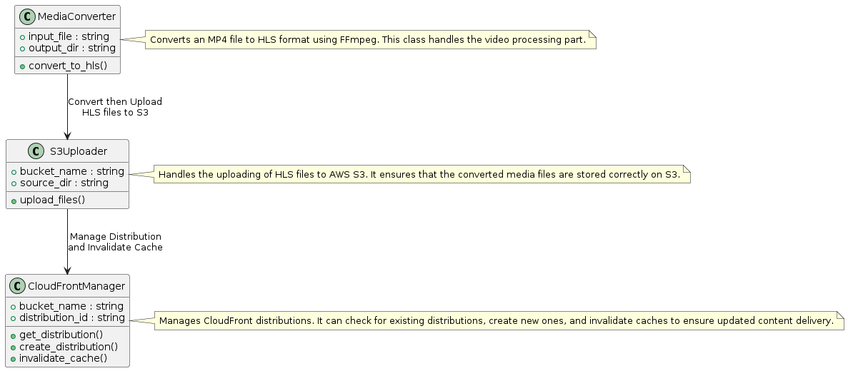
Overview

Slide 3
Steps

Slide 4
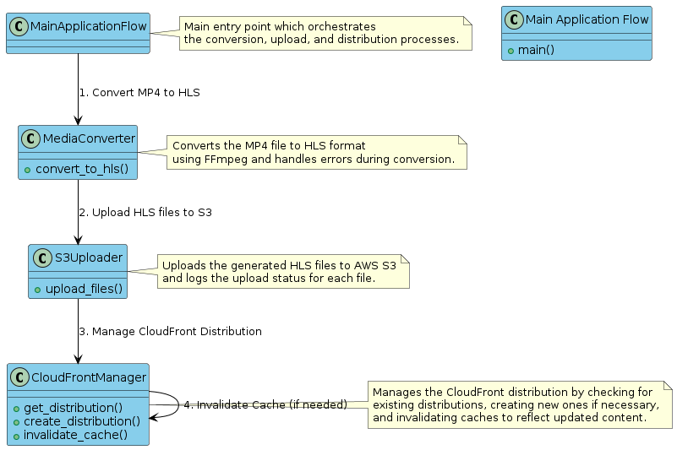
Process Diagram

Slide 5
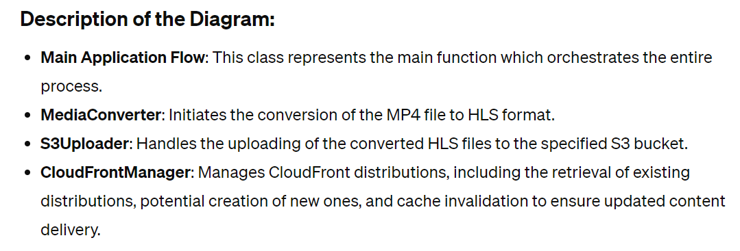

Slide 6
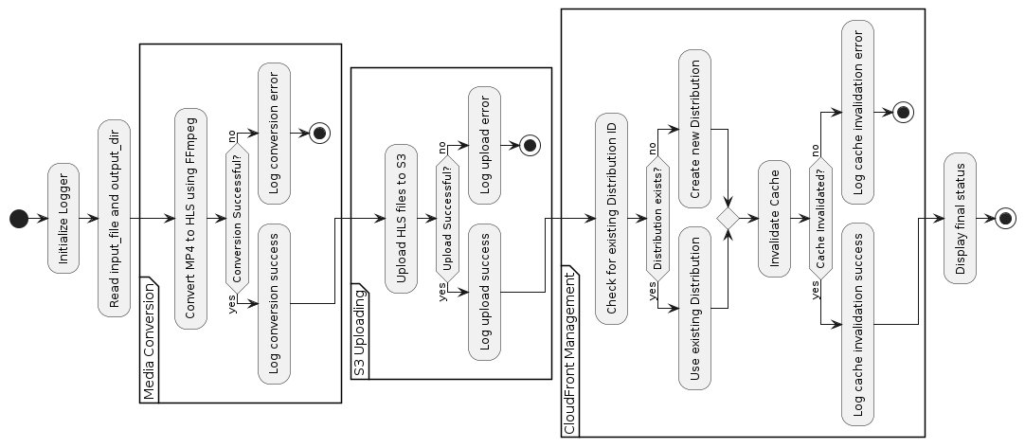
Flow-diagram

Slide 7
Update the Cache of the CloudFront distribution
Step 1: Set Up an S3 Bucket
Assuming you already have an S3 bucket where HLS files are stored, ensure it’s correctly configured to store your HLS files. If not, follow these steps to create one:
Log in to the AWS Management Console.
Navigate to the S3 service and click Create bucket.
Enter a bucket name and select the region.
Leave all other settings as default or configure them according to your organizational policies and click Create.

Slide 8
Update the Cache of the CloudFront distribution
Step 2: Create a Lambda Function
Navigate to the AWS Lambda console and click the Create function.
Choose the Author from scratch. Enter a function name, and select Python 3.8 as the runtime.
Under Permissions, choose or create an execution role that has at least the basic Lambda permissions plus permissions to read from S3 and invalidate CloudFront distributions.
Click the Create function.

Slide 9
Update the Cache of the CloudFront distribution
Step 3: Set S3 Event Notifications
Go to your S3 bucket in the S3 console.
Click on Properties > Event notifications.
Click Create event notification.
Name your event, and select All object create events and All object delete events under the “Events”.
Under “Destination”, select the Lambda function.
Choose the Lambda function you created in Step 2.
Click Save changes.

Slide 10
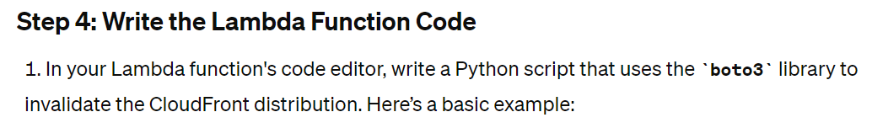
Update the Cache of the CloudFront distribution
import boto3
def lambda_handler(event, context):
# Create CloudFront client
cf = boto3.client(‘CloudFront)
# Define the CloudFront distribution ID and the file paths to invalidate
distribution_id = 'YOUR_DISTRIBUTION_ID'
items = [{'Quantity': len(event['Records']), 'Items': [record['s3']['object']['key'] for record in event['Records']]}]
# Create invalidation
response = cf.create_invalidation(DistributionId=distribution_id,
InvalidationBatch={
'Paths': items,
'CallerReference': str(context.aws_request_id)
})
return response

Slide 11
Update the Cache of the CloudFront distribution
Step 5: Configure IAM Roles and Permissions
Ensure the IAM role used by your Lambda function has the following policies attached:
AmazonS3ReadOnlyAccess
CloudFrontFullAccess (or a custom policy with permissions to invalidate CloudFront distributions).
To add permissions, go to the IAM service, find the role, and attach the policies.
Step 6: Test and Validate
Upload a new file to your S3 bucket or update an existing file.
Check the Lambda function logs in CloudWatch to verify it triggered correctly and executed without errors.
Check your CloudFront distribution’s cache to ensure the specified paths were invalidated.

