Slide 1
Understanding the HLS Stream Protocol

Slide 2
Overview of HLS
HLS works by breaking down a video stream into a sequence of small HTTP-based file downloads. Each segment of the stream is a short-duration chunk of the overall stream, typically around 2-10 seconds long. This segmentation approach allows for easy adaptation to different internet connection speeds and quick recovery from any disruptions in connectivity.
Components of HLS
HLS primarily consists of three components:
Media Segments: These are short media files. Each segment contains a portion of the content, typically encoded at the same bitrate.
Playlist Files (Manifest): There are two types of playlists in HLS:
Master Playlist: Lists all available media playlists, each typically a different resolution or bitrate enabling adaptive streaming.
Media Playlist: Describes a sequence of media segments, providing URLs and information needed for playback of these segments.

Slide 3
Creation of HLS Content
Encoding: The original content (like a video file) is encoded into multiple bitrates and resolutions to support adaptive streaming.
Segmentation: The encoded files are then split into multiple, short-duration media segments (files).
Playlist Generation: A master playlist that references all the media playlists, and individual media playlists that list all the segments for a particular stream are created.
Serving HLS Content
Web Server: HLS files (segments and playlists) are hosted on a standard web server and served over HTTP/HTTPS.
Content Delivery Network (CDN): Often, to reduce latency and handle high traffic, HLS content is distributed through CDNs.

Slide 4
Playing Back HLS Content
Fetching Playlists: The client (like a video player) first downloads the master playlist, and from it, selects a suitable media playlist based on the network conditions, device capabilities, or user preferences.
Downloading Segments: The client then requests the media segments as listed in the selected media playlist, downloads them, and starts playback.
Adaptive Streaming: During playback, the client can switch between different media playlists (and thus different bitrates) depending on changing network conditions to maintain smooth playback without buffering.
Client-Side Handling
Buffering: The client buffers several segments ahead of the current playback position to ensure smooth viewing experience even if temporary network issues occur.
Handling Failures: If a segment fails to download, the client can retry the download or switch to a lower bitrate stream if the network bandwidth appears insufficient.

Slide 5
Let’s Deep-dive more on HLS Components
Media Segments
Media segments are the core elements of HLS streaming, consisting of small chunks of the video content, typically 2-10 seconds in length. These segments are:
File Formats: Usually in the .ts (MPEG-2 Transport Stream) format, though they can also be in .mp4.
Encoding: Segments are encoded at various bitrates and resolutions to enable adaptive streaming. For a pause-and-play feature with a 30-minute buffer, you will need to manage the storage and timely retrieval of these segments effectively.
Storage: In a live streaming scenario, segments are continuously generated by the server and need to be stored temporarily for the buffer period. For a 30-minute buffer, your system must handle the rolling storage of segments efficiently, ensuring that older segments are expired and new ones are available.

Slide 6
Let’s Deep-dive more on HLS Components
Playlist Files (Manifest)
Playlists manage the organization and access to media segments. There are two types:
Master Playlist
The master playlist is crucial for adaptive streaming, as it contains references to all available media playlists, each tailored for different network conditions or device capabilities. Key points include:
Content Organization: Lists all media playlists with attributes such as bandwidth and resolution.
Dynamic Management: In a live streaming setup with a buffering feature, the master playlist needs to be dynamically updated to reflect changes in the media playlists due to the rolling buffer.
Media Playlist
These playlists are critical for the actual streaming and management of content. They provide:
Segment References: Each media playlist includes URLs to the actual media segments and information like duration and sequence number.
Rolling Window: For a 30-minute pause and play buffer, the media playlist acts as a rolling window over the live stream. This means it needs to constantly update to reference the last 30 minutes of segments.
EXT-X tags: Certain tags in the media playlist, like EXT-X-PLAYLIST-TYPE and EXT-X-ENDLIST, can control playlist behavior (e.g., making the playlist behave as a sliding window over a live stream).

Slide 7
Let’s Deep-dive more on HLS Components
Implementation Considerations for 30-Minute Buffer Feature
Implementing this feature involves several key architectural and developmental considerations:
Buffer Management:
Storage: Efficiently storing and managing a rolling buffer of HLS segments, likely on a cloud platform like AWS S3.
Expiration: Automatically managing the lifecycle of segments so that only the last 30 minutes are retained.
Playlist Updates:
Real-time Updating: Media playlists must be updated in real-time to adjust the available segments as the buffer rolls over time.
Accuracy: Ensuring that the timestamps and sequence numbers in the playlists are meticulously managed to prevent any playback issues.
Client-Side Logic:
Fetching Strategy: The client (media player) needs to intelligently handle the downloading and caching of segments to allow for seamless pausing, playing, and seeking within the buffered period.
Adaptive Bitrate Switching: Handling bitrate switching smoothly in the context of the buffered content to adapt to changing network conditions without disrupting the buffered content.

Slide 8
Let’s Deep-dive more on HLS Components
Server-Side Processing:
Segment Generation and Cleanup: Efficiently generating new segments and cleaning up old ones while keeping the integrity of the stream intact.
Manifest Manipulation: Dynamically modifying the manifest files to accurately reflect the current state of the buffer.
Testing and Scalability:
Load Testing: Ensuring the system can handle the expected load of simultaneous users interacting with the buffer.
Scalability: Architecting the system to scale, both in terms of storage and computational power, to handle peak loads.

Slide 9
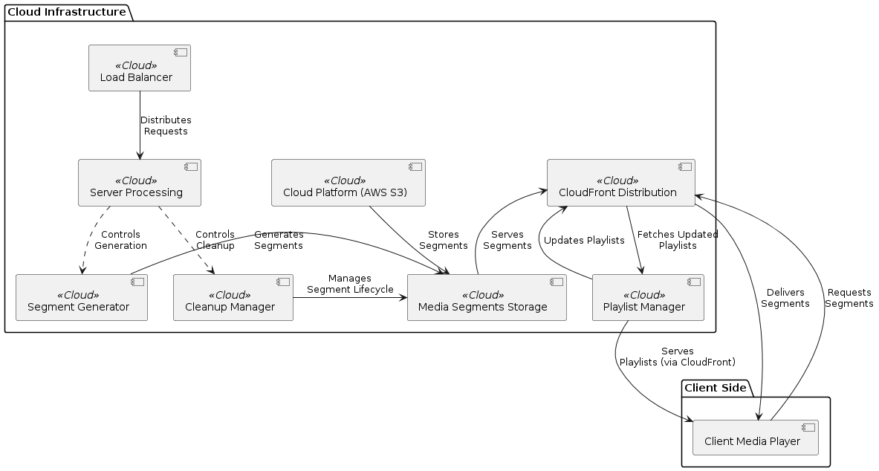
Overview

Slide 10
Logical order of Execution of POC
Segment Generator
Tasks:
Fetch HLS Livestream:
Implement a service to fetch the HLS live stream from the third-party URL.
Ensure the service handles different HLS URL formats and protocols.
Segment Generation:
Use FFmpeg or a similar tool to re-segment the incoming livestream into smaller HLS segments.
Generate segments in various bitrates for adaptive streaming.
Error Handling and Logging:
Implement robust error handling to manage network issues or segmentation errors.
Set up logging mechanisms to track the segment generation process and troubleshoot issues.
Testing:
Test segment generation for various network conditions to ensure robustness.
Verify the integrity and playback quality of the generated segments.

Slide 11
Detailing for Segment Generation
1. Segment Generator Requirements Breakdown
Key Challenges
Fetching HLS Livestream:
Handling different HLS URL formats and protocols.
Ensuring a stable connection to the livestream.
Segment Generation:
Using FFmpeg to segment the livestream efficiently.
Generating segments in various bitrates for adaptive streaming.
Error Handling and Logging:
Managing network issues or segmentation errors.
Tracking the segment generation process for troubleshooting.
Testing:
Testing under various network conditions.
Ensuring the integrity and playback quality of generated segments.

Slide 12
Detailing for Segment Generation
2. Development Structure
We'll develop a Python service using classes to encapsulate the functionality, ensuring the code is easy to extend for multiple resolutions and bitrates.
The main components will be:
HLSFetcher: To fetch the livestream.
SegmentGenerator: To handle the segmentation using FFmpeg.
Logger: For logging information and errors.
MainService: The orchestrator to tie everything together.

Slide 13
Detailing for Segment Generation
3. Implementation
File Structure
segment_generator/
├── fetcher.py
├── generator.py
├── logger.py
├── main_service.py
└── requirements.txt

Slide 14
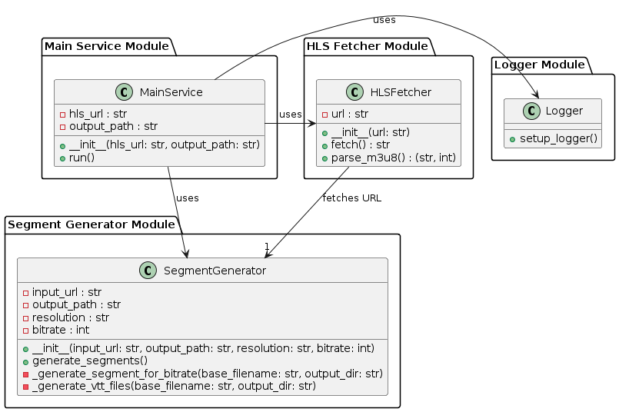
Segment Generation – Initial Design

Slide 15
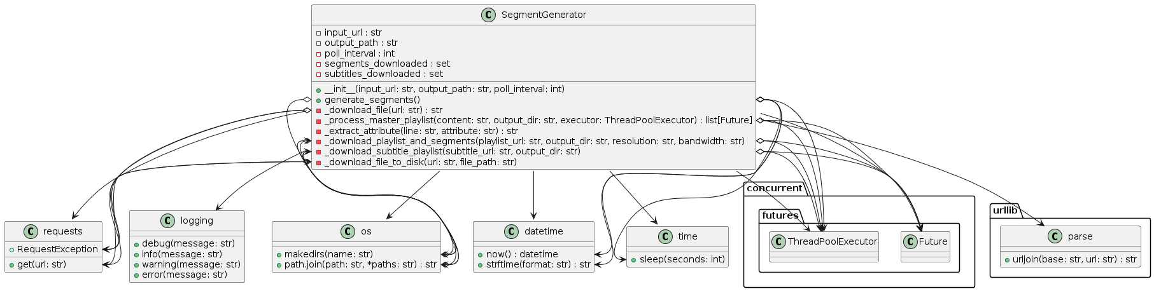
SegmentGenerator class diagram

Slide 16
Folder structure for manifest file,
ts, and subtitles with different resolutions and bitrate
Approach 01
All Files in One Directory
Pros:
Ease of Access: All files related to a particular playlist are in one location, simplifying access and management.
Simpler Path Management: Relative paths within the playlist do not need to account for separate directories for subtitles.
Fewer Directories: Reduced directory depth can make file traversal simpler.
Cons:
Cluttered Directory: As the number of files grows, the directory can become cluttered, making it harder to manage.
Scalability Issues: Managing a large number of files in a single directory can become difficult

Slide 17
Folder structure for manifest file,
ts, and subtitles with different resolutions and bitrate
Approach 02
Separate Directory for Subtitles
Pros:
Organization: Separating subtitles into their directory helps keep the main directory cleaner and more organized.
Scalability: Easier to manage as the number of subtitle files grows, especially if there are multiple languages or versions.
Clear Separation of Concerns: Logical separation of video and subtitle files can make maintenance easier.
Cons:
Path Management: Requires managing paths to subtitle files separately in the playlist, which can add complexity.
Access Complexity: We might need additional logic to fetch and serve subtitle files from a separate directory.

Slide 18
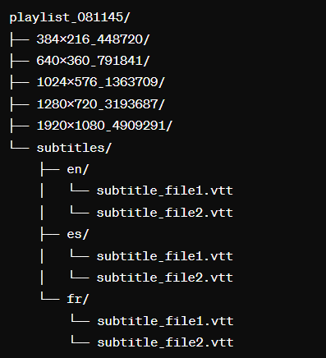
Folder structure for manifest file, ts, and subtitles with different resolutions and bitrate | => Conclusion
Best Practice Recommendation
A good practice is to use a separate directory for subtitles. This approach provides better organization and scalability, especially if you have a large number of subtitle files or multiple languages. An example structure is shown here on the right side.
Conclusion - This structure keeps your main directory focused on video quality variations while providing a clear, organized location for subtitle files, making it easier to manage and scale as needed.

Slide 19
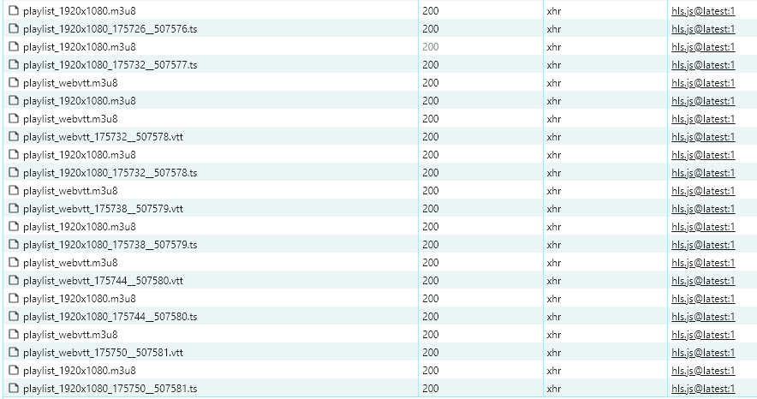
Segment Generation -Sample from Player for reference

Slide 20
Logical order of Execution of POC
Media Segments Storage (S3)
Tasks:
S3 Bucket Setup:
Create an S3 bucket to store HLS segments.
Configure bucket policies and permissions to secure access.
Upload Segments:
Implement logic to upload segments generated by the Segment Generator to S3.
Ensure efficient and reliable upload processes.
Hierarchical Storage Structure:
For easy retrieval, Organize segments in a hierarchical structure (e.g., by timestamp or segment number).
Testing:
Test uploading and retrieving segments from S3.
Ensure the S3 bucket can handle the expected volume of segments.

Slide 21
Logical order of Execution of POC
Load Balancer
Tasks:
Setup Load Balancer:
Set up an AWS Elastic Load Balancer to distribute incoming requests.
Configure the load balancer to balance the load across server processing units.
Health Checks:
Implement health checks to ensure only healthy instances receive traffic.
Set up alerts for unhealthy instances.
Auto-Scaling:
Configure auto-scaling policies to handle varying loads dynamically.
Test auto-scaling to ensure it triggers correctly under load conditions.
Testing:
Test the load balancer under different traffic conditions.
Verify that traffic is distributed evenly and that the system scales appropriately.

Slide 22
Logical order of Execution of POC
Server Processing
Tasks:
Implement Server Logic:
Develop the server-side logic for processing segment generation and playlist management requests.
Set Up EC2 Instances or ECS Containers:
Configure EC2 instances or ECS containers to run the server processing tasks.
Ensure proper networking and security configurations.
Concurrency Management:
Implement multi-threading or asynchronous processing techniques to handle multiple concurrent tasks.
Manage resource utilization efficiently.
Error Handling and Logging:
Implement robust error handling and logging mechanisms.
Set up monitoring to track server performance and issues.
Testing:
Test server processing under different load conditions.
Verify that the server handles multiple requests without performance degradation.

Slide 23
Logical order of Execution of POC
Playlist Manager
Tasks:
Develop Playlist Management Service:
Implement a service to manage HLS playlists, including master and media playlists.
Ensure the playlists are properly formatted with correct segment URLs.
Real-Time Updates:
Implement logic to dynamically update playlists as new segments are generated and old segments are removed.
Ensure playlists reflect the current state of the media segments.
Error Handling and Logging:
Implement error handling for playlist updates.
Set up logging to track playlist changes and issues.
Testing:
Test playlist generation and updating processes.
Verify that playlists are accurate and up-to-date.

Slide 24
Logical order of Execution of POC
Cleanup Manager
Tasks:
Develop Cleanup Service:
Implement a service to manage the lifecycle of HLS segments, ensuring only the last 30 minutes of segments are stored.
Scheduled Cleanup:
Set up logic to regularly delete older segments from S3.
Ensure the cleanup process does not interfere with segment access by the client.
Error Handling and Logging:
Implement error handling for the cleanup process.
Set up logging to track segment deletions and issues.
Testing:
Test the cleanup process to ensure timely removal of old segments.
Verify that no required data is deleted erroneously.

Slide 25
Logical order of Execution of POC
CloudFront Distribution
Tasks:
Set Up CloudFront Distribution:
Configure a CloudFront distribution to cache and deliver HLS segments stored in S3.
Optimize Caching:
Configure CloudFront settings to optimize caching and reduce latency.
Set appropriate TTL (Time To Live) values for segment caching.
Security Configuration:
Implement signed URLs or cookies for secure content delivery if necessary.
Configure access control settings.
Testing:
Test CloudFront integration to ensure fast and reliable segment delivery.
Verify that CloudFront caches segments correctly and improves delivery performance.

Slide 26
Logical order of Execution of POC
Client Media Player
Tasks:
Develop or Configure Media Player:
Implement or configure a media player capable of playing HLS streams.
Integrate the player with the CloudFront distribution to fetch and play segments.
User Controls:
Implement user controls for play, pause, and seek within the buffered content.
Ensure the player handles adaptive bitrate streaming smoothly.
Cross-Platform Compatibility:
Test the player across different devices and browsers to ensure compatibility.
Implement necessary adjustments for various platforms.
Buffer Management:
Implement buffer management to handle network fluctuations without interrupting playback.
Optimize pre-buffering strategies for a seamless viewing experience.
Testing:
Test the player under different network conditions.
Verify playback quality, adaptive bitrate switching, and user interactions.

