Slide 1
How to build 2 min Trailor from the 30 min HLS Stream data Stored in Given S3 Bucket

Slide 2
Requirement Breakdown
For Developers:
FFMPEG Usage: Develop scripts to extract specific clips from HLS stream files (index.m3u8 and *.ts files) based on the timestamps the summarization model provides.
LLM Integration: Implement NLP models to analyze the video's audio and text content to identify key highlights and generate timestamps for important segments.
Object Detection: Use computer vision models to detect significant visual elements within the video to enrich the summarization process.
Implement an object detection algorithm that can identify and track key objects and scenes in the video.
Content Emphasis: Develop algorithms to determine the intensity and importance of different scenes and sounds, prioritizing them during trailer creation.
Develop a content emphasis algorithm to analyze the video and identify the most important and engaging parts.
Implement a summarization algorithm that can condense the 30-minute video into a 2-minute trailer, while ensuring that the key objects, scenes, and content are included.
Use LLMs to fine-tune and optimize the performance of the algorithms.
Integrate FFMPEG to handle the video processing tasks, such as cutting, merging, and encoding.
Ensure the system is scalable, robust, and can simultaneously handle multiple video streams.
AWS and Boto3: Utilize AWS SDK for Python (Boto3) to manage and interact with AWS services such as S3 for accessing the HLS stream files.

Slide 3
Requirement Breakdown
For Architects:
System Design: Design a robust architecture that integrates FFMPEG, LLMs, object detection, and content emphasis modules effectively.
Design a high-level architecture for the system, including the various components, their interactions, and the data flow.
Data Flow: Outline the flow of data between modules and ensure efficient handling of video data through the pipeline.
Select the appropriate AWS services, such as S3, Lambda, EC2, and Elastic Transcoder, to implement the architecture.
Scalability and Performance: Ensure the system is scalable and can handle multiple trailer generation tasks concurrently without performance bottlenecks.
Ensure that the architecture is highly available, fault-tolerant, and can handle failures and errors gracefully.
Security and Compliance: Ensure all data handling complies with relevant data protection regulations and secure access to AWS resources.
Implement the necessary security and compliance measures, such as encryption, access control, and audit logging.
Develop a monitoring and alerting strategy to ensure that the system is performing optimally and any issues are detected and addressed promptly.

Slide 4
Requirement Breakdown
For Engineering Leaders:
Timeline and Milestones: Set realistic timelines and define milestones for the project to track progress and ensure timely delivery.
Define the project scope, timeline, and budget, and ensure that the project is delivered on time and within budget.
Develop a project plan, including the various tasks, milestones, and dependencies, and track the progress of the team.
Resource Allocation: Determine the resources needed for development and deployment, including human resources, computing resources, and budget.
Assemble a team of developers, architects, and QA engineers, and provide them with the necessary guidance, resources, and training.
Quality Assurance: Implement quality assurance processes to ensure the trailers meet the required standards and are generated accurately.
Ensure that the team is following the best practices, such as agile methodology, code reviews, and continuous integration and deployment.
Manage the risks and issues associated with the project, and develop contingency plans as necessary.

Slide 5
Development Items:
Video Processing Module: Using FFMPEG for cutting and processing video segments.
NLP Module: Implementing LLM for audio and text analysis.
Computer Vision Module: Integrating object detection to identify visual highlights.
Content Analysis Module: Developing algorithms for content emphasis and summarization.

Slide 6
Video Processing Module:
Use FFMPEG directly on an EC2 instance.
Use AWS Lambda with FFMPEG layer for serverless operation.

Slide 7
NLP Module:
Use pre-trained models like GPT-3 for summarization.
Develop custom models trained on specific video content.

Slide 8
Computer Vision Module:
Use OpenCV with pre-trained models for object detection.
Use AWS Rekognition for managed object detection.

Slide 9
Content Analysis Module:
Develop heuristic-based algorithms for emphasis.
Use machine learning models to learn content importance from past data.

Slide 10
NLP Module: Implementing LLM for audio and text analysis?

Slide 11
Overall Objective
The objective of the NLP module using LLM is to analyze audio (and potentially the associated text) from video content to extract meaningful and relevant information that can be used to determine the most significant segments for inclusion in a trailer.
Design Considerations
Data Flow:
Input: The primary input for the LLM is the transcript of the audio from the video content, which might be obtained directly (if already available) or through a speech-to-text process.
Processing: The LLM processes this textual data to perform tasks such as sentiment analysis, keyword extraction, summarization, and thematic analysis.
Output: The output will be structured data indicating key points, timestamps, summaries, or other metadata that can be used further in the content emphasis and trailer generation process.

Slide 12
Model Selection:
Pre-Trained vs. Custom Models: Depending on the specific needs and the nature of the content, you can choose between using pre-trained models such as OpenAI's GPT series, or training a custom model. Pre-trained models are generally quicker to implement and can provide robust performance across a wide range of topics. Custom models, however, may provide better results for specialized content but require more resources and time to develop.
Integration:
Interfacing with Other Modules: The LLM will need to interface seamlessly with the video processing modules (for obtaining the correct timestamps and clips) and the object detection modules (to correlate textual and visual data).

Slide 13
Development Steps
Step 1: Speech to Text
Tools: Use services like AWS Transcribe or open-source tools like Mozilla’s DeepSpeech or OpenAI Whisper to convert audio to text. This text will then be the input for further analysis by the LLM.
Considerations: Ensure accuracy in transcription, as errors can propagate through to the analysis phase.
Step 2: Text Analysis with LLM
Tools: Implement LLM using platforms like OpenAI's GPT-3 or alternatives like Hugging Face’s Transformers.
Processes:
Keyword Extraction: Identify key terms that signify important events or topics.
Summarization: Generate concise summaries of the content that highlight significant parts.
Sentiment Analysis: Determine the sentiment of different sections to identify impactful moments.
Thematic Analysis: Understand the themes throughout the content to guide the selection of clips that best represent the overall narrative.

Slide 14
Step 3: Integration with Other Systems
APIs: Develop APIs that allow the transfer of processed data to other components of the trailer creation system.
Data Handling: Ensure robust data handling to manage the inputs and outputs between different components seamlessly.
Challenges and Considerations
Accuracy: The effectiveness of an LLM in understanding and summarizing content is heavily reliant on the quality of the data input and the appropriateness of the model to the domain of the content.
Latency: Depending on the complexity of the tasks and the processing power available, the latency introduced by LLM processing can be significant.
Cost: Utilizing cloud-based LLM services can introduce considerable costs, especially with large datasets or extensive processing needs.
Scalability: The system should be designed to handle varying loads, especially if the content length or volume can vary significantly.

Slide 15
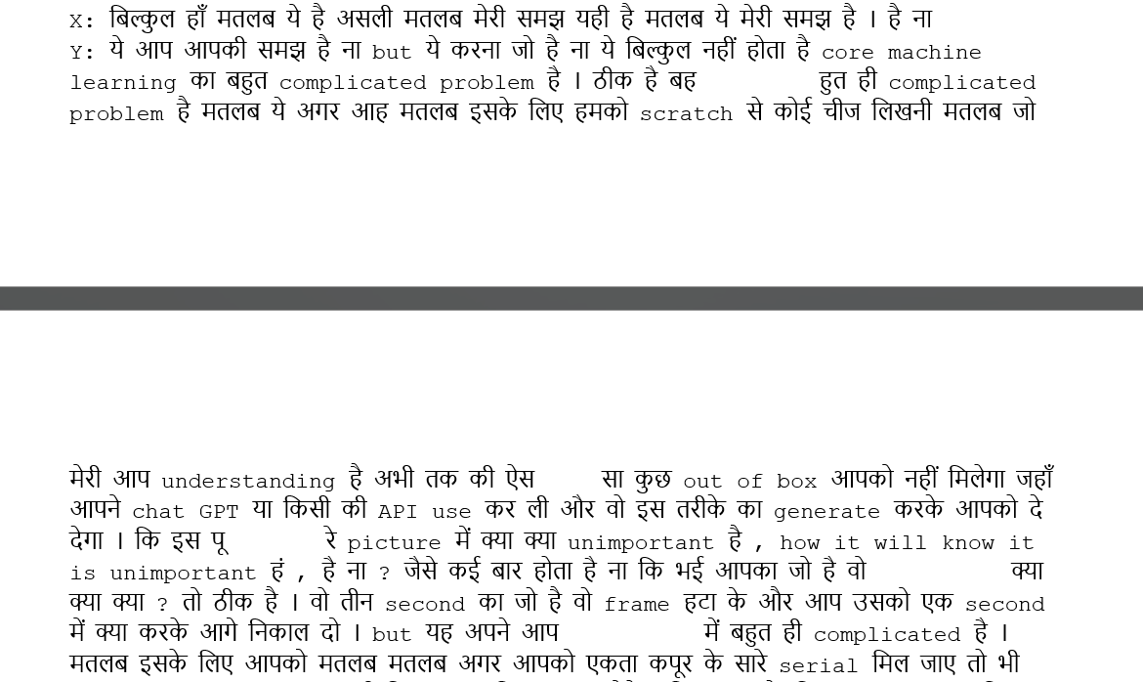
Step 1: Speech to Text
Tools: Use services like AWS Transcribe or open-source tools like Mozilla’s DeepSpeech or OpenAI Whisper to convert audio to text. This text will then be the input for further analysis by the LLM.
Considerations: Ensure accuracy in transcription, as errors can propagate through to the analysis phase.
Challenge/Constraint: We have the following challenge here in this approach.
Identification of the Speaker is a challenge, so as a first step in today’s POC, My target is to create the Transcript file with the Speaker identification and create the raw transcript file.

Slide 16
Use AWS Platform for doing this POC
S3 bucket used for uploading this audio file
Choice of using OpenAI Whisper or AWS Transcribe, and finally decided to use AWS Transcribe
Speaker identification from audio-only is a little complex but achieved with custom code and ML
Design discussion (Next few slides used to explain the design)
Code explanation in brief ( At the End will share the overview of the code)

Slide 17
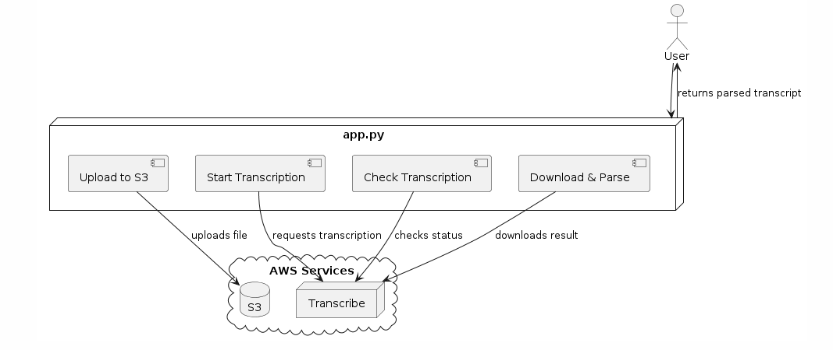
Overview of Process

Slide 18
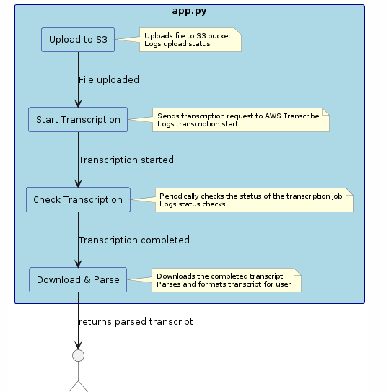
Components/STEPS

Slide 19
Challenges/Solutions
Key Challenge:
The main challenge in this process is efficiently managing the state and response of the AWS Transcribe service, which is handled asynchronously. Polling the service to determine when the transcription job is completed can introduce delays and requires robust error handling to manage possible failures in the transcription process.
Solution Implemented in Code:
Asynchronous Handling: The code uses a loop to continuously check the status of the transcription job, effectively handling the asynchronous nature of AWS Transcribe.
Error Handling: Robust error handling is implemented to catch and log errors during file upload, transcription requests, and status checks. This ensures the process can gracefully handle and report failures.

