Slide 1
FlexStream.io
Brief – FlexStream.io gives you the power to bend time with your live streams. Rewind, pause and catch up on your schedule.

Slide 2
Minimum Viable Product (MVP)
Immediate Time Shift (up to 30 minutes):
Allow users to pause, rewind, and fast-forward a live stream for up to 30 minutes. This feature is crucial for users who join late or want to replay a moment of the live event without missing the current live content.
Implement buffer management to ensure smooth playback and minimal interruption when switching between live and time-shifted content.
The media player software should also allow viewers to view live streams from the beginning, even if they join the stream late. This will ensure that viewers don't miss out on any content.
Visual timeline/progress bar to indicate the available time-shift window.
AI-assited Time Shift Catchup Functionality:
Allow user to catchup the past content of current live stream so that one can join the live stream
Allow user to Catchup with the past part of the content series so that the user is caught up with the previous series content and his/her memory is refreshed.

Slide 3
Minimum Viable Product (MVP)
AI-Enhanced Search Functionality:
Implement AI to understand natural language queries to find specific moments in the live stream or identify when particular topics are discussed, helping users navigate directly to these segments.
The media player software should use generative AI to automatically generate highlights from live streams. This will enable viewers to quickly identify and watch important moments from the live stream.
Ability to search and replay only one user or context videos
AI-Enhanced Caption Functionality:
The media player software should use generative AI to automatically generate captions for live streams. This will make the content more accessible to viewers who are deaf or hard of hearing.
AI-Powered Summarization (MVP):
During rewind mode, offer a "Summarize" option that uses a short-text summarization AI model to provide a quick textual recap of the missed segment

Slide 4
Advance Feature (Next Phase)
Extended Time Shift (Multiple Days):
Gradually extend the time-shift capability to include multiple days, allowing users to access a live stream from the beginning even if they join days after the event started. This would be stored in a cloud DVR setup where users can navigate to any point in the stored stream.
This feature would require robust storage solutions and efficient data retrieval systems to handle long-duration content without degrading performance or quality.
Multi-Day Time Shift:
Transition from a circular buffer to persistent storage (e.g., object storage like Amazon S3).
Segment live stream data into chunks representing specific time durations (e.g., hourly segments).
Allow users to navigate between days using a calendar-like UI and select specific time segments for playback.
Segmented Viewing with Bookmarks and Annotations:
Allow users to bookmark segments of the live stream for easy access and reference. Annotations can be added to these bookmarks to provide context or notes.

Slide 5
Advance Feature (Next Phase)
Integrated Social Sharing Options:
Enable users to share specific time-shifted segments of the live stream on social media or within the platform to enhance engagement and interactivity.
The media player software should allow viewers to create clips from live streams and share them on social media. This will enable viewers to easily share important moments from the livestream with others.
The media player software should allow viewers to interact with the live stream by submitting comments or questions in real time. This will enable viewers to engage with the content and provide feedback to the broadcaster.
The media player software should allow broadcasters to insert ads into the live stream. This will provide a revenue stream for the broadcaster and enable them to monetize their content

Slide 6
Advance Feature (Next Phase)
Multi-view Feature:
Provide an option to view multiple angles or streams of the same live event simultaneously. For example, different camera angles at a sports event or concert can be chosen and viewed side by side.
The media player software should allow viewers to customize their viewing experience by selecting different camera angles or audio tracks. This will provide viewers with a more personalized and engaging experience.
AI-Generated Highlights and Summaries:
Use AI to automatically generate highlights or summaries of live events based on engagement metrics like most rewatched scenes, increase in viewership, or social media activity.
The media player software should use generative AI to automatically generate transcripts of live streams. This will make the content more accessible to viewers who prefer to read rather than watch the content.

Slide 7
Advance Feature (Next Phase)
AI-Driven Accessibility Features:
Implement AI to provide real-time closed captioning, audio descriptions, and language translation, making the live streams more accessible to a diverse audience.
The media player software should use generative AI to automatically translate live streams into different languages. This will make the content more accessible to viewers who speak different languages.
Variable Rewind Speed:
Allow users to control playback speed while in rewind mode (e.g., 2x, 4x, for rapid review)
Event-Driven Highlights:
Option to configure keyword/event triggers (provided by an external integration perhaps)
Create automatic "highlight clips" within the time-shifted window based on those triggers.
Social Sharing:
Enable users to share short clips from the time-shift buffer to social media platforms.

Slide 8
Advance Feature (Next Phase)
AI-Driven Accessibility Features:
Implement AI to provide real-time closed captioning, audio descriptions, and language translation, making the live streams more accessible to a diverse audience.
The media player software should use generative AI to automatically translate live streams into different languages. This will make the content more accessible to viewers who speak different languages.
Content-Aware Search (Advanced):
Use object recognition or scene detection models to enable users to search within the time-shift window using visual queries (e.g., "find the moment a red car appears").

Slide 9
Advance Feature (Next Phase)
Technical Considerations:
Backend Architecture:
Consider serverless architectures (e.g., AWS Lambda, Azure Functions) for scalability and cost-efficiency.
Optimize storage strategies based on expected time-shift duration and cost considerations.
Frontend Development:
Choose a modern JavaScript framework like React, Vue, or Angular for a responsive and interactive user interface.
Use a video player library like Video.js or Hls.js for video streaming and playback controls.
AI Integration:
Leverage pre-trained models from providers like Amazon Comprehend, and Google Natural Language, or consider open-source options.

Slide 10
Requirement Analysis

Slide 11
MVP – Requirement Analysis
General Requirements
Scalability: Ensure the backend infrastructure using AWS is scalable to handle high concurrent user loads and data throughput.
Cross-Platform Support: Develop using technologies like React Native (for mobile) and Electron (for desktop) to maintain a single codebase across platforms.
Security: Implement robust security measures to protect user data and content integrity.
Compliance: Adhere to accessibility and data protection regulations relevant to all operating regions.
Technical Considerations
Backend: Explore a serverless architecture (AWS Lambda, Azure Functions)
Frontend: Choose a modern JavaScript framework (React, Vue, Angular)
Media Player: Video.js, Hls.js, etc.

Slide 12
MVP – Requirement Analysis
1. Immediate Time Shift (up to 30 minutes)
Purpose: Enable users to control live stream playback, including pausing, rewinding, and fast-forwarding up to 30 minutes to accommodate late joiners or replay specific moments without missing ongoing content.
Functionality:
Users can pause live streaming at any moment.
Users can rewind up to 30 minutes from the current live point.
Users can fast-forward to catch up to the live broadcast if they have rewound or paused.
Implement a visual timeline/progress bar indicating the time-shift window and current position within the stream.
Technical Requirements:
Buffer Management: Efficient handling of buffer to provide seamless switching between live and time-shifted content without buffering issues.
Storage: Temporary storage solution to hold up to 30 minutes of high-quality video streams for time
-shift functionality.
UI/UX: Intuitive controls for time manipulation embedded within the player interface.
Compatibility: Ensure the feature works uniformly across all supported platforms including desktop,
mobile, and Samsung Tizen TV.

Slide 13
MVP – Requirement Analysis
Immediate Time Shift (Up to 30 Minutes)
Functional Requirements
Buffer Management: The system shall implement a client-side buffer of 30 minutes for live stream data.
Rewind/Forward: Users shall be able to rewind and fast-forward seamlessly within the buffer.
Buffer Transition: The transition between live and time-shifted playback shall be smooth (minimal latency or buffering).
Catch-Up to Live: The system shall provide a clear mechanism to "catch up" to the live point of the stream. This will provide an AI generated catchup summary video till the point of live stream in user desired catchup time window.
Progress Indicator: A visual timeline/progress bar shall indicate the beginning and end of the available time-shift window.
Non-Functional Requirements
Buffer Latency: Rewind and fast-forward actions within the buffer should have minimal delay (<2 seconds).
Compatibility: The feature shall be compatible with major streaming formats (HLS, MPEG-DASH, etc.)

Slide 14
MVP – Requirement Analysis
2. AI-Enhanced Search Functionality
Purpose: Utilize AI to interpret natural language queries to locate specific moments or topics or users within live streams, facilitating user navigation directly to these segments.
Functionality:
Natural language processing to understand user queries related to specific moments in the live stream.
Capability to identify and navigate to segments where particular topics are discussed.
Integration with the player’s UI for easy access and simplicity.
Technical Requirements:
AI Model: Deploy a machine learning model capable of understanding and processing natural language queries.
Indexing: Timestamped indexing of stream content to allow quick retrieval based on AI search results.
Integration: Seamless integration with existing player controls and search interfaces.

Slide 15
MVP – Requirement Analysis
Basic AI-Enhanced Search
Functional Requirements
Search Interface: A simple search bar shall allow users to enter text-based queries.
NLP Query Processing: The system shall use basic natural language processing (NLP) techniques to interpret and match queries against available metadata (stream title, basic tags, and potentially closed captions if implemented).
Timestamped Results: Search results shall present matching points within the stream as clickable timestamps.
Non-Functional Requirements
Query Scope: Searches shall be limited to the content of the currently loaded stream.
Relevance Ranking: Search results should be ranked with the most relevant matches at the top.

Slide 16
MVP – Requirement Analysis
3. Generative AI for Automatic Highlight Generation
Purpose: Automatically generate highlights from live streams, allowing users to quickly access and view significant moments.
Functionality:
Detect and compile key moments from live streams into highlight reels based on viewer engagement metrics and AI analysis.
Allow users to access these highlights through a dedicated section within the app.
Technical Requirements:
AI Model: Utilize a generative AI model to analyze content and determine highlight-worthy moments.
Processing: Real-time processing capabilities to generate highlights without significant delays.
User Interface: Design an interface within the app where users can view and interact with generated highlights.

Slide 17
MVP – Requirement Analysis
Generative AI for Automatic Highlight Generation
Functional Requirements
The system shall automatically detect and compile key moments from live streams.
This compilation should be based on viewer engagement metrics and AI analysis.
The system shall allow users to access these highlights through a dedicated section within the app.
Non-Functional Requirements
Highlight generation should occur without significant delay relative to the live stream.
The system should be able to handle a variety of live-stream content types (e.g., sports, news, gaming).
The system should be able to scale to accommodate a large number of concurrent viewers.

Slide 18
MVP – Requirement Analysis
4. AI-Powered Summarization During Rewind
Purpose: Provide a textual summary of past segments during rewind mode, aiding users in catching up quickly without watching the entire content.
Functionality:
Offer a "Summarize" button during rewind mode that, when clicked, displays a concise textual summary of the missed content.
Summaries are generated in real-time using AI, based on the segment's audio and visual data.
Technical Requirements:
AI Model: Implement a short-text summarization AI that can generate accurate and concise summaries from multimedia input.
Integration: Embed the summarization feature seamlessly within the playback controls, ensuring ease of access.
Performance: Ensure the summarization process is quick and does not impede the streaming quality or user experience.

Slide 19
MVP – Requirement Analysis
AI-Powered Summarization
Functional Requirements
"Summarize" Button: A "Summarize" option shall be available during rewind mode.
Missed Segment Length: The summarization function shall operate on a configurable time interval (e.g., last 5 minutes, last 10 minutes, etc.)
Short-Text Output: The summarization model shall generate a concise text summary (1-3 sentences) of the selected segment.
Non-Functional Requirements:
Summary Accuracy: The summary shall focus on key events or topics, aiming for factual representation.

Slide 20
Advance Feature (Next Phase)
Extended Time Shift (Multiple Days)
Purpose: Use a cloud DVR-like setup to allow users to access and navigate live streams from the beginning, even days after the event has started.
Functionality:
Transition to persistent storage for storing long-duration live streams.
Segment streams into manageable chunks (e.g., hourly).
Implement a calendar-like UI for easy navigation of recorded content.
Technical Requirements:
Storage: Use AWS S3 for durable and scalable object storage.
Indexing: Implement a database solution like AWS DynamoDB to store metadata about each segment for quick retrieval.
Frontend: Build a robust UI that integrates a calendar for date selection and a timeline for intra-day navigation.

Slide 21
Advance Feature (Next Phase)
Segmented Viewing with Bookmarks and Annotations
Purpose: Enhance user interaction by allowing them to bookmark and annotate specific segments of live streams.
Functionality:
Users can set bookmarks at key points during a live stream.
Users can add annotations to these bookmarks for later reference.
Technical Requirements:
Data Handling: Store bookmarks and annotations with timestamps in a relational or NoSQL database.
UI Integration: Provide an intuitive interface for setting bookmarks and annotations within the video player.

Slide 22
Advance Feature (Next Phase)
Integrated Social Sharing Options
Purpose: Facilitate sharing specific live stream segments on social media and within the platform, boosting user engagement and content visibility.
Functionality:
Users can create clips from live streams.
Enable sharing of these clips on social media platforms.
Allow real-time viewer interaction with the live stream through comments.
Technical Requirements:
Clip Generation: Implement server-side logic to extract and process video clips.
Social Integration: Use APIs for social media platforms to facilitate sharing.
Interaction Layer: Develop a real-time commenting system using WebSockets or similar technology.

Slide 23
Advance Feature (Next Phase)
Multi-view Feature
Purpose: Offer a more immersive viewing experience by allowing users to watch multiple camera angles or streams simultaneously.
Functionality:
Provide options to select different camera angles or audio tracks.
Synchronize multiple video streams for concurrent playback.
Technical Requirements:
Stream Management: Handle multiple video streams and sync them.
UI/UX: Design a user-friendly interface to switch between different streams or angles.

Slide 24
Advance Feature (Next Phase)
AI-Generated Highlights and Summaries
Purpose: Automatically generate highlights and summaries from live events to help users catch up on key moments.
Functionality:
AI analyzes video content to identify and compile highlights.
Generate concise summaries of live streams for quick review.
Technical Requirements:
AI/ML: Leverage machine learning models to analyze and summarize content.
Processing: Ensure the backend is capable of intensive video processing tasks.

Slide 25
Advance Feature (Next Phase)
AI-Driven Accessibility Features
Purpose: Make live streams more accessible by providing real-time closed captioning, audio descriptions, and multi-language translation.
Functionality:
Real-time captioning and descriptions.
Translate spoken content into multiple languages.
Technical Requirements:
AI Translation and Captioning: Utilize AI services like AWS Transcribe and Translate.
Integration: Seamlessly integrate these features into the video player without affecting performance.

Slide 26
Advance Feature (Next Phase)
Variable Rewind Speed and Content-Aware Search
Purpose: Enhance user control over playback and enable advanced content search within videos.
Functionality:
Allow users to adjust the rewind speed.
Enable searching for visual elements within the video (e.g., "find the moment a red car appears").
Technical Requirements:
User Controls: Develop frontend controls for variable speed playback.
Advanced AI Search: Implement object recognition or scene detection models for visual searches.

Slide 27
System Design
Iterative development model

Slide 28
System Design
System Design Considerations
Data Storage and Retrieval:
Approach 1: In-memory caching using services like Redis or Memcached, which can offer very fast data retrieval but may be more costly and limited in storage capacity.
Approach 2: Use of persistent storage such as Amazon S3 combined with a caching layer to store video chunks, which balances cost and performance.
Content Delivery:
Approach 1: AWS Elemental MediaLive for real-time video processing and AWS Elemental MediaStore as a high-performance storage service optimized for media.
Approach 2: Custom solution using Amazon S3 for storage and Amazon CloudFront for distribution, providing a more flexible and possibly cost-effective solution.
Video Processing:
Approach 1: Serverless video processing using AWS Lambda to handle video chunking and indexing.
Approach 2: Use of EC2 instances or ECS for more persistent processing needs, which can handle more complex processing tasks but may increase costs.
Metadata Management:
Using a combination of Amazon DynamoDB for fast metadata retrieval and Amazon RDS/Aurora for more complex queries if needed.

Slide 29
System Design
Proposed System Design
Given the requirements and cost constraints, I suggest a design that combines persistent storage with a serverless architecture for scalability and cost-effectiveness:
Storage: Use Amazon S3 to store video streams in small chunks (e.g., 1-minute segments). S3 is cost-effective and scales automatically.
Video Processing: Use AWS Lambda for processing video chunks. Lambda can trigger on new files added to S3 (via S3 Events), process them for availability, and store metadata in DynamoDB.
Content Delivery: Use AWS CloudFront to distribute the video content efficiently across geographic locations.
Metadata Management: Use Amazon DynamoDB to store and retrieve metadata about video chunks quickly, such as timestamps and availability.
User Interface: Build the frontend with React and integrate AWS Amplify for quick deployment and easy scalability. The frontend will communicate with AWS services via API Gateway and Lambda functions.

Slide 30
System Design
Development Item 1: Pause and Resume Functionality
Understanding and Challenges: Pausing and resuming a live stream effectively requires a mechanism to buffer the live stream so that users can return to the point where they paused. The key challenges include managing latency, synchronizing the live stream post-resume, and ensuring that the buffer does not overflow or lose data.
Approaches:
In-memory buffer on the client side: Quick access but limited by client device capabilities and potential for data loss if the browser is refreshed.
Server-side buffer using Elasticache or a similar in-memory data store: More robust and centralized but could be more costly and complex to implement.
Selected Approach: Use a server-side buffer strategy with AWS Elasticache to manage the pause and resume functionality. This approach offers a good balance between performance and reliability, with a slightly higher cost. It simplifies client-side operations and provides a centralized control mechanism.

Slide 31
System Design
Development Item 2: Rewind and Fast-Forward Functionality
Understanding the Challenges: Enabling users to rewind and fast-forward through a live stream involves segmenting the video stream and storing these segments in a way that they can be quickly accessed. Challenges include efficient data storage, quick retrieval of video segments, and maintaining stream continuity during such operations.
Approaches:
Store segments in Amazon S3:
Using S3 for storing video segments, which can be retrieved and streamed as needed.
Dynamic segmentation with HLS or DASH: Implement HTTP Live Streaming (HLS) or Dynamic Adaptive Streaming over HTTP (DASH), which naturally divides the stream into smaller, manageable chunks.
Selected Approach: Implement HLS or DASH for dynamic segmentation. This method automatically handles segment creation and is well supported across platforms. It simplifies the architecture and reduces the need for complex buffer management. This approach is cost-effective and scalable, reducing complexity and focusing on compatibility.

Slide 32
System Design
Development Item 3: Visual Timeline/Progress Bar
Understanding and Challenges: Implementing a visual timeline that accurately reflects the position within a live stream and available buffered content is challenging, particularly in syncing the timeline with the actual media playback position.
Approaches:
Client-side timeline management: Using JavaScript to update the timeline based on the playback position reported by the media player.
Server-side event signaling: Sending periodic timestamps from the server to ensure the client’s timeline aligns with the server-side buffer state.
Selected Approach: Use client-side timeline management with periodic checks to the server for alignment. This approach minimizes server load and leverages the client’s capabilities to manage UI elements,

Slide 33
System Design
System Design Explanation
AWS API Gateway acts as the entry point for all backend service requests from the client. It routes requests to the appropriate AWS Lambda functions based on API paths and methods.
AWS Lambda handles various backend processes, including session management, playback control commands (e.g., pause, play, rewind, fast-forward), and coordination between AWS Elasticache and Amazon S3 for data management.
AWS Elasticache is used for real-time data buffering. It temporarily stores the live stream data to allow quick retrieval when users pause and then play the stream. This ensures a seamless viewing experience without having to rebuff from the start.
HLS/DASH Streaming Engine processes the live stream into smaller segments stored in Amazon S3. This is crucial for enabling rewind and fast-forward features as it allows users to access historical segments.
Amazon S3 acts as the storage for segmented video content, making older content accessible during operations like rewinds that exceed the buffer period held in AWS Elasticache.
AWS CloudFront serves as the CDN to efficiently distribute both live and stored video content to users, reducing latency and improving load times across different geographical locations.
The client (Web/Mobile/Tizen) interacts directly with the HLS/DASH streaming engine via CloudFront to play live streams. It communicates with AWS API Gateway to send control commands (like pause and rewind) which are processed by Lambda functions.

Slide 34
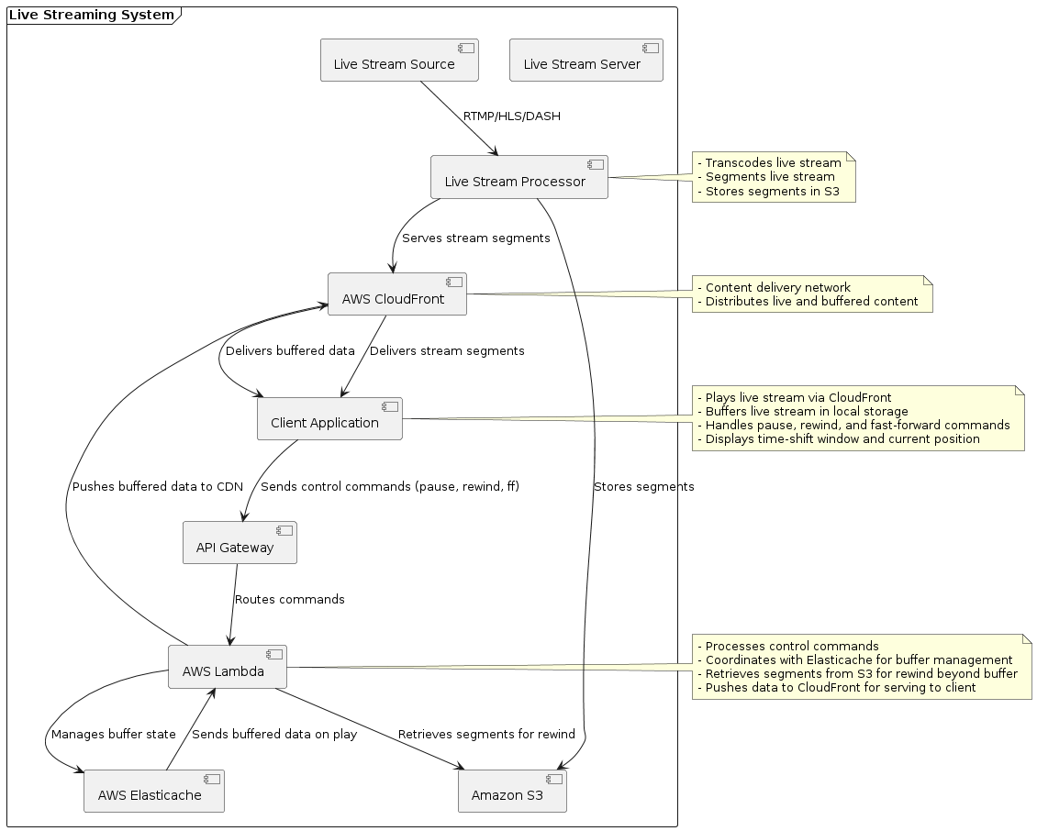
Block diagram

Slide 35
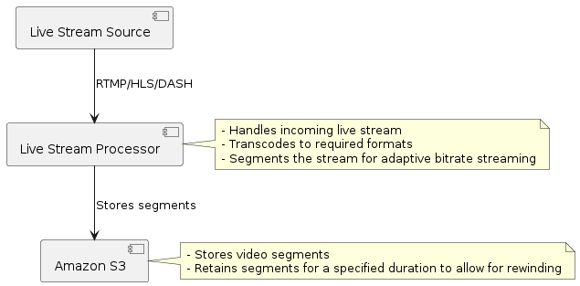
Livestream processing and storage

Slide 36
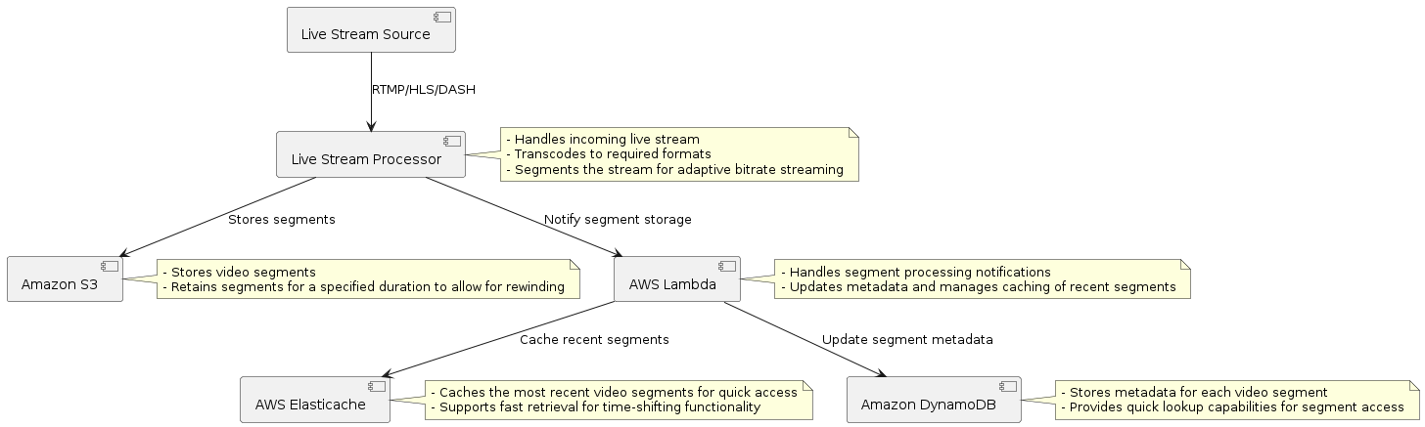
Livestream processing and storage

Slide 37
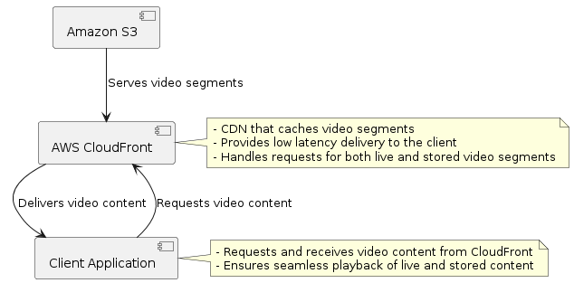
Content delivery via Cloudfront

Slide 38
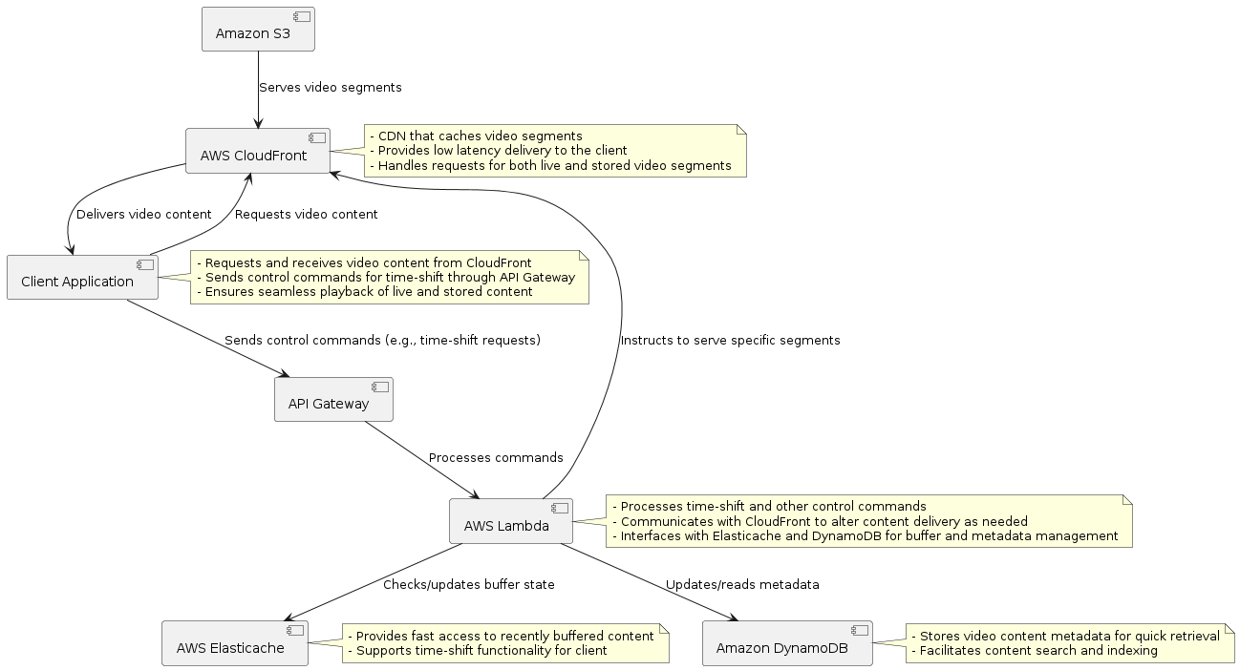
Complete flow for content delivery

Slide 39
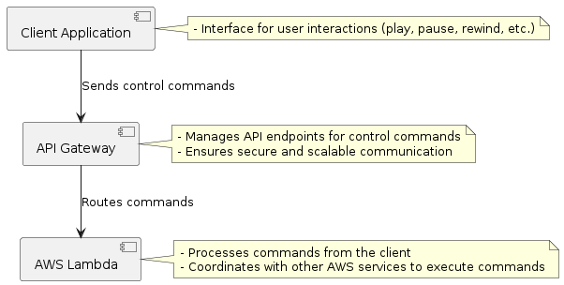
Client-Backend
Interaction for control commands

Slide 40
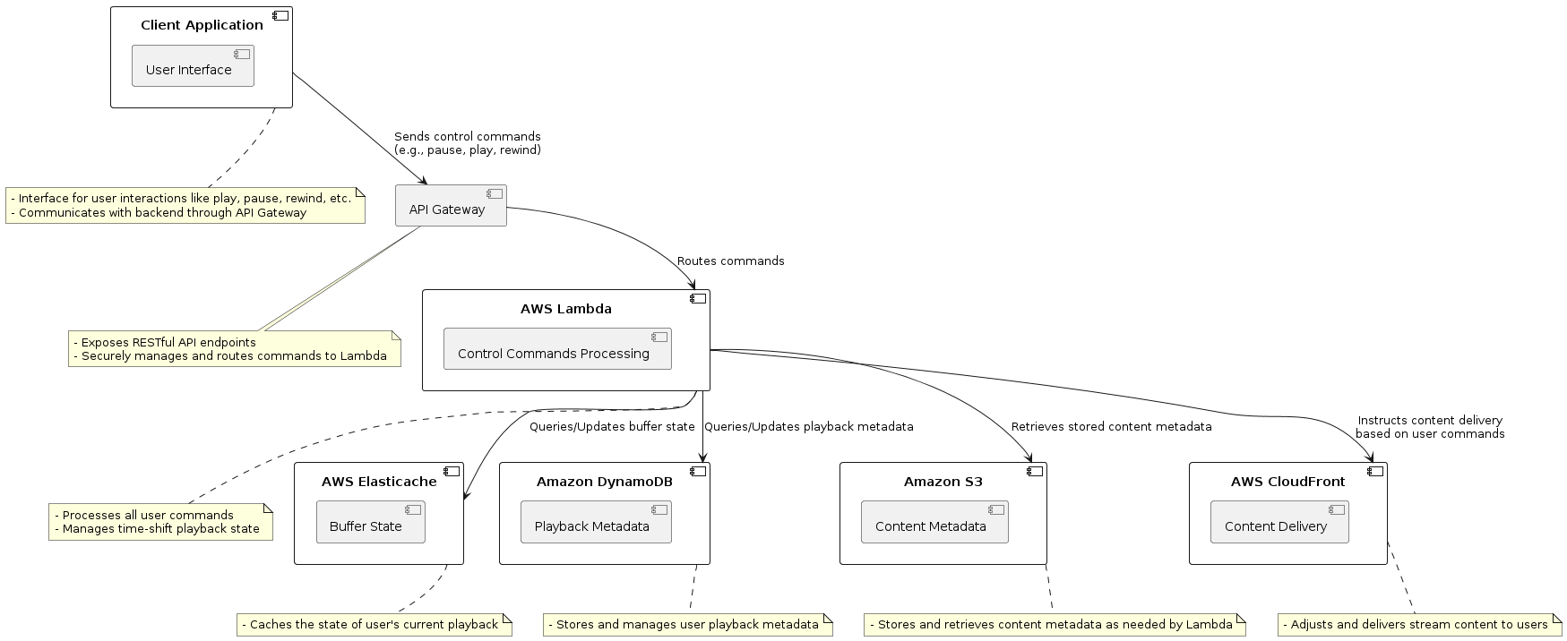
Flow to cover the client and backend interaction

Slide 41
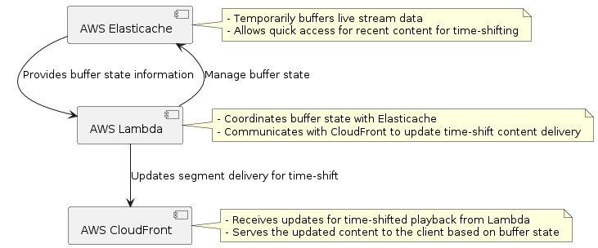
Buffer Management
Elastic cache and Lambda

Slide 42
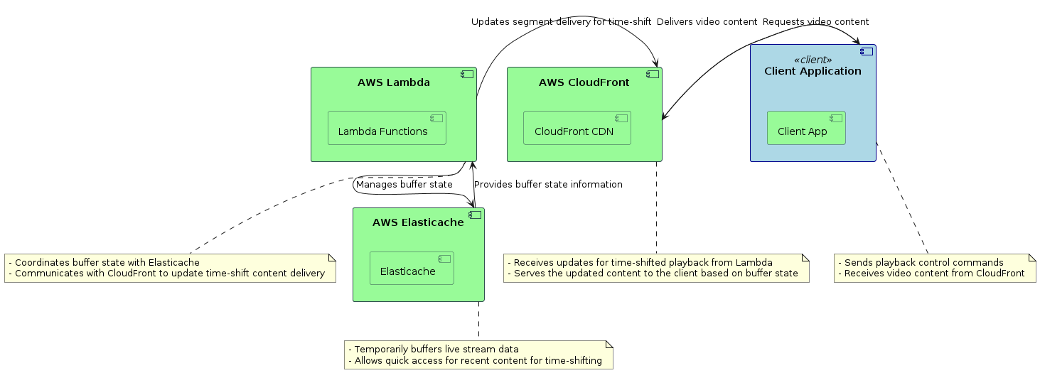
How we are handling latency issues in our design?

