Slide 1
MP4 To HLS Cloudfront Distribution

Slide 2
Build Mp4 to HLS Stream CloudFront Distribution

Slide 3
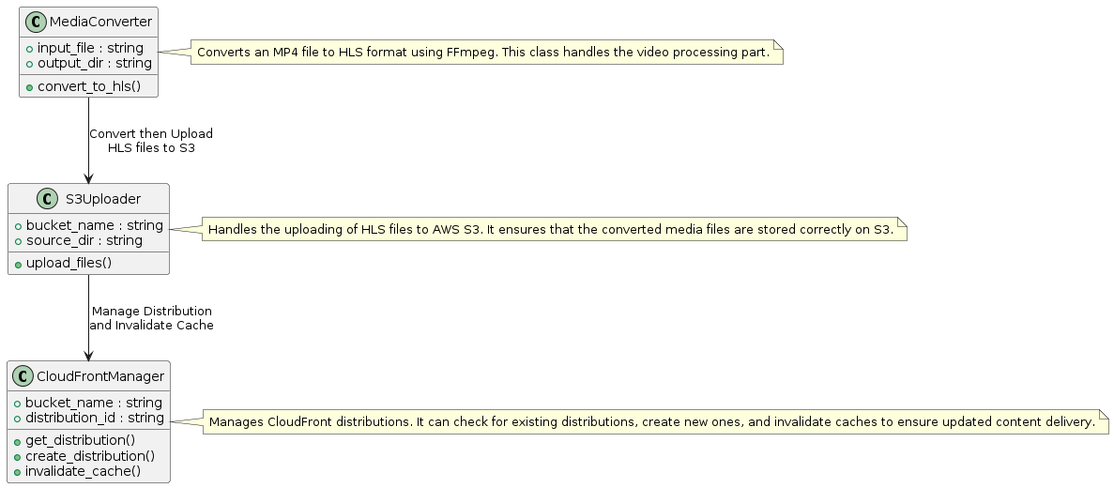
Overview

Slide 4
Steps

Slide 5
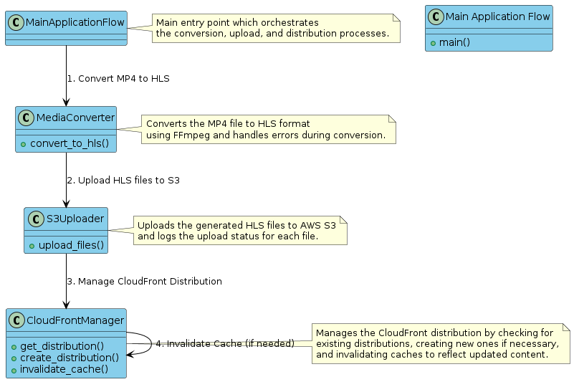
Process Diagram

Slide 6
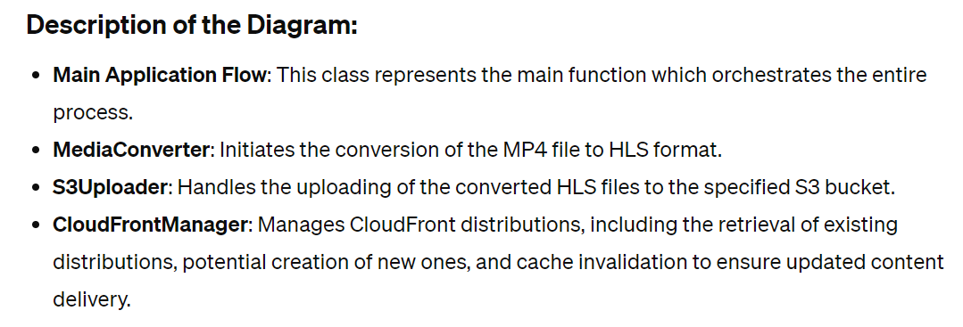

Slide 7
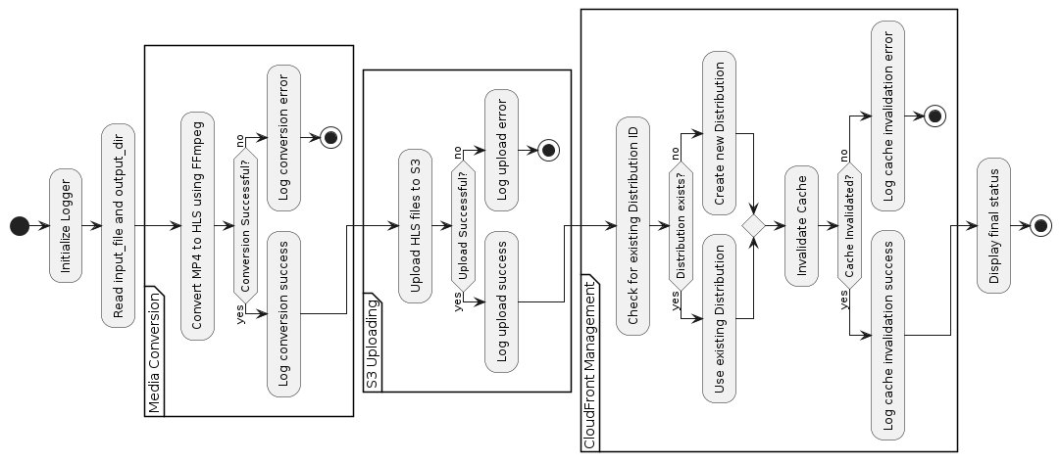
Flow-diagram

Slide 8
How to update the Cache of CloudFront Distribution with Lambda Function and Event on S3 Bucket

Slide 9
Update the Cache of the CloudFront distribution
Final Approach - AWS Lambda with S3 Event Notifications and CloudFront Cache Invalidation
Step 1: Set Up an S3 Bucket
Assuming you already have an S3 bucket where HLS files are stored, ensure it’s correctly configured to store your HLS files. If not, follow these steps to create one:
Log in to the AWS Management Console.
Navigate to the S3 service and click Create bucket.
Enter a bucket name and select the region.
Leave all other settings as default or configure them according to your organizational policies and click Create.

Slide 10
Update the Cache of the CloudFront distribution
Step 2: Create a Lambda Function
Navigate to the AWS Lambda console and click the Create function.
Choose the Author from scratch. Enter a function name, and select Python 3.8 as the runtime.
Under Permissions, choose or create an execution role that has at least the basic Lambda permissions plus permissions to read from S3 and invalidate CloudFront distributions.
Click the Create function.

Slide 11
Update the Cache of the CloudFront distribution
Step 3: Set S3 Event Notifications
Go to your S3 bucket in the S3 console.
Click on Properties > Event notifications.
Click Create event notification.
Name your event, and select All object create events and All object delete events under the “Events”.
Under “Destination”, select the Lambda function.
Choose the Lambda function you created in Step 2.
Click Save changes.

Slide 12
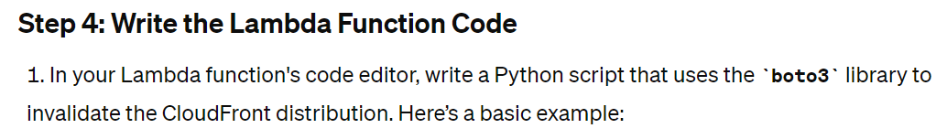
Update the Cache of the CloudFront distribution
import boto3
def lambda_handler(event, context):
# Create CloudFront client
cf = boto3.client(‘CloudFront)
# Define the CloudFront distribution ID and the file paths to invalidate
distribution_id = 'YOUR_DISTRIBUTION_ID'
items = [{'Quantity': len(event['Records']), 'Items': [record['s3']['object']['key'] for record in event['Records']]}]
# Create invalidation
response = cf.create_invalidation(DistributionId=distribution_id,
InvalidationBatch={
'Paths': items,
'CallerReference': str(context.aws_request_id)
})
return response

Slide 13
Update the Cache of the CloudFront distribution
Step 5: Configure IAM Roles and Permissions
Ensure the IAM role used by your Lambda function has the following policies attached:
AmazonS3ReadOnlyAccess
CloudFrontFullAccess (or a custom policy with permissions to invalidate CloudFront distributions).
To add permissions, go to the IAM service, find the role, and attach the policies.
Step 6: Test and Validate
Upload a new file to your S3 bucket or update an existing file.
Check the Lambda function logs in CloudWatch to verify it triggered correctly and executed without errors.
Check your CloudFront distribution’s cache to ensure the specified paths were invalidated.

Slide 14
Update the Cache of the CloudFront distribution
Step - Configure IAM Roles and Permissions – More detailing…
A. Accessing the IAM Management Console
Log in to your AWS Management Console.
In the Find Services search bar, type "IAM" and select IAM to open the IAM dashboard.
B. Creating a New IAM Role
If you have already created a role for your Lambda function during its setup, you can skip to part C. Otherwise, follow these steps to create a new role:
In the IAM dashboard, click on Roles on the left sidebar, then click the Create role button.
Choose Lambda as the service that will use this role, then click Next: Permissions.
In the permissions policy search box, type AmazonS3ReadOnlyAccess and check the box next to the policy. This policy allows the role to read data from any S3 bucket in your account.
Search for CloudFrontFullAccess and check the box next to this policy as well. This policy allows the role full access to CloudFront, which includes creating invalidations.
After selecting the necessary policies, click Next: Tags (optional step - tags are key-value pairs used for resource identification and management).
Click Next: Review.
Enter a Role name, e.g., LambdaS3CloudFrontRole, and an optional description.
Click Create role.

Slide 15
Update the Cache of the CloudFront distribution
Step - Configure IAM Roles and Permissions – More detailing…
C. Attaching Policies to an Existing IAM Role
If you're updating an existing role with new permissions:
In the IAM dashboard, click on Roles on the left sidebar.
Enter the name of the role you created for your Lambda function in the search box, then click on the role.
On the role summary page, click on the Permissions tab.
Click Attach policies.
In the search box, type AmazonS3ReadOnlyAccess and check the box next to it. Then, search for CloudFrontFullAccess and select it too.
Click Attach policy.
D. Verify the Role and Policy Attachment
After attaching the policies, you should see them listed under the Permissions tab when you view your role.
Ensure that AmazonS3ReadOnlyAccess and CloudFrontFullAccess are listed under the policies attached to the role.

Slide 16
Update the Cache of the CloudFront distribution
Step - Configure IAM Roles and Permissions – More detailing…
E. Example of a Custom Policy (Optional)
If you prefer to create a custom policy for more granular permissions, especially limiting the role to only invalidate CloudFront distributions rather than full access, you can create a custom policy:
Go back to the main IAM dashboard and select Policies.
Click Create policy.
Go to the JSON tab and enter the following policy, replacing YOUR_DISTRIBUTION_ID with your actual CloudFront distribution ID:

Slide 17
Update the Cache of the CloudFront distribution
Step - Configure IAM Roles and Permissions – More detailing…
{
"Version": "2012-10-17",
"Statement": [
{
"Effect": "Allow",
"Action": "cloudfront:CreateInvalidation",
"Resource": "*",
"Condition": {
"StringEquals": {
"cloudfront:DistributionId": "YOUR_DISTRIBUTION_ID"
}
}
}
]
}

Slide 18
Update the Cache of the CloudFront distribution
Step - Configure IAM Roles and Permissions – More detailing…
Click Review policy, give your policy a name, e.g., CloudFrontInvalidationOnly, and description, then click Create policy.
Attach this new policy to your Lambda role following the steps in part C.

