Slide 1
Video Upscaling Using GenAI

Slide 2
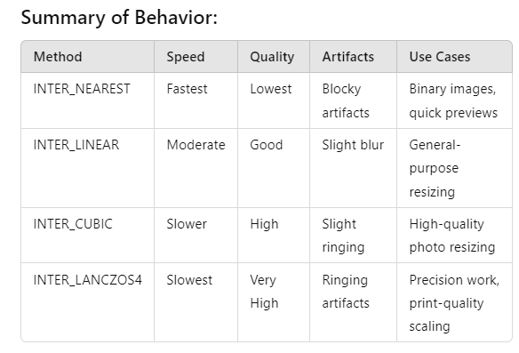

Slide 3
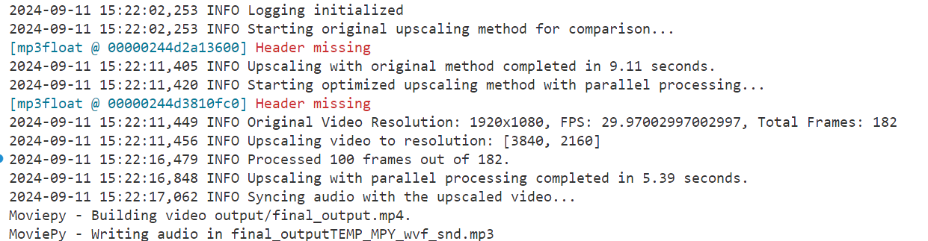

Slide 4
Key Improvements:
Parallel Processing and Batch Handling:
The upscaling is done in parallel with the ThreadPoolExecutor, allowing faster processing while maintaining high quality.
Audio Sync:
The audio is extracted from the original video and synced with the upscaled video using the moviepy library. The extract_and_add_audio function ensures that the final output contains the original audio track.
Performance Comparison:
The original and optimized parallel methods are timed, and the durations are logged for comparison. This will help you compare the speed of both methods.
Cleanup:
Temporary files are cleaned up after the process, ensuring efficient memory and disk usage.

