Slide 1
Build it: Lab 1 → Agentic RAG
LAB 2 · STEP BY STEP
12 TODOs, one at a time: tools → wiring → nodes. Every step has tests that turn green.
FastAPI · LangChain · LangGraph · FAISS · React · azure/gpt-6-luna
Notes:
This deck is the hands-on guide. Each slide = one step, with the file, the TODO number, the code shape and the tests that turn green. Students keep this open next to VS Code. The order is deliberate: tools first (pure functions, easy wins), then wire the whole graph so it compiles, then fill nodes one at a time and watch the trace grow.

Slide 2
What changes in the project (and what stays)
Stays (Lab 1, reused as tools)
New: app/agent/
llm_client.py shared gateway client
app/llm.py chat_complete, embeddings
app/ingest.py chunking
app/vector_store.py FAISS in memory
app/basic_rag.py basic_retrieve, with_meta
app/rerank.py bm25_rank, RRF
app/generation.py build_context_block,
extract_citations
tests/ (Lab 1) 25 regression tests
config.py AGENT_* settings provided
state.py AgentState + reducers provided
prompts.py one prompt per decision provided
parsing.py parse_json provided
graph_rag.py entity graph (lite) provided
tools.py calc, hybrid search TODO 1-2
nodes.py nodes + routing TODO 3-11
graph.py StateGraph wiring TODO 12
service.py run / resume / stream provided
routes.py /api/agent/* provided
+ requirements.txt: langgraph + .env: AGENT_* block
+ frontend: Agentic RAG tab · data/agent_scenarios.json · tests/test_agent_*.py (25)
STEP 0
Notes:
Everything from Lab 1 stays and keeps working: the Lab 1 Chat, Compare, Evaluate and Knowledge base tabs, and the 25 Lab 1 tests (now regression tests). The new code lives in one package, app/agent. requirements.txt gains one line (langgraph). .env gains an 'Agentic RAG' block with the safety rails. main.py creates the AgentService next to the RagService, sharing the same FAISS index.

Slide 3
Starting point and the order of work
pip install -r requirements.txt
cp .env.example .env # enterprise block
python 00_check_setup.py
pytest # 22 failed, 28 passed
uvicorn app.main:app --reload --port 8000
TODO 1–2
tools
tools.py
TODO 12
wiring
graph.py
TODO 3–4
route
nodes.py
TODO 5–6
plan + Send
nodes.py
TODO 7
retrieve
nodes.py
TODO 8
assess loop
nodes.py
Agentic tab right now
"Agent not ready yet (501): TODO 12 build_graph". Lab 1 tabs work as before. That is expected.
TODO 9
generate
nodes.py
TODO 10
check
nodes.py
TODO 11
clarify
nodes.py
STEP 0
Notes:
Unzip, install, copy .env, check setup, run pytest: 22 failed, 28 passed. The 3 Graph RAG lite tests already pass because that file is provided. Start the server: Lab 1 tabs work; the Agentic tab says 'Agent not ready yet (501): TODO 12'.
Order: tools first (pure Python, quick wins), then TODO 12 so the graph compiles, then the nodes in the order a question flows through them. Clarify (TODO 11) last because it needs the whole graph and a checkpointer.

Slide 4
Read first: the state every node shares (provided)
Field | Written by | Kind
messages | start (input), finalize | add_messages: memory
standalone | contextualize, clarify | plain
route, route_reason, direct_reply, clarify_question | route | plain
plan, pending, rounds | plan, assess | plain
evidence, tried_queries | retrieve (parallel!) | accumulate reducer
relevant_ids, sufficient | assess | plain
answer, citations, calculations, used_ids | generate | plain
check, regenerations, feedback | check | plain
steps | every node | accumulate: the UI trace
SubQuery = {
"id": "r1-q2",
"question": "...",
"tool": "search" | "entity",
"entity": "graduate trainee",
"round": 1 }
Remember
A node returns ONLY the keys it changes. Returning None for an accumulate field resets it (start_turn does that).
STEP 1
Notes:
Before writing any node, read state.py together. Point at the three groups. Conversation: messages with add_messages, saved per thread. This turn: plain fields that nodes overwrite. Parallel-safe: evidence, tried_queries and steps use accumulate because retrieve runs in parallel.
SubQuery and Evidence are small TypedDicts; tests compare them as plain dicts. start_turn (provided) resets the per-turn fields at the start of every question.

Slide 5
TODO 1 · safe_calculate(): a calculator tool
def safe_calculate(expr: str) -> str:
tree = ast.parse(expr, mode="eval") # else CalcError
def ev(node):
if isinstance(node, ast.Expression):
return ev(node.body)
if is_number_constant(node): # not bool/str
return node.value
if isinstance(node, ast.BinOp) and op_ok(node):
... # exponent <= 100, catch ZeroDivisionError
if isinstance(node, ast.UnaryOp) and op_ok(node):
...
if is_allowed_call(node): # round/min/max/abs
...
raise CalcError("not allowed")
return format_number(ev(tree)) # 10.0 -> "10"
Input | Result
1.5 * 7 | "10.5"
3 * (2000 + 7500) | "28500"
round(50000/12) | "4167"
__import__('os') | CalcError
2 ** 1000 | CalcError
1 / 0 | CalcError
True + 1 | CalcError
✓ A01, A02
STEP 2
Notes:
Why: LLMs are bad at arithmetic and the answer prompt tells the model to write <calc>expr</calc>. apply_calculations (provided) calls your function for each tag.
The security lesson: the expression comes from an LLM, which reads user text. eval() would run anything, e.g. __import__('os').system(...). Parse with ast and allow only numbers, + - * / // % **, unary minus, parentheses and four functions. Reject the rest. Also cap the exponent: 2 ** 10**9 would freeze the server.

Slide 6
TODO 2 · hybrid_search(): Lab 1 parts, zero LLM calls
def hybrid_search(store, query, k_each=10,
final_k=5, rrf_k=60):
if not query.strip() or store.size == 0:
return []
# Lab 1: FAISS cosine
semantic = basic_retrieve(store, query, k_each)
# Lab 1: BM25 over ALL chunks (not just the pool)
ranked = bm25_rank([query], list(store.docs.values()))
bm25 = [d for d in ranked
if d.metadata["bm25_score"] > 0][:k_each]
# Lab 1: fuse with RRF
return reciprocal_rank_fusion([semantic, bm25],
k=rrf_k, top_n=final_k)
New vs Lab 1
BM25 over all 59 chunks, so PAY-E4035 is found even when the embedding ranks it nowhere.
Two more tools (provided)
FAISS top-10
BM25 top-10
RRF
search_tool(): hybrid or mqr_rrf
entity_tool(): Graph RAG lite lookup
meaning
whole corpus · exact words
top-5
✓ A03, A04
STEP 3
Notes:
The agent's default search tool. It reuses three Lab 1 functions. One important difference from Lab 1: BM25 runs over the WHOLE corpus, not just over the semantic pool. In Lab 1 BM25 could only re-rank what FAISS had already found; here it can find an exact code FAISS never returned.
Why not MQR inside the agent? The planner already writes focused sub-questions, which is MQR's job. AGENT_SEARCH_MODE=mqr_rrf switches back to the full Lab 1 pipeline if you want to compare.

Slide 7
TODO 12 · build_graph(): wire the StateGraph first
g = StateGraph(AgentState)
for name in NODE_NAMES: # the 11 node names
g.add_node(name, getattr(nodes, name))
g.add_edge(START, "start_turn")
g.add_edge("start_turn", "contextualize")
g.add_edge("contextualize", "route")
g.add_conditional_edges("route", nodes.after_route,
["direct_answer", "clarify", "plan"])
g.add_edge("clarify", "route")
g.add_edge("direct_answer", "finalize")
g.add_conditional_edges("plan", nodes.fan_out,
["retrieve", "generate"])
g.add_edge("retrieve", "assess")
g.add_conditional_edges("assess", nodes.after_assess,
["retrieve", "generate"])
g.add_edge("generate", "check")
g.add_conditional_edges("check", nodes.after_check,
["generate", "finalize"])
g.add_edge("finalize", END)
return g.compile(checkpointer=checkpointer
or InMemorySaver())
start_turn
contextualize
route
direct_answer
finalize
direct
user answered
clarify
simple / complex
clarify
plan
ok
Send ×N (parallel)
retrieve
assess
generate
check
enough
not enough → next hop
failed → rewrite once
Check: GET /api/agent/graph returns this graph as Mermaid.
Forgetting the checkpointer = no memory and no interrupt.
✓ A20–A25 need it
STEP 4
Notes:
Wire everything now, even though the nodes still raise NotImplementedError. Why first? The graph compiles, /api/agent/graph shows the diagram, and from now on every node you finish becomes visible in the trace.
Three rules: give every conditional edge its list of possible targets (LangGraph validates and draws them); the loop edges are just conditional edges pointing backwards; compile WITH a checkpointer, otherwise memory and interrupt will not work.

Slide 8
TODO 3–4 · route(): decide how to handle it
clarified = state.get("clarifications", 0) >= 1
user = (f"ALREADY_CLARIFIED: {'yes' if clarified else 'no'}\n"
f"Question: {state['standalone']}")
data = parse_json(chat_complete([ROUTER, user])) or {}
route = data.get("route")
if route not in ROUTES:
route = "simple" # unsure: retrieve
if route == "clarify" and (clarified or not question):
route = "simple" # ask at most once
if route == "direct" and not reply_text:
reply_text = DEFAULT_DIRECT_REPLY
Route | Example | Next node
direct | "hi", a Python question | direct_answer
clarify | "What is the limit?" | clarify
simple | "hotel cap in Pune?" | plan (no LLM)
complex | multi-part, "every", maths | plan (LLM)
Cost trick
def after_route(self, state) -> str:
r = state.get("route")
if r == "direct": return "direct_answer"
if r == "clarify": return "clarify"
return "plan"
The router writes the direct reply itself, so small talk costs exactly 1 LLM call.
✓ A08, A09, A10, A20
STEP 5
Notes:
One LLM call with the ROUTER prompt; the model replies with JSON. The skill: never trust the router. Unparsable reply or unknown route means 'simple' (when unsure, retrieve). Clarify only once and only with a question to ask. Direct with no reply gets a default. A gateway error also falls back to simple.
after_route is the routing function for the conditional edge: it only maps the route to a node name. It must not call the LLM or update state.

Slide 9
TODO 5–6 · plan() and fan_out() with Send
for item in data.get("sub_questions") or []:
if not isinstance(item, dict) or not item.get("question"):
continue
tool = item.get("tool")
if tool not in ("search", "entity"):
tool = "search"
if tool == "entity":
entity = self.graph.resolve(item.get("entity", ""))
if not entity:
tool = "search"
# ...dedupe by query_key(), stop at max_subquestions
S5: "List every rule that applies to graduate trainees"
{"sub_questions": [
{"question": "rules for graduate trainees",
"tool": "entity",
"entity": "graduate trainee"}]}
S6: "3 days and 3 nights in Pune, max claim?"
r1-q1 search: daily per diem metro Pune
r1-q2 search: hotel cap per night metro
→ 2 × Send("retrieve", ...) in parallel
def fan_out(self, state):
tried = set(state.get("tried_queries") or [])
sends = [Send("retrieve", {"sub": s})
for s in state["pending"]
if query_key(s) not in tried]
return sends or "generate"
✓ A11, A12, A13
STEP 6
Notes:
plan: simple → one sub-query, no LLM call. Complex → PLANNER prompt with the list of known entities so the model can pick the entity tool. Validate every item: skip junk, unknown tool → search, unknown entity → search, dedupe, cap at AGENT_MAX_SUBQUESTIONS. If nothing valid: fall back to the simple plan.
fan_out is a routing function that returns a LIST of Send objects: one parallel retrieve per new sub-query. Nothing new → 'generate'. The same function is reused by after_assess for the second round.

Slide 10
TODO 7 · retrieve(): one sub-query, chosen tool
def retrieve(self, payload: dict) -> dict:
sub = payload["sub"] # only the payload!
docs = []
if sub["tool"] == "entity":
docs, info = entity_tool(self.graph, sub["entity"])
if not docs: # fallback
docs = search_tool(self.store, sub["question"],
self.rag_cfg, self.cfg.search_mode)
return {
"evidence": [evidence_from(d, sub) for d in docs],
"tried_queries": [query_key(sub)],
"steps": [self._step("retrieve", ..., sub_id=...)],
}
Payload, not state
Each parallel copy sees only {"sub": ...}. Results flow back via reducers.
Entity tool
graduate trainee → 5 chunks from 4 documents, one per document first.
Trace: retrieve entity: graduate trainee → 5 chunks
✓ A14
STEP 7
Notes:
retrieve receives the Send payload {'sub': ...}, NOT the whole state. Choose the tool: entity → entity_tool (falls back to search if the entity has no chunks); search → search_tool. Return evidence, the query key in tried_queries (so we never repeat a search) and a trace step.
The reducer on evidence is what lets 2-3 of these run in the same step without overwriting each other. Students who forget the reducer get InvalidUpdateError: show that error on purpose if time allows.

Slide 11
TODO 8 · assess(): the Corrective RAG loop
rounds = state.get("rounds", 0) + 1
items = unique_evidence(state["evidence"])[:16]
data = parse_json(chat_complete([ASSESS, passages(items)]))
if not data: # FAIL OPEN
return {"relevant_ids": all_ids, "sufficient": True}
relevant = [items[n - 1]["chunk_id"] for n in valid_nums]
pending = [SubQuery(id=f"r{rounds+1}-q{i}", question=m)
for i, m in new_missing[:2]]
S4 trace (PAY-E5000)
plan 1 sub-question
retrieve search: PAY-E5000 first
response → 5 chunks
assess 1/5 relevant · missing:
"Sev-2 acknowledgement
response time"
retrieve search: Sev-2 ... → 5
assess 2/9 relevant · sufficient
generate 2 passages
def after_assess(self, state):
done = (state["sufficient"]
or state["rounds"] >= self.cfg.max_rounds
or not state["pending"])
return "generate" if done else self.fan_out(state)
round 2 uses a term found in round 1
✓ A15, A16, A17, A21, A22
STEP 8
Notes:
The heart of agentic RAG. assess: number the unique evidence, ask the ASSESS prompt which passages are relevant, whether they are sufficient, and what is missing. Map passage numbers (1-based) to chunk ids; ignore anything invalid. Missing queries become round-2 sub-queries (max 2, never ones already tried). Fail OPEN: if the grader breaks, keep everything and move on.
after_assess is the loop: generate if sufficient, out of rounds, or nothing pending; else fan_out again. Walk through the S4 trace on the right.

Slide 12
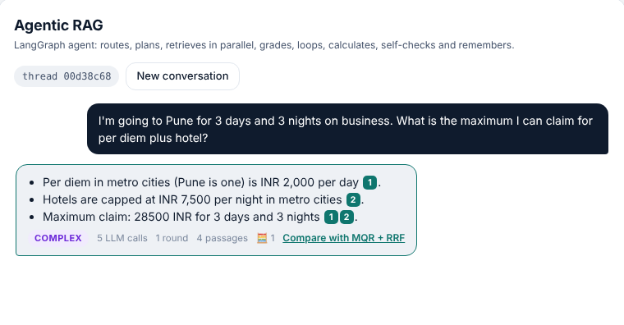
TODO 9 · generate(): grounded answer + calculator
items = [e for e in unique_evidence(state["evidence"])
if e["chunk_id"] in relevant][:max_chunks]
if not items:
return {"answer": NOT_FOUND, ...} # no LLM call
context, used = build_context_block(docs, max_chars) # Lab 1
user = f"Context passages:\n{context}\n\nQuestion: {q}"
if state.get("feedback"):
user += f"\n\nA reviewer found a problem. Fix it: {fb}"
raw = chat_complete([ANSWER, user])
answer, calcs = apply_calculations(raw) # TODO 1
citations = extract_citations(answer, len(used)) # Lab 1
Model writes: Max claim <calc>3*2000 + 3*7500</calc> INR [1][2]
User sees:
Max claim 28500 INR [1][2]
✓ A18
STEP 9
Notes:
Reuse Lab 1: build_context_block for numbered passages within the budget, extract_citations to verify [n]. New: only RELEVANT evidence goes in (assess decided), capped at AGENT_MAX_CONTEXT_CHUNKS; the ANSWER prompt asks for <calc> tags; apply_calculations replaces them using your safe_calculate. If the check node sent feedback, append it so the rewrite fixes the problem. No relevant evidence → NOT_FOUND without any LLM call.

Slide 13
TODO 10 · check(): verify, rewrite at most once
data = parse_json(chat_complete([CHECK, passages_answer])) or {}
grounded = as_bool(data.get("grounded"), True) # fail open
complete = as_bool(data.get("complete"), True)
regen = state.get("regenerations", 0)
retry = ((not grounded or not complete)
and regen < self.cfg.max_regenerations)
return {"check": {..., "retry": retry},
"regenerations": regen + (1 if retry else 0),
"feedback": problem if retry else ""}
generate
INR 9,000 [1]
check
not grounded: 9,000 not in passages
generate
rewrite with feedback
check
passed (or no retries left)
def after_check(self, state) -> str:
retry = state["check"].get("retry")
return "generate" if retry else "finalize"
finalize
saved to memory
✓ A19, A22
STEP 10
Notes:
Self-RAG style. Skip (no LLM call) when the check is disabled, nothing was used, or the answer is NOT_FOUND. Otherwise ask CHECK for grounded / complete / problem. Retry only if something failed AND regenerations < max. Important LangGraph detail: the routing function cannot update state, so the CHECK NODE increments regenerations and stores the feedback; after_check just reads check['retry'].

Slide 14
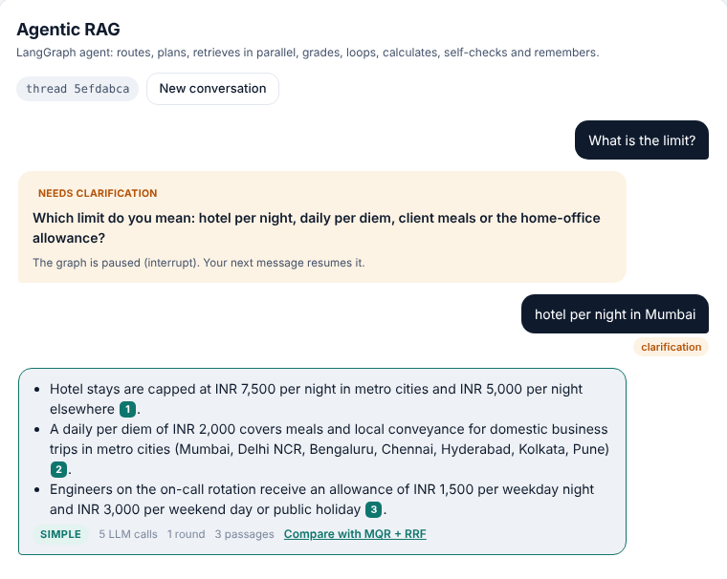
TODO 11 · clarify(): pause the graph, ask the human
def clarify(self, state):
q = state.get("clarify_question", "")
answer = interrupt({"question": q}) # pauses here
answer = str(answer or "").strip() # on resume
before = state["standalone"]
return {
"standalone": f"{before} ({answer})",
"clarifications": state.get("clarifications", 0) + 1,
}
# app/agent/service.py (provided)
self.graph.invoke(Command(resume=answer), config)
# POST /api/agent/resume {thread_id, answer}
# POST /api/agent/stream {resume, thread_id}
✓ A23, A25
STEP 11
Notes:
Three lines of real code. interrupt(payload) stops the graph; the API sees the pending interrupt and returns status needs_clarification. When the user replies, the API calls invoke(Command(resume=answer)) with the same thread_id and interrupt() returns that answer. Append it to the standalone question, increment clarifications, and the edge goes back to route (which will not clarify twice).
Show the screenshot: the trace has route twice, clarify once.

Slide 15
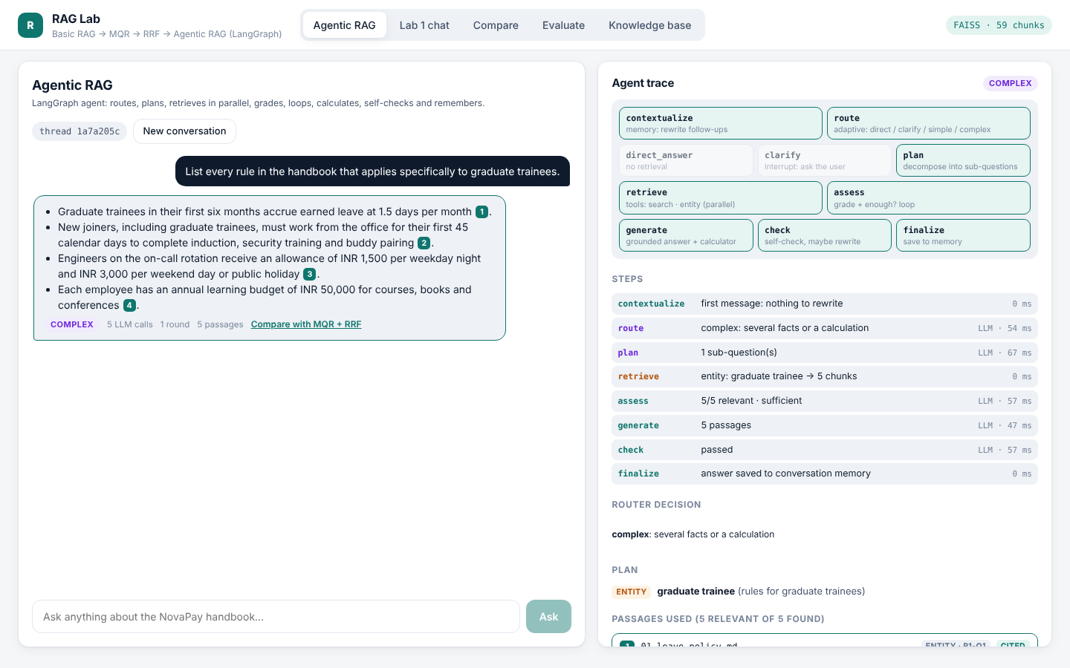
Run it: API, streaming, Agentic RAG tab (provided)
Endpoint | Does
POST /api/agent/chat | one message → answer or needs_clarification
POST /api/agent/resume | continue after a clarification
POST /api/agent/stream | SSE: start, step × N, final
GET /api/agent/graph | Mermaid of the compiled graph
GET /api/graph/entity/{name} | Graph RAG lite lookup
thread_id
the browser creates one per conversation; "New conversation" = new thread = empty memory
STEP 12
Notes:
Nothing to code here, but explain how it fits. service.py runs the graph: ask() for a new message, resume() after a clarification, stream() yields one event per node. routes.py exposes them; /api/agent/stream sends Server-Sent Events. The React tab draws the live timeline, lights up visited nodes, and has a Compare with MQR + RRF button under every answer.

Slide 16
Test map: 25 agent tests, 4 checkpoints
Tests | Area | What it checks | TODO | Checkpoint
A01–A04 | tools | calculator, hybrid search | TODO 1–2 | A
A05–A07 | Graph RAG lite | aggregation, aliases, edges | provided | —
A08–A10 | route | JSON parsing, guards, mapping | TODO 3–4 | B
A11–A13 | plan + Send | validation, fan-out | TODO 5–6 | B
A14 | retrieve | tool choice, fallback | TODO 7 | B
A15–A17 | assess loop | grading, follow-ups, limits | TODO 8 | B
A18 | generate | calculator, citations, feedback | TODO 9 | C
A19 | check | one retry, skip rules | TODO 10 | C
A20–A24 | whole graph | direct, multi-hop, bounds, clarify, memory | TODO 11–12 | C
A25 | API | chat, stream (SSE), resume, graph | all | C
pytest -k "A0" · pytest -x · done = 50 passed (25 Lab 1 + 25 agent)
Notes:
Use pytest -k to run a group: pytest -k A0 for tools, etc. Checkpoints: A after tools, B after the graph compiles and route/plan/retrieve/assess work, C when everything is green. The tests use a fake LLM that answers each TASK prompt, so they run offline and cost nothing. Lab 1's 25 tests must stay green: they protect the tools the agent reuses.

Slide 17
Verify with the 8 scenarios, then compare with Lab 1
# | Question (short) | Expected route | Look for in the trace | Lab 1 does
S1 | Python function? | direct | 1 LLM call, no retrieve
S2 | Hi, what can you do? | direct | 1 LLM call
S3 | What is the limit? | clarify | paused, then route ×2
S4 | PAY-E5000 … acknowledge? | complex | assess asks for a 2nd hop
S5 | Every rule for graduate trainees | complex | entity tool, 4 documents
S6 | Pune 3 days + 3 nights | complex | 2 parallel searches, 1 calculation
S7 | Learning budget vs home office | complex | 2 searches, subtraction
S8 | Sick leave → carried forward? | simple | contextualize rewrites turn 2
Record LLM calls per scenario: is the extra cost worth it for each question type?
Notes:
The acceptance test. Click each scenario in the Agentic RAG tab, check the route and the trace, then press Compare with MQR + RRF. Fill in the last column as a team. Expected behaviour comes from data/agent_scenarios.json; with the real model some routes may differ: discuss why rather than forcing it.

Slide 18
When it breaks: the errors everyone meets
Symptom | Cause | Fix
InvalidUpdateError: can receive only one value per step | parallel retrieve writes a field without a reducer | Annotated[list, accumulate] on evidence / tried_queries / steps
GraphRecursionError | a loop without an exit | after_assess / after_check must check rounds and retry
clarification never resumes | no checkpointer, or a new thread_id | compile(checkpointer=...), reuse the same thread_id
turn 2 shows turn 1's chunks | per-turn fields not reset | start_turn returns None for accumulate fields
router always says simple | model reply is not JSON | read the raw reply; tighten the ROUTER prompt
Agent not ready yet (501) | a TODO still raises NotImplementedError | the message names the TODO
Notes:
Keep this slide up during the lab. Every error here is a classic LangGraph mistake and maps to a test.

Slide 19
Done: an agent built on your own retriever
Stretch goals
WRAP-UP
native tool calling: bind_tools + ToolNode
SqliteSaver: memory survives restarts
LLM-extracted triples for Graph RAG
interrupt before sensitive answers
scenarios as automatic checks
AGENT_SEARCH_MODE=mqr_rrf vs hybrid
50 tests green, 8 scenarios checked, and a clear view of when the extra LLM calls are worth it.
Notes:
Close: what they built, the cost trade-off and the stretch goals. Remind: secrets only in .env.

