Slide 1
Dashboards
File created on: 3/4/2019 10:33:49 AM

Slide 2
FY15 Budget vs Actuals - Revenue and Expenses
File created on: 3/4/2019 10:33:49 AM

Slide 3
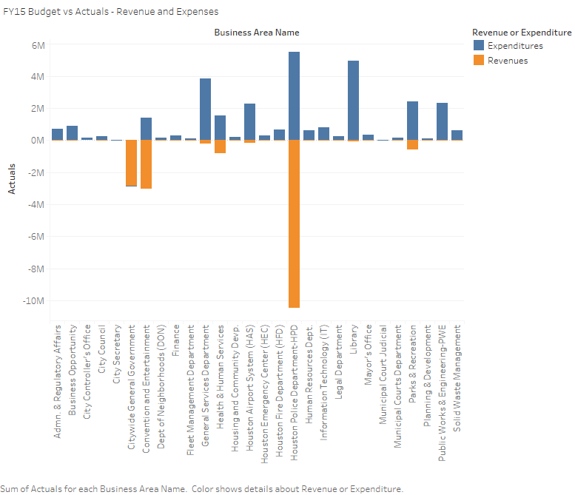

Slide 4
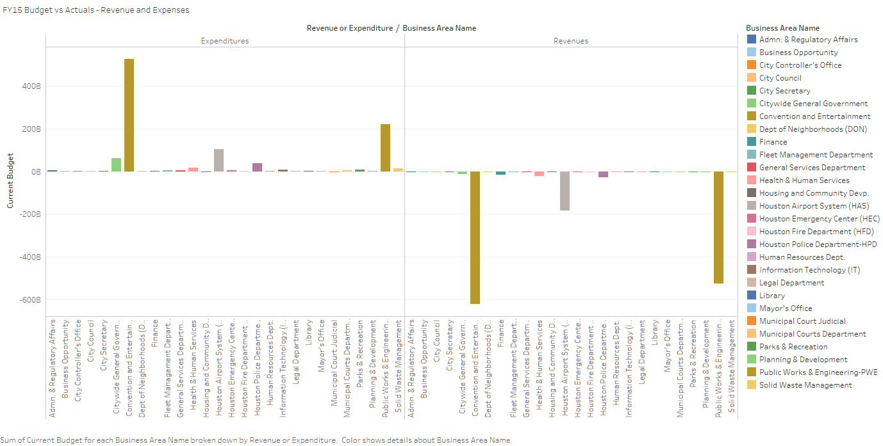

Slide 5
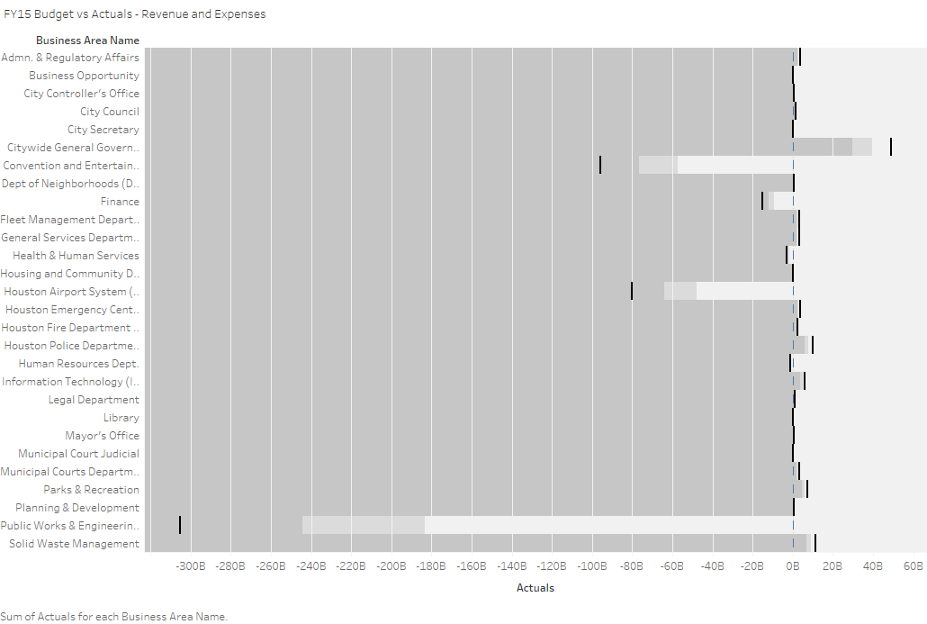

Slide 6
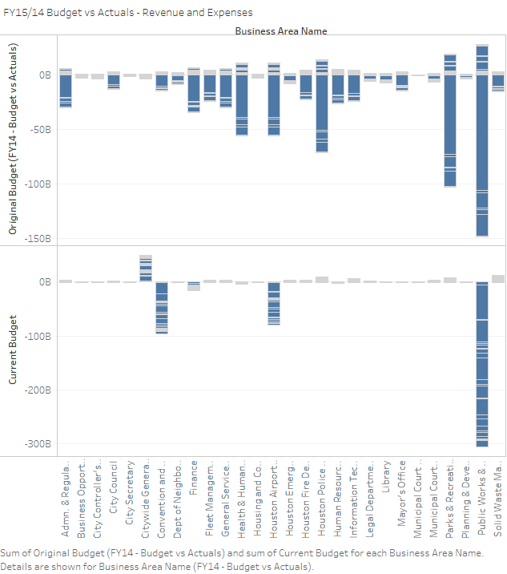

Slide 7
#MondayMorning – Trending Tweet
File created on: 3/4/2019 10:33:49 AM

Slide 8
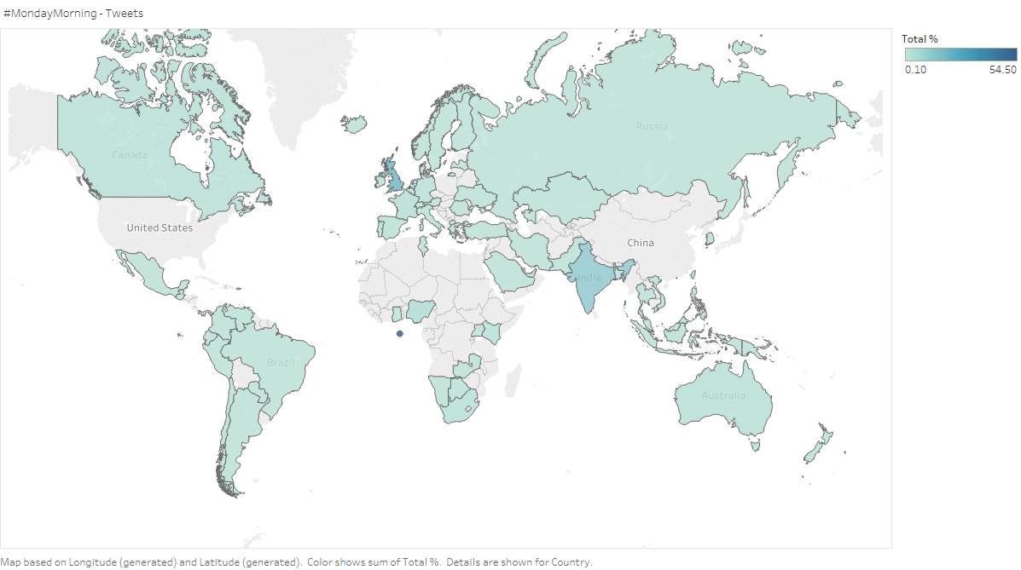

Slide 9
Google_Analytics-3
File created on: 3/4/2019 2:34:15 PM

Slide 10
