Slide 1
Restaurant Lead Generation for Digital Marketing Agency
This project aimed to assist a digital marketing agency by generating leads for restaurants in West Virginia. The goal was to extract business emails from the restaurants' websites, enabling the agency to pitch their services effectively.

Slide 2

Key Features:
Utilized Google Search API to extract data from 1907 restaurants.
Post-processed the data to remove big chain restaurants like KFC, McDonald's, Subway, etc.
Separated restaurants with Facebook links instead of websites.
Created a scrappy crawler to extract business emails from the restaurants' websites.
Developed a scraper for Facebook links to extract email and information from each Facebook link of restaurants.

Slide 3



Technologies Used:
Python
Selenium
Requests
Google Search API
Scrapy
Web scraping and crawling
Post-processing
Automation
Data extraction

Slide 4
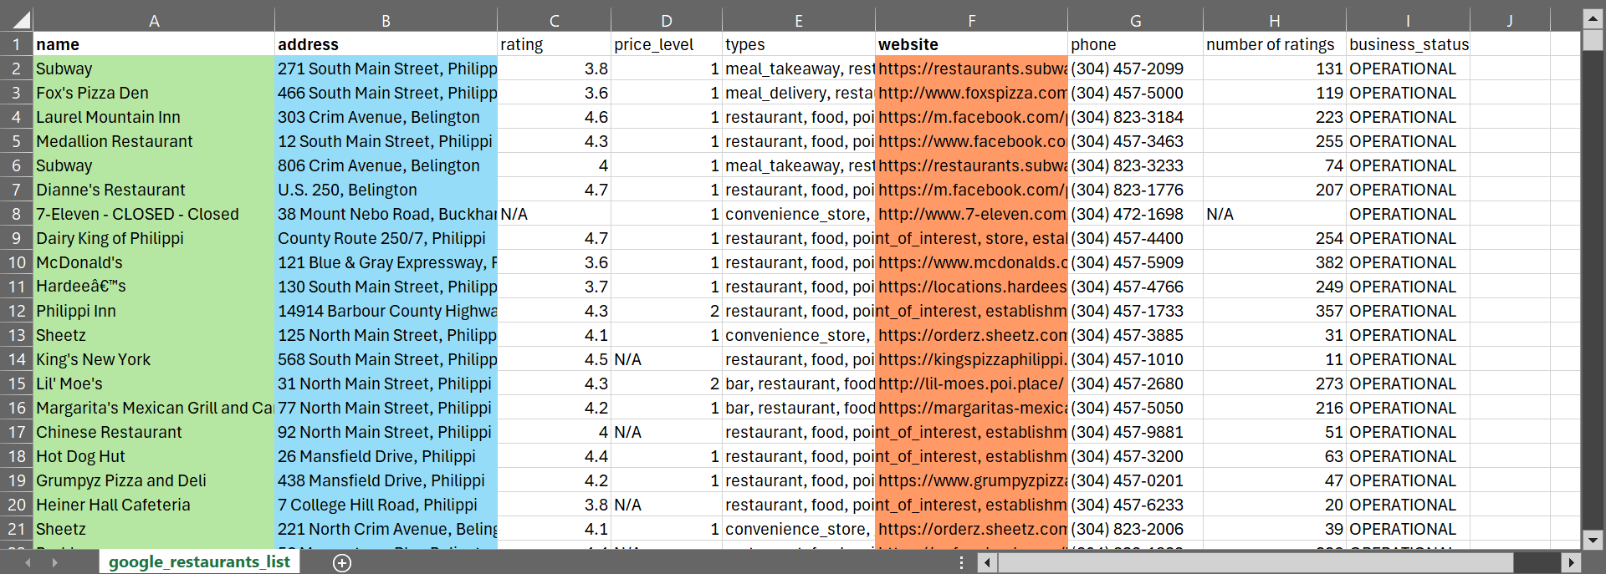
Restaurant Data extracted from google Search

Slide 5
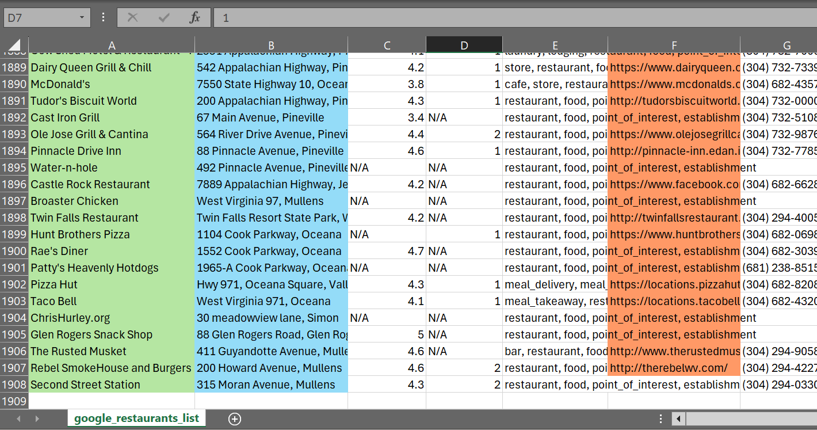

Slide 6
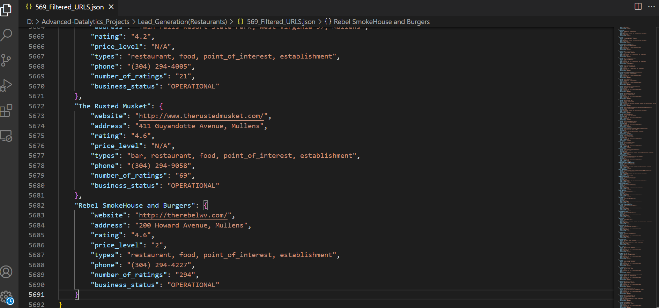
Post Processed data Of Filtered Restaurants

Slide 7
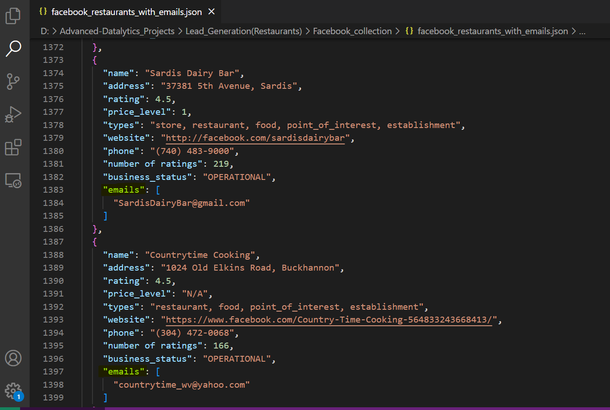
Filtration of Facebook URLS with business Emails Extraction

Slide 8
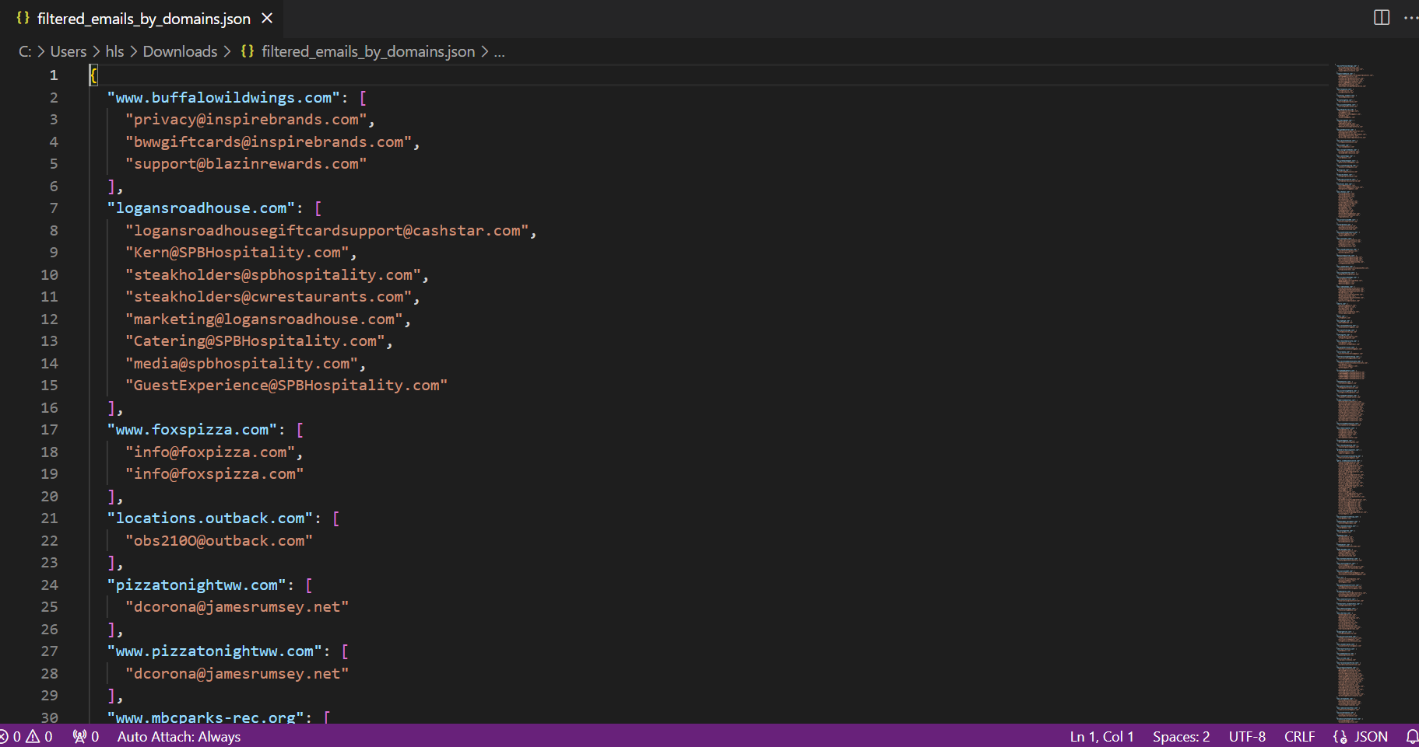
Business Emails Crawled for Each Restaurant

Slide 9
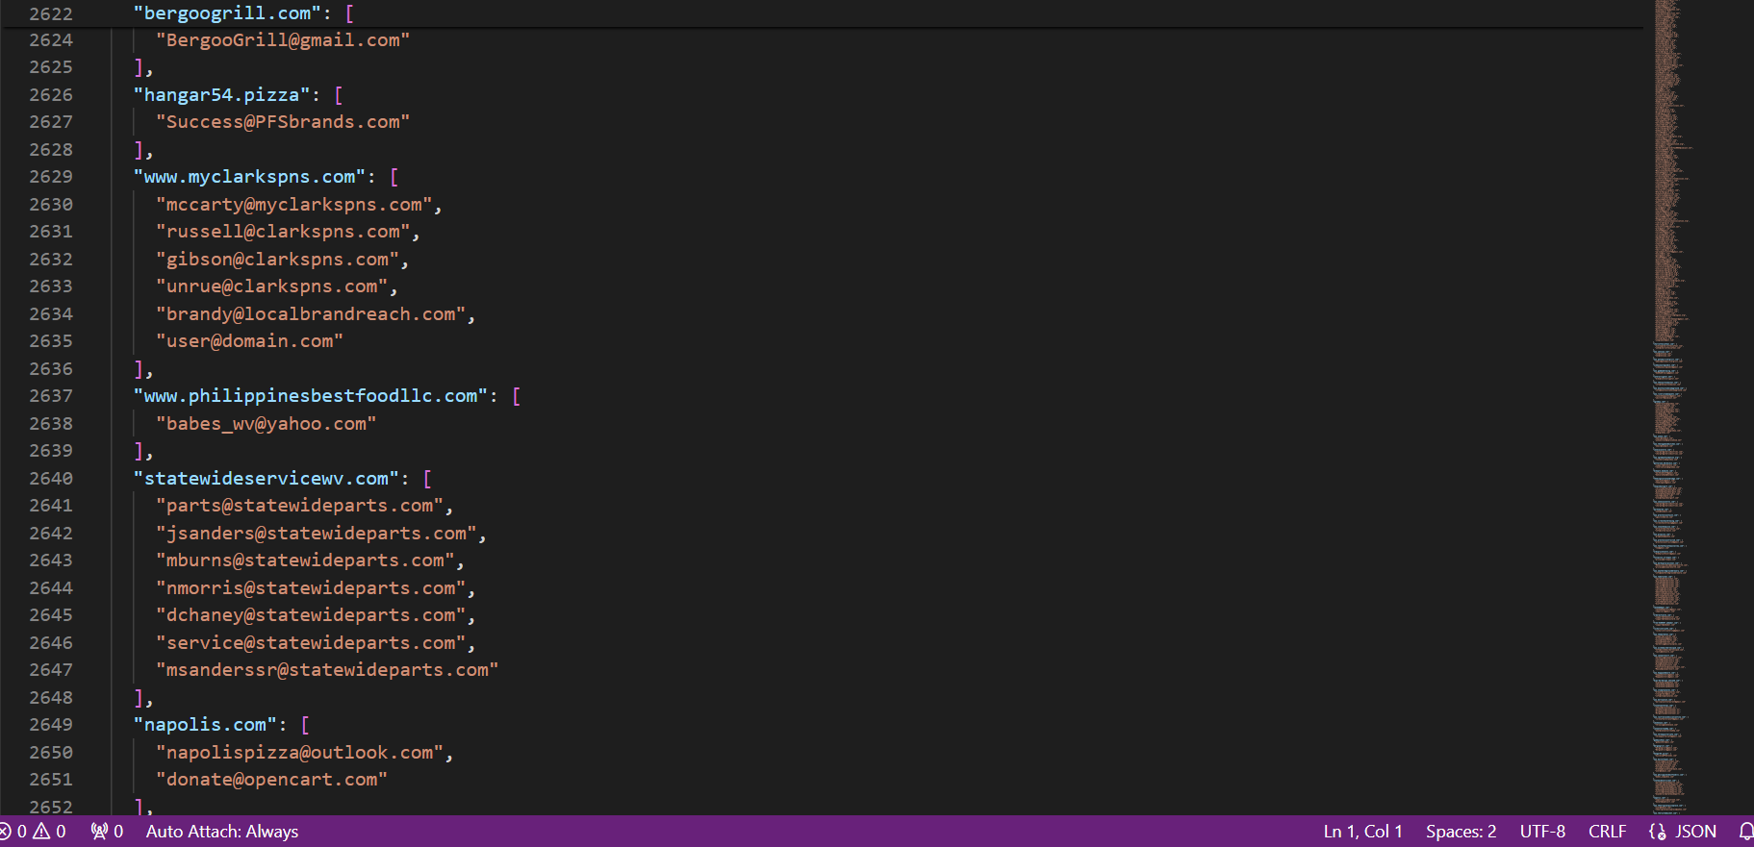

Slide 10
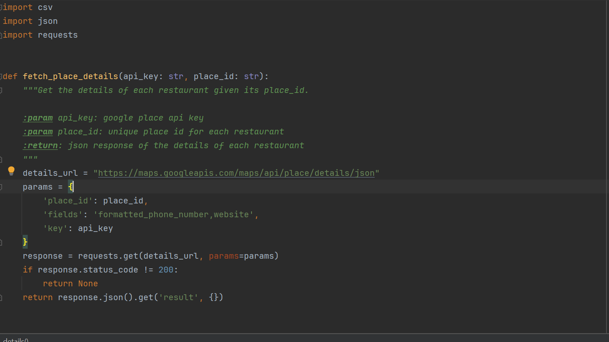
Some Glimpse of Code

Slide 11
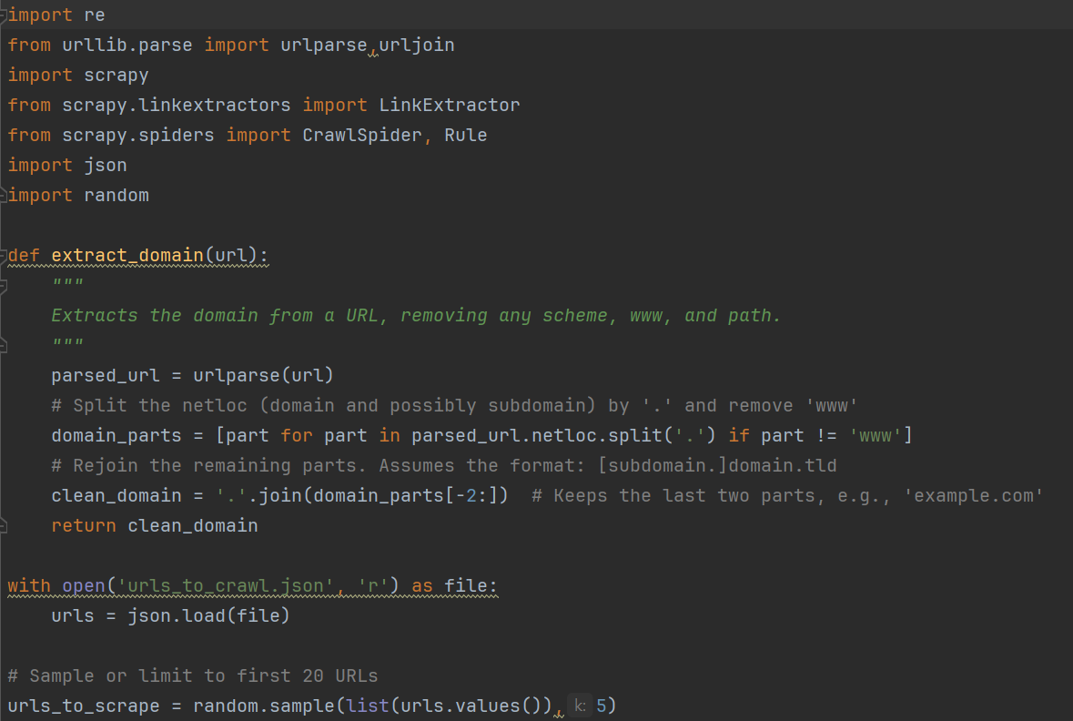
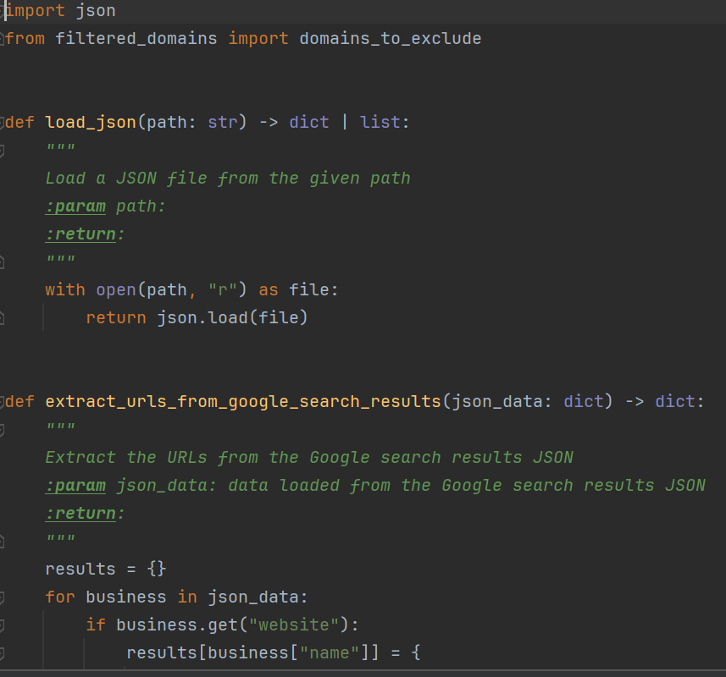
Filtration and Scrapy Crawler

