Slide 1
MATH 290 · SPRING 2026
Relational Graph
Convolutional Networks
Villain identification in murder-mystery knowledge graphs.
Adam Abramowitz · Max DeSantis · Isaac Dreeben · Abhi Mummaneni
Final project presentation

Slide 2
§ 1 · MOTIVATION
Why relational structure matters
Many real-world prediction tasks depend on multi-typed relationships, not just node features.
THE PROBLEM
Standard graph convolution treats all edges identically. In domains where the type of relationship carries the signal — coauthorship vs. citation, employs vs. accuses, witnessed-at vs. located-at — uniform aggregation discards the information that drives prediction.
FIGURE 1 · Same nodes, different edge semantics
THIS WORK
We apply Relational GCNs (Schlichtkrull et al., 2018) to a node-classification task on a corpus of murder-mystery knowledge graphs and compare against a logistic-regression baseline that uses the same node features but ignores relational structure.
Standard GCN
Relational GCN
Edge colour = relation type. R-GCN learns a separate transformation per type; standard GCN cannot distinguish them.
Edge type carries information that uniform aggregation discards.
2

Slide 3
§ 1 · BACKGROUND
What Schlichtkrull et al. (2018) showed
R-GCNs as a unified encoder for entity classification and link prediction on relational knowledge bases.
CORE CONTRIBUTION
BENCHMARK DATASETS
Extending GCN to relational data
Dataset | Task | Entities | Rels.
AIFB | Class. | 8.3 K | 45
MUTAG | Class. | 23.6 K | 23
BGS | Class. | 334 K | 103
AM | Class. | 1.7 M | 133
FB15k-237 | Link | 14.5 K | 237
WN18 | Link | 40.9 K | 18
Standard GCN treats edges identically. R-GCN learns a separate transformation per relation type, with basis decomposition keeping parameters tractable as the number of relations grows.
TWO TASKS DEMONSTRATED
· Entity classification — predict the type of an entity from its neighbourhood. · Link prediction — score whether a candidate triple (head, relation, tail) is true. · Architecture: the same R-GCN encoder is reused for both tasks; only the decoder head differs.
HEADLINE RESULTS
· State-of-the-art on AIFB (95.8 %) and AM (89.3 %) entity-classification accuracy. · Outperforms DistMult on FB15k-237 by +29.8 % filtered MRR — encoder helps when topology matters. · Strongest gains on high-degree nodes where contextual neighbourhood information is rich.
3

Slide 4
§ 2 · OUR WORK
Applying R-GCN to detective fiction
A novel application: villain identification on murder-mystery knowledge graphs.
DEFINITION 2.1 (Task)
WHY THIS IS A NEW APPLICATION
Given a relational graph G = (V, E, R) with node-feature matrix X, learn y : V → {0,1} that classifies each character as villain (1) or non-villain (0).
R-GCN was originally evaluated on academic / molecular / cultural-heritage knowledge bases (AIFB, MUTAG, BGS, AM). To our knowledge, this is the first application to narrative reasoning over fictional knowledge graphs.
OBSERVABLE
Characters and their attributes; locations, occupations, organisations; typed relational edges between entities.
WHAT MAKES THE PROBLEM HARD
· Sparse evidence: fewer than ten characters per story; class imbalance ~9 % positive. · Genre conventions: red herrings, deliberate misdirection, late twists. · Hidden truth: crime-revealing edges withheld; the model must reason from circumstantial evidence alone.
WITHHELD AT TEST TIME
kills, killed_by, assaults, financial-crime edges; narrative prominence; introduction order.
Validated: masking these edges had zero impact on predictions.
4

Slide 5
§ 2 · DATA
576 mysteries as knowledge graphs
Each story yields one typed graph; class labels assigned at the character level.
576
14,020
≈ 32 K
16
stories
nodes
edges
relation types
TABLE 1 · CLASS LABELS
TABLE 2 · NODE FEATURES
TABLE 3 · RELATION TYPES
Label | Count | Share
Uninvolved | 6,953 | 49.6 %
Witness | 3,158 | 22.5 %
Victim | 2,486 | 17.7 %
Villain | 1,275 | 9.1 %
Node type | # feat. | Examples
Character | 8 | alibi, motive, concealment
Occupation | 3 | authority, access, capability
Location | 3 | accessibility, isolability
Organisation | 3 | power, secrecy, scale
Relation | Domain → Range
knows / personal_bond | Char ↔ Char
investigates / accuses | Char → Char
deceives / harms | Char → Char
employed as | Char → Occ.
resides at / present at | Char → Loc.
affiliated with | Char → Org.
Note on directionality: edges are stored as directed; for R-GCN we materialise the inverse of each relation as a separate type, giving 8 base × 2 = 16 types and effectively bidirectional message passing.
5

Slide 6
§ 2 · DATA
Example graph: "The Red-Headed League"
Conan Doyle, 1891 · 10 entities, 14 typed edges across 4 node types.
Character
Location
Occupation
Organisation
Ground-truth villain
Sherlock Holmes
Jabez Wilson
Pawn Shop
Duncan Ross
owns
investigates
employed as
employs
present at
deceives
leads
deceives
near to
personal_bond
harms
affiliated with
Consulting Detective
Vincent Spaulding
Red-Headed League
City Bank Vault
accuses
knows
Dr. Watson
Insp. Jones
Crime edges (kills, killed_by) hidden at test time. The model must identify Spaulding and Ross from circumstantial evidence: deception, affiliation, spatial co-presence with the bank vault.
6

Slide 7
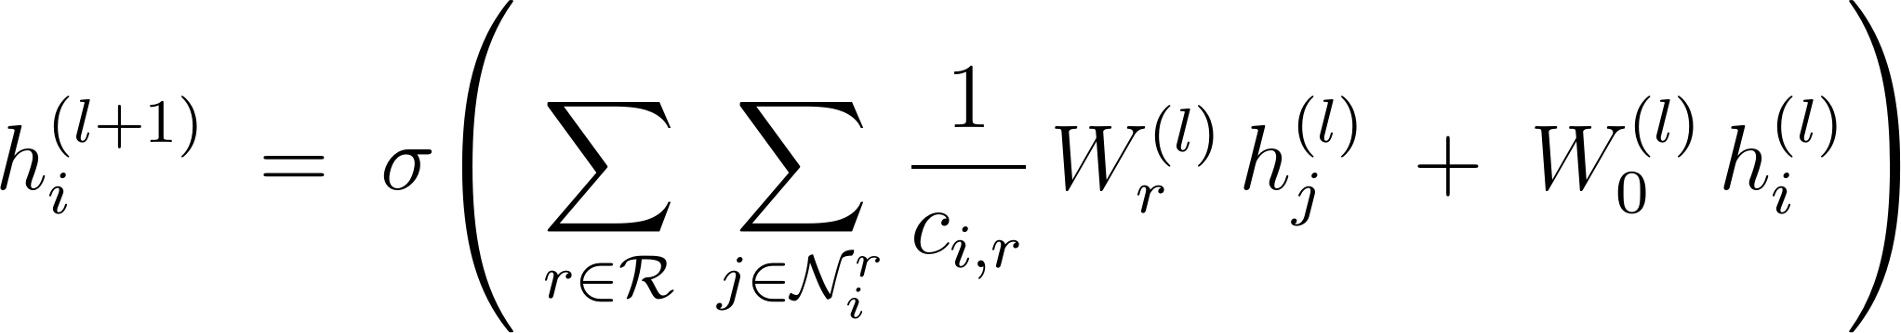
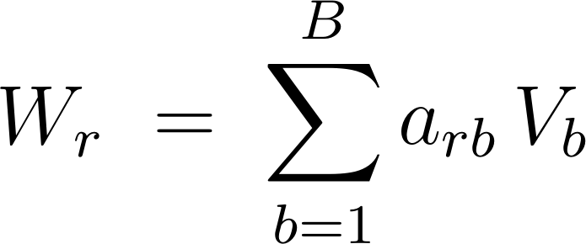
§ 3 · MODEL
R-GCN encoder
Per-relation message passing with basis decomposition for parameter efficiency.
DEFINITION 3.1 (R-GCN propagation rule)
where W_{r} is the relation-specific weight matrix, c_{i,r} = |N_{ir}| is the symmetric normalisation, and W₀ is the self-loop transformation.
PROBLEM
SOLUTION
Parameter explosion
Basis decomposition
With R relations and hidden width d, the encoder needs R · d² parameters per layer. With R = 16 and d = 32, that is 16,384 parameters per layer for relation transformations alone.
Share B basis matrices across all relations; a_{rb} are scalar coefficients. With B = 30, parameter count drops to B · d² + R · B.
7

Slide 8
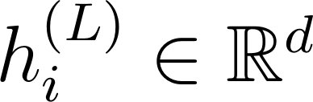
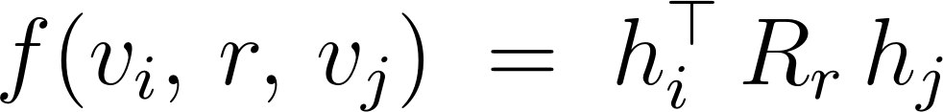
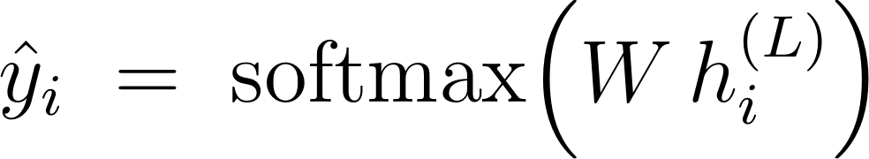
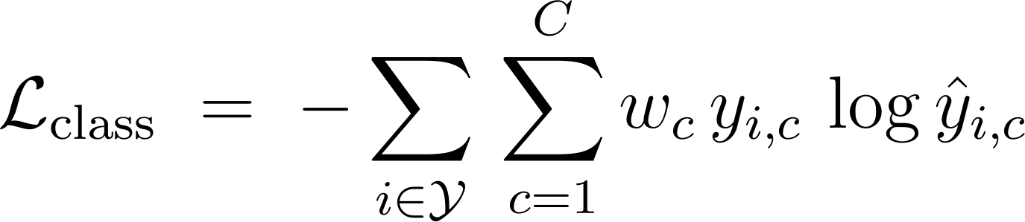
§ 3 · MODEL
One encoder, two task-specific heads
The same R-GCN embedding feeds both decoders; only the head and loss differ.
R-GCN encoder
shared embedding
3.1 · LINK PREDICTION
3.2 · NODE CLASSIFICATION
DistMult scoring + sigmoid cross-entropy
Linear softmax + weighted cross-entropy
Schlichtkrull et al., 2018
Our setup
Score function
Predictor
Loss
Loss (class-weighted)
8

Slide 9
§ 4 · TRAINING
Training procedure
Negative sampling, edge masking, and class balance handled at the loss level.
§ 4.1
§ 4.2
Negative sampling
Bidirectional message passing
For every observed triple (vᵢ, r, vⱼ), draw ω = 1 corrupted triple by perturbing the head or tail uniformly. DistMult is trained on observed-vs-corrupted as a binary task.
Each base relation r has its inverse r⁻¹ materialised as a distinct edge type in the graph, so messages flow in both directions through the encoder and each direction has its own learned transformation. This matters for asymmetric relations like accuses.
§ 4.3
§ 4.4
Crime-edge masking
Class imbalance
Edges that trivially leak the label (kills, killed_by, assaults, financial-crime) are removed from both training and test graphs. Validated via ablation: masking had zero impact on predictions.
Villain class is ~9 % of nodes. Cross-entropy weighted inversely by class frequency; macro-F1 reported alongside accuracy.
9

Slide 10
§ 5 · RESULTS
Quantitative evaluation
R-GCN outperforms feature-only and topology-only baselines on F1 and accuracy.
TABLE 2 · TEST METRICS (5-SEED CROSS-VALIDATED)
Model | Accuracy | Villain F1 | Precision | Recall
Spectral only (4-dim Laplacian eigenmaps, no features) | 0.255 | 0.113 | 0.145 | 0.093
Features + Spectral (concatenated) | 0.588 | 0.696 | 0.727 | 0.667
Logistic regression (features only, no graph) | 0.869 | 0.715 | 0.684 | 0.752
R-GCN (typed relational message passing) | 0.904 | 0.762 | 0.825 | 0.708
KEY FINDINGS
1. Topology alone is essentially useless. Spectral-only F1 = 0.113 — character centrality in a connection graph does not predict villainy. 2. Adding spectral embeddings to features adds nothing. Features + Spectral (0.696) ≈ Features only (0.715). Laplacian structure does not help on top of features. 3. R-GCN's gain comes from typed relational message passing. F1 + 0.047 over LogReg, +14 pp precision. Labelled relations — not raw topology — are what matters.
10

Slide 11
§ 5 · ANALYSIS
R-GCN vs. LogReg: a deep-dive on differences
Most of R-GCN's gain comes from clearing innocents, not catching extra villains.
R-GCN GAINS BY
LOGREG GAINS BY
Clearing innocents
Casting a wider net
It uses relational context — alibis, spatial separation, professional ties — to rule suspects out.
It flags every character with suspicious feature values — catching slightly more villains, but accusing far more innocents.
19
39
false accusations
false accusations
(10 Uninvolved · 7 Witness · 2 Victim)
(22 Uninvolved · 13 Witness · 4 Victim)
Graph structure helps the model exclude false suspects more than it helps find true ones.
11

Slide 12
§ 5 · ANALYSIS
Held-out inference: real cases
Stories the model never saw during training; predicted villain probabilities ranked.
CASE STUDY 1
CASE STUDY 2
Zodiac (2007)
In the Dark — Season 3
Real-world unsolved. Arthur Leigh Allen is the prime suspect.
Curtis Flowers prosecuted six times; exonerated. The podcast tells two interlocking stories: prosecutorial misconduct, and concealed alternate suspects.
Rank | P(Villain) | Character
1 | 1.0000 | Arthur Leigh Allen (real-world prime suspect)
2 | 0.998 | Zodiac Killer (unidentified placeholder)
3 | 0.217 | Rick Marshall (person of interest)
4–20 | < 0.13 | Police, victims, witnesses
Rank | P(Vill.) | Character | Role
1 | 1.0000 | Doug Evans | Prosecutor — misconduct
2 | 1.0000 | Willie J. Hemphill | Alt. suspect (UNK)
3 | 0.9999 | John Johnson | DA investigator
4 / 5 | 0.9999 | Presley & Gamble | Alt. suspects (UNK)
16 | 0.0000 | Curtis Flowers | Wrongfully accused — cleared
The model independently rediscovered both stories — naming the misconduct antagonists (Evans, Johnson) and surfacing the concealed alternate suspects (Hemphill, Presley, Gamble), while clearing Flowers despite a mislabelled training entry.
12

Slide 13
§ 6 · DISCUSSION
Conclusions
What R-GCN does well, where it falls short, and what it tells us about graph-based reasoning.
§ 6.1
§ 6.2
§ 6.3
Typed structure beats topology
Precise but cautious
Better at exclusion
Labelled relations drive performance; topology alone yields F1 = 0.255.
Higher precision than LogReg, slightly lower recall — half as many false accusations.
Most of the gain comes from ruling people out, not finding new culprits.
§ 6.4
§ 6.5
§ 6.6
Multi-task helps
Generalises to held-out cases
Limits remain
Link-prediction signal regularises the encoder; ablation shows F1 drops by 3.1 pp without it.
Correctly ranks real-world prime suspects; overrides a mislabelled training point.
Performance degrades on graphs with noisy or sparse relations; see Appendix C.
References: Schlichtkrull et al., 2018 · Kipf & Welling, 2017 · Yang et al., 2015 (DistMult)
13

Slide 14
Questions
THANK YOU
Adam · Max · Isaac · Abhi

Slide 15
APPENDIX
Supplementary material
A
Mathematical depth
Basis decomposition and the block-diagonal alternative.
B
Methodology
How negative sampling works in link prediction.
C
Limitations & failure modes
Where R-GCN gets it wrong, and why.
D
Dataset construction
How we built the knowledge graphs from synopses.

Slide 16
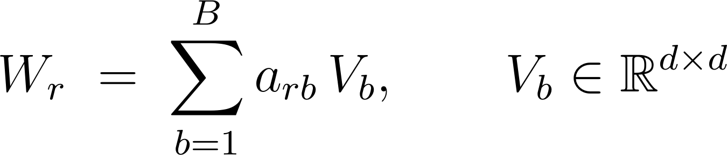
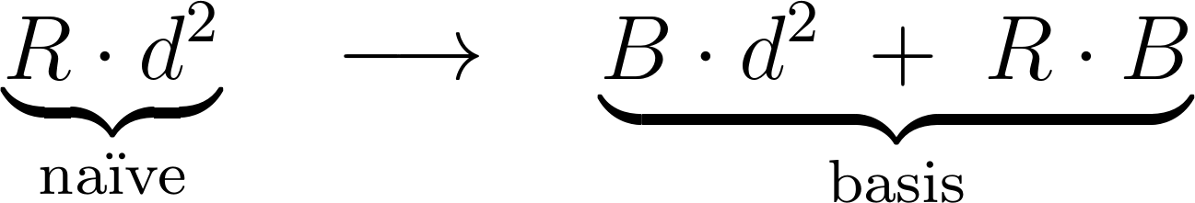
APPENDIX A · MATHEMATICAL DEPTH
Basis & block-diagonal decomposition
A.1 · BASIS DECOMPOSITION
Decomposition of the relation-specific weight matrix:
Parameter count drops from naïve to basis form:
With R = 16, d = 32, B = 30: 16,384 → 31,200 parameters per layer (small absolute, but bounded as R grows).
A.2 · BLOCK-DIAGONAL ALTERNATIVE
Enforces sparsity within Wᵣ rather than parameter sharing across relations. Useful when relations are functionally distinct and shouldn't be approximated as linear combinations.
A1

Slide 17
APPENDIX B · METHODOLOGY
How negative sampling works
Used by the link-prediction decoder; not used in our node-classification training.
THE PROBLEM
A knowledge graph contains only positive examples — observed triples. To train a link-prediction decoder we need negative examples: triples that should score low. The graph itself never gives us these directly.
THE PROCEDURE
For every observed triple (s, r, o), construct ω "corrupted" triples by replacing the head s or the tail o with a uniformly random entity. The model is trained as a binary classifier: positive on observed triples (label 1), negative on corrupted ones (label 0), with sigmoid cross-entropy on the DistMult score.
PRACTICAL CHOICES
· Sampling rate ω. Schlichtkrull et al. use ω = 1 (one negative per positive). Higher ratios saturated quickly in their experiments. · No filtering at training time. Corrupted triples are drawn uniformly without checking whether they happen to exist elsewhere in the graph; the noise is tolerable in practice. · Why we don't use it. Our task is node classification, so we train only the classifier head with weighted cross-entropy on labelled characters. Negative sampling is a property of the link-prediction decoder.
B1

Slide 18
APPENDIX C · LIMITATIONS
Where R-GCN gets it wrong
FAILURE MODES OBSERVED ON DEV SET
STRUCTURAL LIMITS
Failure mode | Frequency | Cause
Sparse-relation graphs | ~30 % | Few edges per character ⇒ encoder relies on features alone.
Two-act structure (red herring) | ~15 % | Apparent villain in act 1 has stronger relational signature than the true one.
Ensemble villains | ~10 % | Multiple co-conspirators ⇒ each gets a diluted P(Villain).
Off-screen perpetrators | ~8 % | Perp barely appears in the narrative ⇒ feature/edge sparsity.
· Two-layer R-GCN ⇒ 2-hop receptive field. Long-range reasoning lost. · Cannot count substructures beyond 1-WL. · Static graph: no temporal evolution of relations.
QUALITATIVE ASSESSMENT
R-GCN is not a detective. It is a precise, cautious classifier that exploits relational sparsity to exclude the obviously-uninvolved. On stories that match the training distribution, it improves macro-F1 by ~5 pp; on edge cases — sparse graphs, two-act narratives, ensemble crimes — it underperforms LogReg. The takeaway is not that graph models replace feature classifiers, but that they complement them when relational structure is rich and class signal is moderate.
C1

Slide 19
APPENDIX D · DATASET
Construction pipeline
STAGE 1
STAGE 2
STAGE 3
STAGE 4
Pull synopses
Extract entities
Extract relationships
Assign labels
Scraped 576 mystery plot synopses from Wikipedia — novels, films, TV episodes, podcasts, short stories.
Ran an LLM (mixtral:8x7b, two-pass) to pull out characters, locations, occupations and organisations along with their features.
Second LLM pass over each synopsis extracted typed edges between the entities, mapped onto the schema's 8 base relation types.
Each character was labelled Villain, Victim, Witness, or Uninvolved. Targeted re-extraction passes cleaned ambiguous cases.
DATASET STATISTICS
Property | Value | Property | Value
Stories | 576 | Mean characters per story | 10.4
Total nodes | 14,020 | Mean edges per story | 55.6
Total edges | ≈ 32,000 | Relation types (8 base × 2 inv.) | 16
Villain class share | 9.1 % | Targeted re-extraction rounds | 3
D1

