Slide 1
Git and Github for Pabio536

Slide 2
Welcome to Pabio536!
Introductions
Structure
Goal
Intro to git and Github
Download files for class using git

Slide 3
Course structure
Class meets MW from 10 to 11:20
Room is either C123A (14) or E130A (6)
Optional lecture then hands-on
Homework most classes
Grades based on:
Participation: 10%
Homework: 70%
Final project: 20%

Slide 4
Course sections
Python as a bioinformatic tool
Tools for nucleic acid analysis
Networks to visualize and analyze biological data
Protein structure and function analysis
Independent final project

Slide 5
Class goals
Comprehension of python
Introduce a range of free software tools
Build your personal data analysis toolkit
By the end of this course, be able to:
Read and understand papers describing code for data analysis
Add software to your toolkit
Use toolkit with your data
Quick demo
Notes:
Demo biojupees with a local notebook

Slide 6
Git and Github

Slide 7
What is git and why am I making you use it?
Git is version control software for repositories (repos)
Repo: A folder full of files + tracking ALL changes
Convenient way to share class code
Class repo >> your remote repo >> your local repo
Free tools on Github and Bitbucket
Place to store your toolkit

Slide 8
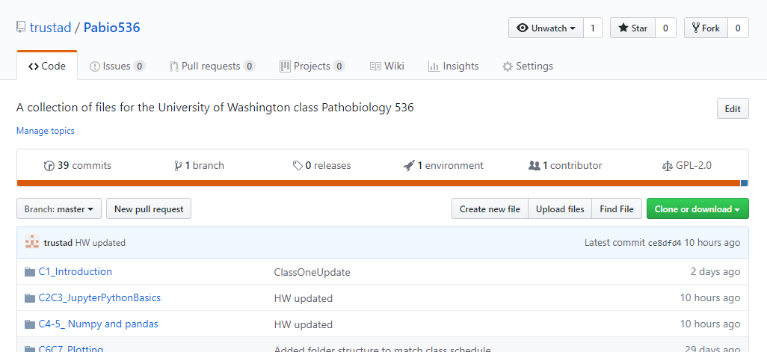
1. Fork a copy >> remote repo
Go to https://github.com/trustad/Pabio536
This is the class repository, or repo
Fork a copy
Get the web address (URL) of your copy
1
2

Slide 9
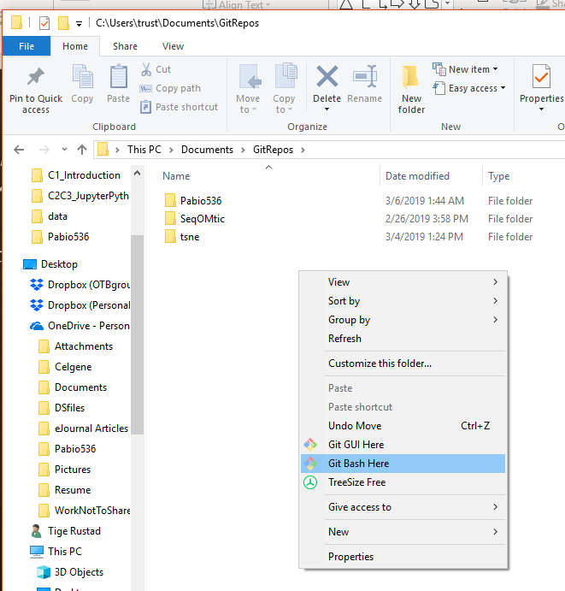
2. Open git Bash or terminal
Windows
Mac
Open git bash
Open terminal

Slide 10
Bare minimum shell script
Command Line Interface
mkdir folder : make new directory
cd folder/subfolder : change directory
** Note Linux uses / vs \ on Windows **
. = This folder
.. = One folder up
~ = Your home directory
ls : list directory contents
Tab for autocomplete
Notes:
Explain:
What is a shell script?
What is a CLI?
Why do we use one?
Three basic commands

Slide 11
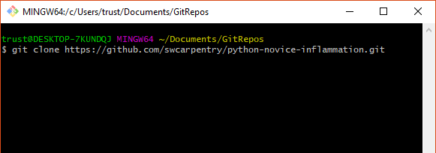
3. Clone a copy: remote repo >> local repo

Slide 13
This course
This course is NOT
A (patho)biology course
Coding familiarity
Sampling of tools
One way to approach problems
A computer science course
Full coding comprehension
Comprehensive survey
The way to approach problems

