Slide 1
Pabio536 Class One: Intro, Git and Github

Slide 2
Welcome to Pabio536!
Introductions
Structure
Goal
Intro to git and Github
Download files for class using git

Slide 3
Course structure
Class meets MW from 10 to 11:20
Room is either C123A (14) or E130A (6)
Optional lecture then hands-on
Homework most classes, due following Monday
Grades based on:
Participation: 10%
Homework: 70%
Final project: 20%

Slide 4
Course sections
Python as a bioinformatic tool
Tools for nucleic acid analysis
Networks to visualize and analyze biological data
Protein structure and function analysis
Independent final project

Slide 5
Class goals
Comprehension of python
Introduce a range of free software tools
Build your personal data analysis toolkit
By the end of this course, be able to:
Read and understand papers describing code for data analysis
Add software to your toolkit
Use toolkit with your data
Quick demo
Notes:
Demo biojupees with a local notebook

Slide 6
Git and Github

Slide 7
What is git and why am I making you use it?
Git is version control software for repositories (repos)
Repo: A folder full of files + tracking ALL changes
Convenient way to share class code
Class repo >> your remote repo >> your local repo
Free software on Github and Bitbucket
Place to store your toolkit

Slide 8
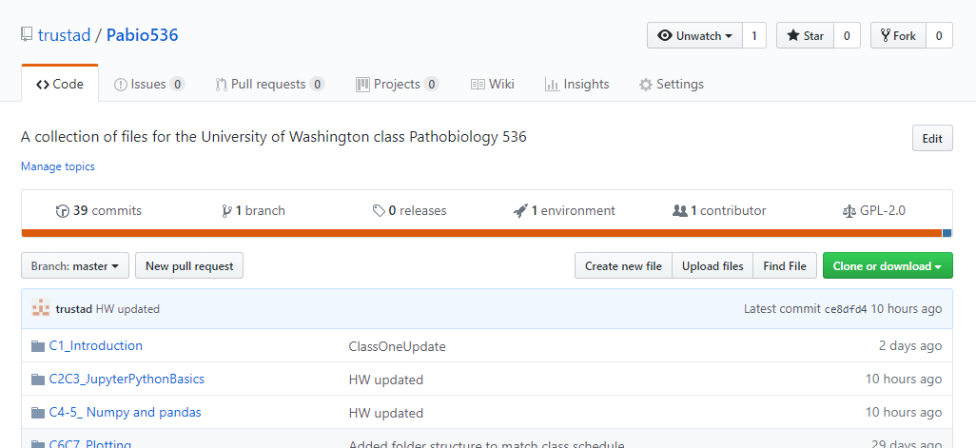
1. Fork a copy >> remote repo
Go to https://github.com/trustad/Pabio536
This is the class repository, or repo
Fork a copy
Get the web address (URL) of your copy
1
2

Slide 9
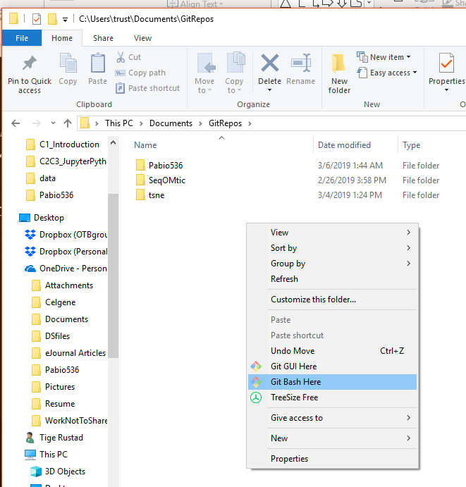
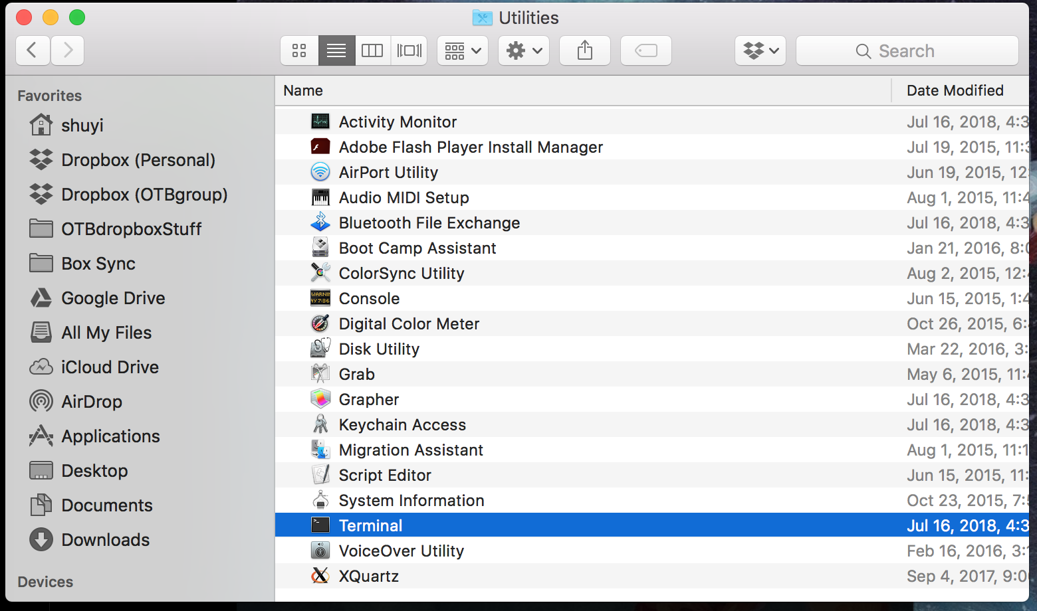
2. Open git Bash or terminal
Windows
Mac
Open git bash
Open terminal

Slide 10
Bare minimum shell script
Command Line Interface
mkdir folder : make new directory
cd folder/subfolder : change directory
** Note Linux uses / vs \ on Windows **
. = This folder
.. = One folder up
~ = Your home directory
ls : list directory contents
Tab for autocomplete
Notes:
Explain:
What is a shell script?
What is a CLI?
Why do we use one?
Three basic commands

Slide 11
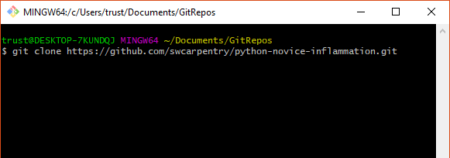
3. Clone a copy: remote repo >> local repo
Use ‘cd’ to change to the directory where you want to store your repo
Type ‘git clone’ and then paste the URL from Github
Verify the files are present

