Slide 1
Git and Github for Pabio536

Slide 2
What is git?
Version control software (VCS) helps you share and collaborate on creating code
Git is the most popular of many VCS
Git has many features for tracking software versions…
Which we will not use for this class
So…

Slide 3
Why am I making you learn git?
It’s a convenient way to share class code
You will finish the class with your own library of code
Github and Bitlocker use git

Slide 4
Github
Github is site for storing, sharing, and writing code using git to track versions
28 million current repositories
Software from thousands of papers is freely available on Github
By the end of this class series I want you to be able to:
Read a paper describing an interesting analysis method
Get that software off Github
Understand the basic function of that code and have a reasonable chance at running it yourself
If you don’t have one, go ahead and create a Github account now

Slide 5
git commands for this class
git init – set up a new git folder
git clone – copy a git repo to your local computer
git add – step one of saving your git files
git commit – step two
git pull – fetch updates and merge them with local copy
git push – send updates
I’ll also touch on branch, merge, and a few others

Slide 6
Step One – git init
Make a new folder for holding your repositories
Open git bash (win) or terminal (mac) in this folder
Type : git init pabio536
Move to the newly created ‘pabio536’ folder

Slide 7
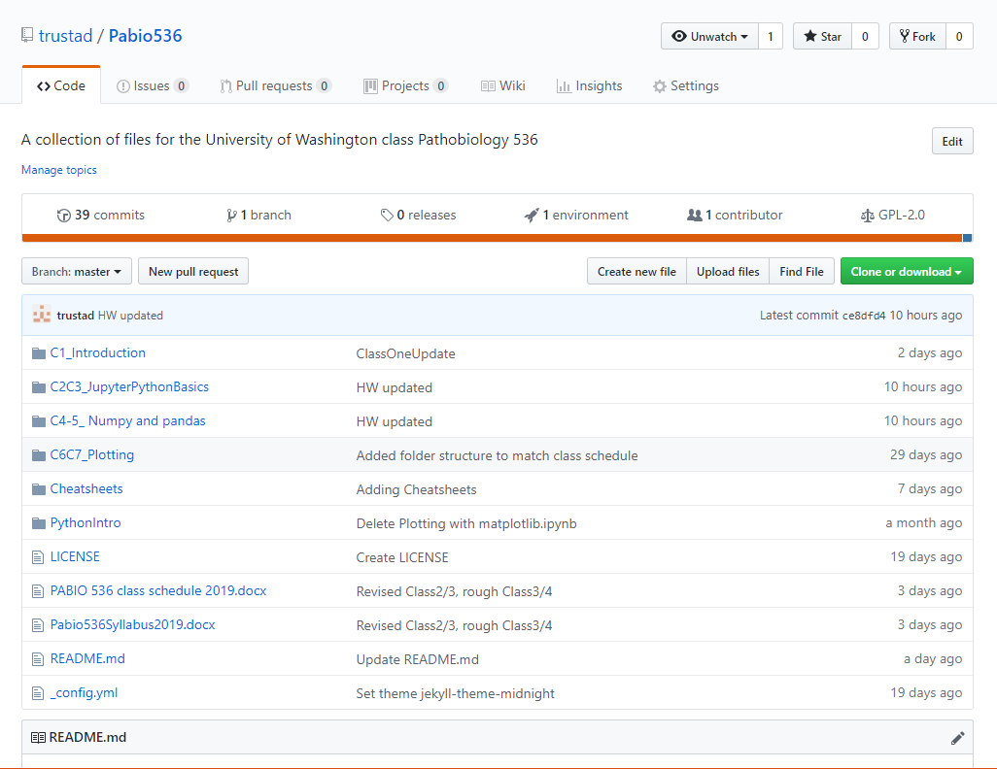
Step Two – fork and git clone
Go to the class github repository:
https://github.com/trustad/Pabio536
‘Fork’ a copy to your own repo
Click on the green ‘Clone or Download’ button
Copy the URL
Back to git bash
Type : git clone <paste here>
Check out downloaded files

Slide 8
Step Three – git add and commit
Open a text editor, type your name, and save that file in a new folder in your pabio536 repo named ‘LastNameFirstInitial’
Back to the git bash
git add and commit essentially save changes in two steps
add determines which changes will be saved
commit saves those changes
Type : git add .
That period at the end is important
Those error messages aren’t
Now enter : git commit –m ‘New test file’
If you leave out the –m “New… part a text editor opens
This can be a less than friendly experience. Use –m.

Slide 9
A quick detour into git branch
Everything done so far was on the ‘master’ branch
You can make a new branch, say ‘local’ with the command:
git branch ‘local’
This is the functional equivalent of saving your repo folders under a new name
Changes to ‘master’ won’t change ‘local’ … until you want them
We won’t use branch in this class, but if you want to try it out, go for it, and I’m happy to answer questions.

Slide 10
Step Four – push back to Github
git push origin master
When your depo is made it saves the original repo address as ‘origin’
‘master’ is the name of the branch you want to send
Go to your Github repo and verify your new folder and file is there

Slide 11
Step Five – make more changes
You can make changes to a repo in your browser
Click on your text file
Click the little pencil button to start editing
Add your email address
Scroll down and click the ‘Commit changes’ button

Slide 12
Step Six – pull updates to ‘local’
git pull origin master
Fetch any changes and merge them with your local copy
Conflicting changes trigger warnings
shouldn’t happen often if you always save to Github
I’ll let you google how to fix things from there

Slide 13
Step Seven – sync with original fork
As we add new files to the class repo you’ll want to add those to your forked copy
Remember how git saved your repo URL as ‘origin’?
We need to add the class repo URL as ‘upstream’ with:
git remote add upstream <class repo URL>
Navigate to the top folder
git fetch upstream
git checkout master
git merge checkout/master
Save all that to your Github repo
git push origin master

Slide 14
git commands for this class
git init – set up a new git folder
git clone – copy a git repo to your local computer
git add – step one of saving your git files
git commit – step two
git pull – fetch remote updates and merge with local repo
git push – send local updates to a remote repo
I’ll also touch on branch, merge, and a few others

