Slide 1
SumMe!
Filipino-English News Article Summarizer using an abstractive semantic-based approach

Slide 2
Statement of the problem:
The study aims to answer the following:
What is the evaluation of the system generated summaries by SumMe in terms of:
Compression Ratio
Retention Ratio
Q&A task Performance

Slide 3
Statement of the problem:
What is the Evaluation of SumMe’s generated summaries in terms of :
Cohesion
Understandability/Coherence
Notes:
Coherence - Coherence in linguistics is what makes a text semantically meaningful.
http://en.wikipedia.org/wiki/Coherence_(linguistics)
Cohesion - Cohesion is the grammatical and lexical linking within a text or sentence that holds a text together and gives it meaning.
http://en.wikipedia.org/wiki/Cohesion_(linguistics)
Cohesion and coherence are terms used in discourse analysis and text linguistics to describe the properties of written texts.
A text may be cohesive without necessarily being coherent: Cohesion does not spawn coherence. Cohesion is determined by lexically and grammatically overt intersentential relationships, whereas coherence is based on semantic relationships.
http://english.stackexchange.com/questions/48481/what-are-coherence-and-cohesion-in-text-linguistics

Slide 4
Introduction
A news article discuss current or recent news about a specific topic or general interest.
Summarization is the art of abstracting key content from one or more information sources.
Summarization is broadly divided into two groups: Abstractive and Extractive.

Slide 5
Introduction
Extractive summarization extracts salient sentences or phrases and group them together without changing the source text.
Abstractive summarization consists of understanding the source text in an effort to produce a generalized summary, conveying the information in a concise way.

Slide 6
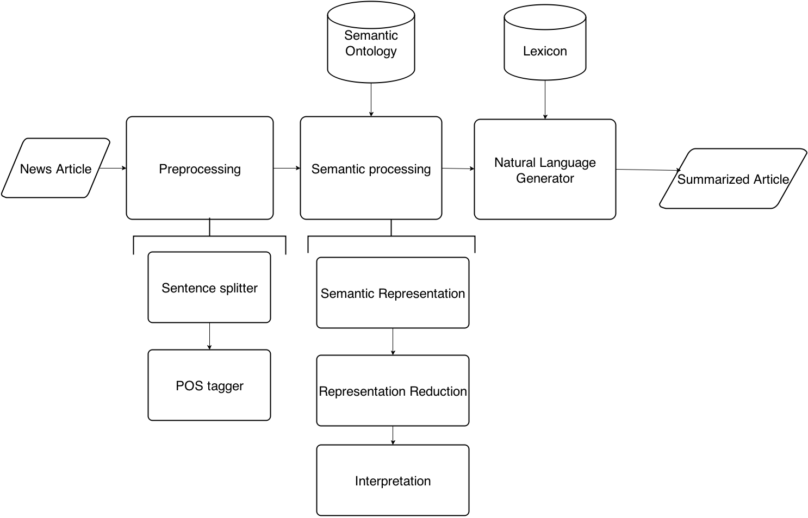
System Architecture

Slide 7
Rules : Preprocessing Module
Input Text should be in either Tagalog or English
The training corpus for which the tagger and chunker would be in should be well annotated and numerous(the more training data the better)

Slide 8
Rules : Semantic Representation
Input should be a list of the sentences, their chunks and pos tags
Output would be a subject verb object triple

Slide 9
Rules : NLG
A sentences’ words that would be generated should be included in the NLG’s xml lexicon
The word should have all the features annotated in the said xml file
Input should be an S-V-O triple

Slide 10
Background of the study
A Review on Abstractive Summarization(Khan, Salim 2014) suggests that:
Ongoing research must deal with issues regarding syntax integration and compressions involving lexical substitution and paraphrasing.
Evaluating abstractive summaries is difficult because there not exists an ideal summary for a given document

Slide 11
Research Hypothesis
There is a significant difference between the evaluation of the system generated summaries of SumMe, TextTeaser , other Summarization systems and human summaries.

Slide 12
System Conceptual Framework
input
process
* Input contents undergo preprocessing, semantic representation, reduction and interpretation, which is then fed into the Natural Language Generator
output
* Input Text file/news article either Filipino or English
* Paste news article on provided text area
Summarized input news article

Slide 13
Study Conceptual Framework
input
process
* Experimental Method
* Expert(s) will compare the input and output of the system for Retention Ratio computation
* Expert(s) are ask to make questions from the input article that must be answered by the output
output
* Recent news articles from selected websites (Filipino and English)
* Output Summary of the System
Answer Recall mean is computed
Compression , Retention Ratio , Coherence and Cohesion means are computed

Slide 14
Significance of the study
This study would benefit:
Students/ Internet surfers
Researchers
Notes:
Would benefit students because summarizing an article saves time in discerning whether the article is of any use to the student/internet user (his interest)
Would benefit Researchers because the study intends to implement improvements in syntax integration and compression of summaries, and re-introduces some metrics that can be used to evaluate an abstractive summary WITHOUT a model summary.

Slide 15
Population of the study
The population of the study consists of all online news articles from Rappler, Inquirer.net and the Philippine star.
Sampling frame consists of all articles from January 2014 to September 2014.

Slide 16
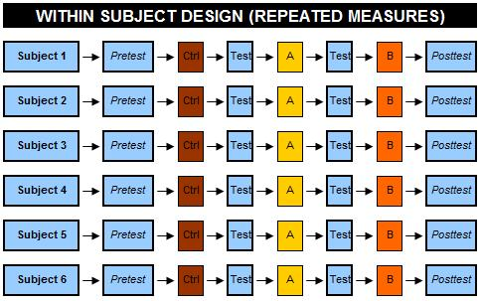
Research Method and Paradigm
Repeated Measures Design
Notes:
Repeated measuers - uses the same subjects with every condition of the research, including the control.
This requires fewer participants and resources and also decreases the effects of natural variation between individuals upon the results.

Slide 17
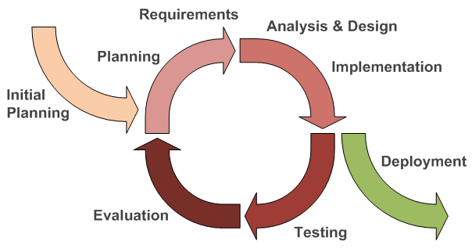
Research Method and Paradigm
Iterative and Incremental Development

Slide 18
Description of Respondents
The Respondents shall consist of currently active faculty from the College of Arts and Letters in Polytechnic University of the Philippines that teaches English and/or Filipino

Slide 19
Sampling Technique
Simple random sampling technique
Chooses each sampling unit randomly and entirely by chance. Such that each individual has the same probability of being chosen at any stage during the sampling process.

Slide 20
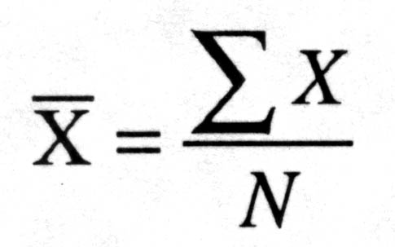
Statistical Treatment
Mean

Slide 21

Statistical Treatment
Compression Ratio
$$CR = \frac{length of summary}{length of source text}$$

Slide 22

Statistical Treatment
Retention Ratio
$$RR = \frac{information in summary}{information in source text}$$

Slide 23

Statistical Treatment
Answer Recall Lenient(ARL)
$$ARL = \frac{n1+(.5 ×n2)}{n3}$$

Slide 24

Statistical Treatment
Answer Recall Strict(ARS)
$$ARS = \frac{n1}{n3}$$

Slide 25

Statistical Treatment
Answer Recall Average(ARA)
$$ARA = \frac{ARL+ARS}{2}$$

Slide 26
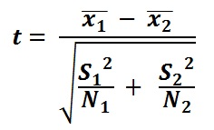
Statistical Treatment
T-test

Slide 27
CHAPTER 4
The study aims to summarize news articles written in Filipino and English using abstraction methods under Semantic-based summarization. The ratings can be categorized by the Compression ratio, Retention ratio, Coherence, Cohesion and Q&A task performance.

Slide 28
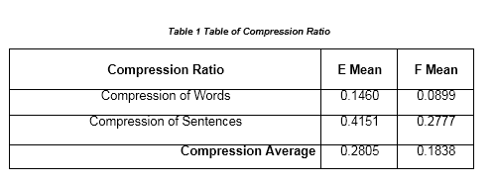
CHAPTER 4

Slide 29
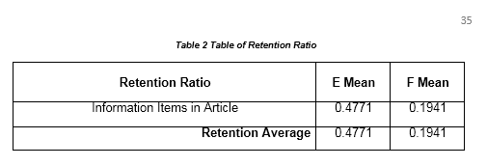
CHAPTER 4

Slide 30
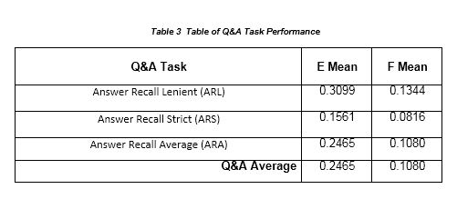
CHAPTER 4

Slide 31
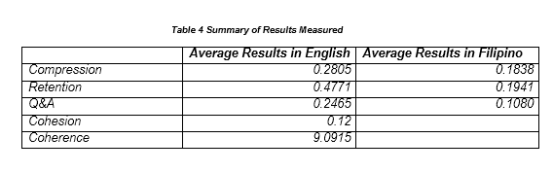
CHAPTER 4

Slide 32
CHAPTER 5 SUMMARY OF FINDINGS, CONCLUSION AND RECOMMENDATIONS

Slide 33
CHAPTER 5
This chapter includes the results of all the findings made on the study, Conclusions made while doing the study based on data analyzed on the previous chapter. Some limitations have been found and recommendations for future researchers that might help improve the system.

Slide 34
CHAPTER 5
The purpose of this research was to probe the essence of using graph based abstractive summarization, especially with the use of Chunking for extracting Information Items instead of Dependency parsers, in both English and Filipino languages.

Slide 35
CHAPTER 5
The objective of the study was to measure the ratings of the system using generated summaries. The results were as follows:

Slide 36
CHAPTER 5
English
a. Compression Ratio – 0.2805
b. Retention Ratio– 0.4771
c. Understandability/Coherence– 9.0915
d. Cohesion- 0.12
e. Q&A Task performance- 0.2465

Slide 37
CHAPTER 5
Filipino
a. Compression Ratio – 0.1838
b. Retention Ratio– 0.1941
c. Q&A Task performance- 0.1080

Slide 38
CHAPTER 5 Conclusions
According to the experimentation made by the language expert, and the implementation results gathered and computed, the system little of the objectives are met. This result on the lack of tools in Filipino, the poor implementation made, the poor application of the SVO triple extraction and scoring and the poor chunking and part of speech tagging made by the tools used on the system.

Slide 39
CHAPTER 5 Conclusions
The poor output can also be affected by the input as the system was made for news format of texts only, and as news articles are always on the passive voice.

Slide 40
CHAPTER 5 Conclusions
The poor output can also be affected by the input as the system was made for news format of texts only, and as news articles are always on the passive voice.

Slide 41
CHAPTER 5 Recommendations
1. Using a complete lexicon of Filipino words to avoid undetected words on the system.

Slide 42
CHAPTER 5 Recommendations
2. More training data both for the English/Filipino POS and Chunk taggers to avoid missing Noun Phrases that should be detected

Slide 43
CHAPTER 5 Recommendations
3. Use of Anaphora resolution to better determine if a verb has an object or if some word is referring to another

Slide 44
CHAPTER 5 Recommendations
4. A port of the language detector in python, as the current used detector requires java

Slide 45
CHAPTER 5 Recommendations
5. An implementation of the Coh-metrix for Filipino to compute the Cohesion and Coherence of the output summaries.

Slide 46
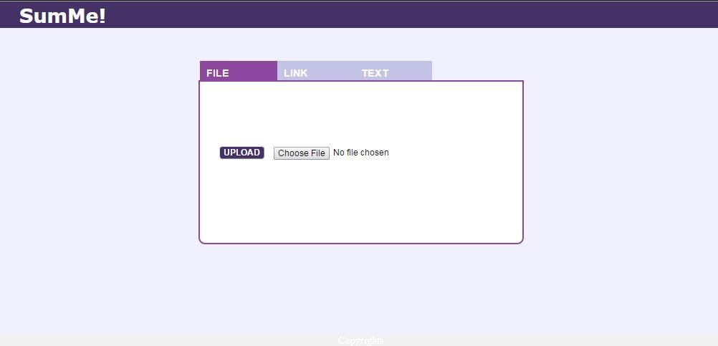
Appendix

Slide 47
Appendix

Slide 48
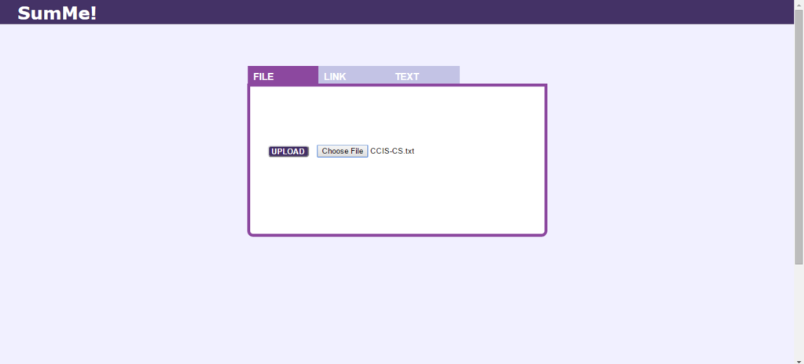
Appendix

Slide 49
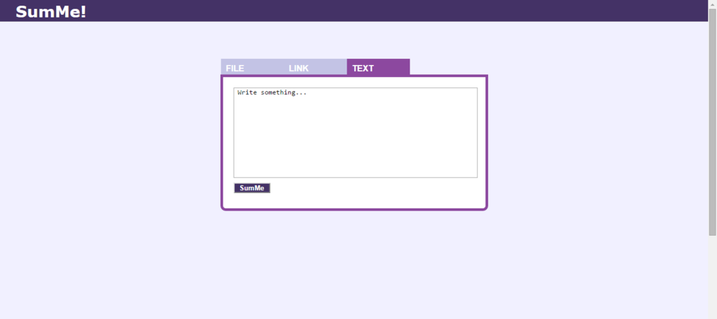
Appendix

Slide 50
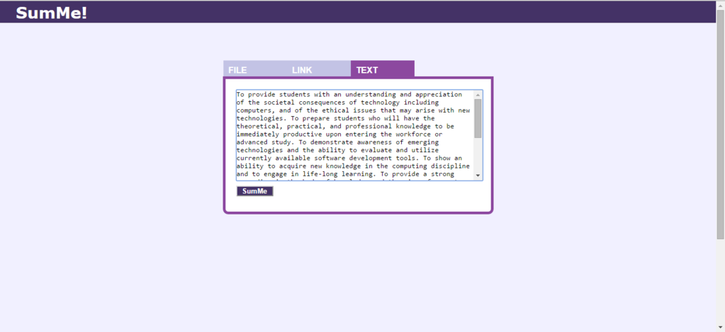
Appendix

Slide 51
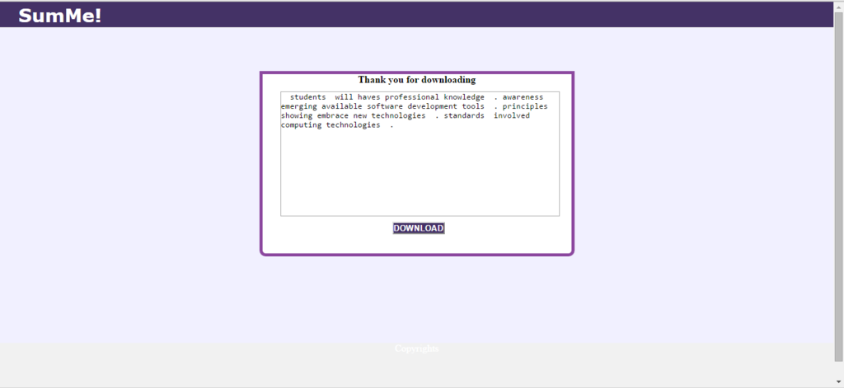
Appendix

Slide 52
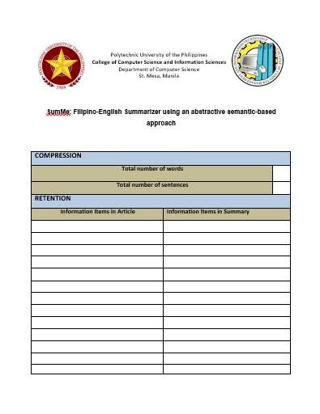

Slide 53
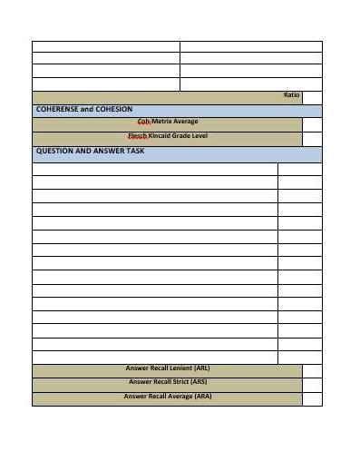

Slide 54
Thank you!
Aranzamendez, Paul Justin
Capalad, Justin Allen
Evangelista, Renz Gio
Panaguiton, Cieron

