Slide 1
Data-based Determinants of Steam Sales
MSDS 698 Capstone Project Taha Ahmad
Notes:
This research project was conducted by Taha Ahmad, a graduate student at CUNY SPS’s Master of Data Science program. He has previous experience in the cybersecurity field working as a cybersecurity analyst and then engineer. Working with log data and alerting has given him an appreciation for what goes into the specifics of machine learning models working into the backend. While a lifelong hobby has led to this project basing itself on machine learnings in the sector of video games.

Slide 2
Outline
Problem Statement
Methodology
Experimentation & Results
Data Collection and Preprocessing
Data Processing and Exploration
Model Building and Selection
Model Evaluation
Summary and Conclusion
Notes:
Introduce yourselves and describe your problem.
Explain your objectives, challenges of your work, proposed methodologies, and the assumptions you made while conducting modeling and/or analysis.
Provide an overview of your approach and/or conceptual model (please do not present your code directly).
Describe the results you obtain and summarize the current achievements and possibility of future works.

Slide 3
Problem Statement
What developer actions and game features can small game developers listing their game on Steam utilize to achieve the most sales?
Notes:
The gaming industry is a sleeping tiger in regards to profit potential for investors and businesses alike. In 2023, the global market for games reached 184 billion USD in revenue (Wijman, 2024). This can be directly compared to the global box office revenue for movies in 2023 hitting $33.9B (Mitchell, 2024) or the global music market revenue hitting $28.6B the same year (IFPI, 2024). This difference of about six times more revenue than these well-established giants of entertainment, showcases the potential for profitability within the video game industry.
The video game industry is made up of multiple sectors though, and we specifically want to focus on the $38.4B slice of the market that is attributed to games sold for use on computers. As this is the fastest growing portion of the industry with +5.3% year over year growth last year. Broken down further there are multiple different platforms that sell games on PC, but the largest by far is Valve’s Steam marketplace with $8.8B in 2023 revenue and 132M monthly active users that will only have grown since the last count in 2021 (Steamworks Development, 2022). Those are 132 million potential customers to sell to, but every new game that comes out is competing with the 108k and counting other games on the storefront (SteamDB, 2024). Large game development companies are able to compete on the marketplace through having existing loyal customers and large marketing budgets. However, independent developers and smaller companies cannot feel confident in their new releases selling even if they are certain in the quality of the product.
Therein lies the crux of the problem we want to tackle: How can a small developer release a game on Steam and stand out amongst the multitude of competitors? We want to take a data driven approach to solving this problem by gathering data available through Steam and third-party APIs to extract features for previously released games. With the data we aim to build a predictive model that is able to accurately assess which features get games by small developers in the hands of the most Steam users as possible. Ideally this research will be able to be used by developers to improve their sales with minimal changes to the vision of the product that they want to release.
The issue at hand hinges on the fact that small game developers have many disadvantages selling their games on Steam mainly owing to a lower marketing budget, less insight into the market, and mostly non-existent customer recognition. Yet, there is still the occasional success story of a small developer creating the latest hit game that's taken the Internet by storm. In theory, these games that are ending up much more successful should be doing something tangibly different. Taking a data-driven approach, relying on game information provided by Steam, to resolve this problem allows us to distill our research question down to:
What developer actions and game features can small game developers listing their game on Steam utilize to achieve the most sales?

Slide 4
Methodology
Predictive model building in Python
Data collection through APIs
Data Processing and Exploration
Model Building
Model Evaluation
Notes:
The main process we will attempt to answer our research question:
Will be through predictive model building in Python through an ipython notebook. Our initial data was planned to be collected mainly through a third-party API called SteamSpy that scrapes the relatively undocumented Steam API. Through this we would have been able to collect data for every game on Steam, and create a model trained on the features of all the games that were released ever since SteamSpy started collecting data, ten years ago. Our target variable was going to be the approximated unit sales for games, one month after they have released, found through SteamSpy’s historical data.
Unfortunately, after paying for a pro subscription to SteamSpy which boasted access to historical pricing data, we found out that historical data was not provided through the API and instead through JavaScript tables in a painfully slow loading website where authentication headers did not properly return historical data due to issues syncing the pro account benefits. This made SteamSpy unfeasible as a source if we were to use historical data. Instead, we pivoted to utilizing the Gamalytic API to collect historical sales data from. The Gamalytic API is very similar in concept to SteamSpy in that it partially contains sales data scraped from the Steam API but also partially has models which estimate sales data at certain points in time. Sales data being partially model driven is a concern for the validity of our response variable. However, Gamalytic claims that “77% of estimates were within 30% margin of error” (Gamalytic, 2024). Additionally, the models which output sales data do not utilize any of the variables that we are going to use, so we will not fall prey to unwittingly including an explanatory variable that is part of what the response is directly derived from.
Meanwhile the explanatory variable set will include a wide variety of descriptors pertaining to information that is available on the Steam product page such as price, genre, multiplayer capability, controller support, description, and more. Additionally, we will need to gather description data from an official Steam app details API with no official documentation (Valve, 2024). Thankfully unofficial documentation uploaded to a wiki site by user “RJackson” was available and used to guide our efforts (RJackson, 2020). We also made precursory attempts to collect data on social media actions that the developers have taken on platforms such as X or Reddit, however those were unsuccessful.
After data collection, we split the data into training and test, then move on to data processing and exploration the data will be cleaned of any errors, outliers, or missing values. We will need to adjust the historical sales data to approximate sales for thirty days. Additionally, variables will be created from the description and names which will be text mined to obtain the maximum amount of usable information from our data. A large number of variables will be pulled from arrays that make up the tags, genres, and features of each game and selected for the most popular ones. Feature selection will take place afterwards seeing if we can narrow our features to those with high correlation to historical sales, or at least does that are not overly collinear. Throughout this step we will be analyzing the relationship between the different variables and each other or the sales data.
Once our data is initially processed, we will begin building models. We will start out with iterating upon an ordinary least squares model to get the best form of a valid model that we can. While a decision tree model will be attempted as well for having the highest amount of interpretability. Finally, we will build an XGBoost model to use as a benchmark for regression accuracy to compare our other models to.
Finally, the performance of the various models will be evaluated using a mix of minimizing the root mean square error and maximizing interpretability to select the best one. We will then answer our research question by using the variable importance from this model as a guide.

Slide 5
Experimentation
& Results

Slide 6
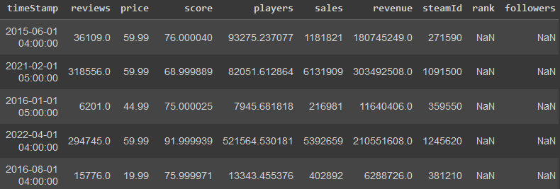
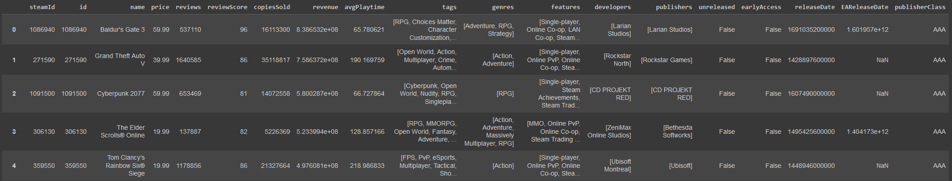
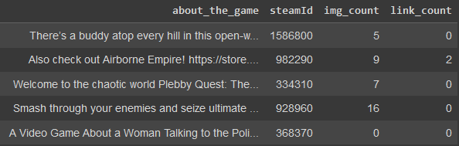
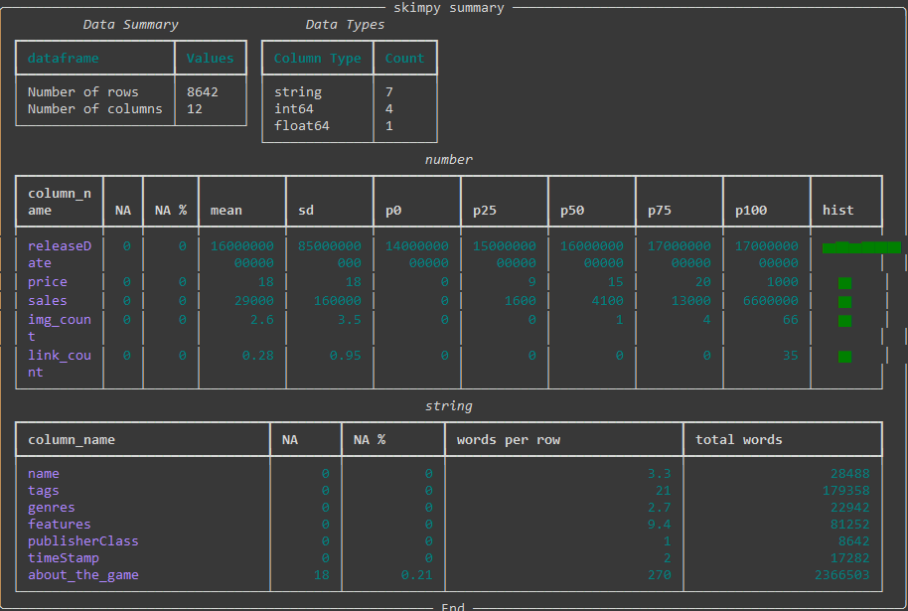
Data Collection and Preprocessing
Notes:
Three APIs:
Gamalytic Paged: General information about the game including tags, genres, features
Gamalytic Historical : Historical pricing information about the game close to 30 days from release
Steam App: The description of the Steam game
All shared by the presence of SteamID
Unfortunately, after 10,811 entries of historical Gamalytic data and Steam descriptions being collected we end up being IP forbidden from accessing the Steam API. We have taken into account the only condition of accessing the API which is being limited to 100,000 requests per day, and also have been taking waiting time between requests. Thus, we end up unsure of the true reason we are being forbidden from the API. However, to take data collection further after being restricted access to the API would not be misuse of a public API that Valve is providing us access to. So, we end our data collection for the extended data with only 10,811 entries of the 45065 we were initially hoping for. Still, this is a good sample of about 2/9ths of the population, games that have been fully released on Steam within the past 10 years, that we are working with.
The last part of data collection is getting rid of fields that we will not use and merging together our three different API collections to get a singular dataframe which we will process further for model building. The fields that we end up keeping are:
SteamID: which is the unique identifier for each game on the Steam store itself. This will not be used as an explanatory variable within our model, but it is good to keep in case we need additional information for a row.
Name: which is self-explanatorily the name of the game, in theory this is something that could influence if a new game is sold more or less based on a few different factors that could be extracted through text mining.
Tags: are keywords that can possibly apply to a game which are added to store pages by Steam users, the lower on the array index a tag is the more users will have applied that tag. Thus, even though some user tags might not be accurate, the top few tags are likely to be apt descriptors of a game due to having large amounts of votes.
Genres: are keywords that the developers or publishers themselves apply to the Steam game page which will be even more accurate descriptors of a game. Typical game genres can include action games, RPG or role-playing games, adventure games, and many more.
Features: are keywords that the developers or publishers themselves apply to the Steam game page and regard features that a game has such as if it is playable online with others, is playable offline alone, has support for controllers, and more.
ReleaseDate: is the day a game is released to the public on Steam in unix time. This will be converted to a date and further processed to isolate the effect of each year passing, but include the effect that releasing at a certain time within a year will have.
PublisherClass: is an ordered categorical feature that classifies the size of the developer. Since, there are going to be differences in the amount of exposure and advertising a smaller company is going to be able to put forth, this variable will almost certainly have an effect on which variables matter the most to increase copies sold. In fact, it might be a good idea to make a different model for each type of variable here if the data allows it. The Gamalytic's API info page provides these four possible values from smallest to largest (Gamalytic, 2024):
Hobbyist (AKA basement dwellers): Any publisher who made less than $10k lifetime on Steam.
Indie: Publishers who made more than $10k and less than $50m lifetime on Steam.
AA: Publishers who published at least 2 games, made more than $50m and less than $500m lifetime on Steam.
AAA: Publishers who published at least 2 games, made more than $500m lifetime on Steam and have at least $10m average revenue per game.
Timestamp: is the date and time where our price and sales variables were recorded. We will utilize this variable to determine the amount of time after the release date our sales record happened to normalize sales based on exactly 30 days.
Price: is how much the game costed at the time of the timestamp. Price may be one of the largest influencers for our response variable due to the importance of money for every type of consumer.
Sales: is our response variable which is the number of units sold at the time of the timestamp. Note that this number can also include preorders and is only an estimate provided by Gamalytic, albeit an educated estimate that tends to have high accuracy. We will be adjusting this number since right now the records will not all be taking place 30 days after release date.
About_the_game: is the main description provided on the Steam product page for a game with any html inside of it extracted by our previous processing. We still want to attempt more NLP on the description to see how it may affect sales.
Img_count: is the number of images that are contained within the description of a Steam game. The prevailing theory from general discussions with small developers is that the higher the image count within the description, the better the sales.
Link_count: is the amount of non-image links that are contained within the description of a Steam game. We're unsure of exactly what effect having regular links might have, if any.

Slide 7
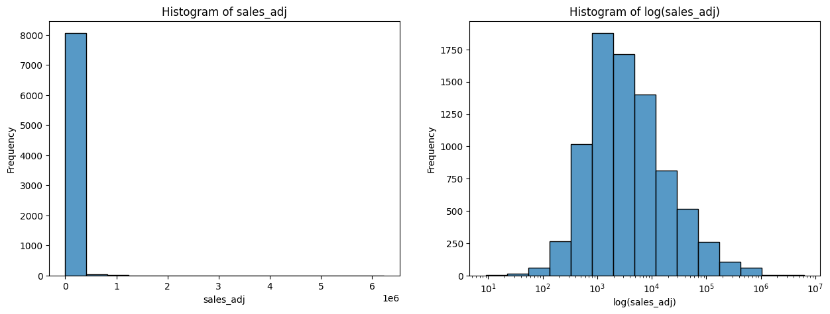
Data Processing and Exploration - Sales
Notes:
One of the things to note in our skim table is that the timestamp and release date columns are not in a proper format for analysis. The release date is currently stored in unix datetime format down to the millisecond. While the timestamp string is found to be contained in three different formats: unix datetime millisecond, year-month-day with time to the second, and year-month-day with time down to the millisecond.
We have to convert these values to proper datetime variables in order to make processing and analyzing the data easier. This conversion is done through the to_datetime function provided by Pandas. We also remove the time from these dates, as our calculations will not be needing such specificity. With these two columns in datetime format we are able to create the new time after release column. This is how long after the release date the historical sales data was actually recorded. As previously mentioned, we are aiming for a month’s worth of sales data after release. However, historical data records do not necessarily match up to exactly thirty days or even approximately close to thirty days. Thus, we need to account for this discrepancy in our data by normalizing the historical sales records by adjusting the value to match a time after of release which was actually thirty days.
Before that, we want to make sure that the time after release is not too large for some titles which might have sparse historical data collection from Gamalytic in order to increase the validity of our adjustment. We utilize sixty days as the threshold for being too far from a month after release to adjust, this number is based on analysis of when new game sales tend to exponentially decay (Birkett, 2018). While we utilize fourteen days as the floor based on Gamalytic taking at least two weeks for estimates to be able to reliably level out (Gamalytic, 2024).
Taking a look at some of these games that fall under the threshold to understand what may have gone wrong: We are able to see that in some cases Gamalytic has the wrong release date which is the case of Naruto to Boruto: Shinobi Striker below. This is concerning for the rest of our data, but manually sampling through it we are able to see that every other game sampled had the correct release date. For games that we see where the timestamp is taken more than sixty days from the release date, such as with Woodle Tree 2: Worlds, it is simply a case of the historical sales date not being updated frequently. In general, more popular and larger name games seem to get their data updated more frequently from the Gamalytic API data. With convincing explanations of why we have deltas that vastly exceed our thresholds we are comfortable with simply dropping the rows containing these timestamps. As 512 rows from our 8643-row training dataset is substantial, but the data is erroneous.
After dropping the degenerate rows, we apply our adjustment formula to the rest of the samples. Our adjustment formula is a fairly simple approach that does assume a fairly linear increase in sales past the two weeks mark up until the two-month mark. We create an adjustment factor that is the percent of thirty days that the historical data was actually recorded. Then this adjustment factor is multiplied by sales and rounded to the nearest whole number as we cannot have a decimal amount of a sale. We additionally extract the year, month, and day from the release date in order to use these to fix in place any date-based trends that might be affecting sales. Finally, we apply a sanity check to our adjusted sales values by taking a look at the highest ones after the conversion.
What we are able to find is that the top sales adjusted entries are extremely well selling games. Using Elden Ring as an example, there was an official announcement for 12 million sales on all platforms within two weeks (Orland, 2022). If anything, 4.5 million sales in a month might be an underestimate even if it's only for the copies sold on Steam. Still, looking at other games in a similar fashion our adjusted sales variable seems to be reasonable data for copies sold.
We also observe the distribution of adjusted sales in both logarithmic and non-logarithmic scales through a boxplot and histogram. Our histograms, showcased below, tells us that despite having a slightly leftward skewed modal peak, the sales data is distributed well enough to a normal distribution once adjusted logarithmically. We consider log transforming to have our response variable more closely approximate a normal distribution, but this is only necessary if the distribution of the residuals is not normal. Thus, we will hold off until later if it is needed (Ford, 2018).

Slide 8
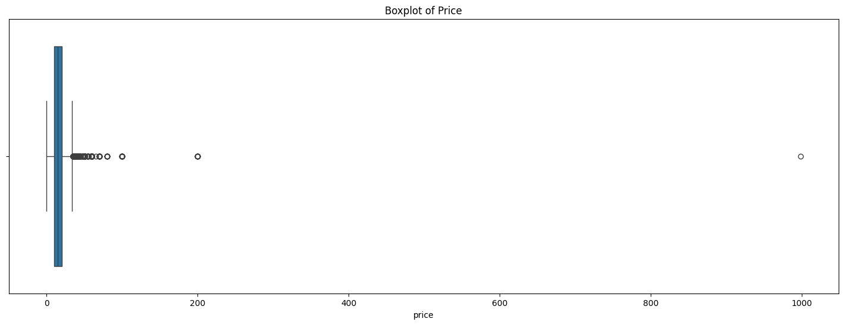
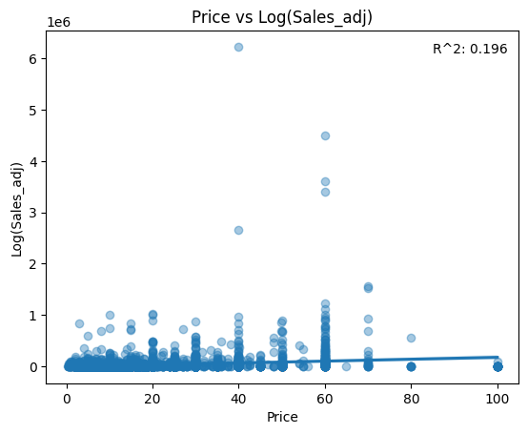
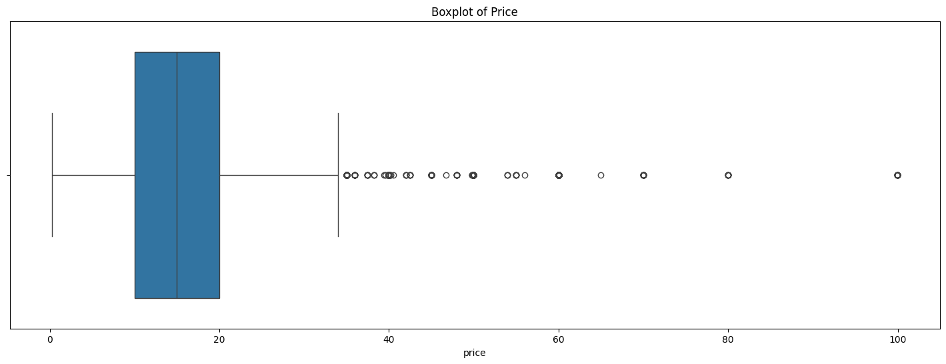
Data Processing and Exploration – Price
Notes:
Next, we move on to price. Every consumer is price conscious, there doesn't need to be any higher reason besides the fact that money is a limited resource. So those games with lower prices will likely sell well, but this is also discounting the effect of perceived value on items that are priced too low. Someone may see a game of their favorite genre that is price $10, but buy one that is priced $30 assuming that the $30 game will be better.
What we mainly want to achieve by processing and exploring price is the pruning of any outliers or erroneous data. We begin this process by taking a look at the general boxplot, shown below with the boxplot after removing outliers, and histogram of price to find absolutely disproportionately priced games on the higher end going up to $1,000. The current accepted high-end price of a game is $69.99, so these points need to be looked into further.
Manually looking through those games that are priced lower than $1 and greater than $70, we are able to see that the collected historical data once again has errors within it. Any free to play games that are priced at $0 should have been excluded from our api queries in the first place, but it seems like occasionally the historical data would bring back an incorrect price on the Gamalytic end. Which means it would show a paid game incorrectly as costing nothing. An example of this is shown below with the game Yakuza 0, a full priced title, shown as costing $0. For the higher priced titles, these involve the correct pricing data, but those that exceed $150 are egregious outliers completely separated from our pricing distribution. The worst example is Ascent Free-Roaming VR Experience which is priced at $999.99, however the game does not have any qualities that would demand such a price differential from other games on the Steam store.
Thus, we remove any points of data that are above $150 or are free. In total this is only a removal of 37 rows from our training data. Removal of the high outliers leaves our data rightward skewed and not normally distributed. Interestingly enough, even the price of $60 which is the standard price point for big game releases is considered an outlier here. This is due to the fact that there are many less big game releases compared to indie game releases on Steam. Still, we keep these points in as they are realistic indicators of possible price points for a game. Despite our assertion at the start of this section, it does not seem that there is a high direct correlation between the price of a game and the number of sales, rather variation of sales tends to increase as price does from our scatterplot below.

Slide 9
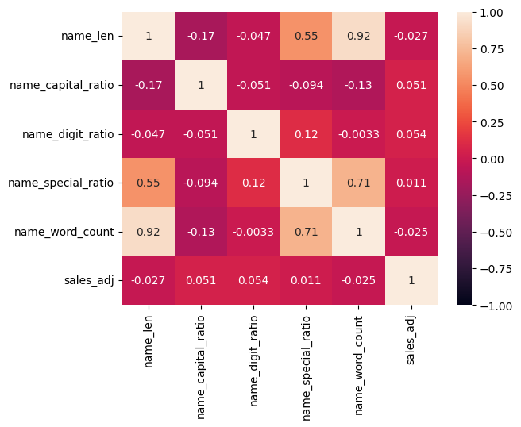
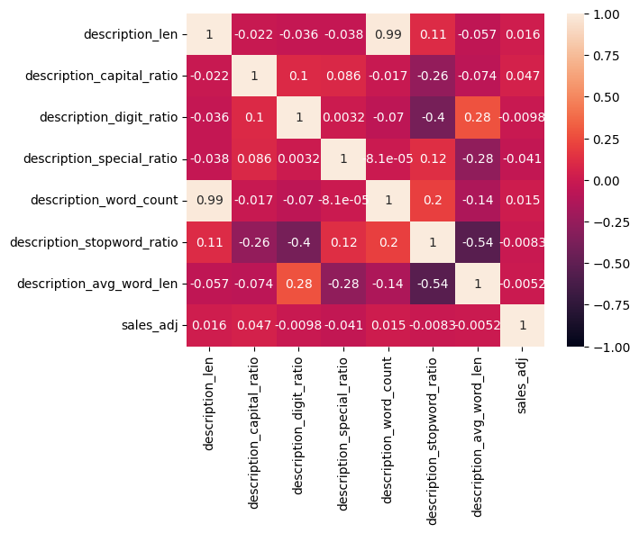
Data Processing and Exploration – Description and Name Features
Notes:
With name and description processing, the name is going to be the first thing that someone coming to your Steam page sees. Thus, it would make sense if different features about the name caused an increase or decrease towards sales. If someone wants to dig deeper into your game because they are intrigued, then they would be looking at the description. Which in theory will also have features that lead to the potential customer deciding to either buy the gamer or not. We want to extract these potential features utilizing some simple string processing.
From our name field we will extract five different features:
The length of the name which could increase sales when it is shorter due to being able to read and recommend more easily.
The capital letter ratio which may draw increased attention if it is larger.
The digit to letter ratio which may decrease sales if it is larger due to having more numbers leading to a more complex name.
The special symbol to letter ratio which may decrease sales if it is larger due to having more symbols leading to a more complex name.
The word count in the name could increase sales when it is shorter due to being able to read and recommend more easily like the total length.
We then take a look at how applicable these new variables might be to our model by correlating them with adjusted sales in the heatmap below. Unfortunately, once more, we have extremely weak correlation in each case against sales_adj. One thing to note is that the length of the name in total seems to have slightly more of an effect on adjusted sales while being highly colinear to the word count of a name. Thus, we will drop the word count of the name variable.
Before we begin feature extraction from the description column, we have noticed from previous skimming of our data that there are NA values present within the descriptions. We want to inspect these NA values to determine if they provide us with information or not. Such as if they are games that don't actually have a description which would also provide us insight as a feature to model with, determining if that has an impact on sales.
Manually sorting through the descriptions, we are able to determine that the games which do not have an entry under the about_the_game field are not games without a description on their Steam page. As a direct example, the game Aokana - Four Rhythms Across the Blue, has no description information when retrieved from the Steam API, but does have a description on the game page itself. These games have their description uploaded as images instead, which is why img_count which was extracted from the description html is still available. Unfortunately, we are limited in our capabilities to extract these images and analyze the text on them. Thus, we will delete the few samples that have an image-based description.
After removing the missing values from within the descriptions we begin to further process the descriptions into the following fields:
The length of the description which could increase sales when it is larger due to having more information provided about the game.
The capital letter ratio which may draw increased attention if it is larger.
The digit to letter ratio which may increase sales if it is larger due to having more numbers such as the amount of playtime or number of characters leading to more information that a potential customer would want to see.
The special symbol to letter ratio which may decrease sales if it is larger due to having more symbols leading to a harder time for the user reading the description.
The word count in the name could increase sales when it is larger due to having more information provided about the game like the total length.
The stop word ratio could increase sales when it is smaller due to having more information provided in the description per word.
The average word length could increase sales when it is smaller due to having more information provided in the description per word like the stop word ratio.
The correlation between sales and the description features seems to be extremely low even compared to the correlation between the name features and adjusted sales when observed in the correlation heatmap below. The highest correlation is just 0.047 between adjusted sales and the capital ratio of the description. Since the data contained within the description can be processed an extreme number of ways, it makes sense that our simple processing doesn't have high correlation out of the gate. Since our model will take advantage of the combination of features, these might still be useful. The one exception is description word count which has an almost perfect colinear relationship with description length at 0.99, but since it has lower correlation with adjusted sales, we drop the variable.

Slide 10
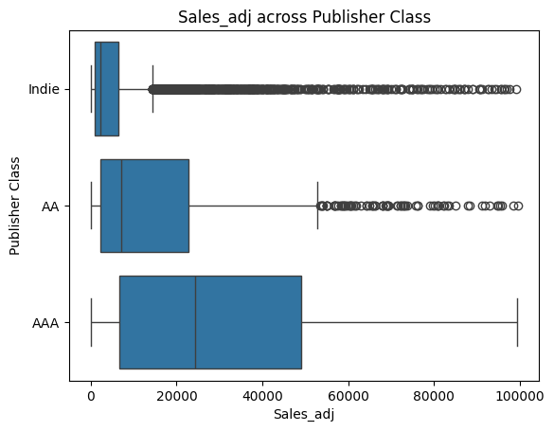
Data Processing and Exploration – Publisher Class
Notes:
The class of publisher is a variable that will likely have a high effect on game sales. As consumer trust and awareness of developers grow as their publisher class does as well. A consumer will be more likely to purchase something from someone that they have either heard of or played a game from before. We believe this variable will be best used to fix effects of class into place, since changing your publisher class is not something a developer can simply due. However, the effects should be accounted for in the model.
First, we find the amount of each type of publisher class within our data to ensure that each class has sufficient samples to build a model against. The hobbyist segment of the publisher class surprisingly is the smallest value with only thirty examples within our training data. This is less than half a percent of the total sample size. Thus, this class is degenerate and not usable for modeling. So, we drop the samples from the hobbyist class. Next, we take a look at a boxplot, shown below, of publisher class against adjusted sales to determine how exactly the publisher class may influences sales. Like we had suggested before, the higher the class of publisher, the greater both the median sales and each percentile range. While independent and AA publishers may have occasional big hits, they are considered as outliers by going beyond 1.5*IQR. Ideally, integrating publisher class into our model may tell us what leads to those outliers to have sales shift higher for independent developers. Finally, we change the publisher class to a categorical variable so it is able to be fit into a model.

Slide 11
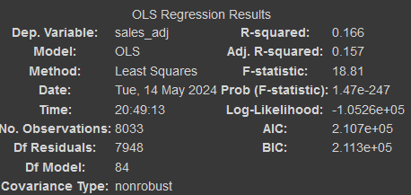
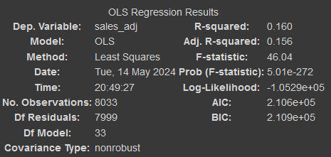
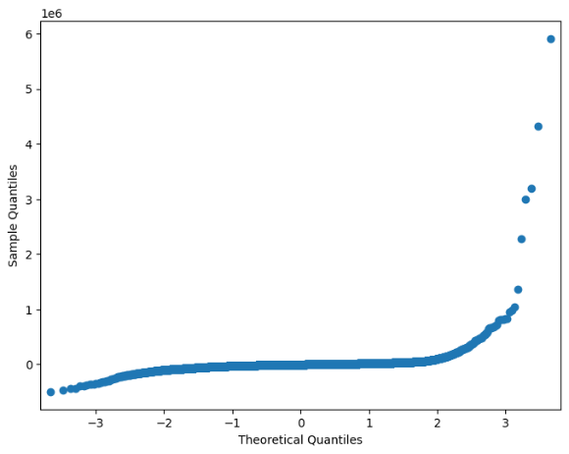
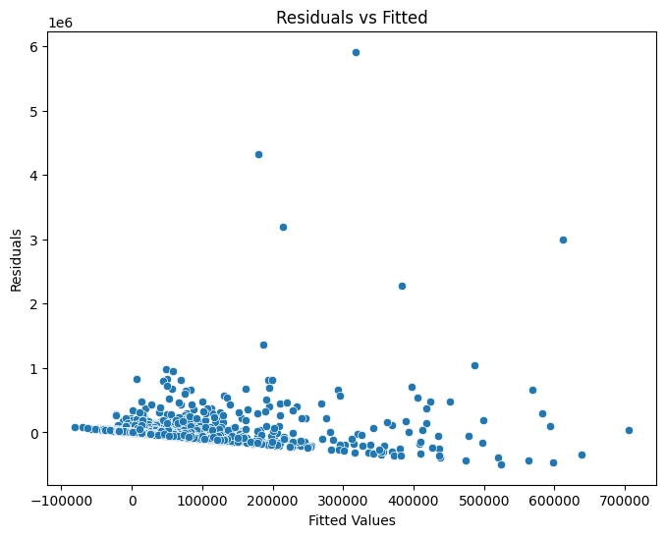
Model Building and Selection – OLS 1
Notes:
We begin our model building journey with a quick and dirty ordinary least squares model to see where we are right out of the gate without any additional variable manipulation. It turns out, that with an adjusted R^2 of 0.157, we're far off from a model that we'd like to see, as you can see below on the left. Looking through the significance of the coefficients within the model, we see that only about 1/4 of our features provide any significant information.
Thus, the next logical step to improve the OLS model is commencing stepwise feature selection. We create a function that iterates upon a model with no features and only selects features that have a p-value of greater than 0.05, our threshold indicator for a significant feature. Unfortunately, even with a restricted number of features that are all significant on their own, we end up with a model with 32 variables but a decrease in the R^2 by 0.001, shown above on the right. Since our variables did decrease by 51, this is an improvement on the previous model, but we want to make our model a good fit.
In order to see what we can do to improve our OLS model; we take a look at the diagnostic graphs for residuals that are shown below. Looking at a residual’s vs fitted graph allows us to see that there seems to be heavy heteroskedasticity in the model. Our QQ plot distribution also looks nothing close to normal. This indicates that our current model is not appropriately extracting all the information it can from our data. Taking a look at partial residual plots for each variable also shows us that for most of the categories, our residuals are evenly distributed but heteroskedastic.

Slide 12
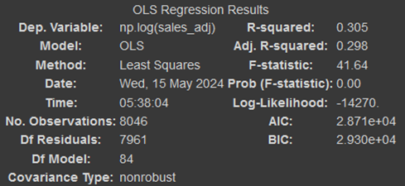
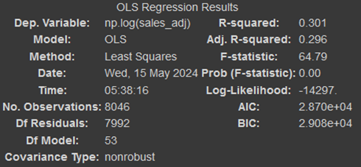
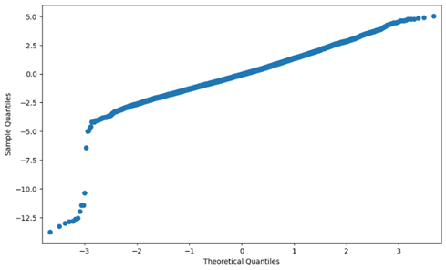
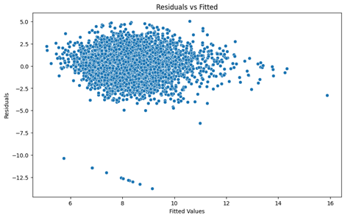
Model Building and Selection – OLS 2
Notes:
One way of decreasing heteroskedasticity is by transforming variables to be closer to a normal distribution. As we're aware of our response variable being non-normal, we begin with transforming it through a log transform. This leads to our adjusted R-squared almost doubling, as shown on the left below, an excellent change. We utilize stepwise feature selection once more to make the number of coefficients we are utilizing more manageable. This time we end up with an adjusted R^2 decrease of 0.02 and only 31 less variables, shown below on the right. The slight decrease in R^2 is worth the increase in parsimony that is achieved here.
Going through and plotting our residual diagnostic plots once more shows us that we have gotten much closer to a viable model with the residual’s vs fitted graph looking much more random and the QQ plot much closer to normal, showcased below. However, our standardized residuals that are below -5 seem to be following a pattern. We want to look further into that before we decide if this model is truly viable. After looking into it we see that something very interesting has been caught by our diagnostic plots here. Out of these games which were predicted to have much more sales than they "actually" do, 11 out of the 13 are recorded as having no sales. This is another error in the data which we didn't catch before. As the author, personally owns two of these games, and there are reviews from paid customers on the other games we know that they do have sales. With another error from our data collection, we will go ahead and drop these before retraining the model.

Slide 13
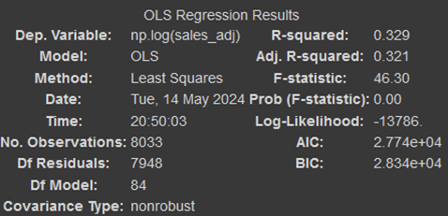
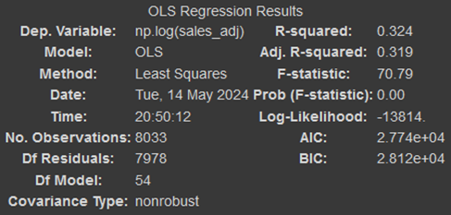
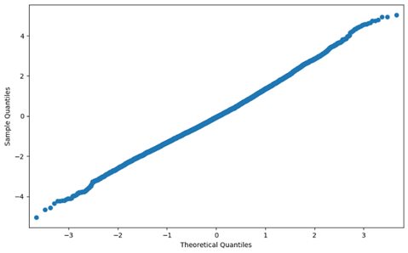
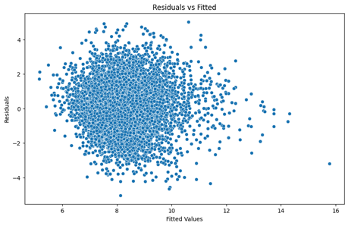
Model Building and Selection – OLS 3
Notes:
By dropping just, the erroneous data we gain a whole point in our adjusted R^2, and more importantly from our diagnostic plots we see that the model can be considered to meet the assumptions of a linear regression model with the errors being close enough to linear, homoscedastic, normal, and independent.

Slide 14
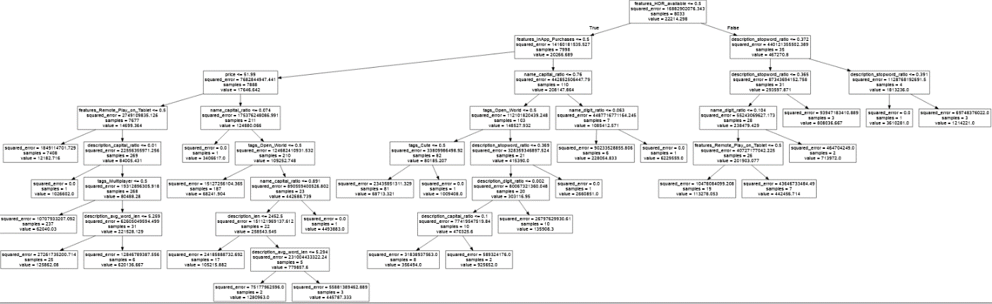
Model Building and Selection – Decision Tree
Notes:
Afterwards, we move on to create a decision tree model to attempt to create a model that can provide interpretability in a visual form. We are required to restrict the depth and max nodes of the decision tree, or else it would perfectly fit itself to the training data. We get an R^2 of 0.82 which is very good, but since decision trees have a tendency to overfit combined with the fact that they are worse at being regressors, we may need to watch this closely. We provide a visual representation of our decision tree below. The split values seem to be chosen quite arbitrarily looking at their extremely large squared errors which are in the billions of dollars squared. The decision tree also focuses on utilizing description features which are likely unique to each game, suggesting overfitting once more. This tree example likely is not a good fit for our purposes.

Slide 15
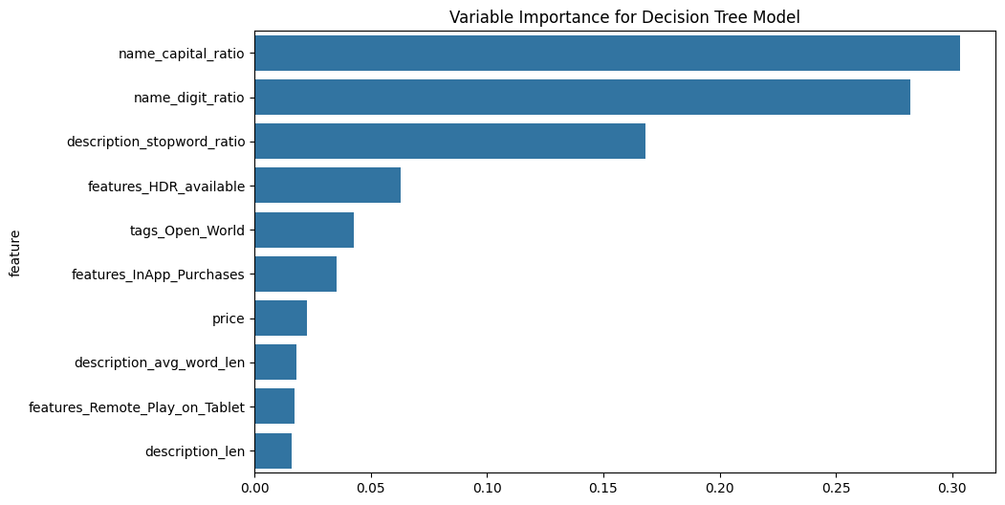
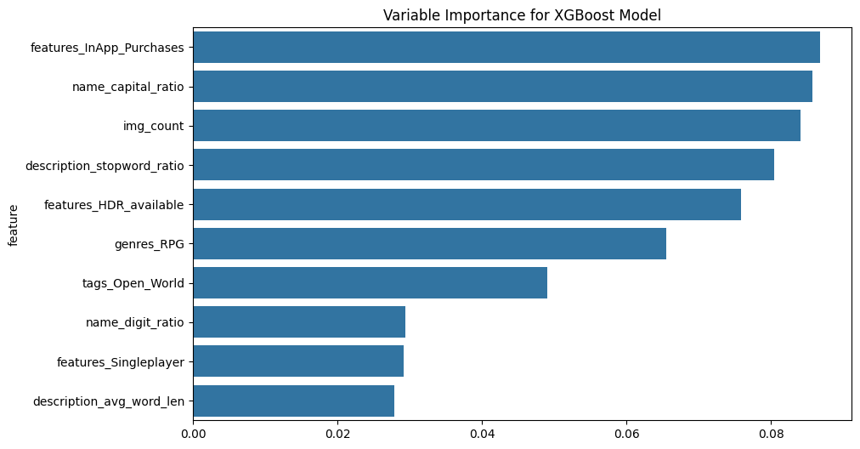
Model Building and Selection – DT + XGB
Notes:
Below is the variable importance for the decision tree model visualized in graph form. This is not directional like the ordinary least squares regression unfortunately. We do see HDR support and tablet remote play as important features for the decision tree model, however the tree is prioritizing the name and description features likely to solve for sales based on identifying a unique game and its sales instead of fitting for sales directly.
The final model that we build is an XGBoost model. This is simply for the fact that an XGBoost model tends to be very accurate, and we want to attempt to use it as a benchmark for how well our two other models are faring in evaluation. Looking at the R^2 of our XGBoost model we get 0.860 which does end up beating the decision tree model and the linear regression model. However, we want to see how it fares in actual evaluation later on. We’re able to see the most important variables for the XGBoost model in absolute terms, but we don't know if in app purchases being part of a game increase or decrease sales.

Slide 16
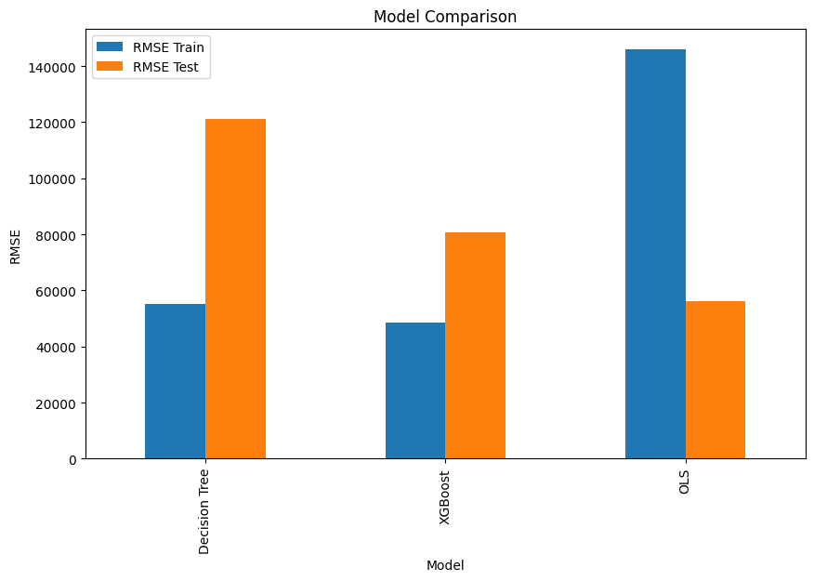

Model Evaluation - Competition
Notes:
With our regression models built, we want to see which one has the best performance for our purposes. We are evaluating the models that we have built on a combination of interpretability and the lowest RMSE on the test data to determine which one is best for solving our problem. With the interpretability being given to the OLS model purely for having readable coefficients while decision tree comes in second from being viewable directly. In a very interesting upset our OLS model starts with the worst training root mean squared error, however it seems to adjust to the data which we held out the best with the lowest test RMSE. The OLS model is the only one that showed improvement from the training RMSE. Still, 56,250 copies sold is a large average difference between actual and predicted sales. However, it is overall the best model we get and we can consider the parameters from this to be a good guiding direction on what may influence game sales within the first month.

Slide 17
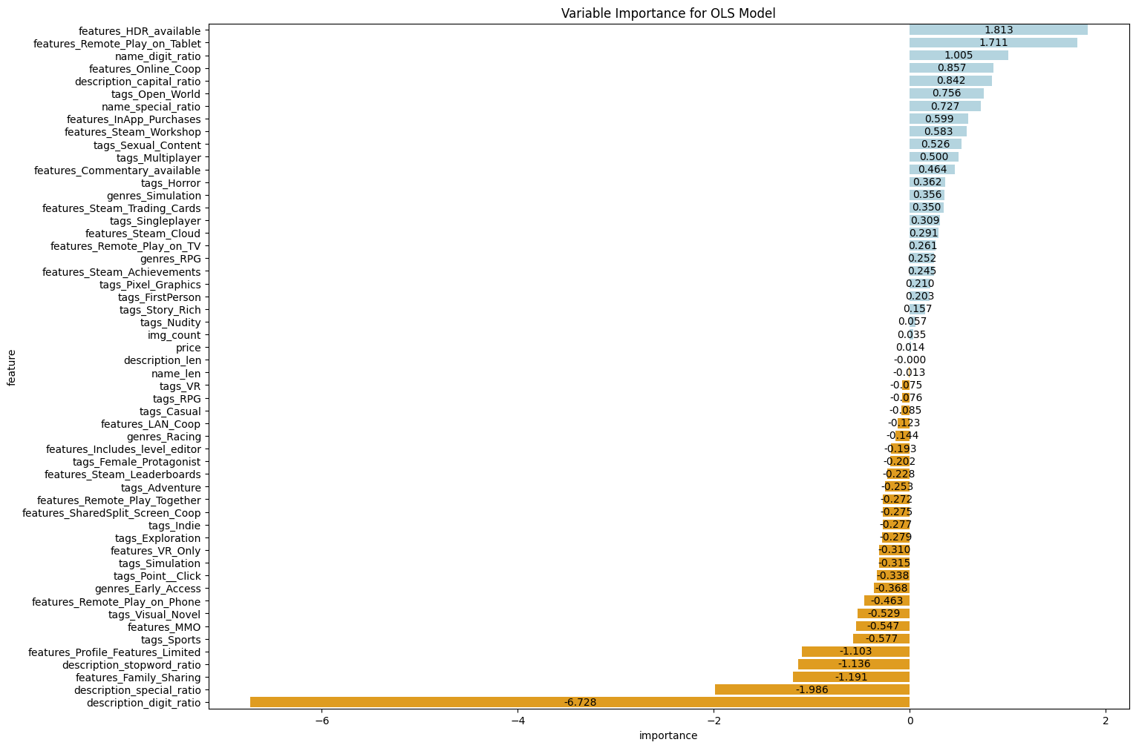
Model Evaluation - Analysis
Notes:
We’ll take a look at the most impactful of the various features and attempt to reason out why they could be a valid or invalid positive predictor. For supporting HDR at the top, there is a portion of players who have HDR monitors and want to play games that take advantage of that increasing sales. Tablet remote play is typically a rare feature for a game to support, and those that want to play Steam games on their tablets likely have limited options so they will gravitate towards these games and increase their sales. The name digit ratio is likely from the effect of sequels having numbers in their titles while most games do not, and sequels of games that do good enough to get a sequel will usually sell more. Thus, it does not seem right to use the name digit ratio within our recommendations. Online co-op support can sell more games simply by encouraging word of mouth marketing between gamers to have people buy the game to join them. The capital ratio of descriptions increasing sales is an interesting one, perhaps having more capital letters in the description draws more attention leading to sales. Regardless, there’s no reason to consider this as an invalid recommendation. Open world games do seem particularly popular, which is why we consider that tag to be valid.
Next, we’ll do the same reasoning for the most impactful negative predictors. For digit ratio in the description, it makes sense that a description with a higher number of digits than words would not be very helpful in conveying information about the game to the potential customer thus losing out in sales. The special ratio within the description also seems valid from following similar reasoning. Family sharing is a feature that allows someone within one’s Steam family to play a game without having to buy it, so this feature will naturally lead to less sales. The stop word ratio in the description can be converted to a measure of junk to information in the description, a description that is not concise will be easily disregarded by a potential sold customer. Profile feature limited is not a feature applied by the developer, but instead a feature applied by Valve when a game seems to be abusing systems such as the marketplace or cards, it makes sense that it decreases sales, but it doesn’t make sense to recommend not to support this feature to a developer. Finally, the sports tag on a game decreasing sale is likely due to sports not being a popular genre on Steam despite our literature review mentioning it should be more popular, still this is likely valid from the data.
So, developer actions and game features that a small developer listing their game on Steam can utilize to achieve the most sales within the first thirty days, according to our OLS model, include: Support HDR to increase sales by 180%, support table remote play to increase sales by 171%, support online co-op to increase sales by 86%, put more capital letters in the description to increase sales by up to 84%, and make the game open world to increase sales by 76%.
While a developer should avoid these actions when listing their game on Steam or else face the consequences of reduced sales for the first month: Do not put more digits in the description or else sales will decrease by up to 672%, do not put more special characters in the description or else sales will decrease by 198%, do not allow family sharing for the game or else sales will decrease by 119%, do not fill the description with meaningless stop words or else sales will decrease by up to 114%, and finally do not make a sports game or else sales will decrease by 57.7%.
It should be noted that due to the low goodness of fit of our OLS model and the high RMSE, the coefficients of these variables should not be taken to heart, as there will be a wide range of variation. However, following the general principles will likely allow for an increase in sales for small game developers.

Slide 18
Summary and Conclusion
What developer actions and game features can small game developers listing their game on Steam utilize to achieve the most sales?
Support HDR
Support Tablet Remote Play
Support Online Coop
Freely utilize uppercase letters in the description
Don’t use too many numbers in the description
Don’t use too many symbols in the description
Don’t allow family sharing
Don’t make a sports game
Notes:
We started this investigation with a simple question:
What developer actions and game features can small game developers listing their game on Steam utilize to achieve the most sales?
Our actions focused on retrieving data from different APIs to scrounge up as much information as we could in games made within the past 10 years. We focused on information that a developer would be able to change rather than things that were not under their control such as what year it was. We processed the data that was acquired through API to adjust our historical sales and get more features from text fields. Finally, we built models and compared them to each other head-to-head. The model most interesting to us is not super accurate or a good fit to game sales data, but it is sufficient to provide us with guiding information on what features a game developer should try to utilize for increasing their game sales such as providing support for HDR, while avoiding having many numbers in the description of the game. So, we were able to answer our question in the end.
There are many things that we wish we could have improved on and would like to see in future works such as: Finding a data source for historical sales that did not have as many errors as we were seeing while going through the data processing. Additionally, a data source which had historical data for exactly 30 days after release would provide our model better results. Spreading out our queries under even more time to gather data for the entirety of the games that were released within the past 10 years, rather than being IP banned after retrieving just a portion would help with a better fitting model.
A method to collect data on how developers and publishers were posting about their games on social media or utilizing marketing through ads and influencers to push for game sales to measure the effects this has on sales. Along with a method to utilize the day and month information within our date that could account for periods of times that games are more or less likely to sell. This would lead to better guidance for possible release dates for developers. Additionally, the method would take into account possible games that are releasing at the same time and creating competition making a game a harder sell.
An indicator of data for if the game was released at a discounted sale or not would provide for a good model feature. A better method for processing the name and description strings would have increased our OLS’s RMSE. Perhaps utilizing sentiment analysis for the description and accounting for where images are placed would as well. Additionally, there are likely models better suited to our data which also carry high interpretability for our data to be used.
Extending this model for use by actual developers to input information about their game and getting recommendations for what steps they should do next to increase revenue would be the ultimate goal for taking the project further beyond.

