Slide 1
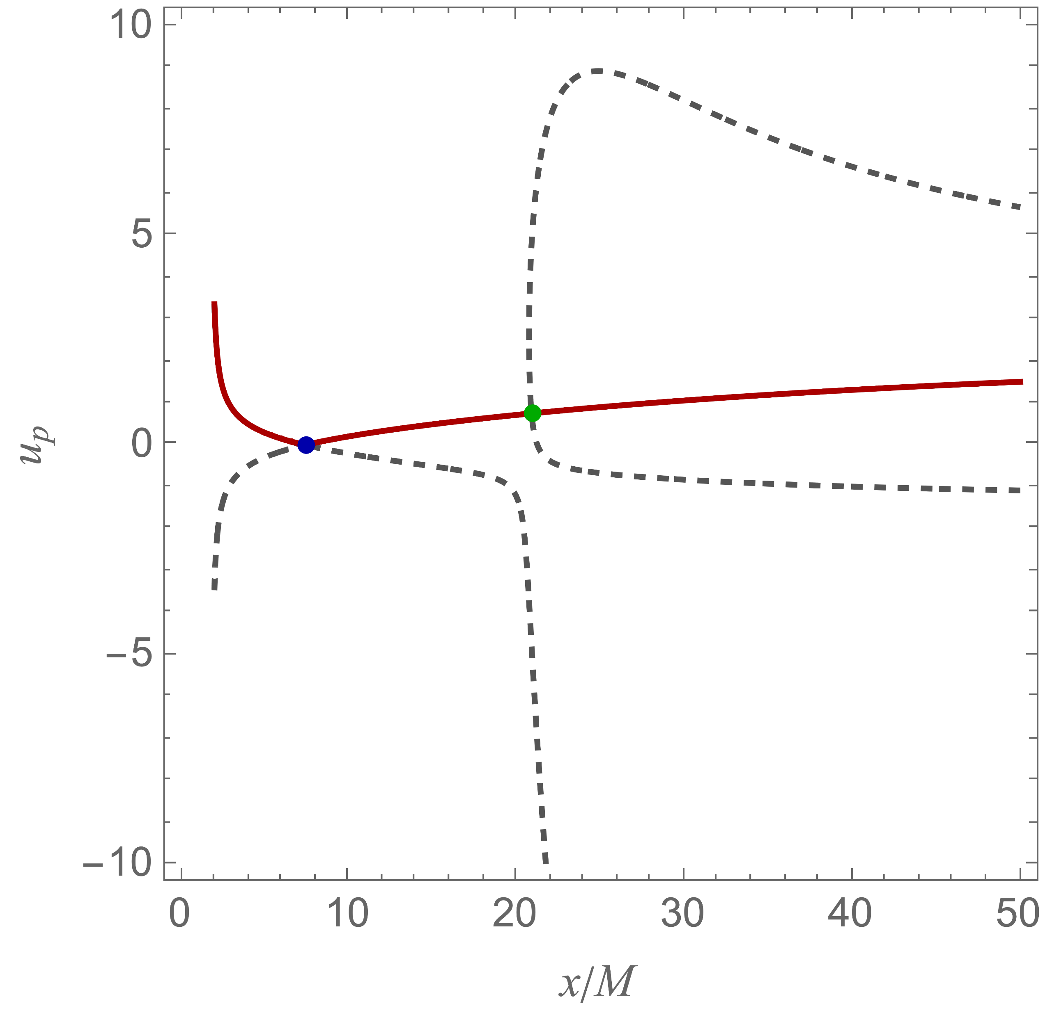
Alfvén point
Inflow
Outflow
Physical solution
Launching point
Unphysical solution
Unphysical solution
Event horizon

