Slide 1
E-commerce Website
Ahmed Mohamed Mohamed

Slide 2
Project Idea
An online store to browse products, add to cart, and checkout easily.

Slide 3
Technologies Used
Frontend: React + Bootstrap
Backend: PHP
Database: MySQL

Slide 4
Features
Product listing
Shopping cart
Checkout system
Responsive design

Slide 5
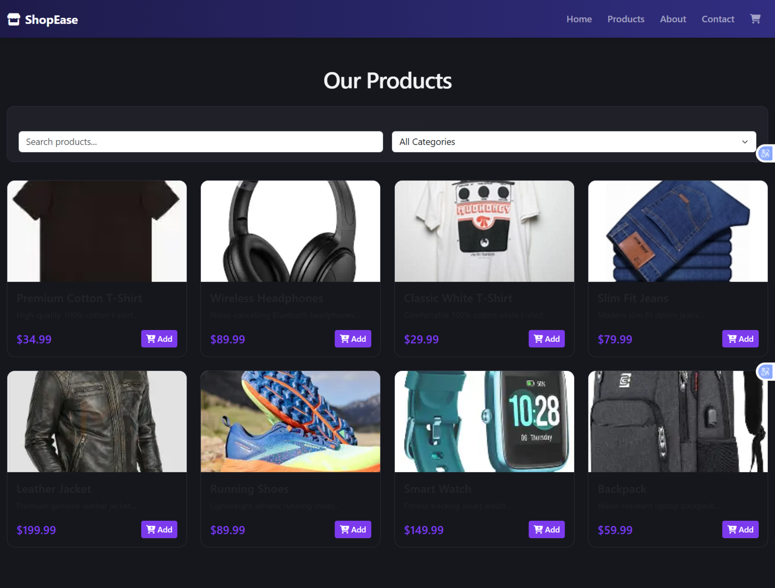
Products Page

Slide 6
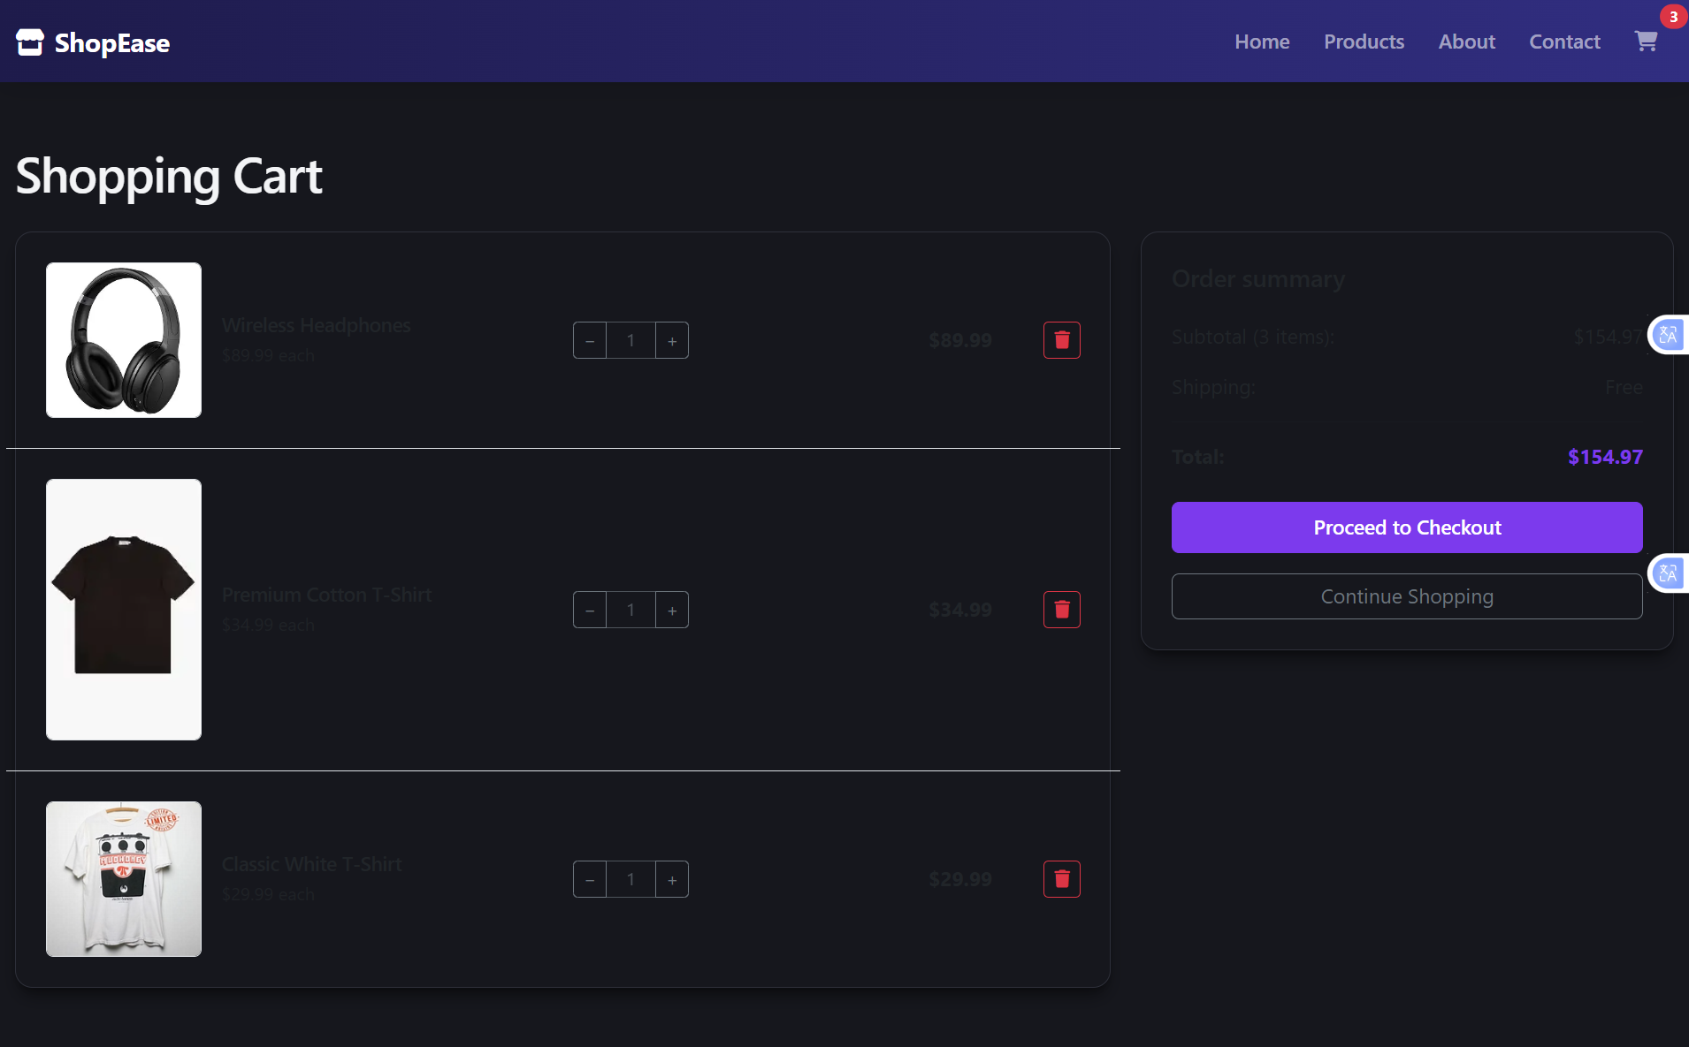
Shopping Cart

Slide 7
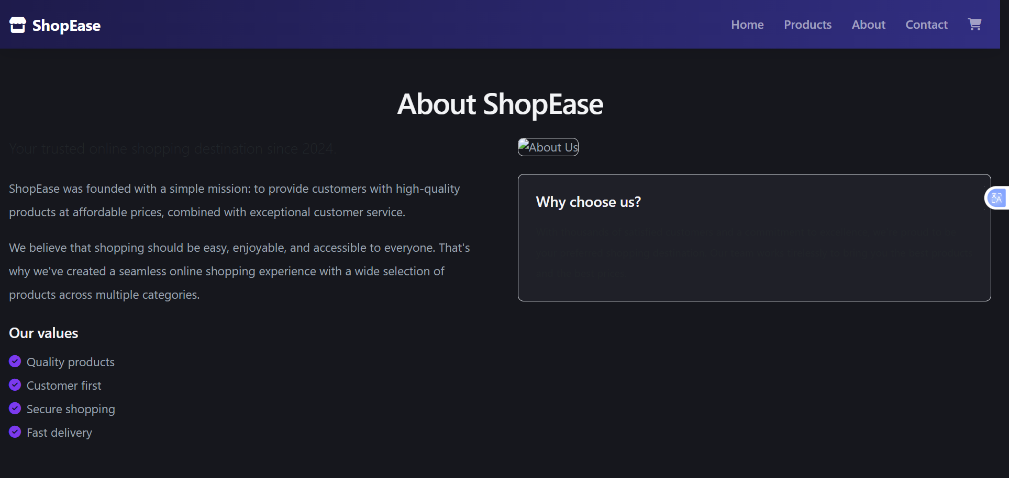
About Page

