Slide 1
Project Idea
Coral Reef AI Detection & Classification
Why it matters
•
Manual reef review is slow and inconsistent.
An end-to-end computer vision system that detects coral colonies in underwater images/videos, classifies the species, and produces stable annotated video output.
•
Underwater video needs temporal stability, not frame-level flicker.
Detection
Species ID
Video Stability
Real-time Goal
•
Species-level outputs support monitoring and reporting.
Underwater
Image / Video
Coral
Boxes
Precise
Mask
Species +
Confidence
Annotated
Video
Coral Reef AI • 1/7

Slide 2
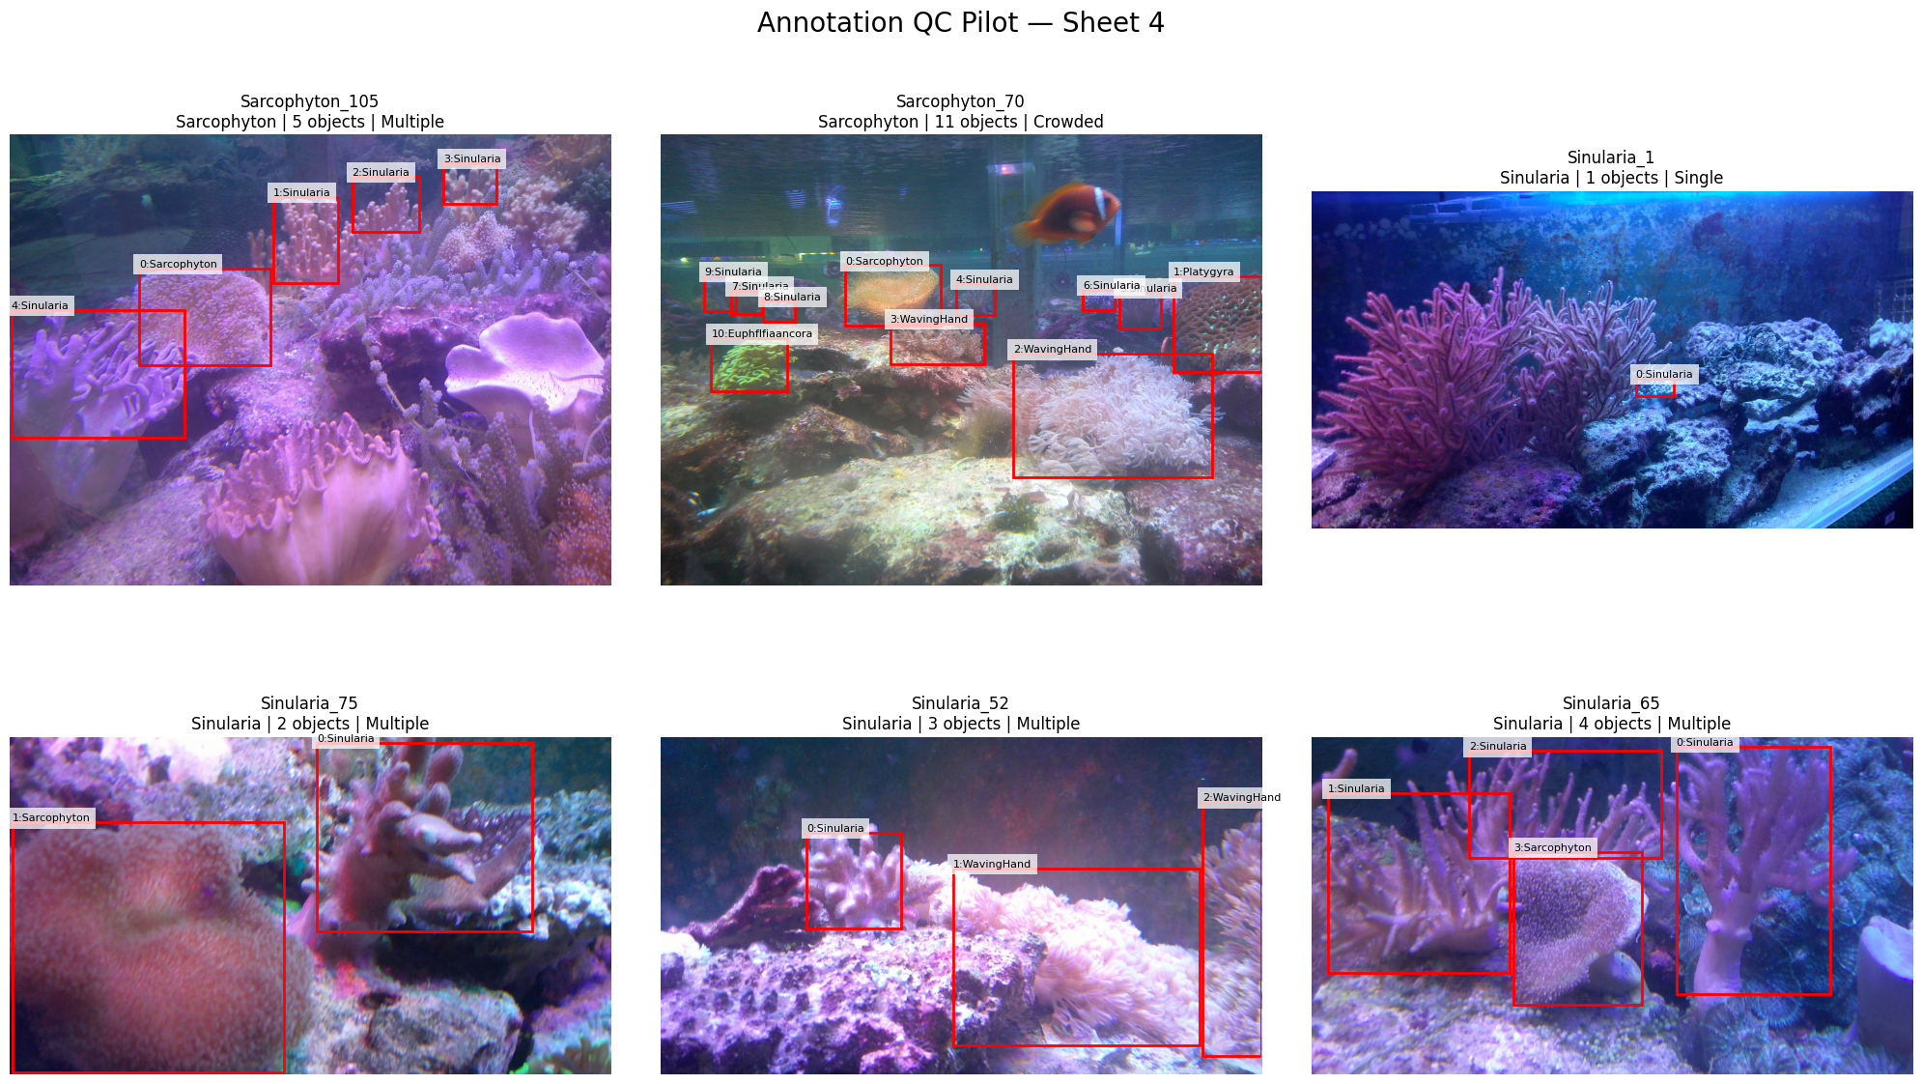
Data
Three-source data strategy: detection, classification, and video validation.
Current data streams
1
Detection Dataset
Images + JSON Boxes
2
Classification Dataset
Species Crops
3
Underwater Videos
End-to-End Demo
Verified local split
452
1,540
100
354
Train images
Train boxes
Validation images
Validation boxes
Held-out test data is preserved for final evaluation; it is not used for tuning.
•
Core risk: taxonomy mismatch between detection labels and classification labels.
•
Data audit focuses on leakage, duplicates, lighting, turbidity, distance, crowding and visibility.
Annotation QC pilot examples: crowded scenes, multi-species boxes, and visibility variation.
Coral Reef AI • 2/7

Slide 3
Methodology
Evidence-driven development: isolate the failure source before changing the model.
1. Audit
data quality
+ leakage
2. Train
detector
+ classifier
3. Evaluate
per-class
+ per-condition
4. Integrate
boxes → masks
→ species
5. Video
stability
+ latency
6. Improve
fix measured
weakness
Method logic
Quality gates
•
Detector answers: where is the coral?
No leakage
split by source/video when possible
•
Classifier answers: what species is the coral?
Realistic crops
+10% context and detector-like errors
•
Masks clean the crop before classification.
•
SAM2 handles temporal propagation across video.
Unknown policy
avoid forced species when confidence is low
Video metrics
flicker, latency, tracks, masks
Coral Reef AI • 3/7

Slide 4
Model
Final accuracy-first architecture selected from the experiments and troubleshooting.
Main path
YOLO26m
Detector
CoralSCOP
Box Prompt
Duplicate
Resolver
Dual-View
EffNetV2-S
SAM2.1
Video Memory
Strong candidate boxes
Precise instance masks
Remove overlap fragments
Masked + context crop
Temporal stability
Why this stack?
Deprecated path
•
Old YOLO26m remains the stronger detector on original GT boxes.
YOLO26m-SEG
as Primary Detector
Kept as
Fast / Backup
•
CoralSCOP produces higher-quality masks than forcing the student segmenter to be the primary detector.
•
Dual-view classification reduces background contamination: masked coral + 10% context.
•
YOLO26m-SEG Student is kept as fast/backup mode, not the main accuracy-first path.
Reason: it learned useful masks, but original-GT detector F1 was lower than the older YOLO26m operating point.
Coral Reef AI • 4/7

Slide 5
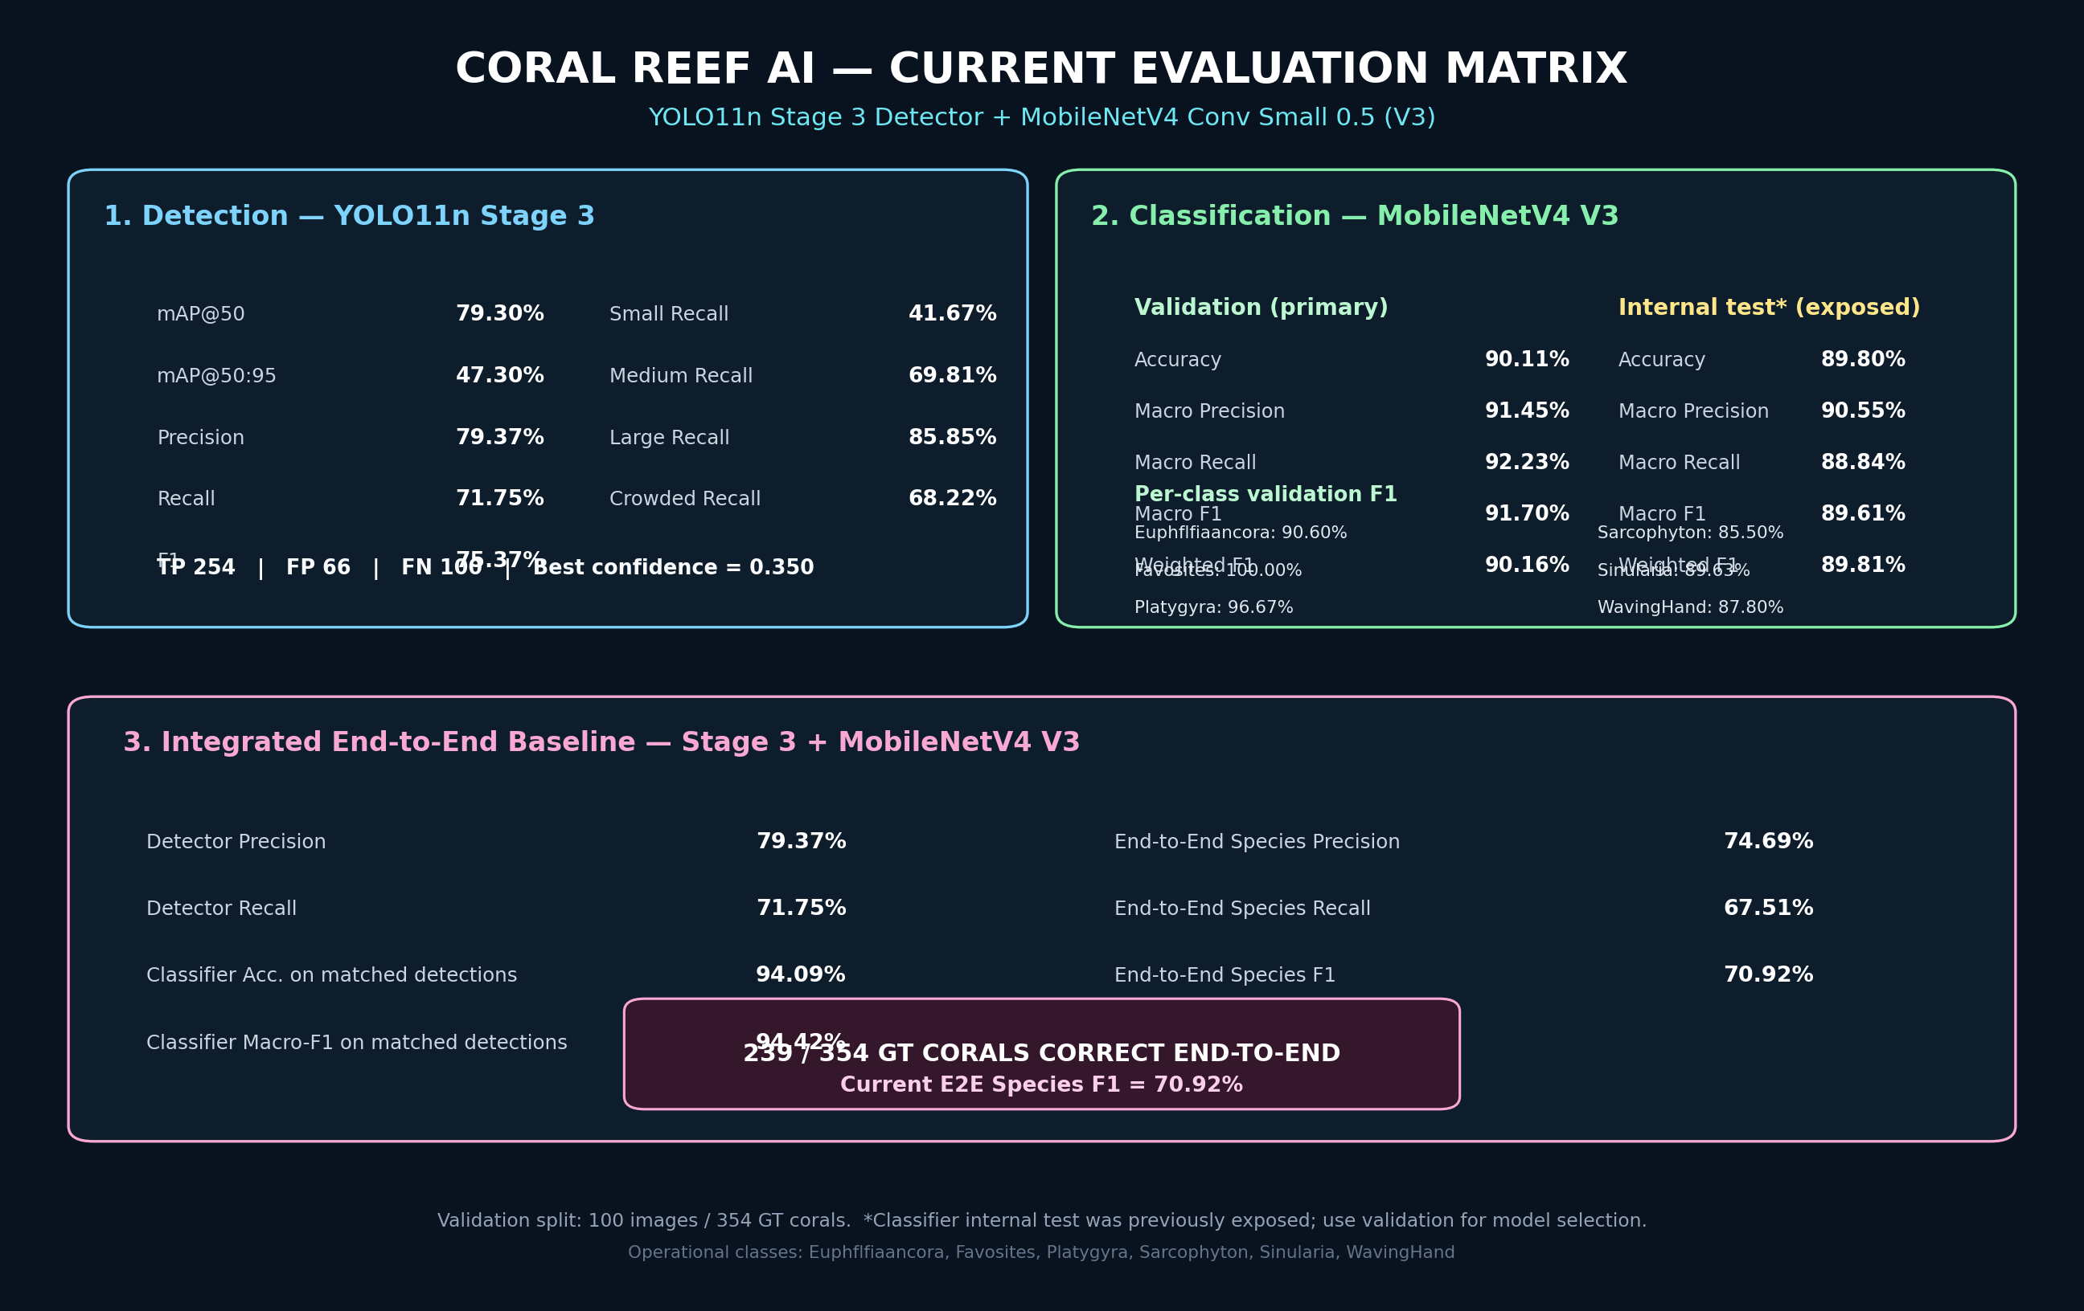
Key Results
Measured milestones from detector, classifier, integrated baseline, and segmentation student.
Headline metrics
79.3%
90.1%
Detection mAP@50
Classifier validation accuracy
70.9%
239 / 354
Baseline end-to-end species F1
Correct end-to-end
Segmentation student validation
Box mAP50-95 0.641 • Mask mAP50-95 0.591 • Original-GT F1 0.731
Interpretation
Stage 3 evaluation matrix
•
Detector-only performance still favors the older YOLO26m path.
•
CoralSCOP masks are prioritized for accuracy-first video output.
Coral Reef AI • 5/7

Slide 6
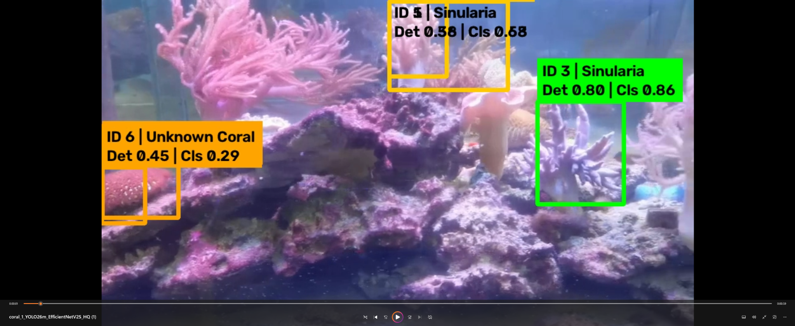
Practical Application
From research notebook to field-ready coral monitoring workflow.
Deployment use cases
Marine survey review
speed up annotation of long underwater videos
Biodiversity tracking
count colonies and species over time
ROV / aquarium inspection
near-real-time overlays for operators
Research reporting
export metrics, failure cases and annotated clips
Operational output
Annotated MP4 + per-video JSON/CSV summary: tracks, masks, labels, latency and flicker diagnostics.
Annotated video demo: coral IDs, species labels, confidence, and unknown handling.
Coral Reef AI • 6/7

Slide 7
Current Status & Next Steps
What is working, what is pending, and what should be improved next.
Working now
Doctor demo output
•
Local Windows environment on RTX A6000 with CUDA is verified.
Quick demo mode
coral_1.mp4 only
Top stable tracks
+ faster encoding
•
YOLO26m detector and CoralSCOP teacher are integrated.
•
Dual-view EfficientNetV2-S training and resume path exist.
•
Accuracy-first video seed pass is operational.
Expected file path
D:\Coral_Local_Workspace\outputs\CoralGuard_X_ACCURACY_FIRST\06_Final_Videos\coral_1\coral_1_ACCURACY_FIRST_FINAL.mp4
Needs improvement
•
Adaptive CoralSCOP refresh: run only on new/uncertain objects, not every keyframe candidate.
•
Track fragmentation control before SAM2 to avoid too many object IDs.
•
Final unseen test set and per-condition reporting are still pending.
Next experiment
Compare accuracy-first video versus fast YOLO26m-SEG mode on the same video, then decide the final speed/accuracy operating mode.
Coral Reef AI • 7/7

