Slide 1

Bottom-Up Rebalancing of Binary Search Trees
Author: Gerth Stølting Brodal
Department of Computer Science, Aarhus University, Denmark
By student: Abedallah zoabi
This paper explores randomized rebalancing schemes for dynamic binary search trees, aiming to maintain low tree height without storing additional balance information. The focus is on bottom-up insertion algorithms that perform limited restructuring near inserted elements, using only local information and few random bits. While the proposed methods fail to guarantee logarithmic depth for all insertion sequences, they provide insights into the challenges of designing efficient randomized rebalancing schemes under constrained conditions.

Slide 2
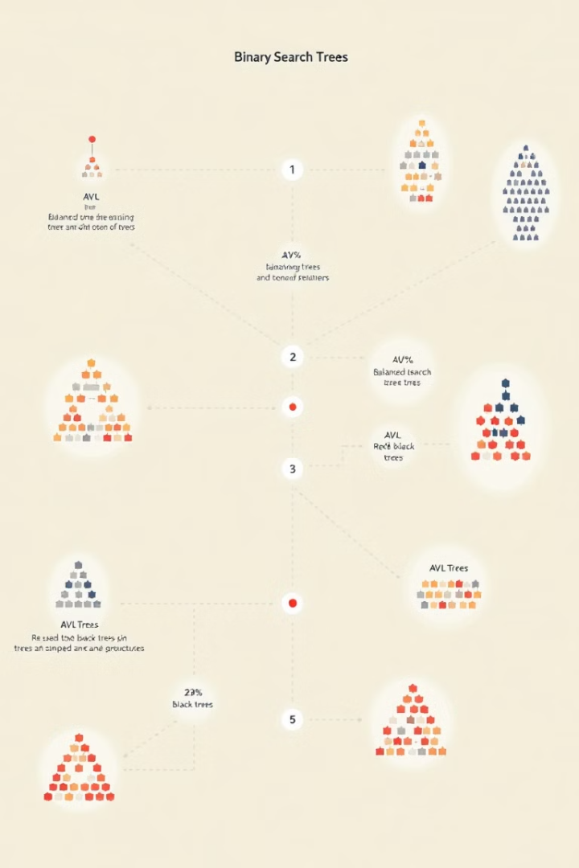
Background and Motivation
Binary search trees are fundamental data structures in computer science, dating back to the 1960s. Various rebalancing schemes have been developed to maintain logarithmic height, including deterministic methods like AVL trees and red-black trees, as well as randomized approaches like treaps. This study explores simple randomized rebalancing schemes for insertion sequences, aiming to achieve good performance without storing balance information, while limiting restructuring and using minimal random bits.
1
Early Development
1960s: Introduction of binary search trees
2
Balanced Trees
AVL trees, red-black trees: Deterministic rebalancing
3
Randomized Approaches
Treaps and randomized BSTs: Probabilistic balancing
4
Current Study
Exploring simple randomized bottom-up rebalancing schemes

Slide 3
The Seven Constraints
The algorithms presented aim to satisfy the following constraints:
No balancing information stored: The tree structure should only include nodes and their values without additional data.
Limited restructuring: Insertions should use O(1) rotations in the worst case.
Local rotations: Most rotations should occur near the insertion point.
Local information use: Rebalancing should depend only on local tree information, not global data like the current tree height.
Expected O(1) time for rebalancing.
Minimal random bit use: Rebalancing should use expected O(1) random bits per insertion.
Low node depth: The expected depth for each node should ideally be O(log n).

Slide 4
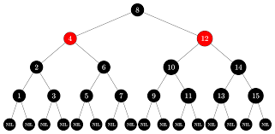
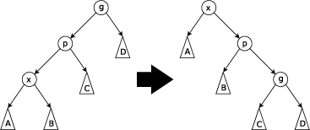
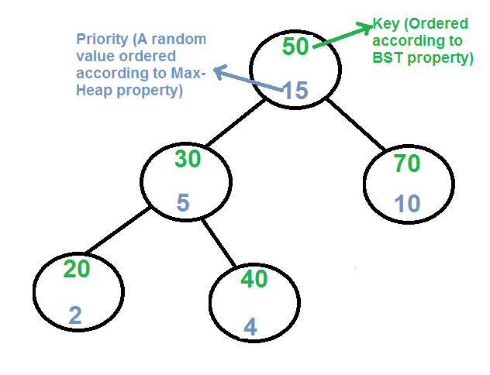
Previous Work Deterministic methods like Red-Black trees ensure O(logn) height with amortized O(1) insertion times but but violate constraint (1) as each node must store a bit of balance information to indicate color. Splay trees operate without extra balance data and achieve amortized O(logn) performance but involve significant restructuring constraint (2). Scapegoat trees rebuild subtrees to maintain O(logn) height but need to store the total element count.
In the randomized domain, Treaps integrate priorities with elements to maintain balanced structures through expected O(1) rotations and time but fail constraint (1) as each node must store a random priority as balance information. Randomized BSTs by Martínez and Roura use subtree sizes for top-down insertions in O(logn) expected time but fail constraint (1) due to the need for storing subtree sizes and constraint (3) as they use top-down rebalancing instead of local rotations near the insertion point.

Slide 5
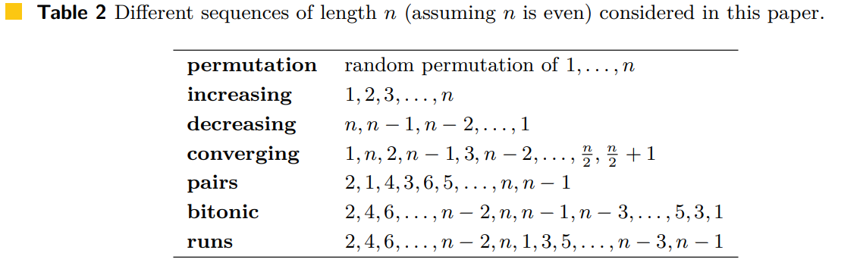
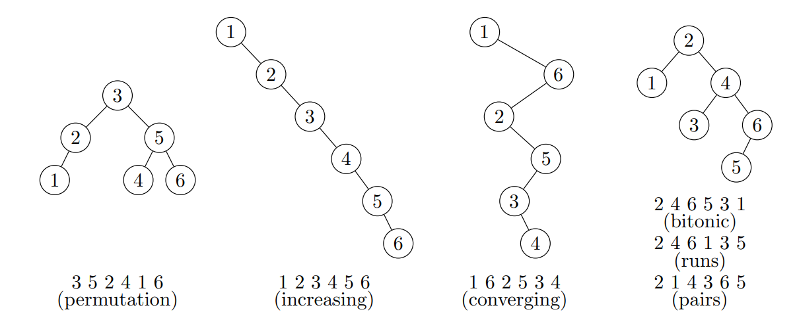
Insertion sequences:

Slide 6
The goal:
We consider two very simple algorithms to rebalance a binary search tree after a new element has been inserted at a leaf. Our aim is to try to meet the requirements (1)–(7), and in particular not the ambitious goal of having the same distribution as random binary search tree.
Both our algorithms repeatedly flip a coin until it comes out head. Whenever the coin shows tail (with probability p) we move to the parent of the current node (starting at the new leaf, and if we reach the root, the rebalancing terminates without modifying the tree).

Slide 7




Algorithm RebalanceZig
RebalanceZig is a simple randomized bottom-up insertion algorithm. After inserting a new leaf, it flips a coin with probability p of tails. If tails, it moves to the parent node and repeats. If heads, it rotates the current node up and terminates. This process continues until reaching the root if no rotation occurs. The algorithm uses O(1) expected time, O(1) random bits, and performs at most one rotation per insertion.
Algorithm 1 RebalanceZig(v): while v.p ̸=nil and coin flip is tail do v ← v.p If v.p ̸=nil then RotateUp(v)
Lemma 9. After inserting n elements in increasing order using RebalanceZig,
with 0 < p < 1, each node has expected depth O(1/p·log1/p n).
Insert Leaf
Add new node as leaf in BST
Flip Coin
Probability p for tails, 1-p for heads
Move or Rotate
If tails, move to parent. If heads, rotate up and stop.
Repeat
Continue until rotation or root reached

Slide 8
RebalanceZig theoroms:
Theorem 1: RebalanceZig achieves O(lg n)expected depth for increasing and decreasing sequences.
Theorem 2: For the converging sequence (1,n,2,n−1,..) RebalanceZig results Θ(n) average depth.
Theorem 3: For the pairs sequence (2,1,4,3,…), RebalanceZig gives Θ(n) depth
unless p=1/2, where depth improves to sqrt(n).

Slide 9
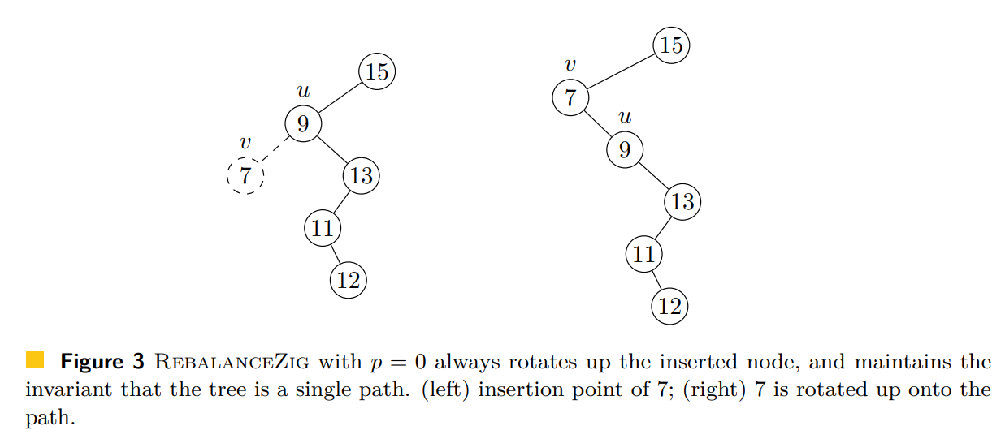

Slide 10
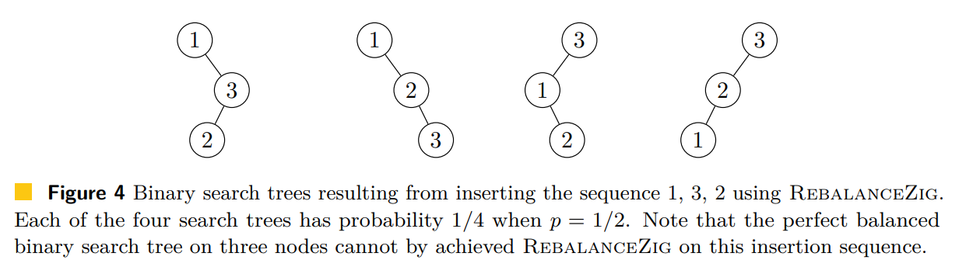

Slide 11
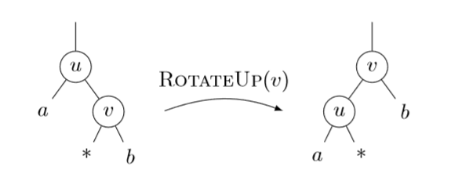
Bad rotation:
Bad zag-zig case for RebalanceZig(v), where rotating up v does not decrease the depth of the insertion point Note: It follows that after the insertion of all n elements, the expected depth of the insertion point is at least ½*np*(1−p).

Slide 12
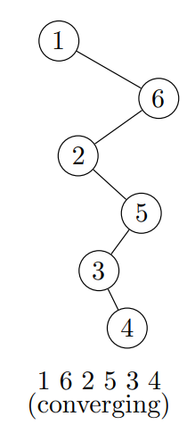
Converging Sequences
Example:
A converging sequence is a type of finger insertion sequence where each new element must be either the immediate predecessor or successor of the last inserted element within the sorted order. (for simplicity, we assume n is even)
1, n, 2, n − 1, 3, n − 2, 4, n − 3, . . . , n/2, n/2 + 1
As can be seen in the experimental evaluation in this figure, the average depth appears to be linear for the nodes in a binary search tree resulting from applying RebalanceZig to the converging sequence.
n = 6

Slide 13
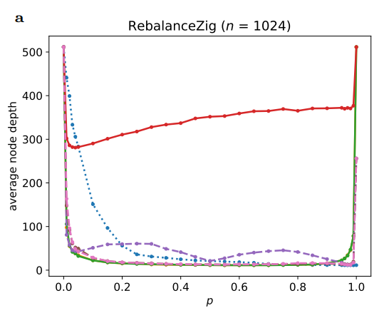
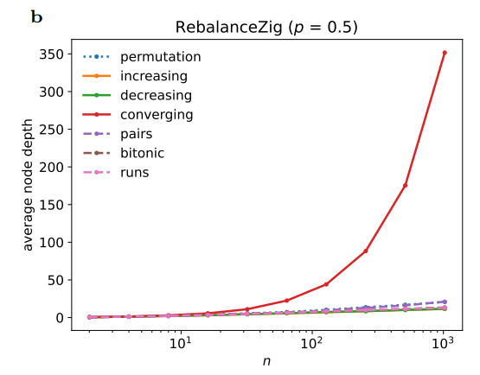
Performance of RebalanceZig
RebalanceZig performs well on increasing and decreasing sequences, achieving O(log n) expected depth per node. However, it struggles with converging sequences, resulting in linear expected average node depth. For pairs sequences, performance varies: with p ≠ 1/2, the expected average node depth is linear, while p = 1/2 may achieve O(√n) depth (conjectured). The algorithm fails to guarantee logarithmic depth for all insertion sequences.
Sequence Type
Performance
Increasing/Decreasing
O(log n) expected depth
Converging
Θ(n) expected average depth
Pairs (p ≠ 1/2)
Θ(n) expected average depth
Pairs (p = 1/2)
O(√n) conjectured

Slide 14
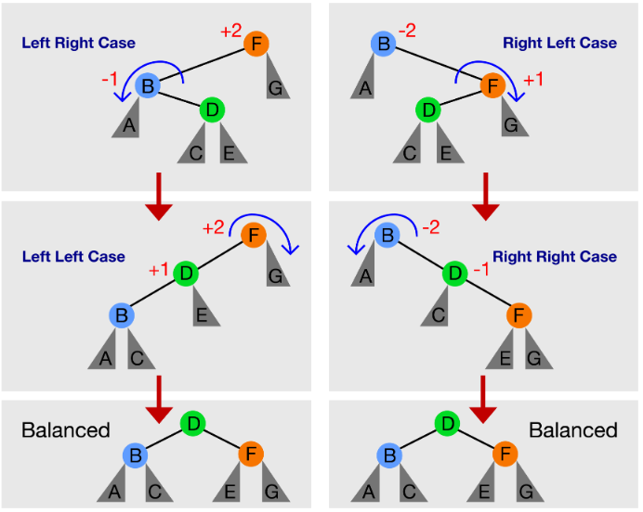




Algorithm RebalanceZigZag
RebalanceZigZag is an enhanced version of RebalanceZig, addressing shortcomings in zig-zag and zag-zig cases. It uses the same coin-flipping process but applies different rotations based on the tree structure. In zig-zig or zag-zag cases, it rotates up the parent of the current node. In zig-zag or zag-zig cases, it rotates up the current node twice. This ensures that everything in the subtree moves up one level when applying the transformation.
Coin Flip
Determine whether to move or rotate
Tree Analysis
Identify zig-zig, zag-zag, zig-zag, or zag-zig case
Rotation
Apply appropriate single or double rotation
Repeat
Continue process until termination

Slide 15
Algorithm 2: RebalanceZigZag(v)
While v.p ≠ nil and coin flip is tail:
Move up: v ← v.p
If v.p ≠ nil and v.p.p ≠ nil:
Case 1: If v and its parent v.p are both left or both right children:
Perform RotateUp(v.p) ▷ (zig-zig or zag-zag case)
Case 2: Otherwise:
Perform RotateUp(v) ▷ (zig-zag or zag-zig case)
Perform RotateUp(v) again.

Slide 16
RebalanceZigZag theoroms:
Theorem 4: RebalanceZigZag performs similarly to RebalanceZig for increasing and decreasing sequences, with O(log⁡n) depth.
Theorem 5: RebalanceZigZag handles the converging and finger sequences better than RebalanceZig, achieving O(logn) depth when (sqrt(5)−1)/2) <p<1.
Theorem 6: For the pairs sequence, RebalanceZigZag fails to balance, resulting in Θ(n) depth for all 0≤p≤1.

Slide 17
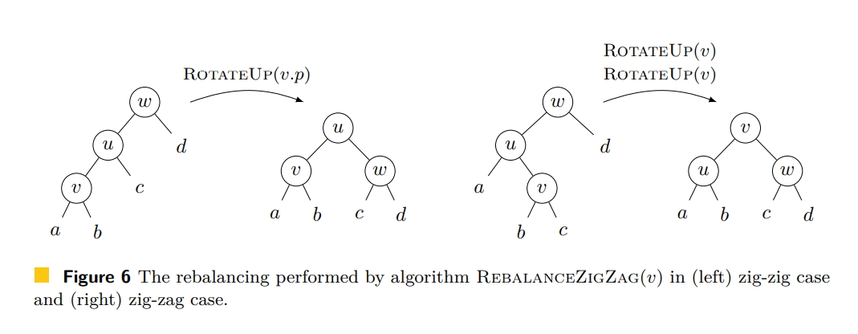
Good Rotations depth decreased

Slide 18
Performance of RebalanceZigZag
RebalanceZigZag shows improved performance on some sequences compared to RebalanceZig. For increasing, decreasing, and finger sequences (including converging sequences), it achieves O(log n) expected depth per node when (√5-1)/2 < p < 1. However, it still struggles with pairs sequences, resulting in linear expected average node depth for all 0 ≤ p ≤ 1. The algorithm's performance on random permutations remains an open question, though experiments suggest near-logarithmic behavior for p ≥ 0.7.

Slide 19
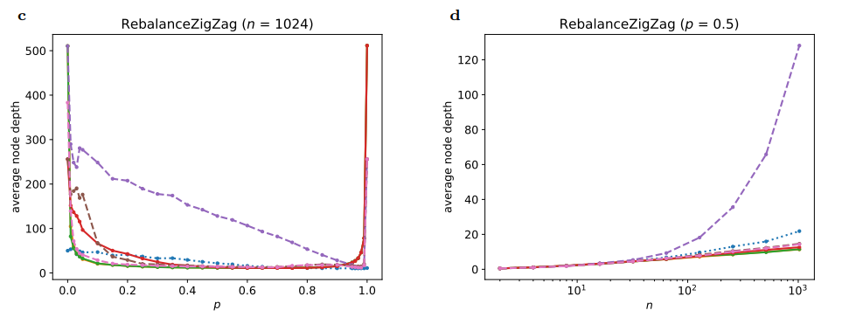
Improved Sequences
Problematic Sequences
Open Questions
- Pairs Expected average depth: Θ(n)
- Increasing - Decreasing - Finger (incl. converging) Expected depth: O(log n)
- Random permutations - Optimal p values - Generalization to all sequences

Slide 20
Feature | RebalanceZig | RebalanceZigZag
Increasing/Decreasing Sequences | Expected depth O(log⁡n) for 0<p<1. Performs well but rotations occur at lower levels. | Expected depth O(log⁡n) for 0<p<1. Rotations occur at higher levels, leading to identical trees ignoring the rightmost inserted node.
Finger Sequences | Handles increasing and decreasing sequences but fails for converging sequences, resulting in Θ(n) depth. | Handles finger and converging sequences efficiently for (sqrt(5)-1)/2​<p<1, achieving O(logn) expected depth.
Pairs Sequences | Performs better for p=1/2​, with conjectured depth O(n). Otherwise, Θ(n) depth for p≠1/2​. | Fails for all 0≤p≤1, resulting in Θ(n) expected depth for pairs sequences.
Random Permutations | No rebalancing for p=1; performs as an unbalanced BST O(log⁡n). For p=0, always generates a path with Θ(n) depth. | Appears “about logarithmic” for p≥0.7, but performance for 0<p≤ (sqrt(5)-1) /2 is an open problem.

Slide 21
At most one rotation per insertion.
Rotations Per Insertion
At most two rotations per insertion (zig-zig or zig-zag cases).
Parameter Dependency | Highly sensitive to ppp. Performs poorly on sequences like converging when p≠12p \neq \frac{1}{2}p=21​. | Performs better for larger ppp, especially for converging sequences (p>5−12p > \frac{\sqrt{5}-1}{2}p>25​−1​).
Experimental Observations | Struggles with converging sequences; creates paths for p=0. | Struggles with pairs sequences but achieves balanced trees for finger and converging sequences when p>0.5.

Slide 22
Conclusion:
RebalanceZig is simpler and efficient for basic sequences like increasing and decreasing but struggles with more complex patterns such as converging and pairs sequences. RebalanceZigZag, with its additional rotation capability, handles finger and converging sequences better, achieving balanced trees for higher p values. However, both algorithms have specific weaknesses, particularly with pairs sequences, highlighting opportunities for improvement in future bottom-up rebalancing algorithms

Slide 23
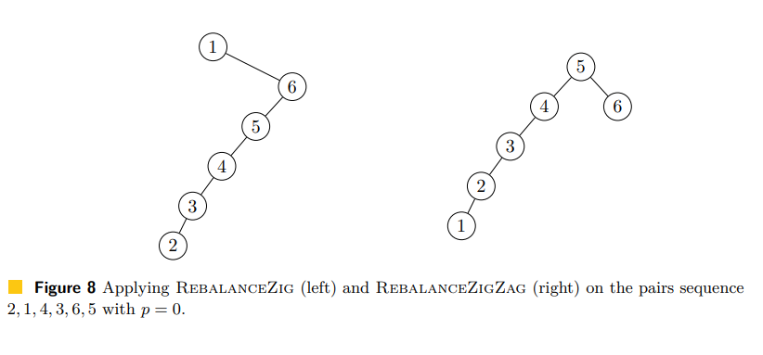
Example:

Slide 24
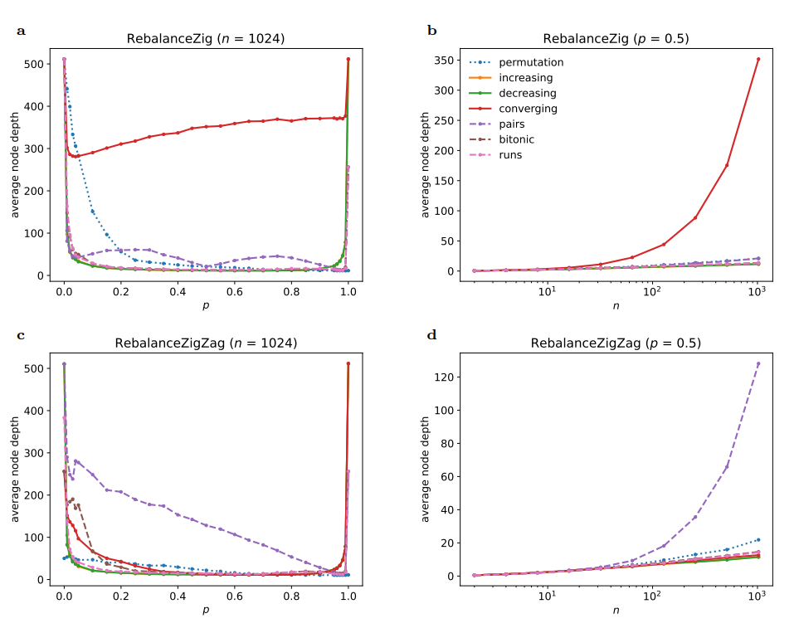
Experimental Evaluation
The algorithms were implemented in Python 3.12 and tested on various insertion sequences with lengths up to 1024 and different p values. Key findings include: RebalanceZig struggles with converging sequences, while RebalanceZigZag handles them better. Both algorithms have difficulty with pairs sequences. RebalanceZigZag often shows the best overall performance, though it doesn't guarantee logarithmic depth for all sequences. The experiments reveal complex relationships between p values, sequence types, and resulting tree structures.
Performance Graphs
Average node depths for different sequence types and p values

Slide 25
Limitations and Open Problems
Neither RebalanceZig nor RebalanceZigZag fully meets all desired conditions for an ideal randomized rebalancing scheme. Key limitations include the inability to guarantee logarithmic depth for all insertion sequences and suboptimal performance on certain sequence types. Open problems include: finding a randomized bottom-up rebalancing scheme that guarantees expected logarithmic average depths for all sequences; determining the best depth guarantee possible under the given constraints; and exploring how much the constraints need to be relaxed to enable expected logarithmic average node depths.
Guarantee Limitations
Sequence Sensitivity
Cannot ensure logarithmic depth for all sequences
Poor performance on specific insertion patterns
Optimal Scheme
Constraint Analysis
Finding a universally effective rebalancing method
Determining minimal requirements for logarithmic depth

Slide 26
Comparison to Existing Methods
The proposed algorithms are compared to existing rebalancing schemes like red-black trees, encoded 2-3 trees, splay trees, treaps, and randomized BSTs. While the new methods meet some desired criteria (constant-time rebalancing, limited rotations, no balance information storage), they fall short in guaranteeing logarithmic depth. Existing methods often provide stronger guarantees but may require additional storage or more complex operations. The study highlights the challenges in designing simple, efficient randomized rebalancing schemes under strict constraints.
Method
Time
Rotations
Random Bits
Extra Space
Red-black tree
O_E(1)
O_A(1)
O(1)
0
1 bit
Encoded 2-3 trees
O(log n)
O(log n)
0
0
Splay trees
O_A(log n)
O_A(log n)
0
0
Treaps
O_E(1)
O_E(1)
O_E(1)
O_E(1)
Randomized BST
O_E(log n)
O_E(1)
O_E(log^2 n)
O(log n)
Seidel [24]
O_E(log^2 n)
O_E(1)
O_E(log^3 n)
0
This paper
O_E(1)
O(1)
O_E(1)
0

Slide 27
Conclusion and Future Directions
The study of RebalanceZig and RebalanceZigZag provides insights into the challenges of designing efficient randomized rebalancing schemes for binary search trees under strict constraints. While these algorithms show promise in some scenarios, they fail to achieve universal logarithmic depth guarantees. Future research directions include exploring more sophisticated randomization techniques, investigating the impact of relaxing certain constraints, and developing hybrid approaches that combine the simplicity of these methods with the guarantees of established algorithms. The ultimate goal remains to find a balance between simplicity, efficiency, and robust performance across all insertion sequences.
1
Constraint Analysis
2
Hybrid Approaches
Investigate the impact of relaxing or modifying current constraints on algorithm performance
Explore combinations of simple randomized methods with traditional balancing techniques
3
Theoretical Bounds
4
Practical Applications
Develop tighter bounds on expected performance for various sequence types
Identify real-world scenarios where these algorithms may offer advantages

