Slide 1




Workspace - 1
- Created By Mukund Desai
Tue, Sep 10, 2024 | 04:36:13 GMT

Slide 2
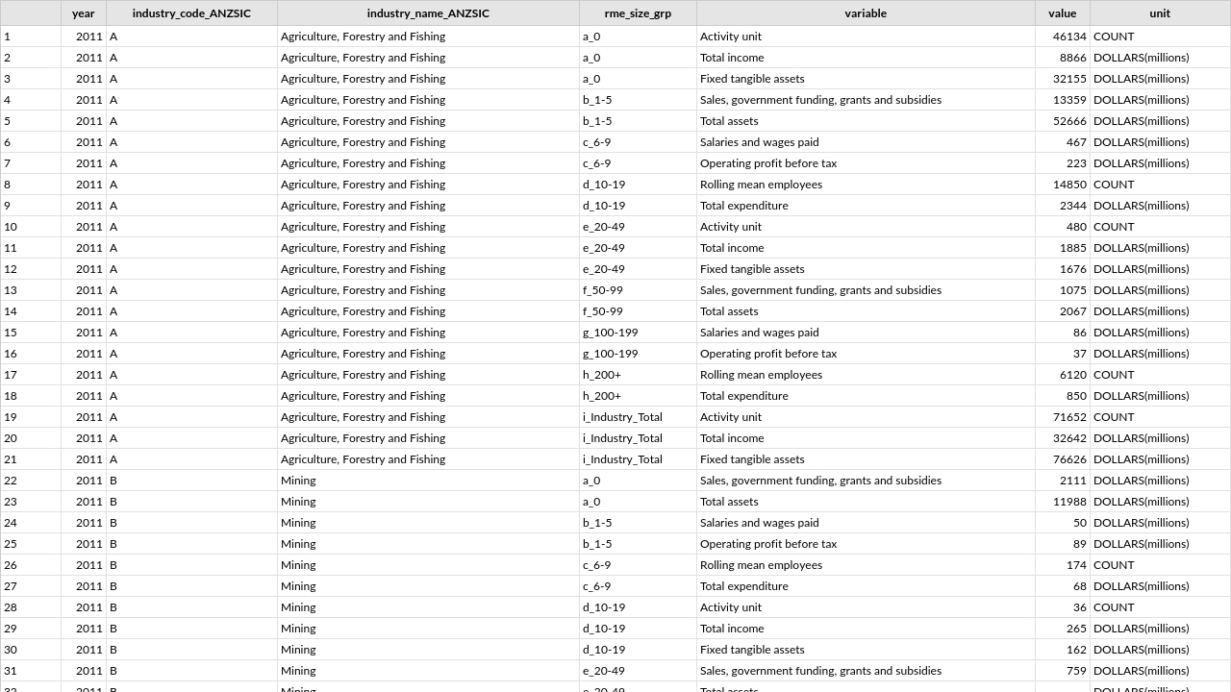

annual-enterprise-survey-2023-financial-year-provisional-size-bands
Powered by

Slide 3

Thank you
Powered by

