Slide 1
LSO Presto
Implementing LSO Presto
Presented by: Rand Hreish & Muhammad Abed Elrazek
Guided by: Itzik Ashkenazi

Slide 2
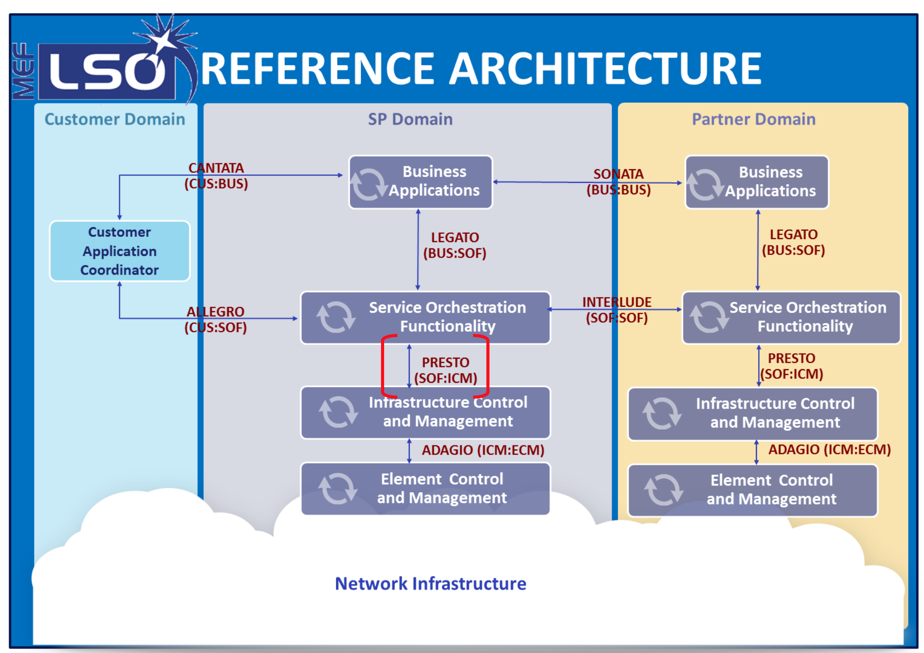
Introduction

Slide 3
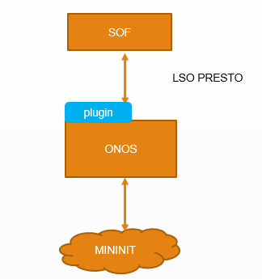
Project Overview
Implement a plugin on Open Network Operating System (ONOS) which knows how to get the topology from ONOS and return it when requested to the Service Orchestration Functionality (SOF) according to the Yet Another Next Generation model (YANG) .

Slide 4
Main Components
LSO PRESTO INTERFACE :
Presto interface is based on RESTCONF , In this type of communication, Client is the one that originates the REST request and the Server is the one who response .

Slide 5
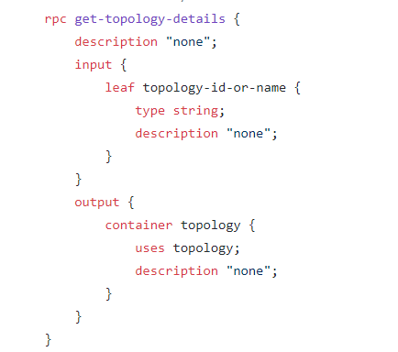
Main Components
MININET:
Mininet is a network emulator which creates a network of virtual hosts, switches, controllers, and links.
YANG Model :
Is a data modeling language for the definition of data sent over the network configuration protocol.

Slide 6
Main Components
ONOS Plugin :
1. Supports REST CONF .
2. Implements the get-topology-details request as it is defined in LSO Presto YANG model .
3. send back responses in JavaScript Object Notation (JSON) format to SOF .

Slide 7
Our Work Flow
Learning about SDN - Software-Defined Networking Networks.
Learning about YANG models.
Learning about ONOS Controller.
Learning LSO Presto Protocol .
Implementing an ONOS Plugin .
Simulating SOF request in POSTMAN .
Feed back for MEF.
Final presentation!

Slide 8
Process flow
SOF sends a get_tolpology_details request to the plugin
ONOS Plugin
Plugin requests the topology from ONOS controller
SOF
The process flow begin with the SOF receiving a MEF service activation request over the LSO LEGATO interface , in our case it’s a create connectivity services request
ONOS Controller
The Plugin sends the response after processing it according to the YANG model back to SOF.
ONOS sends the topology back .

Slide 9
SCHEME
SOF
LSO PRESTO
plugin
ONOS
MININIT

Slide 10
Simulation

Slide 11
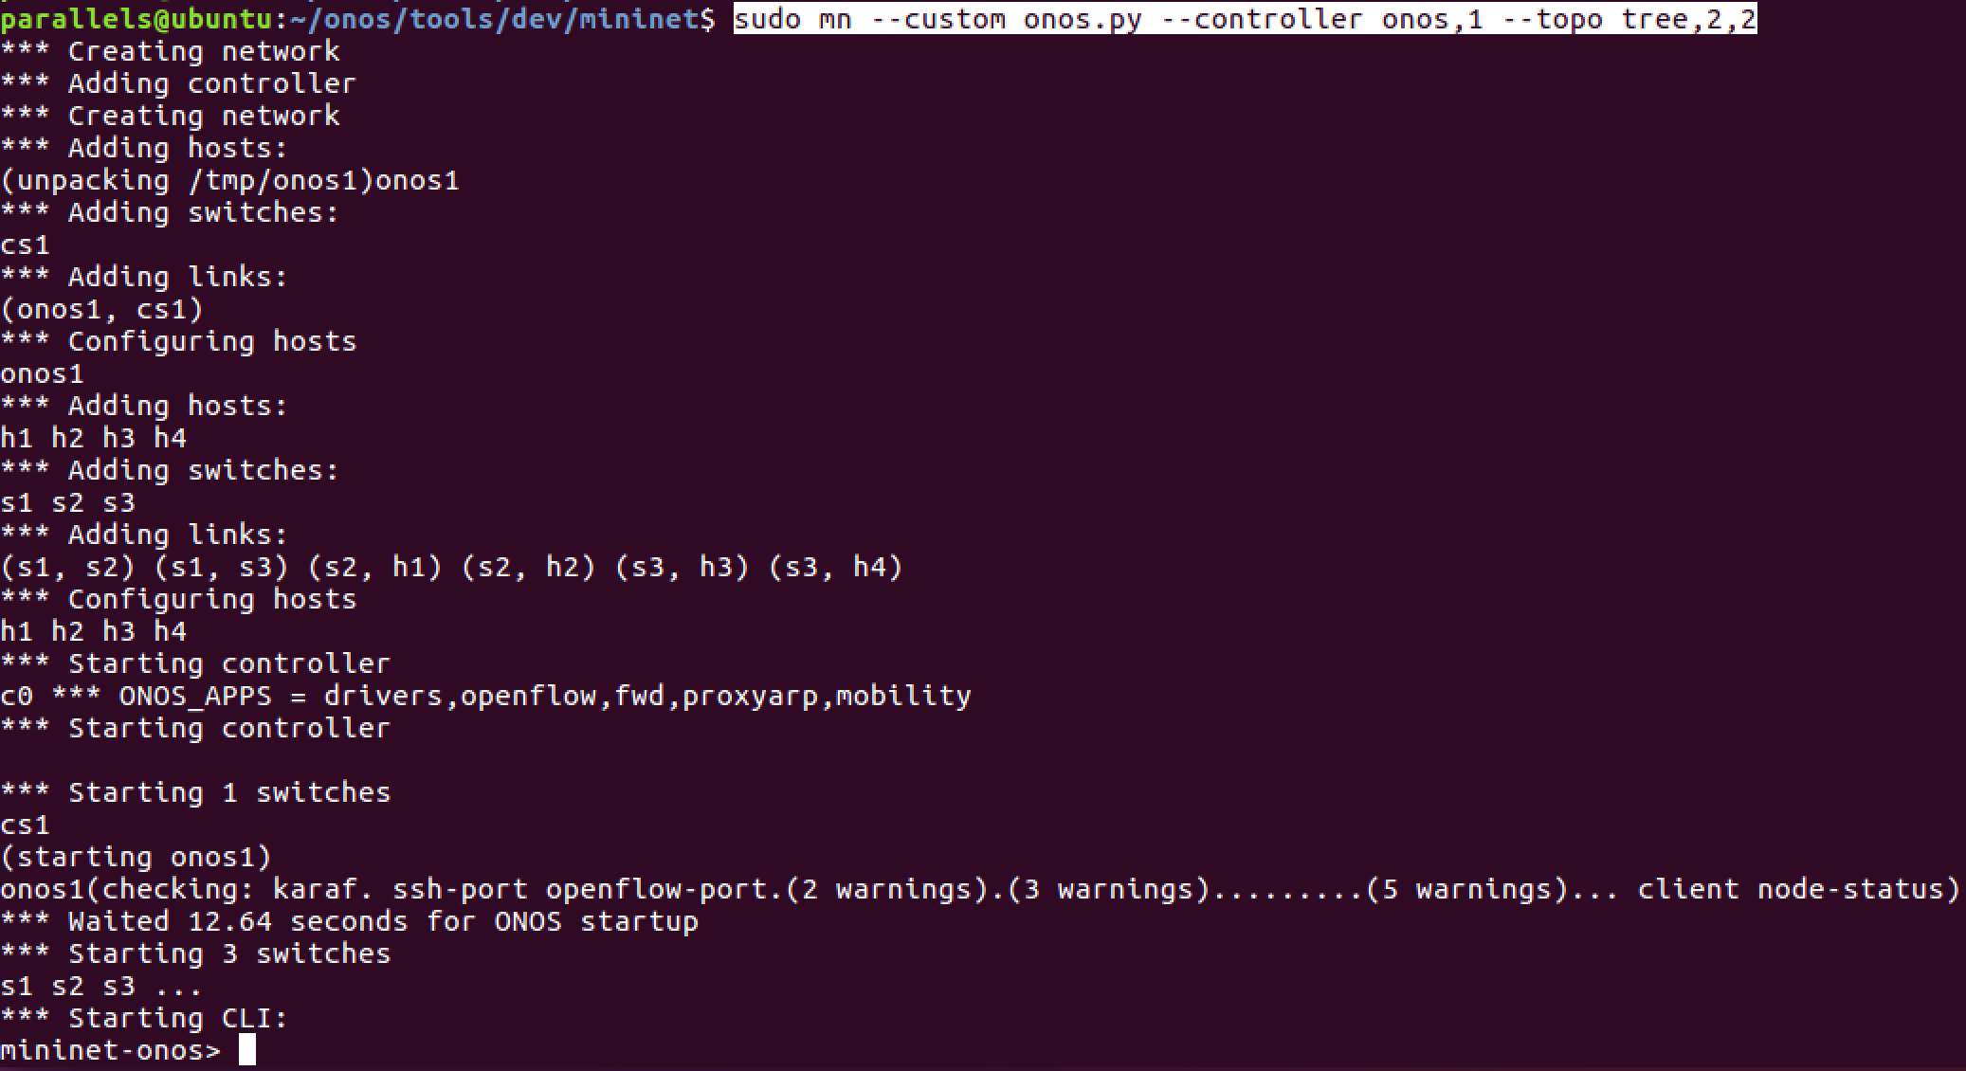
SCHEME
SOF
LSO PRESTO
plugin
ONOS
MININIT

Slide 12
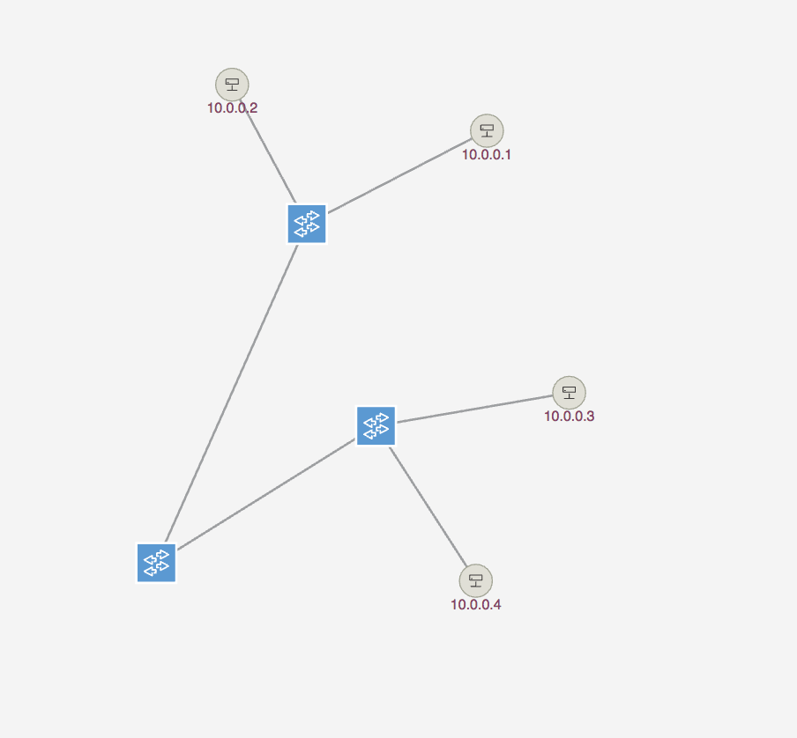
SCHEME
SOF
LSO PRESTO
plugin
ONOS
MININIT

Slide 13
SCHEME
SOF
Installing plugin app
LSO PRESTO
plugin
ONOS
ONOS Log file showing that the plugin has been installed
MININIT

Slide 14
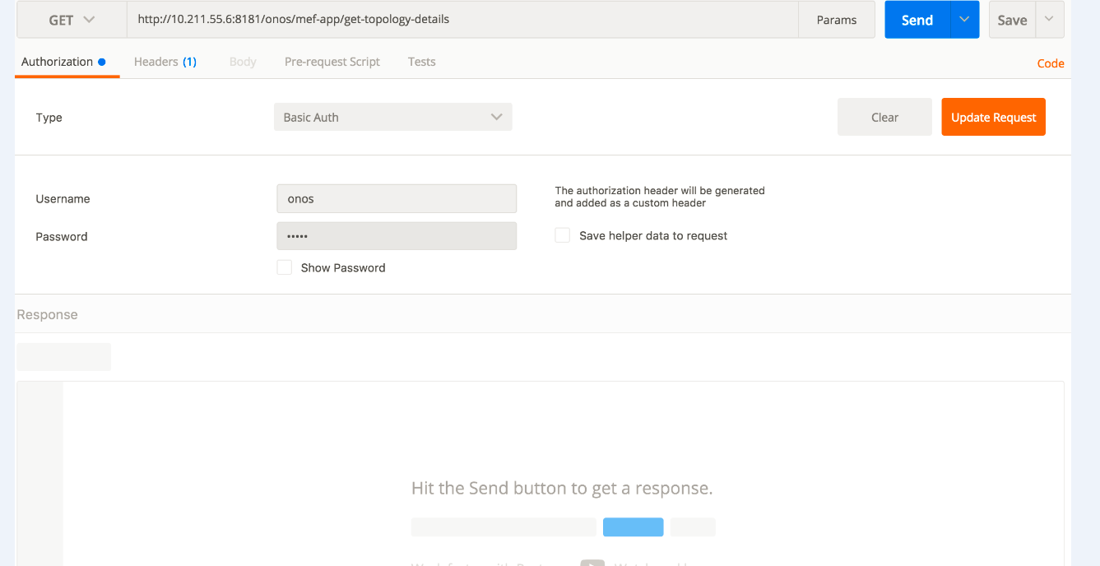
SCHEME
SOF
LSO PRESTO
plugin
ONOS
MININIT

Slide 15
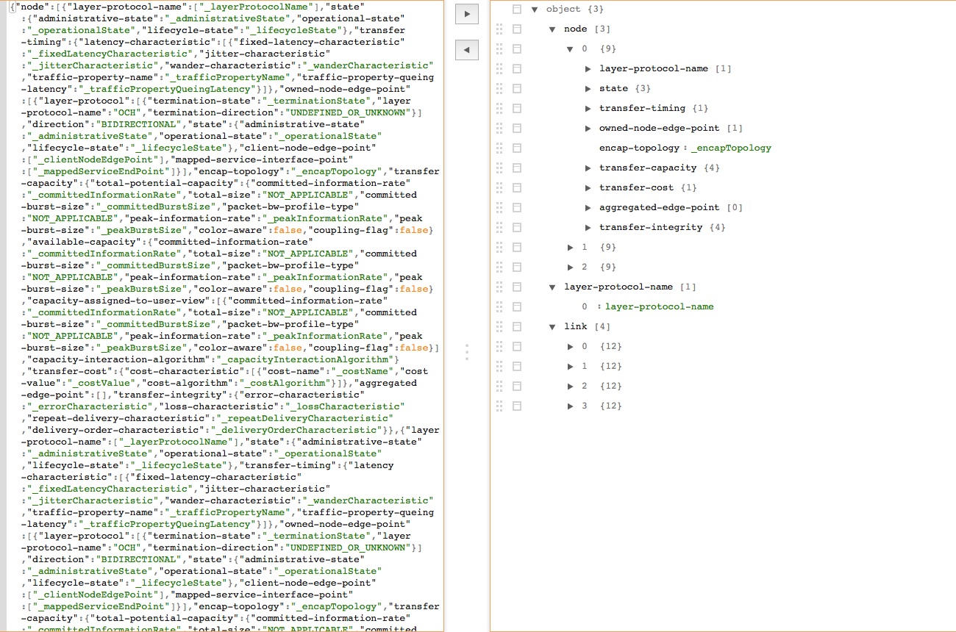
SCHEME
SOF
LSO PRESTO
plugin
ONOS
MININIT

Slide 16
Feedback for MEF
ONOS Controller doesn't provide most of the parameters that the YANG Model defines.
After some discussions with ONOS Developers , we came to a conclusion that the only way to Implement the requested mission is to bypass the ONOS Core,and request these parameters directly form the device (MININET) .
The mentioned way hasn't been tested yet and it also might not do the work !
So we’re sending a default values for all the parameters.

Slide 17
Future recommendations
Implementing the solution mention above which suggest to bypass the ONOS Core , and request these parameters directly form the device(MININET).
Switch the MININET network with real switches .
Implementing the next step which is Create_Connectivity_Service between two hosts .

Slide 18
The things we learned
MININET .
YANG Models .
SDN Networks .
JAVA .
ONOS Controller Architecture .
REST API .

Slide 19

THE END
Thank you!

