Slide 1

Getting Started with dbt
Notes:
TIME: 00:00–01:00
Introduce yourself. Ask for a show of hands: SQL Server, Power BI, Fabric, dbt. Everyone who can read a SELECT is welcome. This session uses dbt Core and a fictional order dataset. No dbt subscription is needed for the demos. By the end, attendees should be able to explain a model, read a dependency, interpret a failing test, and choose an adapter.
[Sources]
https://docs.getdbt.com/docs/introduction
Theme: user-supplied AANA AI Adoption Roadmap.pptx, visual reference only.
[/Sources]

Slide 2


Bio
Andrew Boerger
Analytics Manager · AGC Automotive North America
Live & work in Bellefontaine, Ohio
FIND ME
LinkedIn | Reddit | aboerg.dev
Getting started with dbt
01

Slide 3
Bio 2
Just a user
CERTIFICATIONS
Fabric Analytics Engineer Associate (DP-600)
Fabric Data Engineer Associate (DP-700)
RECOGNITION
HackTogether: The Microsoft Fabric Global AI Hack
Best use of Copilot for Microsoft Fabric: Accounts Payable Payment Prediction
EXPERIENCE
Administering Power BI Premium since 2020
Using Fabric since day 1 of Public Preview
Getting started with dbt
02

Slide 4

My organization
World leader in automotive glass
North American business unit (~3K employees)
DATA PLATFORM JOURNEY
Power BI (2018) · Premium (2020) · Synapse (2021) · Fabric (2023)
Getting started with dbt
03

Slide 5
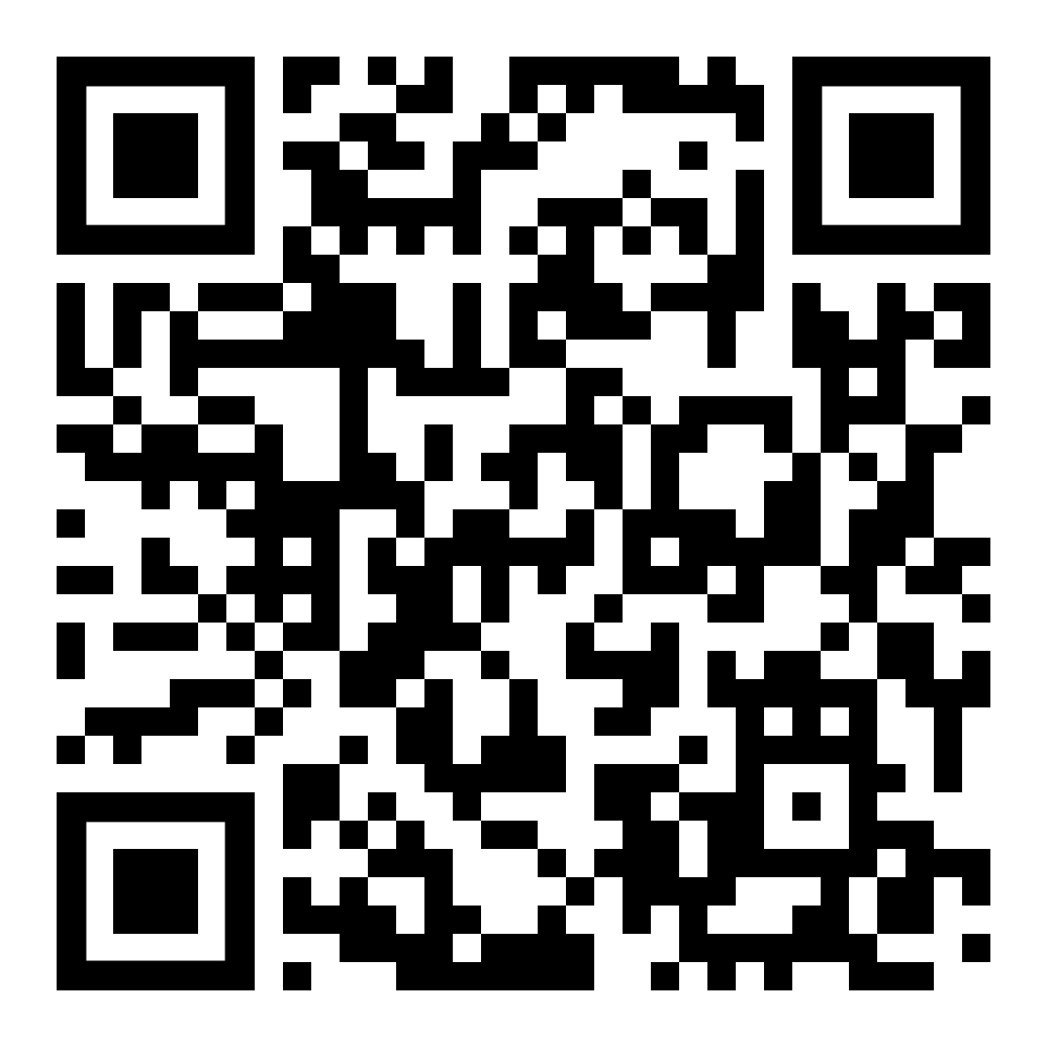
Repo
Getting started with dbt
04

Slide 6
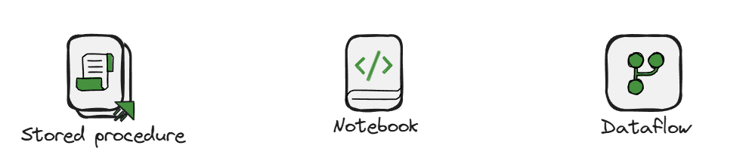
Let’s talk about the “T” in ETL
Getting started with dbt
05
Notes:
TIME: 01:00–03:00
Ask: “Who has changed one SQL object and discovered the dependent report later?” The problem is coordination around transformations as they grow. Stored procedures and notebooks can be engineered well; dbt offers a consistent project workflow so each team does not invent all of it. Avoid claiming that existing tools cannot be tested or versioned.
[Sources]
Original teaching scenario and synthetic demo data.
Theme: user-supplied AANA AI Adoption Roadmap.pptx, visual reference only.
[/Sources]

Slide 7
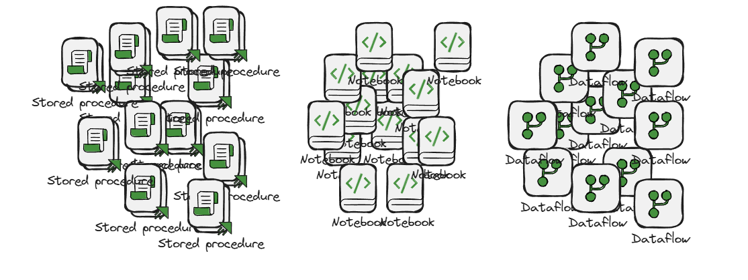
Let’s talk about the “T” in ETL
Getting started with dbt
06
Notes:
TIME: 01:00–03:00
Ask: “Who has changed one SQL object and discovered the dependent report later?” The problem is coordination around transformations as they grow. Stored procedures and notebooks can be engineered well; dbt offers a consistent project workflow so each team does not invent all of it. Avoid claiming that existing tools cannot be tested or versioned.
[Sources]
Original teaching scenario and synthetic demo data.
Theme: user-supplied AANA AI Adoption Roadmap.pptx, visual reference only.
[/Sources]

Slide 8
Common challenges when transforming data
One query
A single SELECT.
A web of scripts
Procedures, views and notebooks maintained by several people.
A codebase
Transformations, tests, documentation, version control. This is where dbt fits.
?
What must run first?
Execution order lives in ten pipelines, a PowerShell script, or someone's head.
?
How do we visualize dependencies?
Finding downstream reports means searching code and asking around.
?
How to we run tests?
Uniqueness, valid statuses and reconciled totals are checked by hand, if at all.
?
Where is the documentation for this table?
Grain, inclusion rules and units are documented somewhere else, or nowhere.
Getting started with dbt
08
Notes:
TIME: 01:00–03:00
Ask: “Who has changed one SQL object and discovered the dependent report later?” The problem is coordination around transformations as they grow. Stored procedures and notebooks can be engineered well; dbt offers a consistent project workflow so each team does not invent all of it. Avoid claiming that existing tools cannot be tested or versioned.
[Sources]
Original teaching scenario and synthetic demo data.
Theme: user-supplied AANA AI Adoption Roadmap.pptx, visual reference only.
[/Sources]

Slide 9
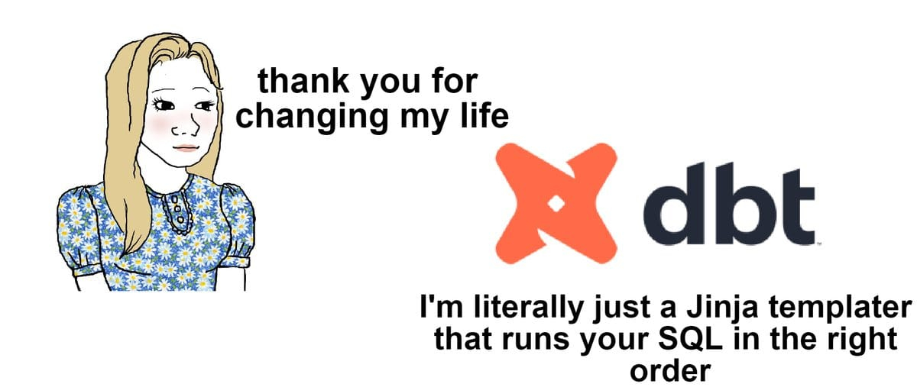
dbt
dbt with Fabric Spark in Production | Raki Rahman
Getting started with dbt
07
Notes:
TIME: 01:00–03:00
Ask: “Who has changed one SQL object and discovered the dependent report later?” The problem is coordination around transformations as they grow. Stored procedures and notebooks can be engineered well; dbt offers a consistent project workflow so each team does not invent all of it. Avoid claiming that existing tools cannot be tested or versioned.
[Sources]
Original teaching scenario and synthetic demo data.
Theme: user-supplied AANA AI Adoption Roadmap.pptx, visual reference only.
[/Sources]

Slide 10
What is dbt?
dbt (data build tool) is a framework for developing, testing and documenting SQL transformations. You write SELECT statements; dbt turns them into database objects, in order, with checks.
EXTRACT & LOAD
Your ingestion tools
Data Factory, mirroring, Dataflows, pipelines, notebooks. Get raw data into the data store.
TRANSFORM
dbt
Models, tests and docs over data the engine can already reach: Warehouse, Lakehouse, SQL database.
SERVE
Semantic model & reports
Power BI, DAX, notebooks, ad-hoc SQL. dbt marts are inputs here — not a replacement.
dbt does
dbt does not
✓
Turns each SELECT into a view or table on your engine
✕
Extract or load data from source systems
✓
Works out execution order from ref() dependencies
✕
Schedule itself. Something needs to run dbt.
✓
Runs data tests: unique, not_null, accepted values, custom SQL
✕
Replace the Power BI semantic model or DAX measures
✓
Generates documentation and a lineage graph
✕
Make SQL faster by itself. Your preferred engine still does the work.
✓
Lives in Git — review, branch, CI like any other code
✕
Pull data onto your laptop. SQL executes where the data lives.
Getting started with dbt
09
Notes:
TIME: 03:00–05:00
Define dbt as data build tool: a framework for developing, testing and documenting data transformations. A dbt model and a Power BI semantic model are different layers. Expand ELT once: extract, load, transform. Keep ingestion, transformation and serving distinct. In a lakehouse design, dbt can own selected Silver or Gold transformations after data is landed. It need not own every layer. dbt does not automatically ingest SAP, schedule source extraction, or create a Power BI semantic model.
[Sources]
https://docs.getdbt.com/docs/introduction
https://docs.getdbt.com/docs/build/sql-models
Theme: user-supplied AANA AI Adoption Roadmap.pptx, visual reference only.
[/Sources]

Slide 11
dbt has become the default transformation layer
75%+
2,900+
50,000
5,000+
of Snowflake customers use dbt
dbt Labs / Snowflake Summit, Jun 2026
customers running dbt on Databricks
Databricks blog, Apr 2026
teams run dbt every week; 100k community members
dbt Labs, 2025
paying customers · $100M+ ARR (Feb 2025)
dbt Labs, 2025
TIMELINE
2016
dbt open-sourced — a CLI that compiles SELECTs and runs them in the warehouse
2019–22
Standard practice on Snowflake and BigQuery; “analytics engineering” becomes a job title
2023–25
Databricks SQL and Redshift teams adopt; Microsoft ships dbt-fabric and dbt-fabricspark
Oct 2025
Fivetran + dbt Labs merge — ingestion and transformation under one company
Nov 2025
dbt job becomes a native Fabric item (preview); Fusion engine announced for Fabric in 2026
Why this matters in a Microsoft shop. The workflow you learn today is the one Snowflake and Databricks teams have standardized on — so the skills, packages, hiring pool and community answers transfer. Fabric now has first-party adapters and a native dbt job: you no longer choose between “the Microsoft way” and the industry’s default transformation layer.
Figures are vendor-reported (dbt Labs, Snowflake, Databricks, Microsoft) and were checked September 2026 — re-verify before presenting.
Getting started with dbt
10
Notes:
TIME: 05:00 (30 seconds, or skip)
Vendor-reported adoption figures, checked September 2026. The point for a Microsoft audience: the workflow is the industry default, and Fabric now has first-party adapters (dbt-fabric, dbt-fabricspark) plus a native dbt job item, so the skills transfer in both directions. Re-verify the figures before presenting.
[Sources]
https://learn.microsoft.com/fabric/data-factory/dbt-job-overview
https://github.com/microsoft/dbt-fabric
https://github.com/microsoft/dbt-fabricspark
Theme: user-supplied AANA AI Adoption Roadmap.pptx, visual reference only.
[/Sources]

Slide 12
dbt execution
WHERE THE DBT PROCESS RUNS
dbt Core (CLI)
Your laptop · an Azure DevOps agent · a container · a Fabric notebook
Reads the project files from Git
Compiles Jinja + ref() into plain SQL
Sends CREATE / SELECT statements to the engine
Collects results, runs tests, writes logs and artifacts
WHERE THE SQL EXECUTES
Your data platform
Fabric Warehouse · Fabric Lakehouse (Spark) · Fabric SQL database · Azure SQL / SQL Server
Runs the compiled SQL where the data already lives
Builds the views and tables
Stores the results — nothing is copied to the dbt host
Does the heavy lifting; dbt does the coordinating
adapter
compiled SQL →
← status, row counts, errors
Data stays put
The dbt host never receives the tables. It sends SQL and reads back status, so a laptop can drive a multi-terabyte Warehouse.
Move the host, keep the SQL
Going from laptop to build agent changes identity, network and credentials — not one line of model code.
The adapter is the translator
dbt-fabric, dbt-fabricspark and dbt-sqlserver turn one project into T-SQL or Spark SQL for the target you pick.
Getting started with dbt
11
Notes:
TIME: 05:00–06:30
Distinguish where the dbt process runs from where transformation compute runs. A laptop can issue work to SQL Server or Fabric Spark. Moving that process to a build agent changes the host and credentials, not the business SQL. The Core CLI does not need to be installed on the database server.
[Sources]
https://docs.getdbt.com/docs/build/sql-models
https://docs.getdbt.com/docs/deploy/deployments
Theme: user-supplied AANA AI Adoption Roadmap.pptx, visual reference only.
[/Sources]

Slide 13
dbt Core, adapters and managed options
 | What it is | Who hosts it | Used today? | Keep in mind
dbt Core | Open-source CLI: compile, build, test, docs | You — laptop, agent, container, notebook | Yes — every demo | No subscription. You own scheduling, secrets, logs and upgrades.
Adapters | Python packages that translate dbt to a platform: dbt-fabric, dbt-fabricspark, dbt-sqlserver | Installed alongside Core | Yes | Each has its own version, maintainer and feature matrix. Pin them.
Managed dbt | Hosted IDE, scheduler, docs hosting, environments, alerts | dbt Labs | No | Adds workflow and governance features; a separate commercial decision. No pricing claims here.
Fusion engine | Newer dbt runtime with its own feature and adapter coverage | Varies | No | Check for support with your adapter.
Rule of thumb: learn the workflow on Core with the adapter for the platform you already run. Everything you build carries forward whichever runtime or hosting you choose later.
Getting started with dbt
12
Notes:
TIME: Appendix
Avoid conflating the open-source Core project with a paid managed service or assuming every Python adapter runs in Fusion. The teaching project intentionally targets Core. Discuss commercial options only if asked; no pricing claims are made.
[Sources]
https://docs.getdbt.com/docs/introduction
https://docs.getdbt.com/docs/dbt/supported-features
Theme: user-supplied AANA AI Adoption Roadmap.pptx, visual reference only.
[/Sources]

Slide 14
Anatomy of a dbt project
jaffle_shop/
├── dbt_project.yml # name, paths, defaults
├── packages.yml # dbt_utils
├── profiles.yml # connections, values from env vars
├── seeds/jaffle-data/
│ └── raw_*.csv # six raw tables, loaded once
├── models/
│ ├── staging/
│ │ ├── __sources.yml # the raw tables, declared
│ │ ├── stg_orders.sql
│ │ └── stg_orders.yml # docs + tests
│ └── marts/
│ ├── orders.sql
│ ├── customers.sql
│ └── customers.yml # docs + tests + unit tests
├── macros/
│ └── cents_to_dollars.sql
└── target/ # compiled SQL, artifacts
dbt_project.yml
Names the project, points at the folders, sets defaults such as “staging as views, marts as tables”. One per project.
models/*.sql
One SELECT per file. The filename is the model name; dbt writes the CREATE VIEW / TABLE for you.
models/*.yml
Descriptions and tests sit beside the SQL they describe — so docs and checks are versioned with the code.
seeds/ and macros/
Seeds are CSVs dbt loads for you — here they stand in for ingestion. macros/ holds reusable Jinja such as cents_to_dollars.
profiles.yml
The connection: adapter type, host, database, schema, authentication. Ours is in Git because every value comes from an environment variable.
Getting started with dbt
14
Notes:
TIME: 06:30–08:00
Preview the project tree, but defer terminal execution. The Jaffle Shop project has six raw CSVs (seeds), six staging views and six marts; the order branch (stg_orders → order_items → orders → customers) is the one we follow all hour. Seeds stand in for ingestion: they are loaded once per engine and declared as sources. Explain that the YAML filename can vary; dbt_project.yml is special. Distinguish the project from the installed adapter.
[Sources]
https://docs.getdbt.com/docs/build/sql-models
https://docs.getdbt.com/docs/build/data-tests
https://github.com/dbt-labs/jaffle-shop
Theme: user-supplied AANA AI Adoption Roadmap.pptx, visual reference only.
[/Sources]

Slide 15
A model is a SELECT statement
WHAT YOU WRITE TODAY
THE SAME THING AS A DBT MODEL
CREATE OR ALTER VIEW jaffle_shop.stg_orders AS
SELECT
id AS order_id,
customer AS customer_id,
store_id AS location_id,
CAST(order_total / 100.0 AS numeric(16,2))
AS order_total,
CAST(ordered_at AS date) AS ordered_at
FROM raw.raw_orders;
-- models/staging/stg_orders.sql
-- grain: one row per order
select
id as order_id,
customer as customer_id,
store_id as location_id,
{{ cents_to_dollars('order_total') }}
as order_total,
{{ dbt.date_trunc('day', 'ordered_at') }} as ordered_at
from {{ source('ecom', 'raw_orders') }}
No DDL in the file
You write the SELECT. dbt generates CREATE VIEW or CREATE TABLE for the target engine — and drops/replaces it on rebuild.
The filename is the model name
stg_orders.sql becomes jaffle_shop.stg_orders. Rename the file, rename the object.
source() and ref() instead of a schema name
source() names a table ingestion owns; ref() names another model. Both declare a dependency dbt can order, select and document — and resolve per environment.
dbt compile → target/compiled/…/stg_orders.sql: from [WH_Jaffle_Shop].[raw].[raw_orders] symbolic name → concrete relation, per target
Getting started with dbt
15
Notes:
TIME: 08:00–10:00
Introduce DAG as directed acyclic graph, then say dependency graph thereafter. Show source() and ref() in one line each: staging models read the raw tables through source('ecom', …); marts read other models through ref(). cents_to_dollars is a project macro — mention it, do not explain Jinja yet. In the actual graph five source branches join at order_items and orders; this slide follows only the order branch. A seed becomes a source node only because __sources.yml declares it.
[Sources]
https://docs.getdbt.com/reference/dbt-jinja-functions/ref
https://docs.getdbt.com/docs/build/sources
Theme: user-supplied AANA AI Adoption Roadmap.pptx, visual reference only.
[/Sources]

Slide 16
Materializations
Materialization | What dbt builds | Use when | Watch out
view | CREATE VIEW — a saved query, nothing stored | Cheap staging layers; logic that must always be current | Every read re-runs the SQL; slow on wide joins
table | Full rebuild of a stored table on every run | Marts consumed by reports; anything expensive to compute | Rebuild cost grows with data; no history kept
incremental | Insert/merge only new or changed rows into an existing table | Large fact tables where full rebuilds are too slow | You define what “new” means — late arrivals and corrections are your problem
ephemeral | Nothing — the SQL is inlined as a CTE into consumers | Small reusable logic you don’t want as a database object | Can’t query or test it directly
# dbt_project.yml
models:
jaffle_shop:
staging:
+materialized: view
marts:
+materialized: table
MODELS CAN OVERRIDE THE DEFAULT
{{ config(materialized='table') }}
select …
The SELECT doesn’t change
Switching view → table is a one-line config edit; dbt generates the right DDL for the engine. Today's project builds staging as views and marts as tables on every engine.
Some materializations are adapter-specific. See what your chosen adapter supports.
Getting started with dbt
16
Notes:
TIME: 19:00–22:00
A model is logical SQL; materialization is the build strategy. Our project defaults to views for staging and tables for marts on all three engines, set once in dbt_project.yml. A table-to-view switch on stg_orders is a good optional ten-second edit. Ephemeral embeds SQL in consumers; materialized_view and friends are adapter-dependent. Incremental is not automatic CDC and should not be the first live demo.
[Sources]
https://docs.getdbt.com/docs/build/materializations
https://docs.getdbt.com/docs/build/incremental-models
Theme: user-supplied AANA AI Adoption Roadmap.pptx, visual reference only.
[/Sources]

Slide 17
Dependencies using ref()
SOURCES · raw tables, seeded once
STAGING · one row per source row
MARTS · one row per customer
MODELS/MARTS/CUSTOMERS.SQL
raw_customers
source · raw schema
stg_customers
view
ref()
with customers as (
select * from {{ ref('stg_customers') }}
),
orders as (
select * from {{ ref('orders') }}
)
select customers.customer_id, customers.customer_name,
count(distinct orders.order_id) as count_lifetime_orders,
sum(orders.order_total) as lifetime_spend
from customers left join orders …
customers
lifetime orders and spend (via orders)
raw_orders
source · raw schema
stg_orders
cents → dollars, timestamp → day
ref()
expression_is_true
test · order_total − tax_paid = subtotal
accepted_values
test · customer_type in [new, returning]
{{ … }} is Jinja
A template that becomes SQL at compile time. In everyday use you will meet ref(), source(), config() and the occasional macro — the rest is ordinary SQL.
Order
dbt builds parents before children. No hand-maintained run list.
Selection
+customers = it and its ancestors. stg_orders+ = it and everything downstream.
Impact
Change how tax is converted? The graph tells you which models and tests are affected.
Getting started with dbt
17
Notes:
TIME: 08:00–10:00 (shared with slide 9)
Read the graph left to right: sources, staging, marts, with tests hanging off the model they check. The reconciliation test sits on stg_orders — the earliest point where cents and dollars can be confused. In the full project five source branches join at order_items and orders; this slide follows only the order and customer branches. Selection syntax: +customers builds everything customers needs; stg_orders+ rebuilds everything that depends on stg_orders — that is the Demo 2 command.
[Sources]
https://docs.getdbt.com/reference/node-selection/syntax
https://docs.getdbt.com/docs/build/jinja-macros
Theme: user-supplied AANA AI Adoption Roadmap.pptx, visual reference only.
[/Sources]

Slide 18
schema.yml: descriptions and tests
MODELS/MARTS/CUSTOMERS.YML
models:
- name: customers
description: >
One row per customer. A customer with a single
order is 'new'; two or more make them 'returning'.
Amounts in USD.
data_tests:
- dbt_utils.expression_is_true:
arguments:
expression: "lifetime_spend_pretax + lifetime_tax_paid = lifetime_spend"
columns:
- name: customer_id
description: Grain key. Matches stg_customers.
data_tests:
- not_null
- unique
- name: customer_type
description: 'new' or 'returning'.
data_tests:
- accepted_values:
arguments:
values: ["new", "returning"]
# … lifetime_spend, first_ordered_at, …
One YAML file, many models
Filename is free (schema.yml, customers.yml…). It’s a list of models; each entry describes one .sql file by name.
Descriptions are documentation
Written once here, they appear in dbt docs, in the lineage graph, and — with the right adapter — as column comments on the warehouse table.
Tests are assertions in YAML
Each entry becomes a SQL query at run time. dbt build runs them right after the model builds; a failure stops downstream models.
Packages add more tests
dbt_utils.expression_is_true, dbt_expectations… installed via packages.yml. Same YAML shape, someone else wrote the SQL.
Tests and docs are versioned with the code
A pull request that changes the SELECT also shows the changed expectation. Review both together.
Getting started with dbt
18
Notes:
TIME: 22:00–24:00 (shared with slide 12)
Walk the real customers.yml: the description states the grain and the new/returning rule; customer_id gets not_null and unique; customer_type gets accepted_values; the model-level expression_is_true reconciles pretax + tax = spend. The same file feeds the docs site in Demo 3, so a reviewer sees the SELECT, the expectation and the documentation in one pull request.
[Sources]
https://docs.getdbt.com/reference/resource-properties/data-tests
https://github.com/dbt-labs/dbt-utils
Theme: user-supplied AANA AI Adoption Roadmap.pptx, visual reference only.
[/Sources]

Slide 19
Tests
MODELS/STAGING/STG_ORDERS.YML · MODELS/MARTS/ORDERS.YML
WHICH TEST CATCHES WHAT?
models:
- name: stg_orders
description: One row per order. Amounts in USD.
data_tests:
- dbt_utils.expression_is_true:
arguments: { expression: "order_total - tax_paid = subtotal" }
columns:
- name: order_id
data_tests: [not_null, unique]
- name: orders # marts/orders.yml
columns:
- name: customer_id
data_tests:
- relationships:
arguments: { to: ref('stg_customers'), field: customer_id }
If this goes wrong… | …this test fails
The same order_id appears twice after a bad join | unique
An order arrives with no key | not_null
Someone types “Returning” instead of “returning” | accepted_values
An order points at a customer that doesn’t exist | relationships
tax_paid stays in cents, so order_total ≠ subtotal + tax | expression_is_true
Data tests check the data that was actually built — unique, not_null, accepted_values, relationships, plus any SQL you write yourself.
Unit tests check the model’s logic against rows you provide e.g. “an order with one jaffle and one drink is both a food and a drink order”. Confirm adapter support first.
Singular tests are one-off SELECTs in data-tests/ Great for reconciliations!
A test is just a query that returns the failing rows. Zero rows back = pass. dbt writes the query for the generic tests; you write it for singular ones.
Getting started with dbt
19
Notes:
TIME: 22:00–24:00
Our demo uses unique, not_null, accepted_values, relationships and dbt_utils.expression_is_true, plus three unit tests from the upstream project. Ask which test would catch a duplicate key and which would catch the cents-versus-dollars slip we cause in Demo 2. Data tests are queries over built data; unit tests use controlled inputs to check model logic. Note the arguments: key — dbt 1.10+ syntax for generic test parameters.
[Sources]
https://docs.getdbt.com/docs/build/data-tests
https://docs.getdbt.com/docs/build/unit-tests
Theme: user-supplied AANA AI Adoption Roadmap.pptx, visual reference only.
[/Sources]

Slide 20
dbt terminology
model
seed
source
ref()
A .sql file containing one SELECT. dbt turns it into a view or table named after the file.
A small CSV in seeds/ that dbt loads as a table. Normally for fixtures and lookups In our demo we use seeds for ingestion of the raw tables.
A declaration of a table that something else owns (ingestion, another team). Gives the graph a named, documented input.
The function that links models. It resolves to the right relation for the target and tells dbt what depends on what.
stg_orders.sql → stg_orders
raw_orders.csv → raw.raw_orders
{{ source('ecom', 'raw_orders') }}
{{ ref('stg_orders') }}
test
materialization
profile / target
adapter
A query that returns failing rows. Generic tests come from YAML (unique, not_null…); singular tests are SQL files in tests/.
How a model is built: view, table, incremental or ephemeral. Set per folder or per model; the SELECT stays the same.
The connection: adapter, host, database, schema, credentials. Lives in profiles.yml (secrets via environment variables); a target is one named environment (warehouse, lakehouse, sqldb, ci).
The Python package that teaches dbt a platform’s SQL dialect and DDL. One per engine, installed alongside dbt Core.
accepted_values: [new, returning]
+materialized: table
profiles.yml → --target lakehouse
dbt-fabric · dbt-fabricspark · dbt-sqlserver
Also worth knowing: DAG = the dependency graph ref() builds · macro = a reusable Jinja snippet · package = shared macros and tests (dbt_utils) · artifacts = manifest.json and run_results.json in target/
Getting started with dbt
13
Notes:
TIME: 06:30–07:15
Eight words, one screen. Use the project's own examples: stg_orders is a model, raw_orders.csv is a seed that lands in the raw schema, source('ecom', 'raw_orders') is how the staging model reads it, ref('orders') is how customers reads the orders mart. Today's raw tables are seeds loaded once and then declared as sources — that is the shape a real project has, with ingestion replacing the seed. One profiles.yml holds three targets; the target, not the model, picks the adapter.
[Sources]
https://docs.getdbt.com/docs/build/sources
https://docs.getdbt.com/docs/core/connect-data-platform/profiles.yml
Theme: user-supplied AANA AI Adoption Roadmap.pptx, visual reference only.
[/Sources]

Slide 21
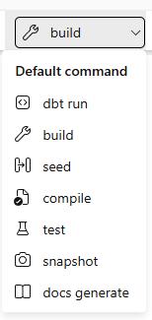
dbt commands
dbt run
Compiles your models to SQL and executes them against the warehouse — builds tables and views.
dbt build
Runs models, tests, seeds and snapshots together in DAG order; stops downstream on failure. The default here.
dbt seed
Loads CSV files from the seeds folder into the warehouse as tables — small static reference data.
dbt compile
Generates the SQL without executing it — inspect what dbt will run in the target folder.
dbt test
Runs data tests (unique, not_null, relationships, custom SQL) against built models.
dbt snapshot
Captures slowly changing dimensions by recording row changes over time (SCD Type 2).
dbt docs generate
Builds the documentation site and lineage graph from your project metadata.
Command picker in the Fabric dbt experience
Getting started with dbt
28
Notes:
TIME: 49:00–51:00
For the team, connect the example to dbt over curated Lakehouse data. Use type fabricspark and method livy for the demonstrated path. Schema-enabled profile uses lakehouse name plus a separate schema; schema-less profiles use the lakehouse name as schema. Newer releases expose more connection modes; those are version-specific extensions. Do not promise starter-pool hits or fixed startup time.
[Sources]
https://docs.getdbt.com/docs/local/connect-data-platform/fabricspark-setup
https://github.com/microsoft/dbt-fabricspark/blob/main/README.md
https://pypi.org/project/dbt-fabricspark/
Theme: user-supplied AANA AI Adoption Roadmap.pptx, visual reference only.
[/Sources]

Slide 22
EXPECTED customers · by customer_type
1
Read the inputs __sources.yml declares the six raw tables; stg_orders.sql and customers.sql. Grain first, then code.
customer_type | customers | lifetime_spend
new | 6 | 113.48
returning | 929 | 671,311.89
total | 935 | 671,425.37
2
dbt build 12 models, 33 data tests and 3 unit tests run in dependency order — one command.
3
Inspect the compiled SQL target/compiled: source('ecom', 'raw_orders') and ref('orders') became real Warehouse names.
4
Query the result How many customers are still “new” after a year of trading — and what does the description say that means?
LIVE DEMO 1 · FABRIC WAREHOUSE
Builds
01
Six staging views and six marts become tested tables — 61,948 orders, 935 customers.
Notes:
TIME: 10:00–19:00
Demo 1 in docs/runbook.md. Fabric Warehouse: .venv-warehouse, dbt build (default target). The raw tables were seeded before the talk; dbt build touches models and tests only, because seeds are disabled unless load_source_data is set. Show __sources.yml, stg_orders.sql and customers.yml, then run dbt build after explaining the command (48 nodes, about one to two minutes). Open target/compiled/jaffle_shop/models/marts/customers.sql for the resolved names. Query: select customer_type, count(*), sum(lifetime_spend) from jaffle_shop.customers group by customer_type — expected new 6 / 113.48, returning 929 / 671,311.89, total 935 / 671,425.37. Ask the audience why only 6 customers are 'new' (a year of data, regulars). Keep code readable; spend no live time installing tools.
[Sources]
https://github.com/aboerger/getting-started-with-dbt (docs/runbook.md)
Theme: user-supplied AANA AI Adoption Roadmap.pptx, visual reference only.
[/Sources]

Slide 23
EXPECTED CONSOLE
1
Predict One line in stg_orders.sql stops converting tax_paid from cents. What happens to lifetime_spend without a test?
$ dbt build --select stg_orders+
PASS view stg_orders
FAIL 61465 dbt_utils_expression_is_true_stg_orders_…
SKIP table order_items · orders · customers
SKIP … their tests and unit tests
Done. PASS=4 WARN=0 ERROR=1 SKIP=17 TOTAL=22
$ echo $LASTEXITCODE → 1
2
Break it tools\scenario.ps1 break, then dbt build --select stg_orders+ — only the order branch and its descendants.
3
Read the failure expression_is_true fails on stg_orders for 61,465 of 61,948 rows (the rest carry no tax); order_items, orders and customers are SKIPPED. The old tables are still there — no rollback.
4
Repair tools\scenario.ps1 reset (a git checkout), rebuild. Green again: 671,425.37. Then ask what the green run actually proves.
LIVE DEMO 2 · FABRIC WAREHOUSE
Tests
02
What happens when tax_paid is left in cents — and how the build tells you.
Notes:
TIME: 24:00–33:00
Demo 2. Ask for a prediction first: tax in cents makes lifetime_spend several times too large and no single row looks wrong. Run tools\scenario.ps1 break (it edits one line of stg_orders.sql so tax_paid no longer goes through cents_to_dollars), show the diff in Git, then dbt build --select stg_orders+. The reconciliation test order_total - tax_paid = subtotal fails for every row; the three downstream marts, their tests and unit tests are skipped; the previously built tables still exist and still hold correct numbers. Open the compiled test SQL under target/compiled and run_results.json. Repair with tools\scenario.ps1 reset (a git checkout), rebuild, see the green recovery. If time remains, break accepted_values instead by returning 'Returning' from customers.sql; do not sacrifice the recovery step.
[Sources]
https://github.com/aboerger/getting-started-with-dbt (tools/scenario.ps1, docs/runbook.md)
Theme: user-supplied AANA AI Adoption Roadmap.pptx, visual reference only.
[/Sources]

Slide 24
dbt results
A green build
It does not prove
✓
Every selected model built without error
✕
That “two or more orders” is the right business definition of a returning customer
✓
Every selected test returned zero failing rows — on this run, against this data
✕
That every row is correct — aggregates can match while details are wrong
✓
Downstream models only ran when their upstream tests passed
✕
That the database is protected: tests are not constraints; tomorrow’s bad insert still lands
✓
You have artifacts (run_results.json, manifest.json) that say exactly what ran
✕
That a failure rolled anything back — the previously built table remains queryable
So how do you keep readers away from invalid data? Build in isolation, then promote on purpose.
1 · Build in an isolated target
A dev or CI schema nobody reports from. Fail here, fix here.
2 · Let the tests gate
dbt build stops downstream models when an upstream test fails — exit code ≠ 0.
3 · Promote deliberately
A scheduled job, a schema swap or a refresh — your explicit decision, not a side effect of a green run.
Getting started with dbt
22
Notes:
TIME: 33:00–35:00
A successful build is not proof that every business rule is correct. Data tests are not database constraints and do not prevent later writes. dbt build is not a whole-project transaction or a universal publish gate. To hide invalid data from readers, use isolated build targets and a deliberate promotion mechanism. The failure demo is in a sandbox.
[Sources]
https://docs.getdbt.com/docs/build/data-tests
https://docs.getdbt.com/reference/commands/build
Theme: user-supplied AANA AI Adoption Roadmap.pptx, visual reference only.
[/Sources]

Slide 25
COMMANDS
1
Open the docs site customers: description, grain, columns — generated from the YAML you already wrote.
$ dbt docs generate # builds catalog + manifest
$ dbt docs serve --port 8080
$ dbt ls --select +customers --resource-type model source
source:jaffle_shop.ecom.raw_customers … raw_supplies
jaffle_shop.staging.stg_customers … stg_supplies
jaffle_shop.marts.order_items
jaffle_shop.marts.orders
jaffle_shop.marts.customers
2
Answer a real question “Why is this customer still ‘new’ after twelve months?” The description says one order = new; nobody reads the SQL.
3
Walk the lineage Expand upstream: five sources, five staging views, order_items and orders — and where the reconciliation test lives.
4
Select by graph dbt ls --select +customers (ancestors) and stg_orders+ (descendants).
LIVE DEMO 3 · DBT DOCS
Docs
03
Find the model, read what it means, and see everything it depends on.
Notes:
TIME: 35:00–39:00
Demo 3. Open the locally generated dbt docs (generate them before the talk: dbt docs generate; dbt docs serve --port 8080), find customers, read the description and columns, open the lineage graph and expand upstream: five sources, five staging views, order_items, orders. Then show dbt ls --select +customers and stg_orders+. Ask which model must change if the definition of a returning customer changes (customers.sql only, and its YAML). Do not regenerate docs on a slow connection if the rehearsed copy is already open. Show real generated docs, not a screenshot.
[Sources]
https://docs.getdbt.com/reference/commands/cmd-docs
https://docs.getdbt.com/reference/node-selection/syntax
Theme: user-supplied AANA AI Adoption Roadmap.pptx, visual reference only.
[/Sources]

Slide 26
Microsoft targets: Pick your adapter
Where your data lives | Adapter | Dialect | Maintained by | Notes for today
Fabric Warehouse | dbt-fabric 1.11 | T-SQL | Microsoft | Demos 1–3. Entra auth via az login or service principal. mssql-python driver — no ODBC install.
Fabric Lakehouse | dbt-fabricspark 1.13 | Spark SQL | Microsoft | Demo 4. Submits Spark via Livy, not the SQL analytics endpoint (read-only).
Fabric SQL database | dbt-sqlserver 1.11 | T-SQL | Community (dbt-msft) | Demo 5. Azure SQL adapter.
SQL Server 2017+ / Azure SQL | dbt-sqlserver 1.11 | T-SQL | Community (dbt-msft) | Same adapter, not demoed today. ODBC Driver 18; Windows, SQL or Entra auth.
Eventhouse / KQL, Power BI | no adapter | — | — | dbt marts feed the semantic model; they don’t replace it.
ONE PYTHON ENVIRONMENT PER ADAPTER
Same project, one profiles.yml, three targets
The target in profiles.yml chooses the adapter, not the models. Keep adapters in separate environments so their dependencies never collide, and pin the versions you rehearsed with.
uv venv .venv-warehouse --python 3.11 && .\.venv-warehouse\Scripts\Activate.ps1
uv pip sync requirements/warehouse.txt # pinned: dbt-core 1.11 + dbt-fabric 1.11.1
dbt --version # rehearse with the lock file, then stop upgrading
Getting started with dbt
24
Notes:
TIME: 42:00–44:00
Keep platform branding subordinate to the adapter mapping. The Fabric adapters are Microsoft-maintained; dbt-sqlserver is community-maintained (dbt-msft). dbt-fabric 1.10+ uses the mssql-python driver, so no ODBC driver install; dbt-sqlserver still defaults to pyodbc and ODBC Driver 18. Fabric SQL database is Azure SQL technology: dbt-sqlserver connects and builds our project in rehearsal, but the adapter pages do not certify it — say so. This training uses Core; availability in hosted dbt or Fusion is a separate question. Do not use the Lakehouse SQL analytics endpoint for table-building dbt workloads.
[Sources]
https://docs.getdbt.com/docs/core/connect-data-platform/fabric-setup
https://docs.getdbt.com/docs/core/connect-data-platform/fabricspark-setup
https://docs.getdbt.com/docs/core/connect-data-platform/mssql-setup
https://pypi.org/project/dbt-fabric/
https://pypi.org/project/dbt-fabricspark/
https://pypi.org/project/dbt-sqlserver/
Theme: user-supplied AANA AI Adoption Roadmap.pptx, visual reference only.
[/Sources]

Slide 27
Portability
Travels with the project
Still needs a review
✓
Project structure, naming and ownership conventions
!
Dialect: TOP vs LIMIT, [brackets] vs `backticks`, date functions, string handling
✓
Dependencies — the ref() graph and selection syntax
!
Data types, collation, case-sensitivity and NULL semantics
✓
Tests, descriptions and generated documentation
!
Materializations and physical design (indexes, distribution, partitioning)
✓
Most of the SQL, if you stay in the common subset
!
Authentication, schema creation and privileges on the new target
✓
The workflow: branch → build → test → review → deploy
!
Packages and macros — each has its own support matrix
YOU WRITE
FABRIC WAREHOUSE · T-SQL
FABRIC LAKEHOUSE · SPARK SQL
{{ cents_to_dollars('order_total') }}
-- same model file, all three engines
cast(order_total / 100.0 as numeric(16, 2))
-- fabric__cents_to_dollars
cast(order_total / 100.0 as decimal(16, 2))
-- default__cents_to_dollars
Our demo project is deliberately designed to be portable: explicit columns and group-bys, simple joins, CASE, SUM, decimal casts…and the raw tables are loaded into each engine separately. Changing a target never moves data.
Getting started with dbt
25
Notes:
TIME: 39:00–42:00
The portability claim is workflow and design reuse, not arbitrary SQL translation. The upstream Jaffle Shop used Postgres habits (group by 1, bare boolean columns); porting it to T-SQL took explicit group-by columns and two tiny dispatch macros, to_bool and is_true, next to the upstream cents_to_dollars. Show cents_to_dollars.sql: one macro, one default body, one fabric/sqlserver body. The raw tables are loaded into each engine independently; changing targets does not transfer data. Packages and macros also have support boundaries.
[Sources]
https://docs.getdbt.com/reference/dbt-jinja-functions/dispatch
https://docs.getdbt.com/reference/dbt-jinja-functions/cross-database-macros
Theme: user-supplied AANA AI Adoption Roadmap.pptx, visual reference only.
[/Sources]

Slide 28
PROFILES.YML · THE LAKEHOUSE TARGET
1
Same files, new target customers.sql is untouched. Only the target changes: dbt build --target lakehouse (adapter, workspace, lakehouse).
lakehouse:
type: fabricspark method: livy
endpoint: https://api.fabric.microsoft.com/v1
workspaceid: "{{ env_var('DBT_FABRIC_WORKSPACE_ID') }}"
lakehouseid: "{{ env_var('DBT_LAKEHOUSE_ID') }}"
lakehouse: LH_Jaffle_Shop schema: jaffle_shop
authentication: CLI spark_config: { name: dbt-jaffle-shop }
reuse_session: true threads: 4
2
dbt build --select customers One mart and its four tests on Spark, ~2 minutes with a warm Livy session. The full 48-node build (~7 min) is the recording.
3
Compare the compiled SQL Relation names, quoting and the boolean macro output differ; the model does not.
4
Query the Delta table Same rows: 6 new, 929 returning — 671,425.37. Compare results, not wall-clock time.
LIVE DEMO 4 · FABRIC LAKEHOUSE (SPARK)
Targets
04
Keep the project. Change the connection. Compare the result.
Notes:
TIME: 44:00–49:00
Demo 4. Switch to .venv-lakehouse and run dbt build --select customers --target lakehouse (measured 1 min 57 s). Do not run the full project live: every Spark statement costs ~20 s over Livy, so 48 nodes take 7.5 min even with 4 threads - run it before the talk and use that as the recording. The profile's lakehouse output points at LH_Jaffle_Shop (schema-enabled, schema jaffle_shop). Show the same model files, then the compiled customers.sql side by side with the Warehouse version: backticks vs brackets, coalesce(..., false) vs cast(... as bit), decimal vs numeric. Query the Delta table in a notebook or the SQL endpoint: 6 new, 929 returning, total 671,425.37. Use the recording if the session is not ready within 20 seconds. Be explicit that the raw tables were loaded into the Lakehouse separately (CSV upload, Load to table) and that the SQL was designed to be compatible.
[Sources]
https://docs.getdbt.com/docs/core/connect-data-platform/fabricspark-setup
https://github.com/aboerger/getting-started-with-dbt (jaffle_shop/profiles.yml)
Theme: user-supplied AANA AI Adoption Roadmap.pptx, visual reference only.
[/Sources]

Slide 29
FABRIC SPARK
dbt on the Lakehouse — how it actually runs
dbt Core
laptop · agent · notebook
dbt-fabricspark compiles the project and submits Spark SQL
Livy endpoint
api.fabric.microsoft.com
REST API that opens or reuses a Spark session in your workspace
Spark session
your Fabric capacity
Runs CREATE TABLE … AS SELECT; starter pool or custom pool
Delta tables
LH_Jaffle_Shop.jaffle_shop.*
Views and tables land in the Lakehouse; readable by notebooks and the SQL endpoint
Downstream: Power BI (Direct Lake) and the SQL analytics endpoint read those Delta tables. The endpoint is read-only — dbt never writes through it.
Schema-enabled vs schema-less
Schema-enabled Lakehouse: lakehouse name + a separate schema (jaffle_shop). Schema-less: the schema field is the lakehouse name. Get this wrong and it looks like a missing table, not an auth error.
Sessions and startup
reuse_session: true skips startup when a valid session exists, but it isn’t a latency guarantee. Warm up before the talk; don’t change pool settings on stage.
Identity
Interactive: authentication: CLI after az login. Automation: service principal with the matching profile fields and tenant settings. In a Fabric notebook: authentication: fabric_notebook.
Keep the boundaries
Newer connection modes, unit tests and advanced incremental strategies are release-specific. Today’s path — table builds, data tests, Livy — is the documented one.
Getting started with dbt
27
Notes:
TIME: 49:00–51:00
For the team, connect the example to dbt over curated Lakehouse data. Use type fabricspark and method livy for the demonstrated path. Schema-enabled profile uses lakehouse name plus a separate schema; schema-less profiles use the lakehouse name as schema. Newer releases expose more connection modes; those are version-specific extensions. Do not promise starter-pool hits or fixed startup time.
[Sources]
https://docs.getdbt.com/docs/local/connect-data-platform/fabricspark-setup
https://github.com/microsoft/dbt-fabricspark/blob/main/README.md
https://pypi.org/project/dbt-fabricspark/
Theme: user-supplied AANA AI Adoption Roadmap.pptx, visual reference only.
[/Sources]

Slide 30
FROM LAPTOP TO PIPELINE
Run the same project as a job
DEVELOP
your own schema or lakehouse
PULL REQUEST
CI builds + tests in an isolated target
MERGE
code changes — not data
SCHEDULED RUN
after ingestion succeeds
PUBLISH
refresh the semantic model
AZURE-PIPELINES.YML · EXCERPT
SMALL OPERATIONAL DEFAULTS THAT ARE ENOUGH TO START
pool: { vmImage: ubuntu-latest } # Fabric is reachable from a hosted agent
steps:
- script: pip install -r requirements/warehouse.txt
- script: dbt build --target ci # schema ci_$(Build.BuildId)
env: { AZURE_CLIENT_SECRET: $(AZURE_CLIENT_SECRET), … }
- publish: jaffle_shop/target # manifest.json, run_results.json
# exit code ≠ 0 fails the stage — nothing downstream runs
Pinned dependencies from a rehearsed lock file
A service identity: least-privilege read on inputs, write on the target
A unique target per developer and per CI run — a Git branch does not create a schema
Alerts on non-zero exit; artifacts retained per run for diagnosis
An explicit publish step — a green build is not a release
WHERE THE JOB CAN LIVE — FOUR HOSTS, ONE COMMAND
Azure DevOps / GitHub agent
A hosted agent reaches Fabric; a self-hosted agent only when the target is on-prem. Service principal identity, secrets from the pipeline library.
Fabric dbt job (preview)
A native workspace item: managed runtime, built-in schedule, run history in the monitoring hub. Pulls the project from GitHub on every run. See next slide.
Fabric notebook
A Python notebook runs the same project: notebookutils auth for the Warehouse, fabric_notebook for the Lakehouse (own Livy session), an access token for the SQL database.
Container or orchestrator
Airflow, a scheduled container or a cron job: any host with Python, the adapter and network access can run the same dbt build.
Getting started with dbt
30
Notes:
TIME: 51:00–53:00
Examples: a Microsoft-hosted Azure DevOps agent (Fabric is public; self-hosted only for on-prem targets); the Fabric dbt job pulling the same GitHub folder; NB_dbt_Runner, a Python notebook that runs the same project against any of the three targets; an Airflow task or container where available. These are alternative hosts, not four more live demos — show a finished pipeline run and the notebook output if time allows. Ingestion should complete before transformation; downstream refresh should depend on successful validation. Archive manifest and run_results per run. A Git merge is not itself a data refresh.
[Sources]
https://docs.getdbt.com/docs/deploy/deployments
https://docs.getdbt.com/reference/artifacts/dbt-artifacts
https://github.com/aboerger/getting-started-with-dbt (azure-pipelines.yml, workspace/NB_dbt_Runner.Notebook)
Theme: user-supplied AANA AI Adoption Roadmap.pptx, visual reference only.
[/Sources]

Slide 31
EXECUTION OPTIONS · FABRIC-NATIVE
The Fabric dbt job: dbt without the plumbing
WHAT IT IS · PUBLIC PREVIEW, TENANT ADMIN MUST ENABLE IT
New item → dbt job
in the workspace, under Prepare Data
Bring the project
upload files, start from the sample, or connect a GitHub repo
Pick the connection
Warehouse · Lakehouse · Azure SQL · Snowflake · PostgreSQL
Run or schedule
from the UI; logs and artifacts land in OneLake
Same dbt Core project, same commands. Microsoft hosts the runtime (v1.0 = dbt Core 1.11 + pinned adapters: dbt-fabric 1.10, dbt-fabricspark 1.12, dbt-sqlserver 1.9) — you stop owning Python environments, agents and cron.
Advantages
Trade-offs
✓
Nothing to install or patch — the managed runtime replaces venvs, lock files and build agents
!
Preview: features, limits and adapter list are still moving — re-check before committing
✓
Scheduling, run history and alerts in the Fabric monitoring hub you already use
!
Warehouse, Lakehouse, Azure SQL, Snowflake, PostgreSQL today; on-prem SQL Server is not a target; Fabric SQL database only via the Azure SQL adapter
✓
Runs under Fabric identity and workspace permissions; no separate secret store
!
No build caching or state: every run compiles fresh — no state:modified+ or --defer for selective CI
✓
Lives in the workspace and runs as a Data Factory pipeline activity — “ingest, then transform” in one pipeline
!
Docs are generated to OneLake but not rendered in Fabric yet; download and dbt docs serve
✓
Sits inside Fabric CI/CD (Git integration, deployment pipelines)
!
GitHub is the only external code source today (classic PAT, read-only in the UI) — Azure DevOps repos are not yet supported
✓
Packages such as dbt_utils install from packages.yml at run time
!
Pinned to the runtime’s Core and adapter versions — you don’t choose when to upgrade
Where it fits today: the easiest production host for a Warehouse- or Lakehouse-targeted project, and the lowest-friction way for a Power BI team to try dbt. Keep an external runner for on-prem SQL Server, state-based CI, or when the code lives in Azure DevOps.
Getting started with dbt
31
Notes:
TIME: 53:00 (one minute, or appendix)
Facts checked September 2026 on learn.microsoft.com: runtime v1.0 is dbt Core 1.11 with dbt-fabric 1.10.0, dbt-fabricspark 1.12.2, dbt-sqlserver 1.9.1, dbt-postgres and dbt-snowflake; Lakehouse support and a Data Factory dbt job activity exist; projects can be uploaded, started from the Jaffle Shop sample, or pulled from a GitHub repository (classic PAT, branch, read-only in the UI). No build caching, no state/defer, docs not rendered in Fabric. Our three DBT_Jaffle_Shop_* jobs pull the jaffle_shop folder of this repository on every run. Preview features move — re-check before presenting.
[Sources]
https://learn.microsoft.com/fabric/data-factory/dbt-job-overview
https://learn.microsoft.com/fabric/data-factory/dbt-job-configure
https://learn.microsoft.com/fabric/data-factory/dbt-run-github
https://learn.microsoft.com/fabric/data-factory/dbt-job-activity
Theme: user-supplied AANA AI Adoption Roadmap.pptx, visual reference only.
[/Sources]

Slide 32
A PRACTICAL FIRST STEP
Start with one mart
1
2
3
4
5
Pick one painful transformation
A real table with a clear owner and real consumers — not a platform migration.
Write down the grain
One row per what? Which inputs? Declare them with source() or ref().
Move the SELECT into a model
Add three tests: the key is unique and not null, plus one business reconciliation.
Describe it for the next person
Grain, inclusion rules, units, refresh expectations — in the YAML next to the code.
Review it, then schedule it
A pull request, a CI build in an isolated target, then a job that runs after ingestion.
Where would you start?
Not on day one
Power BI developer
The mart behind your busiest report — the one you rebuild in Power Query every time the source changes.
Replacing every notebook and stored procedure
Incremental models and snapshots — state before you understand a plain build
Installing adapters or creating cloud resources during a demo
Promising that tests protect the database — they check, they don’t enforce
Cross-engine joins through ref() — one run, one target
DBA / SQL developer
The stored procedure everyone is afraid to touch. Keep the procedure; model its output first.
Fabric / lakehouse team
One Gold table in a schema-enabled Lakehouse, built by dbt-fabricspark from curated Silver inputs.
Getting started with dbt
32
Notes:
TIME: 53:00–55:00
Return to the opening: one shared workflow helps the next change feel less risky. You do not have to replace every notebook or stored procedure. Ask attendees to choose one painful transformation rather than propose a platform migration. For the internal team, nominate an existing Gold mart as a pilot. For Columbus, choose the backend they already operate.
[Sources]
Original teaching scenario and synthetic demo data.
Theme: user-supplied AANA AI Adoption Roadmap.pptx, visual reference only.
[/Sources]

Slide 33
APPENDIX · AFTER THE BASICS
Go further — once the first mart is solid
Incremental models
Snapshots
Unit tests
Process only new or changed rows. You define “new” — late arrivals, corrections and deletes need explicit handling. unique_key helps merge; it is not a uniqueness test.
Record how a row looked each time dbt ran — a slowly-changing-dimension pattern. Not a backup: a change that happens and reverts between runs is never seen.
Feed a model controlled input rows and assert the output — e.g. an order with one jaffle and one drink is both a food and a drink order. Confirm adapter/Core support first.
materialized='incremental'
dbt snapshot
unit_tests: in YAML
Sources & freshness
Packages & macros
State-based CI & defer
Declare the tables ingestion owns with source(); document and test them; check freshness from a timestamp column. Today’s raw tables are already declared this way — a real pipeline replaces the seed.
dbt_utils and friends add reusable tests and cross-database macros. Write your own macros for repeated SQL patterns. Every package has a support matrix.
Build only what changed against production artifacts: --select state:modified+ --defer. Faster CI once the basics are solid.
dbt source freshness
packages.yml · dbt deps
--state · --defer
Getting started with dbt
33
Notes:
TIME: Appendix
Optional directions after the first successful project. A dbt snapshot is not a backup and does not capture changes that happen and revert between observations. Incremental design requires correctness before speed. Selective state-based CI and defer are follow-up topics, not prerequisites for today.
[Sources]
https://docs.getdbt.com/docs/build/unit-tests
https://docs.getdbt.com/docs/build/jinja-macros
https://docs.getdbt.com/docs/build/incremental-models
https://docs.getdbt.com/docs/build/snapshots
Theme: user-supplied AANA AI Adoption Roadmap.pptx, visual reference only.
[/Sources]

Slide 34
FOUR THINGS YOU CAN NOW ANSWER
Where does the dbt process run?
On a client or runner — laptop, agent, notebook. The SQL runs in the engine.
Does ref() copy data between systems?
No. It resolves to a relation name and records a dependency. One run, one target.
What remains after a failing build?
Previously built objects. A failure stops downstream models; it is not a rollback.
What would you test first?
The key of the grain (unique, not_null) and one business reconciliation.
DISCUSSION · 5 MINUTES
Questions
?
Which of your transformations would you trust more with tests and visible dependencies?
Notes:
TIME: 55:00–60:00
Protect five minutes for questions. If the room is quiet, ask: Where does the dbt process run? Does ref copy data between systems? What remains after a failing build? What would you test first? Answer: on a client or runner; no; existing objects can remain; choose an assertion tied to the grain or business rule.
[Sources]
Original teaching scenario and synthetic demo data.
Theme: user-supplied AANA AI Adoption Roadmap.pptx, visual reference only.
[/Sources]

Slide 35
APPENDIX · REFERENCE LINKS
Keep learning
Topic | Where to read
What is dbt? · SQL models · ref() | docs.getdbt.com/docs/introduction · /docs/build/sql-models
Data tests · unit tests · dbt build | docs.getdbt.com/docs/build/data-tests · /reference/commands/build
Materializations · incremental · snapshots | docs.getdbt.com/docs/build/materializations
Documentation · lineage · artifacts | docs.getdbt.com/reference/commands/cmd-docs · /reference/artifacts
Fabric Warehouse adapter (dbt-fabric) | docs.getdbt.com/docs/core/connect-data-platform/fabric-setup · github.com/microsoft/dbt-fabric
Fabric Lakehouse / Spark adapter (dbt-fabricspark) | docs.getdbt.com/docs/core/connect-data-platform/fabricspark-setup · github.com/microsoft/dbt-fabricspark
SQL Server / Azure SQL adapter (dbt-sqlserver) | docs.getdbt.com/docs/core/connect-data-platform/mssql-setup · github.com/dbt-msft/dbt-sqlserver
Deploying dbt · graph selection · Jinja & macros | docs.getdbt.com/docs/deploy · /reference/node-selection/syntax · /docs/build/jinja-macros
Companion material: docs/runbook.md covers environment setup, per-demo commands, expected outputs and recovery steps; docs/fabric-setup.md covers the one-time Fabric, Entra and Azure DevOps setup; the companion repository (https://github.com/aboerger/getting-started-with-dbt) contains the Jaffle Shop project, profiles, pipeline, runner notebook and runbook.
Version-sensitive claims in this deck (adapter versions, connection libraries, auth modes) were checked in September 2026 — re-verify before presenting.
Getting started with dbt
35
Notes:
TIME: Appendix
Clickable full references are in the instructor guide. Sources for claims throughout the deck are included in speaker notes. The demo runbook contains project setup, expected outputs and recovery steps.
[Sources]
https://docs.getdbt.com/docs/introduction
https://docs.getdbt.com/docs/build/sql-models
https://docs.getdbt.com/docs/build/data-tests
https://docs.getdbt.com/docs/local/connect-data-platform/mssql-setup
https://github.com/microsoft/dbt-fabricspark/blob/main/README.md
Theme: user-supplied AANA AI Adoption Roadmap.pptx, visual reference only.
[/Sources]

