Slide 1
Haiti Earthquake Relief Effort Finding Blue Tarps
DS 6030
Name: Alice Bogdan
Computing id: ucn3qn
Date: 5 December 2021

Slide 2
Introduction
Analyzing data from Haiti Earthquake Relief Effort from 2010
  Images collected by Rochester Institute of Technology (RIT)
  CSV and text files provided by Professor Basener
Goal: use various classification methods to correctly identify pixels labeled as Blue Tarps
  Blue tarps were used as makeshift shelters following the destruction from the 2010 Haiti earthquake
According to Wikipedia, the RGB color model is additive. Therefore, the models used throughout the analysis utilized additive models without transformations or interaction effects
Introduction | Methods | Binary | Original | Hold-Out Data | Conclusions

Slide 3
Methods
  Software: R and R Studio
  Classification Methods:
    KNN, LDA, QDA, Logistic Regression, Random Forest, and Support Vector Machine
  Packages:
    Caret: splitting data, building and tuning classification models, and calculating confusion matrix statistics (Accuracy, TPR, FPR)
    ROCR and pROC: ROC plots and calculating AUC
    ggplot2: EDA
    e1071: SVM method
    class: KNN method
    randomForest: Random Forest method
    MASS: lda and qda methods
    Stats: glm and Mahalanobis method
Introduction | Methods | Binary | Original | Hold-Out Data | Conclusions

Slide 4
Data for Part 1
Size of data set:
  63,241 observations
    2,022 Blue Tarps
    61,219 Other
  4 variables
    Red, Green, Blue (RGB) color scale: range from 0 to 255
    Class: Blue Tarp, Rooftop, Soil, Various Non-Tarp, and Vegetation
    Binary Class: Blue Tarp and Other
Data Pre-processing:
  Create alternative data set with binary response variable
    Blue Tarps and Other
Introduction | Methods | Binary | Original | Hold-Out Data | Conclusions

Slide 5
Data for Part 1
Splitting data:
  Split original data set into train and test sets to build and tune classification model
  Proportion split: 80/20 (train/test)
    With small subset of blue tarps (approximately 3% of the observations), I chose an 80/20 split to make sure there were enough observations to train the models properly for identifying blue tarps
  Used Caret library to tune parameters in classification models
Introduction | Methods | Binary | Original | Hold-Out Data | Conclusions

Slide 6
Hold-Out Data for Part 2
Purpose: Test performance of models on hold-data which is unrelated to the ”train” data set used to train the original models
  How well do our models perform when using other data sets?
Size of data set:
  8 data sets: 4 non-blue tarps sets and 4 blue tarp sets
  2,008,623 observations
  4 variables
    Red, Green, Blue (RGB) color scale: range from 0 to 255
    Binary Class: Blue or Other
Apply binary classification models to hold-out data to test performance
Introduction | Methods | Binary | Original | Hold-Out Data | Conclusions

Slide 7
Hold-Out Data for Part 2
  Data Pre-processing:
    Remove excess rows and columns not pertaining to RGB values
      ”skip” first 8 rows
      Subset to columns B1, B2, and B3 (RGB pixel data)
    Add classification column to specify whether observation was Blue Tarp or Other
    Merging 8 data sets into 1 cohesive data set using rbind() function
    Changing column names B1, B2, and B3 to “Red”, ”Green”, and “Blue”, respectively
    Change response variable to be a factor for code useability
Introduction | Methods | Binary | Original | Hold-Out Data | Conclusions

Slide 8
Hold-Out Data for Part 2
  Example code:
  #Non-blue tarp data
  hold_NB1 <- read.table("./Part2/Hold+Out+Data/orthovnir057_ROI_NON_Blue_Tarps.txt",
  header = FALSE,
  sep = "",
  skip = 8)[8:10]
  hold_NB1$BinClass <- "Other”
  …
  #combine all 8 hold-out sets together
  hold_df <- rbind(hold_B1, hold_B2, hold_B3, hold_B4, hold_NB1, hold_NB2, hold_NB3, hold_NB4)
  #rename column names
  names(hold_df)[1] <- "Red"
  names(hold_df)[2] <- "Green"
  names(hold_df)[3] <- "Blue”
  #change response to factor
  hold_df$BinClass <- as.factor(hold_df$BinClass)
Introduction | Methods | Binary | Original | Hold-Out Data | Conclusions

Slide 9
Part 1 and 2:
Binary Classification
Introduction | Methods | Binary | Original | Hold-Out Data | Conclusions

Slide 10
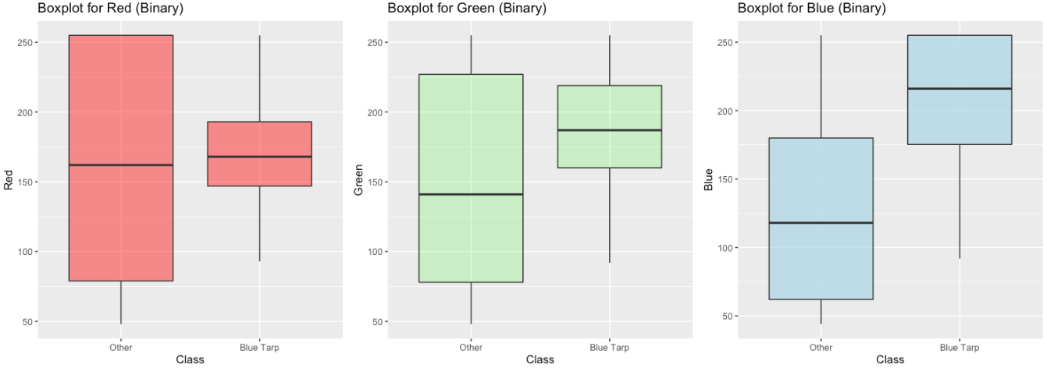
EDA: Boxplots (Binary Classification)
Blue Tarps have higher concentrations of blue color than “Other” classifications (vegetation, soil, rooftops)
Introduction | Methods | Binary | Original | Hold-Out Data | Conclusions

Slide 11
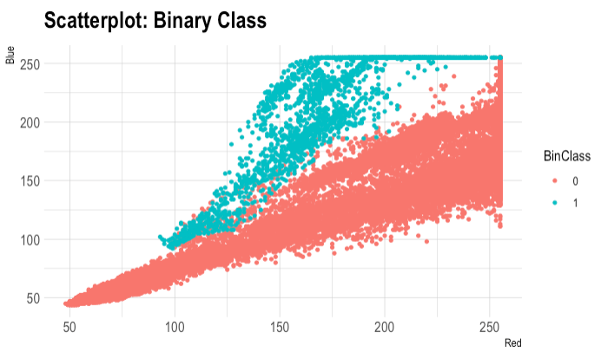
EDA for Binary Classification
Some overlap with Blue Tarps and “Others” for Red range 100 to 150.
Otherwise, seems to be a good separation between Blue Tarps and Other classifications
0: Other
1: Blue Tarp
Introduction | Methods | Binary | Original | Hold-Out Data | Conclusions

Slide 12
Keys for Accuracy Results Tables
Yellow: good performance but not ideal choice due to time complexity
Green: best alternative choice for faster run times
Red: poor performance
True Positive Rate (TPR) for Blue Tarps
False Positive Rate (FPR) for Blue Tarps
Introduction | Methods | Binary | Original | Hold-Out Data | Conclusions

Slide 13
Accuracy Results (Binary Classification)
Method | Accuracy (10X Cross Validation)- No interactions | AUC (test set) | TPR (test set) | Accuracy (10X Cross Validation)- with interactions
KNN (K = 5) | 99.70% | 0.9995 | 97.77%
LDA | 98.40% | 0.9880 | 75.99%
QDA | 99.46% | 0.9985 | 81.12%
Logistic Reg | 99.41% | 0.9989 | 86.14% | 99.59%
Random Forest (mtry = 1) | 99.71% | 0.9997 | 95.29%
SVM (Linear, Cost =100) | 99.45% | 0.9985 | 86.14%
*minimal improvement
*not true relationship for RGB
Introduction | Methods | Binary | Original | Hold-Out Data | Conclusions
Notes:
Yellow: best performance but not ideal choice due to time complexity
Green: best alternative choice for faster run times than KNN
True Positive Rate (TPR) for Blue Tarps

Slide 14
SVM Accuracy Results (Binary Classification)
Method | Cost | Degree | Scale | Accuracy (10X Cross Validation)- No interactions | AUC (test set) | TPR (test set)
Linear | 10 | -- | -- | 99.45% | 0.9984 | 0.8614
*Linear | 100 | -- | -- | 99.45% | 0.9985 | 0.8614
Poly | 10 | 2 | -- | 99.27% | 0.9863 | 0.7921
Poly | 10 | 4 | -- | 99.13% | 0.9872 | 0.7327
*Poly | 100 | 4 | 1 | 99.72% | 0.9821 | 0.9579
*Poly | 10 | 6 | 1 | 99.7% | 0.9832 | 0.9529
*optimal model based on training
Introduction | Methods | Binary | Original | Hold-Out Data | Conclusions
Notes:
Yellow: best performance but not ideal choice due to time complexity
Green: best alternative choice for faster run times than KNN
True Positive Rate (TPR) for Blue Tarps

Slide 15
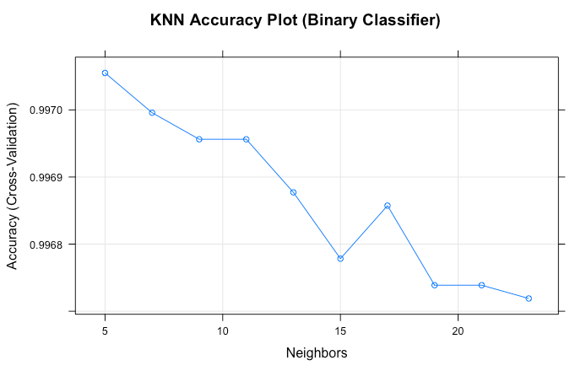
KNN Accuracy Plot
Using the binary response variable, the accuracy decreases as K increases
The best accuracy results for K = 5
This graph is misleading though because the y-axis range is short.
Let’s look at a more accurate representation of the accuracy rates for the KNN model in the next slide.
Introduction | Methods | Binary | Original | Hold-Out Data | Conclusions

Slide 16
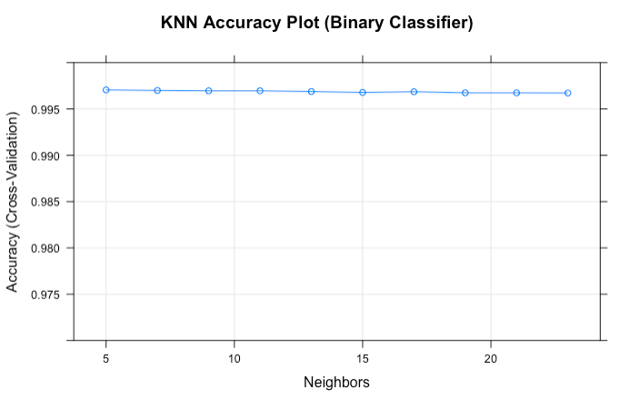
KNN Accuracy Plot
In the previous graph, we would have been mislead to believe that the best accuracy rate was at K = 5.
While technically correct, with a better scale, we can see that the accuracy rate is consistently approximately 96.7%. Based on these values of k, the accuracy rate does not depend on the value of k for a range of k from 5 to 23.
Introduction | Methods | Binary | Original | Hold-Out Data | Conclusions

Slide 17
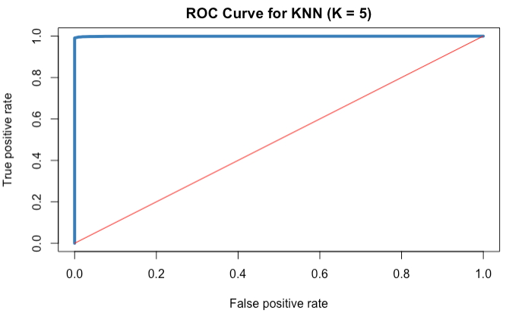
ROC Curve for KNN, K = 5 (Binary)
AUC: 0.9995
Introduction | Methods | Binary | Original | Hold-Out Data | Conclusions

Slide 18
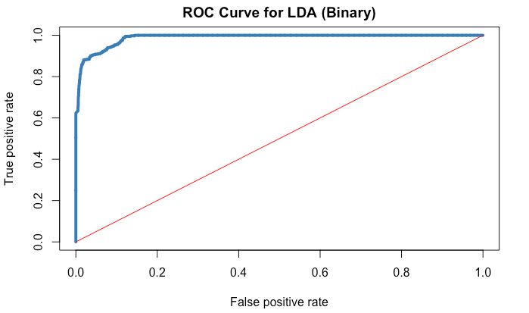
ROC Curve for LDA (Binary)
AUC: 0.9980
Introduction | Methods | Binary | Original | Hold-Out Data | Conclusions

Slide 19
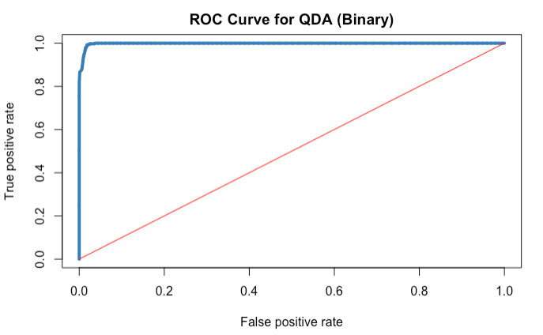
ROC Curve for QDA (Binary)
AUC: 0.9985
Introduction | Methods | Binary | Original | Hold-Out Data | Conclusions

Slide 20
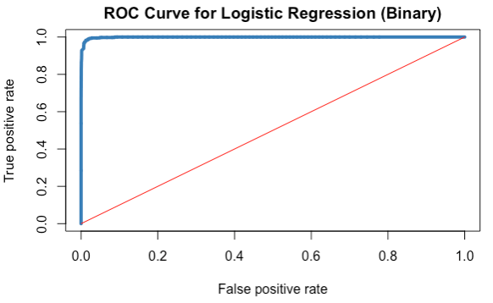
ROC Curve for Logistic Regression (Binary)
AUC: 0.9989
Introduction | Methods | Binary | Original | Hold-Out Data | Conclusions

Slide 21
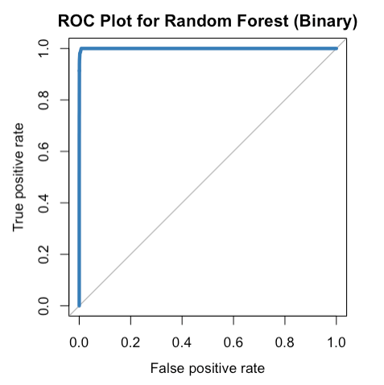
ROC Curve for Random Forest (Binary)
AUC: 0.9997
Introduction | Methods | Binary | Original | Hold-Out Data | Conclusions

Slide 22
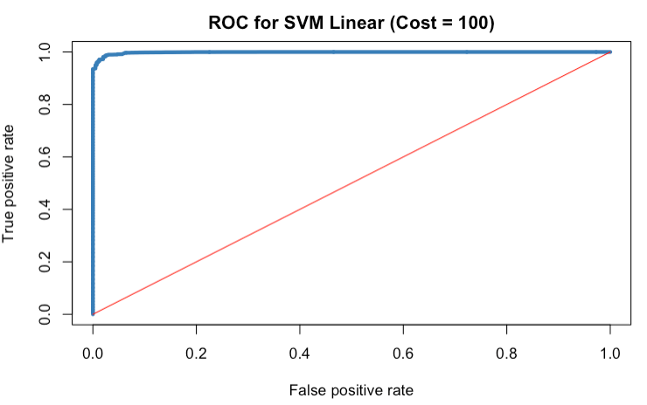
ROC Curve for SVM (Binary)
AUC: 0.9985
Introduction | Methods | Binary | Original | Hold-Out Data | Conclusions

Slide 23
Part 1:
Original Classification
Introduction | Methods | Binary | Original | Hold-Out Data | Conclusions

Slide 24
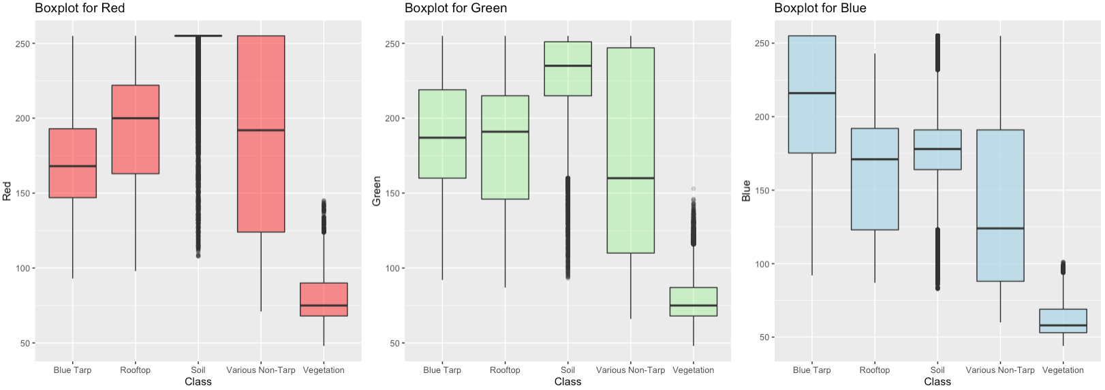
EDA: Boxplots (Original Classification)
Blue Tarps have a higher saturation for Blue than the other classifications
Introduction | Methods | Binary | Original | Hold-Out Data | Conclusions

Slide 25
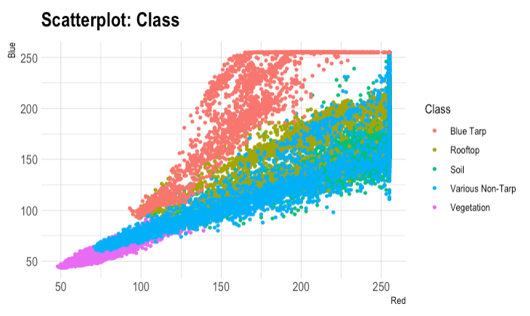
EDA for Original Classification
More overlap between the classes
Harder to classify each class individually and slightly more difficult to classify Blue Tarps from all other classes
Introduction | Methods | Binary | Original | Hold-Out Data | Conclusions

Slide 26
Accuracy Results (Original Classification)
Method | Accuracy (10X Cross Validation)- No interactions | AUC (test set) | TPR (test set)
KNN (K = 15) | 92.84% | 0.9700 | 97.28%
LDA | 85.79% | 0.9095 | 78.90%
QDA | 90.16% | 0.9288 | 82.92%
Logistic Regression | 88.64% | 0.9230 | 91.58%
Introduction | Methods | Binary | Original | Hold-Out Data | Conclusions
Notes:
Yellow: best performance but not ideal choice due to time complexity
Green: best alternative choice for faster run times than KNN
True Positive Rate (TPR) for Blue Tarps

Slide 27
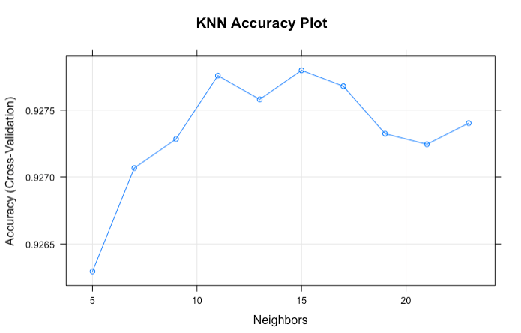
KNN Accuracy Plot
Using the original classifier, in general, the accuracy rates are lower for the KNN models.
This graph is misleading due to the short y-axis range.
Let’s look at a more accurate representation of the accuracy rates in the next slide
Introduction | Methods | Binary | Original | Hold-Out Data | Conclusions

Slide 28
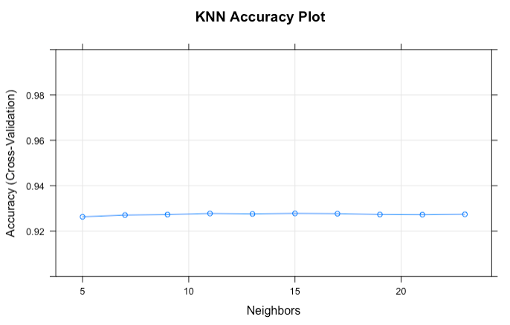
KNN Accuracy Plot
In the previous graph, we would have been mislead to believe that the best accuracy rate was at K = 15.
While technically correct, with a better scale, we can see that the accuracy rate is consistently 92.7%
The KNN with the binary response is a better model is an accuracy of 96.7%
Introduction | Methods | Binary | Original | Hold-Out Data | Conclusions

Slide 29
Part 2:
Hold-Out Data
Introduction | Methods | Binary | Original | Hold-Out Data | Conclusions

Slide 30
Accuracy Results (Hold-Out Data)
Method | Accuracy (10X Cross Validation) | AUC | TPR | FPR
KNN (K = 5) | 99.27% | 0.9604 | 0.9008 | 0.0064
LDA | 98.15% | 0.9924 | 0.8436 | 0.0171
QDA | 99.53% | 0.9921 | 0.6949 | 0.0019
Logistic Regression | 99.03% | 0.9994 | 0.9876 | 0.0096
Random Forest (mtry = 1) | 99.45% | 0.9860 | 0.8069 | 0.0037
SVM (Linear, Cost =100) | 98.58% | 0.9992 | 0.9876 | 0.0142
Introduction | Methods | Binary | Original | Hold-Out Data | Conclusions
Notes:
Yellow: best performance but not ideal choice due to time complexity
Green: best alternative choice for faster run times than KNN
True Positive Rate (TPR) for Blue Tarps

Slide 31
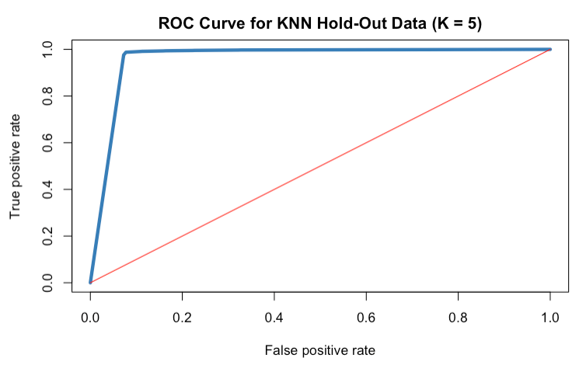
ROC for KNN (Hold-Out)
AUC = 0.9604
Introduction | Methods | Binary | Original | Hold-Out Data | Conclusions

Slide 32
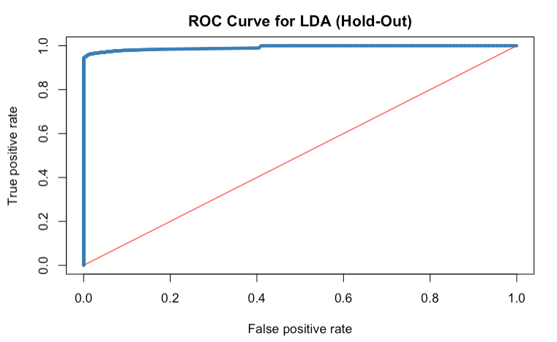
ROC for LDA (Hold-Out)
AUC = 0.9924
Introduction | Methods | Binary | Original | Hold-Out Data | Conclusions

Slide 33

ROC for QDA (Hold-Out)
AUC = 0.9921
Introduction | Methods | Binary | Original | Hold-Out Data | Conclusions

Slide 34
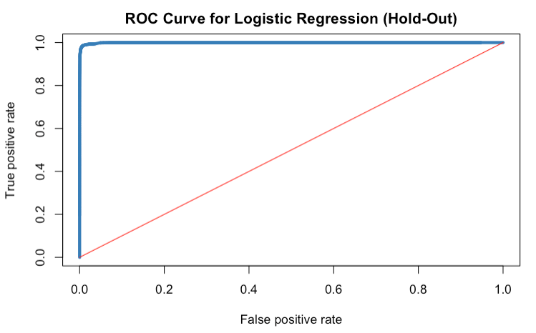
ROC for Logistic Regression (Hold-Out)
AUC = 0.9994
Introduction | Methods | Binary | Original | Hold-Out Data | Conclusions

Slide 35
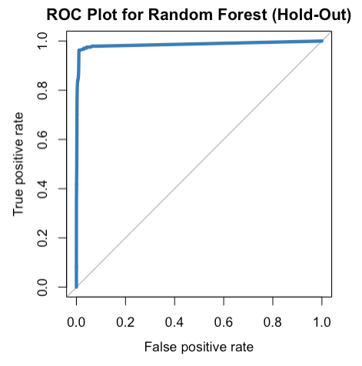
ROC for Random Forest (Hold-Out)
AUC = 0.9860
Introduction | Methods | Binary | Original | Hold-Out Data | Conclusions

Slide 36
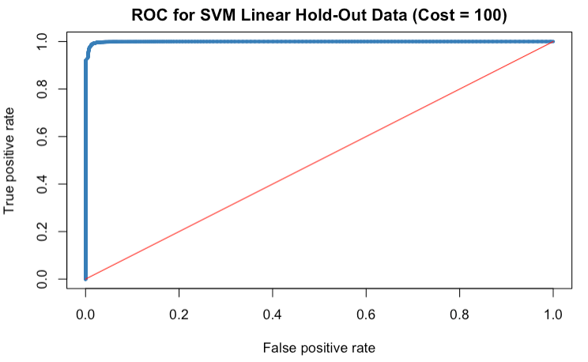
ROC for SVM (Hold-Out)
AUC = 0.9992
Introduction | Methods | Binary | Original | Hold-Out Data | Conclusions

Slide 37
Conclusions – Part 1
Introduction | Methods | Binary | Original | Hold-Out Data | Conclusions

Slide 38
Conclusions – Part 1
1) For all four models (Logistic Regression, LDA, QDA, and KNN), using a binary classifier (“Blue Tarp” vs “Other”) produced significantly better accuracy results than using all the classes provided in the data set (“Blue Tarp”, ”Rooftop”, ”Soil”, “Various Non-Tarp”, “Vegetation”).
2) Based on the binary classifier results, the KNN model (k = 5) had the best results with an accuracy of 99.70%. Note, that there was minimal difference between the accuracy for the KNN model and logistic regression (99.41%) and QDA (99.46%). KNN had the best results but at a cost to the user with longer run times with large datasets and as the tuning parameter K increases.
Introduction | Methods | Binary | Original | Hold-Out Data | Conclusions

Slide 39
Conclusions – Part 1
3) Although KNN had the best results in terms of accuracy (99.70%) and sensitivity (97.77%), the KNN model also has longer run times than the other models. Therefore, I would recommend using the multinomial logistic regression model if the user wants to correctly predict blue tarps.
If the user wanted to focus on the overall classification of all classes then I would recommend using the binary QDA.
Both models would have better time complexities than the KNN models since the run time for KNN increases as the number of observations and the tuning parameter K increase.
Overall, the logistic regression and QDA models performed relatively the same but had their own advantages at classification.
Introduction | Methods | Binary | Original | Hold-Out Data | Conclusions

Slide 40
Conclusions – Part 1
4) To verify what the “best” model is, I would recommend testing the model using other satellite images and comparing the accuracy results and TPRs. How well would the models work on other images? How well would the models work given other conditions such as weather or location? Could this model potentially be used for future disaster relief efforts?
Introduction | Methods | Binary | Original | Hold-Out Data | Conclusions

Slide 41
Conclusions – Part 2
Introduction | Methods | Binary | Original | Hold-Out Data | Conclusions

Slide 42
Conclusions – Part 2
1) The best performing model based on both the original and hold-out data sets was Logistic Regression. Overall, logistic regression had the best performance metrics on the hold-out data for all four metrics where:
  Accuracy = 99.03%
  AUC = 0.9994
  TPR = 98.76%
  FPR = 0.96%
Other models had higher scores for one of the four metrics but logistic regression had the best overall performance across all four statistics.
As stated earlier, the purposed of the hold-out data set is to test the performance of models on a data set unrelated to the ”train” data set used to train the original models. It helps us learn how well a model would work on other images. As stated in conclusion 4 in Part 1, ideally, we would like to know how the training models ran on data sets given other conditions such as weather and/or locations that differed from the original dataset. We want a model that predicts blue tarps well without overfitting to the original data set making it unusable for other datasets such as pixel data from other days as the disaster relief effort continues.
Introduction | Methods | Binary | Original | Hold-Out Data | Conclusions

Slide 43
Conclusions – Part 2
2) Overall, SVM was the next best performing model but is not ideal because the run times for SVM models were longer than other models such as logistic regression, LDA, and QDA. Depending on the tuning specifications and parameters, SVM took anywhere from a couple of minutes to hours to days to run. I would not recommend using SVM because the same results can be achieved using logistic regression in a shorter time period. This is especially important for events with time constraints and urgency like disaster relief efforts.
3) In my opinion, the best performance metric for this effort is the True Positive Rate. TPR calculates the number of blue tarps in the data set that were correctly classified by the model as blue tarps. This is important because we’d like to be able to identify and send relief to as many people as possible.
Introduction | Methods | Binary | Original | Hold-Out Data | Conclusions

Slide 44
Conclusions – Part 2
4) Logistic regression performed well in both Part 1 and Part 2. One of the conclusions from Part 1 was recommending the multinomial logistic regression model when focusing on TPR. As stated in the first conclusion for Part 2, logistic regression is the best performing model for the hold-out data because it performed well according to all four metrics. Therefore, logistic regression performed well for both data sets.
QDA and KNN were recommended as good performing models in Part 1 as well. KNN still performed well in Part 2 but ,as stated in Part 1, KNN has longer run times than other models. Therefore, KNN is not an ideal method due to time constraint placed on disaster relief efforts.
While QDA performed well in terms of accuracy for both Part 1 and Part 2, it performed poorly with TPR both times. As previously stated in conclusion 3 of Part 2, I consider the TPR to be the best performance metric. Knowing that QDA’s TPR decreased from 81% in Part 1 to 70% in Part 2, I would state that the performance for QDA decreased. I would no longer recommend using QDA as method for correctly classifying blue tarps data due to the poor TPR results. QDA would not help in identifying survivors in this disaster relief effort.
Introduction | Methods | Binary | Original | Hold-Out Data | Conclusions

Slide 45
Conclusions – Part 2
5) I ran two different tests for SVM using a polynomial kernel. In both cases, the optimal degree was the largest tested. In case 1, I tested degrees 1-4 where the optimal model utilized degree = 4. In case 2, I tested degrees 1-6 where the optimal model utilized degree = 6. Based on the scatterplots, I would expect to see either a linear or quadratic fit but anything higher would overfit the data. Since both cases picked a higher degree, this leads me to believe that SVM models with a polynomial kernel overfit the data.
Introduction | Methods | Binary | Original | Hold-Out Data | Conclusions

Slide 46
Conclusions – Part 2
6) For SVM, I did not train a model using a radial kernel. This decision was made based on multiple observations from other models.
The linear models performed well (logistic regression and SVM model with linear kernel).
SVM models with a linear kernel outperformed SVM models with polynomial kernels.
When testing SVM models with polynomial kernels, the optimal degree chosen by the train() function in the caret library was the largest degree tested (4 and 6, respectively) leading me to believe that SVM models with polynomial kernels were overfitting the model.
Based on the scatterplots and performance of other models, an SVM model with a with a radial kernel would not be an ideal way to fit the data.
SVM models with polynomial kernel had longer run times than SVM models with linear kernels leading me to believe a radial kernel would also have longer run times.
Based on this information, I concluded that an SVM model with a radial kernel would not be an appropriate model for our Haiti data. The cost (longer run times on training and tuning the model) would not outweigh the benefit (poor performance metrics) of attempting to model this method.
Introduction | Methods | Binary | Original | Hold-Out Data | Conclusions

Slide 47
Conclusions – Part 2
7) Based on the binary training and tests, Random Forest with mtry = 1 had the best overall performance. Although the run time for this method was slower than logistic regression, it had the best overall performance metric on the original dataset with a binary response. But as shown in the accuracy results table for the hold-out data, this performance, specifically for TPR, dropped significantly from 95.29% to 80.69%. Based on these results, I would not recommend using Random Forest for this scenario when focusing on the TPR metric.
Introduction | Methods | Binary | Original | Hold-Out Data | Conclusions

Slide 48
Conclusions – Mahalanobis Method
Introduction | Methods | Binary | Original | Hold-Out Data | Conclusions

Slide 49
Mahalanobis: Comparing Professor Basener’s Results
In this section, I calculated the Mahalanobis distance using Mahalanobis(x, center, cov) function and the p-value using the chi-squared statistic on both the original and hold-out data sets. I classified each p-value less than 0.05 as FALSE and anything greater than 0.05 as TRUE. Then I compared these results to the known classifications where Blue Tarps were labeled as TRUE and Other labeled as FALSE. The results are shown below in table as “Basener Mahalnobis.”
Method | Accuracy | TPR
Logistic Regression (Test) | 99.41% | 86.14%
Basener Mahalanobis (Original) (p-value > 0.05) | 95.61% | 95.70%
Logistic Regression (Hold-Out) | 99.03% | 98.76%
Basener Mahalanobis (Hold-Out) (p-value > 0.05) | 82.94% | 94.97%
Introduction | Methods | Binary | Original | Hold-Out Data | Conclusions

Slide 50
Mahalanobis: Comparing Professor Basener’s Results
Compared to the original data set, the Mahalanobis method had a weaker accuracy than logistic regression but a significantly better TPR which I previously stated is the most important statistic because we are more concerned with identifying Blue Tarps correctly than any other material.
Compared to the hold-out data set, logistic regression outperformed both the accuracy and TPR of the Mahalanobis method. Therefore, overall, logistic regression outperformed the Mahalanobis method.
Although one of the benefits of running our model on the hold-out data set is to see how our models performs on unrelated data, Mahalanobis is standard equation that does not need to train, tune, and test to check performance. It also takes less time and effort to run compared to the other models tested. Overall, Mahalanobis also performed well averaging around 95% in terms of TPR, the most important metric for identifying Blue Tarps. While Logistic Regression outperformed the Mahalanobis method in the hold-out dataset, the Mahalanobis method outperformed most of the other models tested in this project. Therefore, I would recommend using it along side with logistic regression.
Introduction | Methods | Binary | Original | Hold-Out Data | Conclusions

