Slide 1

Uncertainty, Bayes’ Theorem, and You
Module 1 Live Session (5/25/2022)
DS6040 Summer 2021
Taylor R. Brown

Slide 2

Outline
Syllabus
Uncertainty in Machine Learning
Probability Density Functions
Conditional Probabilities
Bayes’ Theorem
The Monty Hall Problem

Slide 3
Syllabus – Course Structure
Live Sessions – 715-815 or 830-930pm Wednesdays
Office Hours – 7- 8pm Mondays
Discussion Forum – Slack
Material Distribution – Collab
Submissions and Deadlines - Gradescope

Slide 4
Syllabus – Assignments and Grading
5 Homework Assignments – 50% total grade
Use Jupyter notebooks and turn-in as PDF
Participation – 15% total grade
Primarily Slack discussion based
Project Report + Presentation – 35% total grade
Group or Solo Projects
May be related to DS Capstone

Slide 5
Syllabus – Instructor Contact
Email (trb5me@virginia.edu)
Course related questions (i.e. about due dates/grading)
Give me 24 hours before following up
Slack
Content related questions
Can be public discussion or private message to me (public is preferred)
I check Slack all the time
Weekend Policy
I work on weekends, but I don’t want to.
I’ll be responding to emails/Slack on weekends, but only as catchup.

Slide 6
Syllabus – Class Project
Analyze a real data problem of your choosing using a Bayesian method.
Note: This can be related to your DS Capstone project (and often is)
Group (2-3 people) or Solo
Project Proposal Due 6/15
Description of the problem, data, and group.
Project Report
4-6 page report detailing problem, analysis and conclusions
Written for informed stakeholders (rather than for a class project…)
Project Presentation
5-7 minutes, present the problem and your findings

Slide 7
Uncertainty in Data Science
Data lies…
Sampling Variability – even if you know the model and its parameters, there is usually noise assumed
Parameter/Latent-variable uncertainty – estimate w/ finite sample…
Model Misspecification – “all models are wrong”...yours is too, probably
To account for uncertainty, all frameworks must pay some sort of informational price.
You pay this price (in part) when you propose how variables are related
A linear regression assumes linearity…
Statistical frameworks all pay the rest in several different ways
One way is not necessarily better, it all comes down to what you are willing to pay…

Slide 8
The Price of Uncertainty
Frequentist Statistics
Parameters aren’t random–we don’t talk about their distributions
Only data have distributions
exact distributions under strict (i.e. probably incorrect) assumptions
approx. or asymptotic distributions often more convenient or applicable
Bayesian Statistics – Pays in prior information
Parameters are random–they have distributions
Their distribution can depend on the data you have (e.g. posterior distributions)
Their distribution can reflect previous/subjective knowledge of the phenomena at hand without data (e.g. prior distributions)
Many choices for priors – objective, subjective, noninformative, empirical

Slide 9
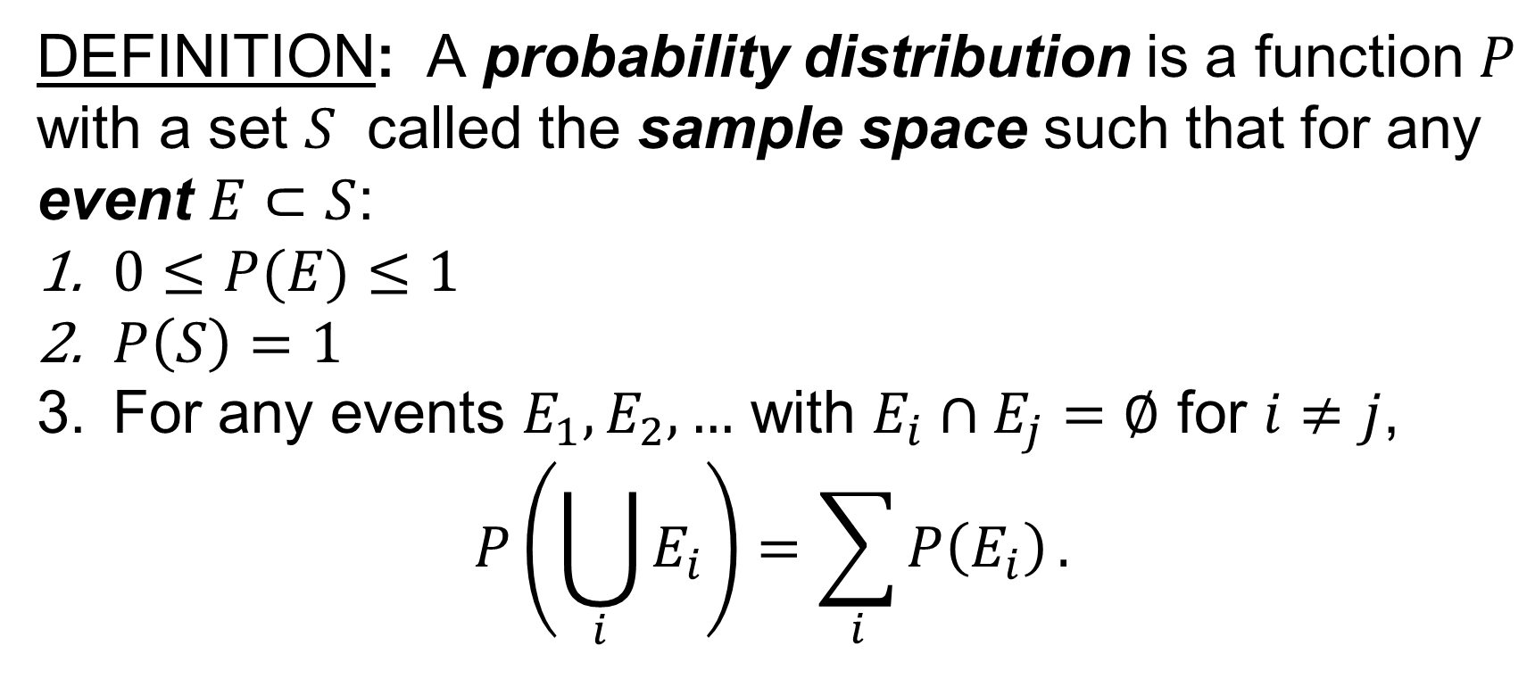
Probability Distributions

Slide 10
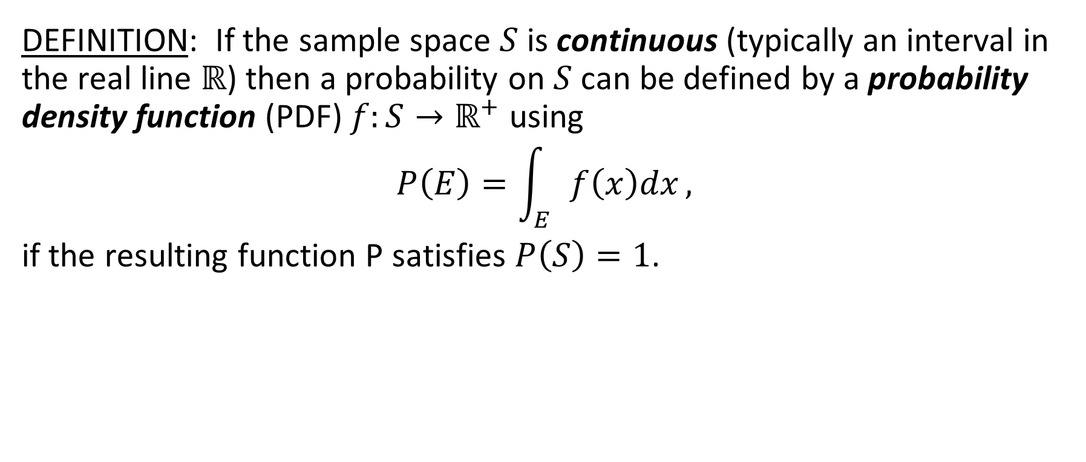
Probability Distributions

Slide 11
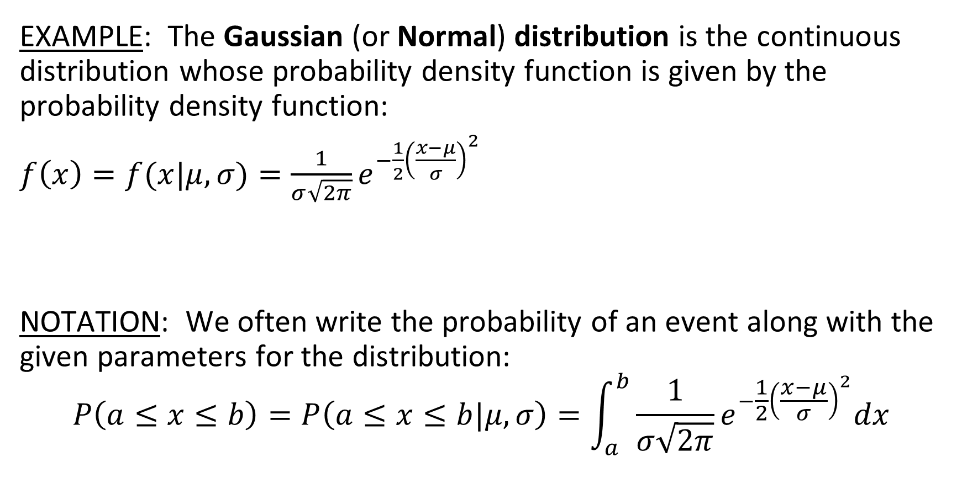
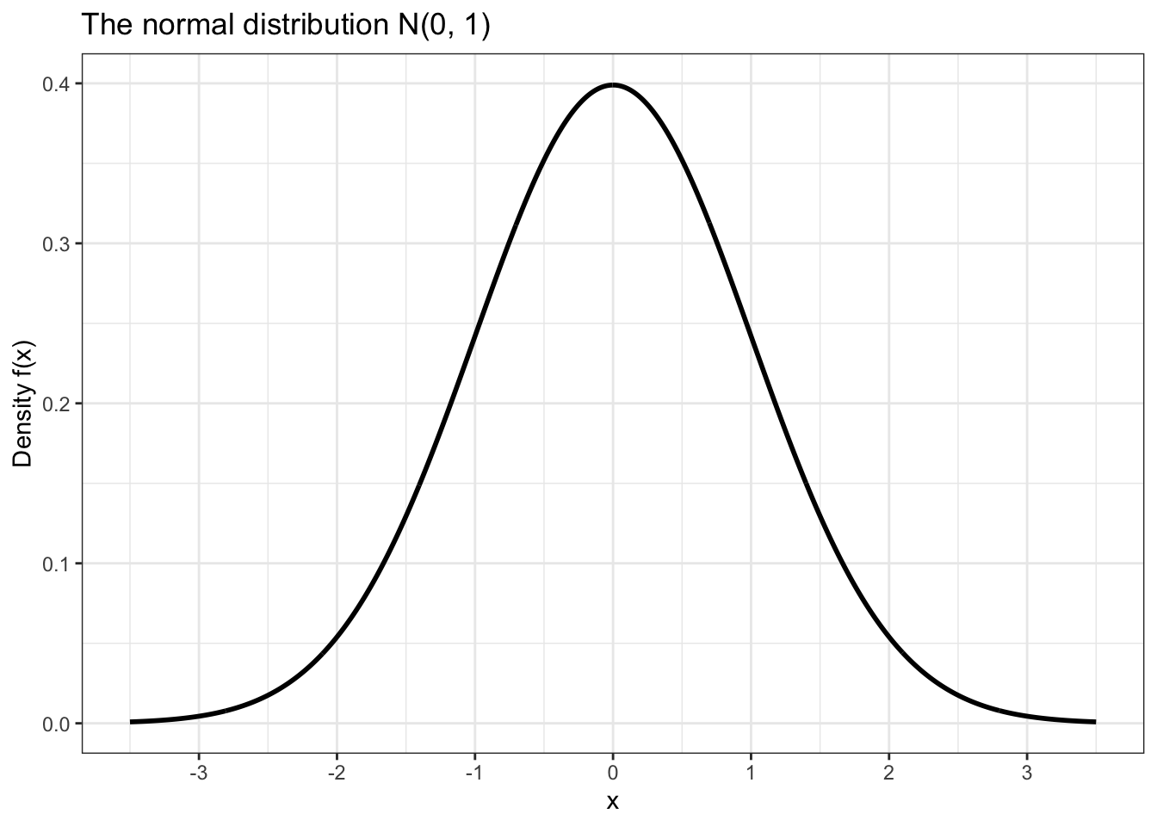
Probability Distributions

Slide 12
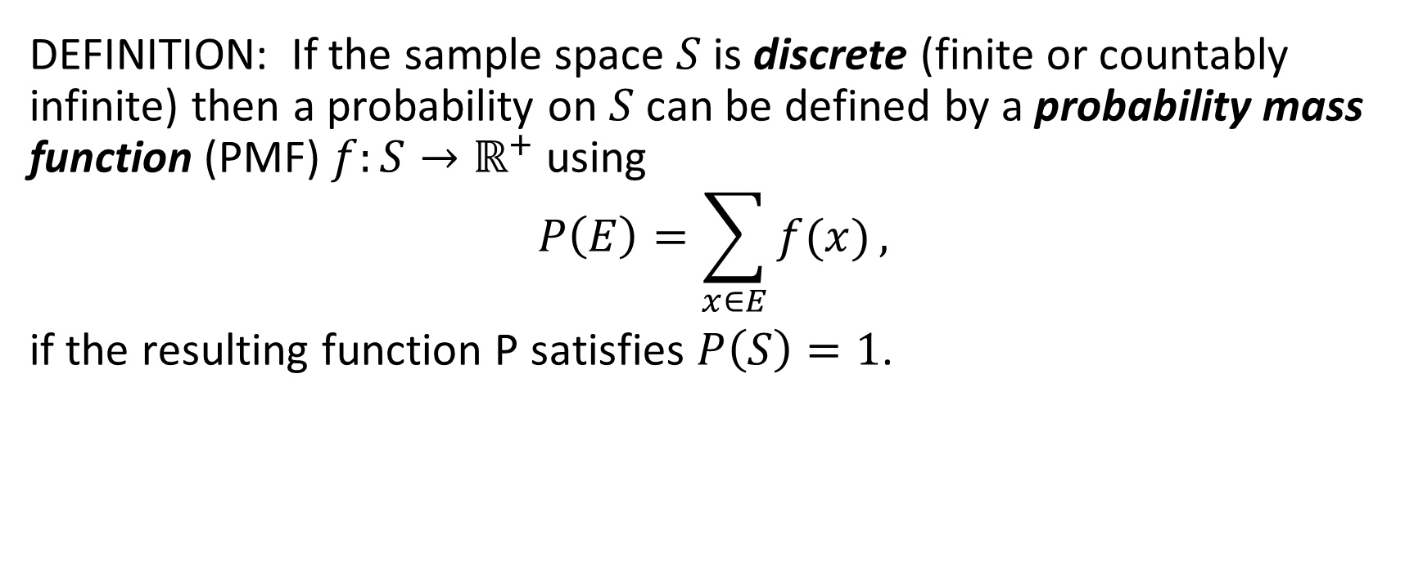
Probability Distributions

Slide 13
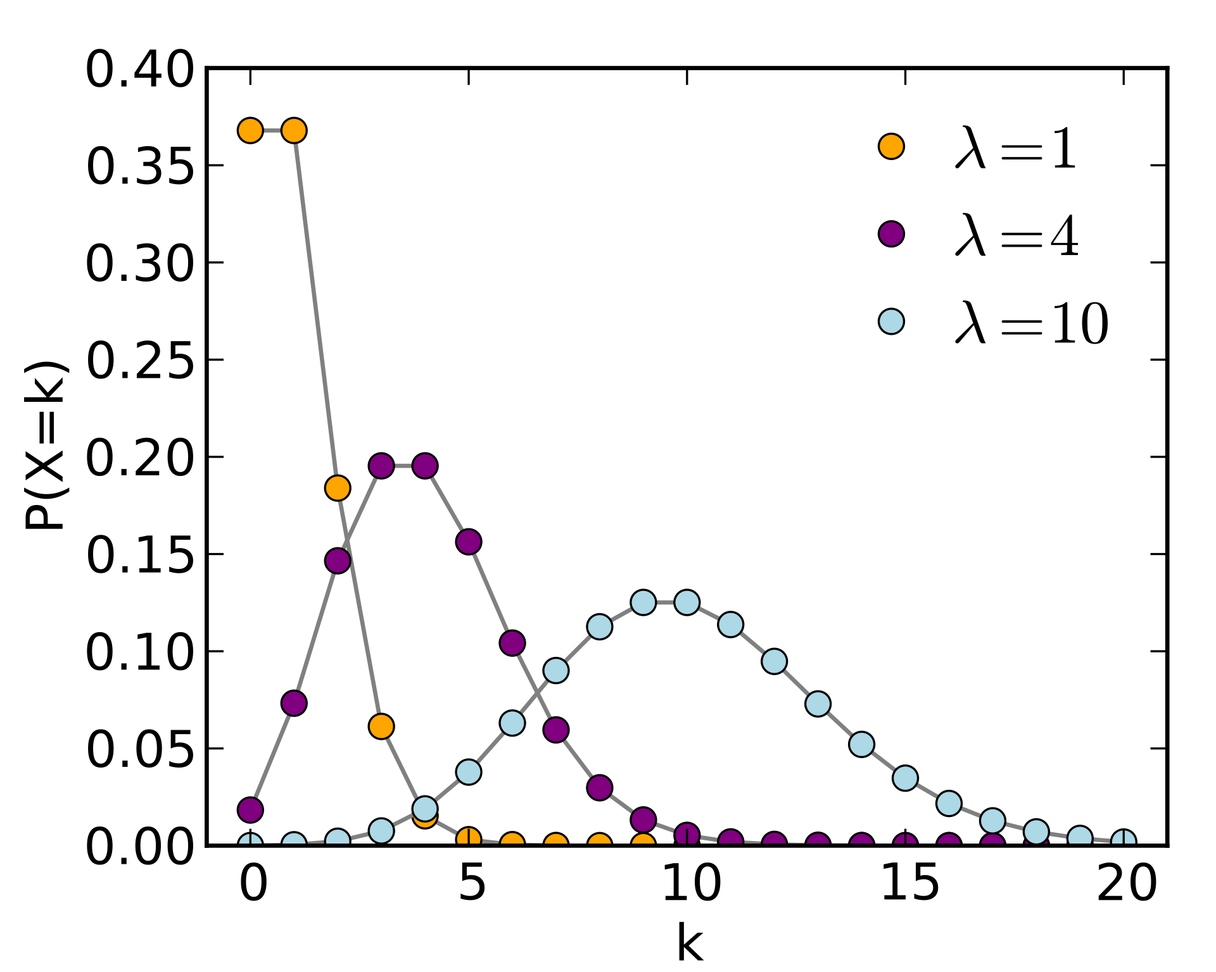
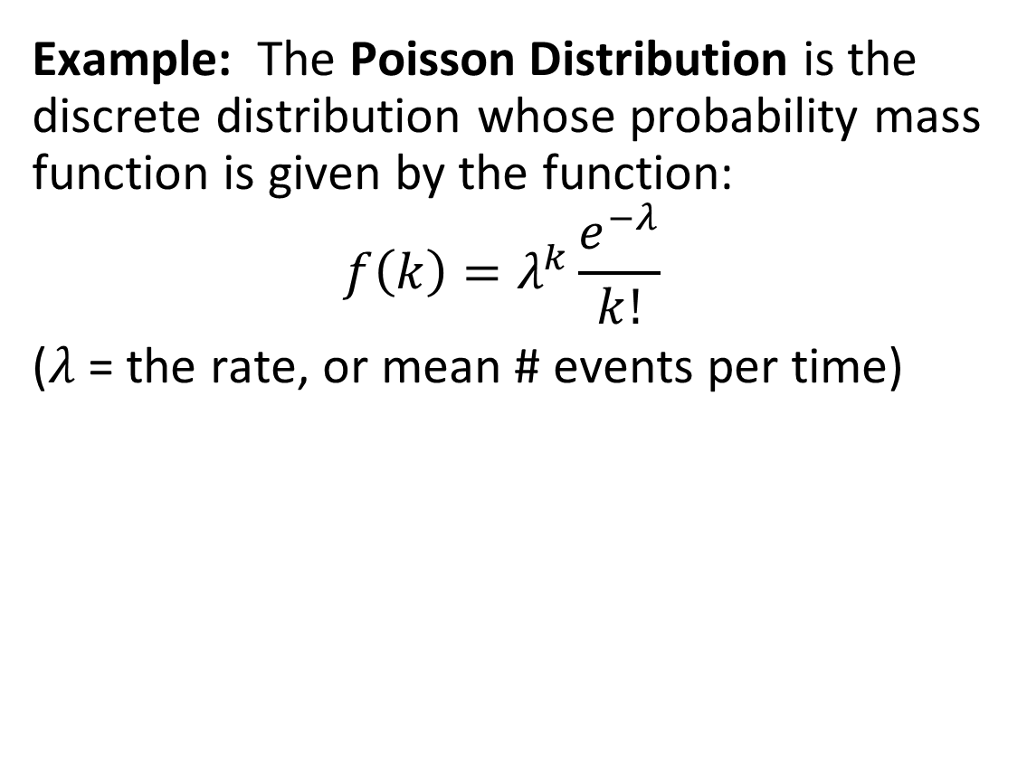
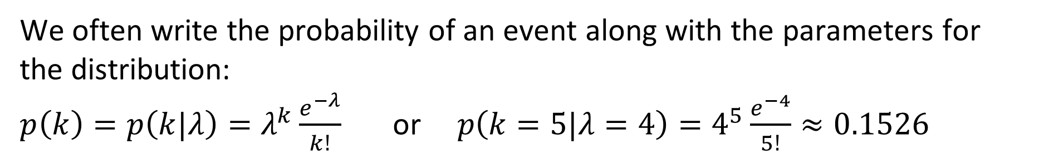
Probability Distributions

Slide 14
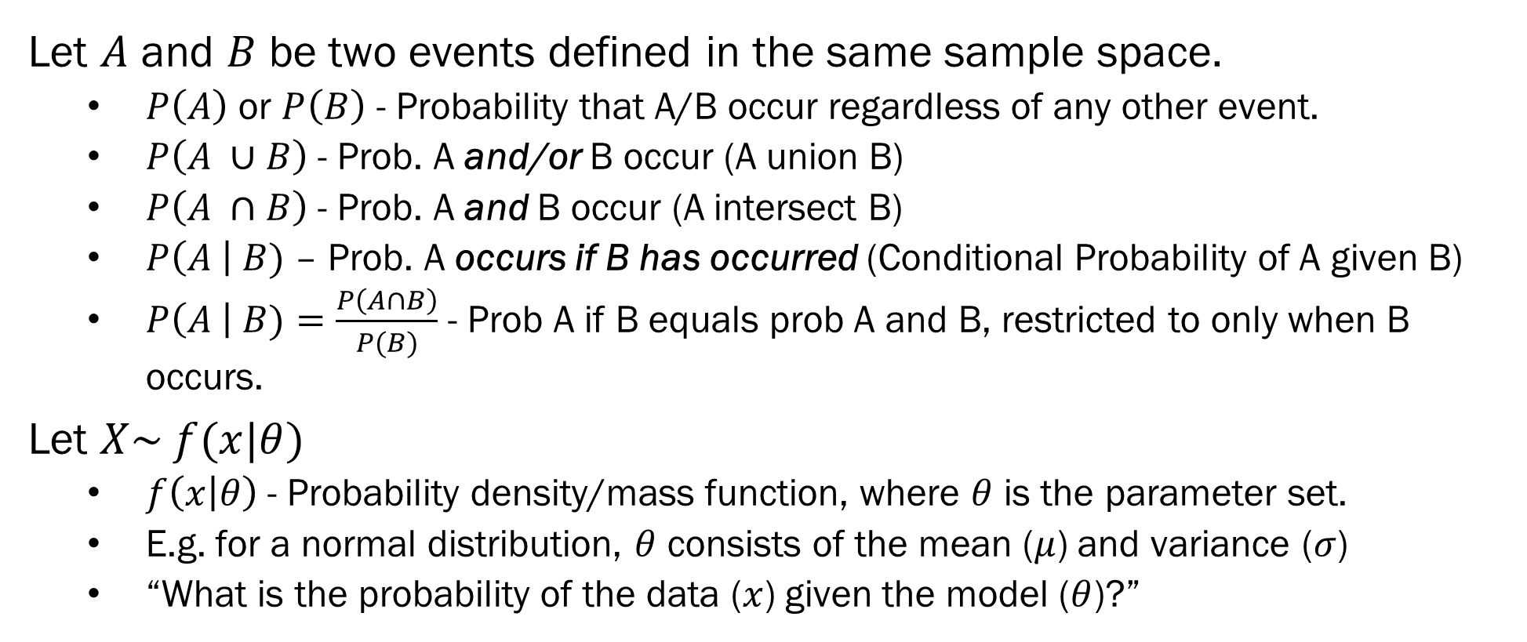
Conditional Probabilities

Slide 15
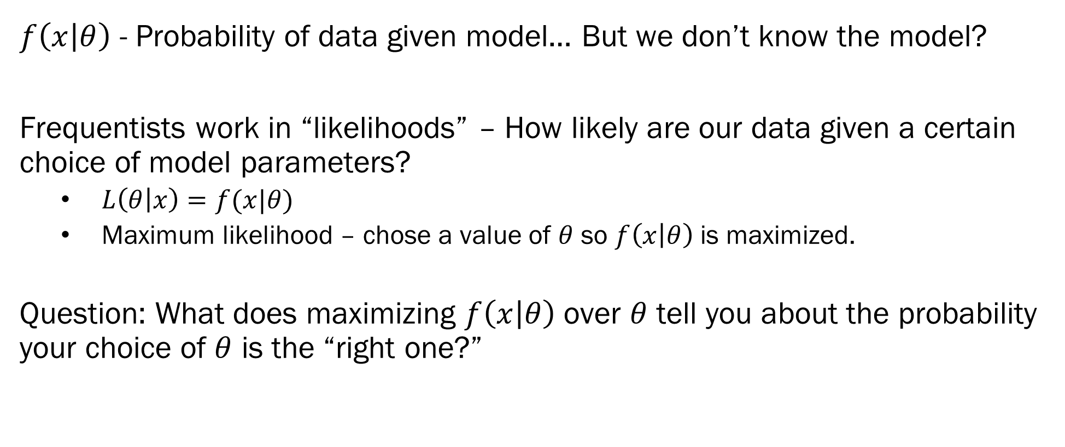
Likelihood Functions

Slide 16
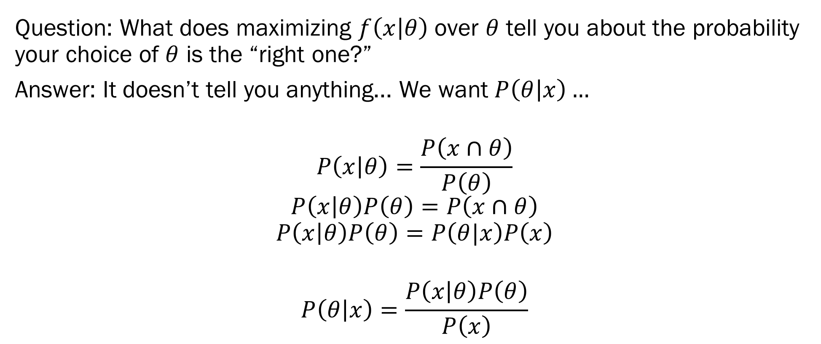
Bayes’ Theorem

Slide 17
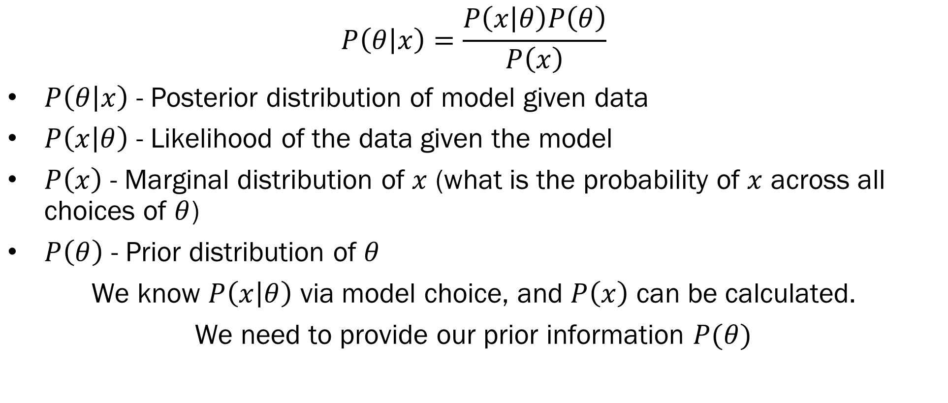
Bayes’ Theorem

Slide 18
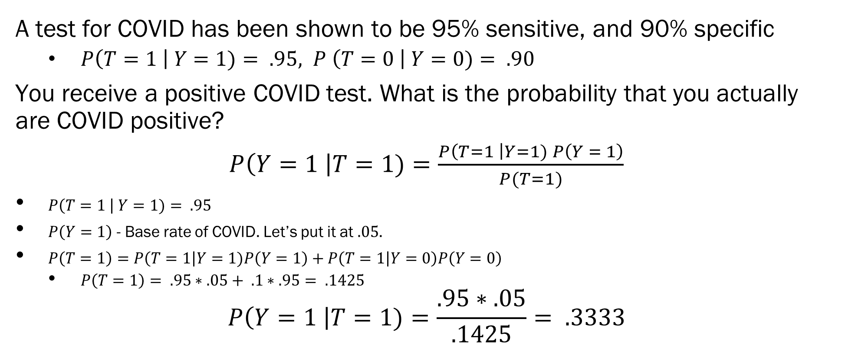
Example – Base Rates are Important

Slide 19
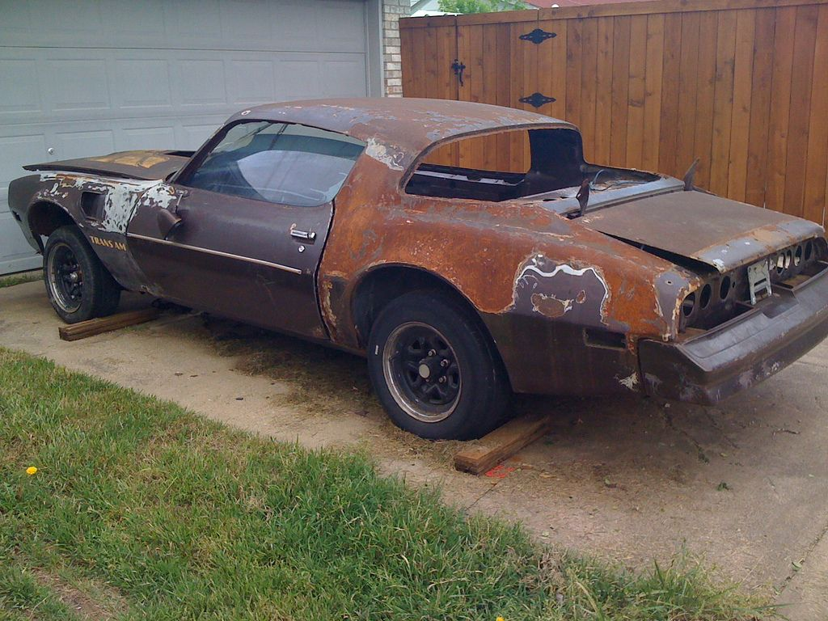
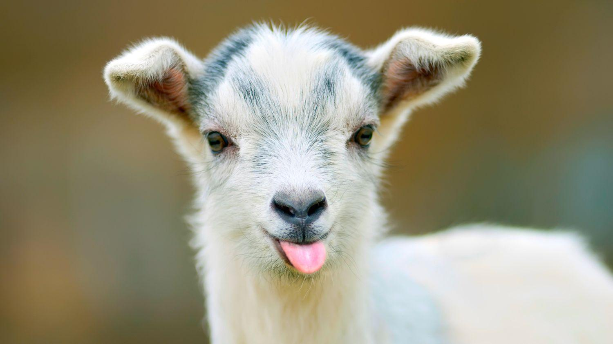
The Monty Hall Problem – Goat Edition
You are a goat farmer. You are presented with 3 doors. Two of those doors hold cars, one holds a goat. After you select a door, the host opens one of the unselected doors to reveal a car. Should you switch your choice of door to the other (unselected, unopened) door, if you are aiming to win the goat?

Slide 20
The Monty Hall Problem – Goat Edition

Slide 21
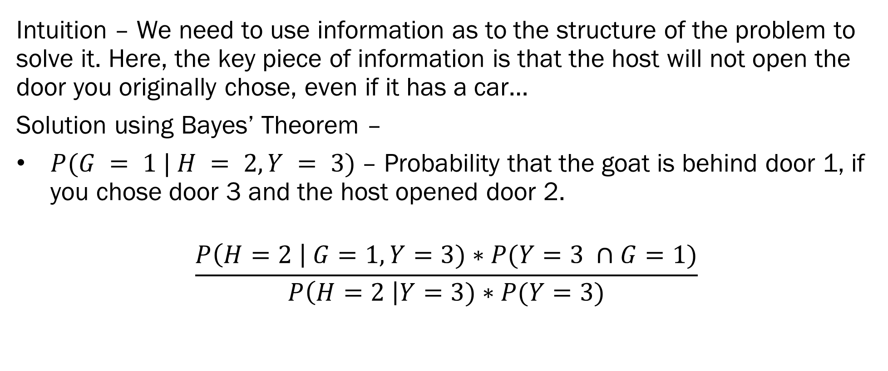
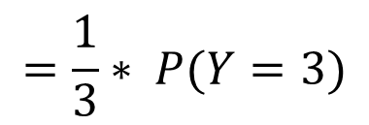
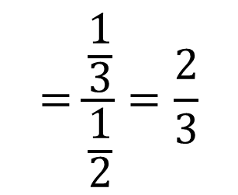
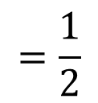
The Monty Hall Problem – Goat Edition
= 1

Slide 22
Next Week on Bayesian ML
Priors – What are they, and how do we get them?
Conjugate Priors – math is “nice” – no fancy algorithms required
Objective Priors – choice is made for you
Subjective Priors – choose to express your personal beliefs
Non-informative priors – you don’t have a lot of prior information
Important Info for Module 1 –
Homework 1 has been released! Due 6/15
Discussions are open in Slack
Several optional assignments are open

