Slide 1

Prior Selection in Bayesian Statistics
Module 2 Live Session (6/01/2022)
DS6040 Summer 2022
Taylor R. Brown

Slide 2

Outline
Bayes’ Theorem Review
Prior Overview
Conjugate Priors
Improper Priors
Noninformative Priors
Jeffreys Priors
Empirical Bayes Priors

Slide 3
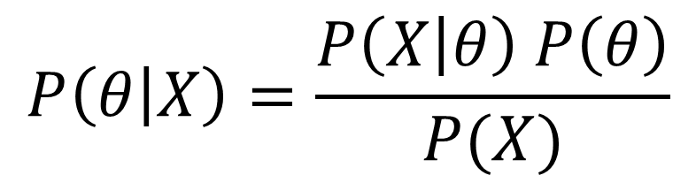
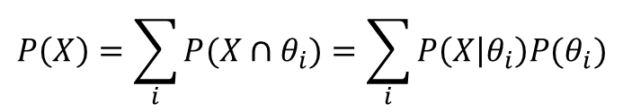

Bayes’ Theorem
Likelihood
(Probability of Data Given parameter)
Posterior Distribution
(Probability/density of parameter Given Data)
Prior Distribution
(Probability of parameter)
Marginal Distribution
(Probability of Data)

Slide 4
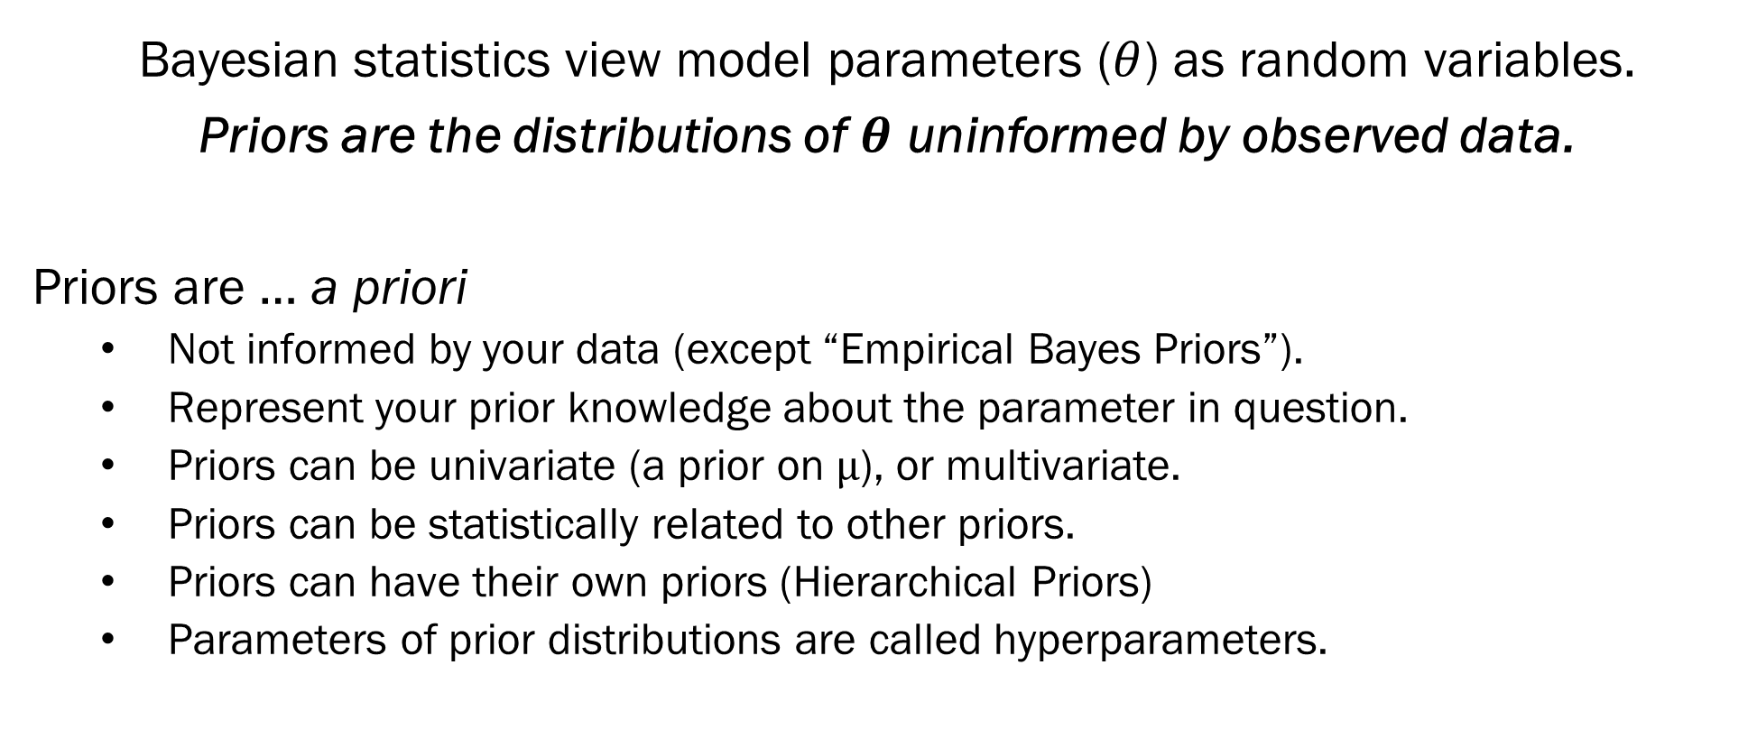
Prior Overview

Slide 5
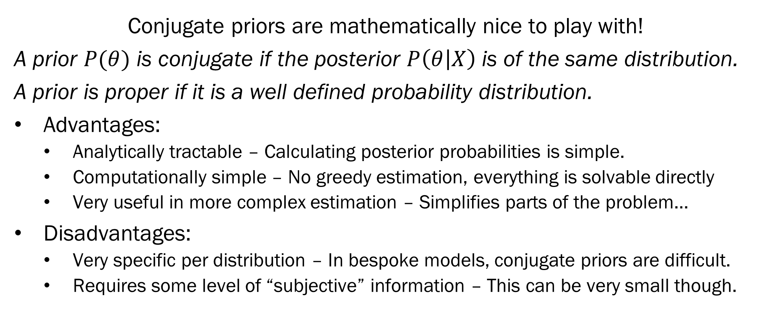
Conjugate Priors

Slide 6
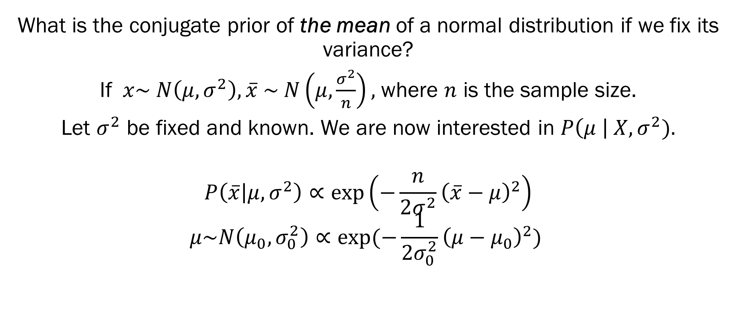
Conjugate Priors – Normal Distribution

Slide 7
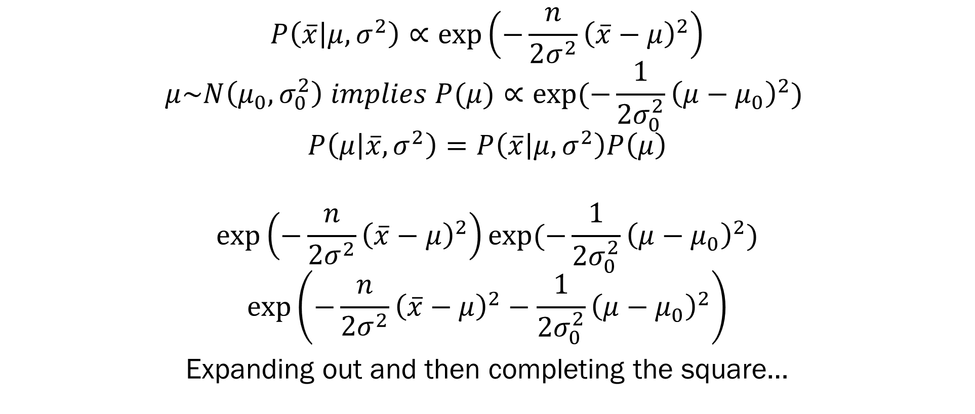
Conjugate Priors – Normal Distribution

Slide 8
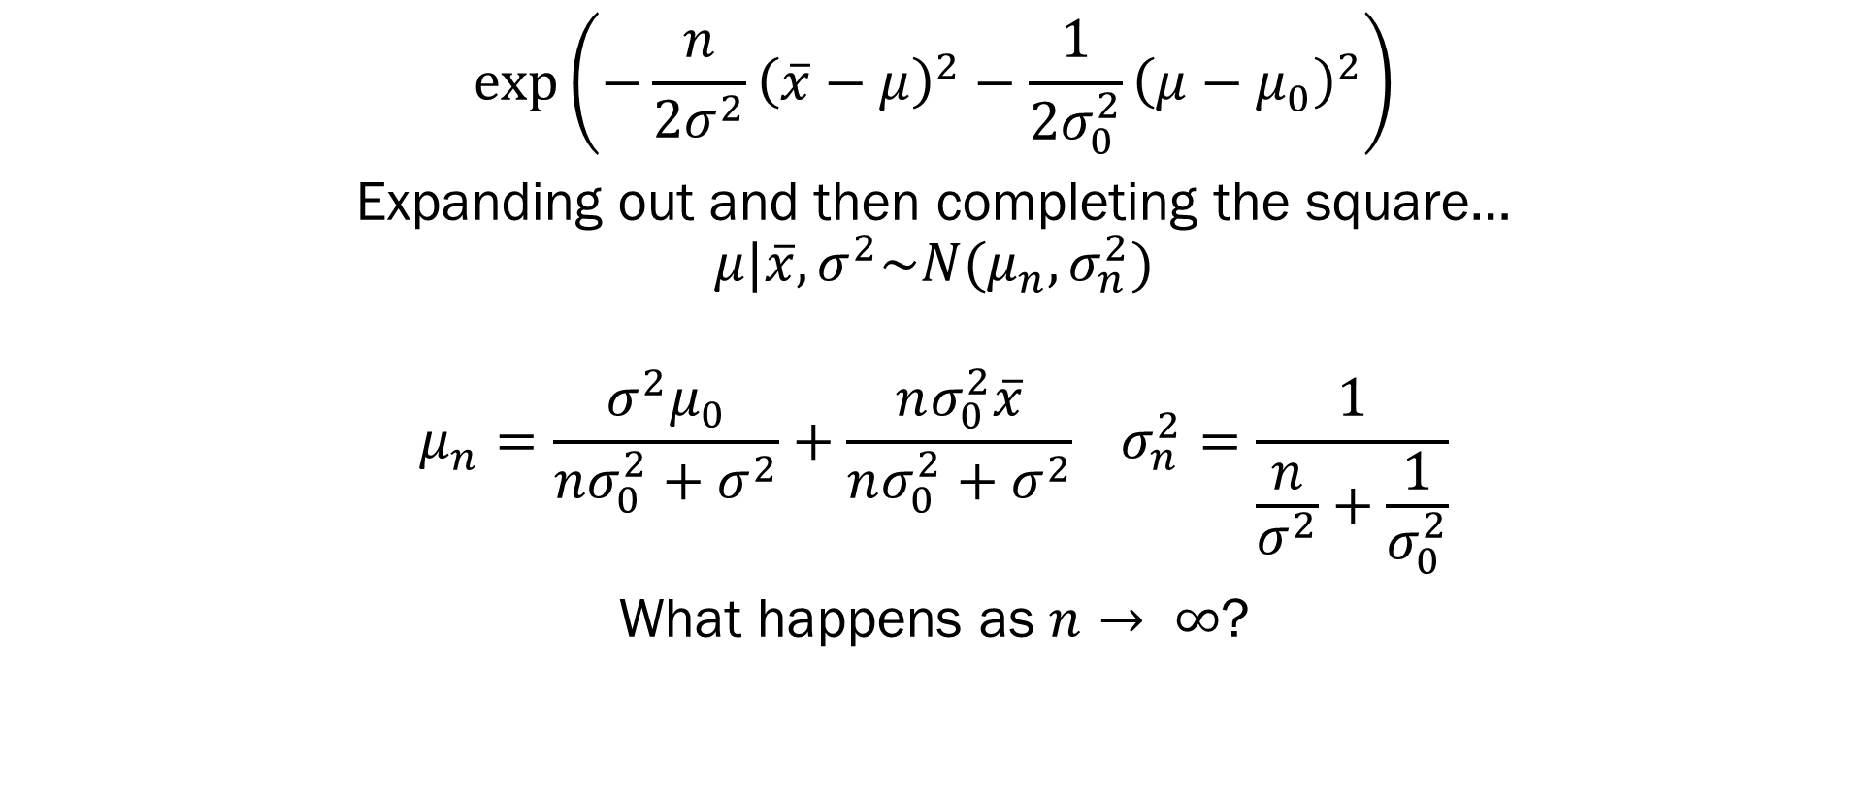
Conjugate Priors – Normal Distribution

Slide 9
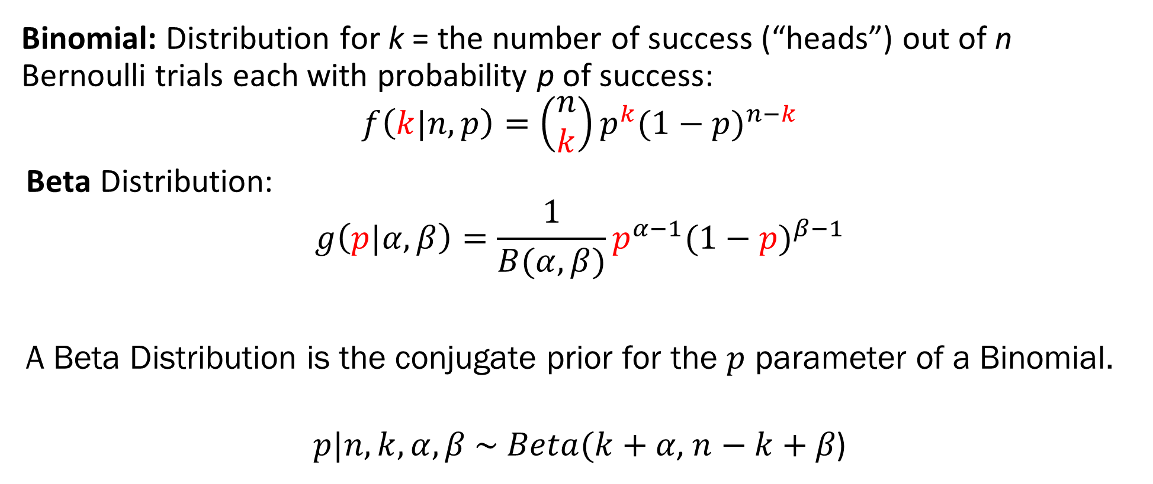
Conjugate Priors – Beta Distribution

Slide 10
Improper Priors
Improper priors are ones that don’t integrate to 1
They may still lead to a *posterior* that’s proper
If you use an improper prior, you will need to verify via integration that this is the case
For this reason, I recommend you stick to noninformative proper priors–they guarantee propriety of the posterior

Slide 11
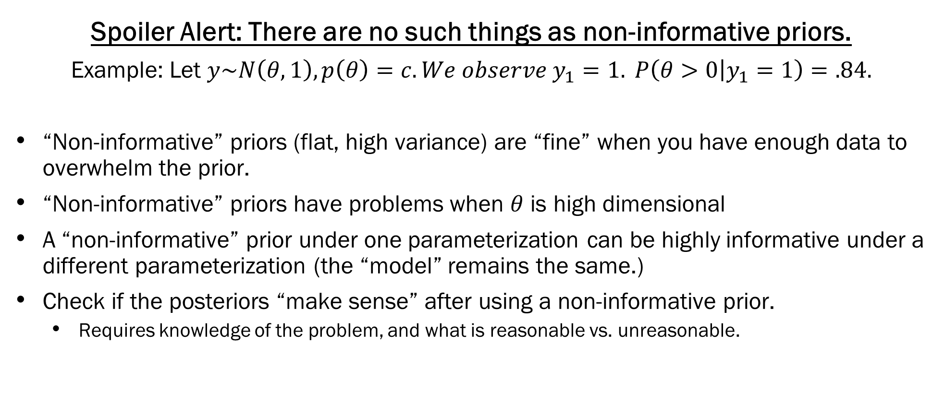
“Non-informative” Priors
Great, albeit a little technical, post: https://statmodeling.stat.columbia.edu/2013/11/21/hidden-dangers-noninformative-priors/

Slide 12
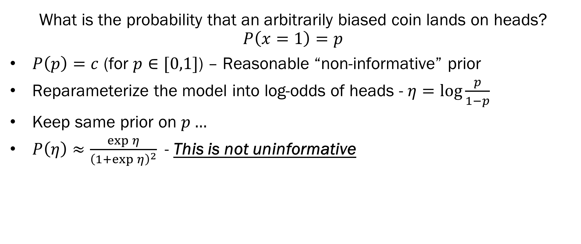
Jeffreys Priors

Slide 13
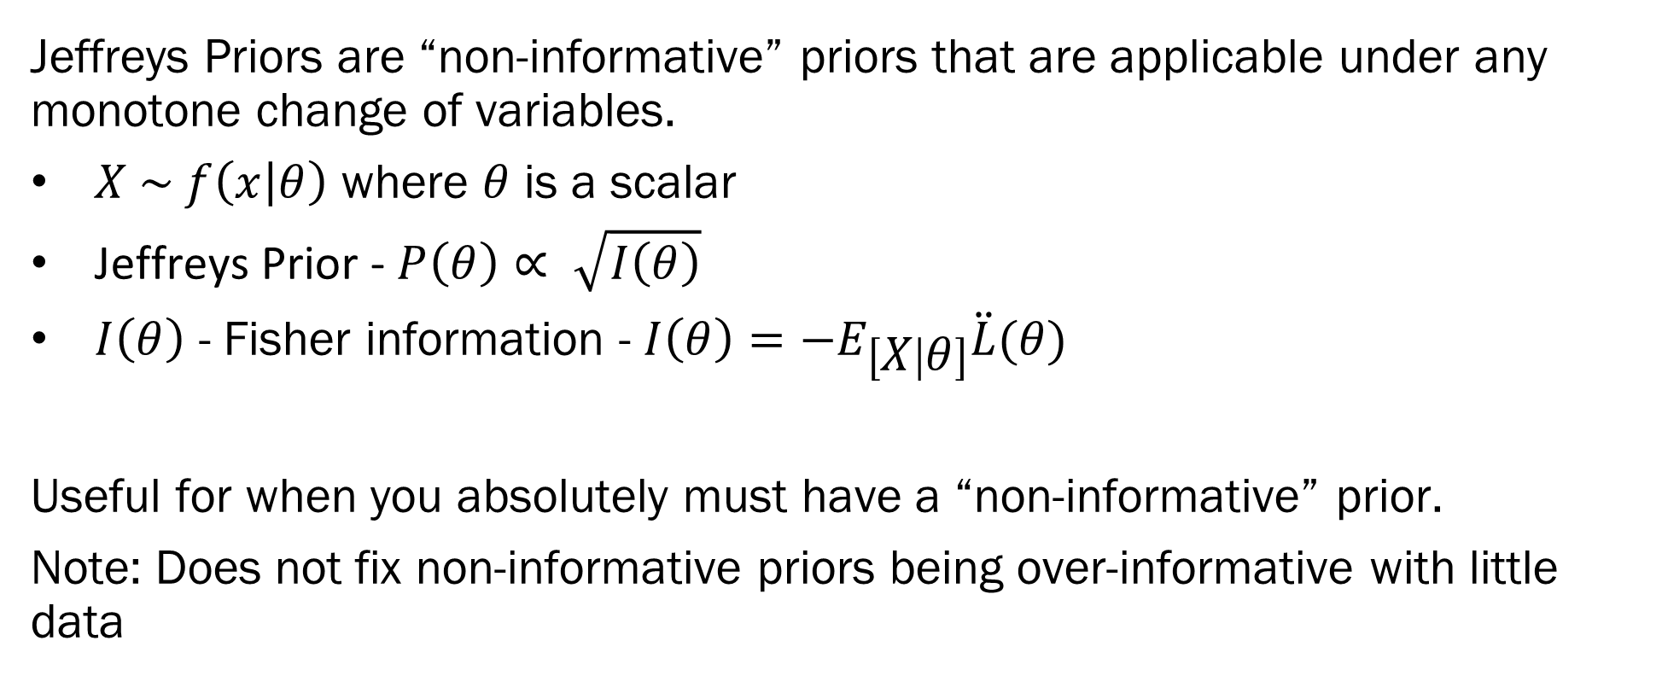
Jeffreys Priors

Slide 14
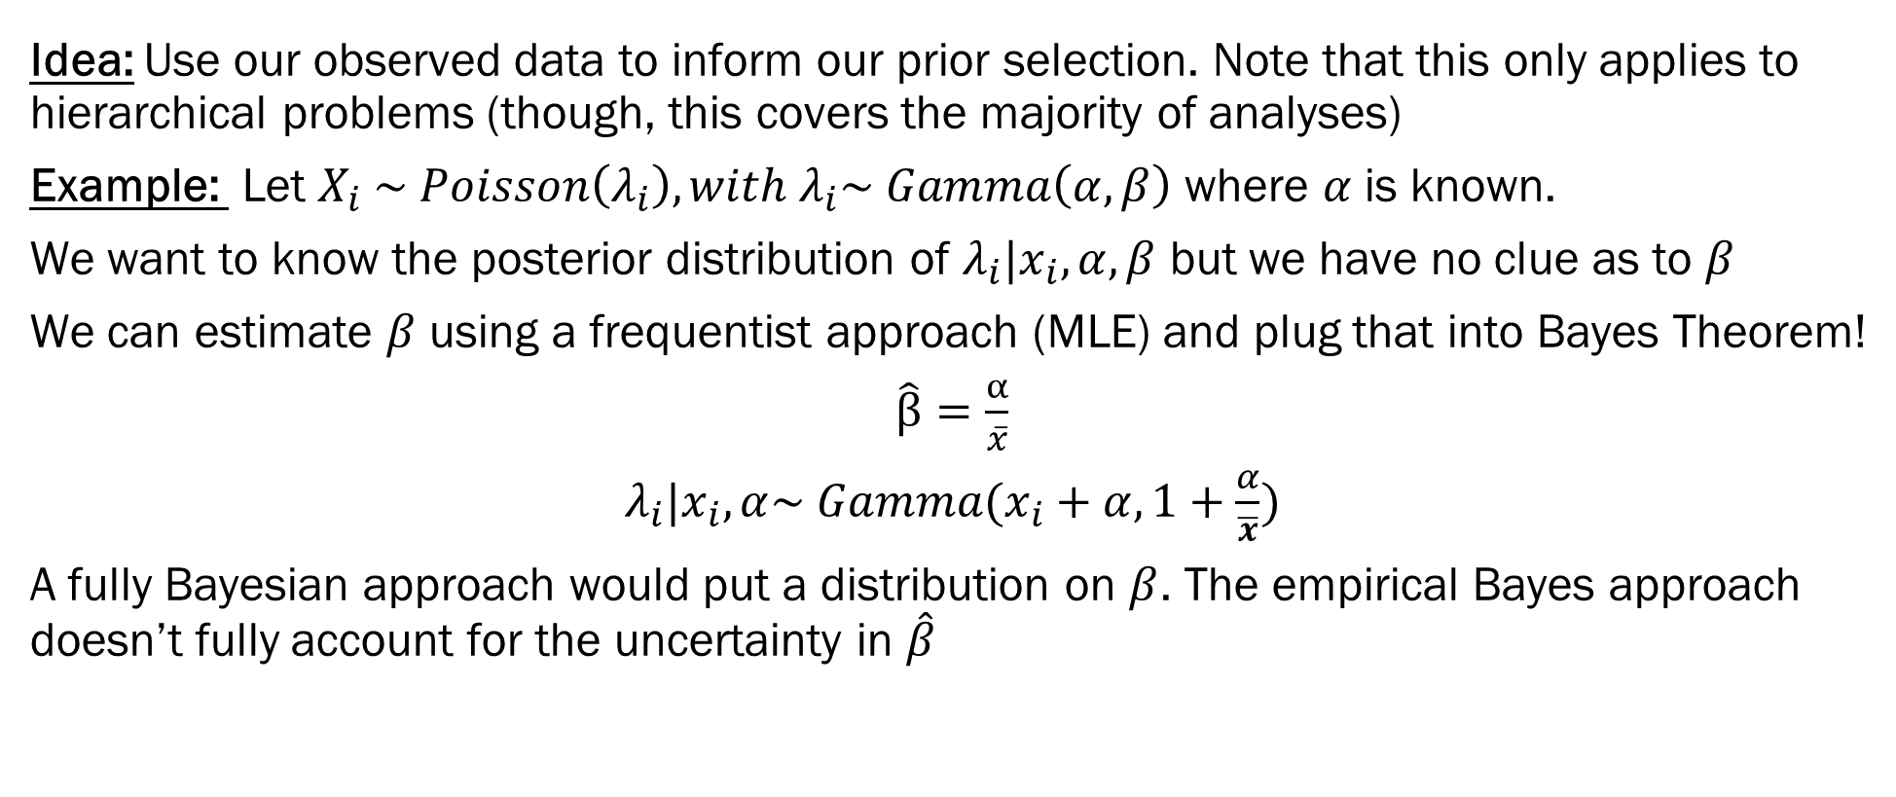
Empirical Bayes Priors

Slide 15
Homework 1 Hints…
List out all of the possible sequences, remembering that once you get “the results you were looking for”, you stop searching.
Markov Chains are in Module 3. To show this is a Markov Chain, list the possible states of the system and the transition matrix.
Use the normal conjugate priors from this lecture
Model using Binomial (and/or Bernoulli) with Beta conjugate priors
Ignore “Use prior alpha…” Because correlations = 0, treat each variable as an independent normal variate.
Use Wikipedia…

Slide 16
Next Week…
Classification with Bayes!
Linear and Quadratic Discriminant Analysis
Bayesian Regression!
Zellner’s g priors!

