Slide 1

Uncertainty, Bayes’ Theorem, and You
Module 1 Live Session (5/24/2021)
DS6040 Summer 2021
Teague R. Henry

Slide 2

Outline
Syllabus
Uncertainty in Machine Learning
Probability Density Functions
Conditional Probabilities
Bayes’ Theorem
The Monty Hall Problem

Slide 3
Syllabus – Course Structure
Live Sessions – 7- 8pm Tuesdays
Office Hours – 7- 8pm Mondays
Discussion Forum – Piazza
Course Information Hub – Collab

Slide 4
Syllabus – Assignments and Grading
5 Homework Assignments – 50% total grade
Use Jupyter notebooks and turn-in as PDF
Participation – 15% total grade
Primarily Piazza discussion based
Project Report + Presentation – 35% total grade
Group or Solo Projects
May be related to DS Capstone

Slide 5
Syllabus – Instructor Contact
Email (ycp6wm@virginia.edu)
Course related questions (i.e. about due dates/grading)
Give me 24 hours before following up
Piazza
Content related questions
Can be public discussion or private message to me (public is preferred)
I check Piazza in the evening most days
Weekend Policy
I work on weekends, but I don’t want to.
I’ll be responding to emails/Piazza on weekends, but only as catchup.

Slide 6
Syllabus – Class Project
Analyze a real data problem of your choosing using a Bayesian method.
Note: This can be related to your DS Capstone project (and often is)
Group (2-3 people) or Solo
Project Proposal Due 6/18
Description of the problem, data, and group.
Project Report
4-6 page report detailing problem, analysis and conclusions
Written for informed stakeholders (rather than for a class project…)
Project Presentation
5-7 minutes, present the problem and your findings

Slide 7
Uncertainty in Data Science
Data lies…
Sampling Variability – unbiased noise due to only observing a sample of a population
Measurement Error – noise due to faulty sensors, bad measures, etc…
Model Misspecification – are you sure you have the “right” model?
To account for uncertainty, all frameworks must pay some sort of informational price.
You pay this price (in part) when you propose how variables are related
A linear regression assumes linearity…
Statistical frameworks all pay the rest in several different ways
One way is not necessarily better, it all comes down to what you are willing to pay…

Slide 8
The Price of Uncertainty
Frequentist Statistics – Pays in assumptions and asymptotics
Assume that certain relations hold as we repeat our experiment infinite times
By assuming asymptotic properties, we can quantify uncertainty
These assumptions are often counterintuitive, and violations can be problematic
Historically, frequentist statistics is a roundabout attempt to remain absolutely objective about the problem under analysis.
Bayesian Statistics – Pays in prior information
Instead of invoking asymptotics to account for uncertainty, Bayesian statistics instead asks us to explicitly quantify uncertainty in the form of priors
Priors reflect our previous knowledge of the phenomena at hand.
Many choices for priors – objective, subjective, non-informative, empirical

Slide 9
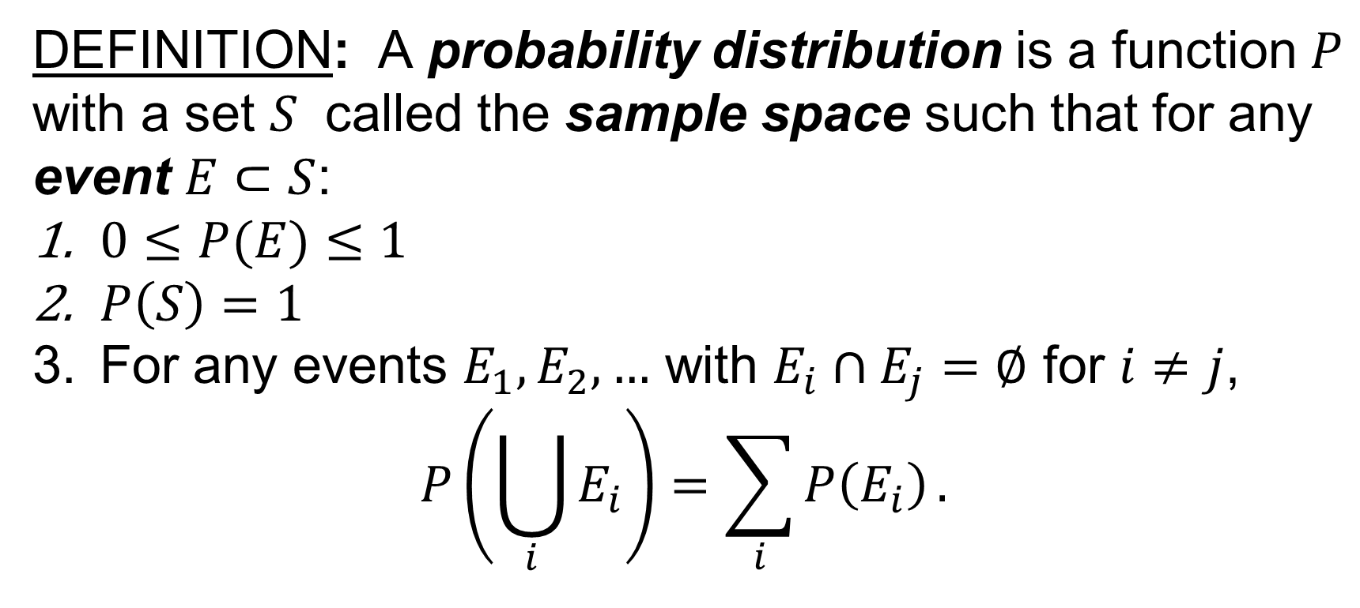
Probability Distributions
DEFINITION: A probability distribution is a function $P$ with a set $S$ called the sample space such that for any event $E⊂S$:
$0≤P(E)≤1$
$P\left(S\right)=1$
For any events $E_{1},E_{2},…$ with $E_{i}∩E_{j}=∅$ for $i≠j$,
$$P\left(\bigcup_{i}{E_{i}}\right)=\sum_{i}{P\left(E_{i}\right)}.$$

Slide 10
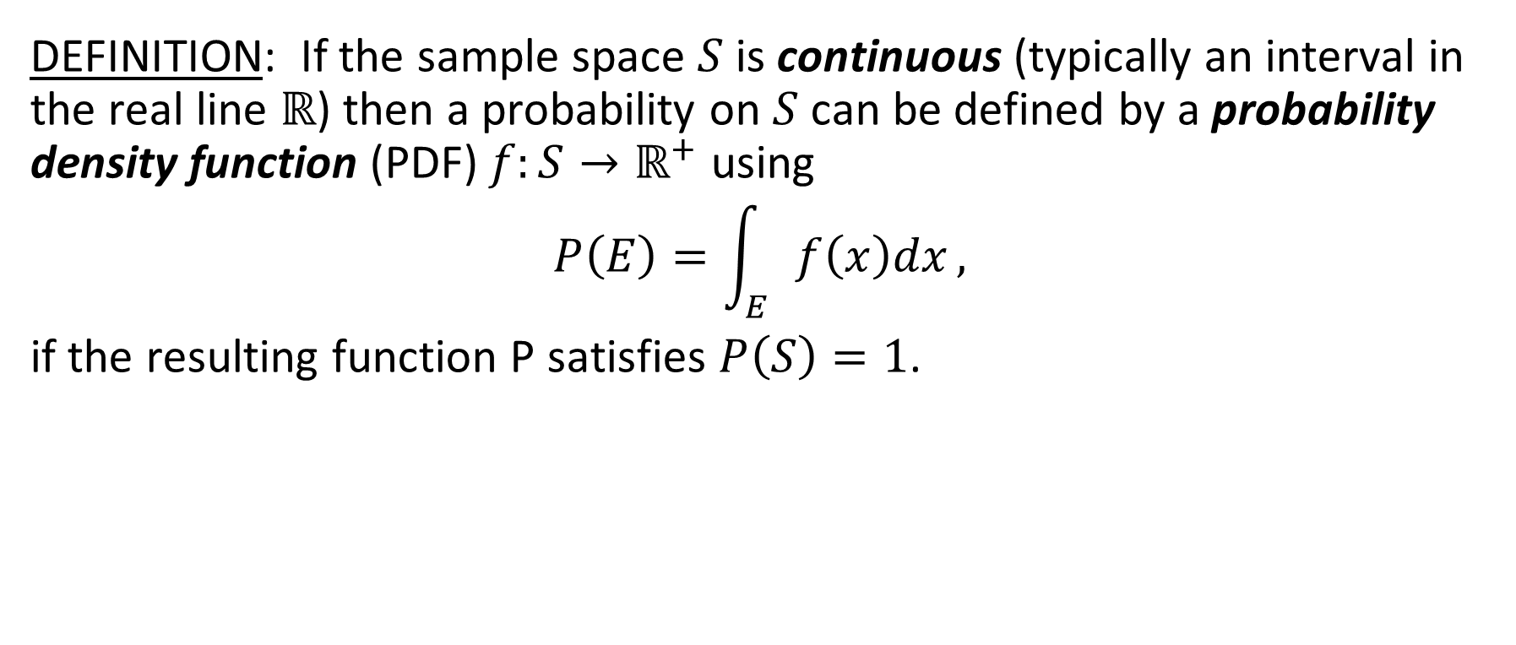
Probability Distributions
DEFINITION: If the sample space $S$ is continuous (typically an interval in the real line $ℝ$) then a probability on $S$ can be defined by a probability density function (PDF) $f:S→ℝ^{+}$ using
$$P\left(E\right)=\int_{E}{f\left(x\right)dx},$$
if the resulting function P satisfies $P\left(S\right)=1$.

Slide 11
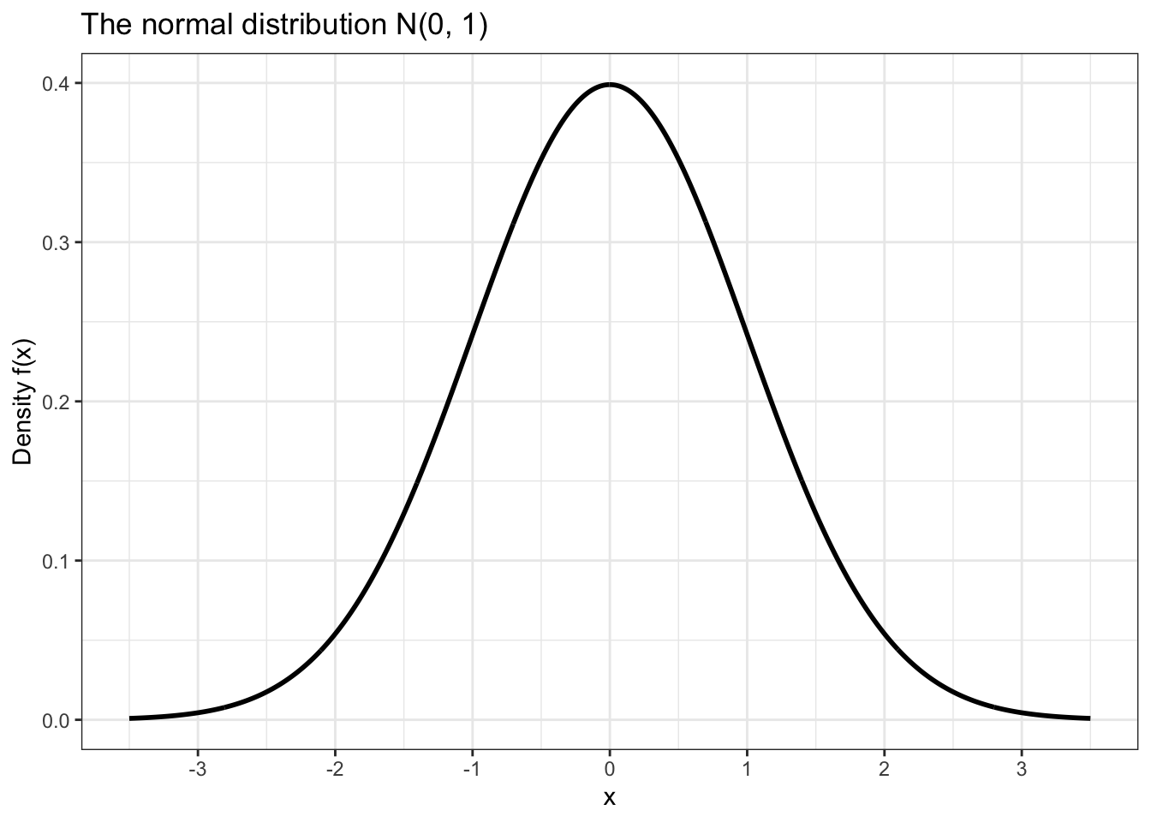
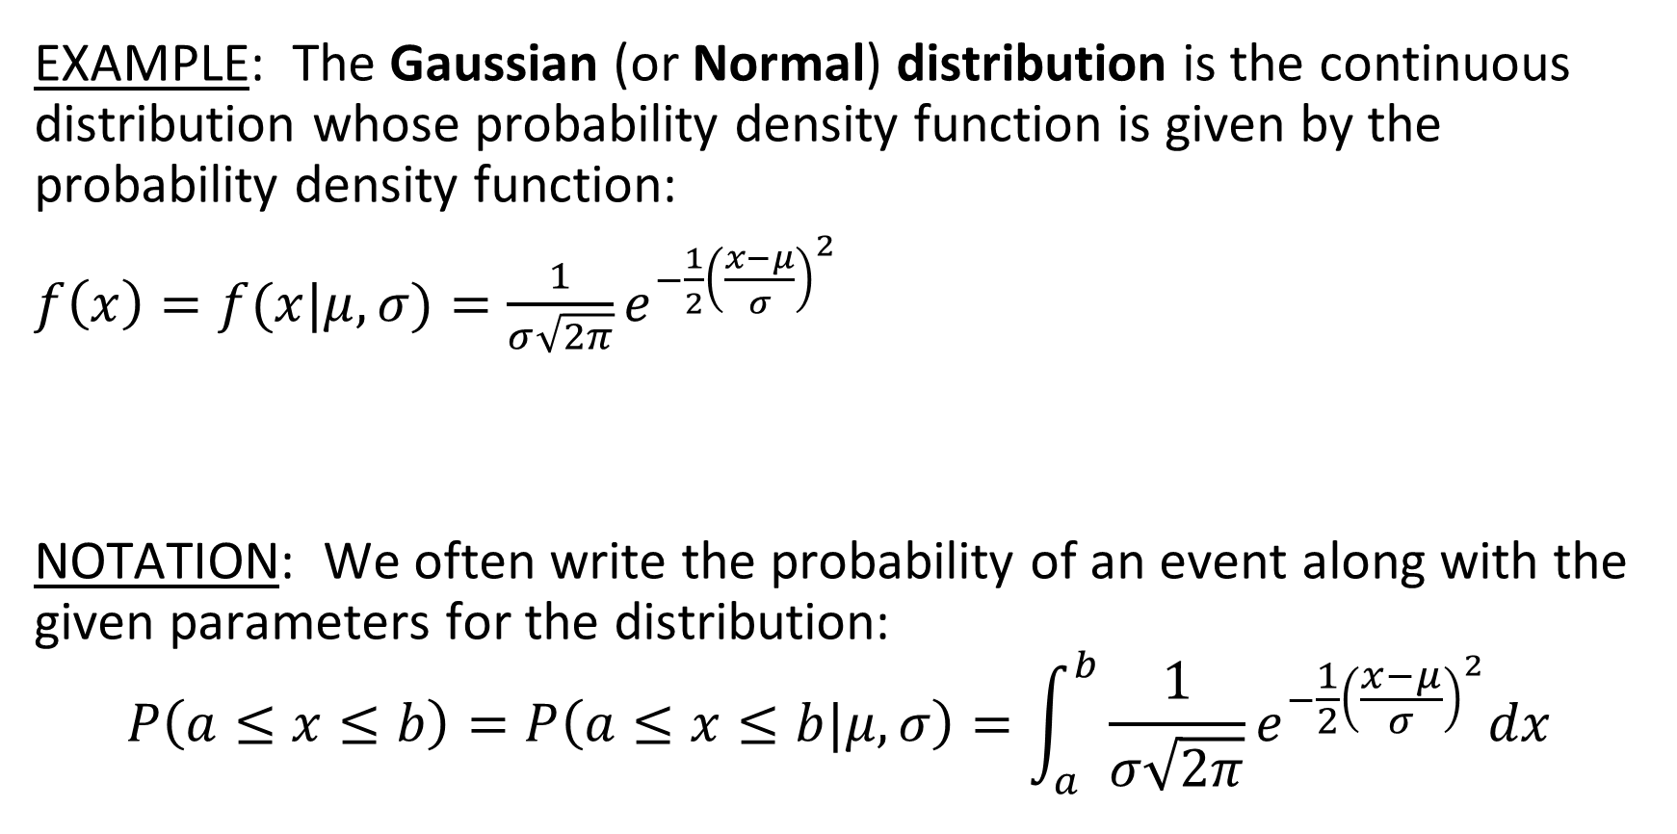
Probability Distributions
EXAMPLE: The Gaussian (or Normal) distribution is the continuous distribution whose probability density function is given by the probability density function:
$f\left(x\right)=f(x|μ,σ)=\frac{1}{σ\sqrt{2π}}e^{−\frac{1}{2}{\left(\frac{x−μ}{σ}\right)}^{2}}$
NOTATION: We often write the probability of an event along with the given parameters for the distribution:
$$P\left(a≤x≤b\right)=P\left(a≤x≤b|μ,σ\right)=\int_{a}^{b}{\frac{1}{σ\sqrt{2π}}e^{−\frac{1}{2}{\left(\frac{x−μ}{σ}\right)}^{2}}dx}$$

Slide 12
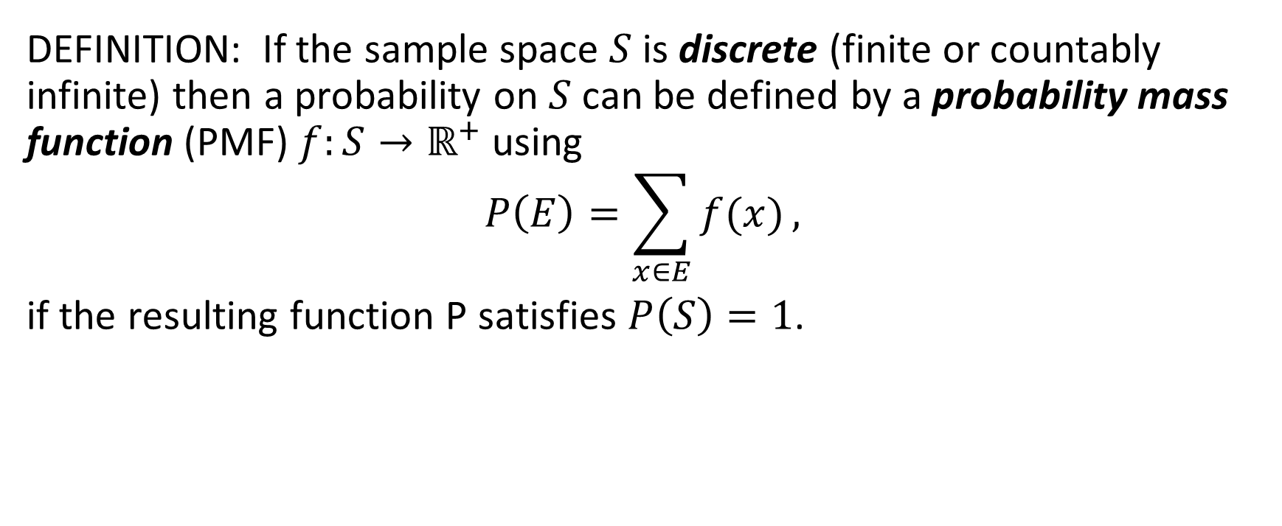
Probability Distributions
DEFINITION: If the sample space $S$ is discrete (finite or countably infinite) then a probability on $S$ can be defined by a probability mass function (PMF) $f:S→ℝ^{+}$ using
$$P\left(E\right)=\sum_{x∈E}{f(x)},$$
if the resulting function P satisfies $P\left(S\right)=1$.

Slide 13
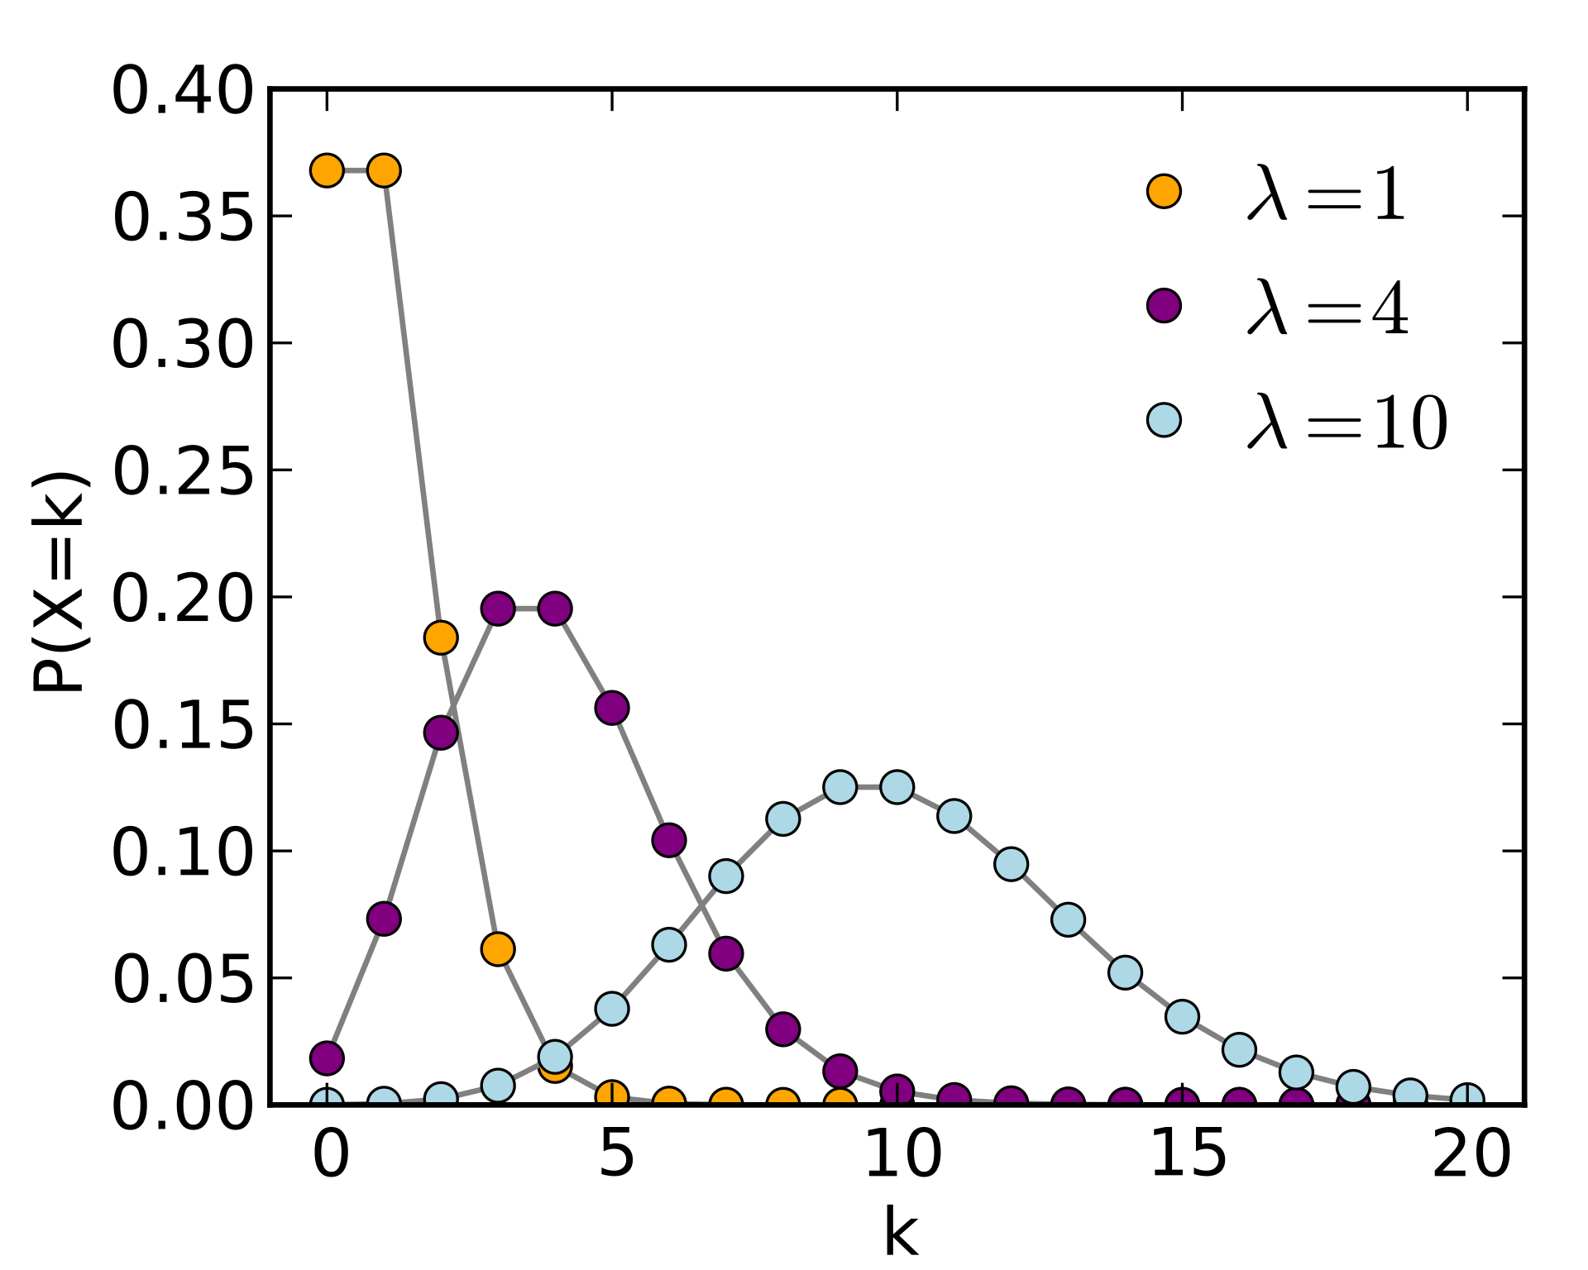
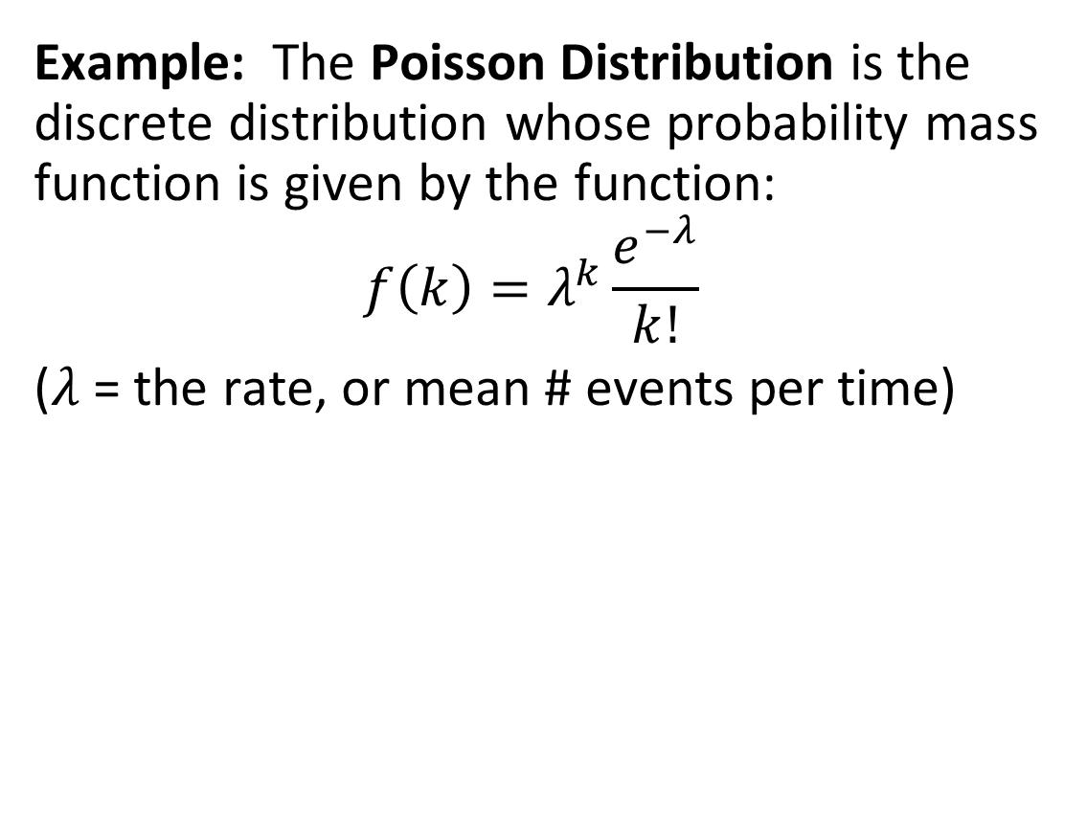
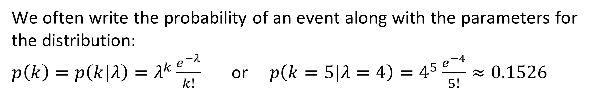
Probability Distributions
Example: The Poisson Distribution is the discrete distribution whose probability mass function is given by the function:
$$f\left(k\right)=λ^{k}\frac{e^{−λ}}{k!}$$
($λ$ = the rate, or mean # events per time)
We often write the probability of an event along with the parameters for the distribution:
$p\left(k\right)=p\left(k|λ\right)=λ^{k}\frac{e^{−λ}}{k!}$ or $p\left(k=5|λ=4\right)=4^{5}\frac{e^{−4}}{5!}≈0.1526$

Slide 14
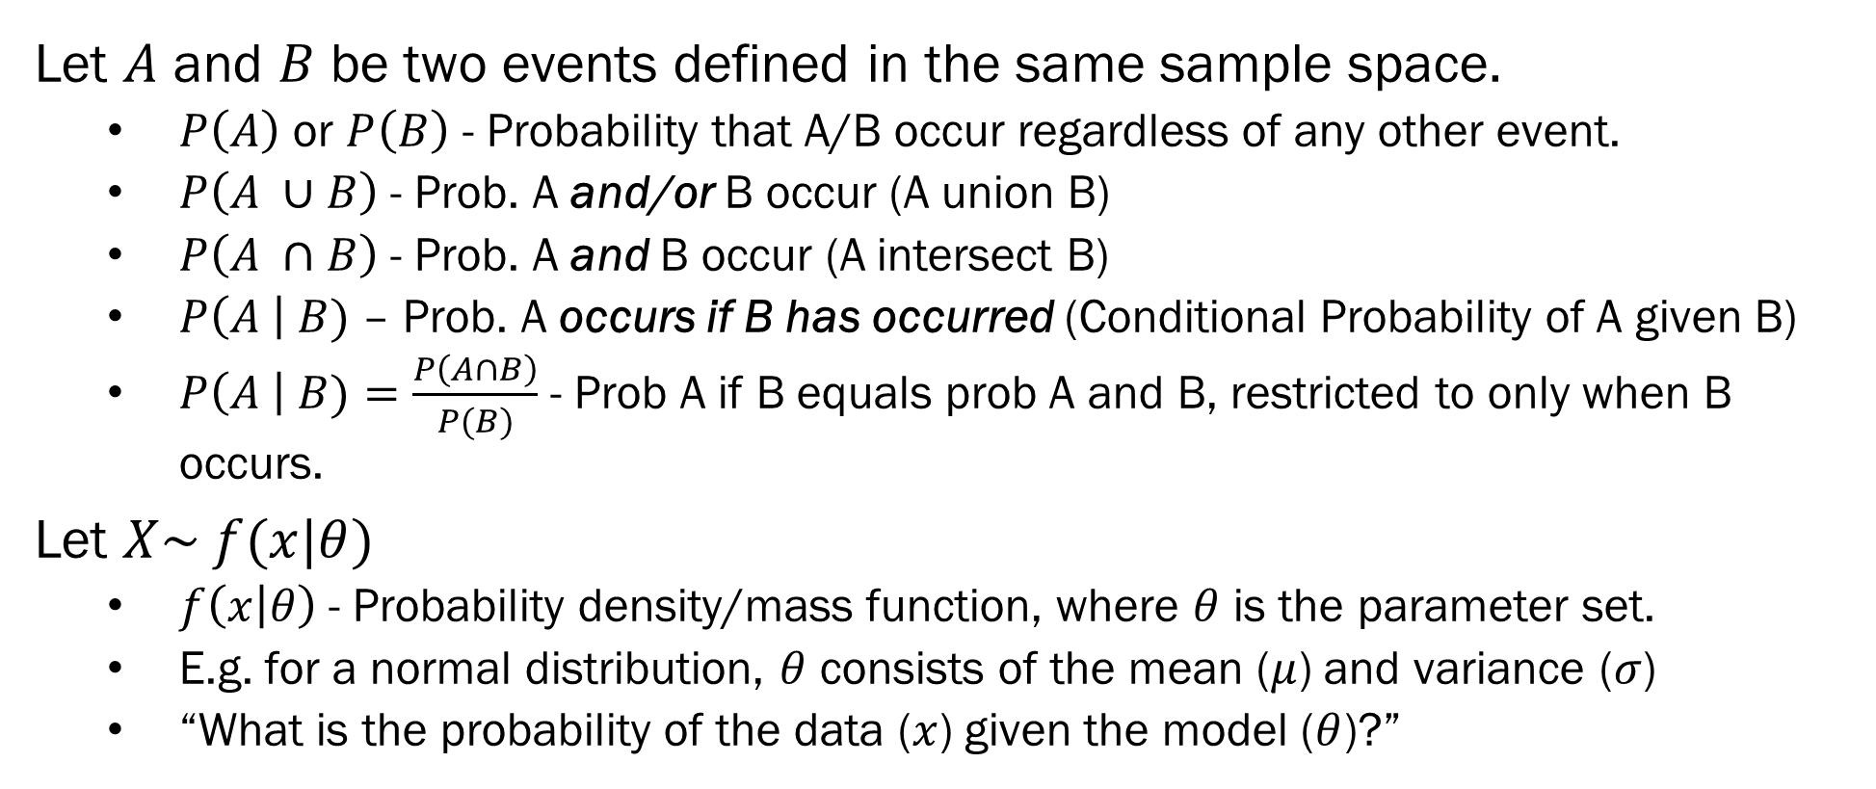
Conditional Probabilities
Let $A$ and $B$ be two events defined in the same sample space.
$P\left(A\right)$ or $P\left(B\right)$ - Probability that A/B occur regardless of any other event.
$P\left(A ∪B\right)$ - Prob. A and/or B occur (A union B)
$P\left(A ∩B\right)$ - Prob. A and B occur (A intersect B)
$P\left(A \right| B)$ – Prob. A occurs if B has occurred (Conditional Probability of A given B)
$P\left(A \right| B)=\frac{P\left(A∩B\right)}{P(B)}$ - Prob A if B equals prob A and B, restricted to only when B occurs.
Let $X\sim f(x|θ)$
$f\left(x | θ\right)$- Probability density/mass function, where $θ$ is the parameter set.
E.g. for a normal distribution, $θ$ consists of the mean ($μ$) and variance ($σ$)
“What is the probability of the data ($x$) given the model ($θ$)?”

Slide 15

Likelihood Functions
$f\left(x | θ\right)$ - Probability of data given model… But we don’t know the model?
Frequentists work in “likelihoods” – How likely are our data given a certain choice of model parameters?
$L\left(θ | x\right)=f(x|θ)$
Maximum likelihood – chose a value of $θ$ so $f\left(x | θ\right)$ is maximized.
Question: What does maximizing $f\left(x | θ\right)$over $θ$ tell you about the probability your choice of $θ$ is the “right one?”

Slide 16

Bayes’ Theorem
Question: What does maximizing $f\left(x | θ\right)$over $θ$ tell you about the probability your choice of $θ$ is the “right one?”
Answer: It doesn’t tell you anything... We want $P\left(θ | x\right)…$
$$P\left(x | θ\right)=\frac{P\left(x∩θ\right)}{P\left(θ\right)}$$
$$P\left(x | θ\right)P\left(θ\right)=P\left(x∩θ\right)$$
$$P\left(x | θ\right)P\left(θ\right)=P\left(θ|x\right)P\left(x\right)$$
$$P\left(θ | x\right)=\frac{P\left(x | θ\right)P\left(θ\right)}{P\left(x\right)}$$

Slide 17

Bayes’ Theorem
$$P\left(θ | x\right)=\frac{P\left(x | θ\right)P\left(θ\right)}{P\left(x\right)}$$
$P\left(θ | x\right)$ - Posterior distribution of model given data
$P\left(x | θ\right)$ - Likelihood of the data given the model
$P\left(x\right)$ - Marginal distribution of $x$ (what is the probability of $x$ across all choices of $θ$)
$P\left(θ\right)$ - Prior distribution of $θ$
We know $P\left(x | θ\right)$ via model choice, and $P\left(x\right)$ can be calculated.
We need to provide our prior information $P(θ)$

Slide 18

Example – Base Rates are Important
A test for COVID has been shown to be 95% sensitive, and 90% specific
$P\left(T=1 \right| Y=1)= .95, P \left(T=0 \right| Y=0)= .90$
You receive a positive COVID test. What is the probability that you actually are COVID positive?
$P\left(Y=1 \right|T=1)=\frac{P\left(T=1 \right|Y=1) P\left(Y = 1\right)}{P(T=1)}$
$P\left(T=1 \right| Y=1)= .95$
$P\left(Y=1\right)$ - Base rate of COVID. Let’s put it at $.05$.
$P\left(T=1\right)=P\left(T=1\right|Y=1)P\left(Y=1\right)+P\left(T=1 | Y=0\right)P\left(Y=0\right)$
$P\left(T=1\right)= .95∗.05+ .1∗.95= .1425$
$$P\left(Y=1 \right|T=1)=\frac{.95∗.05}{.1425}= .3333$$

Slide 19
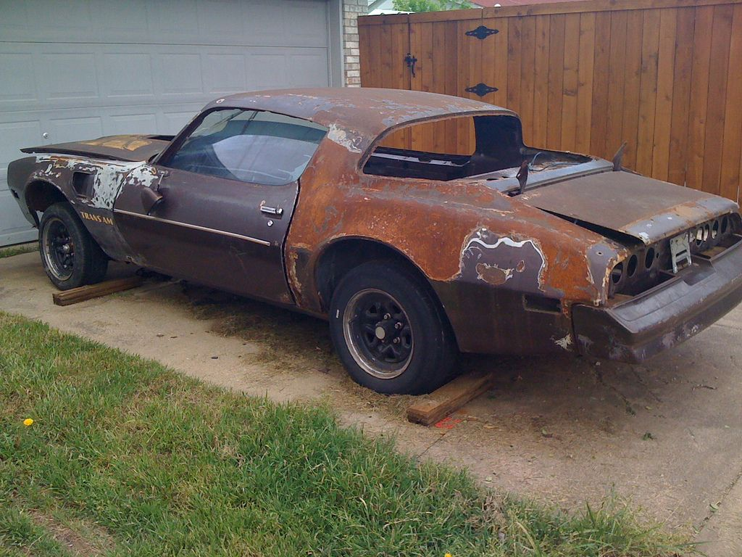
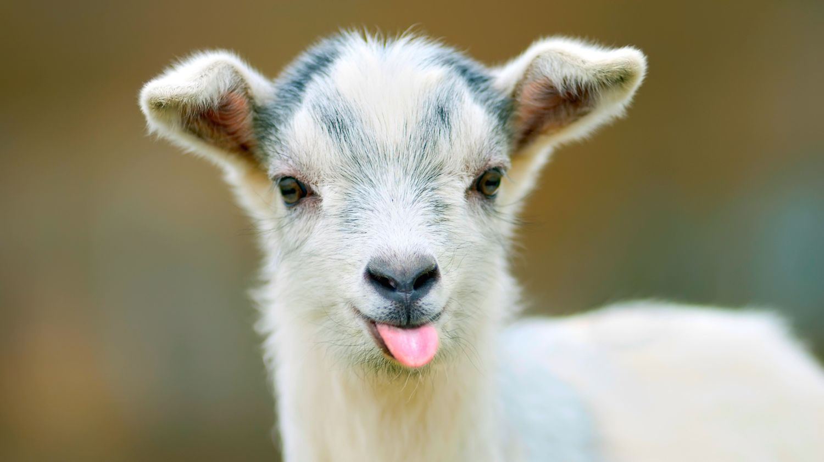

The Monty Hall Problem – Goat Edition
You are a goat farmer. You are presented with 3 doors. Two of those doors hold cars, one holds a goat. After you select a door, the host opens one of the unselected doors to reveal a car. Should you switch your choice of door to the other (unselected, unopened) door, if you are aiming to win the goat?

Slide 20

The Monty Hall Problem – Goat Edition
Stage 1 – Before the Reveal
$P\left(Choosing the Goat | Goat is behind 1 of 3 doors\right)=\frac{1}{3}$
Stage 2 – After the Reveal
Imagine you have to make the choice of doors again from any door… What additional information do you have?
$P\left(Goat behind opened door\right)=0$ (obviously)
$P\left(Goat behind door you chose originally\right)=\frac{1}{3}$
Why? Because your choice locks the door down. The host won’t open it regardless of goat, so you get no additional information as to what is behind your door.
$P\left(Goat behind other, unopened door\right)=\frac{2}{3}$

Slide 21




The Monty Hall Problem – Goat Edition
Intuition – We need to use information as to the structure of the problem to solve it. Here, the key piece of information is that the host will not open the door you originally chose, even if it has a car…
Solution using Bayes’ Theorem –
$P(G = 1 | H = 2, Y = 3)$– Probability that the goat is behind door 1, if you chose door 3 and the host opened door 2.
$$\frac{P\left(H=2 \right| G=1, Y=3)∗P(Y=3 ∩G=1)}{P\left(H=2 \right|Y=3)∗P(Y=3)}$$
$$=\frac{1}{3}∗ P(Y=3)$$
= 1
$$=\frac{\frac{1}{3}}{\frac{1}{2}}=\frac{2}{3}$$
$$=\frac{1}{2}$$

Slide 22
Next Week on Bayesian ML…
Priors – What are they, and how do we get them?
Conjugate Priors – Great for the math, nearly non-applicable for analysis.
Objective Priors – For when you really really want to be frequentist… almost…
Subjective Priors – For when you really want to annoy a frequentist
Non-informative priors – For when you want to be a frequentist, but also annoy other Bayesians…
Important Info for Module 1 –
Homework 1 has been released! Due 6/18
Discussions are open in Piazza
Several optional assignments are open

