Slide 1

Variational Inference Part III:
Advanced Variational Inference in PyMC3
Module 10 Live Session (7/27/2021)
DS6040 Summer 2021
Teague R. Henry

Slide 2

Course Updates
HW4 Due 7/30
Projects Due Last Day of Class (8/10)
Possible extension till 8/13 for Report
Secondary office hours Wednesday at 6pm.
I’ll send around instructions for presentation video upload
I expect everybody to contribute to the presentation, but I don’t require everybody to speak
Though I would encourage it, presenting findings is part of the profession

Slide 3
Outline
Review of CAVI
Coordinate Ascent Variational Inference
Variational Inference in PyMC3
Automatic Differentiation Variational Inference
Example: Linear Spline Models
Variational Inference Wrap-up

Slide 4
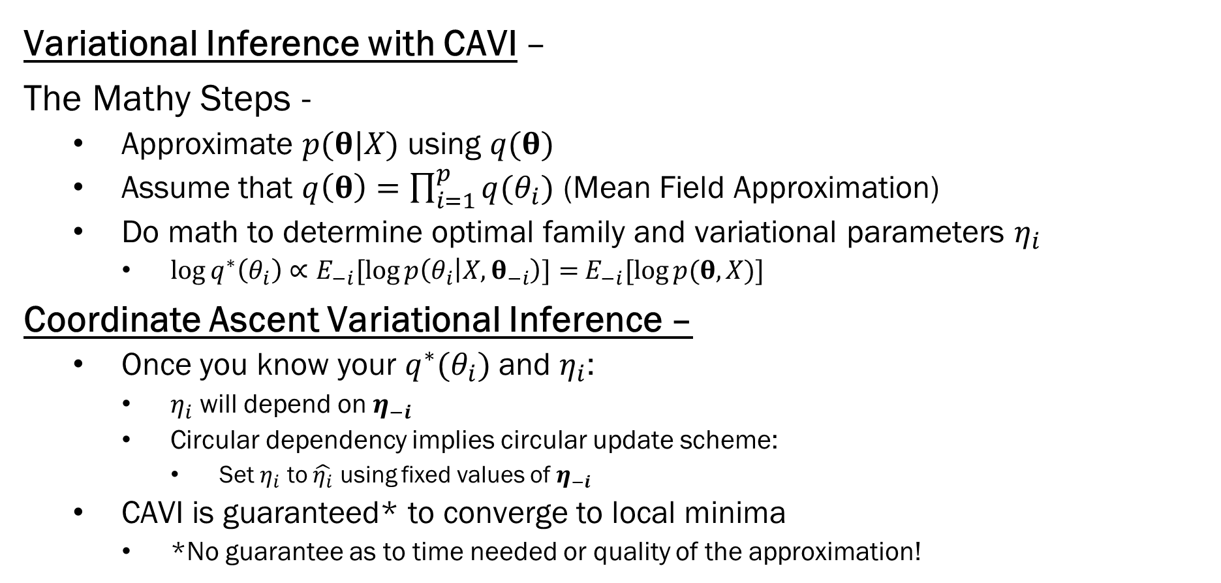
Review
Variational Inference with CAVI –
The Mathy Steps -
Approximate $p(θ|X)$ using $q(θ)$
Assume that $q\left(θ\right)=\prod_{i=1}^{p}{q(θ_{i})}$ (Mean Field Approximation)
Do math to determine optimal family and variational parameters $η_{i}$
$\log{q^{∗}\left(θ_{i}\right)}∝E_{−i}[\log{p\left(θ_{i} | X, θ_{−i}\right)]=}$ $E_{−i}[\log{p(θ, X)]}$
Coordinate Ascent Variational Inference –
Once you know your $q^{∗}(θ_{i})$ and $η_{i}$:
$η_{i}$ will depend on $η_{−i}$
Circular dependency implies circular update scheme:
Set $η_{i}$ to $\hat{η_{i}}$ using fixed values of $η_{−i }$
CAVI is guaranteed* to converge to local minima
*No guarantee as to time needed or quality of the approximation!

Slide 5
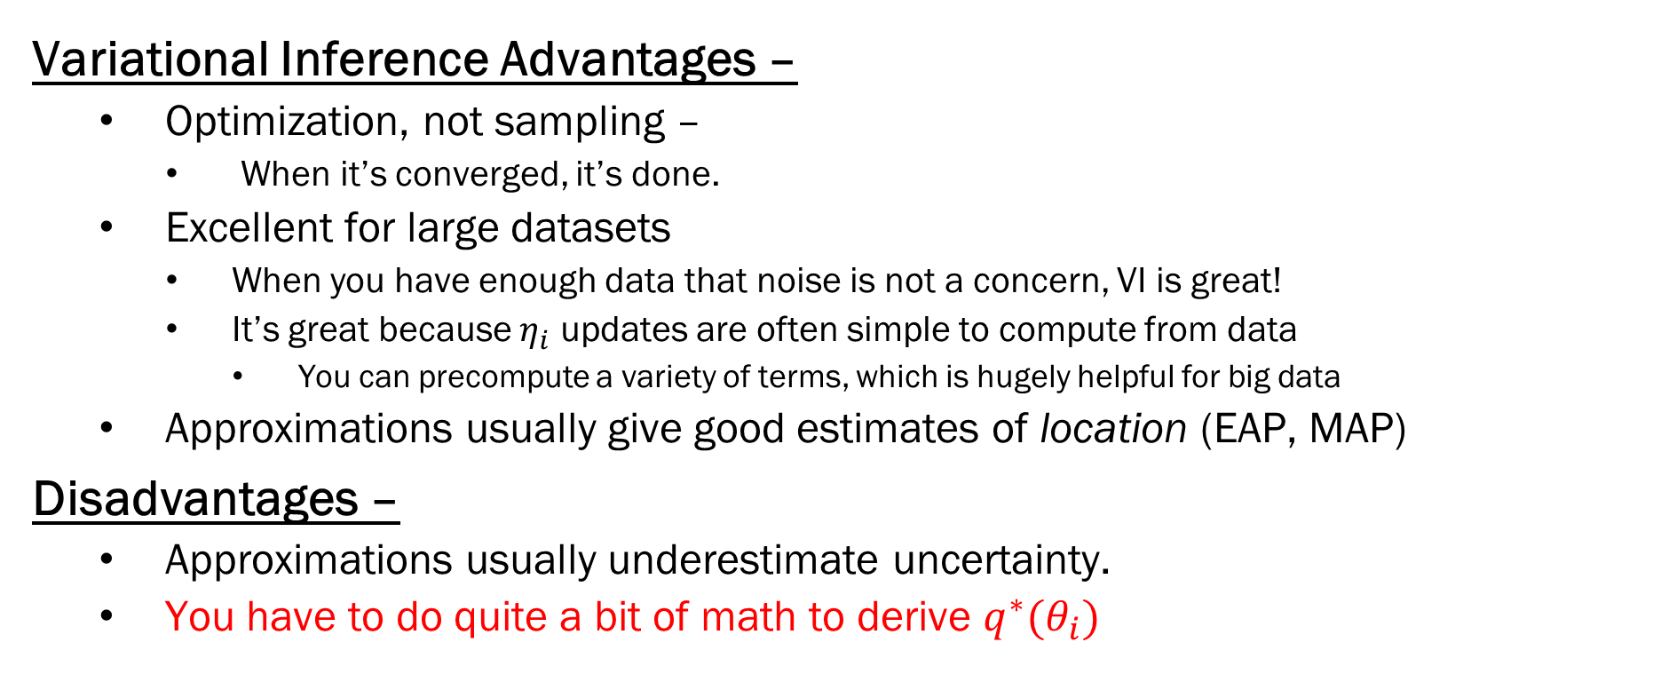
Variational Inference
Variational Inference Advantages –
Optimization, not sampling –
When it’s converged, it’s done.
Excellent for large datasets
When you have enough data that noise is not a concern, VI is great!
It’s great because $η_{i}$ updates are often simple to compute from data
You can precompute a variety of terms, which is hugely helpful for big data
Approximations usually give good estimates of location (EAP, MAP)
Disadvantages –
Approximations usually underestimate uncertainty.
You have to do quite a bit of math to derive $q^{∗}(θ_{i})$

Slide 6
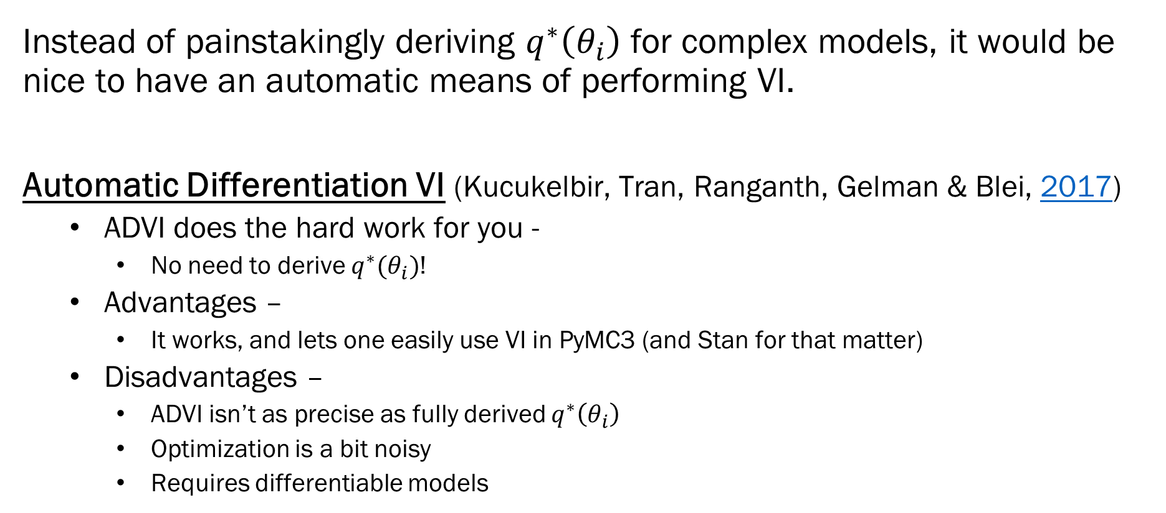
Automatic Differentiation VI (ADVI)
Instead of painstakingly deriving $q^{∗}\left(θ_{i}\right)$ for complex models, it would be nice to have an automatic means of performing VI.
Automatic Differentiation VI (Kucukelbir, Tran, Ranganth, Gelman & Blei, 2017)
ADVI does the hard work for you -
No need to derive $q^{∗}(θ_{i})$!
Advantages –
It works, and lets one easily use VI in PyMC3 (and Stan for that matter)
Disadvantages –
ADVI isn’t as precise as fully derived $q^{∗}\left(θ_{i}\right)$
Optimization is a bit noisy
Requires differentiable models

Slide 7
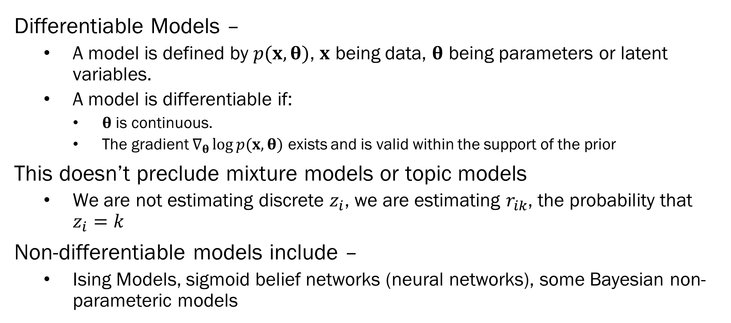
Automatic Differentiation VI (ADVI)
Differentiable Models –
A model is defined by $p(x, θ)$, $x$ being data, $θ$ being parameters or latent variables.
A model is differentiable if:
$θ$ is continuous.
The gradient $∇_{θ}\log{p(x, θ)}$ exists and is valid within the support of the prior
This doesn’t preclude mixture models or topic models
We are not estimating discrete $z_{i}$, we are estimating $r_{ik}$, the probability that $z_{i}=k$
Non-differentiable models include –
Ising Models, sigmoid belief networks (neural networks), some Bayesian non-parameteric models

Slide 8
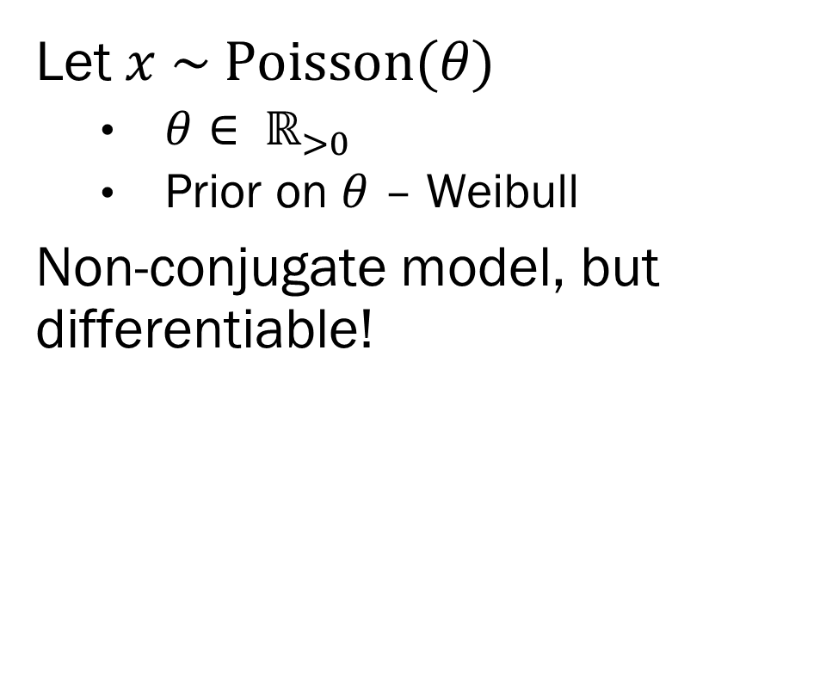
A Sidecar Example – Poisson Weibull
Let $x \sim Poisson(θ)$
$θ∈ ℝ_{>0}$
Prior on $θ$ – Weibull
Non-conjugate model, but differentiable!

Slide 9
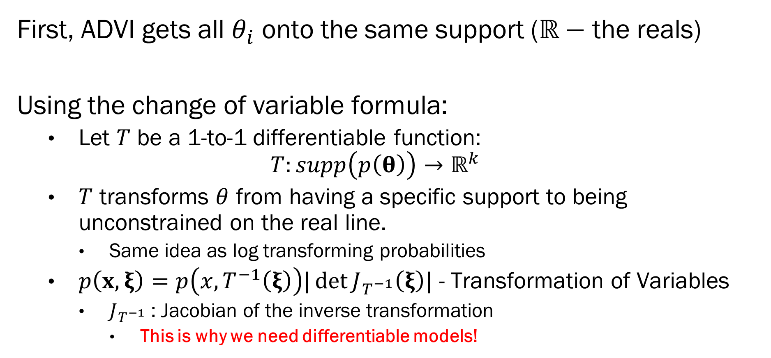

ADVI Step 1 – Transform $θ$
First, ADVI gets all $θ_{i}$ onto the same support ($ℝ−$ the reals)
Using the change of variable formula:
Let $T$ be a 1-to-1 differentiable function:
$$T:supp\left(p\left(θ\right)\right)→ℝ^{k}$$
$T$ transforms $θ$ from having a specific support to being unconstrained on the real line.
Same idea as log transforming probabilities
$p\left(x, ξ\right)=p\left(x, T^{−1}\left(ξ\right)\right)|\det{J_{T^{−1}}\left(ξ\right)|}$ - Transformation of Variables
$J_{T^{−1}}$ : Jacobian of the inverse transformation
This is why we need differentiable models!

Slide 10
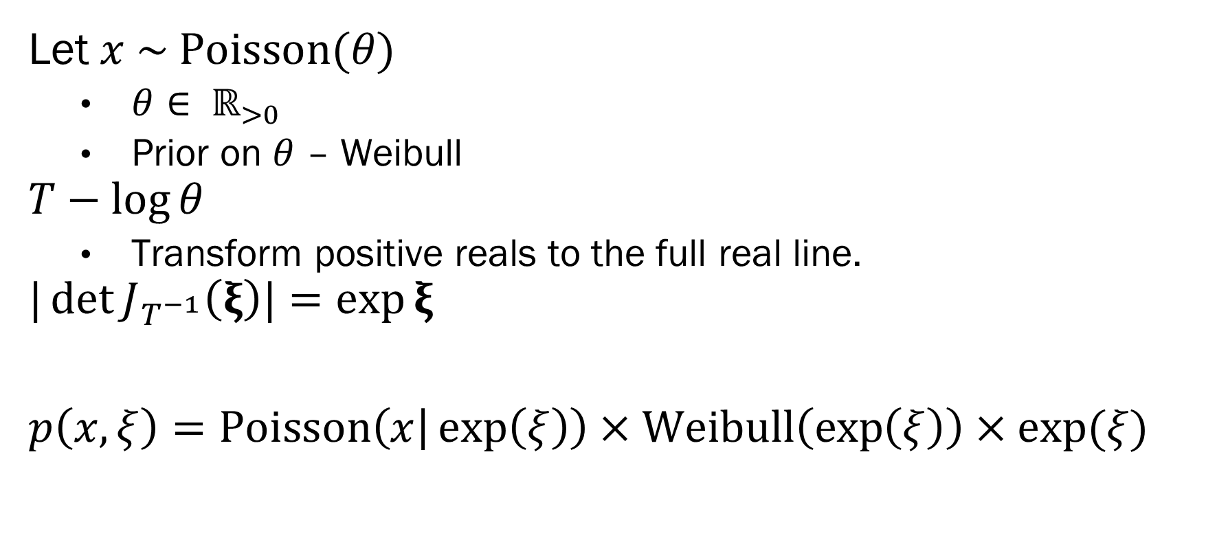
A Sidecar Example – Poisson Weibull
Let $x \sim Poisson(θ)$
$θ∈ ℝ_{>0}$
Prior on $θ$ – Weibull
$$T−\log{θ}$$
Transform positive reals to the full real line.
$$|\det{J_{T^{−1}}\left(ξ\right)|}=\exp{ξ}$$
$p\left(x, ξ\right)=Poisson\left(x | \exp\left(ξ\right)\right)×Weibull\left(\exp\left(ξ\right)\right)×\exp{(ξ)}$

Slide 11
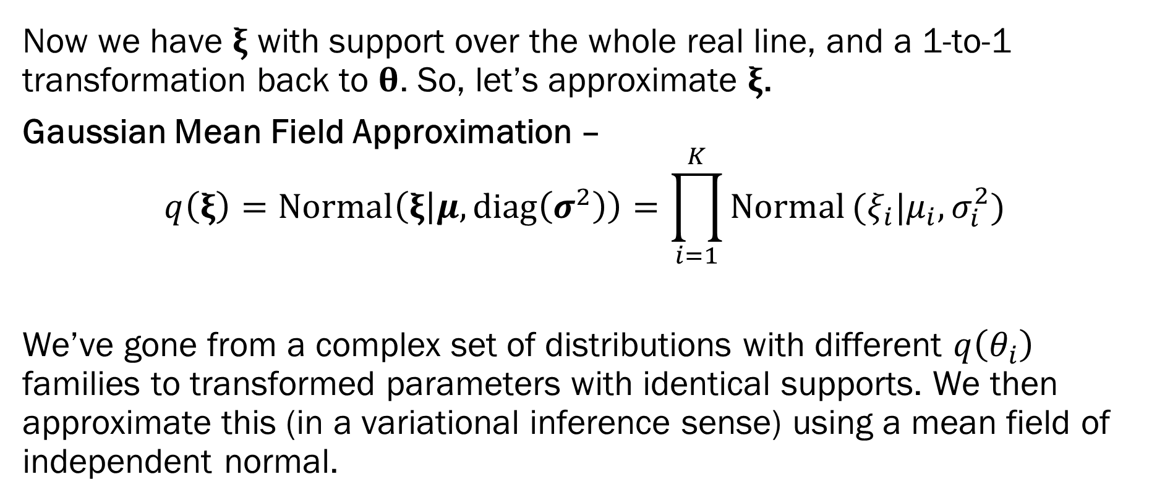
ADVI Step 2 – Gaussian Mean Field
Now we have $ξ$ with support over the whole real line, and a 1-to-1 transformation back to $θ$. So, let’s approximate $ξ$.
Gaussian Mean Field Approximation –
$$q\left(ξ\right)=Normal\left(ξ | μ, diag\left(σ^{2}\right)\right)=\prod_{i=1}^{K}{Normal}(ξ_{i}|μ_{i},σ_{i}^{2})$$
We’ve gone from a complex set of distributions with different $q\left(θ_{i}\right)$ families to transformed parameters with identical supports. We then approximate this (in a variational inference sense) using a mean field of independent normal.

Slide 12
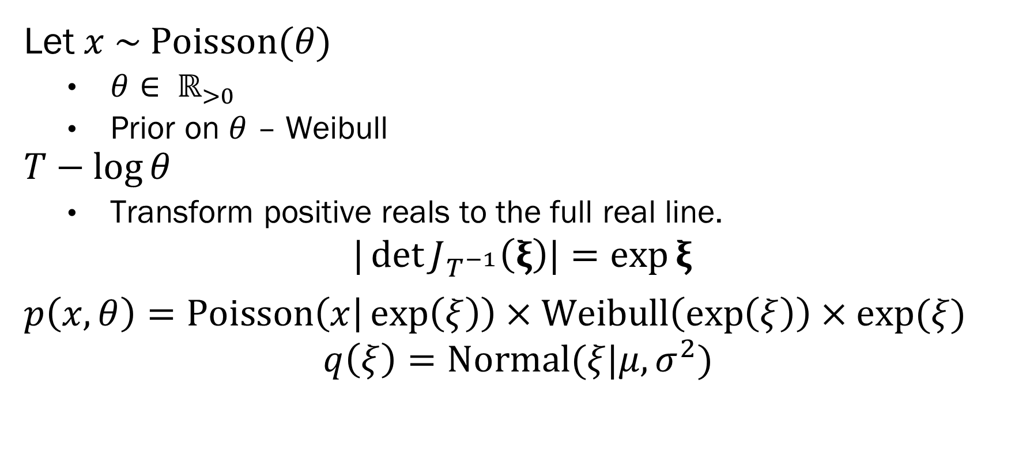
A Sidecar Example – Poisson Weibull
Let $x \sim Poisson(θ)$
$θ∈ ℝ_{>0}$
Prior on $θ$ – Weibull
$$T−\log{θ}$$
Transform positive reals to the full real line.
$$|\det{J_{T^{−1}}\left(ξ\right)|}=\exp{ξ}$$
$p\left(x, θ\right)=Poisson\left(x | \exp\left(ξ\right)\right)×Weibull\left(\exp\left(ξ\right)\right)×\exp{(ξ)}$
$$q\left(ξ\right)=Normal(ξ|μ, σ^{2})$$

Slide 13
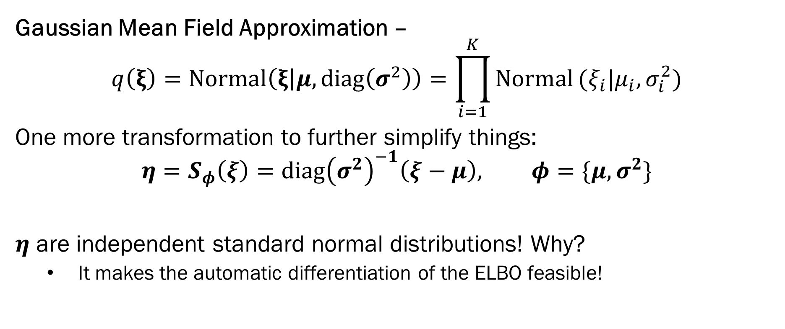
ADVI Step 3 – Elliptical Standardization
Gaussian Mean Field Approximation –
$$q\left(ξ\right)=Normal\left(ξ | μ, diag\left(σ^{2}\right)\right)=\prod_{i=1}^{K}{Normal}(ξ_{i}|μ_{i},σ_{i}^{2})$$
One more transformation to further simplify things:
$$η=S_{φ}\left(ξ\right)=diag{\left(σ^{2}\right)}^{−1}\left(ξ−μ\right), φ=\{μ, σ^{2}\}$$
$η$ are independent standard normal distributions! Why?
It makes the automatic differentiation of the ELBO feasible!

Slide 14
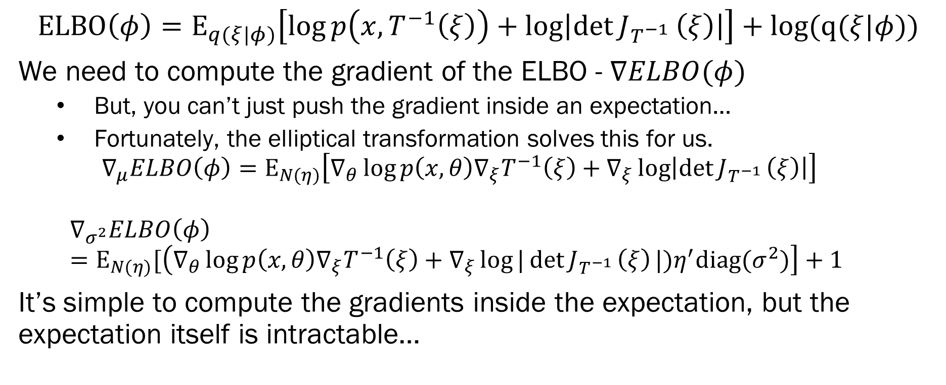
ADVI Step 4 – Automatic Differentation
$$ELBO\left(φ\right)=E_{q(ξ|φ)}\left[\log{p\left(x, T^{−1}\left(ξ\right)\right)+\log\left|\det{J_{T^{−1}}}\left(ξ\right)\right|}\right]+log(q(ξ|φ))$$
We need to compute the gradient of the ELBO - $∇ELBO(φ)$
But, you can’t just push the gradient inside an expectation…
Fortunately, the elliptical transformation solves this for us.
$$∇_{μ}ELBO\left(φ\right)=E_{N(η)}\left[∇_{θ}\log{p\left(x,θ\right)∇_{ξ}T^{−1}\left(ξ\right)+∇_{ξ}\log\left|\det{J_{T^{−1 }}\left(ξ\right)}\right|}\right]$$
$$∇_{σ^{2}}ELBO\left(φ\right)=E_{N(η)}[\left(∇_{θ}\log{p\left(x,θ\right)∇_{ξ}T^{−1}\left(ξ\right)+∇_{ξ}\log{|\det{J_{T^{−1 }}\left(ξ\right)}|)η^{′}diag(σ^{2})}}\right]+1$$
It’s simple to compute the gradients inside the expectation, but the expectation itself is intractable…

Slide 15
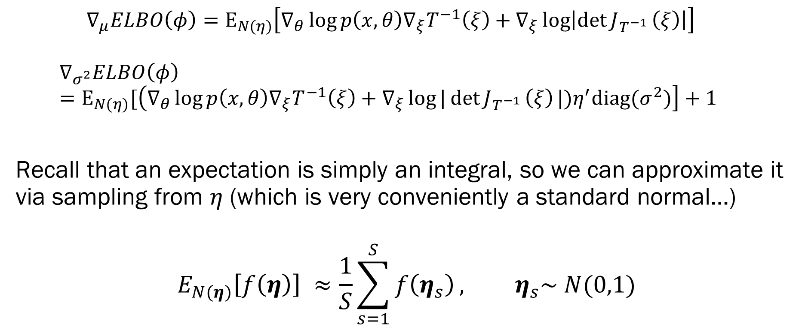
ADVI Step 5 – MC Integration
$$∇_{μ}ELBO\left(φ\right)=E_{N(η)}\left[∇_{θ}\log{p\left(x,θ\right)∇_{ξ}T^{−1}\left(ξ\right)+∇_{ξ}\log\left|\det{J_{T^{−1 }}\left(ξ\right)}\right|}\right]$$
$$∇_{σ^{2}}ELBO\left(φ\right)=E_{N(η)}[\left(∇_{θ}\log{p\left(x,θ\right)∇_{ξ}T^{−1}\left(ξ\right)+∇_{ξ}\log{|\det{J_{T^{−1 }}\left(ξ\right)}|)η^{′}diag(σ^{2})}}\right]+1$$
Recall that an expectation is simply an integral, so we can approximate it via sampling from $η$ (which is very conveniently a standard normal…)
$$E_{N(η)}\left[f\left(η\right)\right] ≈\frac{1}{S}\sum_{s=1}^{S}{f\left(η_{s}\right)}, η_{s}\sim N(0,1)$$

Slide 16
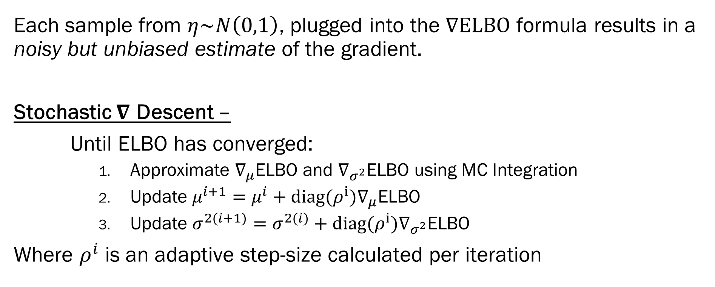

ADVI Step 6 – Stochastic $∇$ Descent
Each sample from $η\sim N\left(0,1\right)$, plugged into the $∇ELBO$ formula results in a noisy but unbiased estimate of the gradient.
Stochastic $∇$ Descent –
Until ELBO has converged:
Approximate $∇_{μ}$ELBO and $∇_{σ^{2}}$ELBO using MC Integration
Update $μ^{i+1}=μ^{i}+diag(ρ^{i})∇_{μ}\text{ELBO}$
Update $σ^{2(i+1)}=σ^{2(i)}+diag(ρ^{i})∇_{σ^{2}}\text{ELBO}$
Where $ρ^{i}$ is an adaptive step-size calculated per iteration

Slide 17
ADVI Summary
ADVI reparameterizes the original model into an equivalent, but mathematically tractable, model based on normal distributions.
Advantages –
With few exceptions, this is completely automatic and requires no derivation on the part of the analyst.
Using data subsamples, this can be applied to big data (Millions/Billions of observations).
Every transformation is 1-to-1… This is not an approximation to optimal VI, it is optimal VI…
Disadvantages –
Requires differentiable models (not a horrible requirement)
MC Integration is technically an approximation (but usually a decent one)

Slide 18
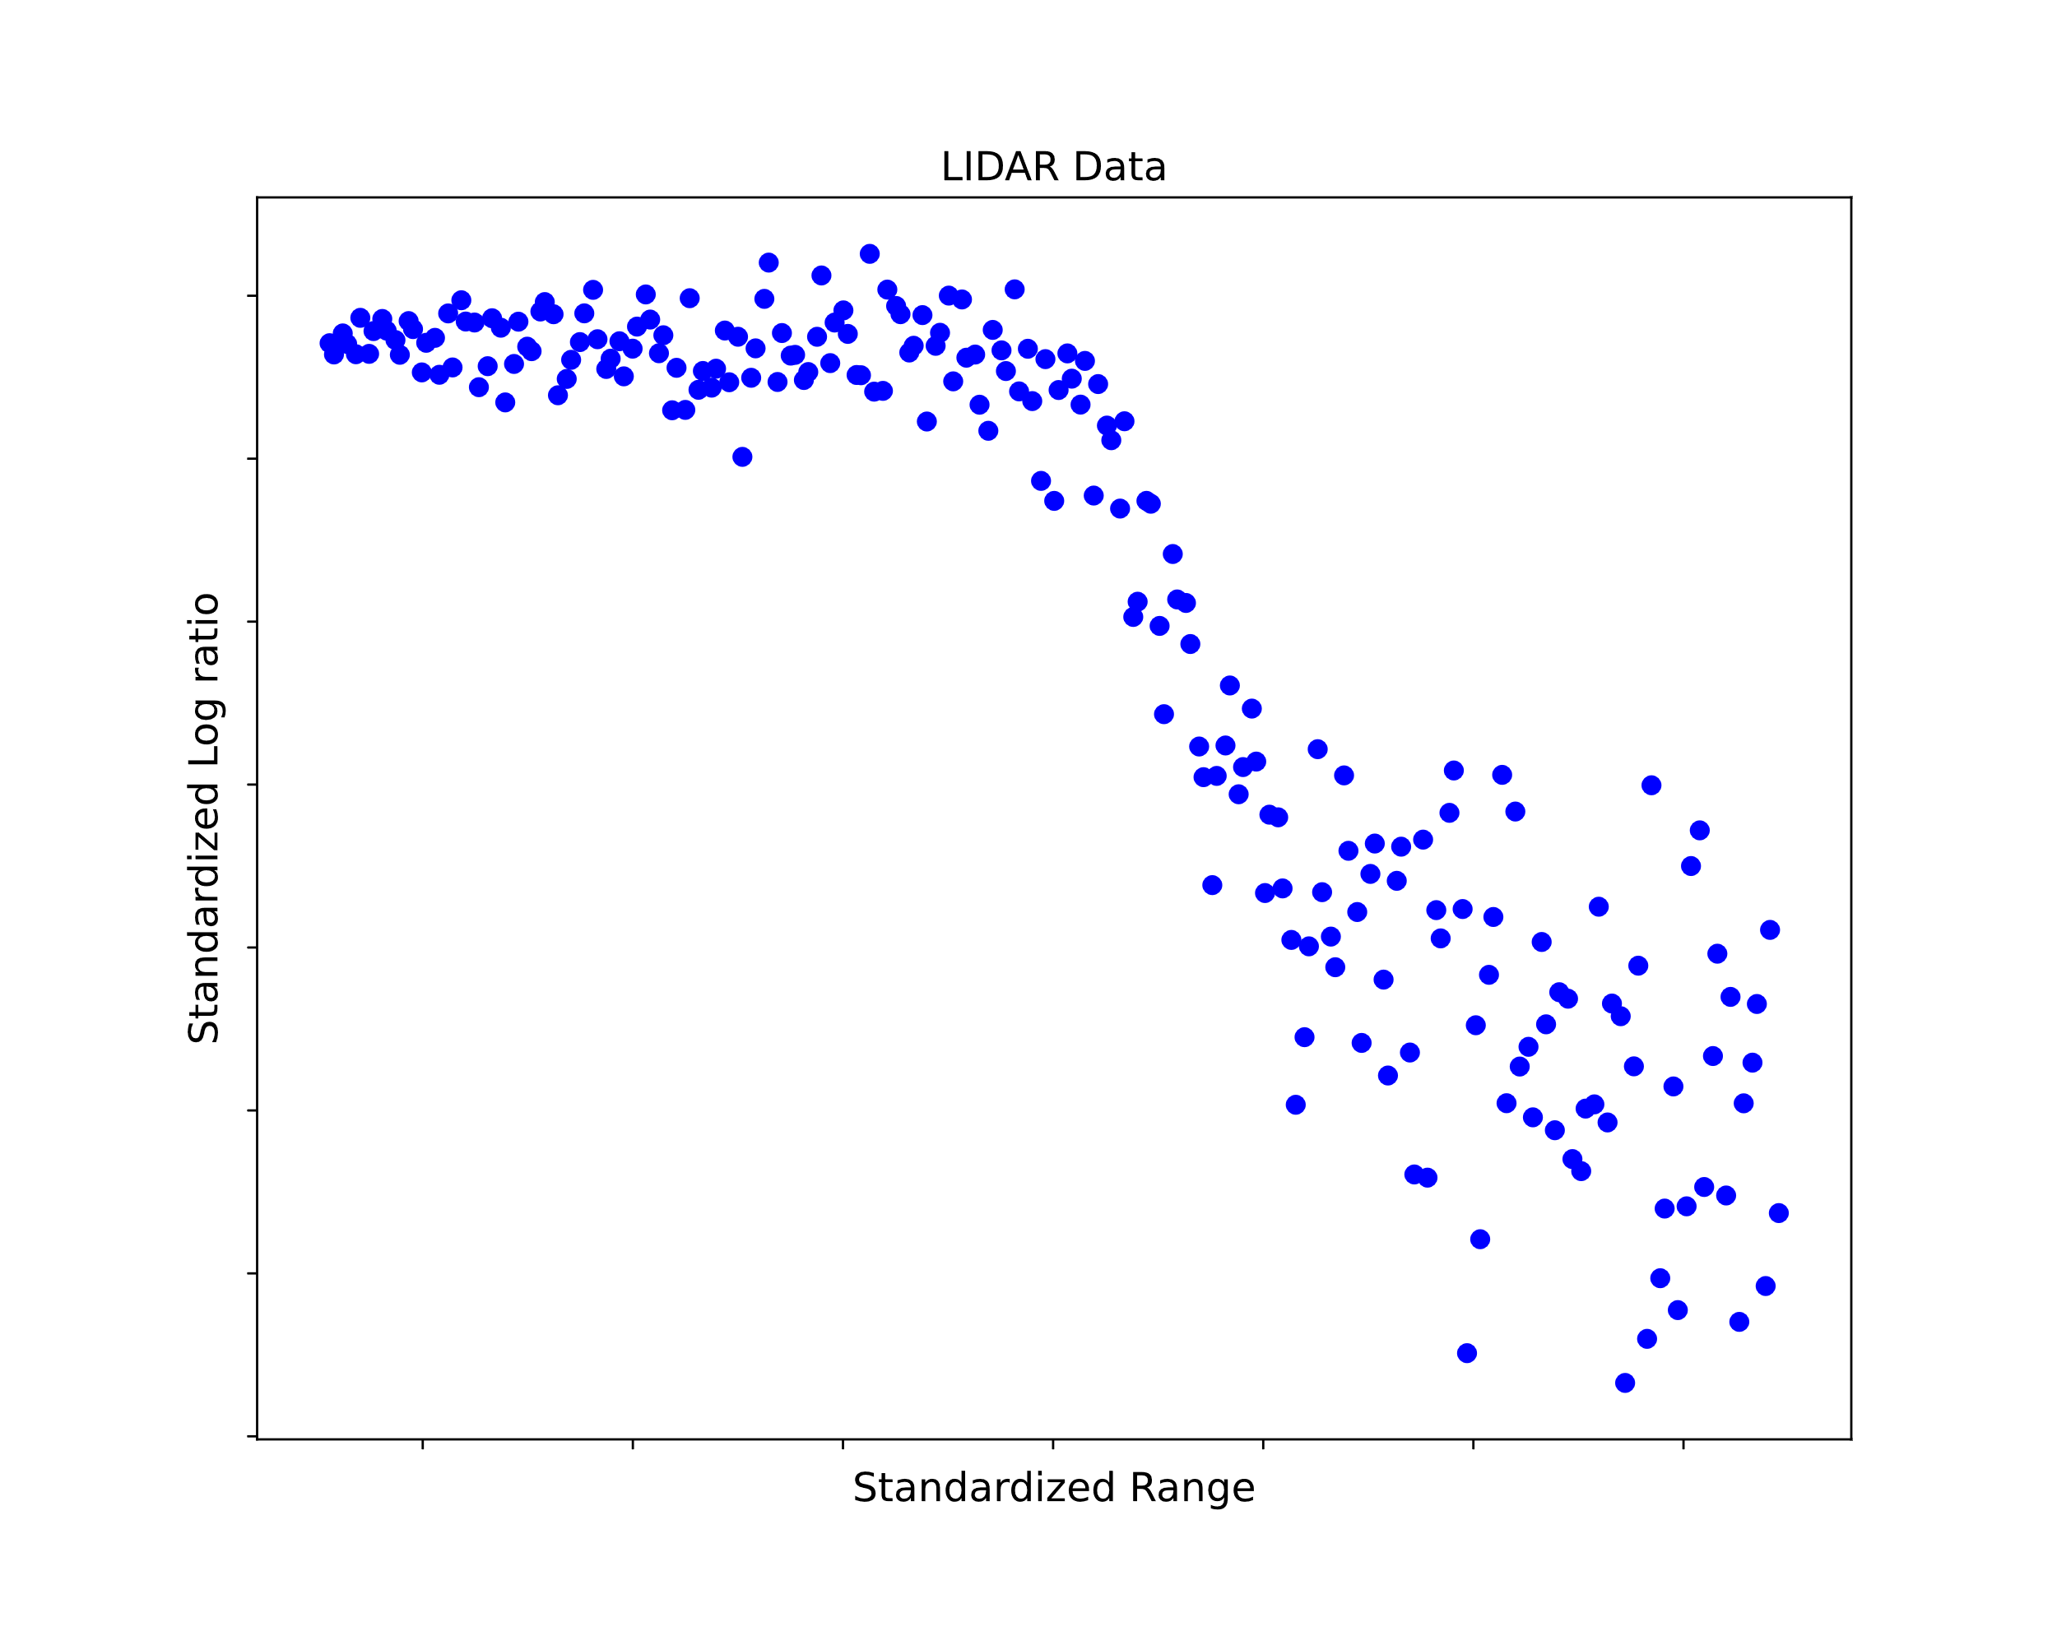
ADVI Example – Linear Spline Mixture
How to predict new observations using non-linear relations?
Linear Splines –
Set the changepoints a priori
Estimate a regression over each interval.
Mixtures of Regression lines –
Estimate the changepoints
A form of smoothing (ala Loess)
If time is the dependent variable, also a form of changepoint detection.

Slide 19
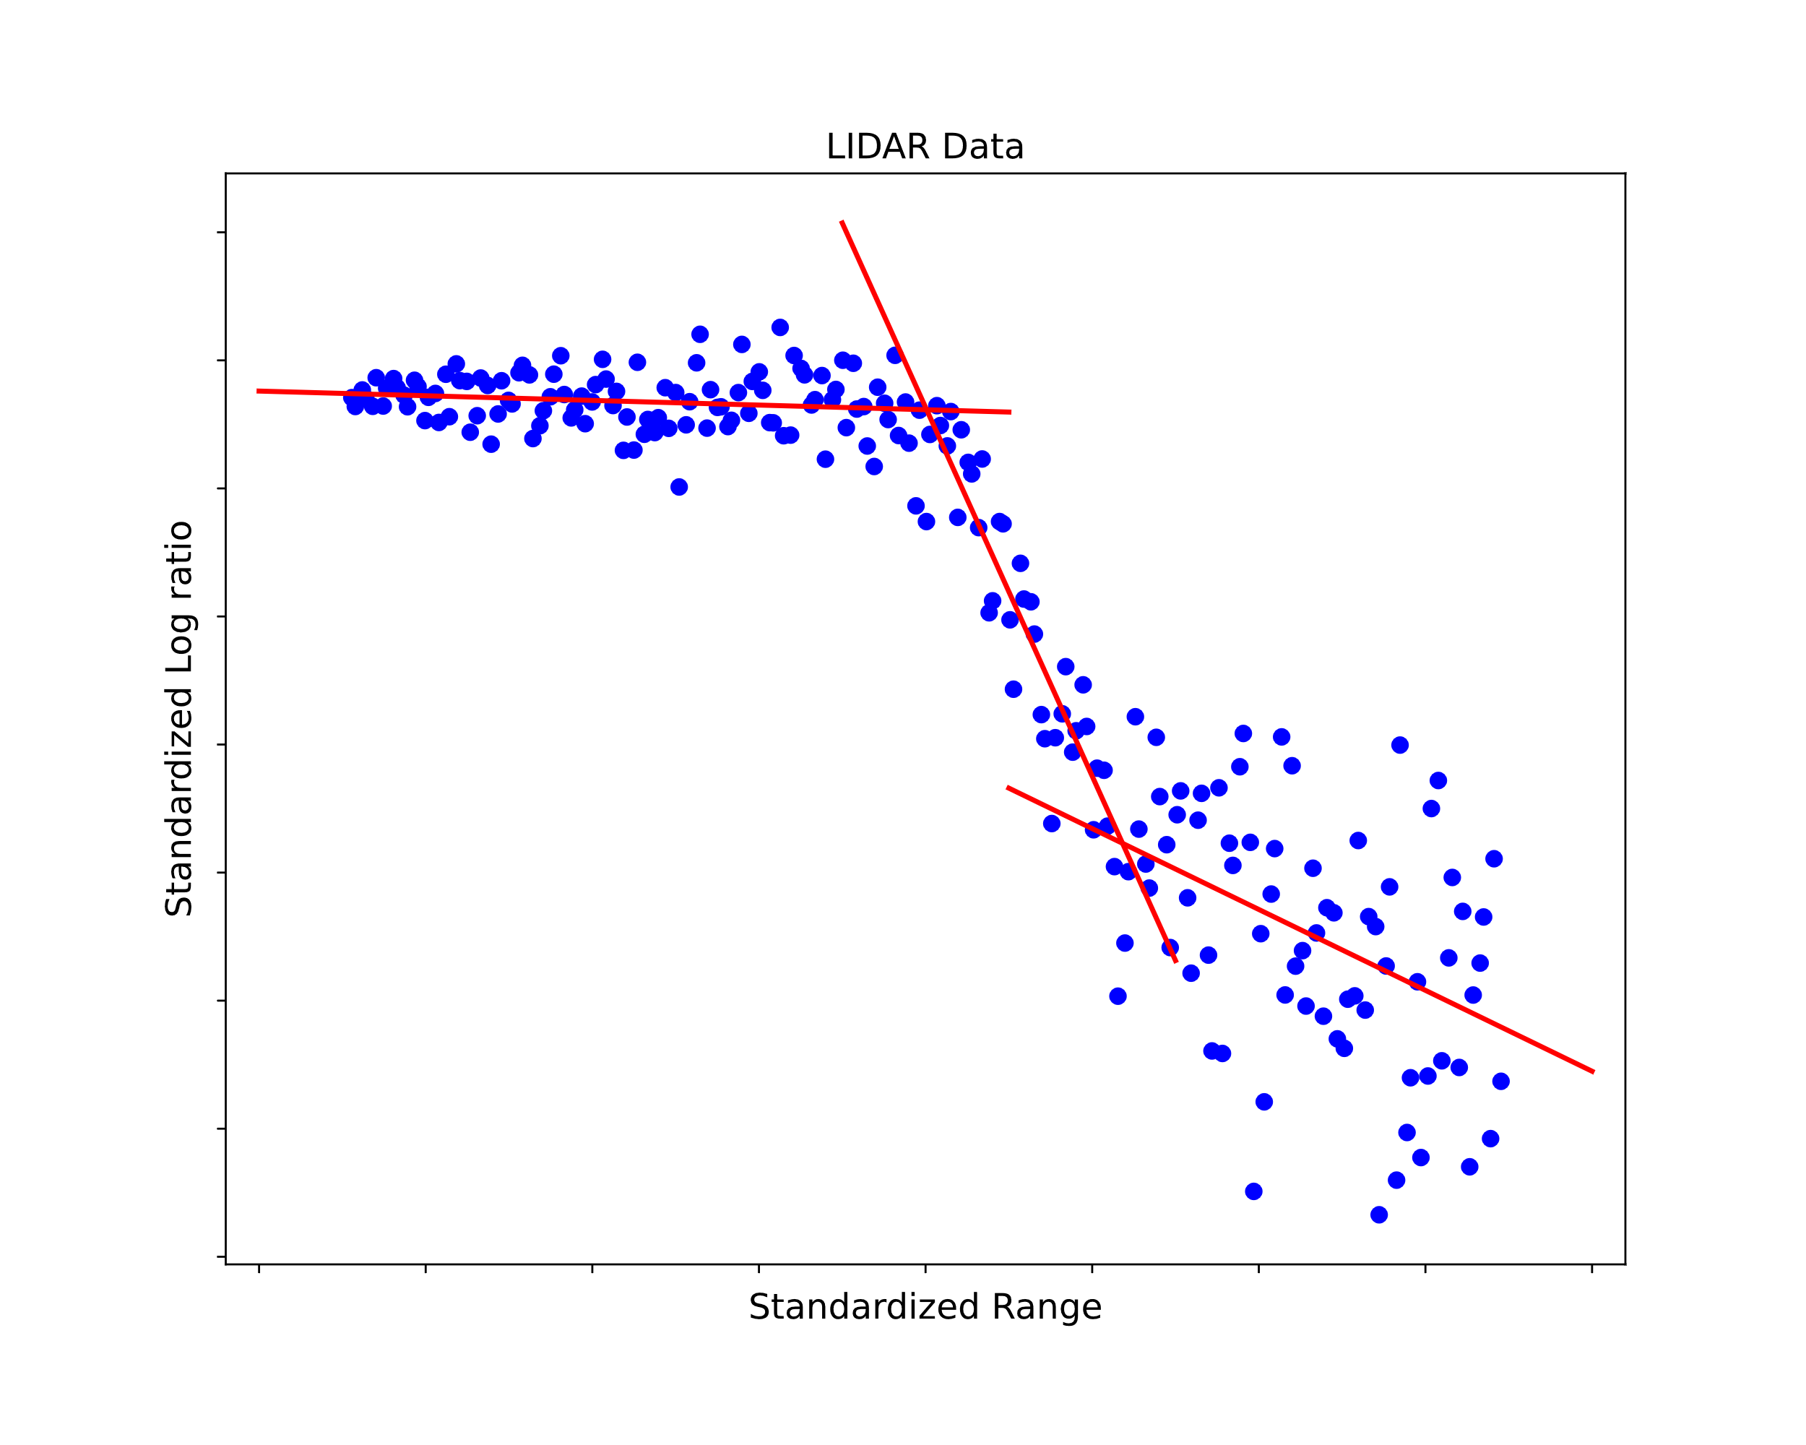
ADVI Example – Linear Splines

Slide 20
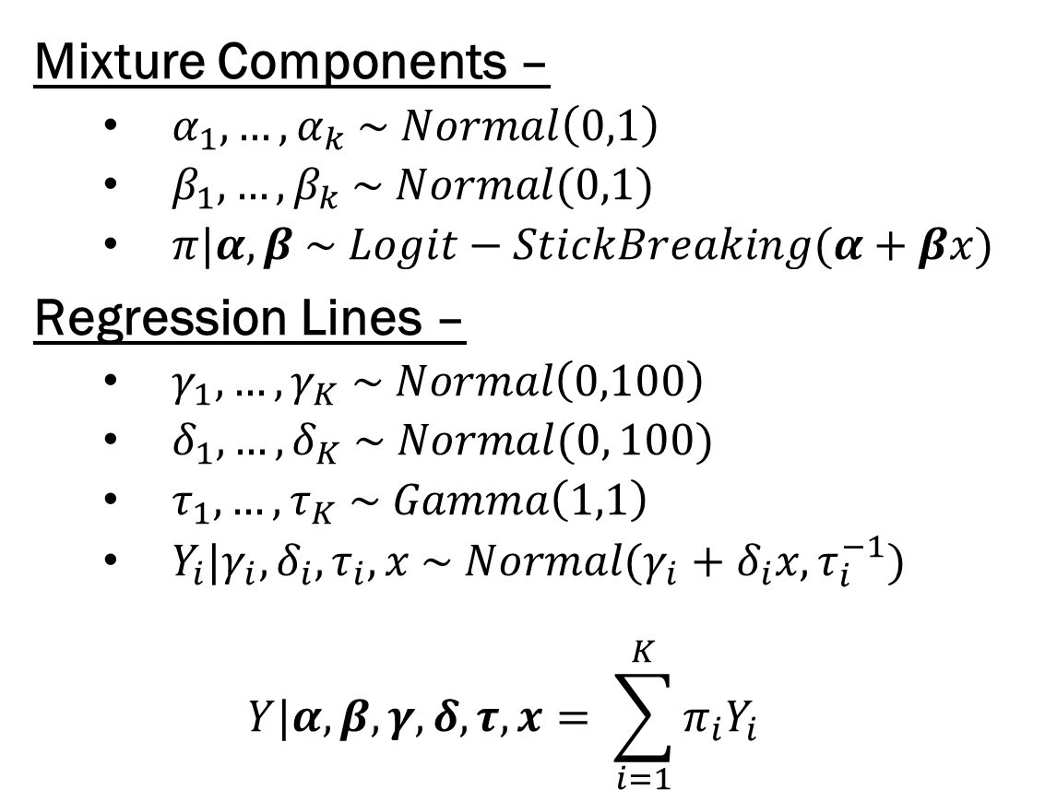
ADVI Example – Mixture of Regressions
Mixture Components –
$α_{1},…,α_{k} \sim Normal\left(0,1\right)$
$β_{1},…,β_{k} \sim Normal(0,1)$
$π|α, β \sim Logit−StickBreaking(α+βx)$
Regression Lines –
$γ_{1},…,γ_{K} \sim Normal\left(0,100\right)$
$δ_{1},…,δ_{K} \sim Normal(0, 100)$
$τ_{1},…,τ_{K} \sim Gamma\left(1,1\right)$
$Y_{i}|γ_{i},δ_{i},τ_{i},x \sim Normal(γ_{i}+δ_{i}x, τ_{i}^{−1})$
$$Y|α, β,γ,δ, τ, x= \sum_{i=1}^{K}{π_{i}Y_{i}}$$

Slide 21
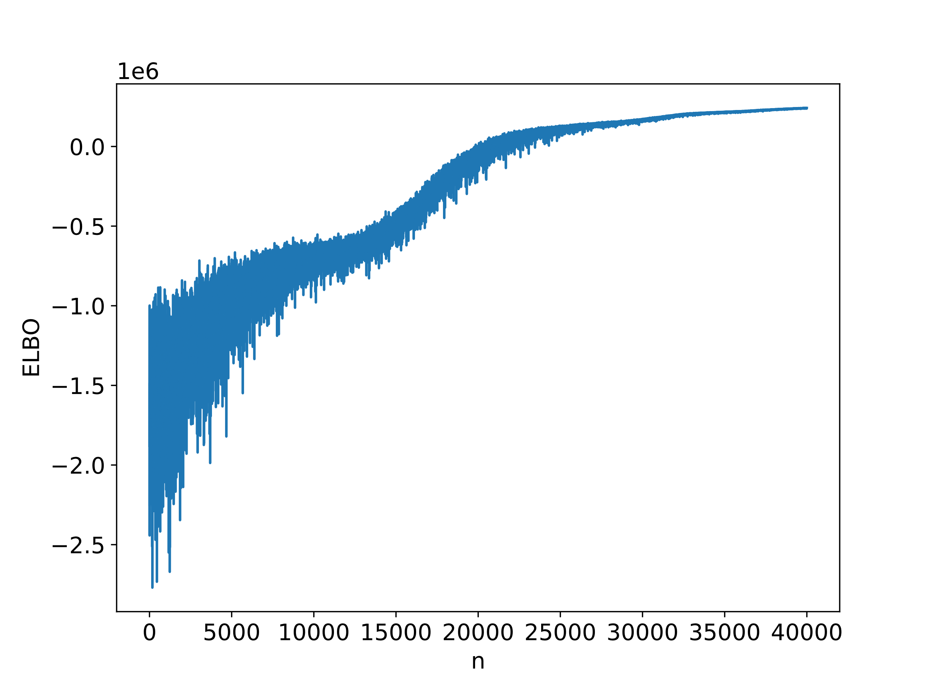
ADVI Example – Mixture of Regressions
After model setup, ADVI can be used with:
pm.fit(n=<#Iterations>, method='advi’)
<#Iterations> - A placeholder for # iterations
Besides # iterations, very little to do for tuning…
BUT: PyMC3 doesn’t stop after convergence, nor does it warn you about convergence.
Why? It’s difficult to use tolerance rules when your optimization is stochastic.
After 40000 iterations (~ 30 seconds), we get decent convergence (visually speaking…)

Slide 22
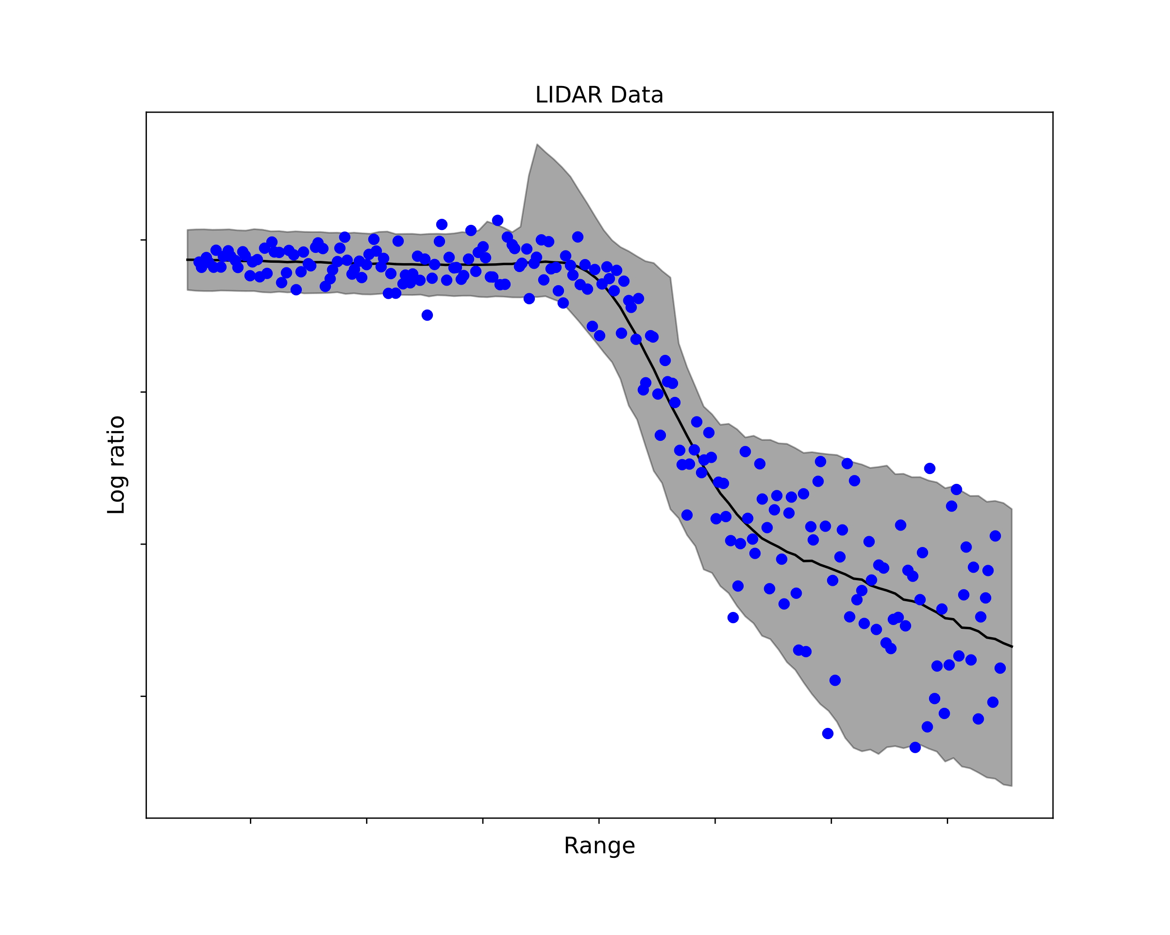
ADVI Example – Mixture of Regressions
Here, ADVI performs quite well.
Predictive EAP (thin black line)
Nicely tracks the non-linearity
We would expect that, VI tends to recover location parameters well
Predictive Credible Interval (grey shading)
Contains the spread of observations
Not many points outside (some are to be expected…)

Slide 23
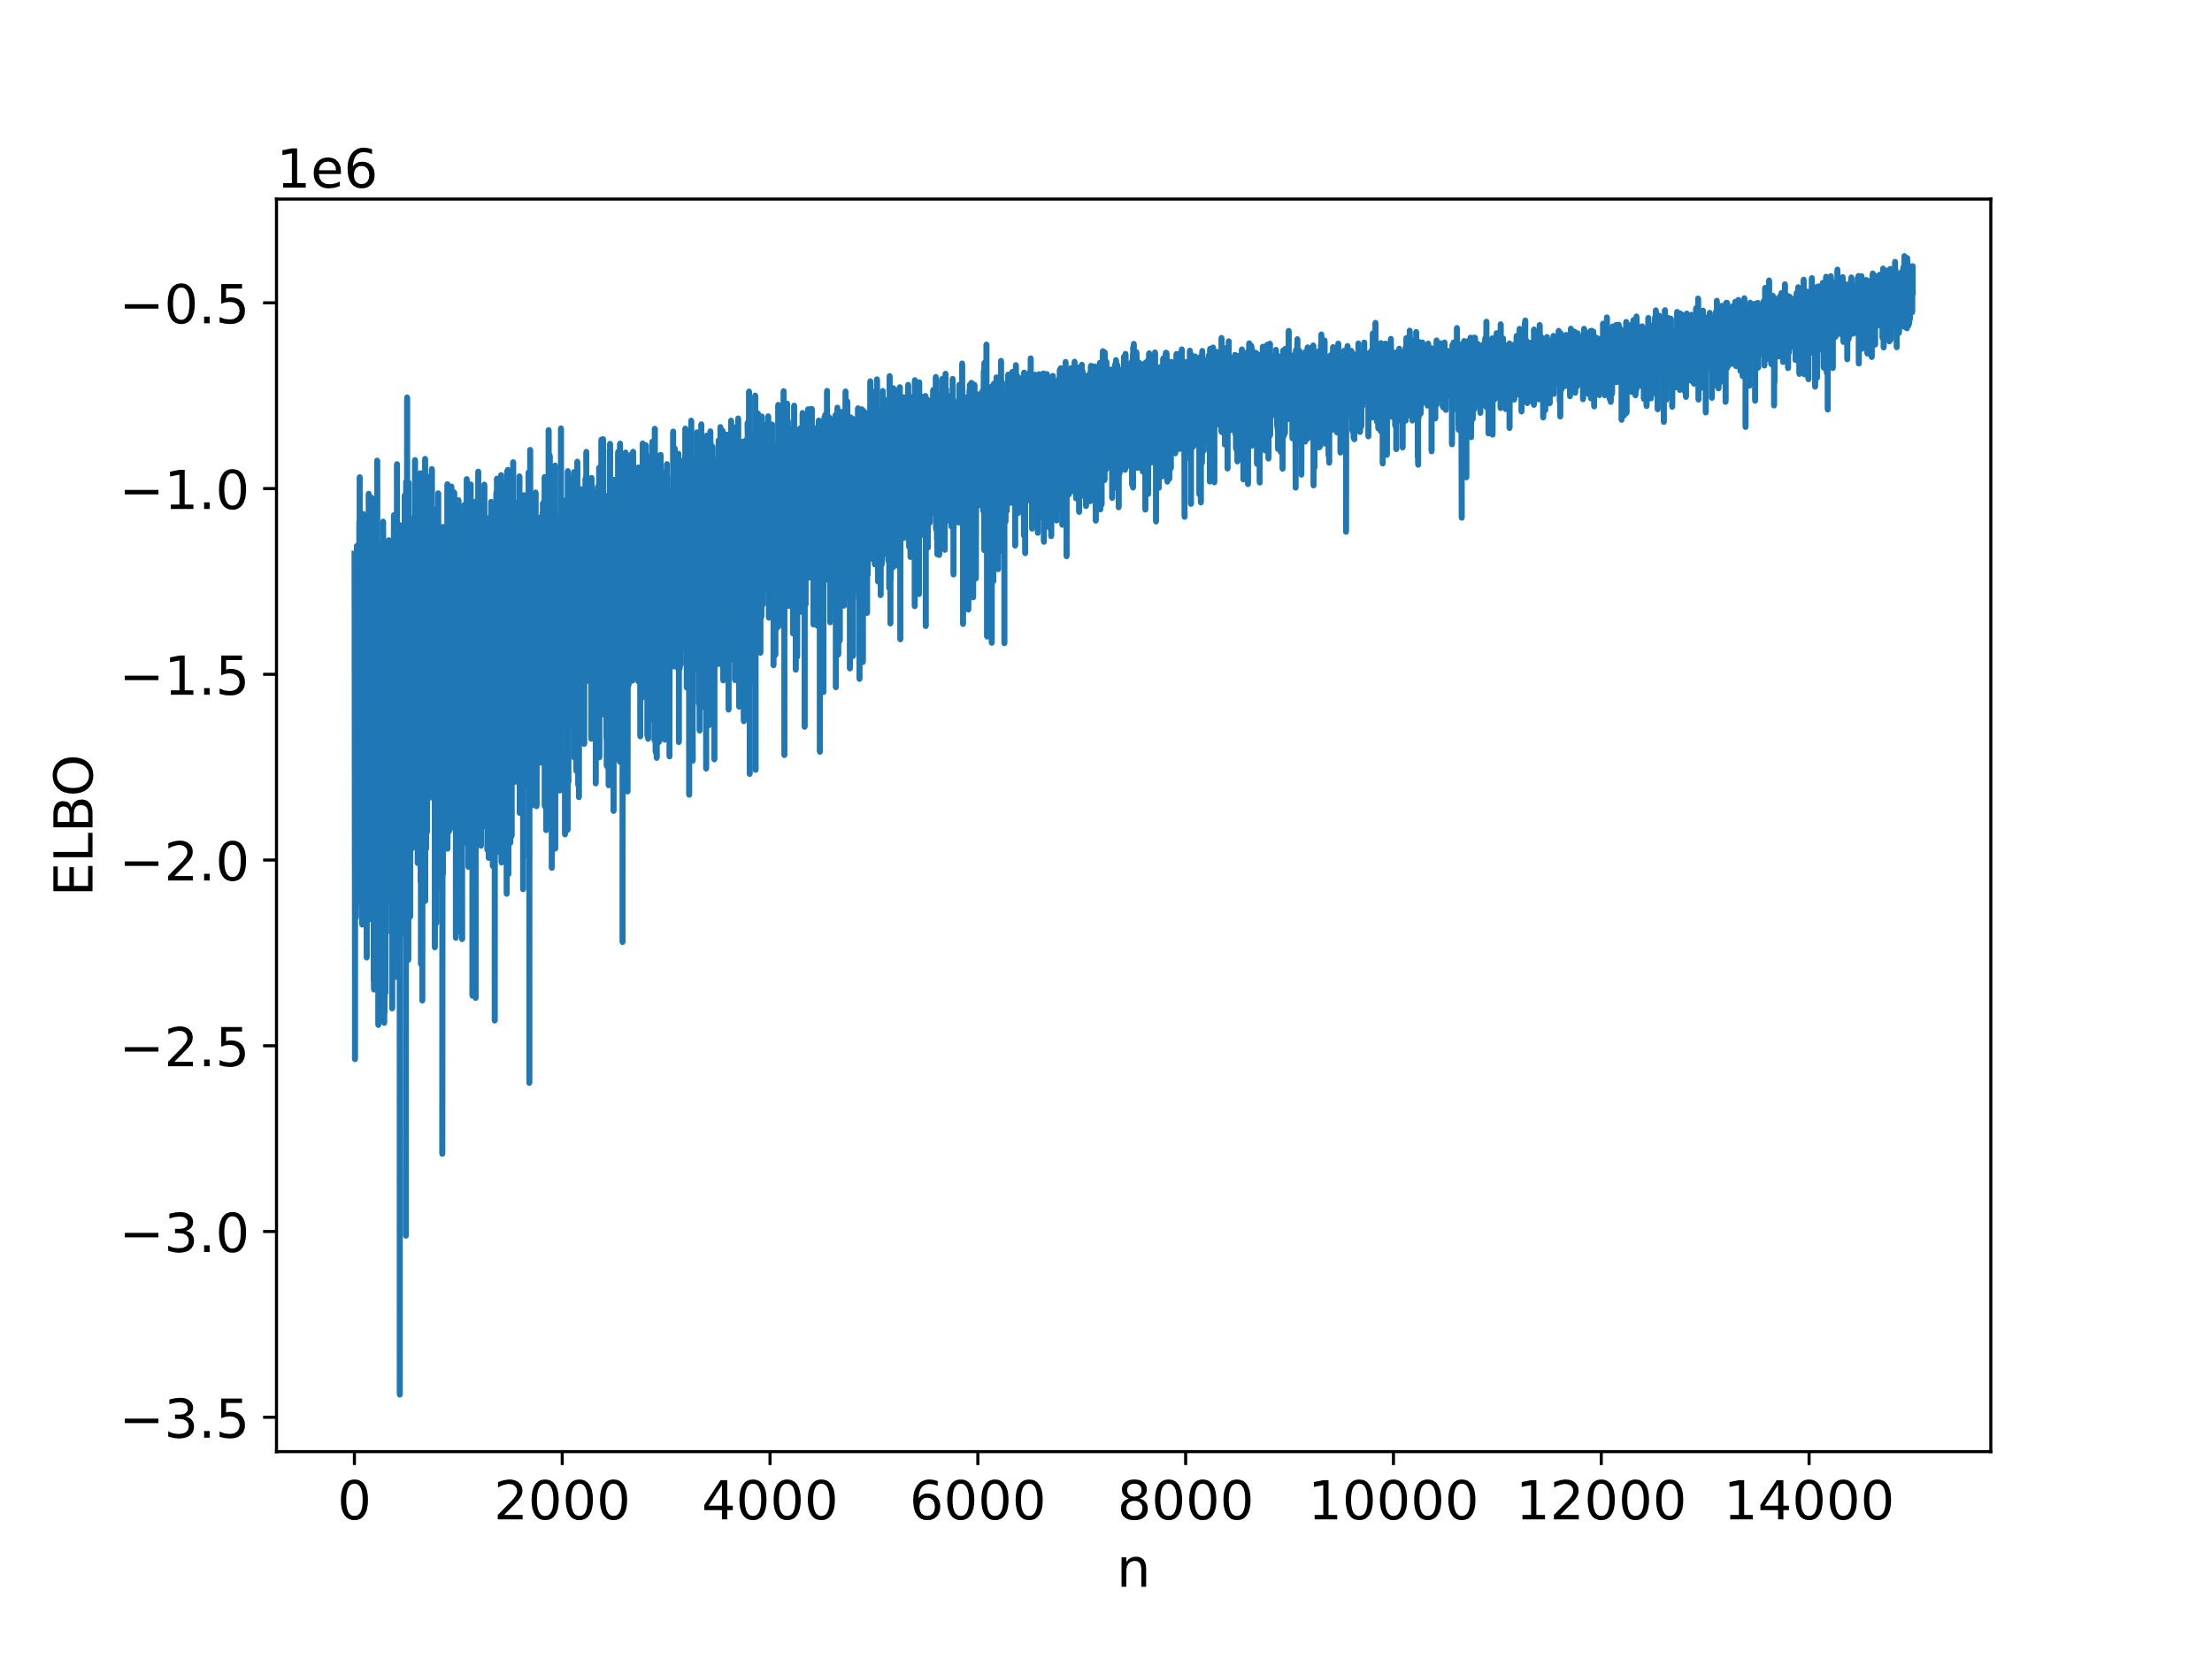
Importance of Convergence
Convergence of the ELBO is vital!
Reran previous model with 15000 iterations.
Not converged. Why?
Lack of convergence is indicated by the trend upwards, not the fluctuations

Slide 24
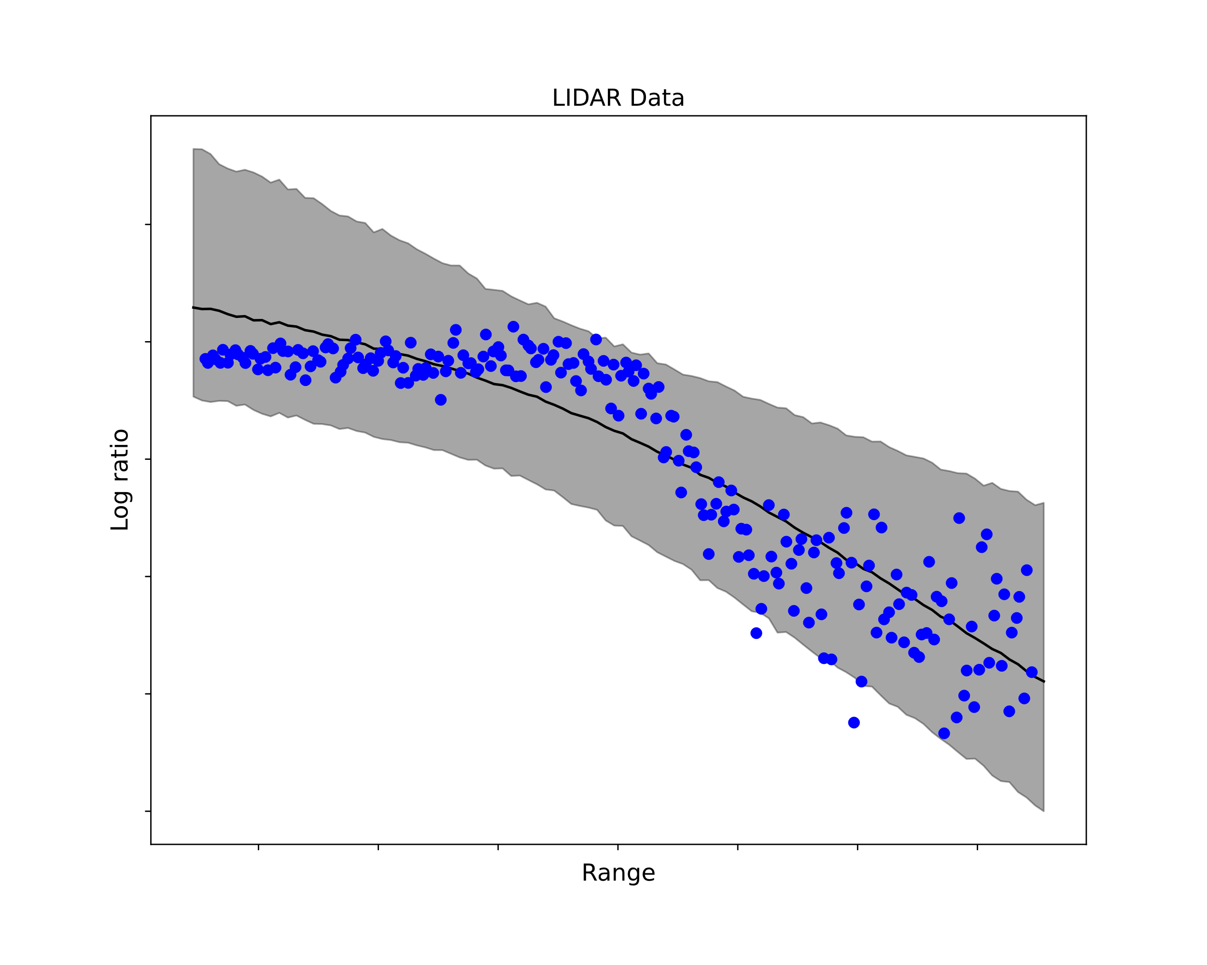
Importance of Convergence
Like with frequentist methods, you really want to have converged estimates…
Unlike with many frequentist methods, ADVI is a stochastic optimizer…
Convergence is guaranteed under certain conditions
The stochastic nature of the optimization leads to fluctuations in the ELBO
Practically speaking, you need to assess convergence yourself.

Slide 25
Summary
Automatic Differentiation Variational Inference –
Variational Inference that doesn’t require you to do math.
Requires differentiable models.
90% of the time, it works every time…
Disadvantages –
Still an approximation to the posterior.
Some models can’t be estimated with it.
Stochastic optimization can cause some confusion.

Slide 26
Next Week – Non-Parametric Bayes
Bayes, but in infinite dimensional space.
Cluster models with unknown number of clusters
Non-linear regression (like what we just saw!)
Hidden Markov Models
These methods benefit from massive datasets, and are particularly amenable to prediction
Final Week – Course Wrap Up and Summary!

