Slide 1

Non-Parametric Bayes:
Bayes for Infinite Dimensional Problems
Module 11 Live Session (8/3/2021)
DS6040 Summer 2021
Teague R. Henry

Slide 2

Course Updates
Presentations Due Last Day of Class (8/10)
Report Due 8/13
Upload presentations to Youtube/Vimeo (you can make them private)
Embed the video in the Project Presentation thread in the course Piazza

Slide 3
Outline
What is non-parametric Bayes?
Infinite Mixture Models via the Chinese Restaurant Process
Gaussian Process Models

Slide 4
Parametric Bayes
Every model we have talked about this semester is parametric
Parametric Model – A model with a fixed number of parameters
Any given regression model has a fixed number of features (and parameters)
A finite mixture model has a fixed number of mixtures
LDA/QDA has a fixed number of classes
Even Bayesian Model Averaging (or other model selection techniques) are parametric

Slide 5
Non-Parametric Bayes
Non-Parametric Models –
Models that grow/change with increasing amounts of data
Warning: Non-parametric is poorly defined
It can refer to models that do not assume parametrized distributions
Wilcoxian Sign Rank Test
Non-Parametric Bayesian Models are ones where the structure is not specified a priori.

Slide 6
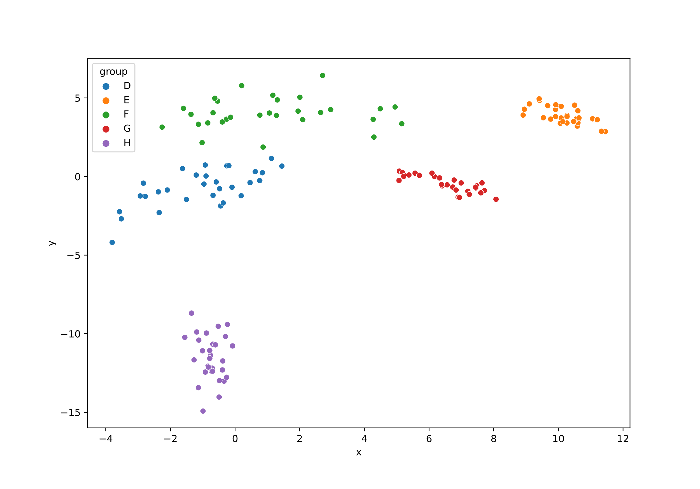
Infinite Mixture Models
Mixture Models –
Specify K components
Automatically classify observations into classes/components
How many components?
Very hard question
Important to get right

Slide 7
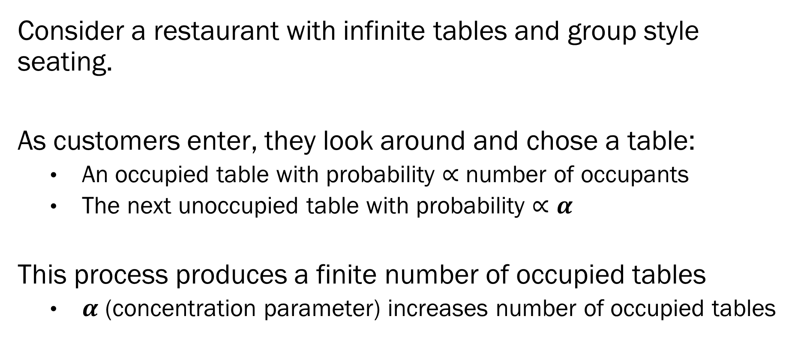
Chinese Restaurant Process
Consider a restaurant with infinite tables and group style seating.
As customers enter, they look around and chose a table:
An occupied table with probability $∝$ number of occupants
The next unoccupied table with probability $∝α$
This process produces a finite number of occupied tables
$α$ (concentration parameter) increases number of occupied tables

Slide 8




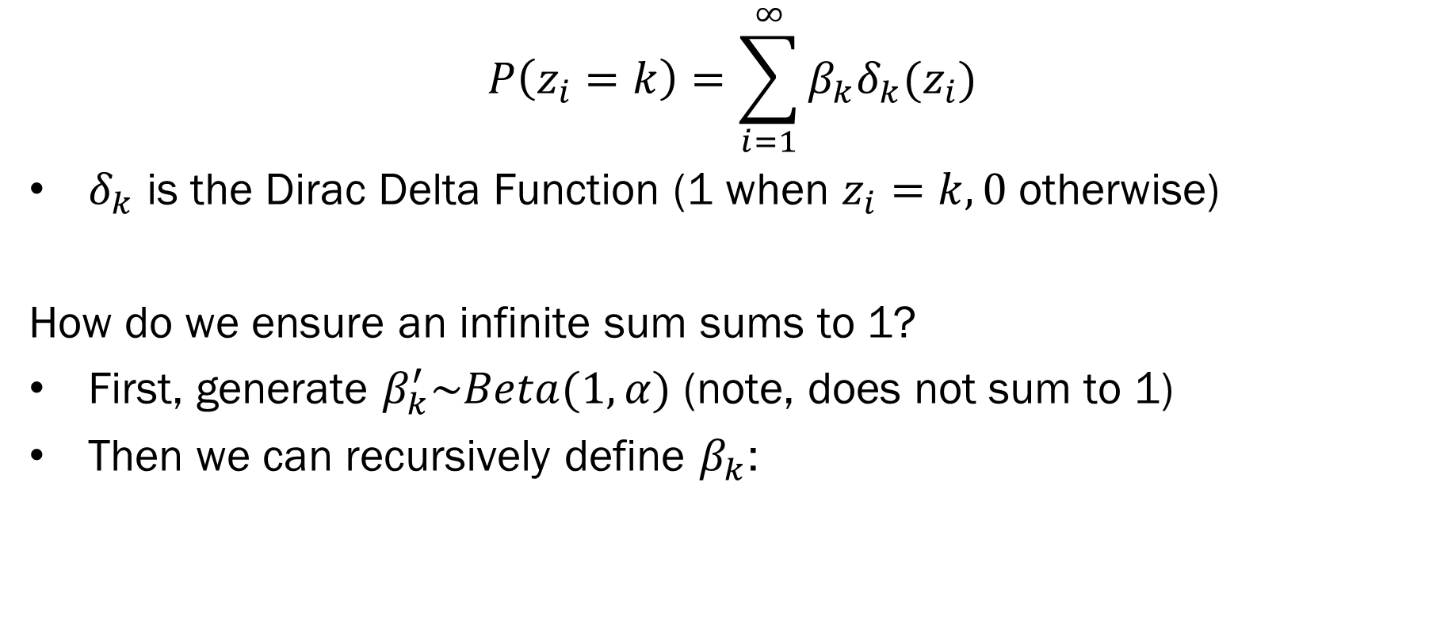






Stick Breaking Process
$$P\left(z_{i}=k\right)=\sum_{i=1}^{∞}{β_{k}δ_{k}(z_{i})}$$
$δ_{k}$ is the Dirac Delta Function (1 when $z_{i}=k, 0$ otherwise)
How do we ensure an infinite sum sums to 1?
First, generate $β_{k}^{′}\sim Beta(1,α)$ (note, does not sum to 1)
Then we can recursively define $β_{k}$:
$$β_{1}^{′}= .25$$
$$β_{2}^{′}= .20$$
$$β_{3}^{′}= .50$$
$$β_{4}^{′}= …$$
$$0$$
$$1$$
$$β_{1}= .25$$
$$β_{2}= .15$$
$$β_{3}= .30$$
$$β_{4}= …$$

Slide 9
Infinite Mixture Model
A mixture model with an infinite number of potential classes…
With a strong tendency for classes to be empty.
Conceptual difference is in how to model an infinite number of classes?
Theoretically, class membership is a Dirichlet Process
i.e the Chinese Restaurant/Stick Breaking Process
Practically, infinity doesn’t play nice with computers
We use truncated infinite mixture models – put an upper limit on occupied classes
Note that a Dirichlet Process is not the same thing as a Dirichlet Distribution
They are related though.

Slide 10
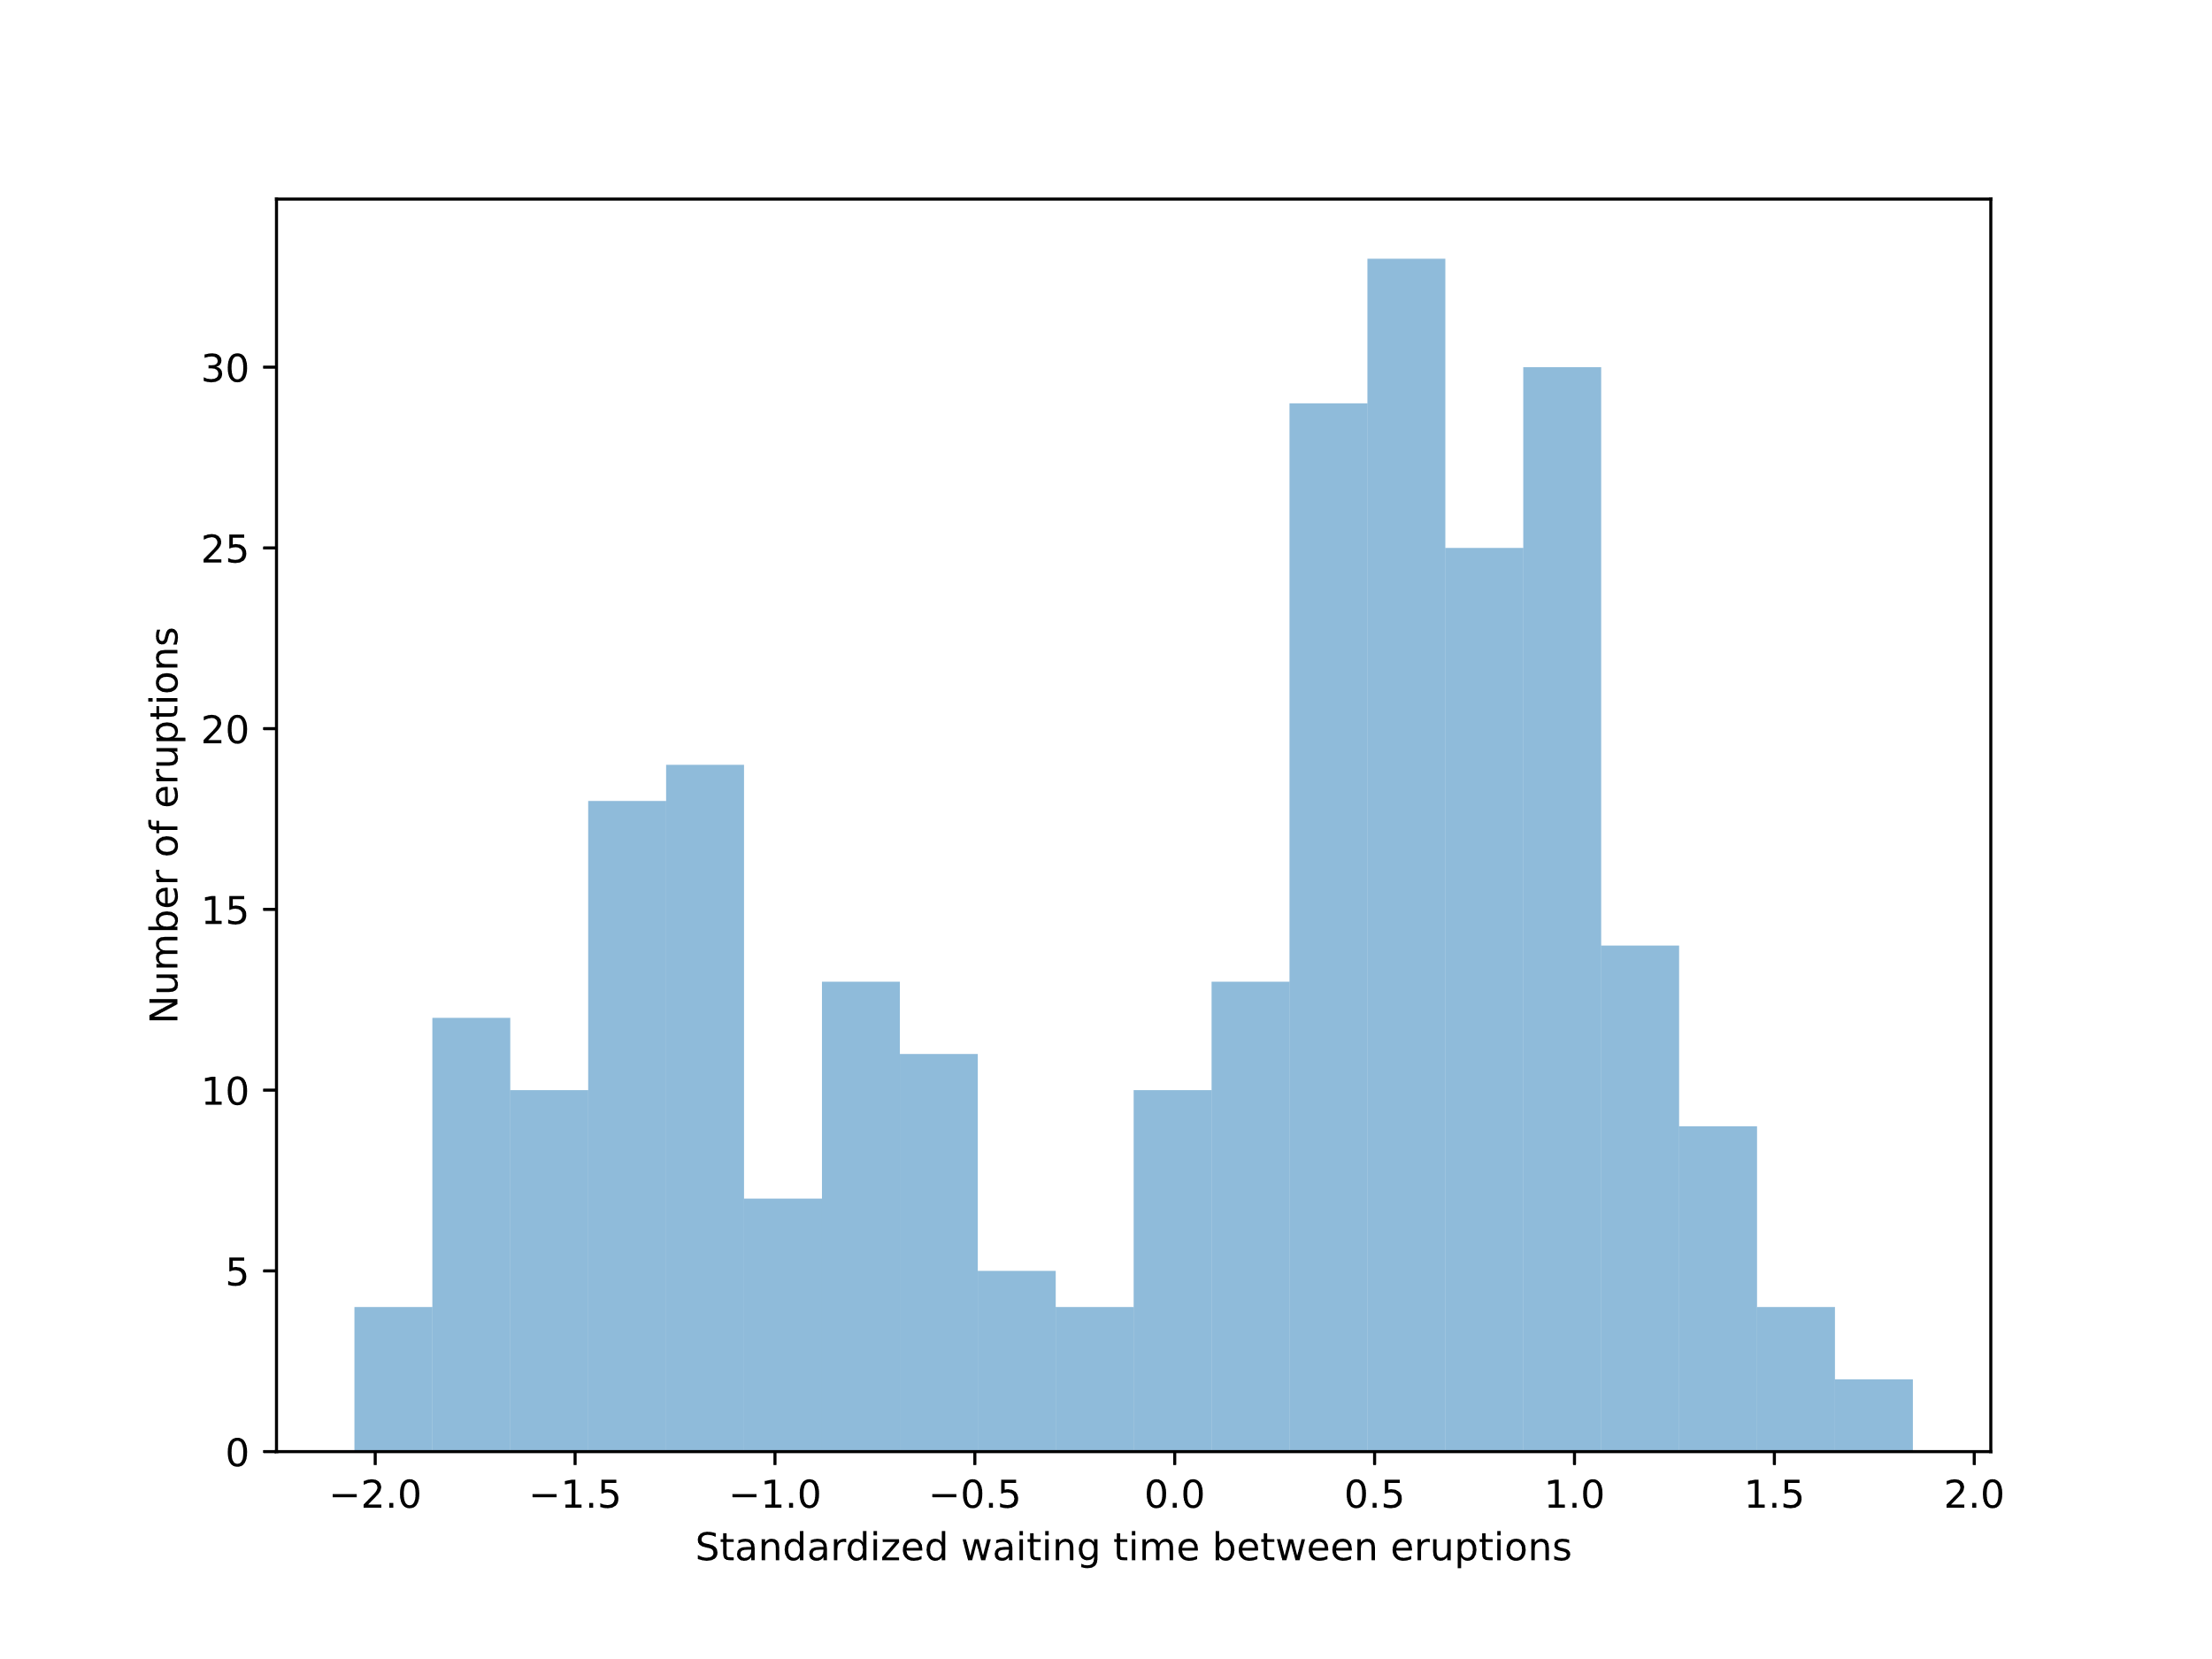
Infinite Mixture Model – Old Faithful
Old Faithful – Geyser in Yellowstone
Model wait times as an infinite mixture
Within cluster, wait times are normally distributed.
Let’s start with 30 max.

Slide 11
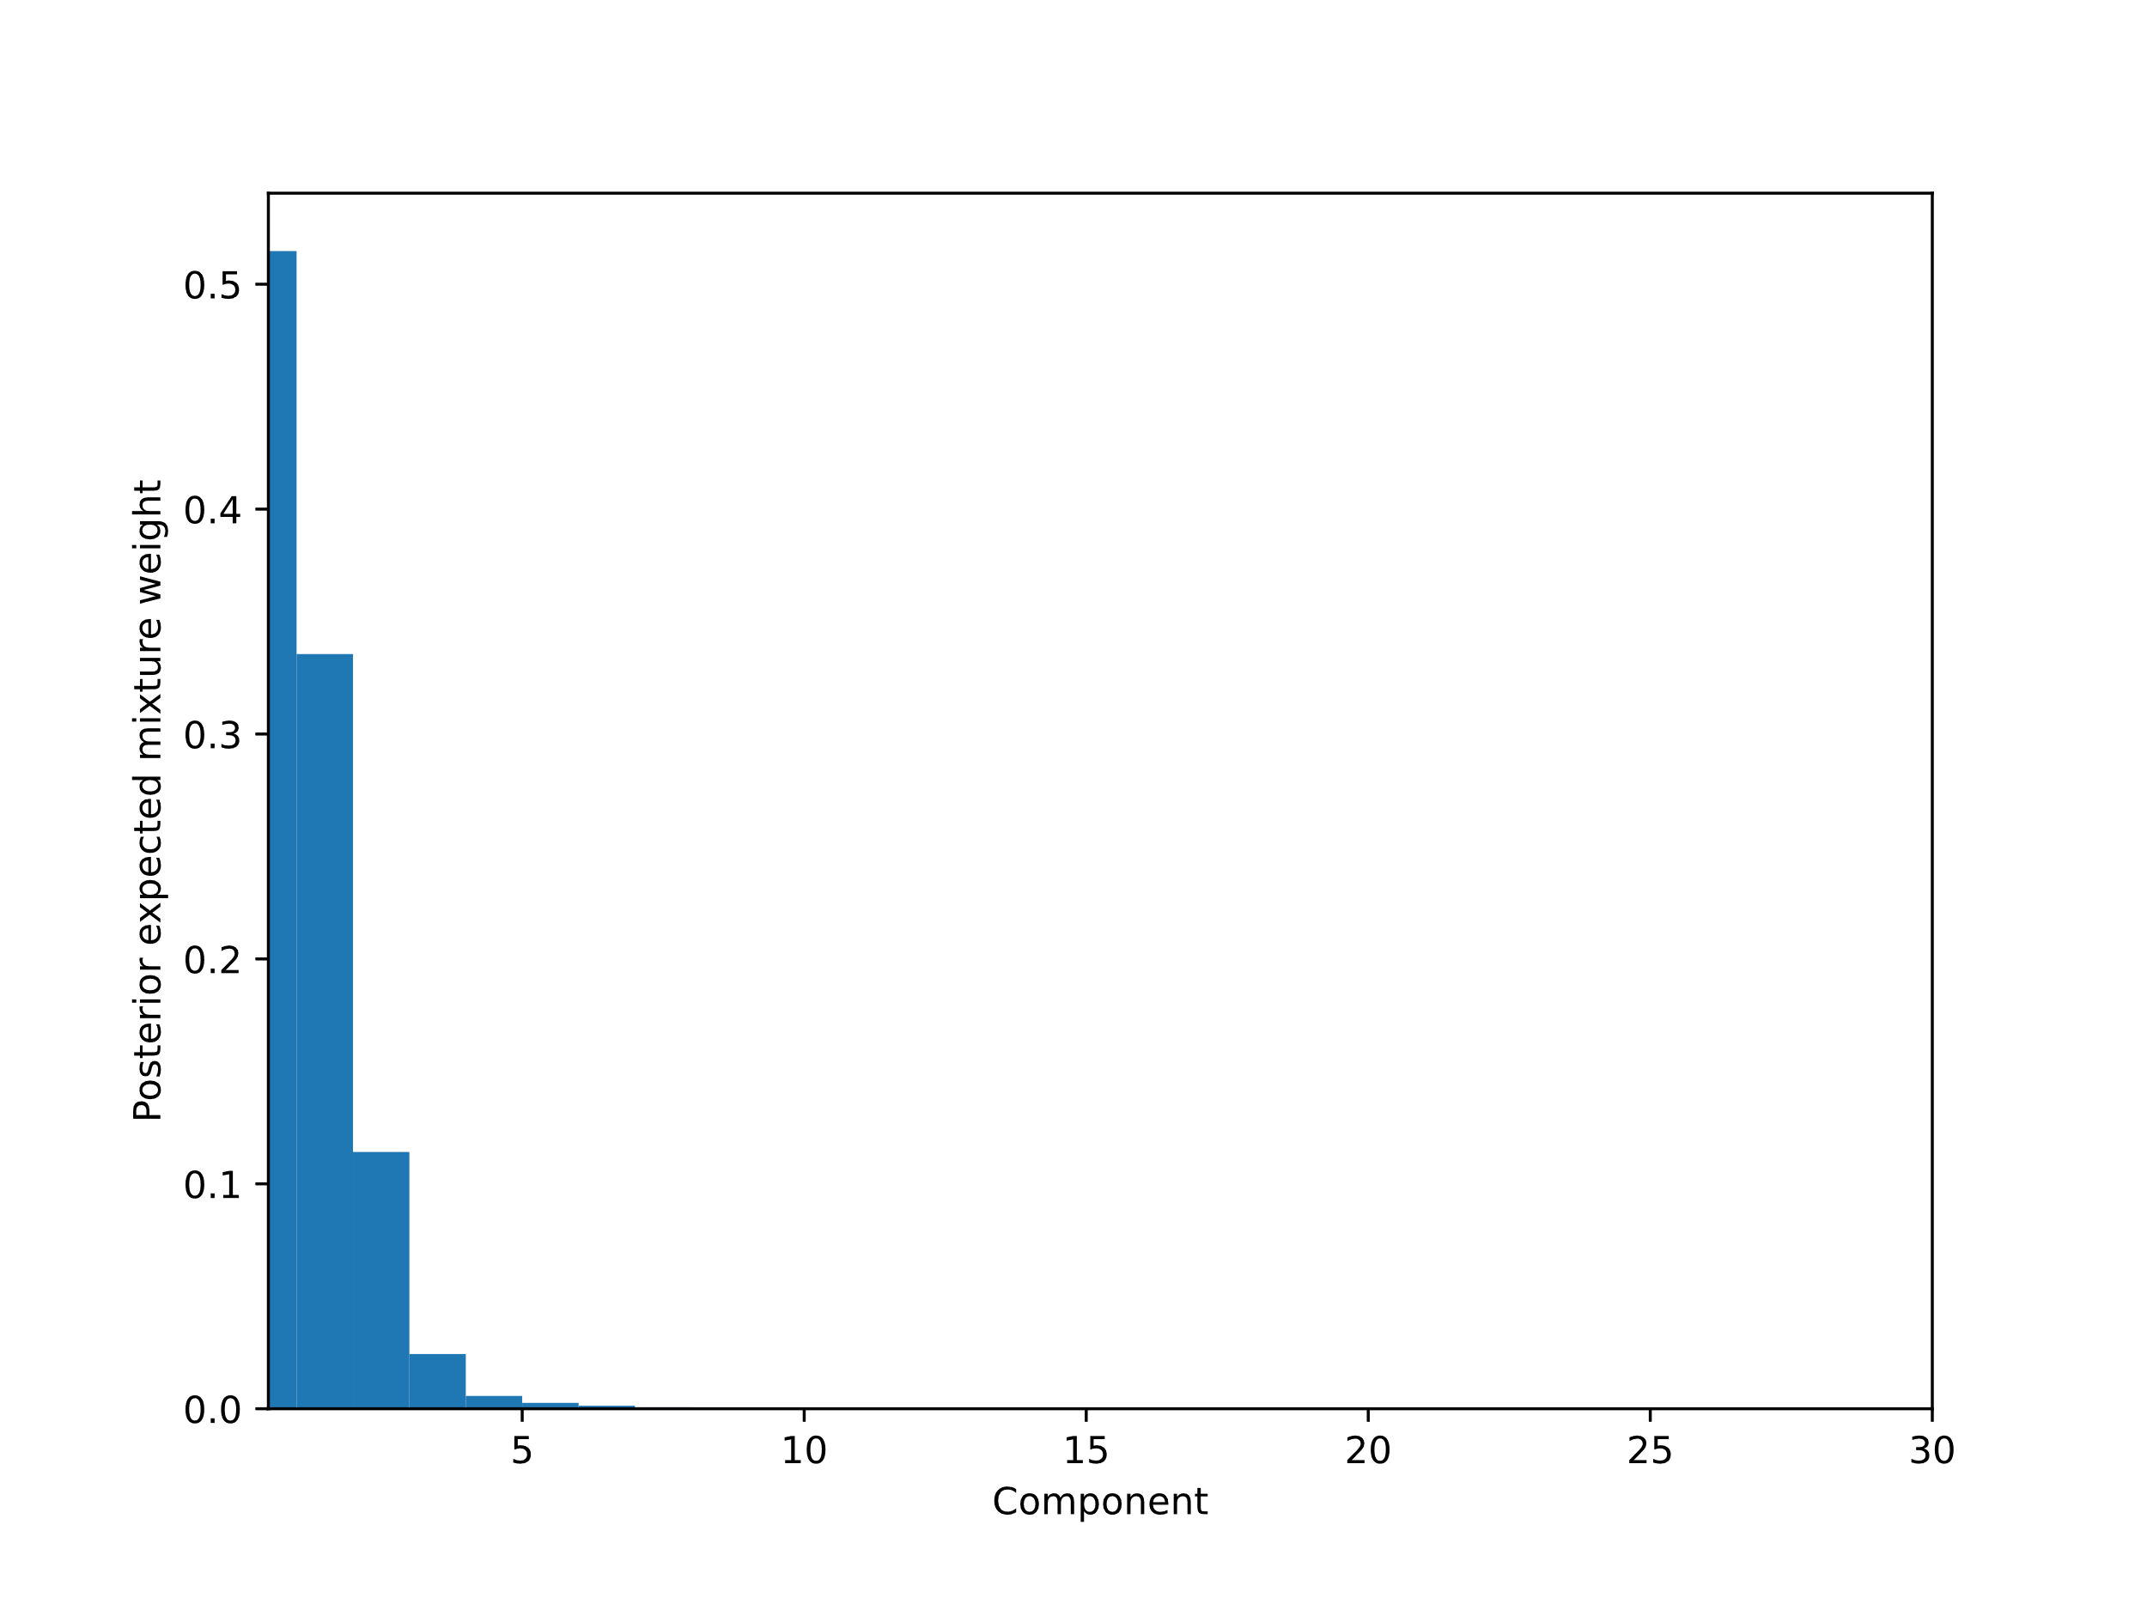
Infinite Mixture Model – Old Faithful
K = 30
def stick_breaking(beta):
portion_remaining = tt.concatenate([[1],
tt.extra_ops.cumprod(1 - beta)[:-1]])
return beta * portion_remaining
with pm.Model() as model:
alpha = pm.Gamma("alpha", 1.0, 1.0)
beta = pm.Beta("beta", 1.0, alpha, shape=K)
w = pm.Deterministic("w", stick_breaking(beta))
tau = pm.Gamma("tau", 1.0, 1.0, shape=K)
lambda_ = pm.Gamma("lambda_", 10.0, 1.0, shape=K)
mu = pm.Normal("mu", 0, tau=lambda_ * tau, shape=K)
obs = pm.NormalMixture(
"obs", w, mu, tau=lambda_ * tau,
observed=old_faithful_df.std_waiting.values
)
with model:
trace = pm.sample(1000, tune=2500, chains=2,
init="advi", target_accept=0.9, random_seed=SEED)
From: https://docs.pymc.io/pymc-examples/examples/mixture_models/dp_mix.html

Slide 12
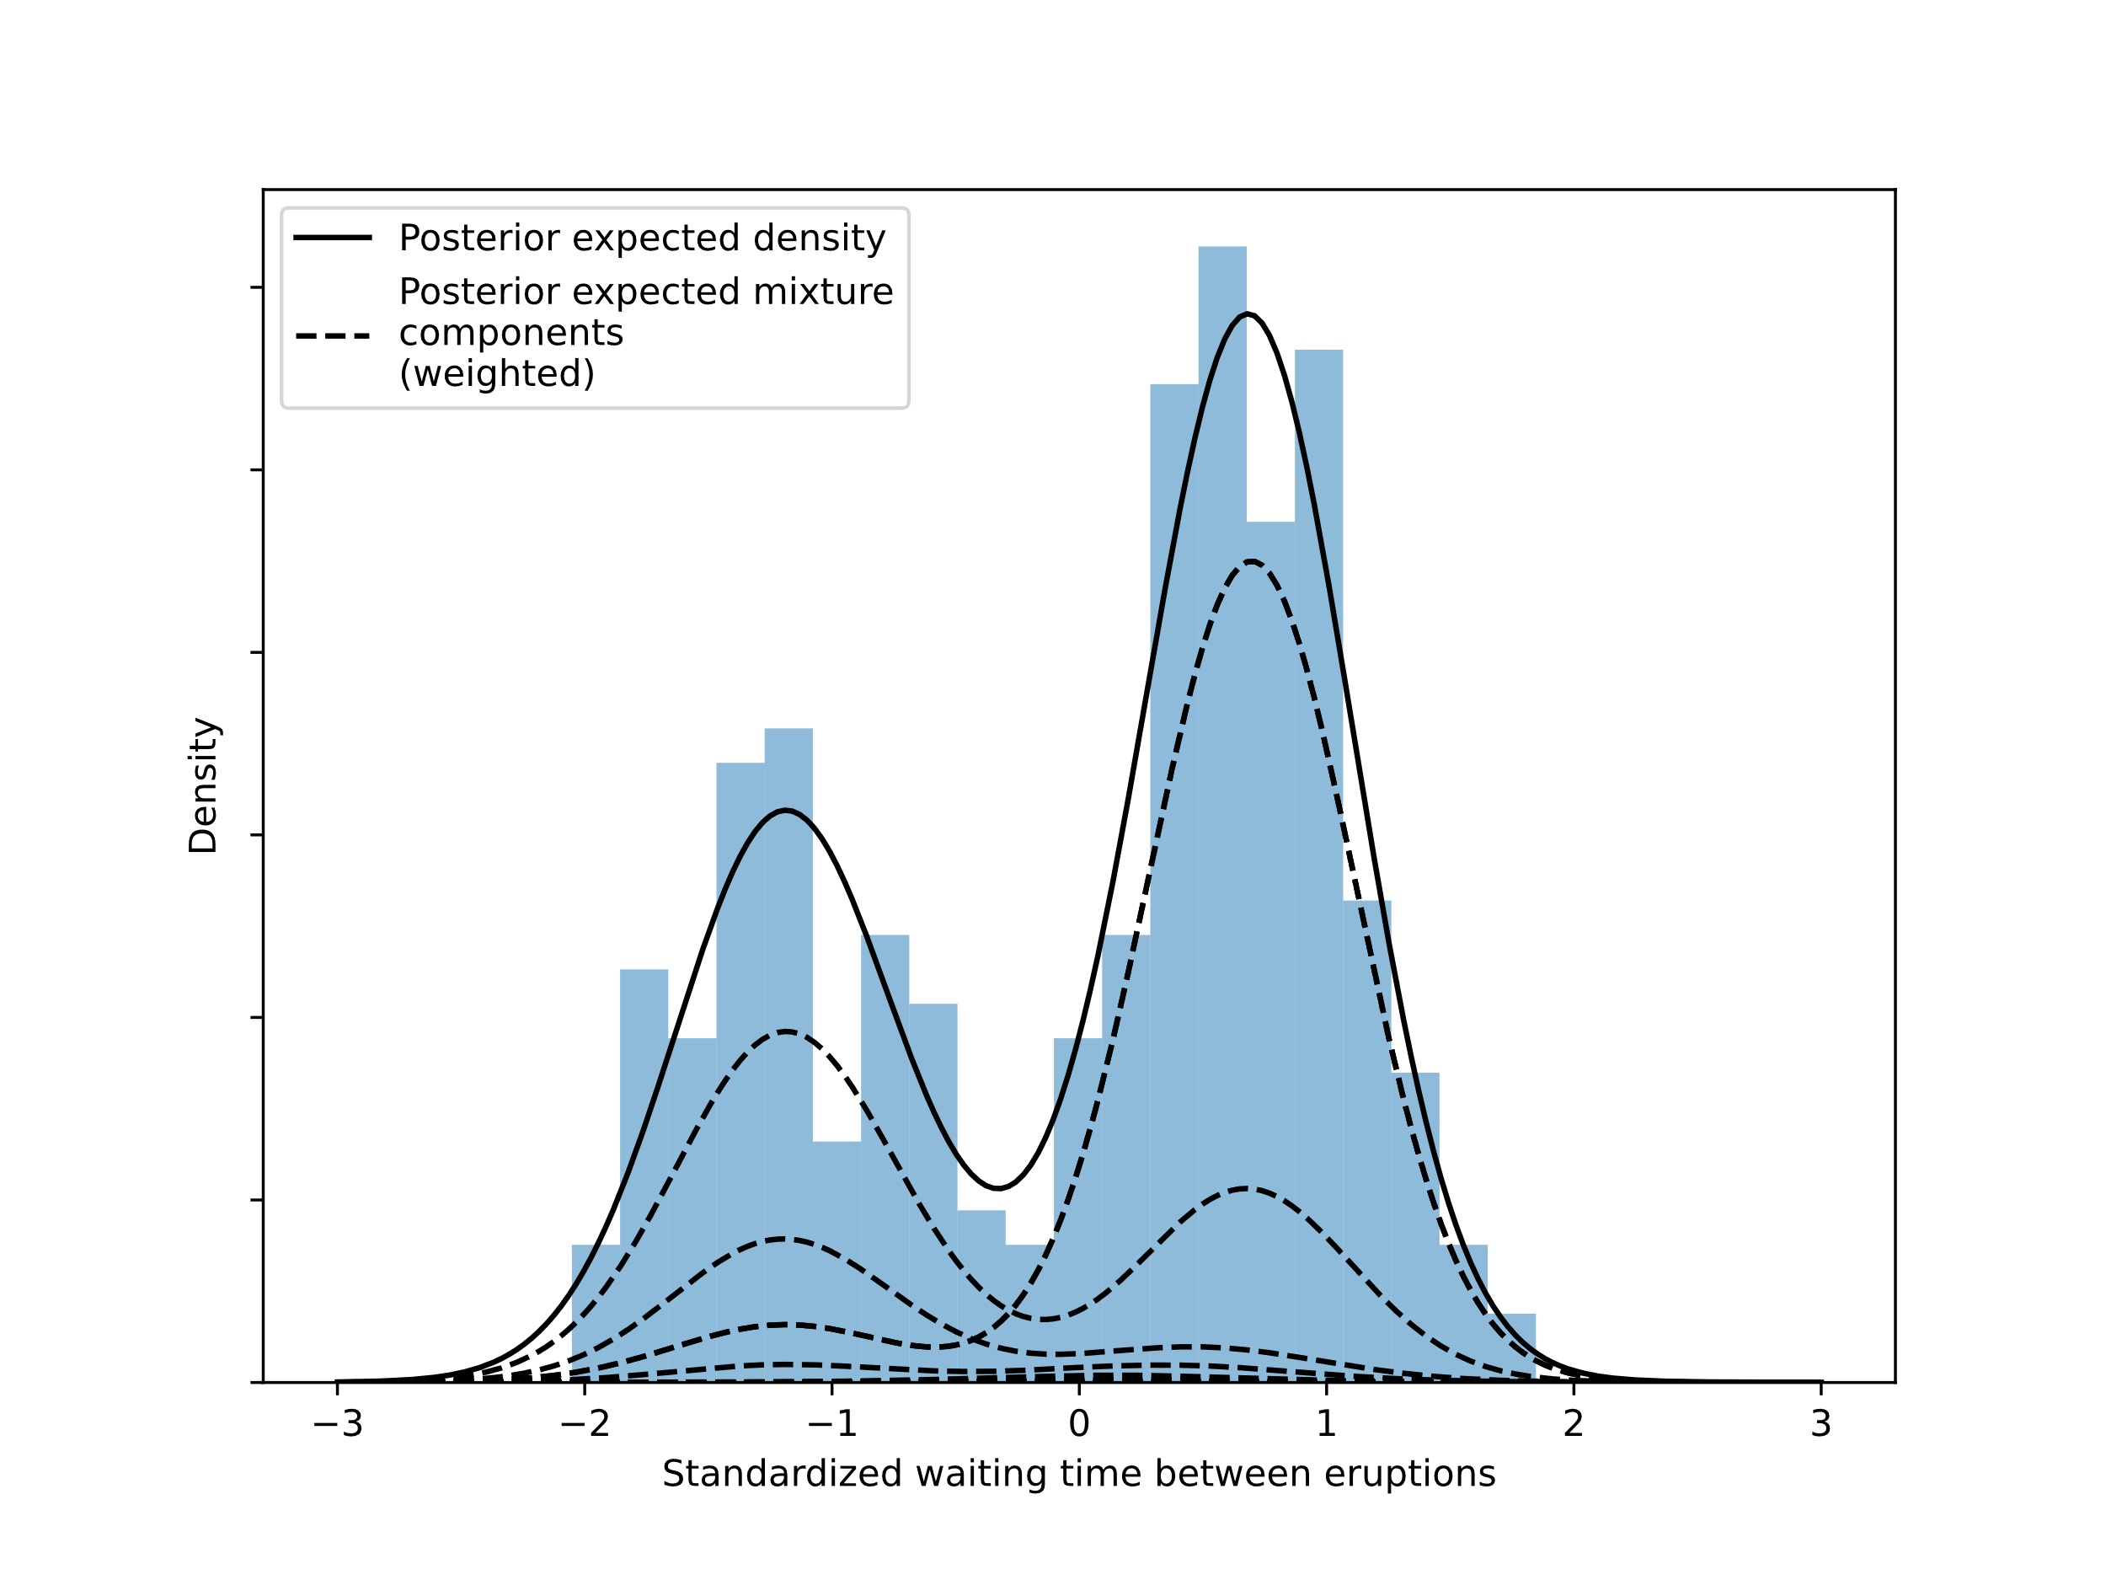
Infinite Mixture Model – Old Faithful
5 components –
Really 2 components
Ask for infinite components, get infinite components…
5 components fit the data best!
But 2 components are more interpretable…
From: https://docs.pymc.io/pymc-examples/examples/mixture_models/dp_mix.html

Slide 13
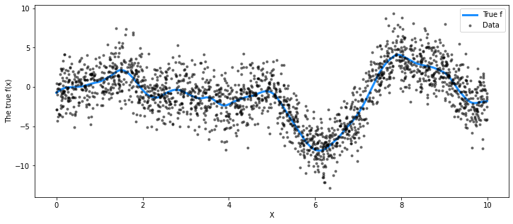
Gaussian Process Models
Infinite mixture models at a basic level are analogous to finite mixture models. But we can go further…
How can we model arbitrary functions of data?
From: https://docs.pymc.io/pymc-examples/examples/gaussian_processes/GP-SparseApprox.html

Slide 14
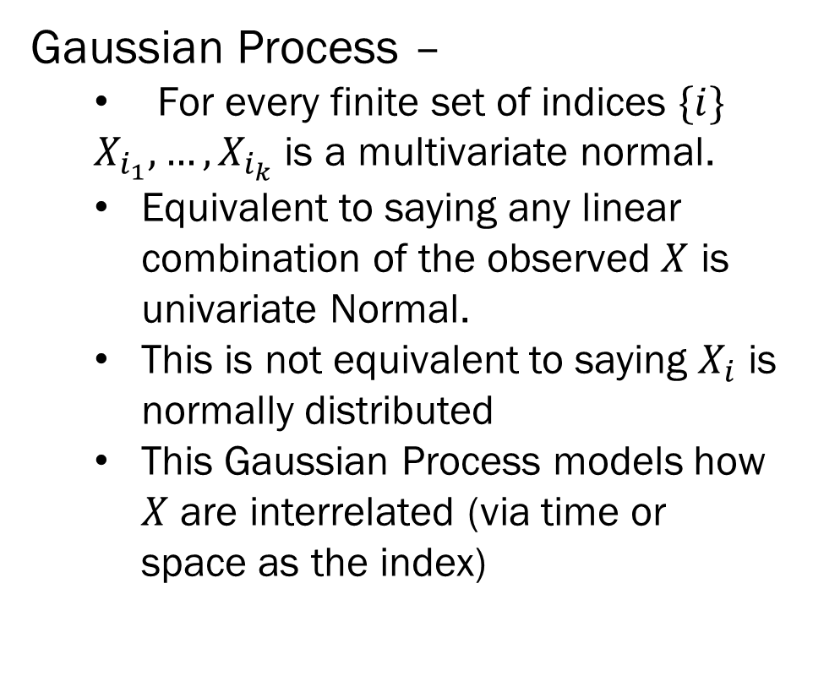
Gaussian Process Models
Gaussian Process –
For every finite set of indices $\{i\}$
$X_{i_{1}},…,X_{i_{k}}$ is a multivariate normal.
Equivalent to saying any linear combination of the observed $X$ is univariate Normal.
This is not equivalent to saying $X_{i}$ is normally distributed
This Gaussian Process models how $X$ are interrelated (via time or space as the index)
From: https://docs.pymc.io/pymc-examples/examples/gaussian_processes/GP-SparseApprox.html

Slide 15
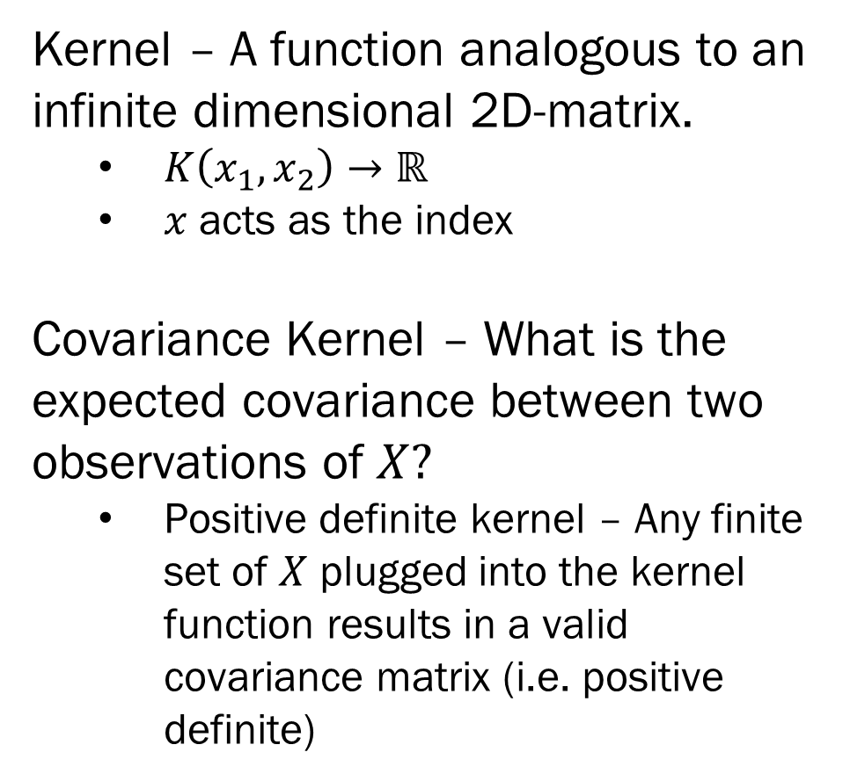
Covariance Kernels
Kernel – A function analogous to an infinite dimensional 2D-matrix.
$K\left(x_{1}, x_{2}\right)→ℝ$
$x$ acts as the index
Covariance Kernel – What is the expected covariance between two observations of $X?$
Positive definite kernel – Any finite set of $X$ plugged into the kernel function results in a valid covariance matrix (i.e. positive definite)
From: https://docs.pymc.io/pymc-examples/examples/gaussian_processes/GP-SparseApprox.html

Slide 16
Covariance Kernels
Kernel – A function analogous to an infinite dimensional 2D-matrix.
$K\left(x_{1}, x_{2}\right)→ℝ$
$x$ acts as the index
Covariance Kernel – What is the expected covariance between two observations of $X?$
Positive definite kernel – Any finite set of $X$ plugged into the kernel function results in a valid covariance matrix (i.e. positive definite)
From: https://docs.pymc.io/pymc-examples/examples/gaussian_processes/GP-SparseApprox.html

Slide 17
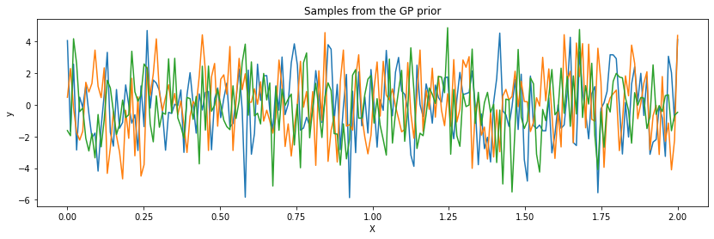
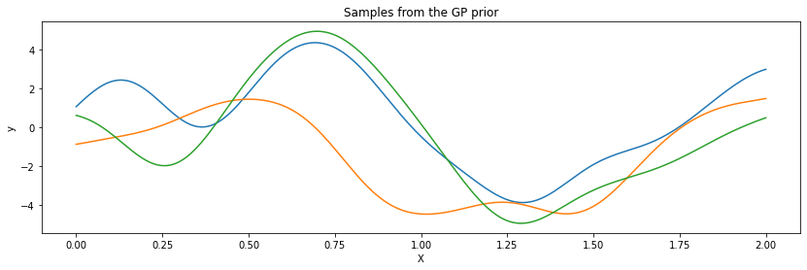
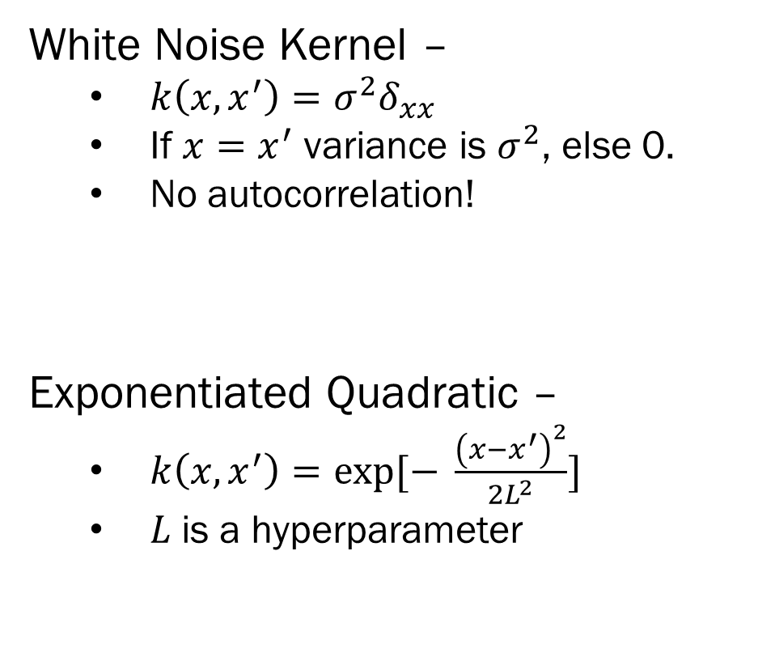
Covariance Kernels
White Noise Kernel –
$k\left(x, x^{′}\right)=σ^{2}δ_{xx}$
If $x=x^{′}$ variance is $σ^{2}$, else 0.
No autocorrelation!
Exponentiated Quadratic –
$k\left(x, x^{′}\right)=\exp{[− \frac{{\left(x−x^{′}\right)}^{2}}{2L^{2}}]}$
$L$is a hyperparameter
From: https://docs.pymc.io/pymc-examples/examples/gaussian_processes/GP-SparseApprox.html

Slide 18
Choosing Covariance Kernels
Covariance kernels define the functional form of your data.
For example:
Exponential Quadratic kernels allow for smooth trends
White noise allows for uncorrelated white noise…
Kernels, because they produce positive definite matrices, can be combined:
Additively: An exponential quadratic + white noise allows for trend with additional variance around the trend.
Multiplicatively: Kernels multiplied together result in valid covariance matrices.
From: https://docs.pymc.io/pymc-examples/examples/gaussian_processes/GP-SparseApprox.html

Slide 19
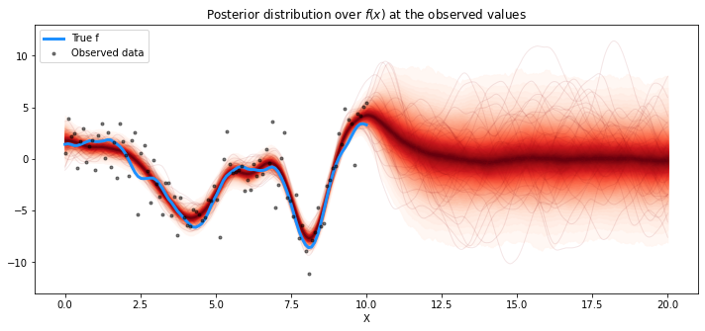
What Gaussian Process Models Do
The construction of a GP model is complex, but fundamentally, GP models are approximating complex non-linear functions.
They can be used for inference, as you can interpret the various kernel estimates, but this is difficult
They are much better for prediction…
From: https://docs.pymc.io/pymc-examples/examples/gaussian_processes/GP-SparseApprox.html

Slide 20
Gaussian Process Models in PyMC3
PyMC3 has a dedicated GP module, with many covariance functions already defined.
X = np.linspace(0, 1, 10)[:,None]
with pm.Model() as marginal_gp_model:
ℓ = pm.Gamma("ℓ", alpha=2, beta=1)
η = pm.HalfCauchy("η", beta=5)
cov = η ** 2 * pm.gp.cov.Matern52(1, ℓ)
gp = pm.gp.Marginal(cov_func=cov)
σ = pm.HalfCauchy("σ", beta=5)
y_ = gp.marginal_likelihood("y", X=X, y=y, noise=σ)
The above code defines a GP with a Matern covariance and marginal white noise with a HalfCauchy prior. ℓ and η have Gamma and Half Cauchy priors
From: https://docs.pymc.io/pymc-examples/examples/gaussian_processes/GP-SparseApprox.html

Slide 21
Summary
Non-Parametric Bayes –
When the structure of the model needs to be flexible and grow with increasing data.
Infinite mixture models allow one to determine the number of components rather than setting it a priori
Gaussian Process Models allow for the modeling and prediction of arbitrary non-linear models
Inference (interpreting what each parameter estimate means) is difficult with these models
But prediction is much simpler!
Next Week – Course Wrap-up and Summary!
From: https://docs.pymc.io/pymc-examples/examples/gaussian_processes/GP-SparseApprox.html

