Slide 1

Everything You Need to Know About Bayes
Module 12 Live Session (8/10/2021)
DS6040 Summer 2021
Teague R. Henry

Slide 2

Course Updates
Please upload and embed your presentations in the Piazza Thread!
Course Evaluations are now open!
Final Project Reports and Presentations due Friday!

Slide 3
Outline
Bayes Theorem Redux
What are Priors?
Specifying a Model
Estimating Bayesian Models
Reporting Bayesian Results
Bayesian Statistics Vs. Frequentist Statistics
Final Thoughts on Bayesian Statistics
Some Final Thoughts on Data Science

Slide 4
Bayes’ Theorem Redux
Statistics/Data Science/ML has two major components –
Represent Complex Data using Simplifications
All models are data reductions going from full complexity (all your data, all your features, all your observations) to a smaller, more understandable set of parameters (1000’s of observations with 10 features -> 10 regression coefficients)
Quantify How “Good” Our Simplifications Are
Frequentists do this by comparing models against a null model
If our data was generated according to the null, how likely would these parameters be?
Bayesians do this by making an initial guess about what the model should be
If this is our prior guess, how does data update those expectations?

Slide 5
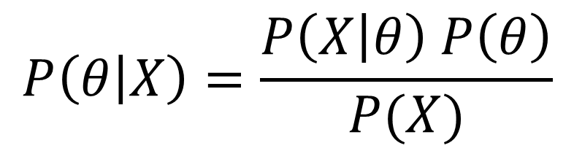

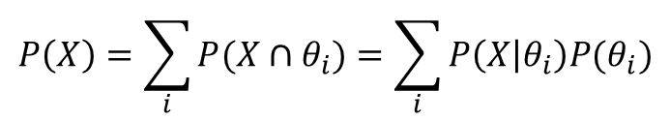
Bayes’ Theorem
Likelihood
(Probability of Data Given Model)
Posterior Distribution
(Probability of Model Given Data)
$$P\left(θ | X\right)=\frac{P\left(X | θ\right) P\left(θ\right)}{P(X)}$$
Prior Distribution
(Probability of Model)
$$P\left(X\right)=\sum_{i}{P(X∩θ_{i})}=\sum_{i}{P\left(X | θ_{i}\right)P(θ_{i})}$$
Marginal Distribution
(Probability of Data)
Probability of your data occurring for any choice of $θ$
Note: Possible $θ_{i}$ are constrained by the model type.

Slide 6
Why Bayes?
The Posterior – The probability of the model given the data
This is a direct, interpretable, measure of how well our model represents the data.
The posterior is everything that frequentist statistics wants, but cannot obtain. Why?
All inference (making claims about the underlying structure of data) exacts a price. Frequentists pay this price using asymptotics and null distributions.
Bayesian statistics pays this by requiring priors

Slide 7
Priors
Every parameter or unobserved latent variable in your model has a prior
Even though data can be associated with a parameter (i.e. a regression coefficient), the parameter has a prior, not the data.
A prior is a distribution over possible values that parameter can take.
A prior is what you think the parameter will be before you see the data.
Priors can be proper – a known distribution like the Normal or Gamma
Priors can be improper – Not a “known distribution” (i.e. a constant)
Really, a prior is improper if you don’t know the normalizing constant to make it a real probability distribution (the technical definition of improper)
Priors can be conjugate – they play nicely with the likelihood and the posterior is directly calculatable.
Priors can be non-conjugate – The resulting posterior doesn’t have a “known” distribution.

Slide 8
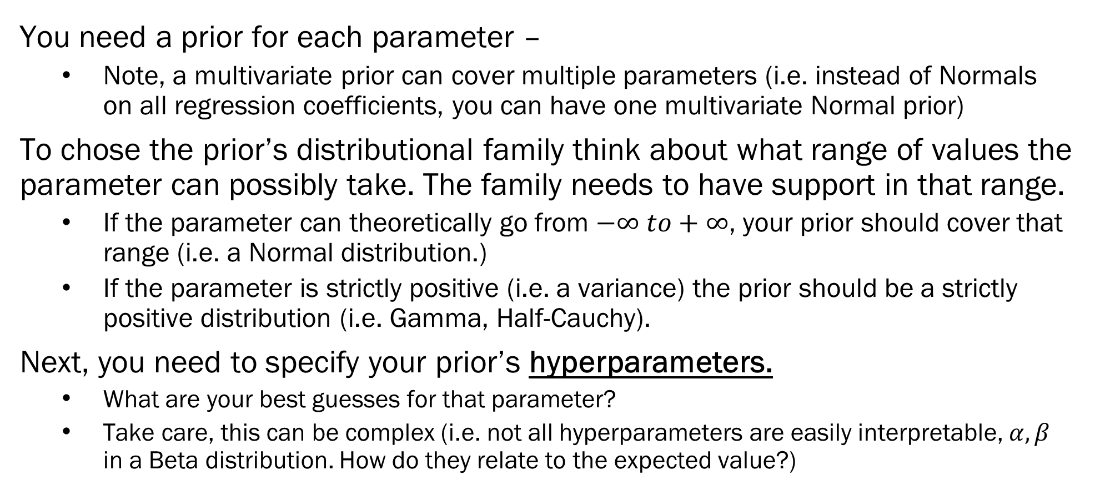
How Do You Chose Your Priors?
You need a prior for each parameter –
Note, a multivariate prior can cover multiple parameters (i.e. instead of Normals on all regression coefficients, you can have one multivariate Normal prior)
To chose the prior’s distributional family think about what range of values the parameter can possibly take. The family needs to have support in that range.
If the parameter can theoretically go from $−∞ to+∞$, your prior should cover that range (i.e. a Normal distribution.)
If the parameter is strictly positive (i.e. a variance) the prior should be a strictly positive distribution (i.e. Gamma, Half-Cauchy).
Next, you need to specify your prior’s hyperparameters.
What are your best guesses for that parameter?
Take care, this can be complex (i.e. not all hyperparameters are easily interpretable, $α, β$ in a Beta distribution. How do they relate to the expected value?)

Slide 9
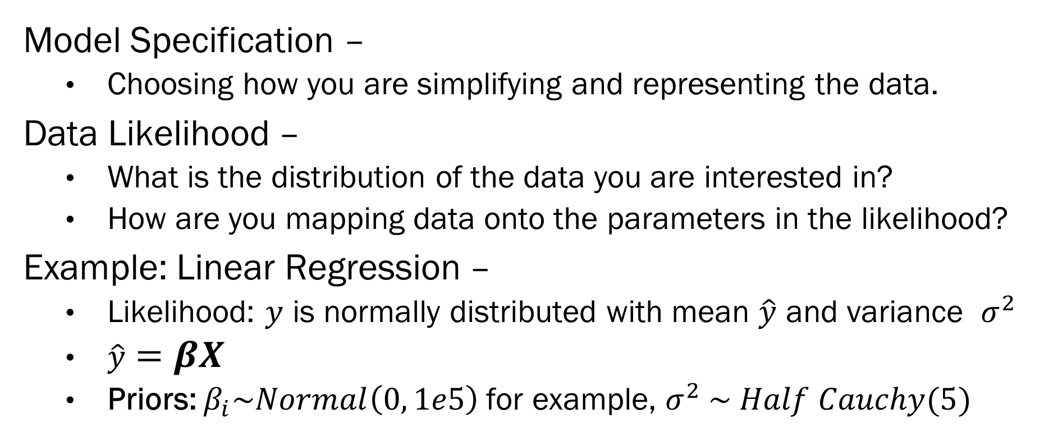
But How do We Choose Parameters?
Model Specification –
Choosing how you are simplifying and representing the data.
Data Likelihood –
What is the distribution of the data you are interested in?
How are you mapping data onto the parameters in the likelihood?
Example: Linear Regression –
Likelihood: $y$ is normally distributed with mean $\hat{y}$ and variance $σ^{2}$
$\hat{y}=βX$
Priors: $β_{i}\sim Normal\left(0, 1e5\right)$for example, $σ^{2} \sim Half Cauchy(5)$

Slide 10
What is Bayes Good For?
There are Bayesian versions of most statistical techniques.
Bayes is particularly good for:
Hierarchical Models – When the data has units of clustering, and the parameters need to vary between those units
Students in schools, patients in hospitals, radon in counties
Small samples or imbalanced data – Use weakly informative priors to adjust for lack of actual data
Tricky to do, make sure to be very transparent about prior choice
Bespoke Models – Bayes is very flexible, and can handle very custom models
i.e. a dynamic topic model that also simultaneously clusters a communication network based on the topic results.

Slide 11
Estimating Bayesian Models
Using Bayesian Stats is more programming heavy than most frequentist models
To make a bespoke model, you need to have a good understanding of how the pieces fit together, AND then implement the model in a probabilistic programming language.
Beware “easy” Bayesian implementations – They often hide prior/likelihood choices and the point of Bayes is to understand and control every part of the modeling process.
Use a probabilistic programming language –
“Programming” languages that let you programmatically set up your model
Stan or PyMC3 are the main ones
Stan is more developed, but PyMC3 is native in Python (Stan can run in Python but the model code is separate)
Honestly, I prefer Stan:
You can prep all your data in Python, then feed it into Stan, which then just works
Using PyMC3 you can use all sorts of Python code during model creation, but you have to fix all sorts of incompatibilities and errors.
That being said, PyMC3 would likely be best in a production environment (rather than a 1 shot model).

Slide 12
Estimating Bayesian Models
Conjugate Models –
The posteriors have nice calculable forms
Usually not seen outside of teaching Bayes, or as technical components in much more complex models (i.e. BMA often uses conjugate priors for speed).
MCMC Samplers (NUTS) –
Literally sampling from your true posterior.
NUTS makes things much easier, but samplers are difficult to apply to BIG data
Also require a diagnostics.
Variational Inference (ADVI) –
Instead of sampling from your true posterior, approximate it using simpler distributions
ADVI just works, and provides point estimates.
Best for starting values for samplers, and for BIG data.

Slide 13
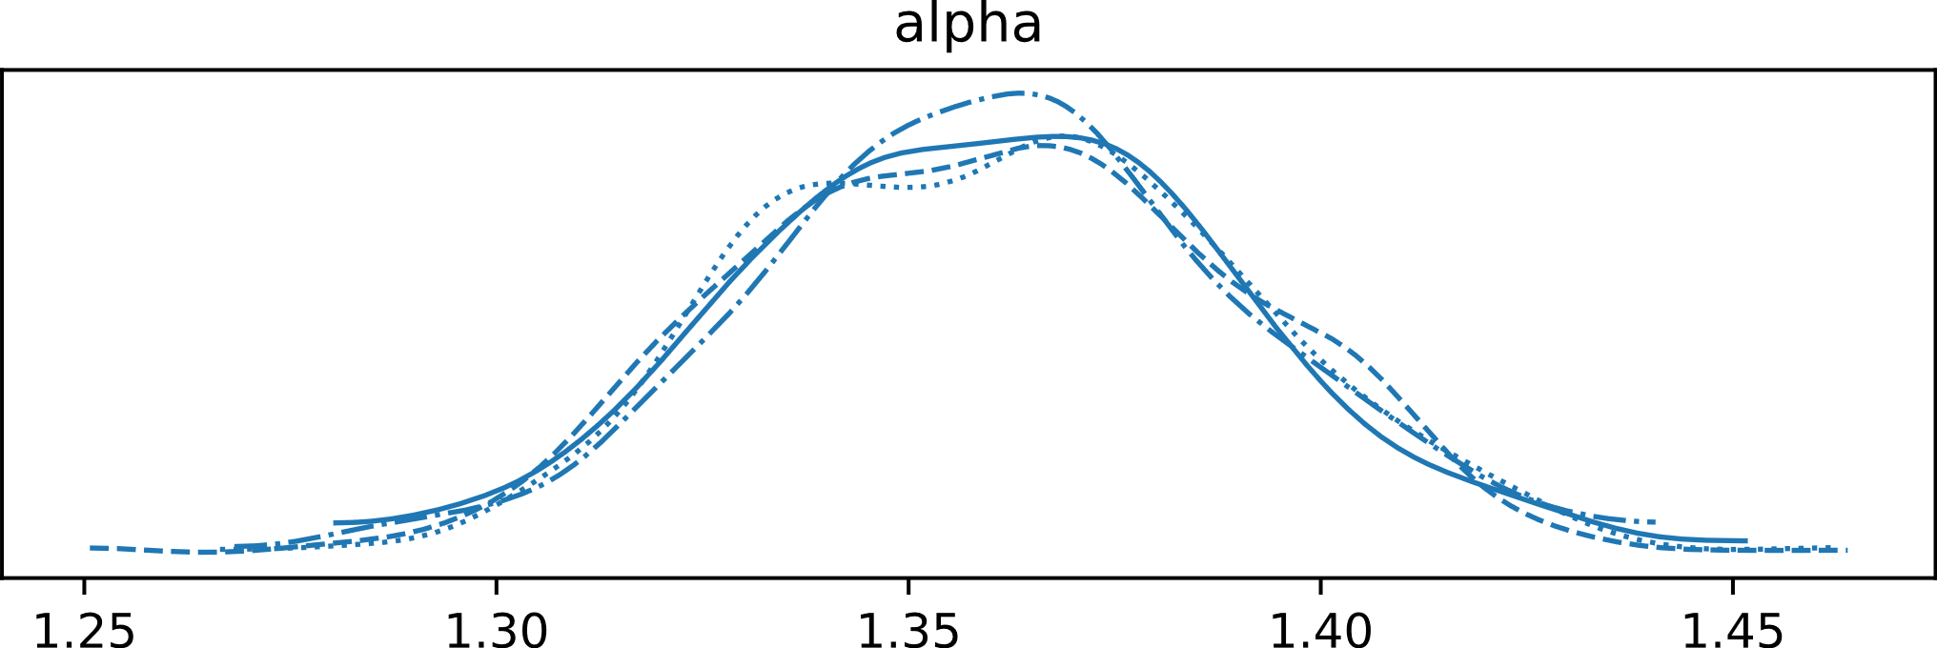
Interpreting Bayesian Models
Rule 1: Remember that parameters have distributions in Bayes, and are not point estimates.
Posterior Distributions – The distribution of the parameter once we “add” data to the prior.

Slide 14
Interpreting Bayesian Models
Descriptive Statistics for Posteriors –
EAP (Expected A Posteriori Value) -
The expected value or mean of the posterior distribution
The EAP is the closest we get to the frequentist point estimate
MAP (Modal A Posteriori Value) –
The value with the highest probability
Most useful for categorical variables (i.e. classification/mixtures)
Also useful for highly skewed posteriors (i.e. variances)
Credible Intervals –
What range of the posterior values contain XX% of the probability.
What confidence intervals want to be

Slide 15
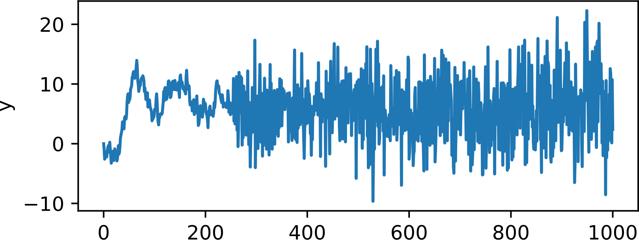
Plotting Bayesian Results
Posterior Density Plot –
Lets you see the distribution
Useful for interpretation and diagnostics.
Trace Plots –
Shows you how your sampler sampled over estimation
ONLY used for diagnosing estimator performance
Forest Plots –
Shows EAP and various CIs for each parameter
Useful summaries!

Slide 16
Frequentist vs. Bayesian
Frequentist Definition of Probability-
Over an infinite series of samples, how often do we see something happen?
Relies on asymptotics
NHST –
Probability of observing something if the null hypothesis is correct.
Parameters –
Point estimates: What is the value for this one sample.
Confidence Intervals: If take an infinite set of samples, where do 95% of the parameter estimates fall?
Bayesian Definition of Probability-
Degree of belief in something happening
No asymptotics! (But needs priors)
Posteriors –
The probability of our parameter given data
Not an NHST type thing at all!
Parameters –
Parameters have distributions
Distributions reflect how certain we are about the values of the parameters
Parameters do not have a single point estimate (EAP, MAP are summary statistics)

Slide 17
Final Thoughts on Bayesian ML
Bayesian Statistics is a tool to explore data, not an end in of itself.
Doing ML methods using Bayesian Models is quite difficult
ML is more mathy/heuristic, and in many cases doesn’t use probability
Bayes requires probability distributions attached to almost everything.
Bayesian methods are well suited for traditional statistical modeling problems
You can specify each parameter, and are interested in each parameter
Non-parametric Bayes is the closest to ML
Bayesian methods are ideal for bespoke models/applications
You can build nearly any type of statistical model from scratch
Using Bayesian methods requires computational knowledge

Slide 18
Final Thoughts on Data Science
Always approach a problem “data-first”:
What data do you have? How was it produced? Is it sufficient to answer the questions?
This has very little to do with math/statistics. This requires domain knowledge.
You cannot model your way out of bad data.
Frequentist/Bayesian/ML/AI, none of them fix bad data.
More (in terms of sample size) bad data is worse than less bad data
It just makes you more confident in incorrect results.
Models are tools to explore the data. Different tools give you different views.
Some views aren’t helpful. Some views lie or mislead.
The art of data science is in using tools to best understand the data with respect to a given problem.

Slide 19
More Final Thoughts on Data Science
Data management takes 80-95% of the time (you all know this by now!):
Learn the computational/programming aspects of data management well
How do you reshape data from wide to long format? How do you flag outliers? How do you identify missing data? How do you make sure Pandas has the right dtype?
Much of successful analysis is dependent on successful preprocessing
Example: How you center/scale/transform data is key to interpreting it.
Understand the computational resources available to you:
You can’t fit a billion observation model on your laptop
You might need to understand how to deploy a model in parallel on proprietary super computing systems. Don’t think that others will do this for you!
You have an ethical duty as a data scientist: You report on what the data tells you, not what is the desired result.

Slide 20
Thank You!

