Slide 1

Prior Selection in Bayesian Statistics
Module 2 Live Session (6/01/2021)
DS6040 Summer 2021
Teague R. Henry

Slide 2

Outline
Bayes’ Theorem Review
Prior Overview
Conjugate Priors
Flat Priors
Non-Informative Priors
Jeffreys Priors
Empirical Bayes Priors

Slide 3
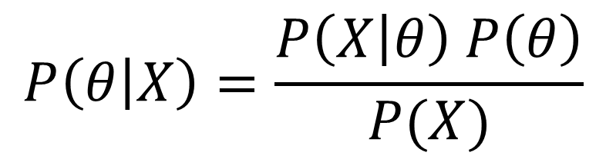

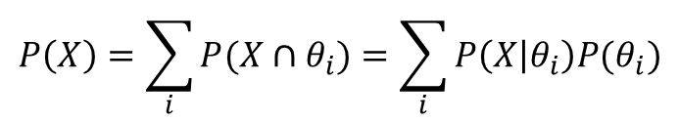
Bayes’ Theorem
Likelihood
(Probability of Data Given Model)
Posterior Distribution
(Probability of Model Given Data)
$$P\left(θ | X\right)=\frac{P\left(X | θ\right) P\left(θ\right)}{P(X)}$$
Prior Distribution
(Probability of Model)
$$P\left(X\right)=\sum_{i}{P(X∩θ_{i})}=\sum_{i}{P\left(X | θ_{i}\right)P(θ_{i})}$$
Marginal Distribution
(Probability of Data)
Probability of your data occurring for any choice of $θ$
Note: Possible $θ_{i}$ are constrained by the model type.

Slide 4
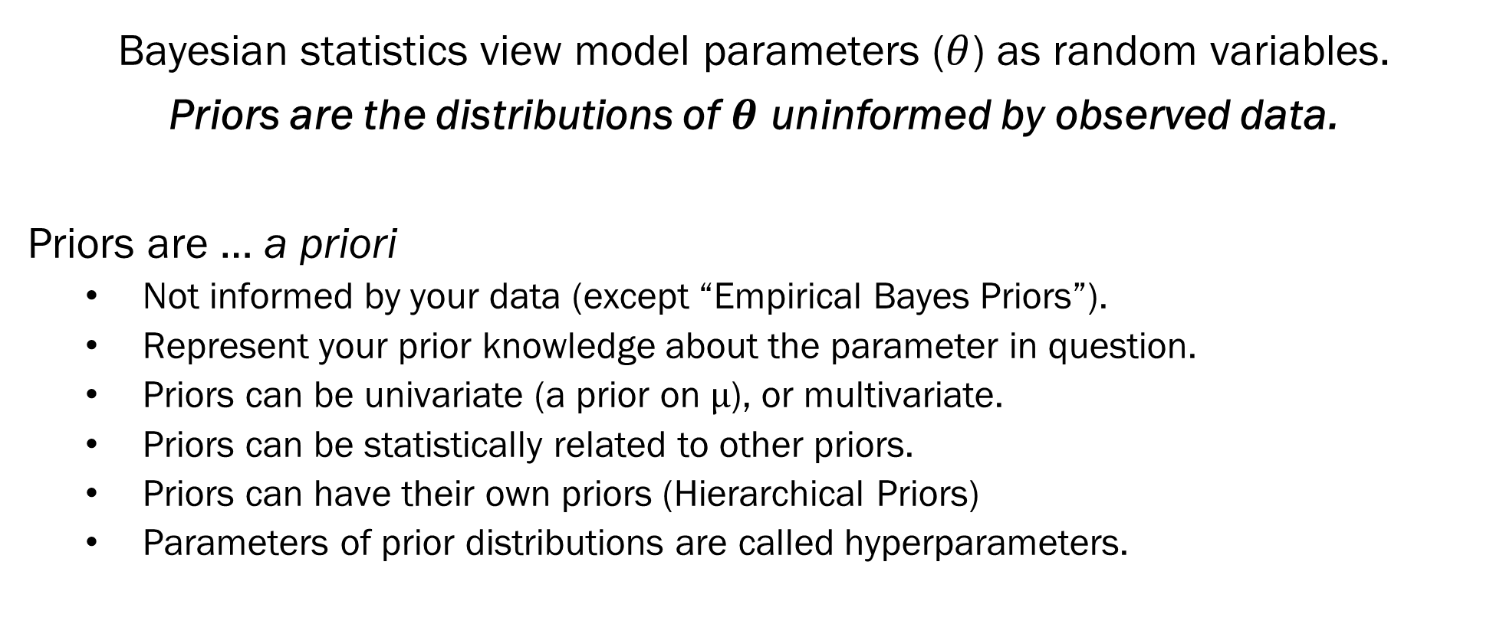
Prior Overview
Bayesian statistics view model parameters ($θ$) as random variables.
Priors are the distributions of $θ$ uninformed by observed data.
Priors are … a priori
Not informed by your data (except “Empirical Bayes Priors”).
Represent your prior knowledge about the parameter in question.
Priors can be univariate (a prior on $μ$), or multivariate.
Priors can be statistically related to other priors.
Priors can have their own priors (Hierarchical Priors)
Parameters of prior distributions are called hyperparameters.

Slide 5
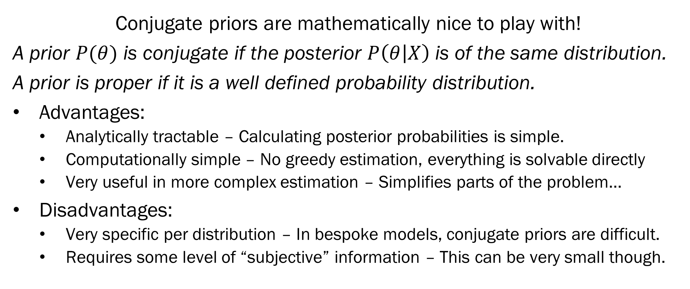
Conjugate Priors
Conjugate priors are mathematically nice to play with!
A prior $P(θ)$ is conjugate if the posterior $P\left(θ | X\right)$ is of the same distribution.
A prior is proper if it is a well defined probability distribution.
Advantages:
Analytically tractable – Calculating posterior probabilities is simple.
Computationally simple – No greedy estimation, everything is solvable directly
Very useful in more complex estimation – Simplifies parts of the problem…
Disadvantages:
Very specific per distribution – In bespoke models, conjugate priors are difficult.
Requires some level of “subjective” information – This can be very small though.

Slide 6
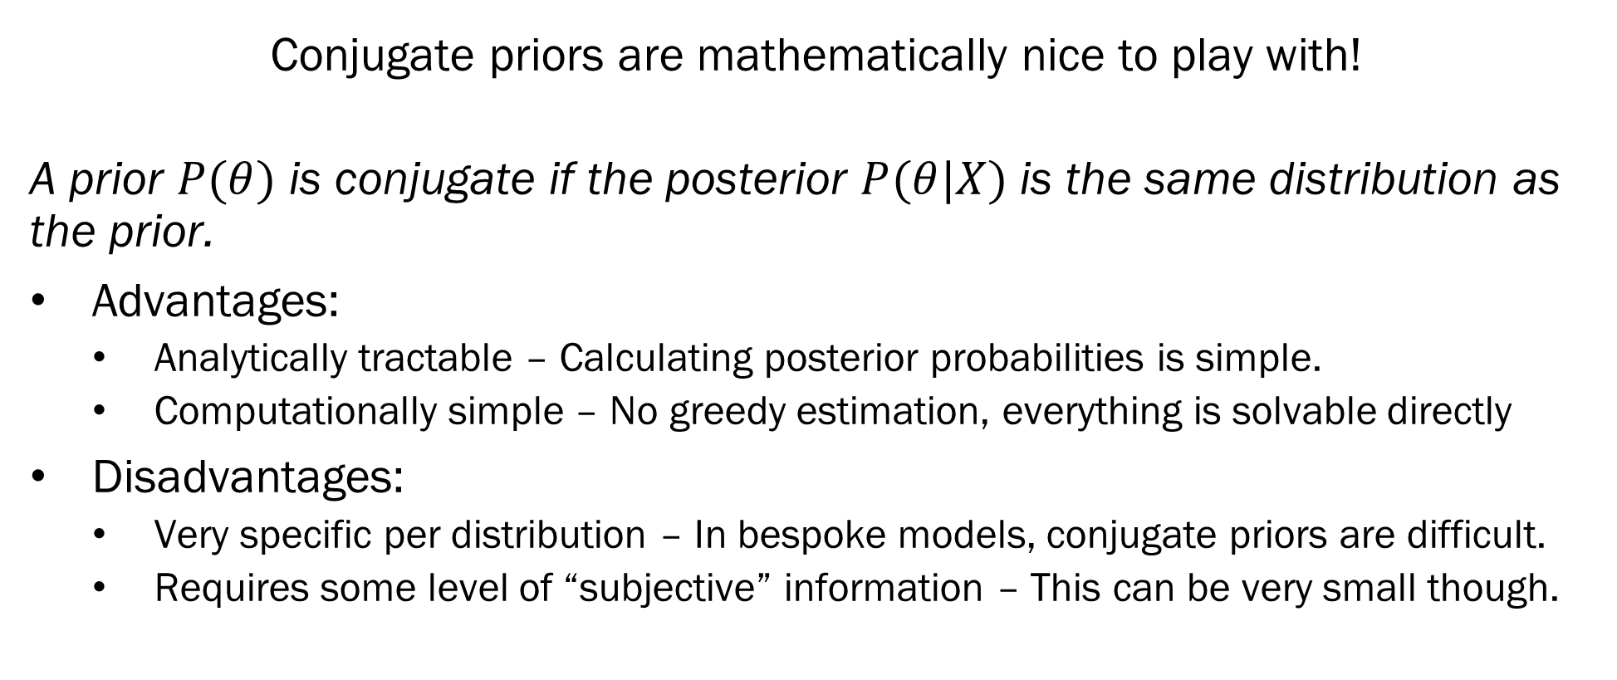
Conjugate Priors – Binomial
Conjugate priors are mathematically nice to play with!
A prior $P(θ)$ is conjugate if the posterior $P(θ|X)$ is the same distribution as the prior.
Advantages:
Analytically tractable – Calculating posterior probabilities is simple.
Computationally simple – No greedy estimation, everything is solvable directly
Disadvantages:
Very specific per distribution – In bespoke models, conjugate priors are difficult.
Requires some level of “subjective” information – This can be very small though.

Slide 7
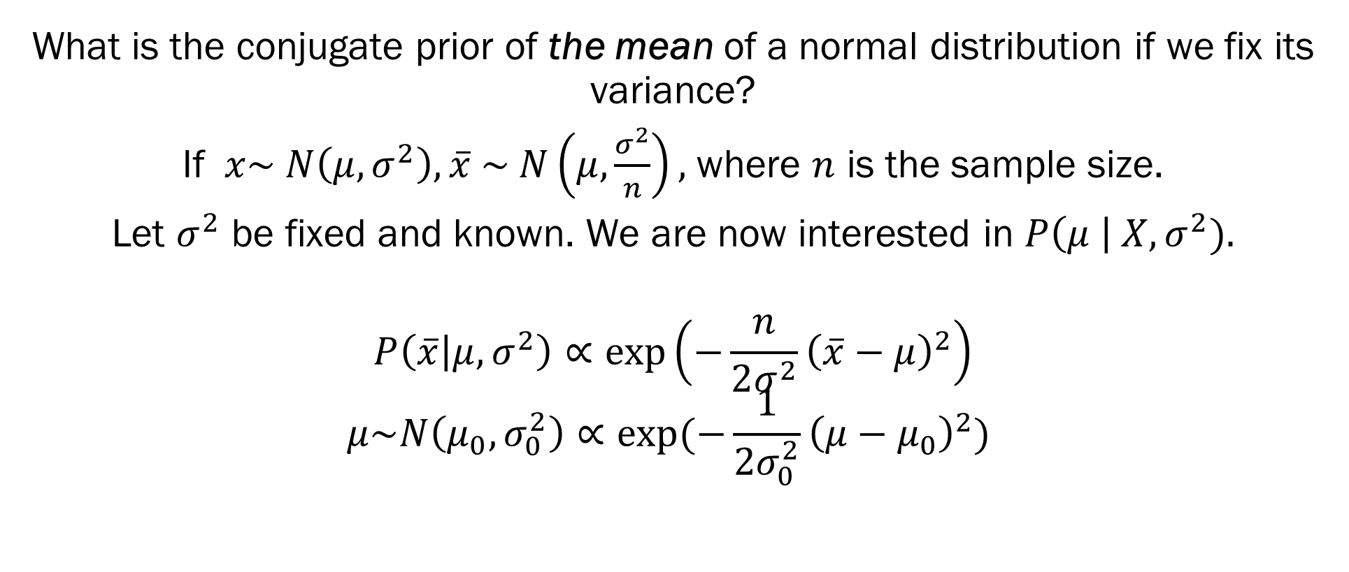
Conjugate Priors – Normal Distribution
What is the conjugate prior of the mean of a normal distribution if we fix its variance?
If $x\sim N\left(μ, σ^{2}\right), \overline{x} \sim N\left(μ,\frac{σ^{2}}{n}\right),$ where $n$ is the sample size.
Let $σ^{2}$ be fixed and known. We are now interested in $P\left(μ \right| X, σ^{2}).$
$$P\left(\overline{x} | μ, σ^{2}\right)∝\exp\left(−\frac{n}{2σ^{2}}{\left(\overline{x}−μ\right)}^{2}\right)$$
$$μ\sim N\left(μ_{0}, σ_{0}^{2}\right)∝\exp{(−\frac{1}{{2σ}_{0}^{2}}{\left(μ−μ_{0}\right)}^{2})}$$

Slide 8
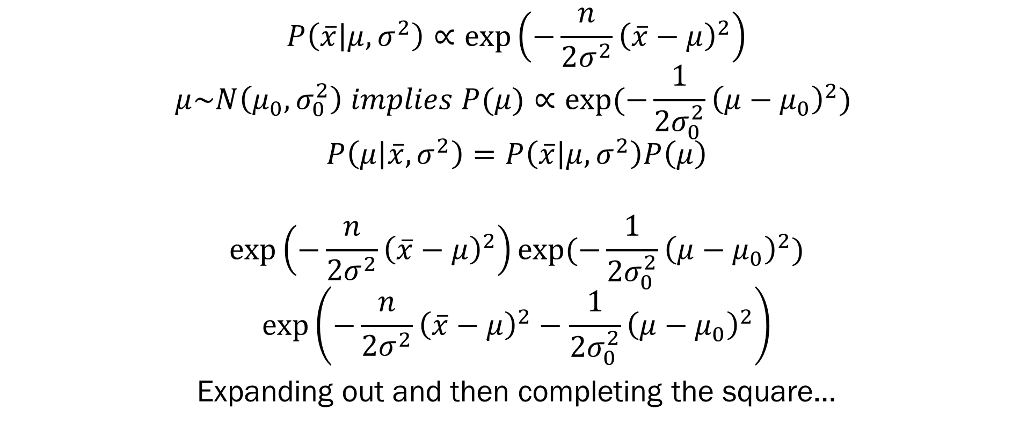
Conjugate Priors – Normal Distribution
$$P\left(\overline{x} | μ, σ^{2}\right)∝\exp\left(−\frac{n}{2σ^{2}}{\left(\overline{x}−μ\right)}^{2}\right)$$
$$μ\sim N\left(μ_{0}, σ_{0}^{2}\right) implies P(μ)∝\exp{(−\frac{1}{{2σ}_{0}^{2}}{\left(μ−μ_{0}\right)}^{2})}$$
$$P\left(μ | \overline{x}, σ^{2}\right)=P\left(\overline{x} | μ, σ^{2}\right)P\left(μ\right)$$
$$\exp\left(−\frac{n}{2σ^{2}}{\left(\overline{x}−μ\right)}^{2}\right)\exp{(−\frac{1}{{2σ}_{0}^{2}}{\left(μ−μ_{0}\right)}^{2})}$$
$$\exp\left(−\frac{n}{2σ^{2}}{\left(\overline{x}−μ\right)}^{2}−\frac{1}{{2σ}_{0}^{2}}{\left(μ−μ_{0}\right)}^{2}\right)$$
Expanding out and then completing the square…

Slide 9
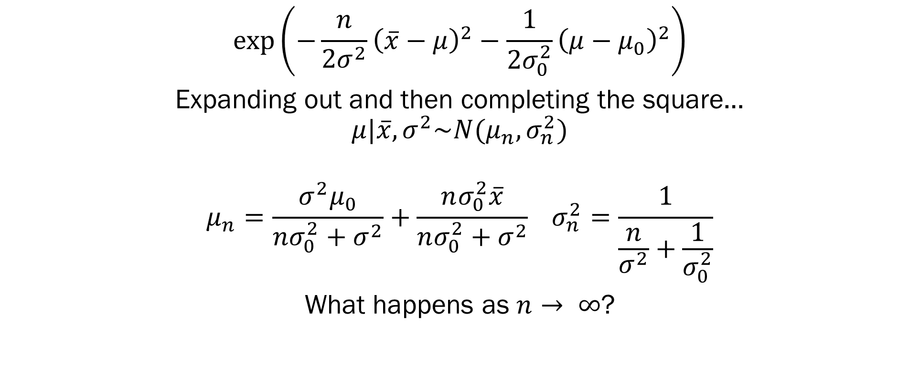
Conjugate Priors – Normal Distribution
$$\exp\left(−\frac{n}{2σ^{2}}{\left(\overline{x}−μ\right)}^{2}−\frac{1}{{2σ}_{0}^{2}}{\left(μ−μ_{0}\right)}^{2}\right)$$
Expanding out and then completing the square…
$$μ|\overline{x},σ^{2}\sim N(μ_{n}, σ_{n}^{2})$$
$$μ_{n}=\frac{σ^{2}μ_{0}}{nσ_{0}^{2}+σ^{2}}+\frac{nσ_{0}^{2}\overline{x}}{nσ_{0}^{2}+σ^{2}} σ_{n}^{2}=\frac{1}{\frac{n}{σ^{2}}+\frac{1}{σ_{0}^{2}}}$$
What happens as $n→ ∞$?

Slide 10
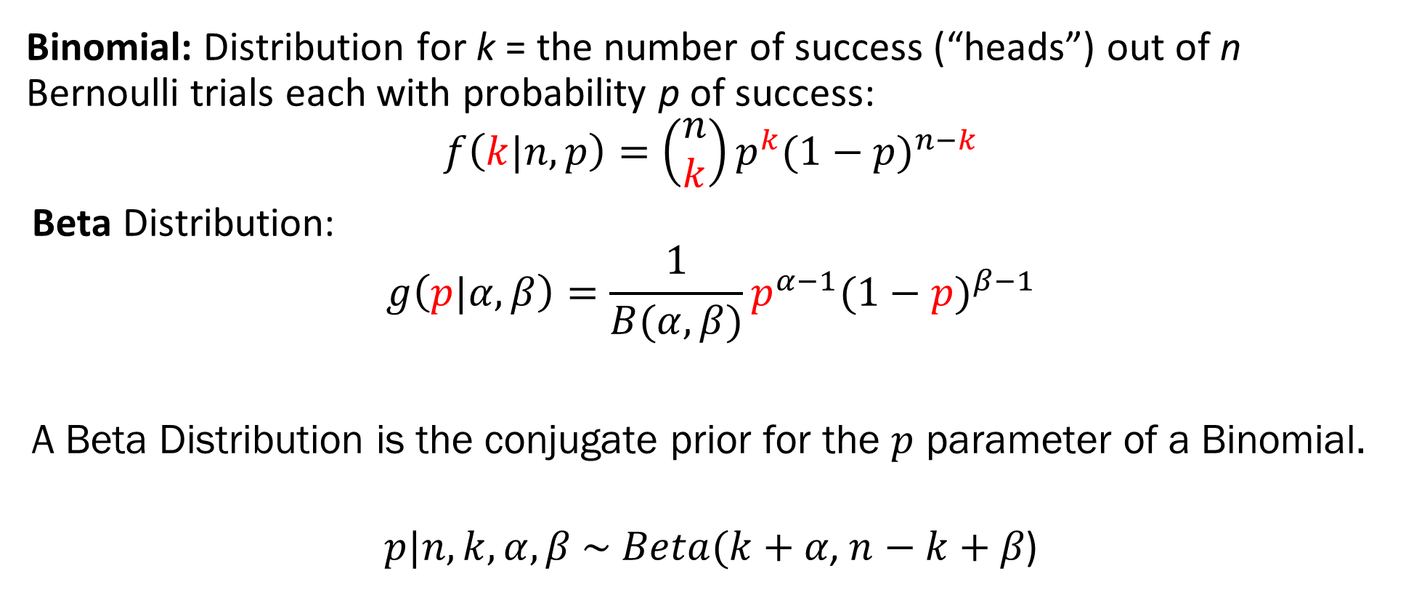
Conjugate Priors – Beta Distribution
Binomial: Distribution for k = the number of success (“heads”) out of n Bernoulli trials each with probability p of success:
$$f\left(k|n,p\right)=\left(\begin{matrix}n \\ k\end{matrix}\right)p^{k}{(1−p)}^{n−k}$$
Beta Distribution:
$$g\left(p|α,β\right)=\frac{1}{B(α,β)}p^{α−1}{(1−p)}^{β−1}$$
A Beta Distribution is the conjugate prior for the $p$ parameter of a Binomial.
$$p|n, k, α, β \sim Beta(k+α\text{,} n−k+β\text{)}$$

Slide 11
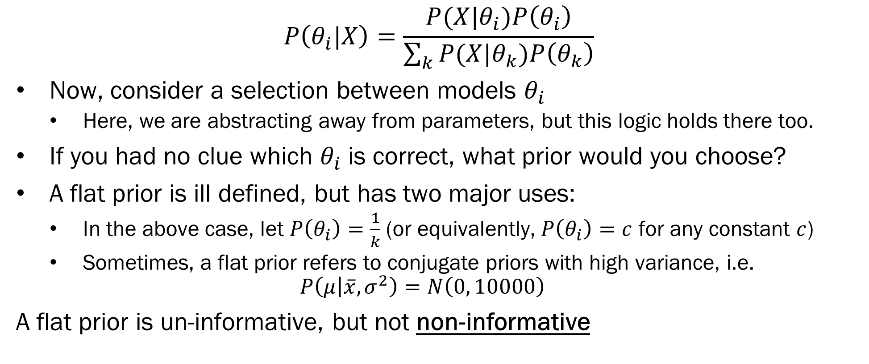
Flat Priors
$$P\left(θ_{i}|X\right)=\frac{P(X|θ_{i})P\left(θ_{i}\right)}{\sum_{k}{P(X|θ_{k})P\left(θ_{k}\right)}}$$
Now, consider a selection between models $θ_{i}$
Here, we are abstracting away from parameters, but this logic holds there too.
If you had no clue which $θ_{i}$ is correct, what prior would you choose?
A flat prior is ill defined, but has two major uses:
In the above case, let $P\left(θ_{i}\right)=\frac{1}{k}$ (or equivalently, $P\left(θ_{i}\right)=c$ for any constant $c$)
Sometimes, a flat prior refers to conjugate priors with high variance, i.e.
$$P\left(μ | \overline{x}, σ^{2}\right)=N\left(0, 10000\right)$$
A flat prior is un-informative, but not non-informative

Slide 12
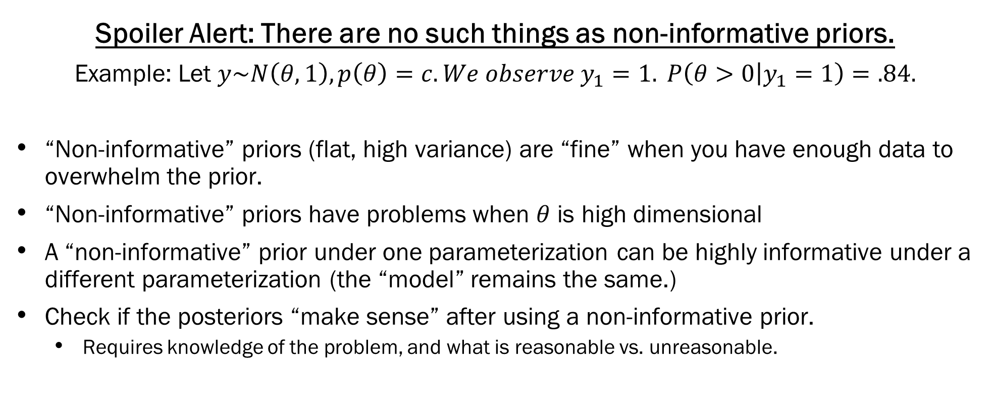
“Non-informative” Priors
Spoiler Alert: There are no such things as non-informative priors.
Example: Let $y\sim N\left(θ, 1\right), p\left(θ\right)=c. We observe y_{1}=1. P\left(θ>0 | y_{1}=1\right)=.84.$
“Non-informative” priors (flat, high variance) are “fine” when you have enough data to overwhelm the prior.
“Non-informative” priors have problems when $θ$ is high dimensional
A “non-informative” prior under one parameterization can be highly informative under a different parameterization (the “model” remains the same.)
Check if the posteriors “make sense” after using a non-informative prior.
Requires knowledge of the problem, and what is reasonable vs. unreasonable.
Great, albeit a little technical, post: https://statmodeling.stat.columbia.edu/2013/11/21/hidden-dangers-noninformative-priors/

Slide 13
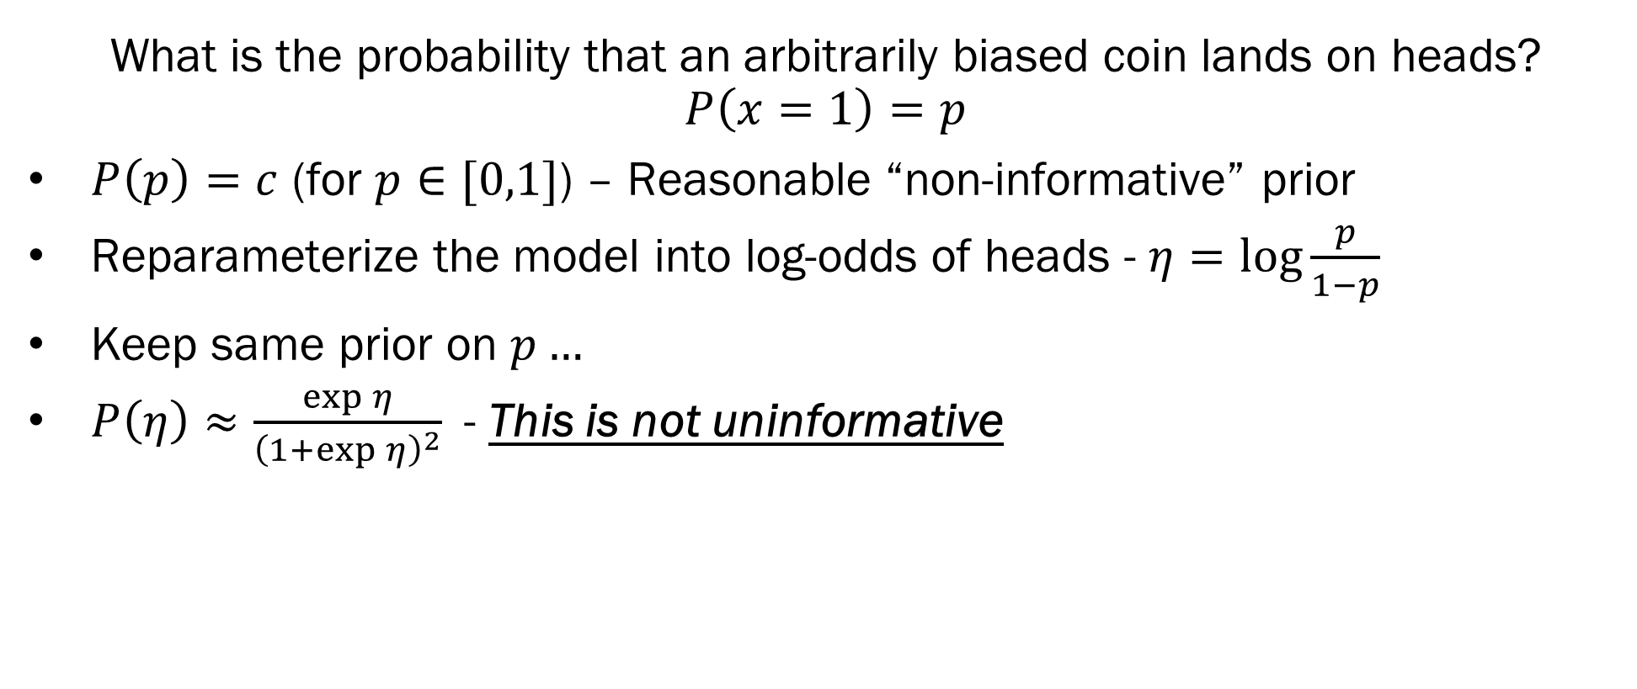
Jeffreys Priors
What is the probability that an arbitrarily biased coin lands on heads?
$$P\left(x=1\right)=p$$
$P\left(p\right)=c$ (for $p∈[0,1]$) – Reasonable “non-informative” prior
Reparameterize the model into log-odds of heads - $η=\log{\frac{p}{1−p}}$
Keep same prior on $p…$
$P\left(η\right)≈\frac{\exp{η}}{{\left(1+\exp{η}\right)}^{2}}$- This is not uninformative

Slide 14
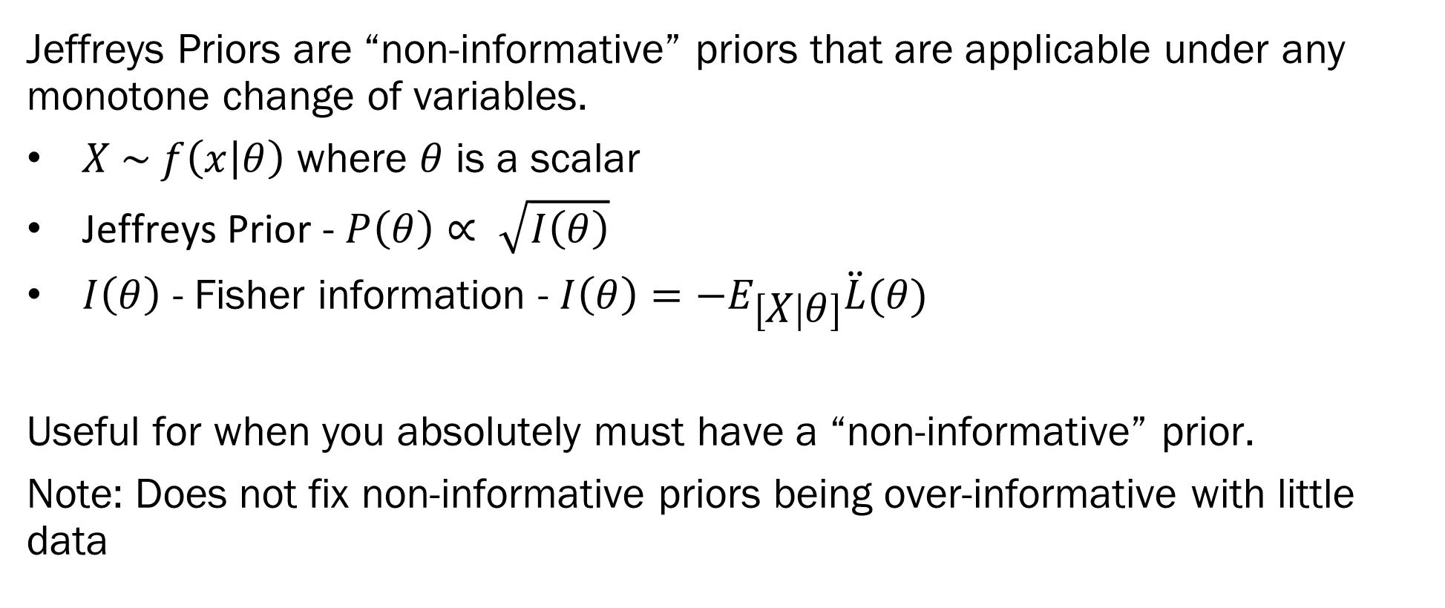
Jeffreys Priors
Jeffreys Priors are “non-informative” priors that are applicable under any monotone change of variables.
$X \sim f\left(x | θ\right)$ where $θ$ is a scalar
Jeffreys Prior - $P\left(θ\right)∝ \sqrt{I\left(θ\right)}$
$I\left(θ\right)$ - Fisher information - $I\left(θ\right)=−E_{\left[X | θ\right]}\ddot{L}(θ)$
Useful for when you absolutely must have a “non-informative” prior.
Note: Does not fix non-informative priors being over-informative with little data

Slide 15

Empirical Bayes Priors
You, a clever data scientist: But Teague, we have information about the parameters… we collected data to estimate them, can’t we just use that?

Slide 16
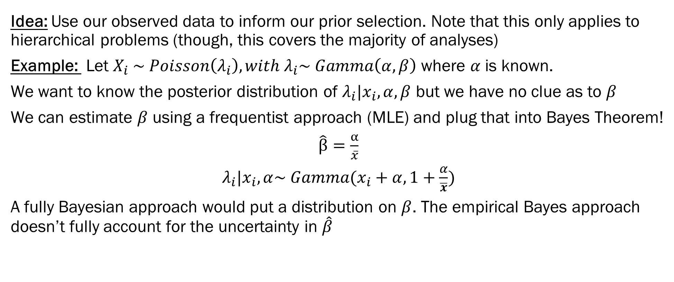
Empirical Bayes Priors
Idea: Use our observed data to inform our prior selection. Note that this only applies to hierarchical problems (though, this covers the majority of analyses)
Example: Let $X_{i} \sim Poisson\left(λ_{i}\right), with λ_{i}\sim Gamma\left(α, β\right)$ where $α$ is known.
We want to know the posterior distribution of $λ_{i}|x_{i}, α,β$ but we have no clue as to $β$
We can estimate $β$ using a frequentist approach (MLE) and plug that into Bayes Theorem!
$\hat{β}=\frac{α}{\overline{x}}$
$λ_{i}|x_{i}, α\sim Gamma(x_{i}+α, 1+\frac{α}{\overline{x}})$
A fully Bayesian approach would put a distribution on $β$. The empirical Bayes approach doesn’t fully account for the uncertainty in $\hat{β}$

Slide 17
Homework 1 Hints…
List out all of the possible sequences, remembering that once you get “the results you were looking for”, you stop searching.
Markov Chains are in Module 3. To show this is a Markov Chain, list the possible states of the system and the transition matrix.
Use the normal conjugate priors from this lecture
Model using Binomial (and/or Bernoulli) with Beta conjugate priors
Ignore “Use prior alpha…” Because correlations = 0, treat each variable as an independent normal variate.
Use Wikipedia…

Slide 18
Next Week on Attack of the Living Prior
Classification with Bayes!
Linear and Quadratic Discriminant Analysis
Bayesian Regression!
Zellner’s g priors!

