Slide 1

Estimation Part I:
Samplers
Module 5 Live Session (6/21/2021)
DS6040 Summer 2021
Teague R. Henry

Slide 2

Course Updates
HW 1 has been successfully turned in!
I’ll be grading these throughout the week
Project Proposals have been turned in!
I’ll be reaching out with comments throughout the week.
HW 2 Due - July 2nd
Project Milestone Check-in – July 18th

Slide 3
Outline
Posterior Review
Monte Carlo Sampling
Markov Chain Monte Carlo Sampling
Gibbs Samplers
Random Walk Metropolis/-Hastings
Hamiltonian MCMC
NUTS – No U-Turn Sampler

Slide 4
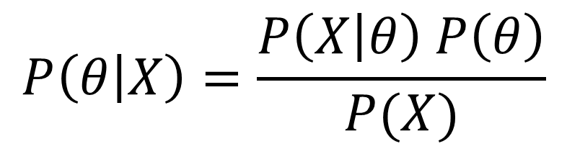

Review
Likelihood
We know the analytic form
Posterior Distribution
Our Target Distribution
$$P\left(θ | X\right)=\frac{P\left(X | θ\right) P\left(θ\right)}{P(X)}$$
Prior Distribution
We also know the analytics here
$$P\left(X\right)=\int_{ℝ^{p}}^{ }{P\left(X | θ\right)P\left(θ\right)dθ}$$
Marginal Distribution
Calculating an integral (or sum) over high dimensional
space is a massive pain at least, and intractable at worst

Slide 5
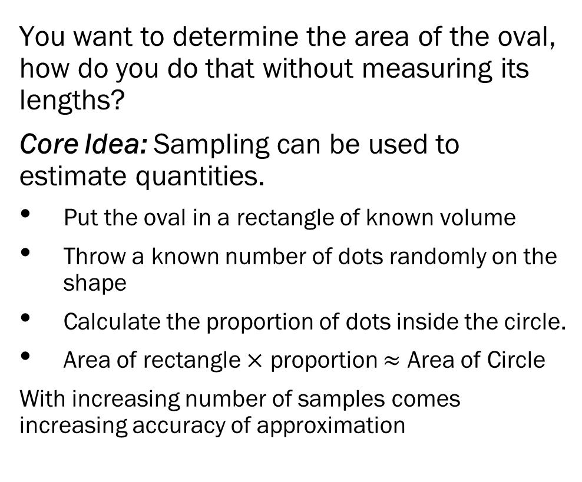
Sampling – Not Just for Data Collection
You want to determine the area of the oval, how do you do that without measuring its lengths?
Core Idea: Sampling can be used to estimate quantities.
Put the oval in a rectangle of known volume
Throw a known number of dots randomly on the shape
Calculate the proportion of dots inside the circle.
Area of rectangle $×$ proportion $≈$ Area of Circle
With increasing number of samples comes increasing accuracy of approximation

Slide 6
Sampling – Approximating the Posterior
Sampling in Bayesian Estimation –
You can’t easily calculate the marginal distribution (i.e. no conjugate priors)
Goal - Sample from the posterior distribution.
Two Key Issues:
Parameter space is very large for even small models
Sampling from probability distributions needs to involve probabilities.

Slide 7
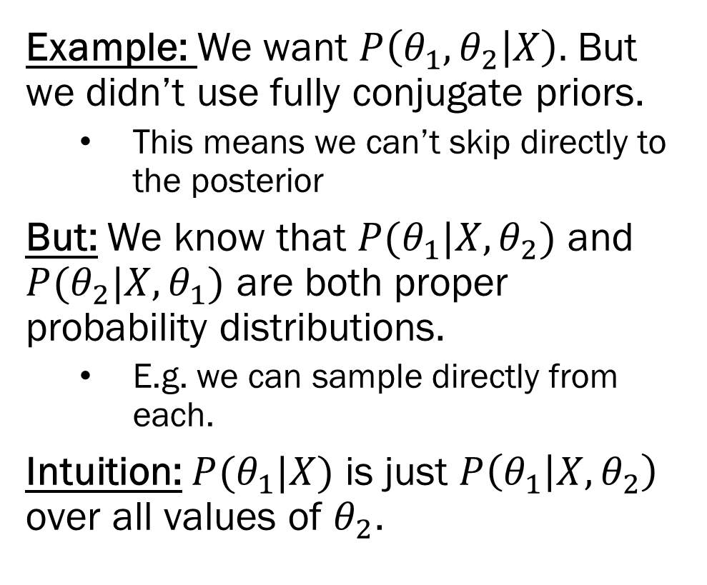
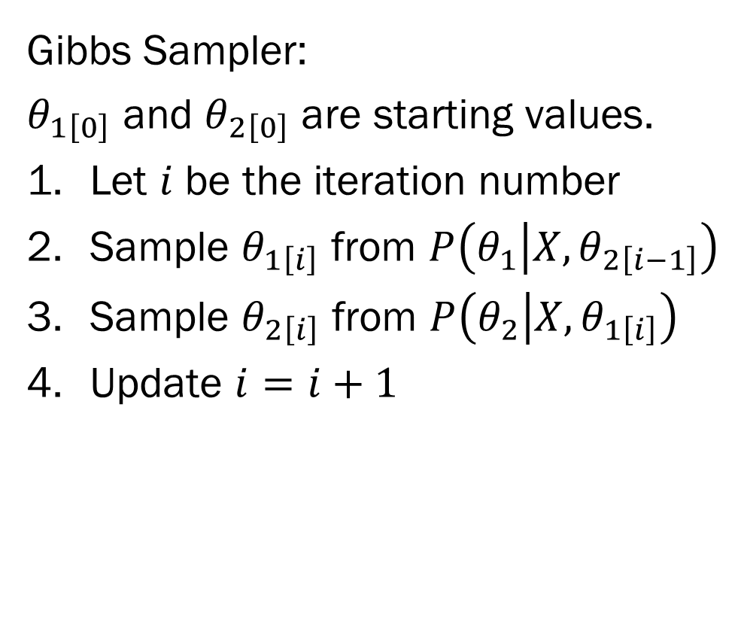
The Gibbs Sampler
Example: We want $P\left(θ_{1},θ_{2} | X\right).$ But we didn’t use fully conjugate priors.
This means we can’t skip directly to the posterior
But: We know that $P(θ_{1}|X,θ_{2})$ and $P(θ_{2}|X,θ_{1})$ are both proper probability distributions.
E.g. we can sample directly from each.
Intuition: $P(θ_{1}|X)$ is just $P\left(θ_{1} | X, θ_{2}\right)$ over all values of $θ_{2}$.
Gibbs Sampler:
$θ_{1\left[0\right]}$ and $θ_{2\left[0\right]}$ are starting values.
Let $i$ be the iteration number
Sample $θ_{1\left[i\right]}$ from $P\left(θ_{1} | X, θ_{2\left[i−1\right]}\right)$
Sample $θ_{2\left[i\right]}$ from $P\left(θ_{2} | X, θ_{1\left[i\right]}\right)$
Update $i=i+1$

Slide 8
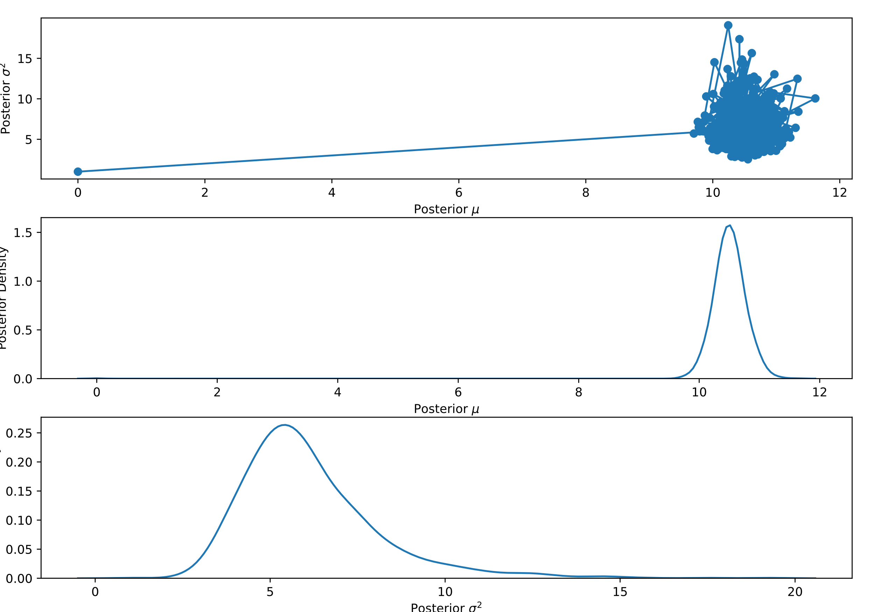
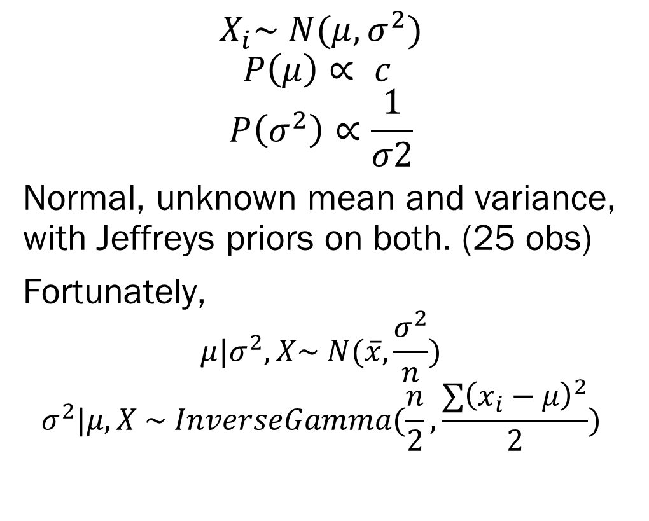
The Gibbs Sampler - Example
$$X_{i}\sim N(μ, σ^{2})$$
$$P\left(μ\right)∝ c$$
$$P\left(σ^{2}\right)∝\frac{1}{σ2}$$
Normal, unknown mean and variance, with Jeffreys priors on both. (25 obs)
Fortunately,
$$μ|σ^{2}, X\sim N(\overline{x},\frac{σ^{2}}{n})$$
$$σ^{2}|μ, X \sim InverseGamma(\frac{n}{2},\frac{∑{\left(x_{i}−μ\right)}^{2}}{2})$$

Slide 9
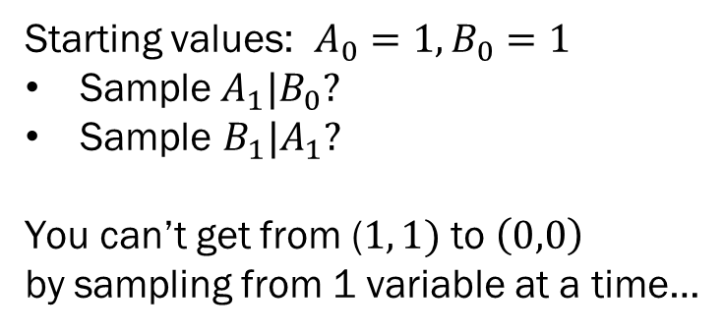
The Gibbs Sampler
Gibbs Sampling simplifies estimation by only requiring that the conditional densities are proper distributions
i.e. we can sample directly from them…
Gibbs tends to perform well, given the restrictive assumptions needed. But:
For categorical variables, or extremely high dimensional variables with pathological distributions, Gibbs can take forever to converge.
Gibbs can’t sample what it cannot get to…
Probability Matrix for a 2 Dimensional State Variable
 | A = 1 | A = 0
B = 1 | .5 | 0
B = 0 | 0 | .5
Starting values: $A_{0}=1, B_{0}=1$
Sample $A_{1}|B_{0}?$
Sample $B_{1}|A_{1}?$
You can’t get from ($1, 1)$ to $\left(0,0\right)$
by sampling from 1 variable at a time…

Slide 10
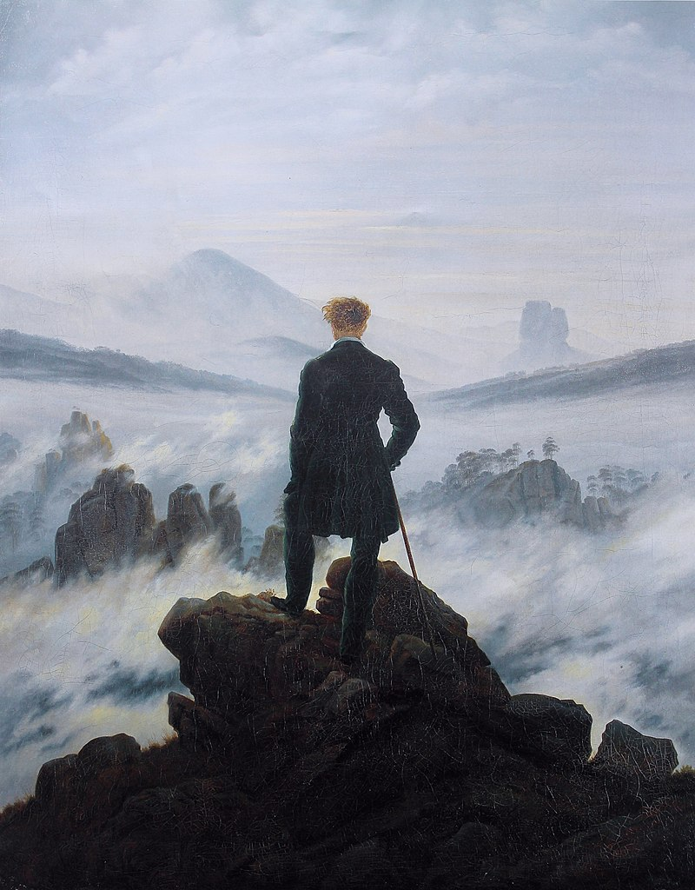
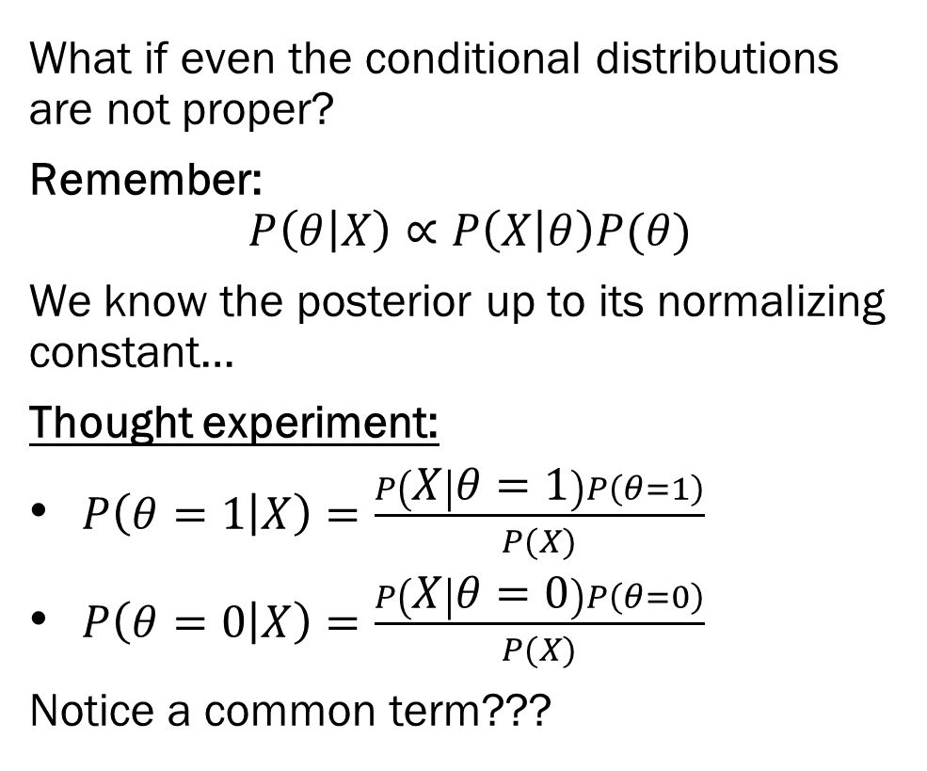
Into the Unknown
What if even the conditional distributions are not proper?
Remember:
$$P\left(θ | X\right)∝P\left(X | θ\right)P(θ)$$
We know the posterior up to its normalizing constant…
Thought experiment:
$P\left(θ=1 | X\right)=\frac{P\left(X | θ=1\right)P\left(θ=1\right)}{P(X)}$
$P\left(θ=0 | X\right)=\frac{P\left(X | θ=0\right)P\left(θ=0\right)}{P(X)}$
Notice a common term???

Slide 11
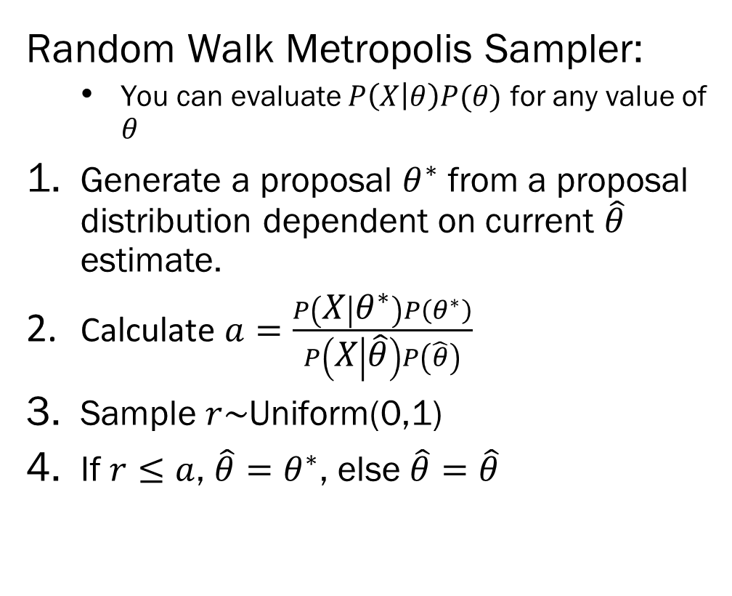
Random Walk Metropolis
Consider the pool game Marco-Polo
Player is blindfolded, trying to find other players
Player says “Marco,” other players say “Polo”
Player moves in the direction of loudest “Polo”
Metropolis Marco-Polo–
Opponent stays still
Before you move, you point in a random direction
Opponent says “Polo” with volume proportional to how far away your pointing is
You chose to remain in the same location or move a couple of steps in the direction of your finger.
Random Walk Metropolis Sampler:
You can evaluate $P\left(X | θ\right)P(θ)$ for any value of $θ$
Generate a proposal $θ^{∗}$ from a proposal distribution dependent on current $\hat{θ}$ estimate.
Calculate $a=\frac{P\left(X | θ^{∗}\right)P\left(θ^{∗}\right)}{P\left(X | \hat{θ}\right)P\left(\hat{θ}\right)}$
Sample $r\sim$Uniform(0,1)
If $r≤a$, $\hat{θ}=θ^{∗}$, else $\hat{θ}=\hat{θ}$

Slide 12
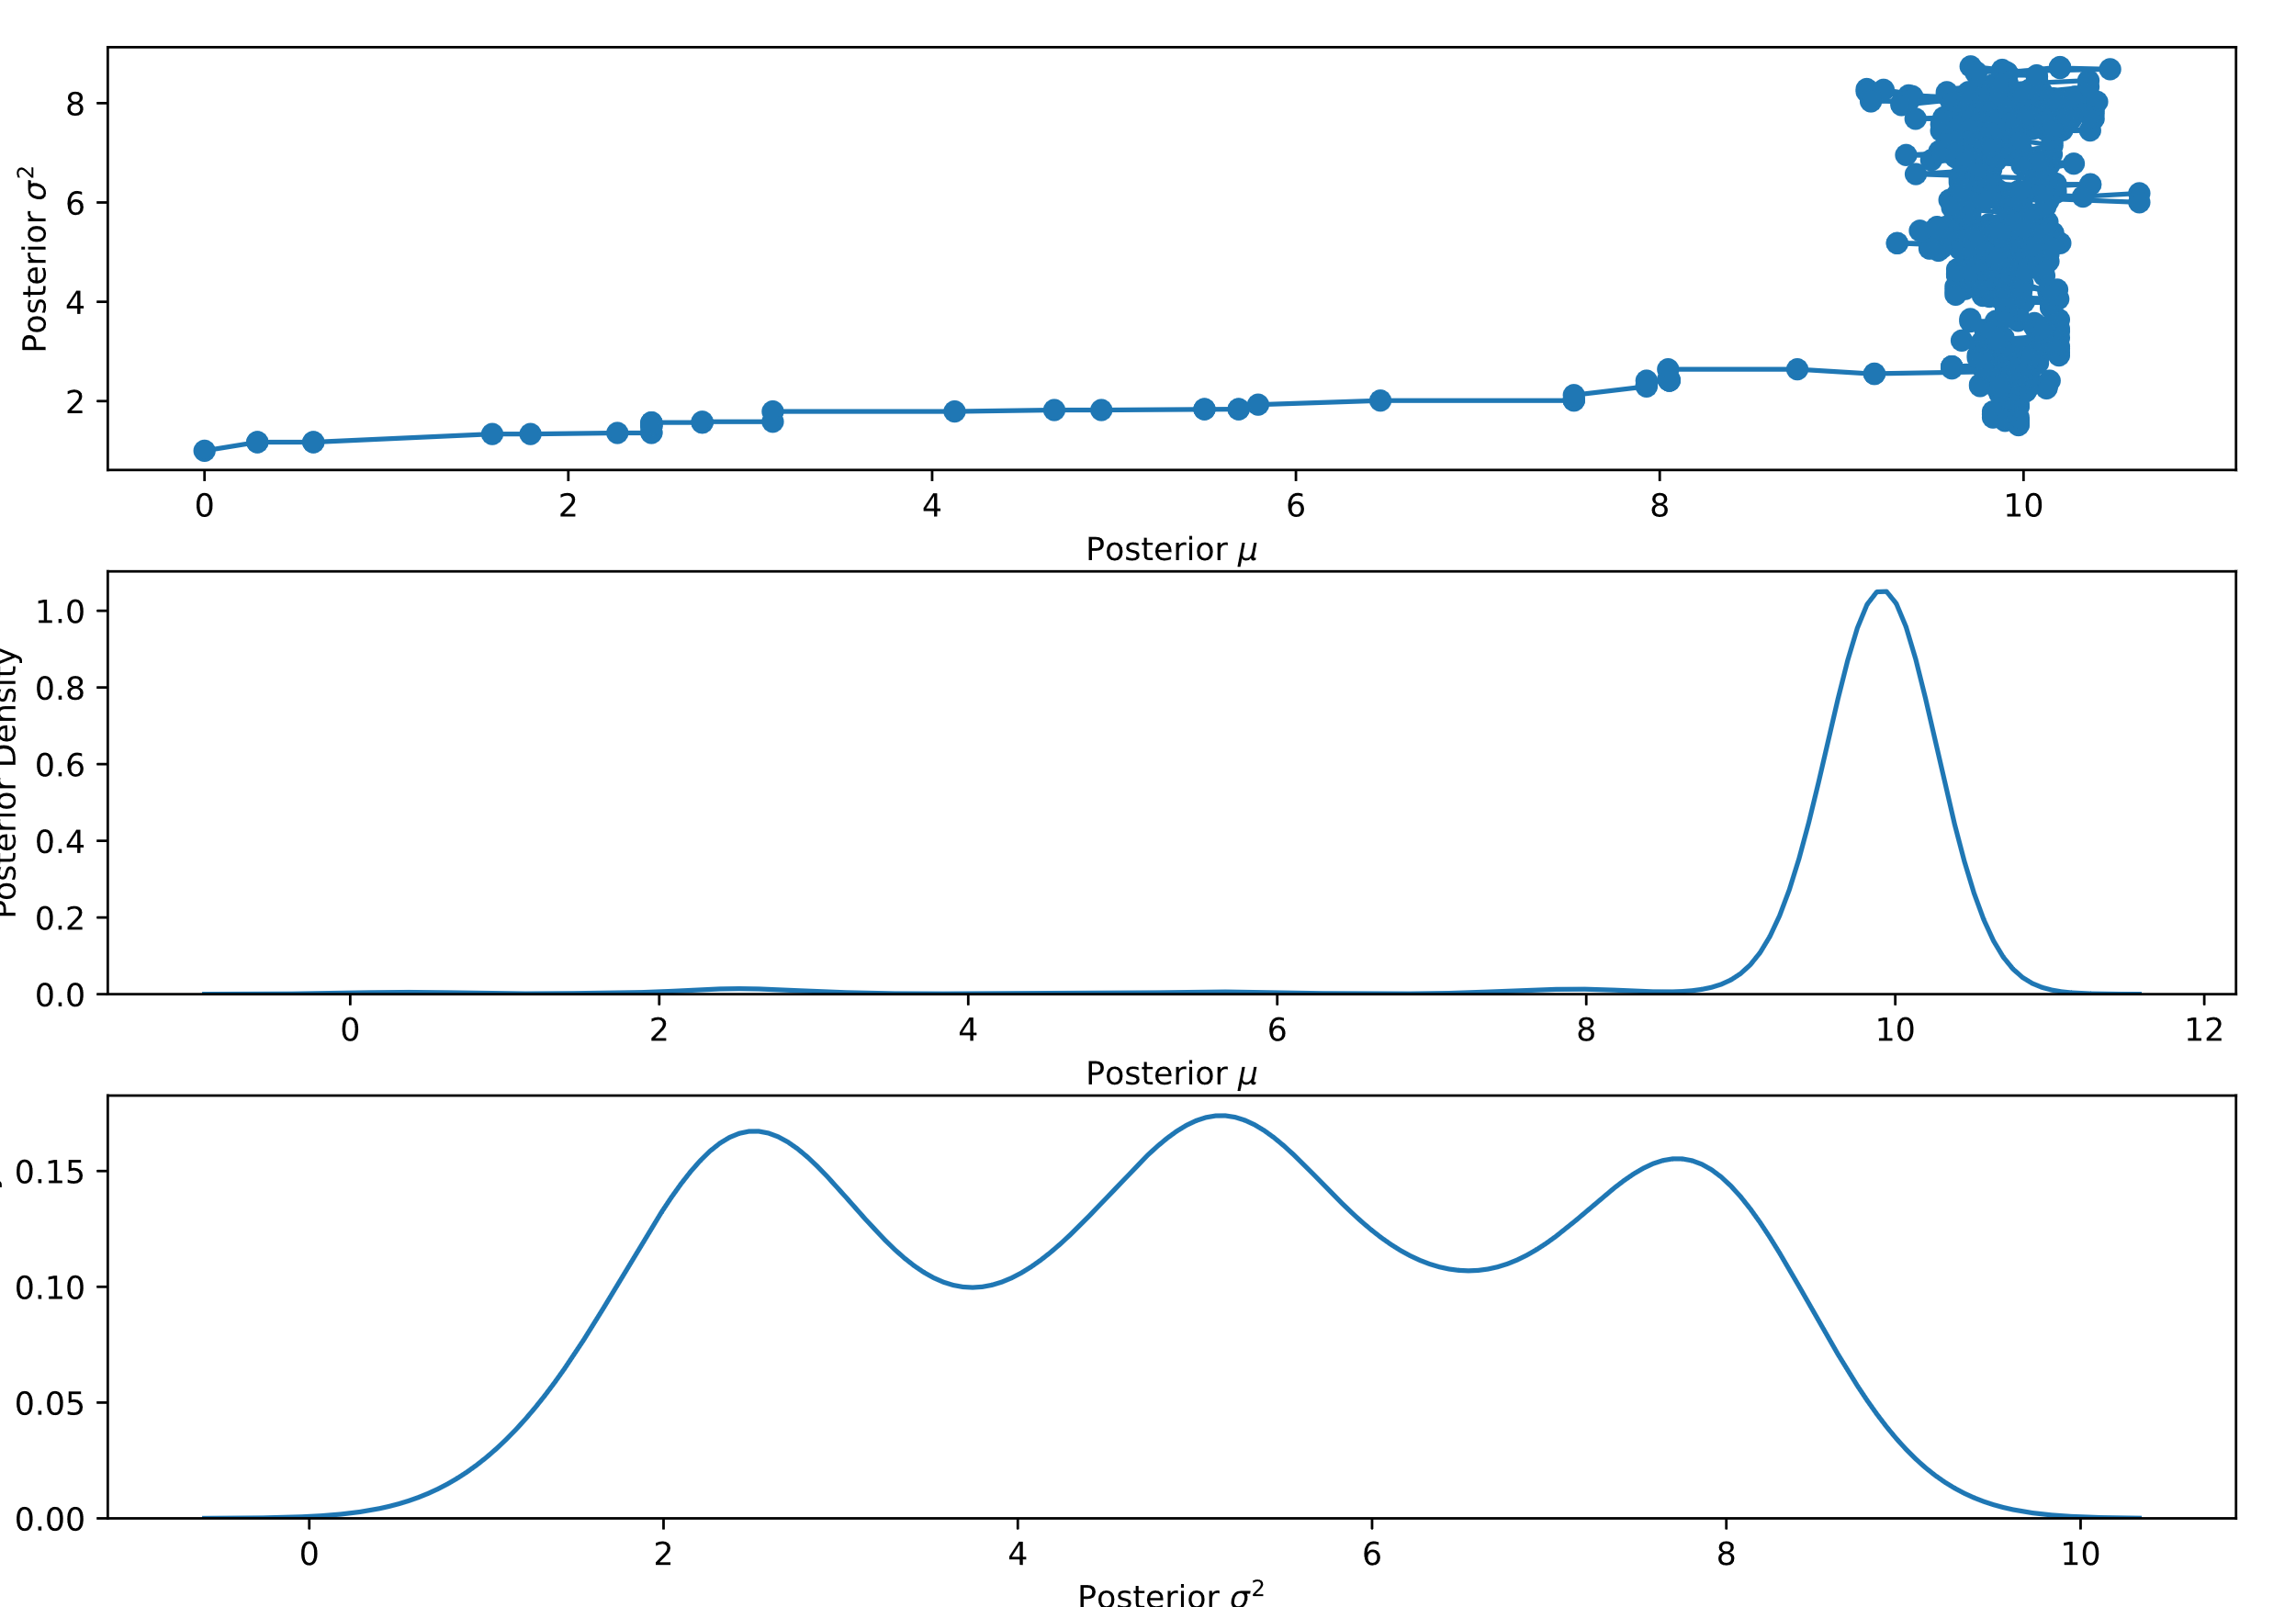
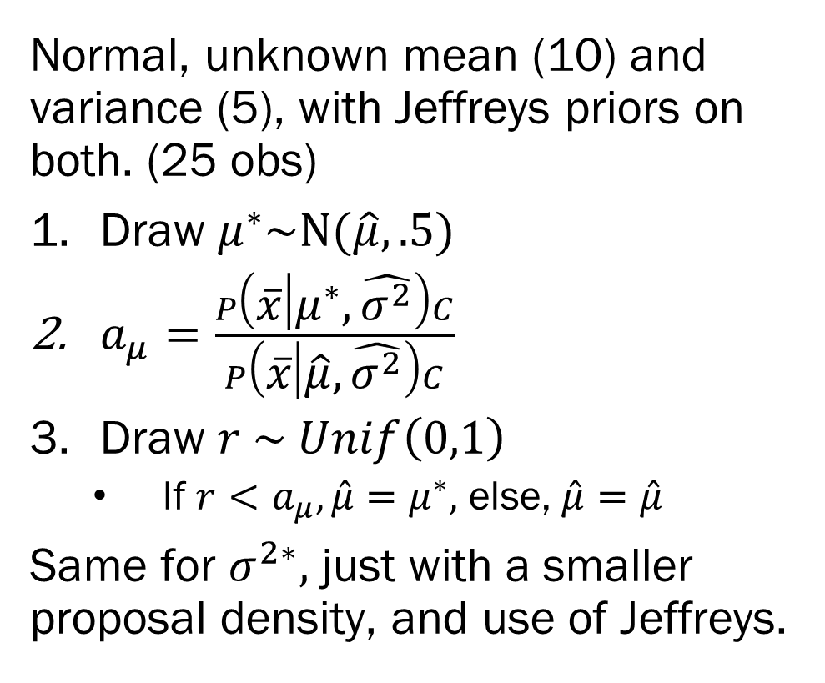
Metropolis Sampler - Example
Normal, unknown mean (10) and variance (5), with Jeffreys priors on both. (25 obs)
Draw $μ^{∗}\sim N(\hat{μ}, .5)$
$a_{μ}=\frac{P\left(\overline{x} | μ^{∗}, \hat{σ^{2}}\right)C}{P\left(\overline{x} | \hat{μ}, \hat{σ^{2}}\right)C}$
Draw $r \sim Unif\left(0,1\right)$
If $r<a_{μ}, \hat{μ}=μ^{∗},$ else, $\hat{μ}=\hat{μ}$
Same for $σ^{2∗},$ just with a smaller proposal density, and use of Jeffreys.

Slide 13
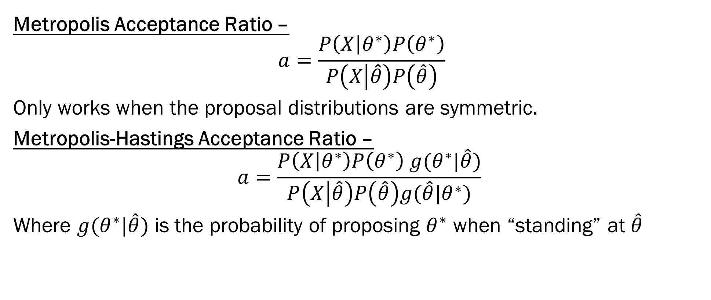
Metropolis Sampler - Extensions
Metropolis Acceptance Ratio –
$$a=\frac{P\left(X | θ^{∗}\right)P\left(θ^{∗}\right)}{P\left(X | \hat{θ}\right)P\left(\hat{θ}\right)}$$
Only works when the proposal distributions are symmetric.
Metropolis-Hastings Acceptance Ratio –
$$a=\frac{P\left(X | θ^{∗}\right)P\left(θ^{∗}\right) g(θ^{∗}|\hat{θ})}{P\left(X | \hat{θ}\right)P\left(\hat{θ}\right)g(\hat{θ}|θ^{∗})}$$
Where $g(θ^{∗}|\hat{θ})$ is the probability of proposing $θ^{∗}$ when “standing” at $\hat{θ}$

Slide 14
Metropolis Sampler – Within Gibbs
You don’t need to sample your whole joint posterior in one shot (in fact, terrible idea).
Guideline: It tends to be easier to sample from smaller dimensional, conditional distributions, than it is to sample from high dimensional distributions
So, you don’t have nicely behaved conditionals (so no Gibbs) but you have many many parameters (so no one shot Metropolis-Hastings.).
Metropolis-in-Gibbs – Use Metropolis/Metropolis-Hastings to update each parameter conditional on the previous value of all other parameters.
Instead of sampling directly from nicely behaved conditionals…

Slide 15
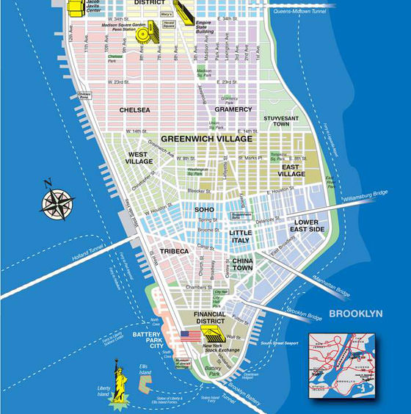
Metropolis Sampler – Considerations
Metropolis/Metropolis-Hastings is akin to navigating a city blindfolded, pointing random directions, and only moving when you hear you would be going in the right direction.
It’s better than randomly teleporting around the city until you get to your destination (rejection sampling).
It’s not quite as good as being told a how far to move vertically/horizontally and alternating (Gibbs)
It’s not nearly as good as just having the map (Conjugate priors)
But you will eventually (most likely) get there.

Slide 16
Metropolis Sampler – Considerations
Metropolis/Metropolis-Hastings is the brute force sampler, the monkeys banging on typewriters sampler.
Issues:
What your proposal density is matters quite a bit
You don’t want to make huge leaps and miss, and you don’t want to crawl and not move…
Starting locations –
E.g. Mean is 1 billion, you start at 0. Proposals like 1000, 100, 10 are almost indistinguishable from 0, so why would you move?
Slow as all get out
You have to first reach the posterior, then you have to sample from it

Slide 17
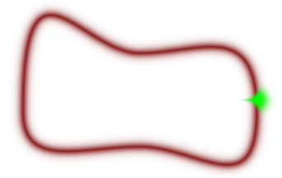
Hamiltonian Monte Carlo
Big issue: In high dimensions probability densities are concentrated around the mode, but due to this concentration, don’t make much contribution to the expected value. What we want is the “typical set.”
HMC –
Uses gradient information about the target posterior (a topological map)
Models our parameter estimates as “physical” particles moving along the posterior landscape
Give our guesses momentum so they keep going in the same “direction”
Instead of falling and getting trapped into high density areas, HMC samples from the posteriors typical area
From Fig 10 of “A Conceptual Introduction to
Hamiltonian Monte Carlo” by Michael Betancourt

Slide 18
No U-Turn Sampler – NUTS
HMC is sensitive to two tuning parameters set by the analyst
The main one is the number of steps the “physical” simulation runs for any given update.
If tuning is set poorly, the HMC might loop back to where you started
In essence, it was too enthusiastic following the gradients.
NUTS automatically tunes the HMC to avoid those sorts of issues.

Slide 19
Summary
Samplers attempt to sample from the posterior distribution
Gibbs – When you have conjugate conditional distributions
Random Walk Metropolis Hastings – For, well, almost anything
Hamiltonian MC – A much better version of MH-MCMC
For high dimensional continuous parameter sets
Not much good for discrete parameters like mixtures (no gradient information)
NUTS – A auto-tuned Hamiltonian MC method
Integrated into PyMC3
Issues arise with samplers because of how the posteriors probability landscape is structured (hills and valleys, flat plains, sharp corners all cause issues).

Slide 20
Next Week – Characterization and Computation
Diagnosing your Sampler –
Multiple sampling chains
Convergence/divergence statistics
Eyeballing your traceplots
What’s the deal with categorical variables?
Handling combinatorics
Mixture models and label switching
Next, Next Week –
Putting it all together with a Bayesian Logistic Regression…
HW3 will involve samplers!
Some simple implementation, and a bit of diagnosing.

