Slide 1

Estimation Part II:
Samplers Strike Back
Module 6 Live Session (6/29/2021)
DS6040 Summer 2021
Teague R. Henry

Slide 2

Course Updates
Halfway through the course!
HW2 is Due on Friday (7/2)
Keep working on the Projects
I’m available for questions/concerns!
HW3 is out now!

Slide 3
Outline
Sampler Review
What could Possibly Go Wrong? (With Samplers)
What a Sampler Should Do
Eyeballing Your Sampler
Formal Diagnostics
Sampling Categorical Variables

Slide 4
Sampler Review
The basic ideas behind samplers are:
Find where in the parameter space the posterior is.
Sample from that region of parameter space.
If all goes well, your set of samples can be used to characterize your posterior distribution.
Important Aside: Remember you can mix and match sampling steps…

Slide 5
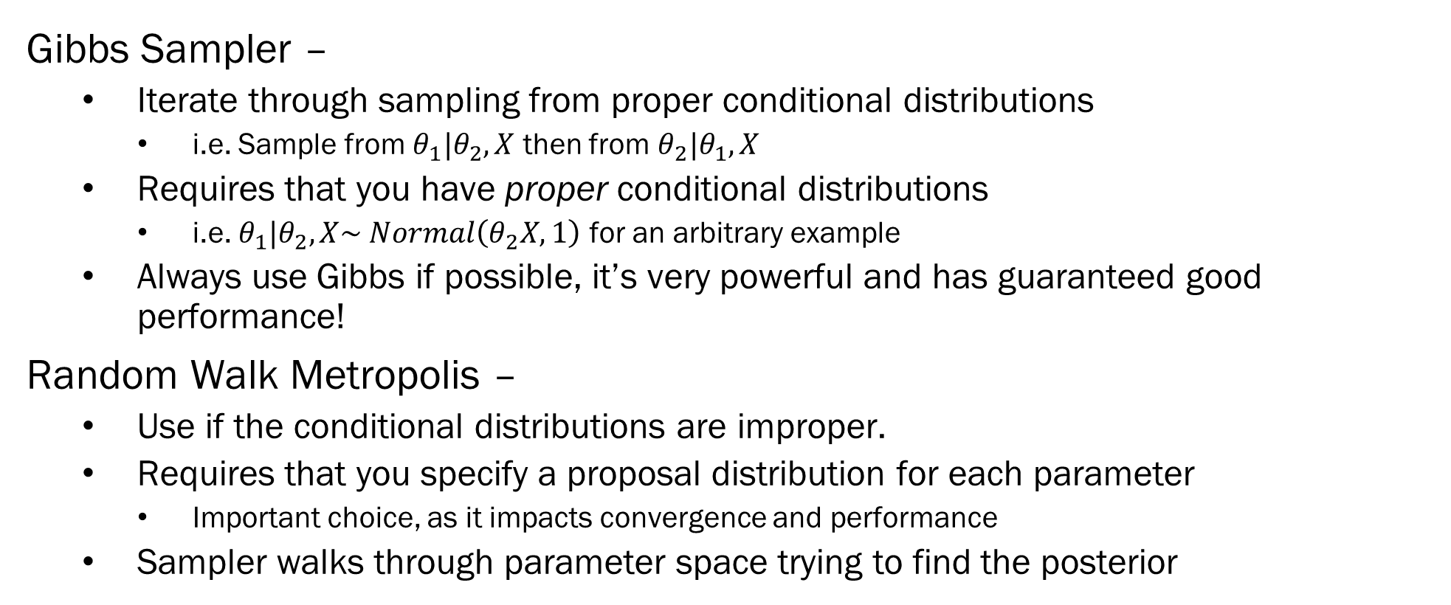
Sampler Review – Types of Samplers
Gibbs Sampler –
Iterate through sampling from proper conditional distributions
i.e. Sample from $θ_{1}|θ_{2},X$ then from $θ_{2}|θ_{1},X$
Requires that you have proper conditional distributions
i.e. $θ_{1}|θ_{2},X\sim Normal\left(θ_{2}X, 1\right)$ for an arbitrary example
Always use Gibbs if possible, it’s very powerful and has guaranteed good performance!
Random Walk Metropolis –
Use if the conditional distributions are improper.
Requires that you specify a proposal distribution for each parameter
Important choice, as it impacts convergence and performance
Sampler walks through parameter space trying to find the posterior

Slide 6
Sampler Review – Types of Samplers
Random Walk Metropolis-Hastings –
Slight modification to the acceptance ratio step of the Metropolis sampler to account for asymmetric proposal distributions
Symmetry here refers to the probability of proposing values, not necessarily what the proposal distribution looks like.
Hamiltonian MC –
Just a much better version of Metropolis-Hastings
Uses gradient information
Very powerful for use in high dimensional problems
Not appropriate for use on categorical variables
No U-Turns Sampler -
Fixes issues in Hamiltonian MC

Slide 7
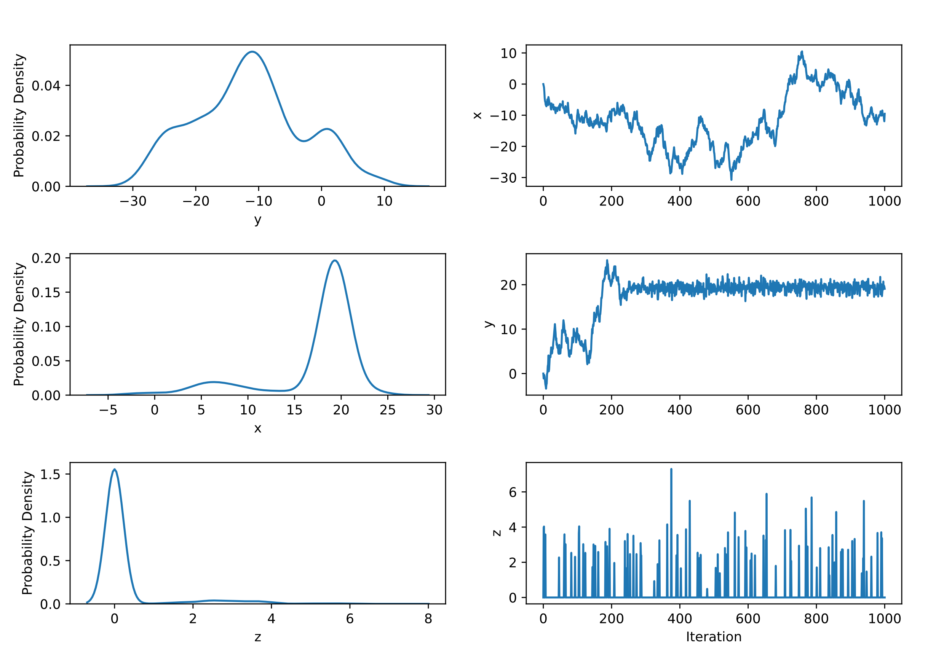
What Samplers Should Do
If everything goes right, samplers should converge to the posterior and stay there forever.
Well constructed samplers are ergodic
They cover the whole space
Which means they tend to find the posterior.
You can have an appropriate model, and still have sampler issues

Slide 8
What Goes Wrong with Samplers
Samplers are highly sensitive to the topology of the parameter space.
They can get lost in valleys
They can drop down holes
They can’t climb massive cliffs
If the space is nice, the sampler is ergodic, in that it will nicely ramble all around the space.
Like data itself, samplers can and will lie to you..
The results you get can look completely reasonable, and be completely incorrect

Slide 9
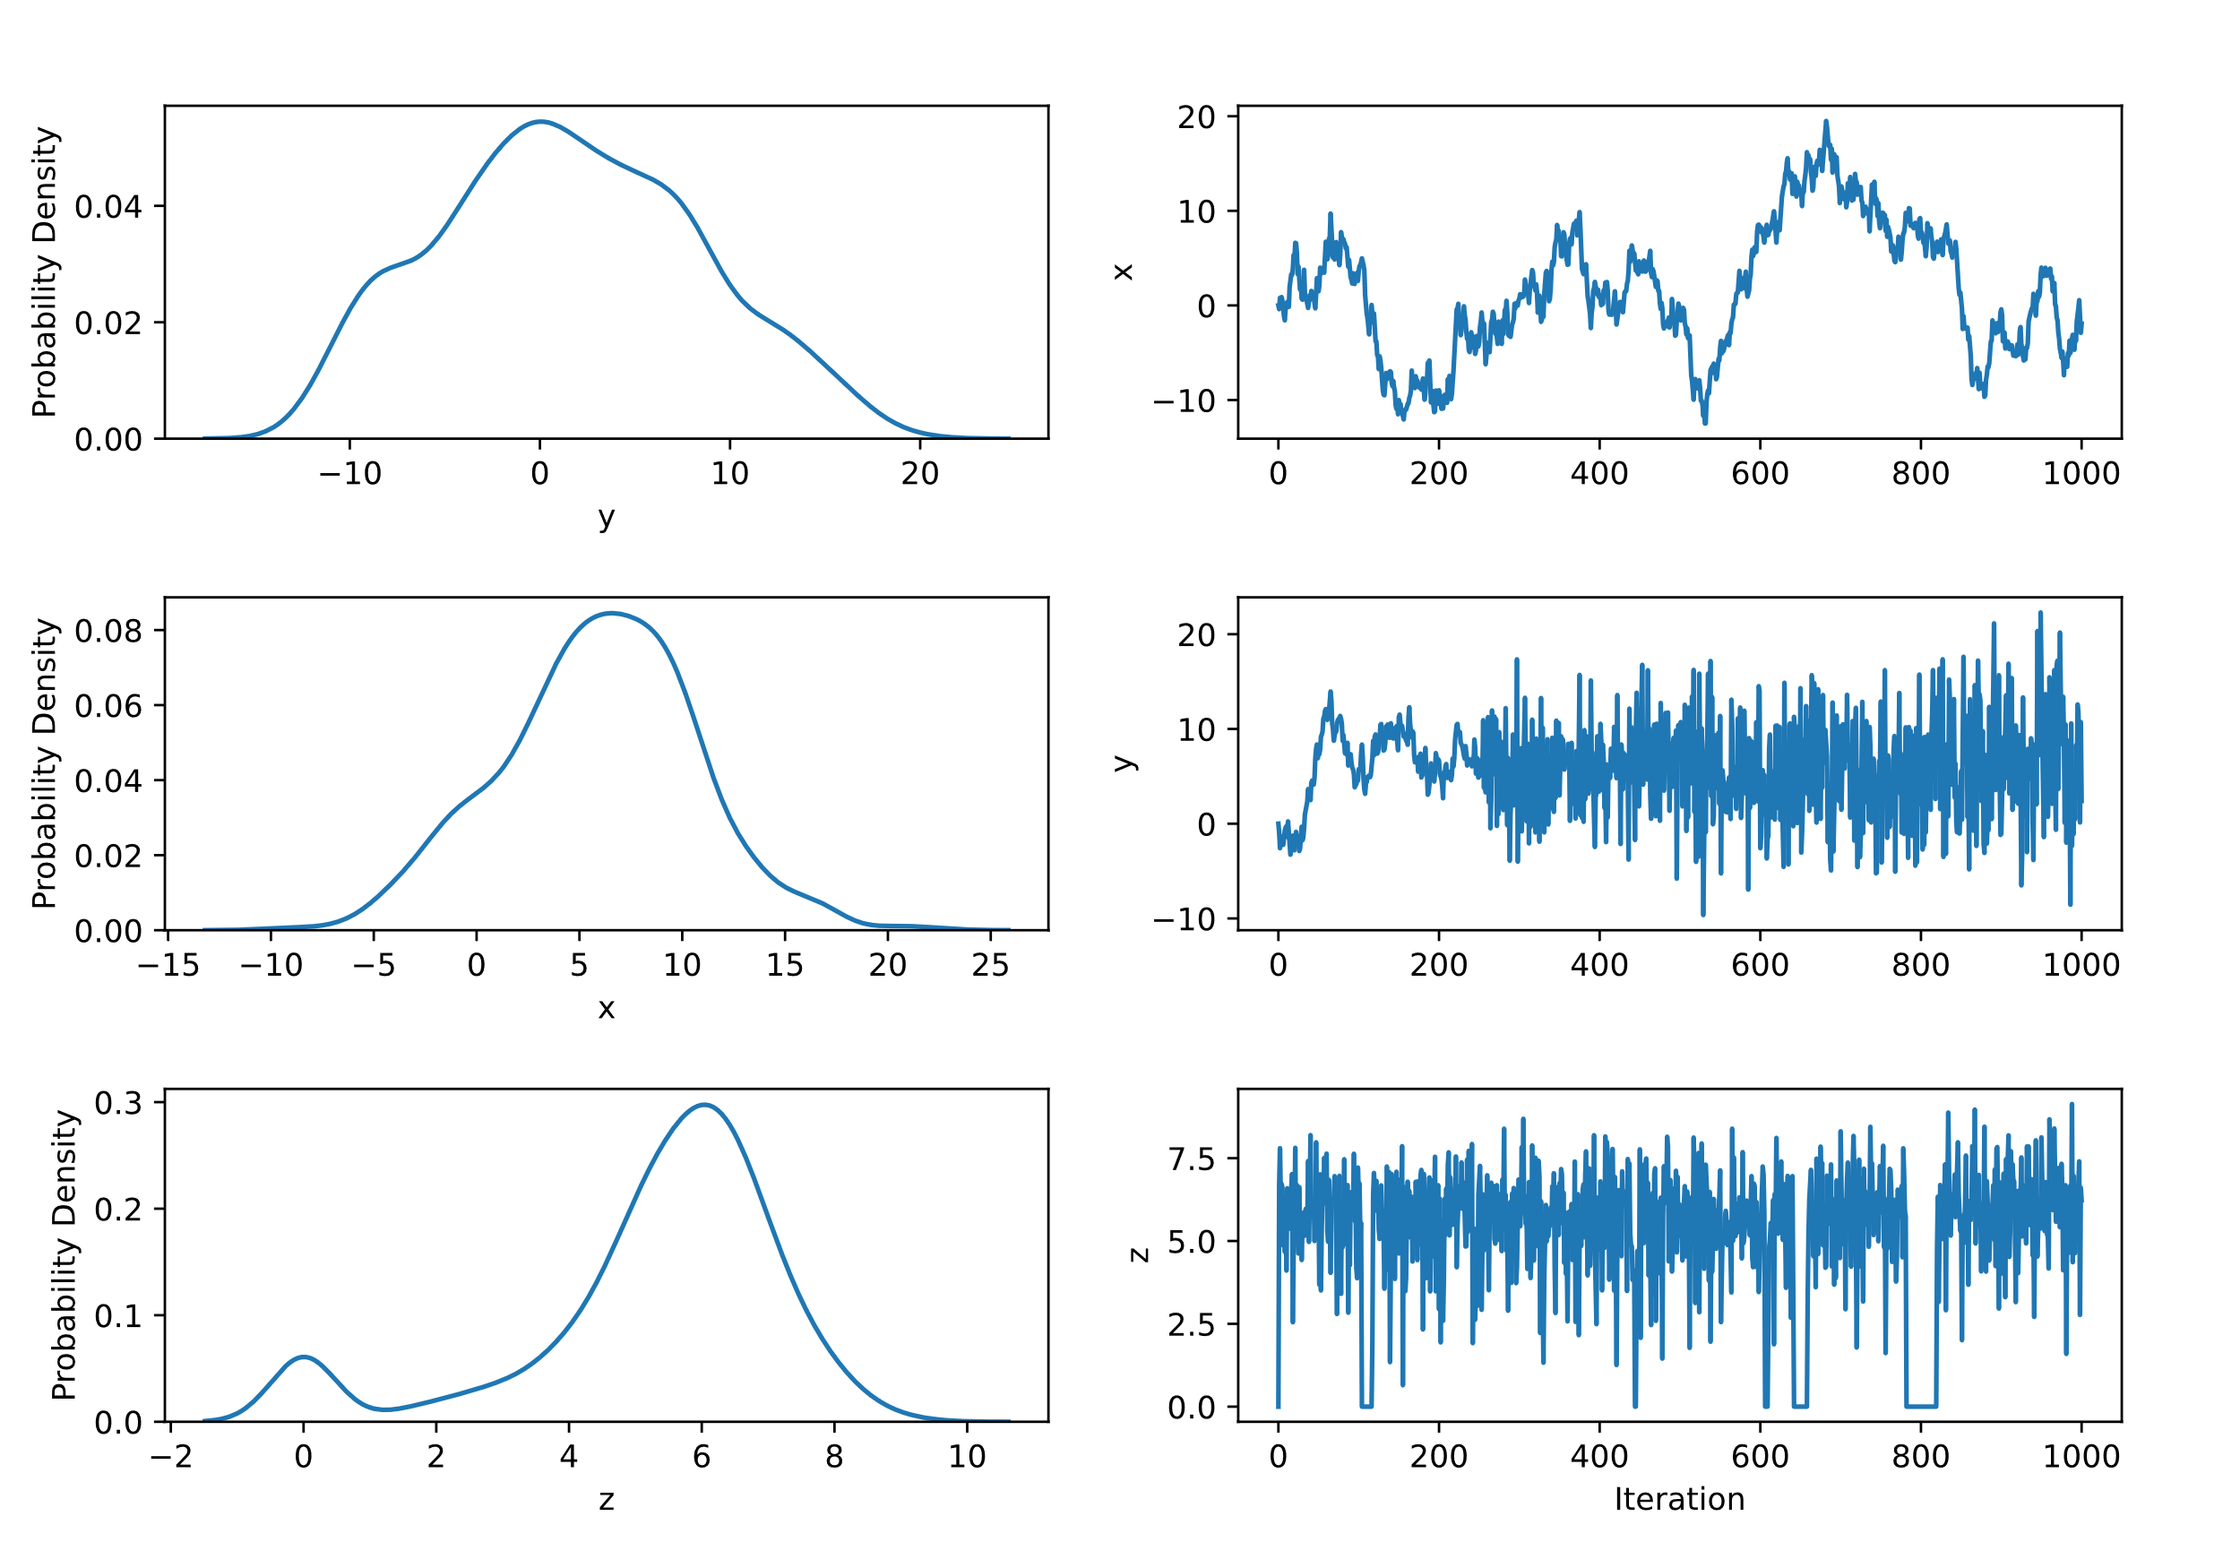
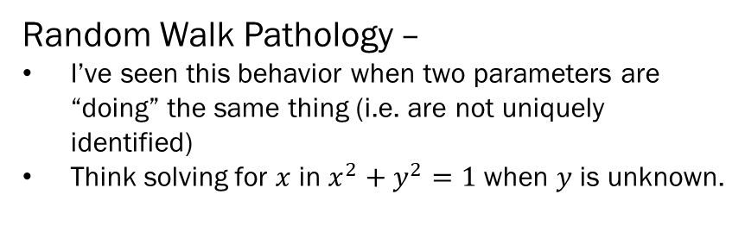
Sampler Pathologies – An Informal Guide
Random Walk Pathology –
I’ve seen this behavior when two parameters are “doing” the same thing (i.e. are not uniquely identified)
Think solving for $x$ in $x^{2}+y^{2}=1$when $y$ is unknown.
Funnel Pathology –
The walk’s variance is increasing (or changing more broadly)
Usually something do to with bad identification in other parts of the model.
Switching Pathology –
Usually a PEBCAK, you probably misspecified a mixture somewhere
e.g. the marginal mean of a mixture

Slide 10
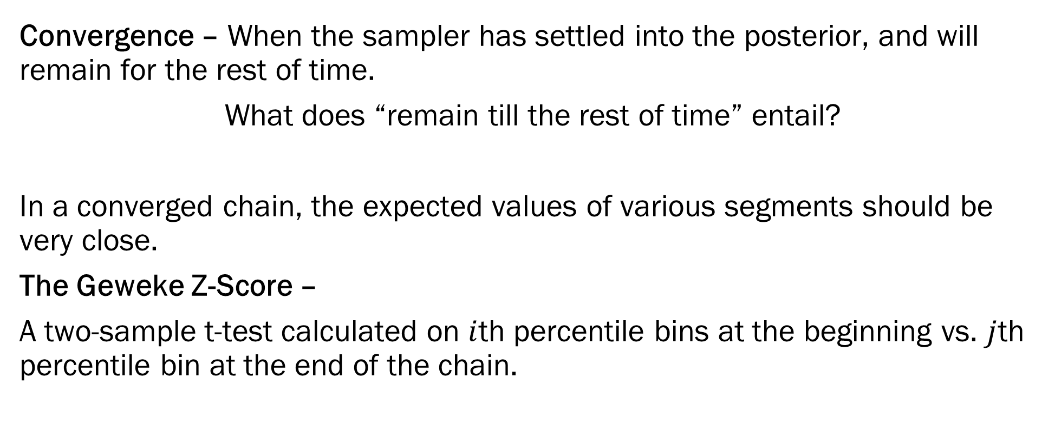
Geweke’s Z-score Diagnostic
Convergence – When the sampler has settled into the posterior, and will remain for the rest of time.
What does “remain till the rest of time” entail?
In a converged chain, the expected values of various segments should be very close.
The Geweke Z-Score –
A two-sample t-test calculated on $i$th percentile bins at the beginning vs. $j$th percentile bin at the end of the chain.

Slide 11
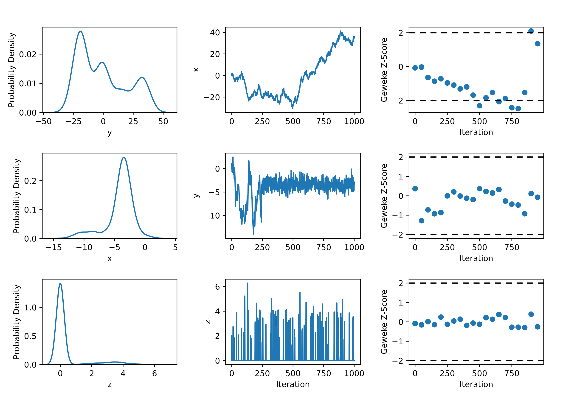
Geweke’s Z-score Diagnostic
Top Panel – Yes, bad convergence.
Mid Panel – Not an issue
Last Panel – No evidence, but bad chain.

Slide 12
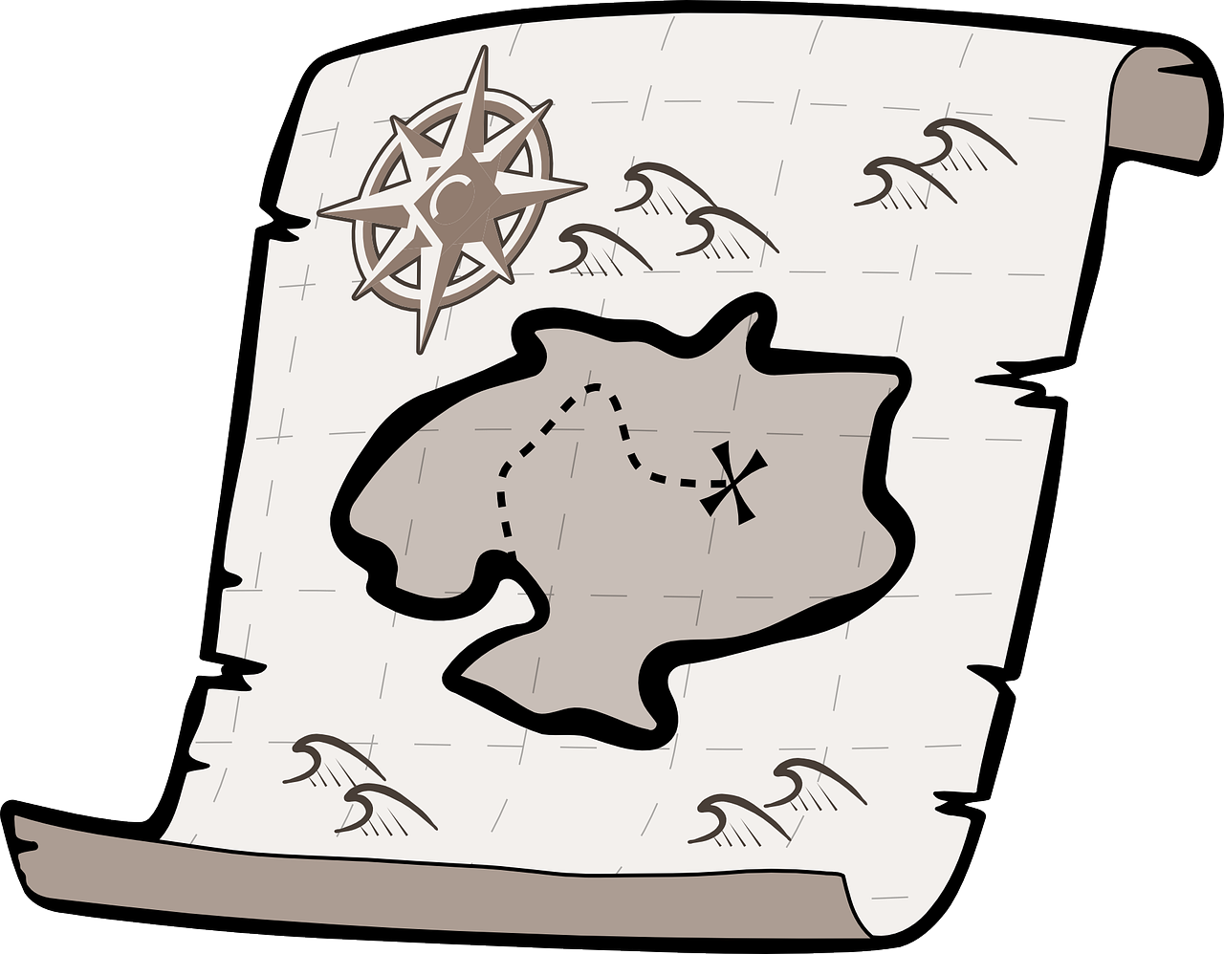
Sampler Diagnostics – An Informal Guide
Q: If you are digging for buried treasure, what’s better?
Sending out 1 digger with a month’s supply of food?
Sending out 30 diggers with a day’s supply of food?
Our sampler is in the space, and our goal is to map it. One powerful method is simply to have multiple chains going from different starting points.

Slide 13
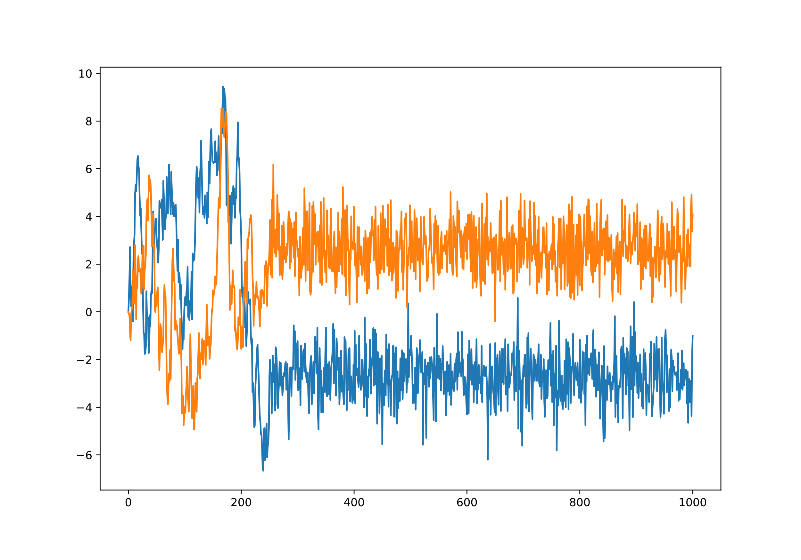
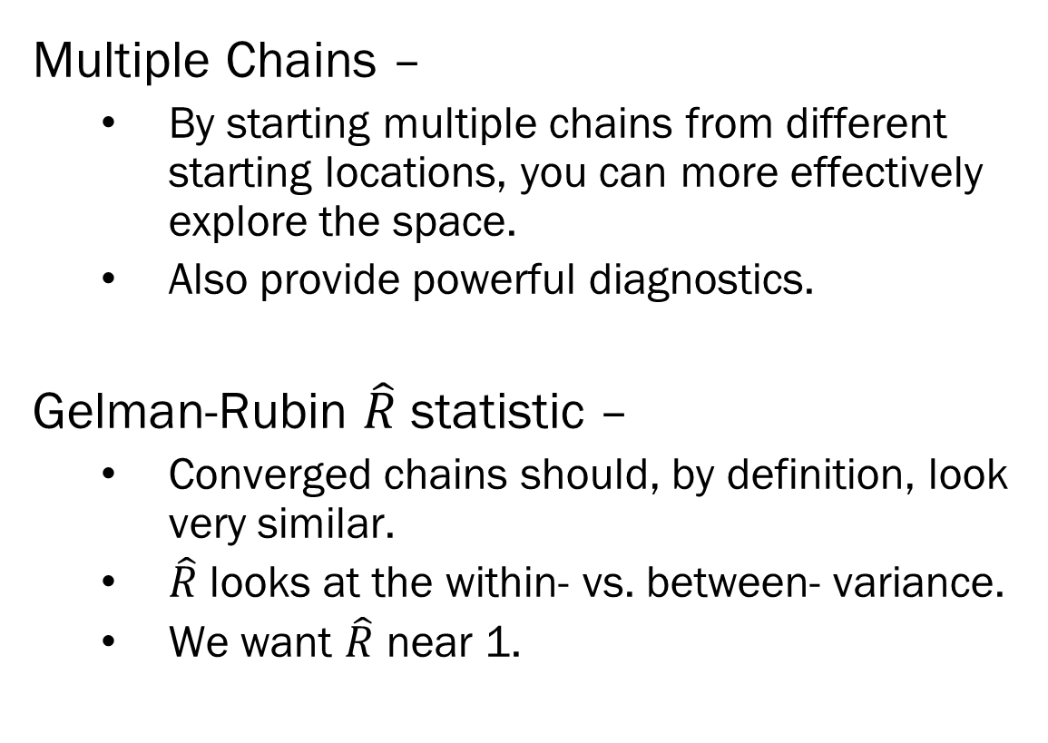
Sampler Diagnostics – An Informal Guide
Multiple Chains –
By starting multiple chains from different starting locations, you can more effectively explore the space.
Also provide powerful diagnostics.
Gelman-Rubin $\hat{R}$ statistic –
Converged chains should, by definition, look very similar.
$\hat{R}$ looks at the within- vs. between- variance.
We want $\hat{R}$ near 1.

Slide 14
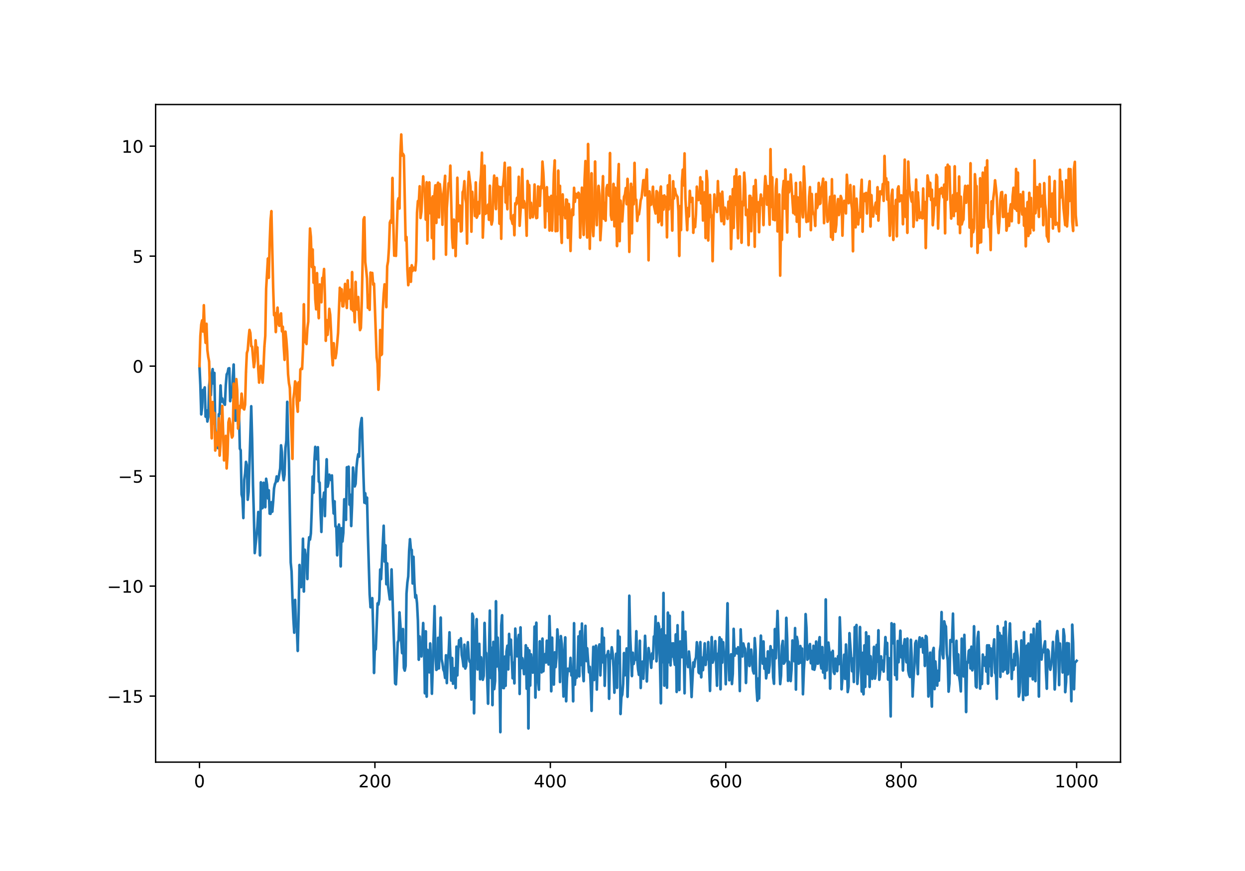
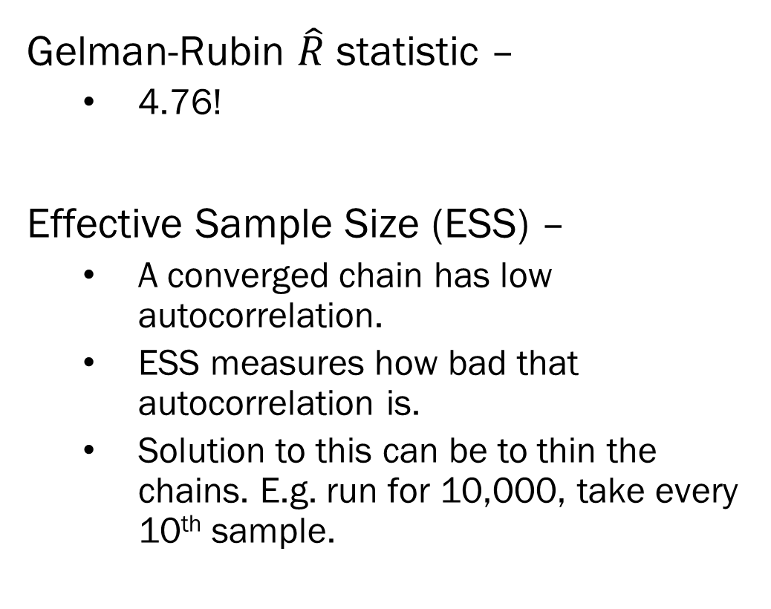
Sampler Diagnostics – An Informal Guide
Gelman-Rubin $\hat{R}$ statistic –
4.76!
Effective Sample Size (ESS) –
A converged chain has low autocorrelation.
ESS measures how bad that autocorrelation is.
Solution to this can be to thin the chains. E.g. run for 10,000, take every 10th sample.

Slide 15
NUTS Diagnostics– An Informal Guide
Recall that the NUTS sampler is using a “physical” simulation to, in essence, rollerblade around the space more effectively.
Divergence – When the sampler jumps too far from the target set.
Indicates that the space has some pathological curvature.
Possibly fixed by model reparameterization.

Slide 16
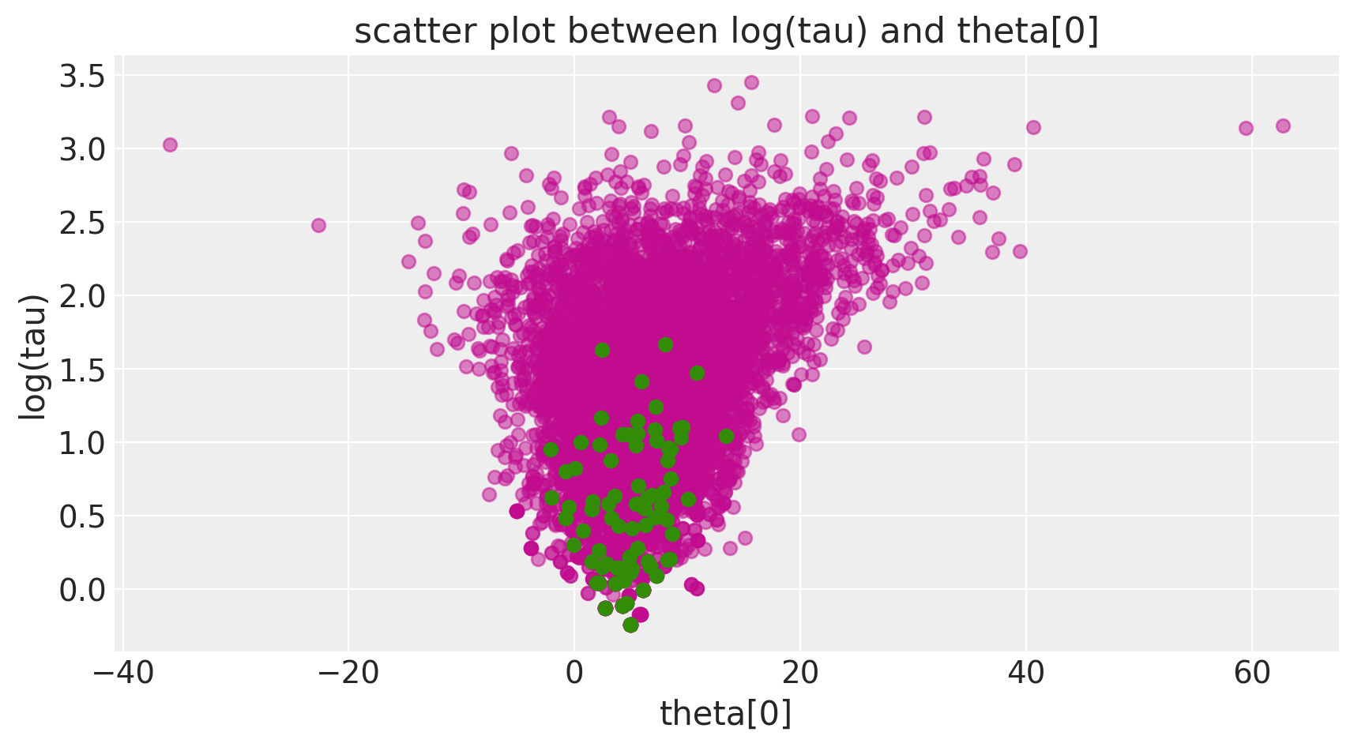
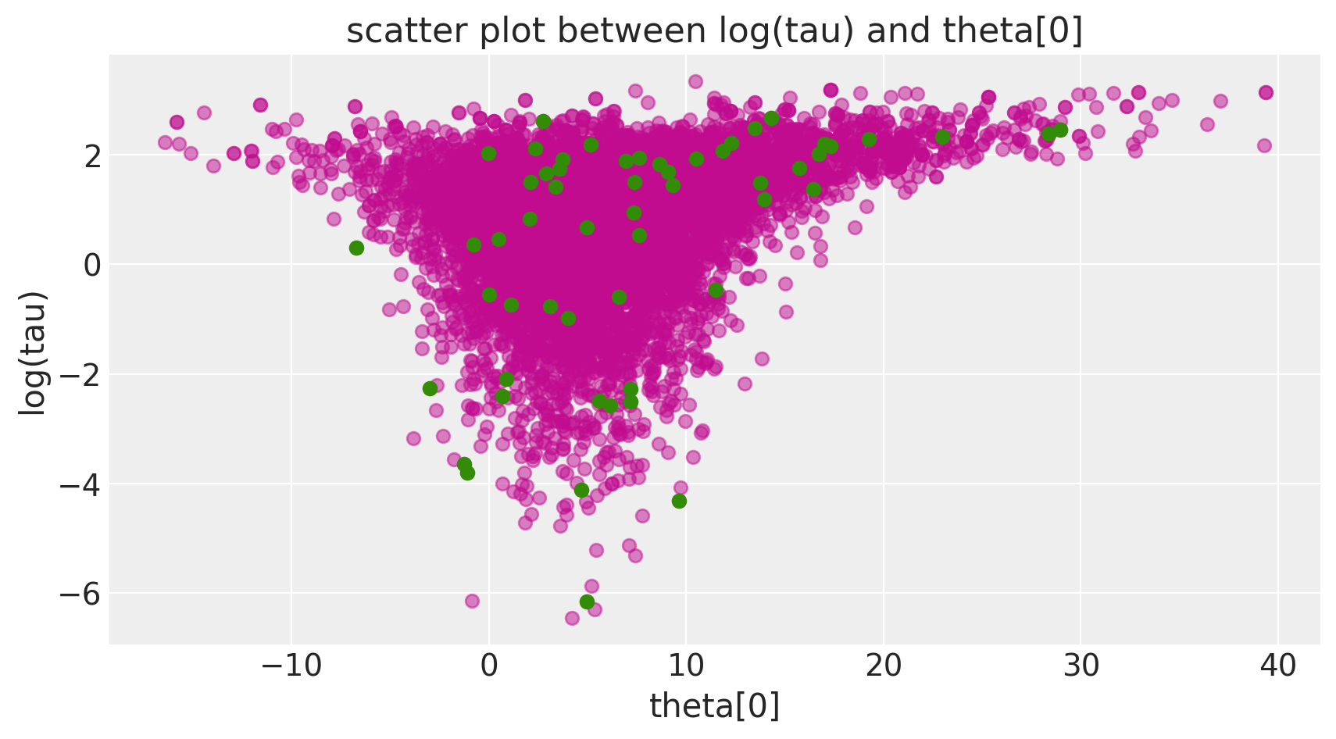
NUTS Diagnostics– An Informal Guide
Divergences indication where in the parameter space there might be problems.
Clustered divergences are indicators!
But divergences can happen because the step size is too large.
Then the divergences are more uniformly distributed.
Guideline: More divergences, more issues.
Plots taken from the excellent tutorial (Author: Michael Betancourt)
https://docs.pymc.io/notebooks/Diagnosing_biased_Inference_with_Divergences.html

Slide 17











Sampling Categorical Variables
Simple Gaussian Mixture Model –
Hyperparameters suppressed in figure.
Unsupervised Clustering –
$μ_{k}$ is estimated from the data.
Consider a mixture model of 2 groups
A and B, each having different means.
When you build your sampler, you create a variable z_i, which takes on values A and B.
Question: Are (A and B), and (A and B) the same?
$$k=1, …K$$
$$μ_{k}\sim Norm(μ_{0}, σ_{0})$$
$$Σ$$
$$[D]$$
$$[D,D]$$
$$z_{i}\sim Cat(π)$$
$$X_{i}\sim MVN(μ_{z_{i}},Σ)$$
$$K$$
$$[D]$$
$$i=1, …n$$

Slide 18
Label Switching
Label switching – When the meaning of category (i.e. discrete classes) differs between AND WITHIN sampling runs/chains.
Why? – In unsupervised clustering, a label is just that, a label.
The definition of each cluster depends on the observations in it
In one chain, True Group A could be labeled as Group 1, in another chain, Group 2.
If the clusters are not well defined, then this switch can happen mid sample.
Problems – Can’t run label specific between chain diagnostics.
Solution – Evaluate convergence using a label switch immune similarity measure like Adjusted Rand Index (ARI) or Variation of Information (VI)

Slide 19
Combinatorics and Networks
Consider a (real) social network:
You make friends based on common interests.
You also make friends from the friends of your current friends. (Transitivity).
Two related problems:
Clustering the network
Estimating a parametric model on the network.
Mr. Hi
John A.

Slide 20
Combinatorics and Networks
Clustering –
When you move a node from one cluster to another, you change more than one nodes’ most probable cluster.
You can’t update blocks of nodes, you need to update one at a time.
Parametric Modeling –
In transitivity respecting models of networks, the normalizing constant is over all possible combination of edges.
More networks than particles in the universe…
Mr. Hi
John A.

Slide 21
Combinatorics and Networks
Clustering –
When categorical variables where the meaning of the categorical variable depends on the values across the entire sample (i.e. clustering), think carefully about how you update your cluster labels, and definitions of the clusters themselves.
Parametric Modeling –
Consider estimating multiple categorical variables within an observation…
It pains me to my core, but I’ll use the Myers-Briggs personality “test” as an example.
If the meaning of the combination is highly specific to the exact combination, then each combination needs to be evaluated.
Assumptions help:
For example, define the combination of categories as an additive sum, e.g. mental health diagnoses.
Fairly niche topic yes, but when it comes up, it comes up bad…

Slide 22
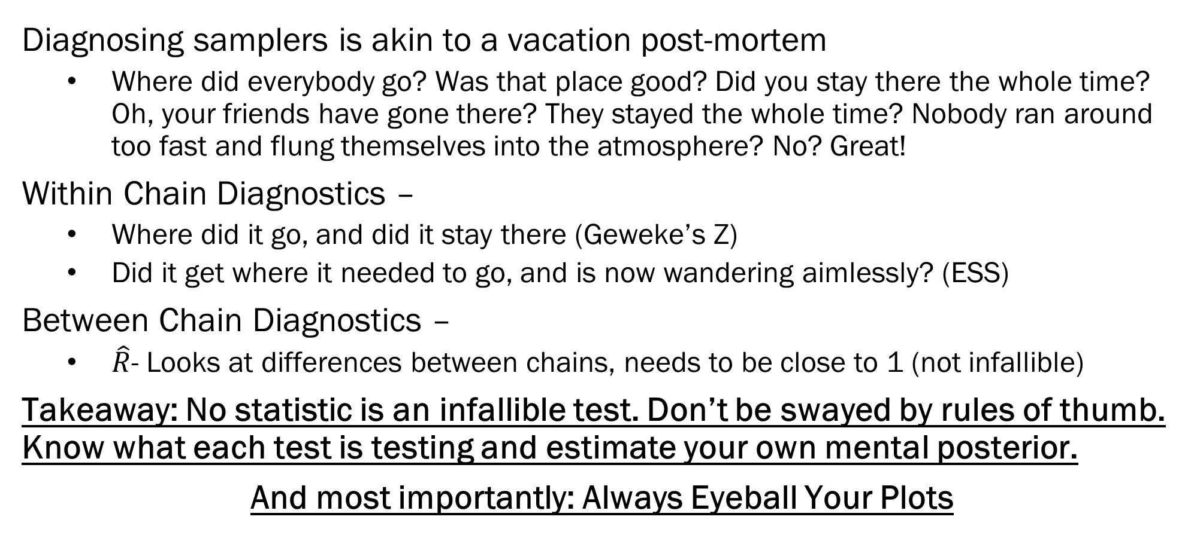
Summary
Diagnosing samplers is akin to a vacation post-mortem
Where did everybody go? Was that place good? Did you stay there the whole time? Oh, your friends have gone there? They stayed the whole time? Nobody ran around too fast and flung themselves into the atmosphere? No? Great!
Within Chain Diagnostics –
Where did it go, and did it stay there (Geweke’s Z)
Did it get where it needed to go, and is now wandering aimlessly? (ESS)
Between Chain Diagnostics –
$\hat{R}$- Looks at differences between chains, needs to be close to 1 (not infallible)
Takeaway: No statistic is an infallible test. Don’t be swayed by rules of thumb. Know what each test is testing and estimate your own mental posterior.
And most importantly: Always Eyeball Your Plots

Slide 23
Next Time: Wrapping Up Samplers
Hierarchical Bayesian Models
Nested Data – It’s everywhere. And not accounting for it is not an option.
Sales within person
Students in schools
Time within patient within doctor crossed with hospital within state within country.
Document within action with agent within country within region (for you GDELT fans)
Bayes really shines with nested data.
Bayesian Model Averaging
The Bayesian Ensemble Method
Focus on computability, not complexity
HW4 will be on both of these.

