Slide 1

Variational Inference Part I:
Expectation Maximization and Friends
Module 8 Live Session (7/13/2021)
DS6040 Summer 2021
Teague R. Henry

Slide 2

Course Updates
HW3 Due 7/16
Project Updates –
I’ll be checking in with each group over this week
Paper+Presentation due 8/12 (last day of semester)
HW4 has been released!
Due 7/30
HW5 will be due 8/6 (released 7/25)
Less time to complete, so will be shorter
I need the time to grade and allow resubmissions.

Slide 3
Outline
Unsupervised Clustering as Mixture Models
The Expectation-Maximization Algorithm
Variational Inference Writ Large

Slide 4
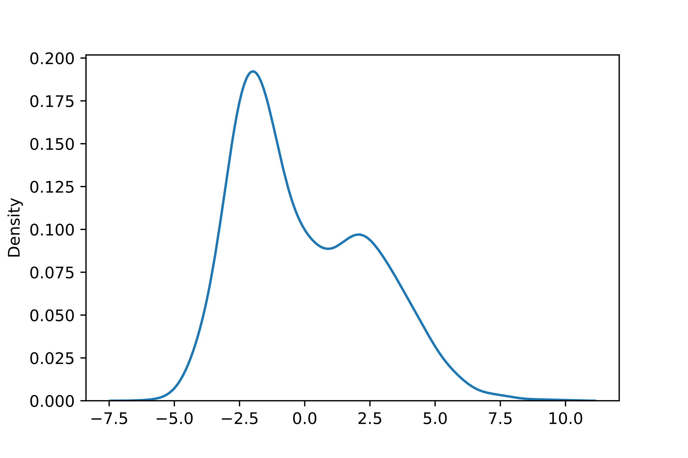
Mixture Models and Latent Variables
Data is rarely “nicely” distributed…
Assumption – Once external factors are controlled for, the data is nicely distributed…
We rarely (never) have all possible important features.
Sometimes this is ignorable…
How can we model data with features we need but don’t have?

Slide 5
Mixture Models and Latent Variables
Data Augmentation – Propose unobserved (latent) variables to explain your data…
Latent variables are defined by the relations you impose between them observed data.
Example – Mixture membership…

Slide 6
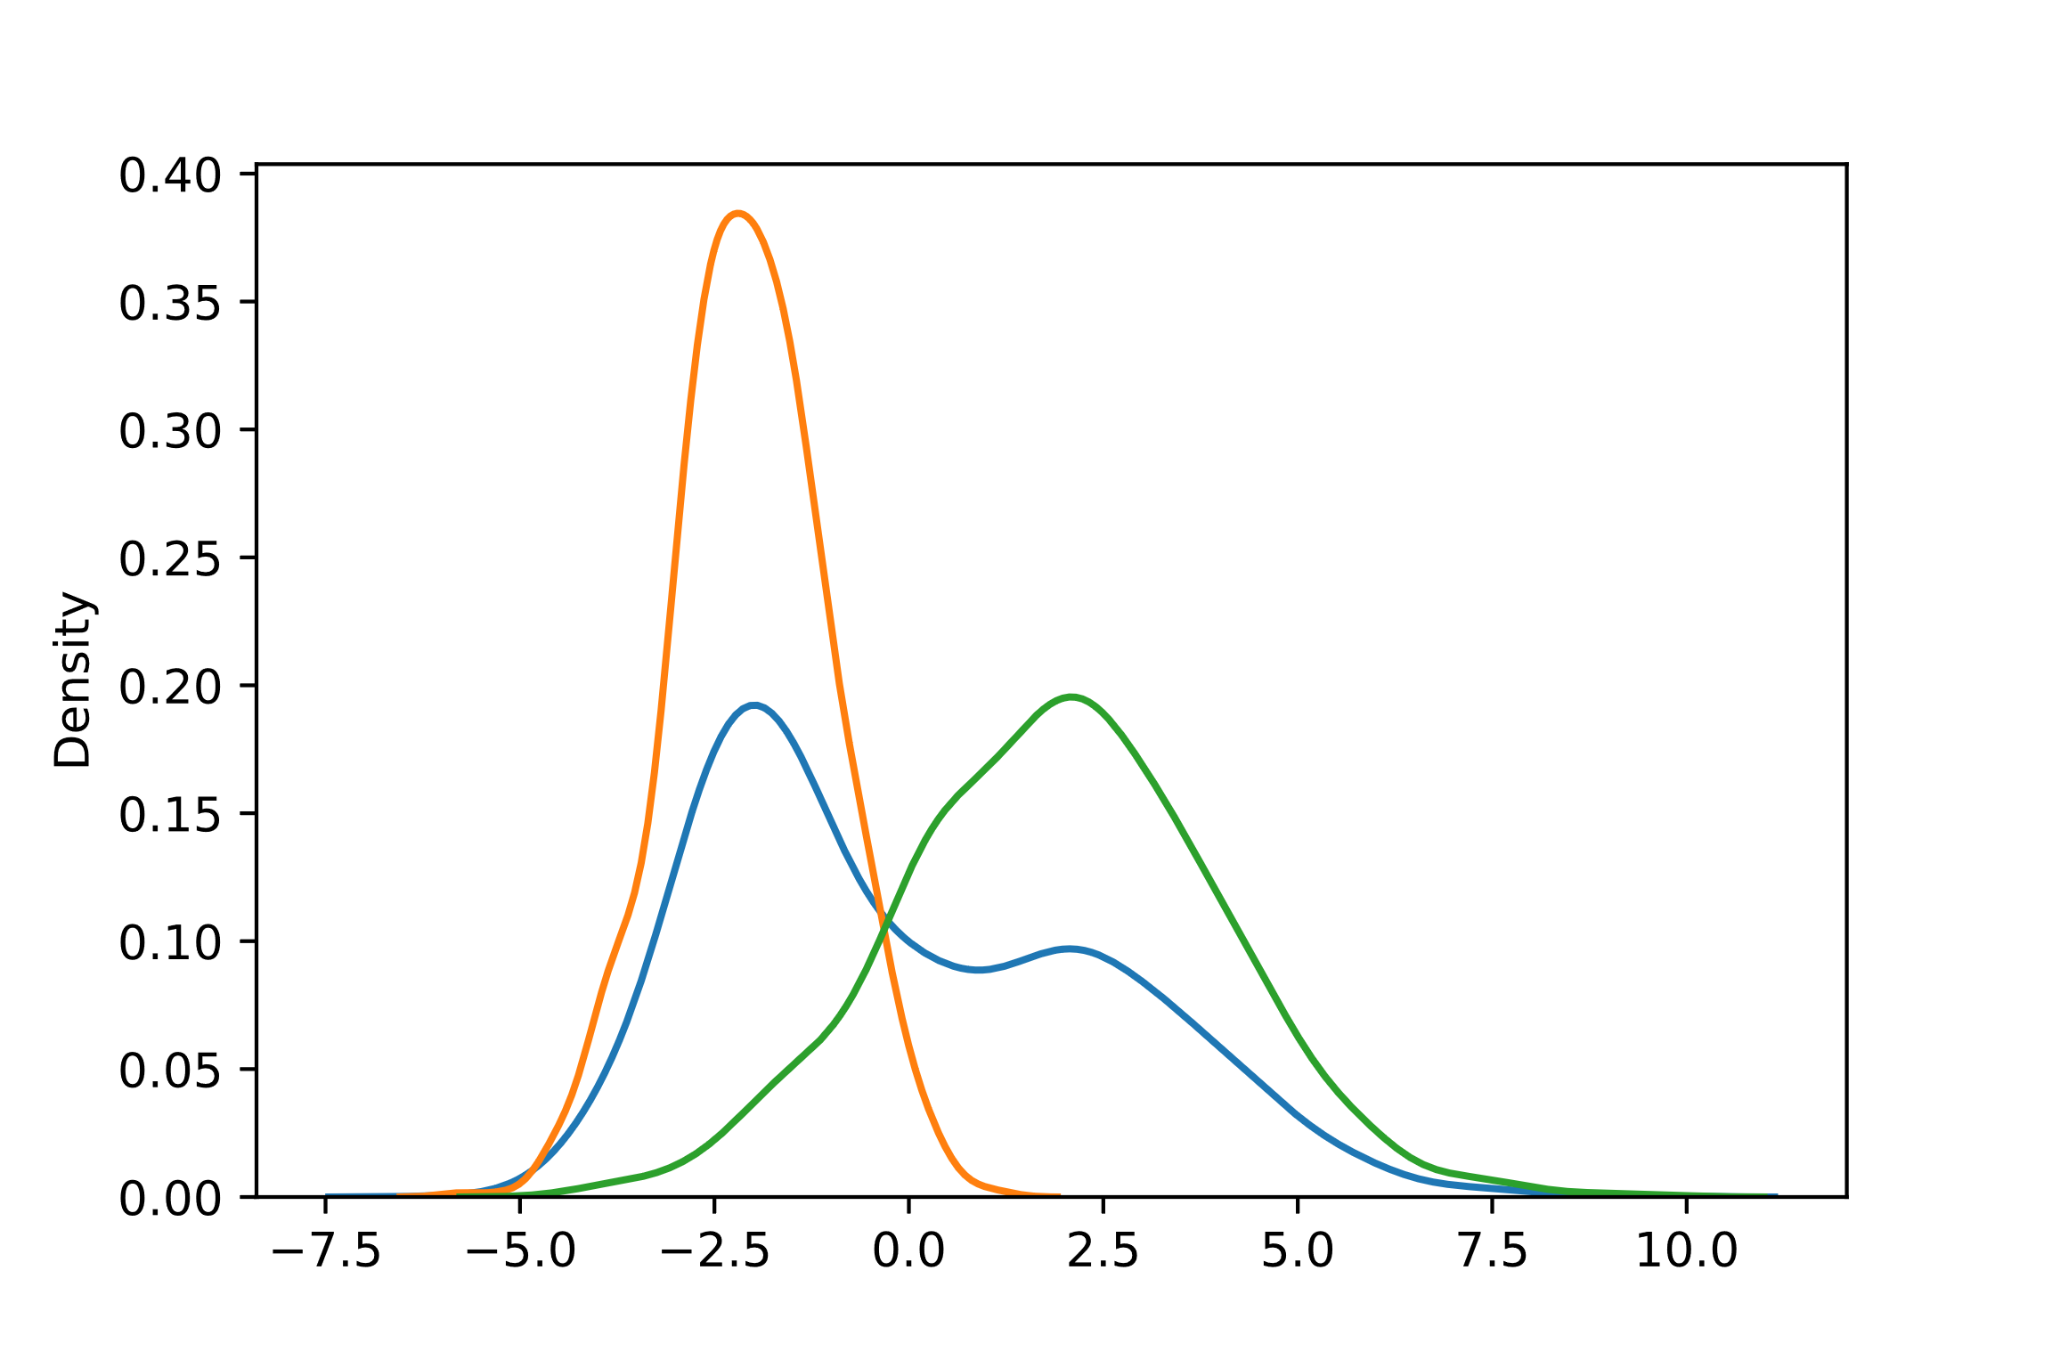
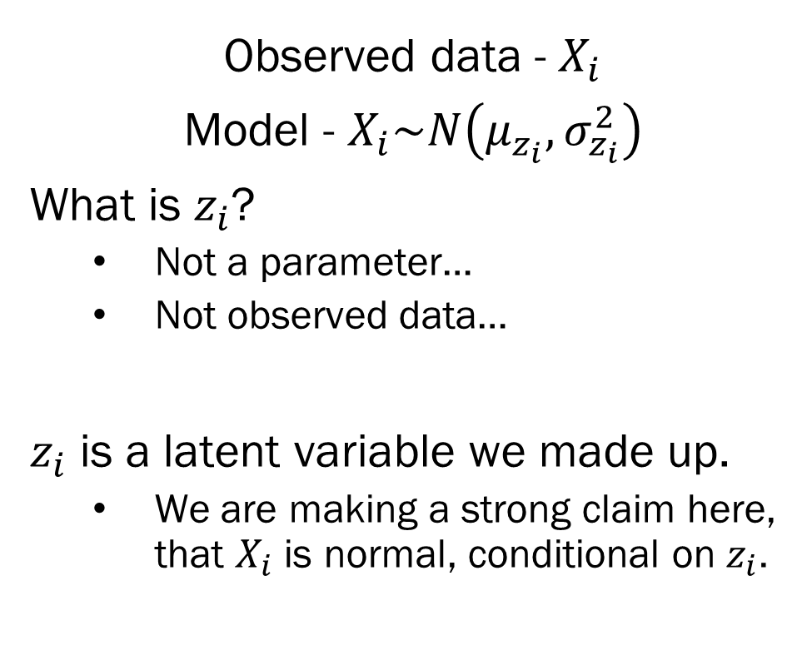
Simple Gaussian Mixture Model
Observed data - $X_{i}$
Model - $X_{i}\sim N\left(μ_{z_{i}}, σ_{z_{i}}^{2}\right)$
What is $z_{i}$?
Not a parameter…
Not observed data…
$z_{i}$ is a latent variable we made up.
We are making a strong claim here, that $X_{i}$ is normal, conditional on $z_{i}$.

Slide 7
A Word of Warning
Beware clustering, mixture models and unsupervised learning methods…
Reification Fallacy -
Just because you find a cluster / component, doesn’t mean it’s a real thing…
Sometimes a weird distribution is just that, a weird distribution…

Slide 8
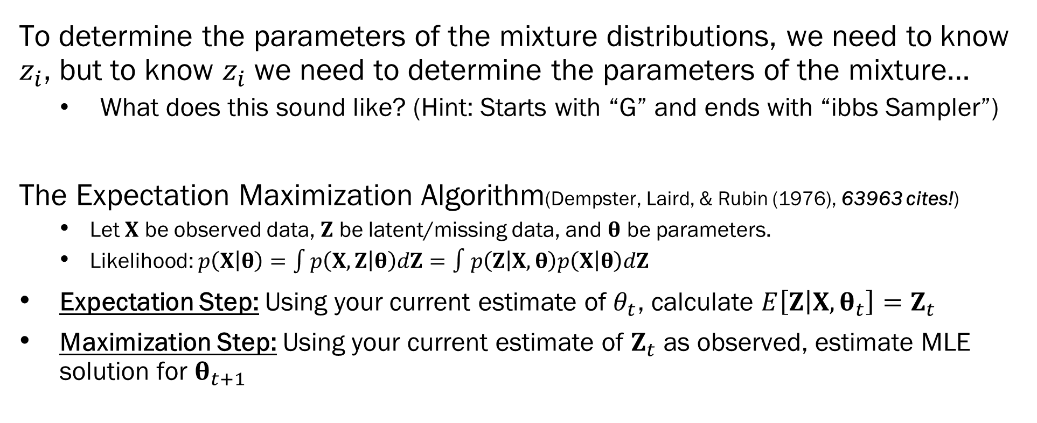
The EM Algorithm
To determine the parameters of the mixture distributions, we need to know $z_{i}$, but to know $z_{i}$ we need to determine the parameters of the mixture…
What does this sound like? (Hint: Starts with “G” and ends with “ibbs Sampler”)
The Expectation Maximization Algorithm(Dempster, Laird, & Rubin (1976), 63963 cites!)
Let $X$ be observed data, $Z$ be latent/missing data, and $θ$ be parameters.
Likelihood: $p\left(X | θ\right)=\int{p\left(X, Z | θ\right)dZ}=∫p\left(Z | X,θ\right)p\left(X | θ\right)dZ$
Expectation Step: Using your current estimate of $θ_{t}$, calculate $E\left[Z | X, θ_{t}\right]=Z_{t}$
Maximization Step: Using your current estimate of $Z_{t}$ as observed, estimate MLE solution for $θ_{t+1}$

Slide 9
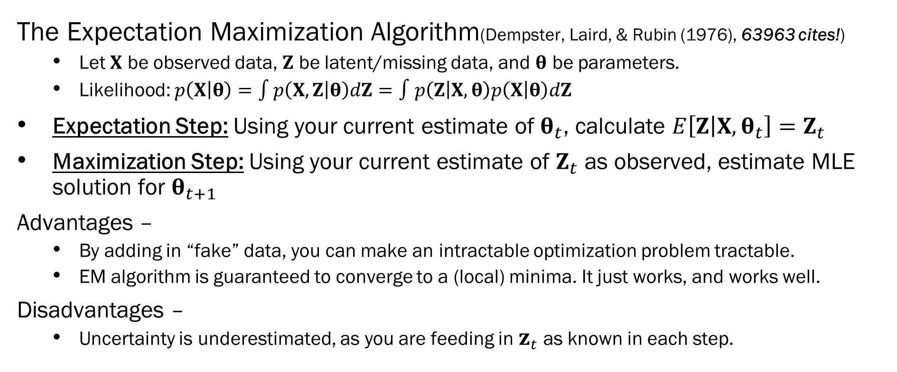
The EM Algorithm
The Expectation Maximization Algorithm(Dempster, Laird, & Rubin (1976), 63963 cites!)
Let $X$ be observed data, $Z$ be latent/missing data, and $θ$ be parameters.
Likelihood: $p\left(X | θ\right)=\int{p\left(X, Z | θ\right)dZ}=∫p\left(Z | X,θ\right)p\left(X | θ\right)dZ$
Expectation Step: Using your current estimate of $θ_{t}$, calculate $E\left[Z | X, θ_{t}\right]=Z_{t}$
Maximization Step: Using your current estimate of $Z_{t}$ as observed, estimate MLE solution for $θ_{t+1}$
Advantages –
By adding in “fake” data, you can make an intractable optimization problem tractable.
EM algorithm is guaranteed to converge to a (local) minima. It just works, and works well.
Disadvantages –
Uncertainty is underestimated, as you are feeding in $z_{t}$ as known in each step.

Slide 10
Variational Inference
As we know, any “interesting” Bayesian model has an improper posterior.
Samplers – Construct a Markov Chain that samples from the posterior…
Still approximate, but we are sampling from the full posterior.
Variational Inference
Instead of trying to sample from an improper posterior, why don’t we just… not?
Let’s instead approximate the posterior using a much simpler set of proper distributions
That way, if we get a good approximation, we can calculate our EAP, MAP, and credible intervals directly.

Slide 11
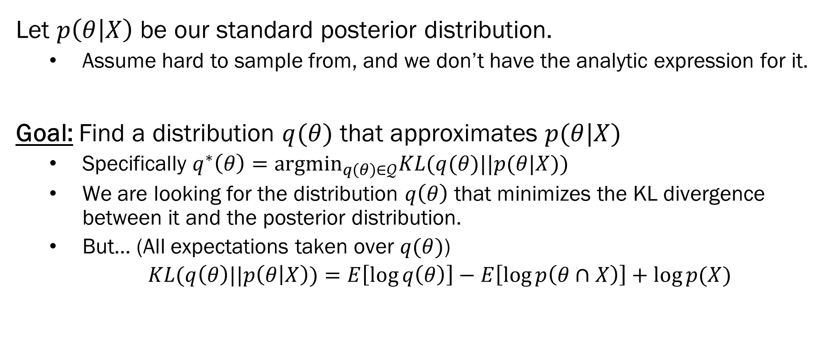
Variational Inference – Technical Deets
Let $p\left(θ | X\right)$ be our standard posterior distribution.
Assume hard to sample from, and we don’t have the analytic expression for it.
Goal: Find a distribution $q(θ)$ that approximates $p(θ|X)$
Specifically $q^{∗}\left(θ\right)=argmin_{q\left(θ\right)∈𝒬}KL(q(θ)||p(θ|X))$
We are looking for the distribution $q\left(θ\right)$ that minimizes the KL divergence between it and the posterior distribution.
But… (All expectations taken over $q(θ)$)
$KL(q\left(θ\right)||p\left(θ | X\right))=E\left[\log{q\left(θ\right)}\right]−E\left[\log{p\left(θ∩X\right)}\right]+\log{p(X)}$
The marginal strikes again!

Slide 12
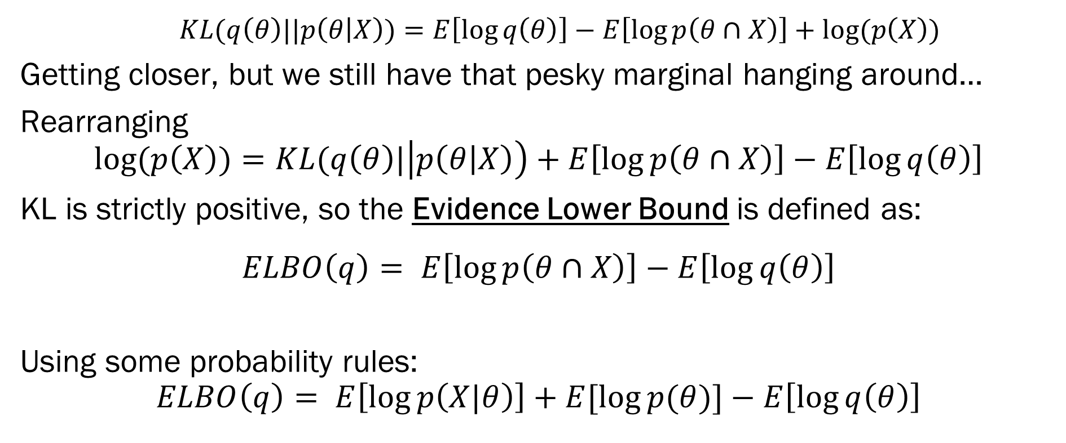
Variational Inference – Technical Deets
$KL(q\left(θ\right)||p\left(θ | X\right))=E\left[\log{q\left(θ\right)}\right]−E\left[\log{p\left(θ∩X\right)}\right]+log⁡(p\left(X\right))$
Getting closer, but we still have that pesky marginal hanging around…
Rearranging
$$log⁡(p\left(X\right))=KL(q\left(θ\right)|\left|p\left(θ | X\right)\right)+E\left[\log{p\left(θ∩X\right)}\right]−E\left[\log{q\left(θ\right)}\right]$$
KL is strictly positive, so the Evidence Lower Bound is defined as:
$$ELBO\left(q\right)= E\left[\log{p\left(θ∩X\right)}\right]−E\left[\log{q\left(θ\right)}\right]$$
Using some probability rules:
$$ELBO\left(q\right)= E\left[\log{p\left(X|θ\right)}\right]+E[\log{p(θ)}]−E\left[\log{q\left(θ\right)}\right]$$
Just uses the likelihood!
Just uses the priors!
Uses our variational distribution

Slide 13
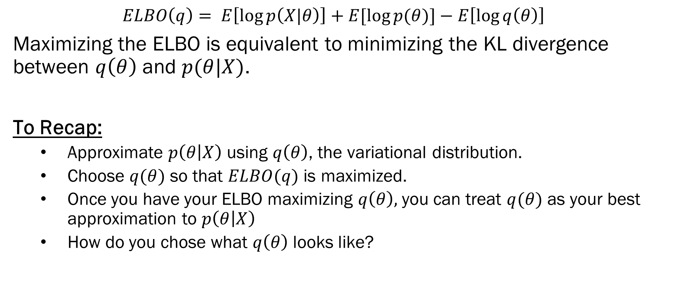
Variational Inference – Technical Deets
$$ELBO\left(q\right)= E\left[\log{p\left(X|θ\right)}\right]+E[\log{p(θ)}]−E\left[\log{q\left(θ\right)}\right]$$
Maximizing the ELBO is equivalent to minimizing the KL divergence between $q\left(θ\right)$ and $p(θ|X)$.
To Recap:
Approximate $p\left(θ | X\right)$ using $q\left(θ\right)$, the variational distribution.
Choose $q(θ)$ so that $ELBO(q)$ is maximized.
Once you have your ELBO maximizing $q\left(θ\right),$you can treat $q(θ)$ as your best approximation to $p\left(θ | X\right)$
How do you chose what $q\left(θ\right)$ looks like?

Slide 14
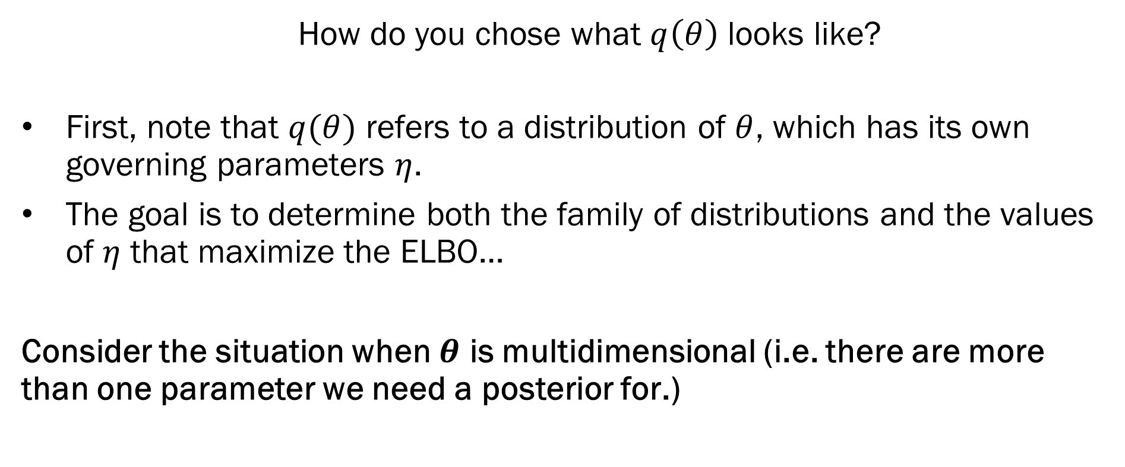
Mean Field Approximation
How do you chose what $q\left(θ\right)$ looks like?
First, note that $q(θ)$ refers to a distribution of $θ$, which has its own governing parameters $η$.
The goal is to determine both the family of distributions and the values of $η$ that maximize the ELBO…
Consider the situation when $θ$ is multidimensional (i.e. there are more than one parameter we need a posterior for.)

Slide 15
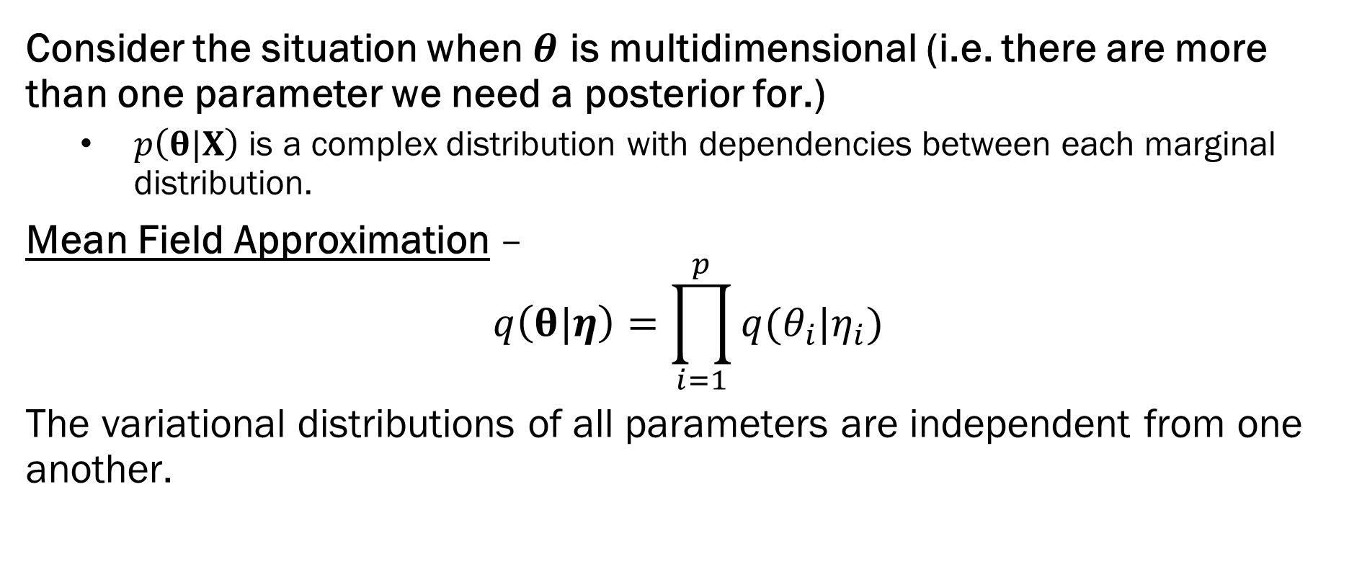
Mean Field Approximation
Consider the situation when $θ$ is multidimensional (i.e. there are more than one parameter we need a posterior for.)
$p\left(θ|X\right)$ is a complex distribution with dependencies between each marginal distribution.
Mean Field Approximation –
$$q\left(θ|η\right)=\prod_{i=1}^{p}{q(θ_{i}|η_{i})}$$
The variational distributions of all parameters are independent from one another.

Slide 16
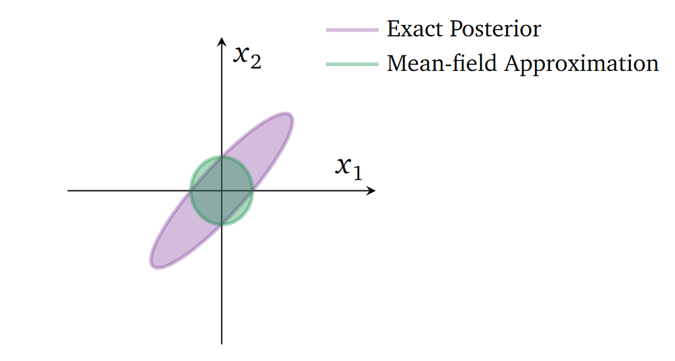
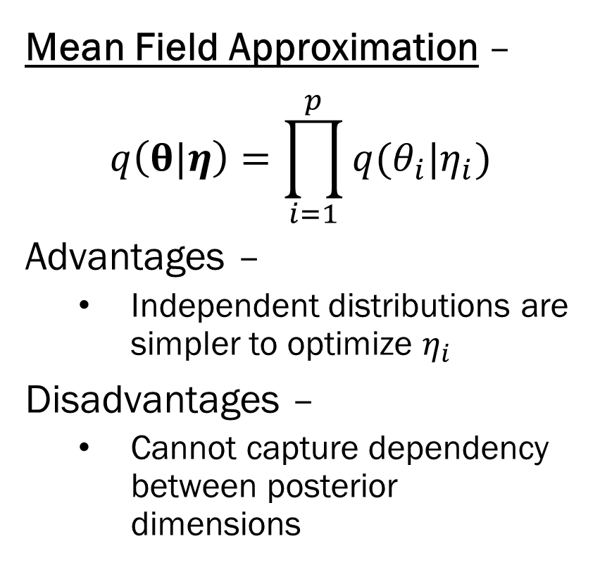
Mean Field Approximation
Mean Field Approximation –
$$q\left(θ|η\right)=\prod_{i=1}^{p}{q(θ_{i}|η_{i})}$$
Advantages –
Independent distributions are simpler to optimize $η_{i}$
Disadvantages –
Cannot capture dependency between posterior dimensions
Figure from: https://arxiv.org/pdf/1601.00670.pdf
An excellent overview of variational inference ^

Slide 17

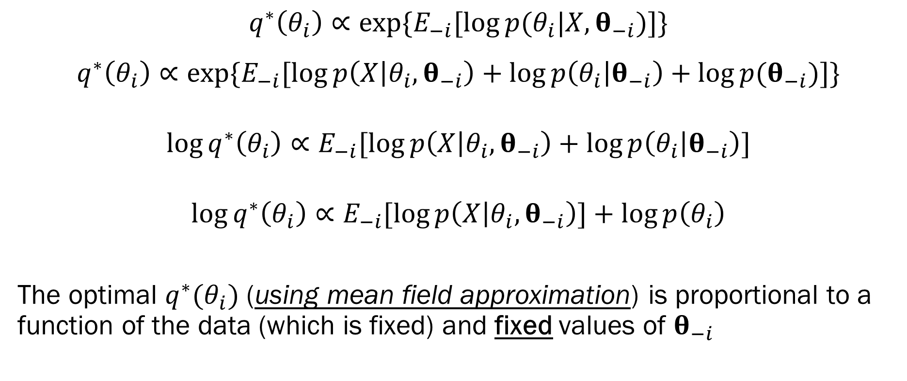


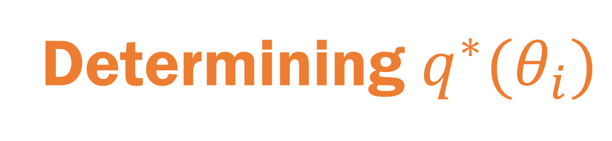
Determining $q^{∗}(θ_{i})$
$$q^{∗}\left(θ_{i}\right)∝\exp{\{E_{−i}[\log{p(θ_{i}|X, θ_{−i})}]\}}$$
$$q^{∗}\left(θ_{i}\right)∝\exp{\{E_{−i}[\log{p\left(X | θ_{i}, θ_{−i}\right)}+\log{p\left(θ_{i} | θ_{−i}\right)}+\log{p(θ_{−i})}]\}}$$
$$\log{q^{∗}\left(θ_{i}\right)}∝E_{−i}[\log{p\left(X | θ_{i}, θ_{−i}\right)}+\log{p\left(θ_{i} | θ_{−i}\right)}]$$
$$\log{q^{∗}\left(θ_{i}\right)}∝E_{−i}[\log{p\left(X | θ_{i}, θ_{−i}\right)]}+\log{p\left(θ_{i}\right)}$$
The optimal $q^{∗}(θ_{i})$ (using mean field approximation) is proportional to a function of the data (which is fixed) and fixed values of $θ_{−i}$
Just your likelihood!
Given by your prior setup
Constant with respect to $θ_{i}$
This is inside an expectation over $θ_{−i}$
Just the prior on $θ_{i}$

Slide 18
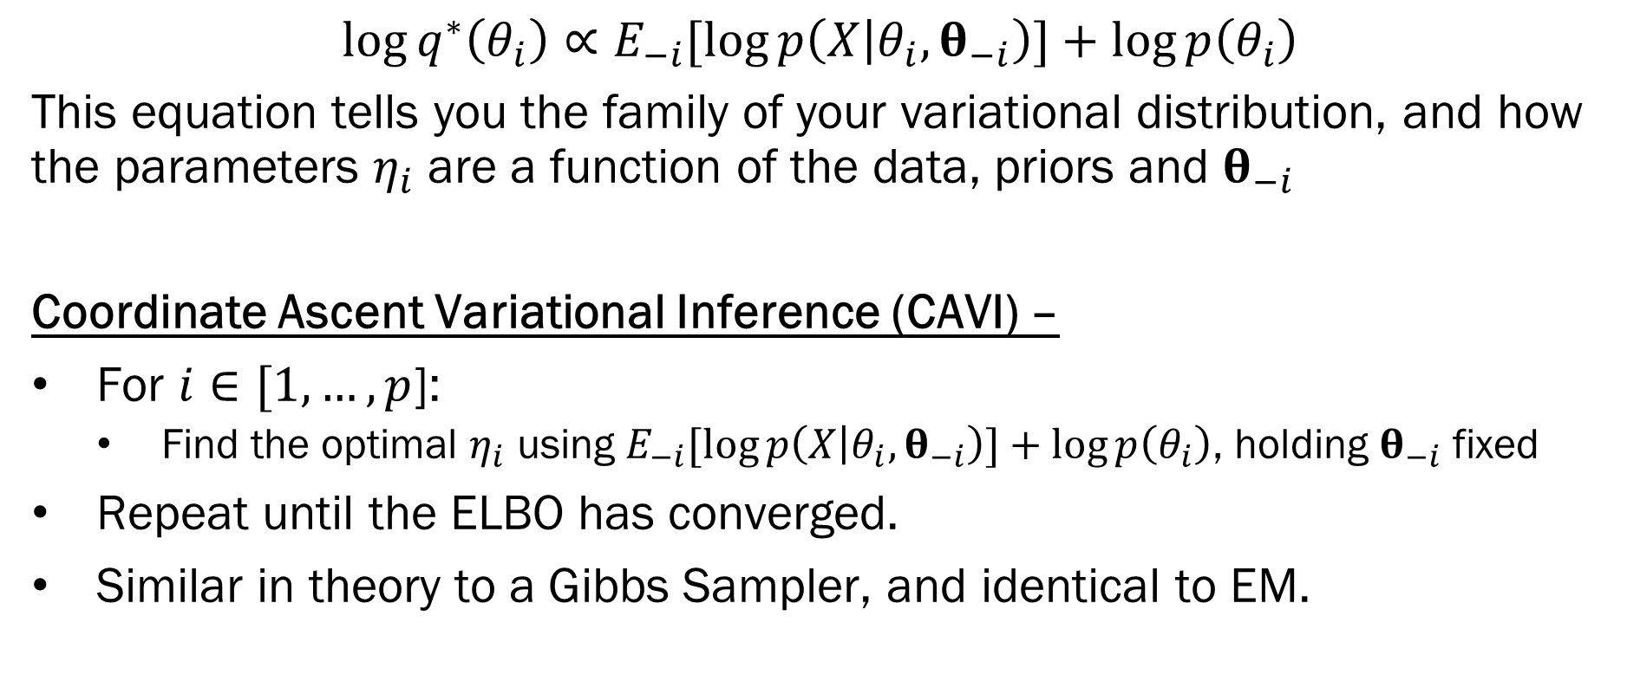
Optimizing ELBO using CAVI
$$\log{q^{∗}\left(θ_{i}\right)}∝E_{−i}[\log{p\left(X | θ_{i}, θ_{−i}\right)]}+\log{p\left(θ_{i}\right)}$$
This equation tells you the family of your variational distribution, and how the parameters $η_{i}$ are a function of the data, priors and $θ_{−i}$
Coordinate Ascent Variational Inference (CAVI) –
For $i∈[1,…,p$]:
Find the optimal $η_{i}$ using $E_{−i}[\log{p\left(X | θ_{i}, θ_{−i}\right)]}+\log{p\left(θ_{i}\right)}$, holding $θ_{−i}$ fixed
Repeat until the ELBO has converged.
Similar in theory to a Gibbs Sampler, and identical to EM.

Slide 19
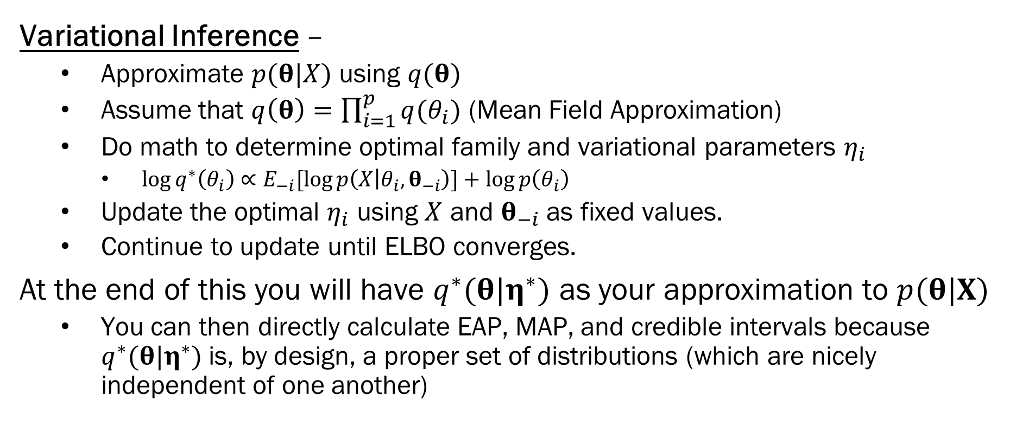
Summary
Variational Inference –
Approximate $p(θ|X)$ using $q(θ)$
Assume that $q\left(θ\right)=\prod_{i=1}^{p}{q(θ_{i})}$ (Mean Field Approximation)
Do math to determine optimal family and variational parameters $η_{i}$
$\log{q^{∗}\left(θ_{i}\right)}∝E_{−i}[\log{p\left(X | θ_{i}, θ_{−i}\right)]}+\log{p\left(θ_{i}\right)}$
Update the optimal $η_{i}$ using $X$ and $θ_{−i}$ as fixed values.
Continue to update until ELBO converges.
At the end of this you will have $q^{∗}(θ|η^{∗})$ as your approximation to $p(θ|X)$
You can then directly calculate EAP, MAP, and credible intervals because $q^{∗}(θ|η^{∗})$ is, by design, a proper set of distributions (which are nicely independent of one another)

Slide 20
Next Week
Two Examples of Variational Inference –
Gaussian with unknown mean and variance
Yes, this is a conjugate problem, so we already know the real solution.
Gaussian Mixture Model
Classic problem for variational inference.
When to use VI vs Samplers -
It depends!
VI for big data where approximations are “fine”
Samplers for valuable datasets when precision is required.

