Slide 1

Variational Inference Part III:
Examples of Variational Inference
Module 9 Live Session (7/13/2021)
DS6040 Summer 2021
Teague R. Henry

Slide 2

Course Updates
HW3 Extension till Tomorrow 7/21
HW4 Due 7/30
HW5 is cancelled!
HW4 is fairly extensive, and I want to allow time for any resubmissions.
Class Projects are in full swing, so don’t want to distract from them.
My email access/responses will be limited 7/21-7/25

Slide 3
Outline
Review of Variational Inference
Example 1: Gaussian with Unknown Mean and Variance
Example 2: Gaussian Mixture Model

Slide 4
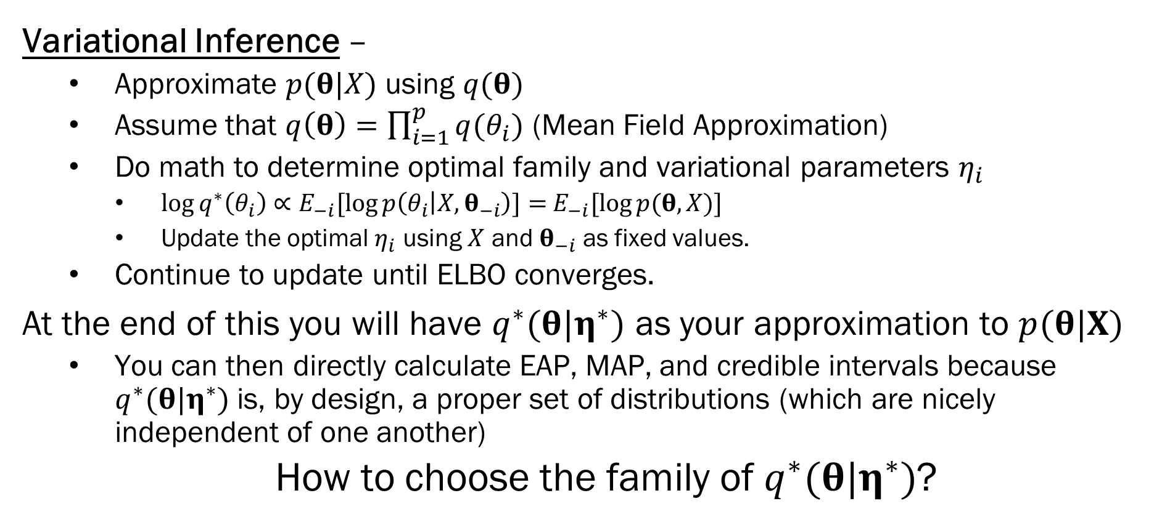
Review
Variational Inference –
Approximate $p(θ|X)$ using $q(θ)$
Assume that $q\left(θ\right)=\prod_{i=1}^{p}{q(θ_{i})}$ (Mean Field Approximation)
Do math to determine optimal family and variational parameters $η_{i}$
$\log{q^{∗}\left(θ_{i}\right)}∝E_{−i}[\log{p\left(θ_{i} | X, θ_{−i}\right)]=}$ $E_{−i}[\log{p(θ, X)]}$
Update the optimal $η_{i}$ using $X$ and $θ_{−i}$ as fixed values.
Continue to update until ELBO converges.
At the end of this you will have $q^{∗}(θ|η^{∗})$ as your approximation to $p(θ|X)$
You can then directly calculate EAP, MAP, and credible intervals because $q^{∗}(θ|η^{∗})$ is, by design, a proper set of distributions (which are nicely independent of one another)
How to choose the family of $q^{∗}(θ|η^{∗})$?

Slide 5
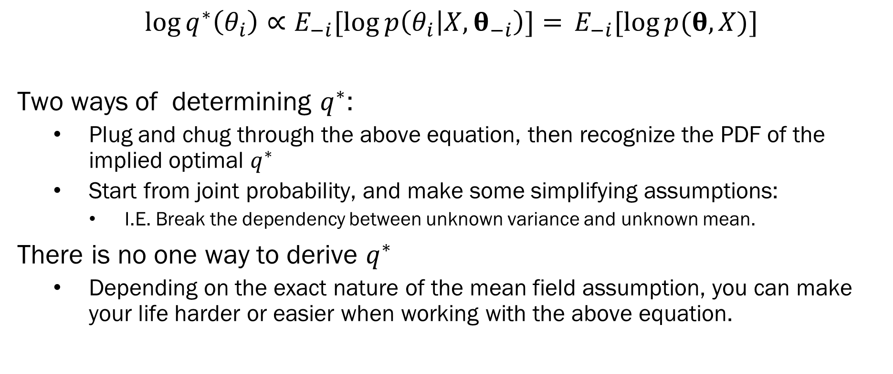
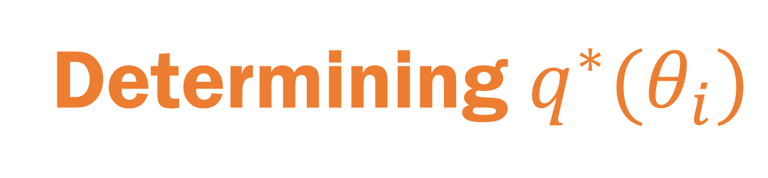
Determining $q^{∗}(θ_{i})$
$$\log{q^{∗}\left(θ_{i}\right)}∝E_{−i}[\log{p\left(θ_{i} | X, θ_{−i}\right)]=} E_{−i}[\log{p(θ, X)]}$$
Two ways of determining $q^{∗}$:
Plug and chug through the above equation, then recognize the PDF of the implied optimal $q^{∗}$
Start from joint probability, and make some simplifying assumptions:
I.E. Break the dependency between unknown variance and unknown mean.
There is no one way to derive $q^{∗}$
Depending on the exact nature of the mean field assumption, you can make your life harder or easier when working with the above equation.

Slide 6
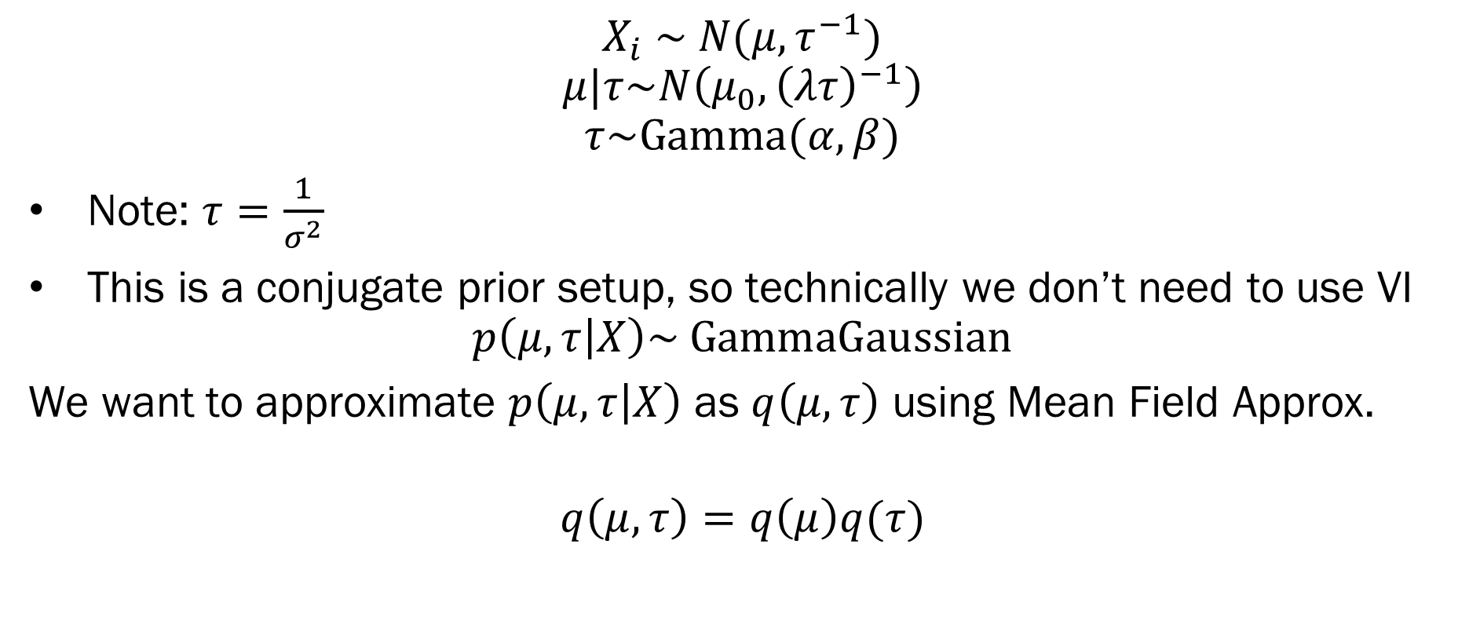
Example: Gaussian
$$X_{i} \sim N(μ, τ^{−1})$$
$$μ|τ\sim N\left(μ_{0}, {\left(λτ\right)}^{−1}\right)$$
$$τ\sim Gamma(α, β)$$
Note: $τ=\frac{1}{σ^{2}}$
This is a conjugate prior setup, so technically we don’t need to use VI
$$p\left(μ,τ | X\right)\sim GammaGaussian$$
We want to approximate $p\left(μ,τ | X\right)$ as $q\left(μ, τ\right)$ using Mean Field Approx.
$$q\left(μ, τ\right)=q\left(μ\right)q(τ)$$

Slide 7
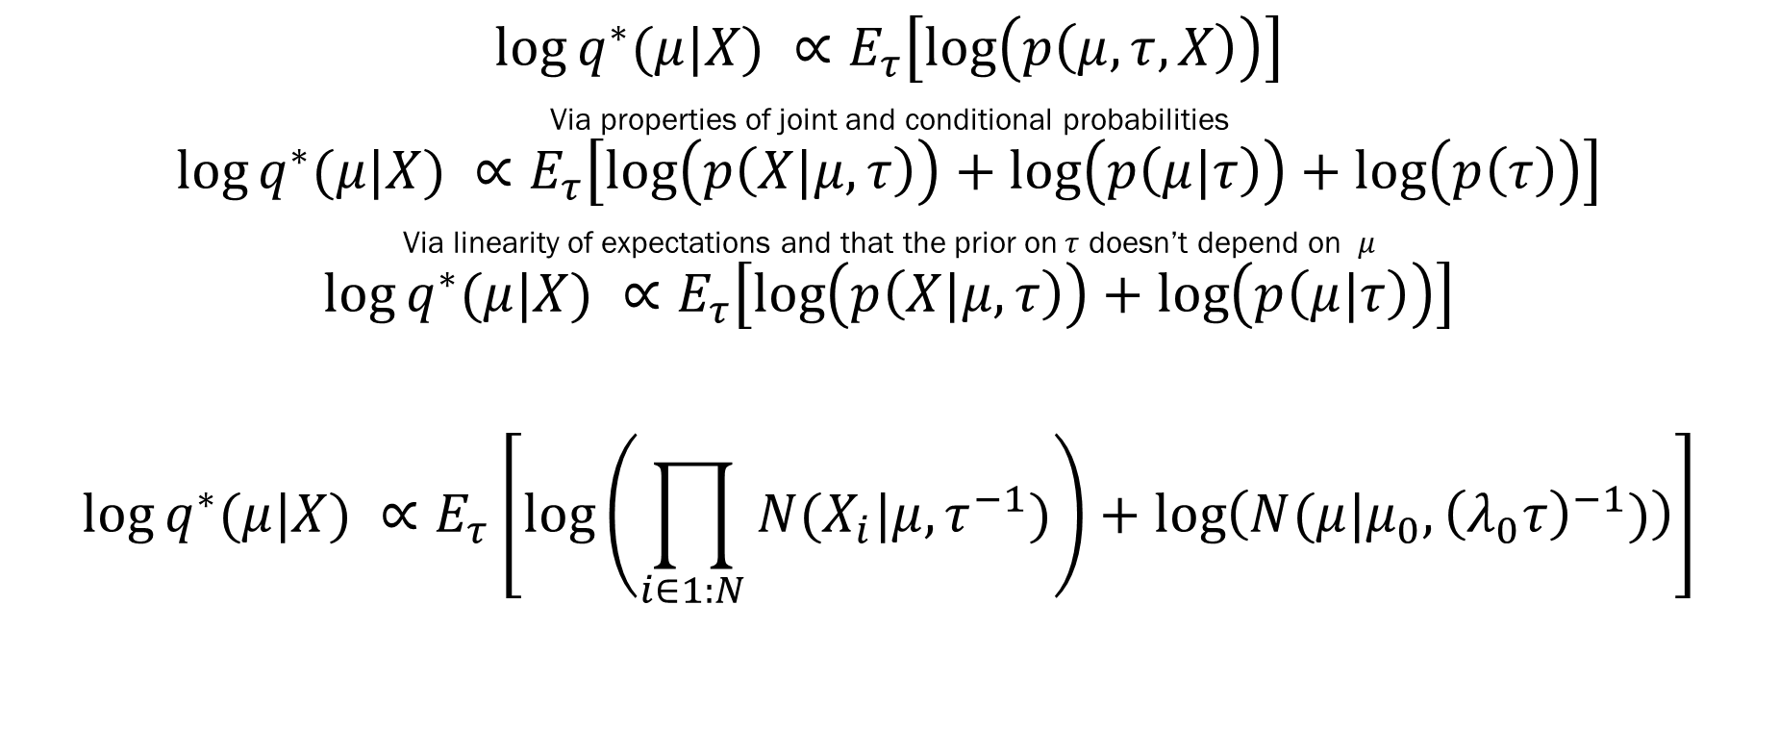
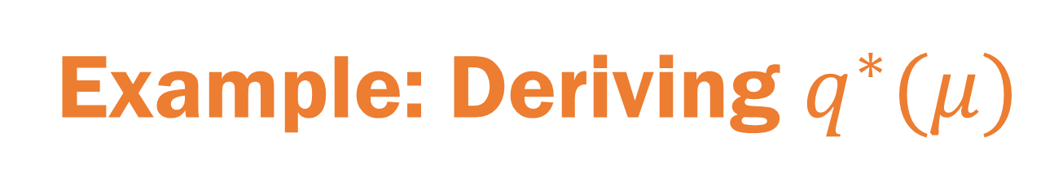
Example: Deriving $q^{∗}(μ)$
$$\log{q^{∗}(μ|X)} ∝E_{τ}\left[\log\left(p\left(μ,τ,X\right)\right)\right]$$
Via properties of joint and conditional probabilities
$$\log{q^{∗}(μ|X)} ∝E_{τ}\left[\log\left(p\left(X|μ,τ\right)\right)+\log\left(p\left(μ|τ\right)\right)+\log\left(p\left(τ\right)\right)\right]$$
Via linearity of expectations and that the prior on$τ$ doesn’t depend on $μ$
$$\log{q^{∗}(μ|X)} ∝E_{τ}\left[\log\left(p\left(X|μ,τ\right)\right)+\log\left(p\left(μ|τ\right)\right)\right]$$
$$\log{q^{∗}(μ|X)} ∝E_{τ}\left[\log\left(\prod_{i∈1:N}{N(X_{i}|μ, τ^{−1})}\right)+\log\left(N(μ|μ_{0}, {\left(λ_{0}τ\right)}^{−1})\right)\right]$$
Normal Likelihood
Normally Distributed

Slide 8
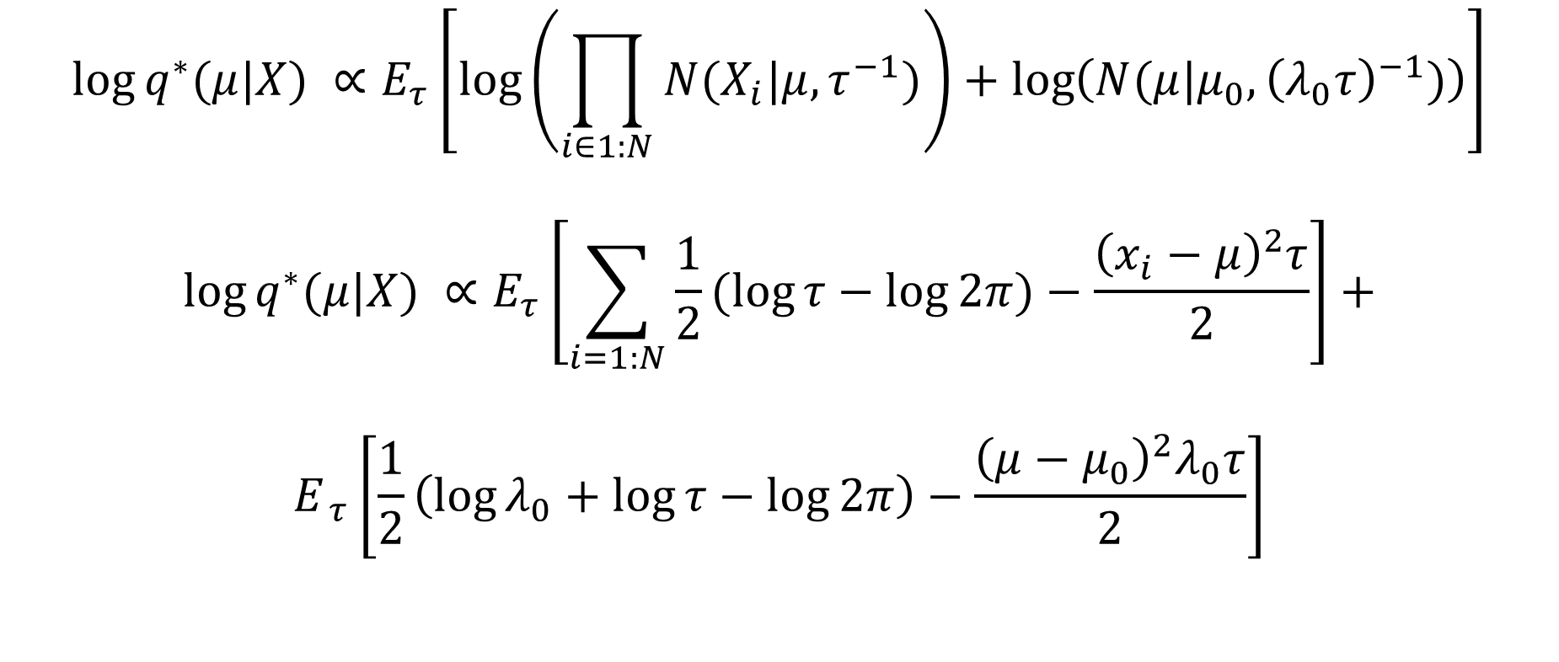
Example: Deriving $q^{∗}(μ)$
$$\log{q^{∗}(μ|X)} ∝E_{τ}\left[\log\left(\prod_{i∈1:N}{N(X_{i}|μ, τ^{−1})}\right)+\log\left(N(μ|μ_{0}, {\left(λ_{0}τ\right)}^{−1})\right)\right]$$
$$\log{q^{∗}(μ|X)} ∝E_{τ}\left[\sum_{i=1:N}{\frac{1}{2}(\log{τ−\log{2π)−\frac{{\left(x_{i}−μ\right)}^{2}τ}{2}}}}\right]+$$
$$E_{ τ}\left[\frac{1}{2}\left(\log{λ_{0}}+\log{τ}−\log{2π}\right)−\frac{{\left(μ−μ_{0}\right)}^{2}λ_{0}τ}{2}\right]$$

Slide 9
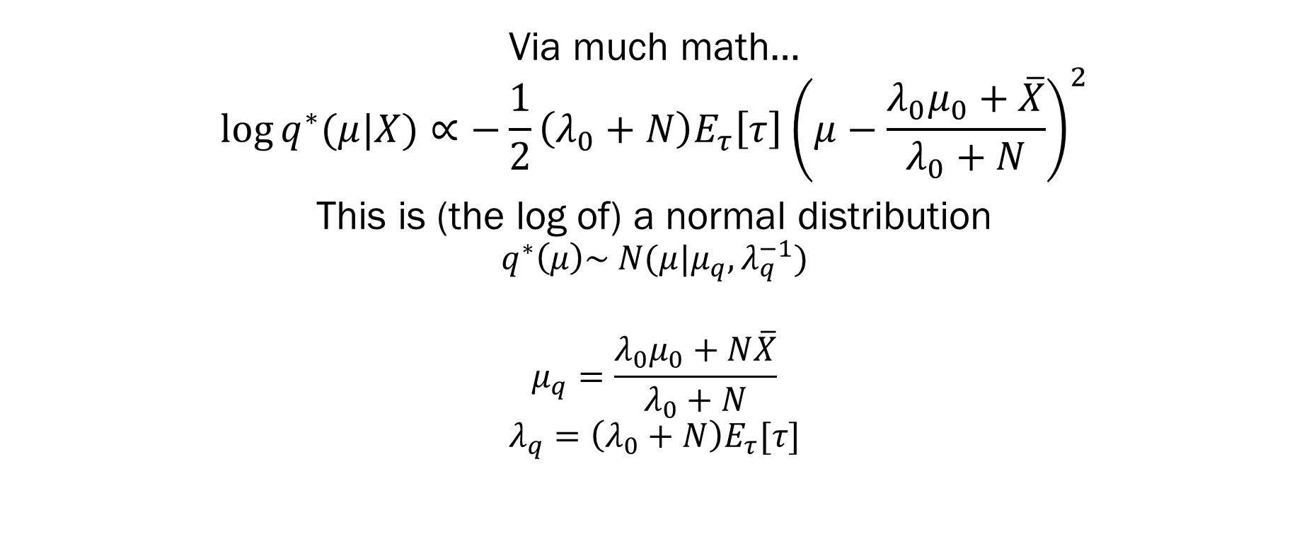
Example: Deriving $q^{∗}(μ)$
Via much math…
$$\log{q^{∗}(μ|X)}∝−\frac{1}{2}\left(λ_{0}+N\right)E_{τ}\left[τ\right]{\left(μ−\frac{λ_{0}μ_{0}+\overline{X}}{λ_{0}+N}\right)}^{2}$$
This is (the log of) a normal distribution
$$q^{∗}\left(μ\right)\sim N(μ|μ_{q}, λ_{q}^{−1})$$
$$μ_{q}=\frac{λ_{0}μ_{0}+N\overline{X}}{λ_{0}+N}$$
$$λ_{q}=\left(λ_{0}+N\right)E_{τ}[τ]$$
Note the circular dependency here

Slide 10
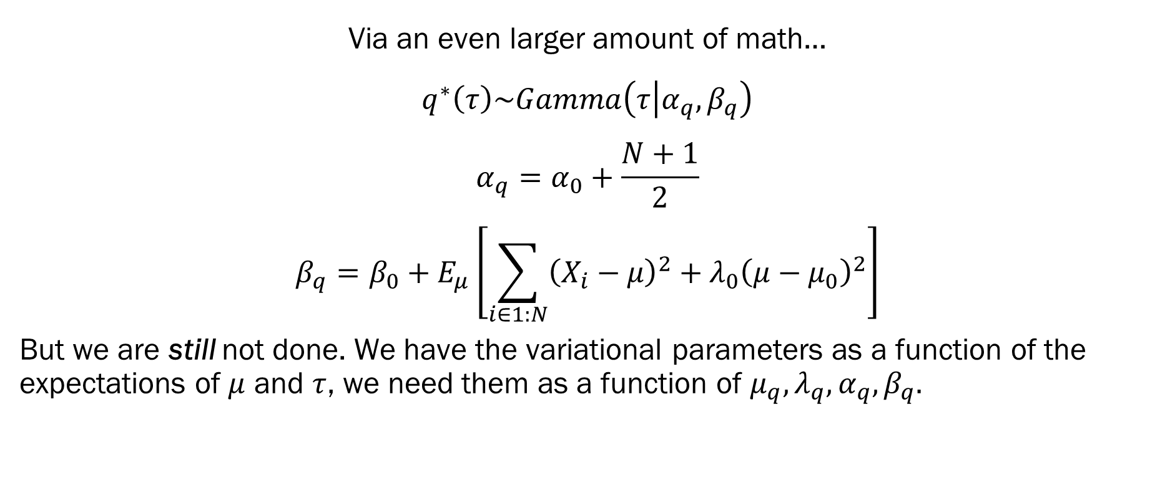
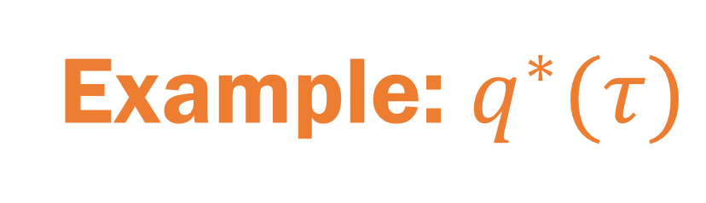
Example: $q^{∗}(τ)$
Via an even larger amount of math…
$$q^{∗}\left(τ\right)\sim Gamma\left(τ | α_{q},β_{q}\right)$$
$$α_{q}=α_{0}+\frac{N+1}{2}$$
$$β_{q}=β_{0}+E_{μ}\left[\sum_{i∈1:N}{{\left(X_{i}−μ\right)}^{2}}+λ_{0}{\left(μ−μ_{0}\right)}^{2}\right]$$
But we are still not done. We have the variational parameters as a function of the expectations of $μ$ and $τ$, we need them as a function of $μ_{q}, λ_{q}, α_{q}, β_{q}.$

Slide 11
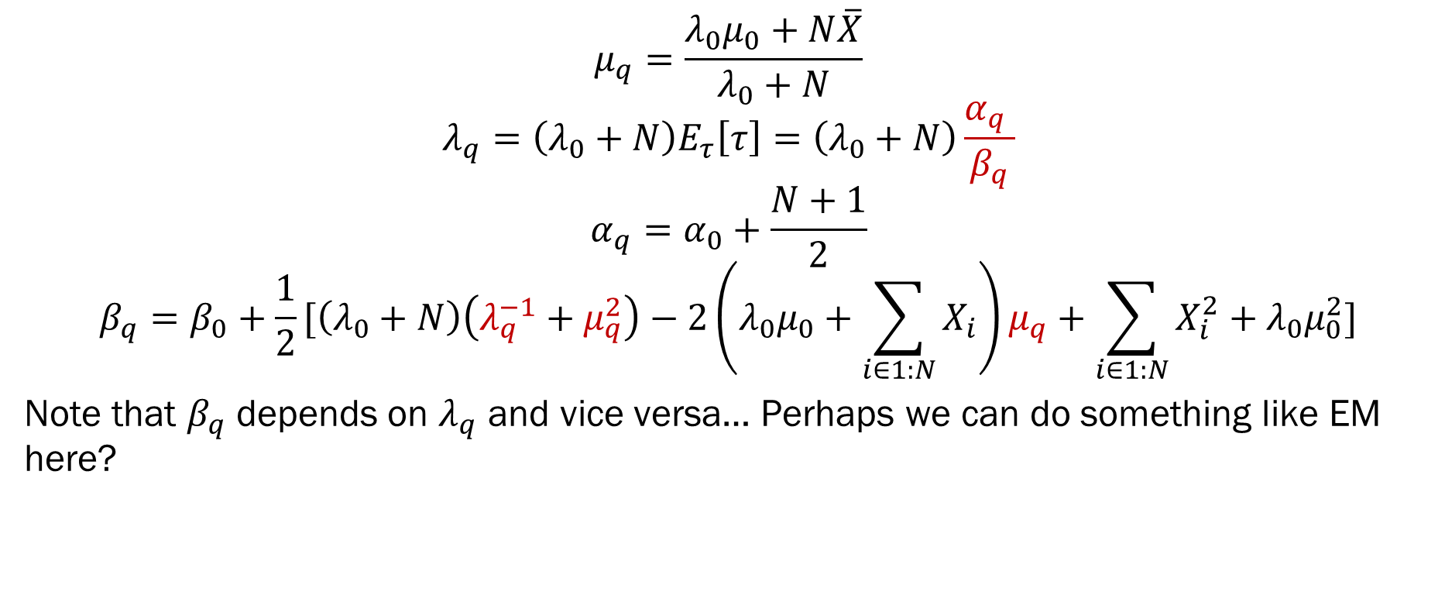
Example: Variational Parameters
$$μ_{q}=\frac{λ_{0}μ_{0}+N\overline{X}}{λ_{0}+N}$$
$$λ_{q}=\left(λ_{0}+N\right)E_{τ}\left[τ\right]=\left(λ_{0}+N\right)\frac{α_{q} }{β_{q}}$$
$$α_{q}=α_{0}+\frac{N+1}{2}$$
$$β_{q}=β_{0}+\frac{1}{2}[\left(λ_{0}+N\right)\left(λ_{q}^{−1}+μ_{q}^{2}\right)−2\left(λ_{0}μ_{0}+\sum_{i∈1:N}{X_{i}}\right)μ_{q}+\sum_{i∈1:N}{X_{i}^{2}}+λ_{0}μ_{0}^{2}]$$
Note that $β_{q}$ depends on $λ_{q}$ and vice versa… Perhaps we can do something like EM here?

Slide 12
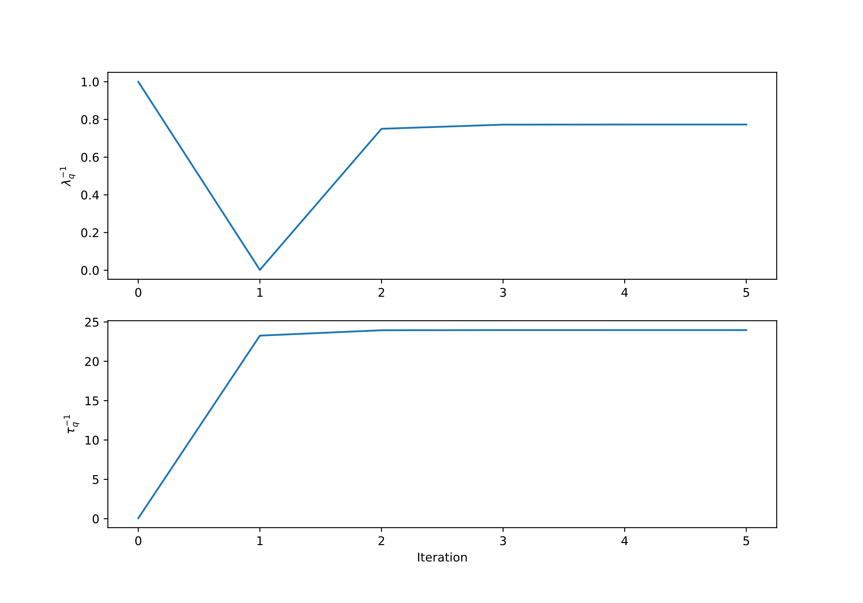
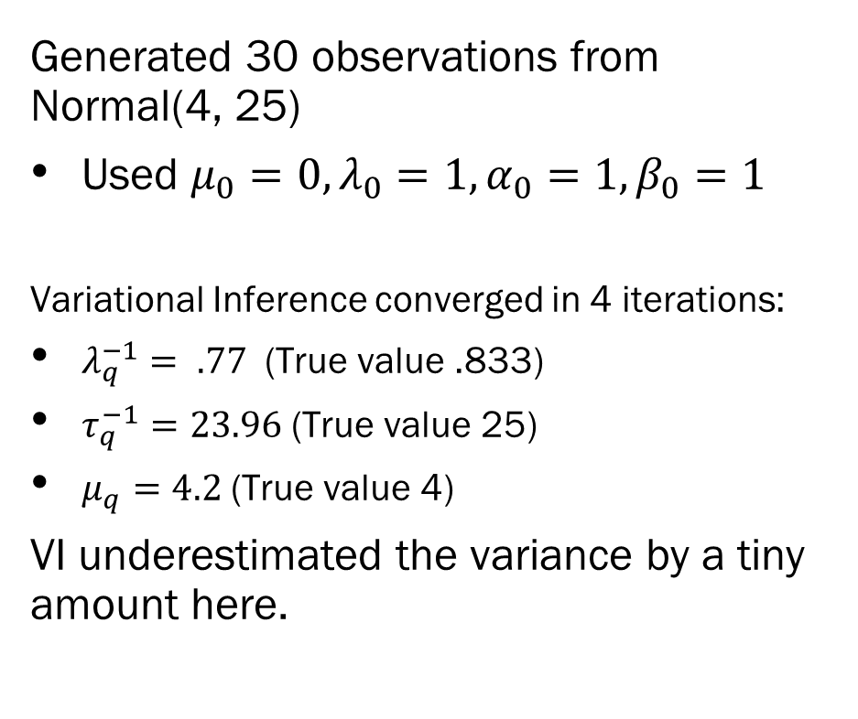
23.968931
Example: Variational Parameters
Generated 30 observations from Normal(4, 25)
Used $μ_{0}=0, λ_{0}=1, α_{0}=1, β_{0}=1$
Variational Inference converged in 4 iterations:
$λ_{q}^{−1}= .77$ (True value .833)
$τ_{q}^{−1}=23.96$ (True value 25)
$μ_{q}=4.2$ (True value 4)
VI underestimated the variance by a tiny amount here.

Slide 13
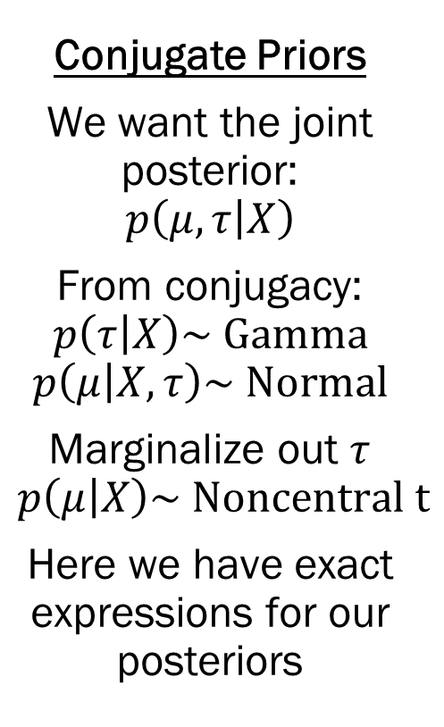
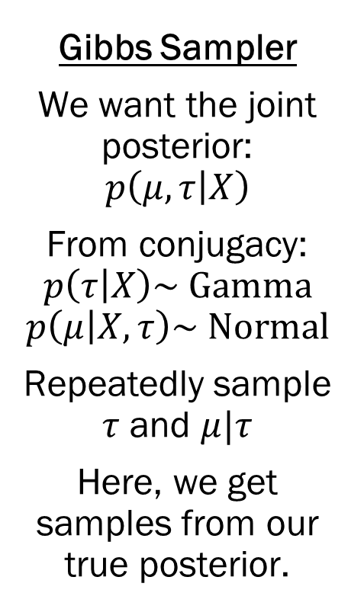
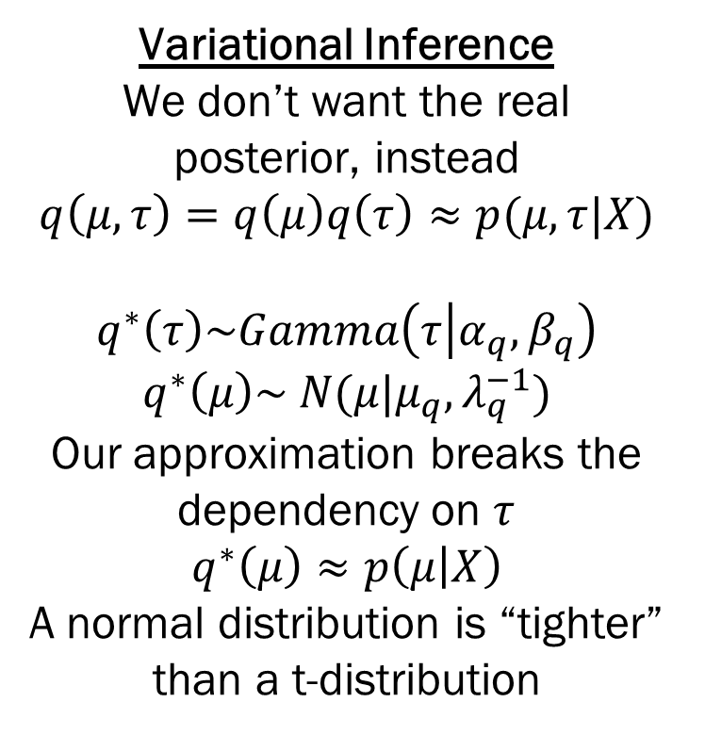
Backing up a Minute
Conjugate Priors
We want the joint posterior:
$$p\left(μ,τ | X\right)$$
From conjugacy:
$$p\left(τ | X\right)\sim Gamma$$
$$p\left(μ | X, τ\right)\sim Normal$$
Marginalize out $τ$
$$p\left(μ | X\right)\sim Noncentral t$$
Here we have exact expressions for our posteriors
Gibbs Sampler
We want the joint posterior:
$$p\left(μ,τ | X\right)$$
From conjugacy:
$$p\left(τ | X\right)\sim Gamma$$
$$p\left(μ | X, τ\right)\sim Normal$$
Repeatedly sample $τ$ and $μ|τ$
Here, we get samples from our true posterior.
Variational Inference
We don’t want the real posterior, instead
$$q\left(μ,τ\right)=q\left(μ\right)q\left(τ\right)≈p(μ,τ|X)$$
$$q^{∗}\left(τ\right)\sim Gamma\left(τ | α_{q},β_{q}\right)$$
$$q^{∗}\left(μ\right)\sim N(μ|μ_{q}, λ_{q}^{−1})$$
Our approximation breaks the dependency on $τ$
$$q^{∗}\left(μ\right)≈p\left(μ | X\right)$$
A normal distribution is “tighter” than a t-distribution

Slide 14
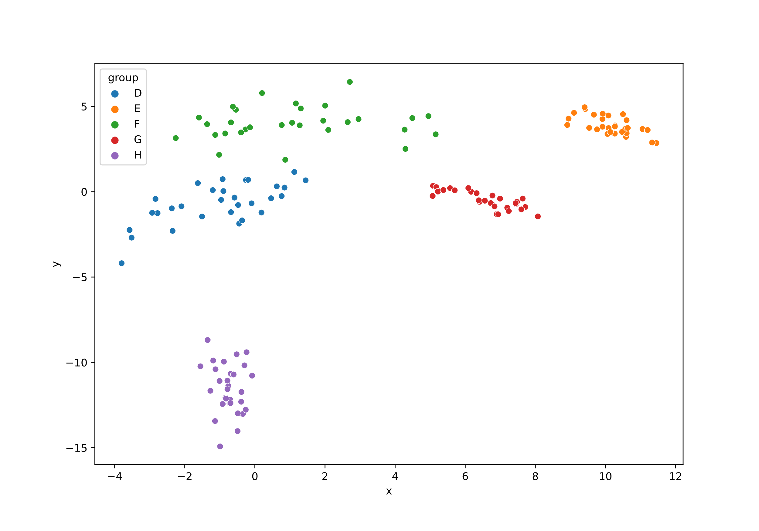
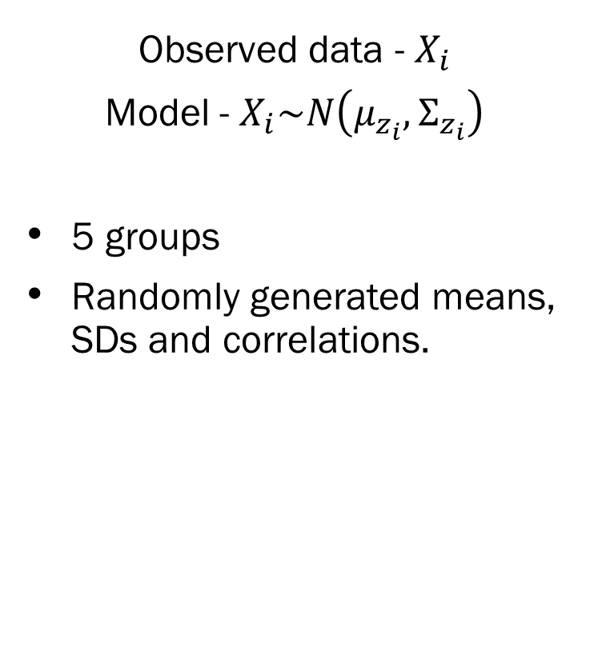
Example: Bivariate Mixture Models
Observed data - $X_{i}$
Model - $X_{i}\sim N\left(μ_{z_{i}}, Σ_{z_{i}}\right)$
5 groups
Randomly generated means, SDs and correlations.
Example based on:
https://ashkush.medium.com/variational-inference-gaussian-mixture-model-52595074247b

Slide 15
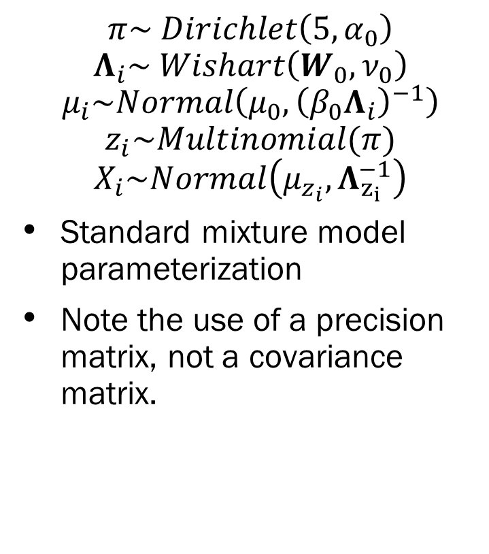
Bivariate Mixture Models - Priors
$$π\sim Dirichlet\left(5, α_{0}\right)$$
$$Λ_{i}\sim Wishart\left(W_{0}, ν_{0}\right)$$
$$μ_{i}\sim Normal\left(μ_{0},{\left(β_{0}Λ_{i}\right)}^{−1}\right)$$
$$z_{i}\sim Multinomial(π)$$
$$X_{i}\sim Normal\left(μ_{z_{i}}, Λ_{z_{i}}^{−1}\right)$$
Standard mixture model parameterization
Note the use of a precision matrix, not a covariance matrix.
Example based on:
https://ashkush.medium.com/variational-inference-gaussian-mixture-model-52595074247b

Slide 16
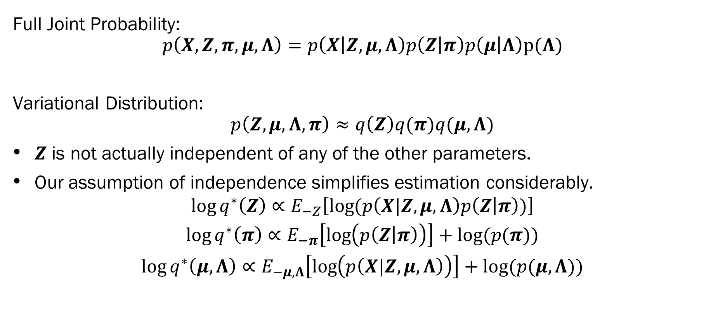
Bivariate Mixture Models - VI
Full Joint Probability:
$$p\left(X, Z, π, μ,Λ\right)=p\left(X | Z,μ, Λ\right)p\left(Z | π\right)p\left(μ | Λ\right)p(Λ)$$
Variational Distribution:
$$p\left(Z,μ,Λ,π\right)≈q\left(Z\right)q(π)q(μ, Λ)$$
$Z$ is not actually independent of any of the other parameters.
Our assumption of independence simplifies estimation considerably.
$$\log{q^{∗}\left(Z\right)∝E_{−Z}\left[\log{(p\left(X|Z,μ,Λ\right)p\left(Z | π\right))}\right]}$$
$$\log{q^{∗}\left(π\right)∝E_{−π}\left[\log\left(p\left(Z | π\right)\right)\right]+log⁡(p(π))}$$
$$\log{q^{∗}\left(μ, Λ\right)∝E_{−μ,Λ}\left[\log\left(p\left(X|Z,μ,Λ\right)\right)\right]+log⁡(p(μ, Λ))}$$
Example based on:
https://ashkush.medium.com/variational-inference-gaussian-mixture-model-52595074247b

Slide 17
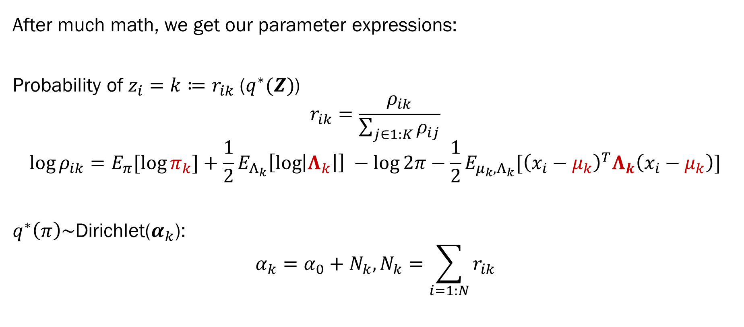
Bivariate Mixture Models - VI
After much math, we get our parameter expressions:
Probability of $z_{i}=k≔r_{ik}$ ($q^{∗}(Z)$)
$$r_{ik}=\frac{ρ_{ik}}{\sum_{j∈1:K}{ρ_{ij}}}$$
$$\log{ρ_{ik}}=E_{π}[\log{π_{k}}]+\frac{1}{2}E_{Λ_{k}}\left[\log\left|Λ_{k}\right|\right] −\log{2π}−\frac{1}{2}E_{{μ_{k},Λ}_{k}}[{\left(x_{i}−μ_{k}\right)}^{T}Λ_{k}\left(x_{i}−μ_{k}\right)]$$
$q^{∗}\left(π\right)\sim$Dirichlet($α_{k}$):
$$α_{k}=α_{0}+N_{k}, N_{k}=\sum_{i=1:N}{r_{ik}}$$
Example based on:
https://ashkush.medium.com/variational-inference-gaussian-mixture-model-52595074247b

Slide 18
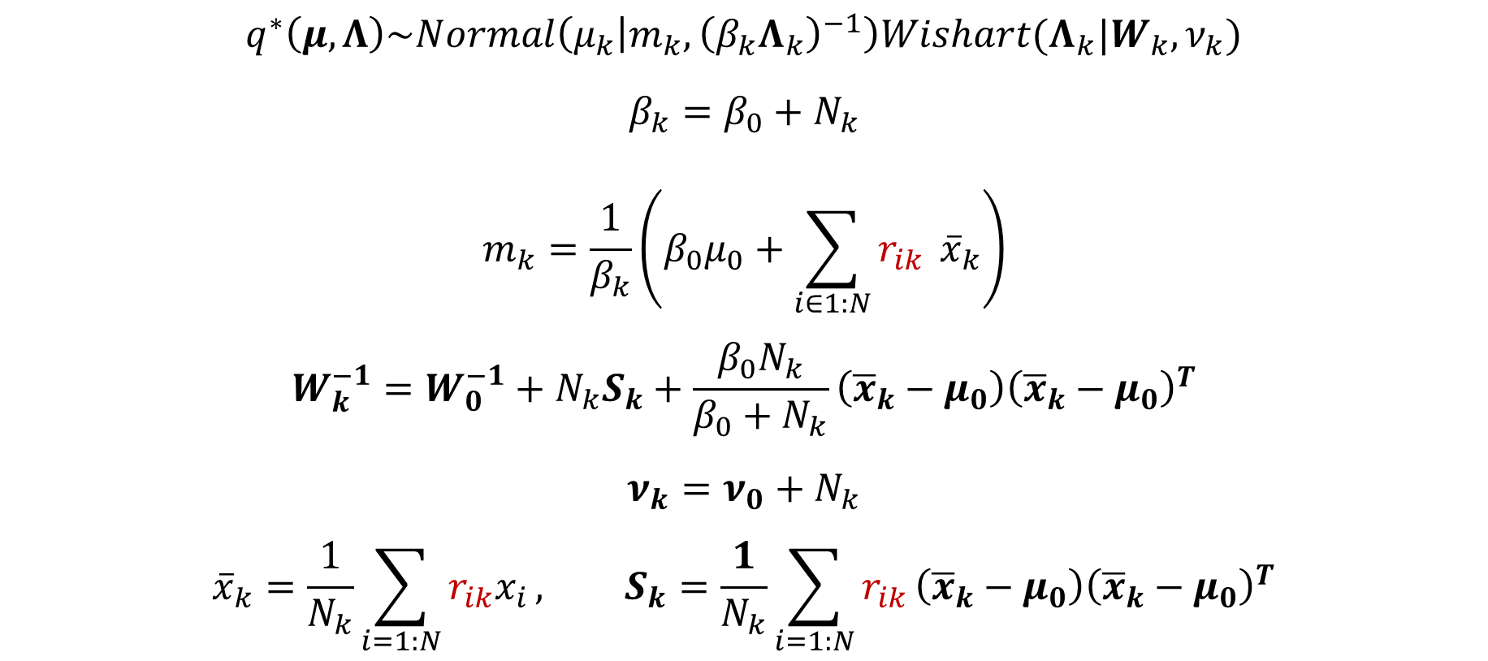
Bivariate Mixture Models - VI
$$q^{∗}\left(μ,Λ\right)\sim Normal\left(μ_{k} | m_{k}, {\left(β_{k}Λ_{k}\right)}^{−1}\right)Wishart(Λ_{k}|W_{k},ν_{k})$$
$$β_{k}=β_{0}+N_{k}$$
$$m_{k}=\frac{1}{β_{k}}\left(β_{0}μ_{0}+\sum_{i∈1:N}{r_{ik}} {\overline{x}}_{k}\right)$$
$$W_{k}^{−1}=W_{0 }^{−1}+N_{k}S_{k}+\frac{β_{0}N_{k}}{β_{0}+N_{k}}\left({\overline{x}}_{k}−μ_{0}\right){\left({\overline{x}}_{k}−μ_{0}\right)}^{T}$$
$$ν_{k}=ν_{0}+N_{k}$$
$${\overline{x}}_{k}=\frac{1}{N_{k}}\sum_{i=1:N}{r_{ik}x_{i}}, S_{k}=\frac{1}{N_{k}}\sum_{i=1:N}{r_{ik}}\left({\overline{x}}_{k}−μ_{0}\right){\left({\overline{x}}_{k}−μ_{0}\right)}^{T}$$
Example based on:
https://ashkush.medium.com/variational-inference-gaussian-mixture-model-52595074247b

Slide 19
Example: Bivariate Mixture Models
Observed data - $X_{i}$
Model - $X_{i}\sim N\left(μ_{z_{i}}, Σ_{z_{i}}\right)$
5 groups
Randomly generated means, SDs and correlations.
Example based on:
https://ashkush.medium.com/variational-inference-gaussian-mixture-model-52595074247b

Slide 20
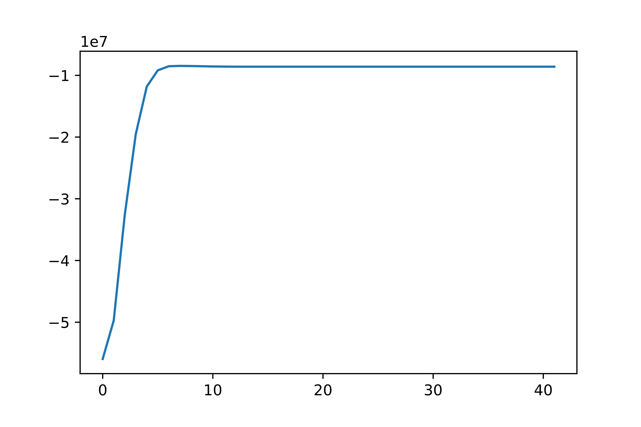
Bivariate Mixture Models - Results
ELBO converged within 10 iterations.
Convergence is influenced by:
Prior hyperparameter choice
Variational family choice
If your ELBO hasn’t converged, your solution is meaningless
It also might be wrong, even if it converged…
ELBO
Iteration
Example based on:
https://ashkush.medium.com/variational-inference-gaussian-mixture-model-52595074247b

Slide 21
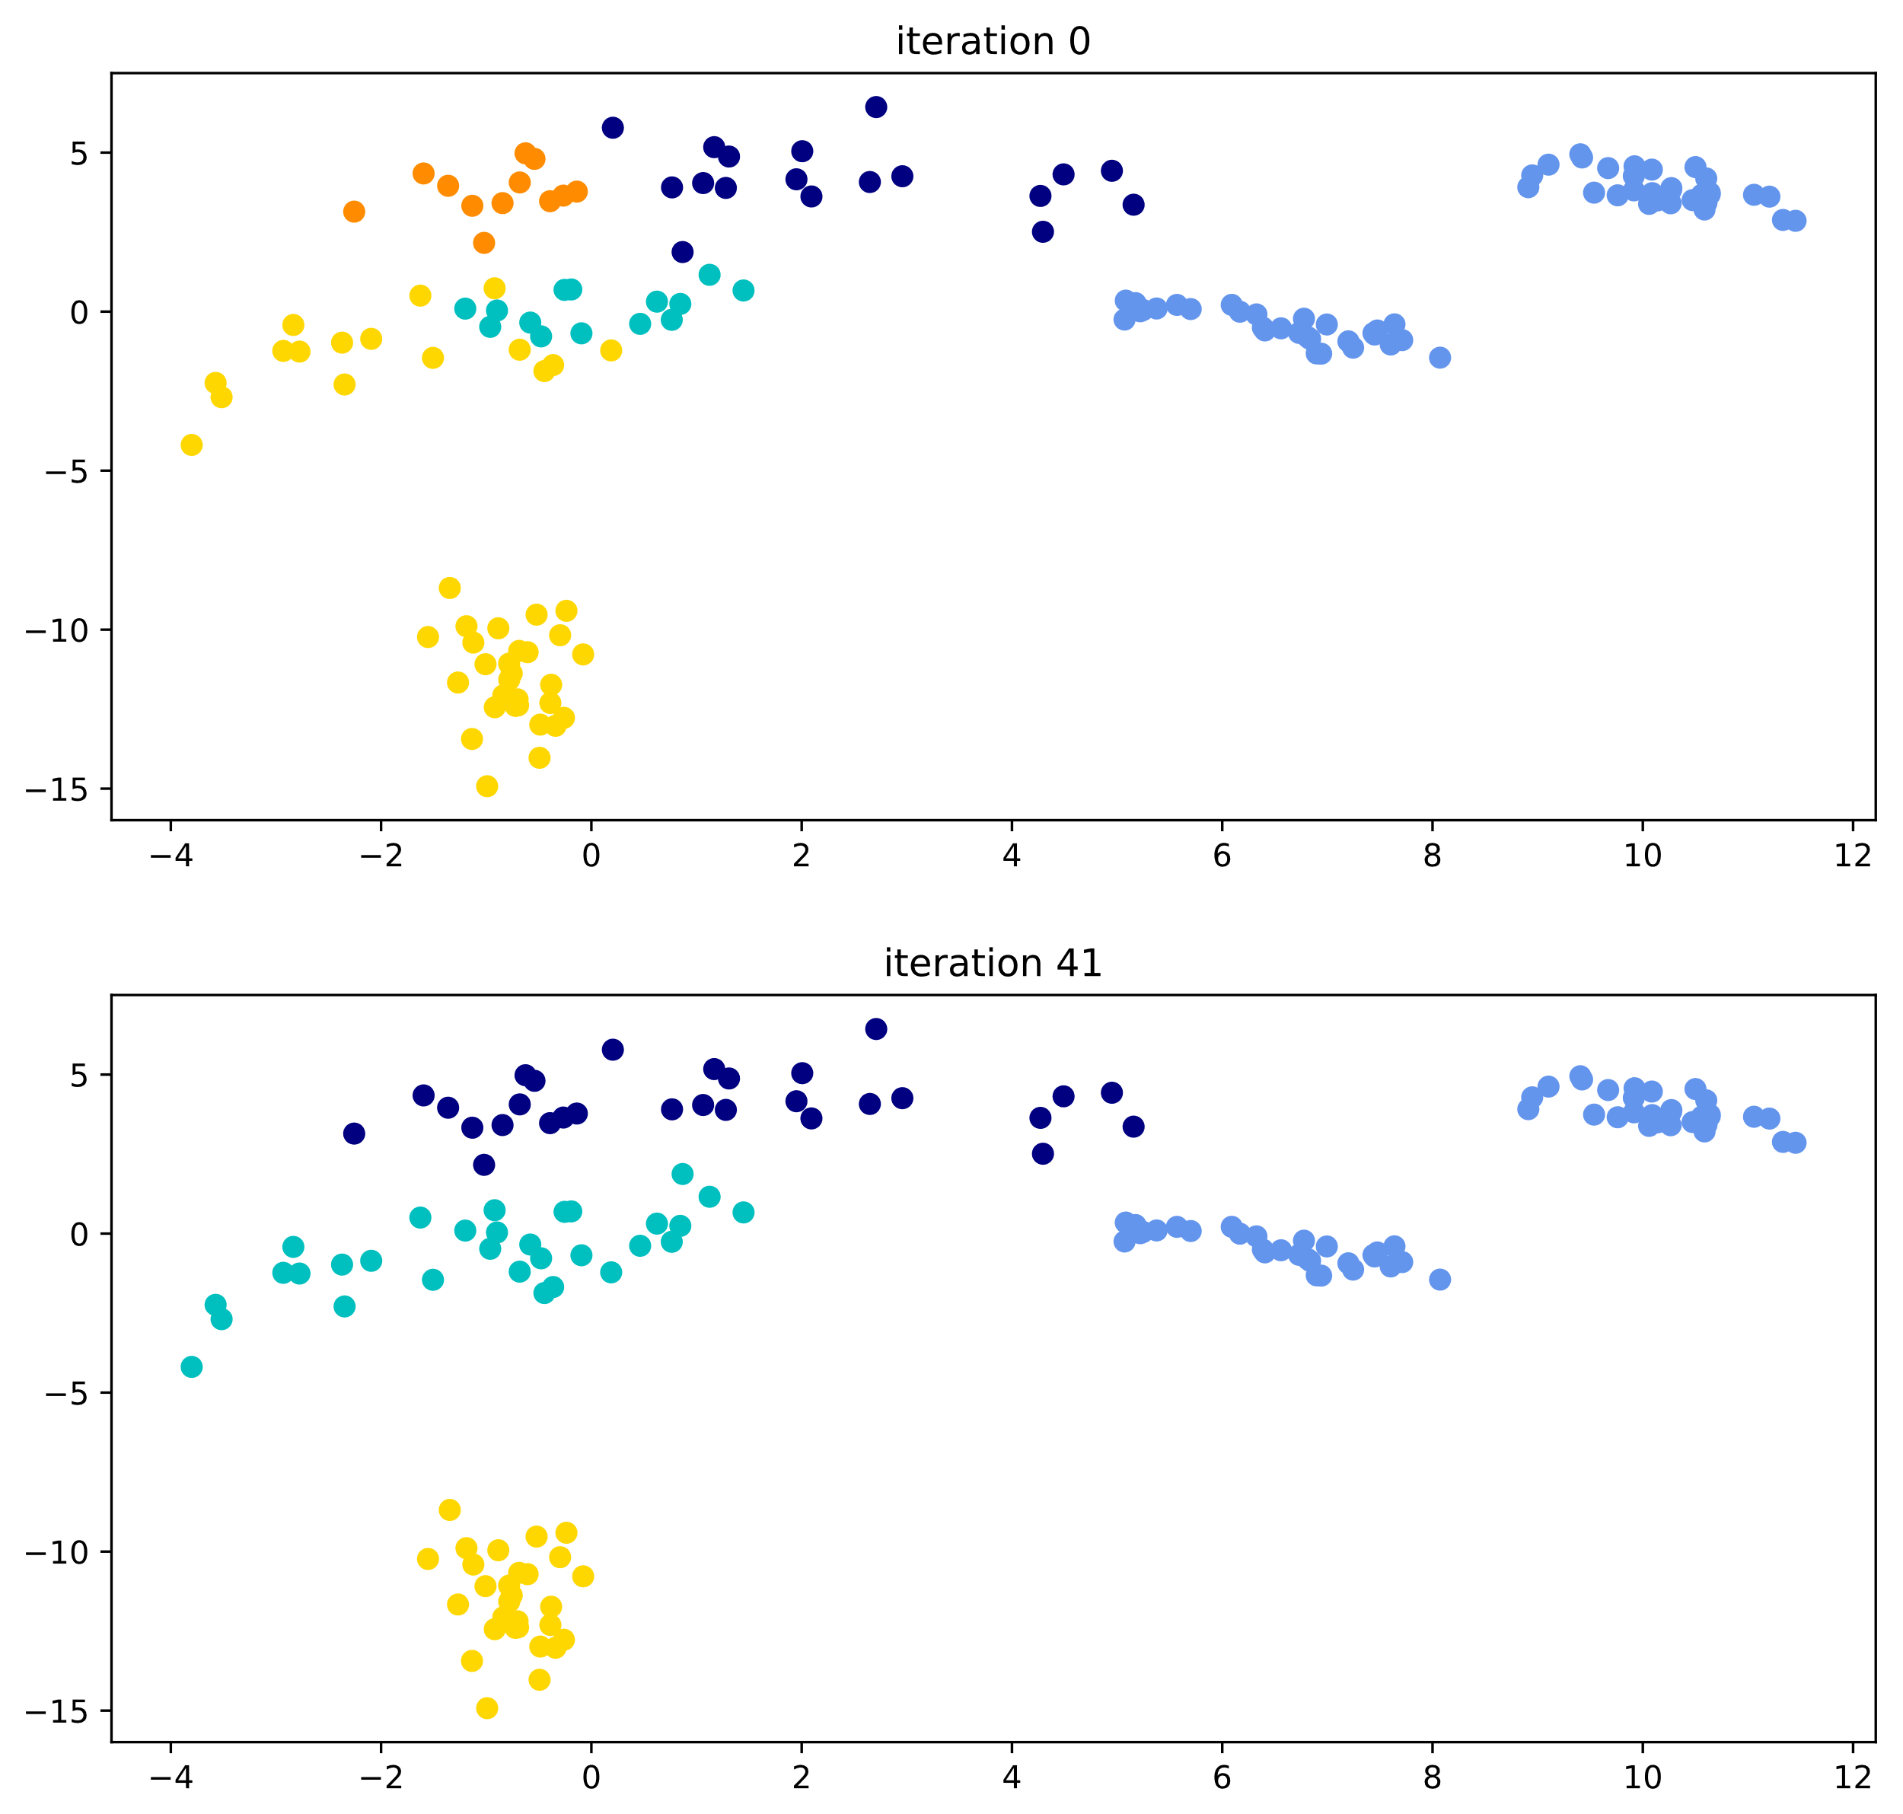
Bivariate Mixture Models - Results
Example based on:
https://ashkush.medium.com/variational-inference-gaussian-mixture-model-52595074247b

Slide 22
Bivariate Mixture Models - Results
Fairly good recovery of most clusters
But all clusters are extraordinarily well defined…
If you can visually determine clusters, then any algorithm should be able to perfectly recover them.
Why didn’t VI recover the two far right clusters?
Likely has to do with high correlations
Difficult to estimate as the likelihood surface becomes weird around the boundaries.
In practice, this can be quite problematic (those clusters might be important!)
Example based on:
https://ashkush.medium.com/variational-inference-gaussian-mixture-model-52595074247b

Slide 23
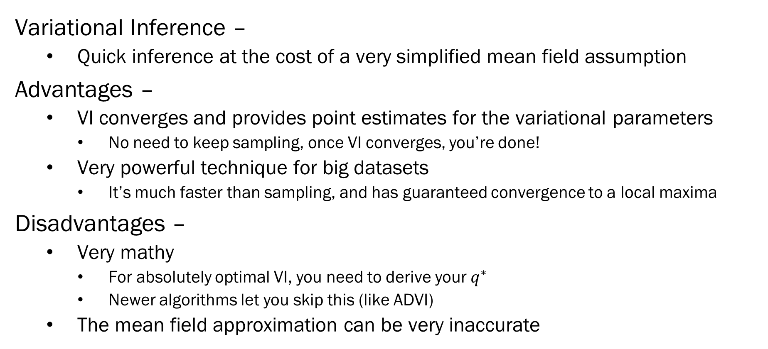
Summary
Variational Inference –
Quick inference at the cost of a very simplified mean field assumption
Advantages –
VI converges and provides point estimates for the variational parameters
No need to keep sampling, once VI converges, you’re done!
Very powerful technique for big datasets
It’s much faster than sampling, and has guaranteed convergence to a local maxima
Disadvantages –
Very mathy
For absolutely optimal VI, you need to derive your $q^{∗}$
Newer algorithms let you skip this (like ADVI)
The mean field approximation can be very inaccurate

Slide 24
Next Week
Variational Inference in PyMC3
Current generation algorithms like ADVI
Fitting arbitrary models using VI
Diagnosing convergence
Example –
Linear Spline Modelling with PyMC3
The following week –
Course review and summary
What you need to know about Bayesian ML!
Final Week – Class Project Highlights!

