Slide 1
CLOUD HASKELL Haskell support for the development of distributed applications
Alexandra Flinta
George Abordioaie

Slide 2
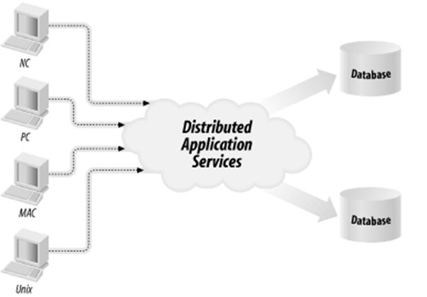
Distributed applications
Distributed applications (distributed apps) are applications or software that runs on multiple computers within a network at the same time and can be stored on servers or with cloud computing.

Slide 3
Distributed applications
Can communicate with multiple servers or devices on the same network from any geographical location
Are broken up into two separate programs: the client software and the server software:
The client software or computer accesses the data from the server or cloud environment
The server or cloud processes the data
It can failover to another component If a distributed application component goes down

Slide 4
Distributed applications - benefits
Allow multiple users to access the apps at once
Developers, IT professionals or enterprises choose to store distributed apps in the cloud:
cloud elasticity
cloud scalability
ability to handle large applications
ability to handle workloads

Slide 5
Cloud Haskell – Erlan-style concurrency
Cloud Haskell is a set of libraries that bring Erlang-style concurrency and distribution to Haskell programs
Fast process creation/destruction
Ability to support >> 10 000 concurrent processes with largely unchanged characteristics.
Fast asynchronous message passing.
Copying message-passing semantics (share-nothing concurrency).
Process monitoring.
Selective message reception.

Slide 6
Cloud Haskell – New approach
Has be re-written from the ground up and supports a rich and growing number of features for:
building concurrent applications using asynchronous message passing
building distributed computing applications
building fault tolerant systems
running Cloud Haskell nodes on various network transports
working with several network transport implementations (and more in the pipeline)
supporting static values (required for remote communication)

Slide 7
Cloud Haskell – Components
Cloud Haskell comprises the following components, some of which are complete, others experimental.
distributed-process: Base concurrency and distribution support
distributed-process-platform: The Cloud Haskell Platform - APIs
distributed-static: Support for static values
rank1dynamic: Like Data.Dynamic and Data.Typeable but supporting polymorphic values
network-transport: Generic Network.Transport API
network-transport-tcp: TCP realisation of Network.Transport
network-transport-inmemory: In-memory realisation of Network.Transport (incomplete)
network-transport-composed: Compose two transports (very preliminary)
distributed-process-simplelocalnet: Simple backend for local networks
distributed-process-azure: Azure backend for Cloud Haskell (proof of concept)

Slide 8
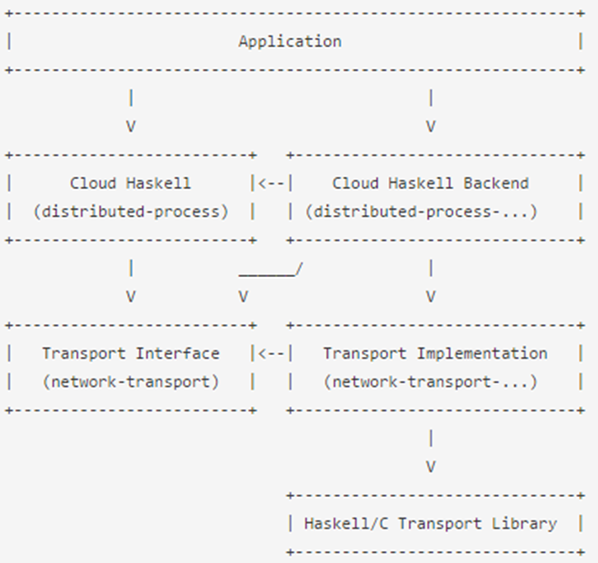
Cloud Haskell – Support for Haskell
The following diagram shows dependencies between the various subsystems, in an application using Cloud Haskell, where arrows represent explicit directional dependencies.

Slide 9
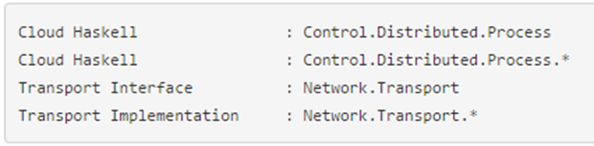
Cloud Haskell – Support for Haskell
In this diagram, the various nodes roughly correspond to specific modules:
Control.Distributed.Process module defines abstractions such as nodes and processes
The Transport interface provided by the Network.Transport module is used by the Cloud Haskell interface and backend
The Network.Transport.* module provides a specific implementation for the current transport

Slide 10

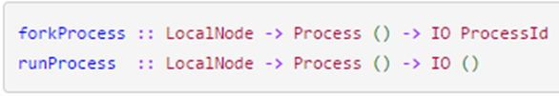
Concurrency and distributed applications
The Process Layer is where Cloud Haskell’s support for concurrency and distributed programming are exposed to application developers.
Processes reside on nodes, which in our implementation map directly to the Control.Distributed.Processes.Node module. Given a configured Network.Transport backend, starting a new node is fairly simple:
Given a new node, there are two primitives for starting a new process.

Slide 11
Building Examples
Prerequisites:
Haskell environment
Stack: cross-platform program for developing Haskell projects
Cabal: system for building and packaging Haskell libraries
distributed-process and network-transport-tcp libraries from Cloud Haskell Platform

Slide 12
Building the libraries
Download and install Cabal
Download and unzip distributed-process and network-transport-tcp libraries
Go to the root folder of every library and type: cabal install library-name.cabal

Slide 13
Setting up the project
Setting up the project is made using stack.
Type stack new project-name in a fresh new directory. This will populate the directory with a number of files, chiefly stack.yaml and *.cabal metadata files for the project.
You’ll want to add distributed-process and network-transport-tcp to the build-depends stanza of the executable section.

Slide 14

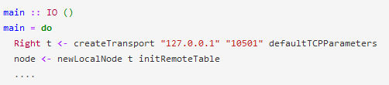
Create a node
Cloud Haskell’s lightweight processes reside on a “node”, which must be initialized with a network transport implementation and a remote table.

Slide 15
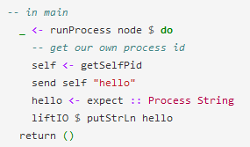
Sending Messages
We start a process by evaluating runProcess which takes a Process and a node to run:
Each process has an identifier associated to it.
Each process also has a mailbox associated with it. Messages sent to a process are queued in this mailbox in a asynchronous .

Slide 16


Sending Messages II
receiveWait and similarly named functions can be used with the Match data type to provide a range of advanced message processing capabilities.
In the echo server, our first match prints out whatever string it receives. If the first message in our mailbox is not a String, then our second match is evaluated.

Slide 17
Serializable Data

