Slide 1
powerlifter wilks coefficient
Alex Bohlken, Noah Kenn,
Qualen Pollard, and Ryan Rodriguez

Slide 2
Purpose & Motivation
Purpose - To predict the Wilks Coefficient of a powerlifter based on Age, Body weight, Weight Class, Bench, Total kg, Sex, and Equipment used.
Wilks Coefficient: a coefficient used to measure how strong a powerlifter is against other powerlifters despite the differences in weight.
The original data set was sufficient for our ideal size.
Offered plenty of choices for prediction variables.
The topic seemed interesting.

Slide 3
Process for data collection and cleaning
Searched Kaggle for relevant sized data.
Downloaded the most sufficient dataset.
Consisted of 16 original independent variables.
Filtered out independent variables that weren’t going to be used.
Filtered out any records that didn’t have a value.
Converted any text field into a specific enumerated value.

Slide 4
theoretical description of machine learning model
Hypothesis: Using all of the independent variables, we try to produce the best Linear Regression model to predict the significance of each independent variable using the p-value.
The main features we expect to stand out out of all of the independent variables is Body Weight and Total kg.

Slide 5
description of salient features and process for evaluating and selecting model
Independent variables: Age, Body weight, Weight Class, Bench, Total kg, Sex, and Equipment
Dependent variable: Wilks Coefficient
The model we used was obtained from an exhaustive search algorithm that gave us the top R-squared values based on various combinations of independent variables.
The model developed the combination of features: Body Weight, Total kg, and the Sex; as the top model.

Slide 6
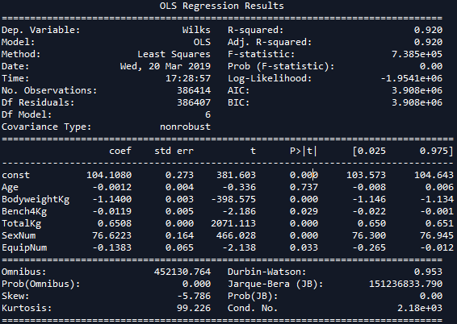
regression model

Slide 7
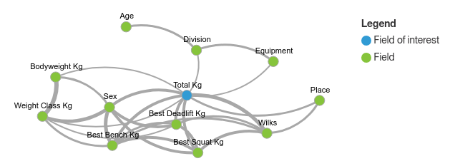
Regression model

