Slide 1
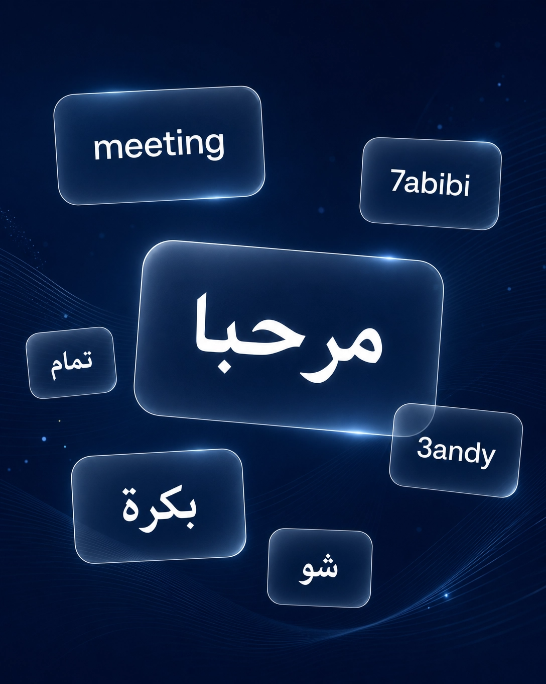
Handling Code-Switching in
Arabic-English Tasks
Benchmarking LLMs on Arabizi and Mixed Arabic-English Text
Yousef Joudeh · Seyed Almadani
Abdulaziz Mohammed · Abdallah Almekhyal
CS496 · Department of Computer Science · Kuwait University
Supervised by Dr. Lulwah Alkulaib

Slide 2

Outline
Motivation & Research Questions
Error Analysis
1
6
Datasets & Annotation
Statistical Significance & Ablation
2
7
Experimental Setup & Metrics
Limitations & Future Work
3
8
Results
Key Takeaways & Q&A
4
9
Gold-Label Discovery
5

Slide 3

Why Code-Switching Matters
The Phenomenon
The Gap
Arabic speakers on social media routinely mix:
Arabic script + English
Arabizi (Latin-script Arabic with numerals: 3 = ع, 7 = ح)
Other languages (e.g., French)
Example:
"ana raye7 el jam3a today"
LLMs are largely untested on Arabic-English code-switching
Prior work focused on translation or encoder-based models only
Arabizi adds complexity most benchmarks ignore
No prior evaluation of LLMs on script-level token identification

Slide 4

Research Questions & Hypotheses
RQ1: How accurately can LLMs perform token-level language identification on code-switched text?
H1: AR-LAT (Arabizi) tokens will have lower F1 than AR and EN tokens
H2: Few-shot prompting will yield higher macro F1 than zero-shot
H3: Models will perform differently across the two datasets
RQ2: How do different LLMs compare on Arabic-English token-level LID?
H1: Models difference significantly in token-level accuracy, macro F1 is used for ranking.
H2: The best model on AR will also rank first on AR-LAT
5 testable, falsifiable hypotheses mapped to specific comparison rows in results tables

Slide 5

Datasets
Statistic | Arabizi (WANLP 2022) | AR-EN CS (Kaggle 2021)
Sentences | 2,574 | 2,507
Tokens | 29,810 | 30,321
Avg. tokens/sent | 11.6 | 12.1
AR tokens (%) | 9.0% | 63.9%
EN tokens (%) | 55.6% | 23.4%
AR-LAT tokens (%) | 21.0% | —
Source | Twitter / Reddit | WhatsApp / FB / Twitter
Why These Two?
Complementary coverage:
Arabizi corpus = English-dominant, Latin-script mixing
AR-EN CS corpus = Arabic-dominant, script-based mixing
Combined:
5,081 sentences
60,131 tokens
Unified 5-Label Scheme
AR
EN
AR-LAT
OTHER
OL
Arabic script
English
Arabizi
Punct/symbols
Other lang.

Slide 6

Annotation & Inter-Annotator Agreement
3 annotators independently labeled 250 code-switched sentences (2,952 tokens) from the Arabizi dataset
Stratified to cover all label categories
Excluded purely monolingual English sentences
No discussion between annotators
Metric | κ | Interpretation
Ann. 1 vs 2 (Cohen) | 0.9873 | Almost perfect
Ann. 1 vs 3 (Cohen) | 0.9823 | Almost perfect
Ann. 2 vs 3 (Cohen) | 0.9848 | Almost perfect
Fleiss' κ (overall) | 0.9847 | Almost perfect
Per-Label Agreement Rates
35
of 2,952 tokens with any disagreement (1.2%)
Well above 0.80 reliability threshold

Slide 7

Experimental Setup
GPT o4-mini
Claude Sonnet 4.6
OpenAI — o-series reasoning model
Anthropic — First CS eval for this model
Gemini 2.5 Flash
LLaMA 3.3 70B
Google — Optimized for speed
Meta (open-source) — Via Together AI API
Fixed Parameters
Prompting Strategies
Parameter | Value
Temperature | 0.0
Max tokens | 2,048
Sample size | 500 (250/dataset)
Random seed | 42
Few-shot examples | 5 (all 5 labels)
Zero-shot: Task instructions + label definitions + JSON format + compliance rules
Few-shot: Same as zero-shot + 5 worked examples covering all 5 labels (no overlap with eval set)

Slide 8

Evaluation Metrics
Primary Metric
Token-Level Accuracy
Micro F1
Macro F1
Overall % of correctly labeled tokens — simple global measure
F1 weighted by label frequency — global performance summary
Unweighted average F1 across all 5 labels — gives equal importance to rare labels like OL and AR-LAT, avoiding inflated scores from dominant classes.
Per-Label P / R / F1
Parse Failure Rate
Precision, recall, F1 for each of the 5 labels separately
% of sentences where model output was unparseable JSON
Interpretability Tools
5 × 5 Confusion Matrix
Qualitative Error Analysis
Reveals which labels are systematically confused (e.g., AR-LAT ↔ EN, AR → AR-LAT). Essential for identifying error patterns beyond aggregate scores.
Categorized error taxonomy with contrastive examples showing where models agree and disagree on ambiguous tokens.
Why this set? Accuracy and F1 are standard for token-level LID. Macro F1 prevents high-frequency labels (EN, OTHER) from masking poor performance on rare but important labels (AR-LAT, OL). Parse failure rate is non-standard but essential for LLM evaluation — invalid outputs can't be scored at all.

Slide 9



Results: Overall Performance
Model | Strategy | Accuracy | Macro F1 | PF%
GPT o4-mini | Zero-shot | 0.754 | 0.621 | 7.0
GPT o4-mini | Few-shot | 0.734 | 0.649 | 13.0
Claude Sonnet | Zero-shot | 0.737 | 0.683 | 9.2
Claude Sonnet | Few-shot | 0.737 | 0.682 | 8.4
Gemini Flash | Zero-shot | 0.760 | 0.680 | 7.6
Gemini Flash | Few-shot | 0.763 | 0.661 | 7.6
LLaMA 70B | Zero-shot | 0.742 | 0.618 | 11.4
LLaMA 70B | Few-shot | 0.750 | 0.608 | 13.2
Highest Macro F1
Claude Sonnet ZS: 0.683
Highest Accuracy
Gemini Flash FS: 0.763
Few-shot ≠ better
Parse failures nearly double for GPT o4-mini (7% → 13%)

Slide 10
Results: Per-Label F1 Breakdown
Model | Str. | AR | EN | AR-LAT | OTHER | OL
GPT o4-mini | ZS | .568 | .942 | .465 | .908 | .222
GPT o4-mini | FS | .576 | .938 | .467 | .909 | .357
Claude | ZS | .574 | .934 | .470 | .915 | .522
Claude | FS | .566 | .939 | .468 | .914 | .522
Gemini | ZS | .598 | .941 | .471 | .912 | .480
Gemini | FS | .609 | .943 | .460 | .922 | .370
LLaMA | ZS | .516 | .935 | .468 | .887 | .286
LLaMA | FS | .558 | .938 | .485 | .884 | .174
H1 & H3 Supported
AR-LAT F1 (0.46–0.49) far below EN (0.93–0.94). Arabizi is the hardest label for every model.
H2 (RQ2) Not Supported
Gemini ranks 1st on AR F1, but LLaMA FS is highest on AR-LAT. Script recognition ≠ Arabizi recognition.

Slide 11

The 35-Point Gap & Gold-Label Discovery
Key Discovery
55.1% of AR-labeled tokens in the AR-EN CS corpus are actually written in Latin script
Original corpus labeled by language identity, not orthographic script
When models labeled these as AR-LAT, they were following instructions correctly!
Corrected Evaluation (re-scored, no new API calls)
 |  | Original |  | Corrected
Model | Str. | Acc. | MaF1 | Acc. | MaF1
GPT o4-mini | FS | .734 | .649 | .940 | .824
Claude Sonnet | FS | .737 | .682 | .944 | .861
Gemini Flash | ZS | .760 | .680 | .942 | .850
LLaMA 70B | ZS | .742 | .618 | .923 | .795
+19pp
avg. accuracy gain
after gold-label correction

Slide 12
Error Analysis
After Gold-Label Correction (2,320 errors remain)
Error Category | Count | % | Severity
AR-LAT → EN | 885 | 38.1% | Severe
OTHER → EN | 345 | 14.9% | Mild
AR → EN | 229 | 9.9% | Severe
EN → OTHER | 208 | 9.0% | Mild
EN → AR-LAT | 137 | 5.9% | Severe
Other errors | 516 | 22.2% | Mixed
Contrastive Examples (116 tokens with model disagreement)
Token | Gold | GPT o4 | Claude | Gemini | LLaMA
"El" | AR-LAT | OL ✗ | AR-LAT ✓ | AR-LAT ✓ | EN ✗
"en" | EN | AR-LAT ✗ | AR-LAT ✗ | AR-LAT ✗ | EN ✓
"Allah" | AR-LAT | AR-LAT ✓ | EN ✗ | EN ✗ | EN ✗

Slide 13
Statistical Significance & Ablation
McNemar's Test: Zero-Shot vs. Few-Shot
Pairwise Model Comparison
Model | p-value | Sig.
GPT o4-mini | 0.004 | **
Claude | 1.000 | ns
Gemini | 0.136 | ns
LLaMA | 0.076 | ns
Comparison | p-value | Sig.
o4-mini vs Claude | 0.137 | ns
o4-mini vs Gemini | 0.013 | *
o4-mini vs LLaMA | <0.001 | ***
Claude vs Gemini | 0.658 | ns
Claude vs LLaMA | <0.001 | ***
Gemini vs LLaMA | <0.001 | ***
Three Tiers Emerge:
Tier 1: Claude ≈ GPT o4-mini
Tier 2: Gemini
Tier 3: LLaMA
Ablation: Targeted 10-Shot (Claude Sonnet)
Parse failures halved (46 → 21)
But macro F1 unchanged — short-token ambiguity (la, ana, en) is intrinsic, not a prompting problem
Condition | Acc. | Macro F1 | Parse Failures
Zero-shot | 0.941 | 0.859 | 46
Few-shot (5 ex.) | 0.944 | 0.861 | 42
Ablation (10 ex.) | 0.946 | 0.858 | 21

Slide 14

Hypothesis Testing Summary
RQ1-H1
Supported
AR-LAT F1 < AR/EN F1
RQ1-H2
Not Supported
Few-shot > zero-shot
RQ1-H3
Strongly Supported
Dataset-level performance differs
RQ2-H1
Partially Supported
Meaningful cross-model differences
RQ2-H2
Not Supported
Best AR model = best AR-LAT model

Slide 15
Limitations & Future Work
Limitations
Future Directions
Sample size: 500 sentences ≈ 10% of combined dataset; may not capture full CS distribution
1
Audit other CS benchmarks
Language-vs-script labeling may affect other corpora combining different annotation conventions
Parse failures: 7–13% across runs, not missing at random — complex CS sentences more likely to fail
2
Chain-of-thought prompting
Social media only: Both corpora are informal registers; no formal or spoken code-switching
Require models to reason about surrounding tokens before labeling — may resolve short-token ambiguity
Single-model ablation: Targeted 10-shot tested only on Claude Sonnet; may not generalize
3
Fine-tuned sequence labelers
OL label sparsity: Only 6 gold OL tokens in eval set — F1 estimates unreliable
mBERT / XLM-RoBERTa with contextual objectives for comparison with LLM prompting
No fine-tuned baselines: Only zero/few-shot LLMs tested; mBERT/XLM-R may differ
4
Optimize few-shot composition
Systematically vary number and type of examples to find optimal format compliance

Slide 16
Key Takeaways
1
Annotation Conventions Matter
Gold-label inconsistency inflated error rates by 19pp. Language-vs-script labeling is a systemic risk in code-switching evaluation.
2
LLMs Are Better Than They Look
After correction, all models achieve 92–95% accuracy. Claude Sonnet ranks first (macro F1 = 0.861).
3
Few-Shot Isn't Always Better
McNemar's test: significant improvement for only 1 of 4 models. Token-level LID is sufficiently defined by label definitions alone.
4
Data > Models
The 35-point dataset gap dwarfs the 7.5-point model spread. Dataset composition is a stronger predictor of difficulty than model choice.
5
Short-Token Ambiguity Is Intrinsic
Tokens like la, ana, en remain misclassified even with targeted prompting. Needs contextual sequence labeling.

Slide 17

Questions & Discussion
Thank you for your attention
github.com/abojoudah/cs496-codeswitching
Yousef Joudeh · Seyed Almadani · Abdulaziz Mohammed · Abdallah Almekhyal
CS496 · Kuwait University · Spring 2025/2026

