Slide 1
Statistique TopUp Requests
2022-03-15 – 2022-03-16 ( 00:00:00 – 00:00:00 )

Slide 2
Les packages Etudiant
Package | Frais | Crm | Ussd | Total | Coût
ETUDIANT_MOIS | 3850 | 120 | 61 | 181 | 696850
ETUDIANT_SEMESTRE | 21945 | 1 | 0 | 1 | 21945
ETUDIANT_ANNEE | 39270 | 0 | 0 | 0 | 0

Slide 3
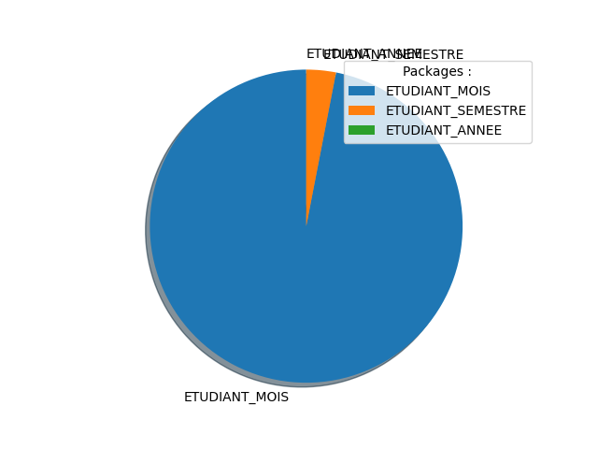
Graph

Slide 4
Les packages Etudiant Région
Package | Frais | Crm | Ussd | Total | Coût
ETUDIANT_MOIS_REGION | 3300 | 4 | 0 | 4 | 13200
ETUDIANT_SEMEST_REGION | 18810 | 0 | 0 | 0 | 0
ETUDIANT_ANNEE_REGION | 33660 | 0 | 0 | 0 | 0

Slide 5
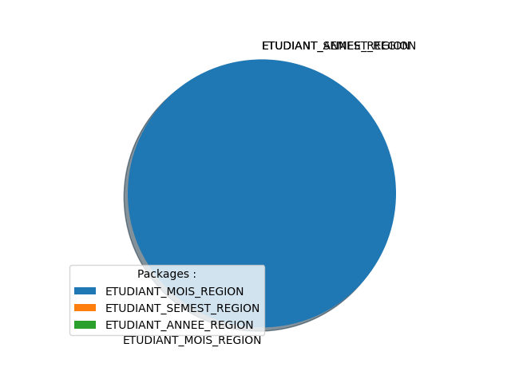
Graph

Slide 6
Les packages Résidentiel
Package | Frais | Crm | Ussd | Total | Coût
RESIDENTIEL_3M_MOIS | 11495 | 22 | 2 | 24 | 275880
RESIDENTIEL_3M_SEMESTR | 65520 | 0 | 0 | 0 | 0
RESIDENTIEL_3M_ANNEE | 117250 | 0 | 0 | 0 | 0
RESIDENTIEL_4M_MOIS | 16995 | 2 | 0 | 2 | 33990
RESIDENTIEL_4M_SEMESTR | 96870 | 0 | 0 | 0 | 0
RESIDENTIEL_4M_ANNEE | 171350 | 0 | 0 | 0 | 0
RESIDENTIEL_5M_MOIS | 21395 | 5 | 0 | 5 | 106975
RESIDENTIEL_5M_SEMESTR | 121950 | 0 | 0 | 0 | 0
RESIDENTIEL_5M_ANNEE | 218230 | 0 | 0 | 0 | 0
RESIDENTIEL_6M_MOIS | 29095 | 3 | 0 | 3 | 87285
RESIDENTIEL_6M_SEMESTR | 165840 | 0 | 0 | 0 | 0
RESIDENTIEL_6M_ANNEE | 296770 | 0 | 0 | 0 | 0

Slide 7
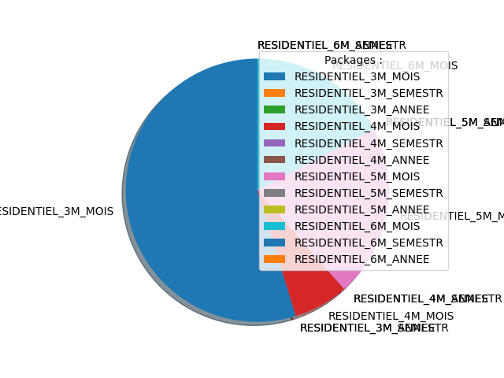
Graph

Slide 8
Les packages Grand Public Postpaid
Package | Frais | Crm | Ussd | Total | Coût
GRAND_PUBLIC_1M_MOIS | 2750 | 0 | 0 | 0 | 0
GRAND_PUBLIC_1M_SEMEST | 15675 | 0 | 0 | 0 | 0
GRAND_PUBLIC_1M_ANNEE | 28050 | 0 | 0 | 0 | 0
GRAND_PUBLIC_3M_MOIS | 9900 | 3 | 1 | 4 | 39600
GRAND_PUBLIC_3M_SEMEST | 56430 | 0 | 0 | 0 | 0
GRAND_PUBLIC_3M_ANNEE | 100980 | 0 | 0 | 0 | 0
GRAND_PUBLIC_4M_MOIS | 15400 | 2 | 0 | 2 | 30800
GRAND_PUBLIC_4M_SEMEST | 87780 | 0 | 0 | 0 | 0
GRAND_PUBLIC_4M_ANNEE | 157080 | 0 | 0 | 0 | 0
GRAND_PUBLIC_5M_MOIS | 19800 | 0 | 0 | 0 | 0
GRAND_PUBLIC_5M_SEMEST | 112860 | 0 | 0 | 0 | 0
GRAND_PUBLIC_5M_ANNEE | 201960 | 0 | 0 | 0 | 0
GRAND_PUBLIC_6M_MOIS | 27500 | 0 | 0 | 0 | 0
GRAND_PUBLIC_6M_SEMEST | 156750 | 0 | 0 | 0 | 0
GRAND_PUBLIC_6M_ANNEE | 280500 | 0 | 0 | 0 | 0

Slide 9
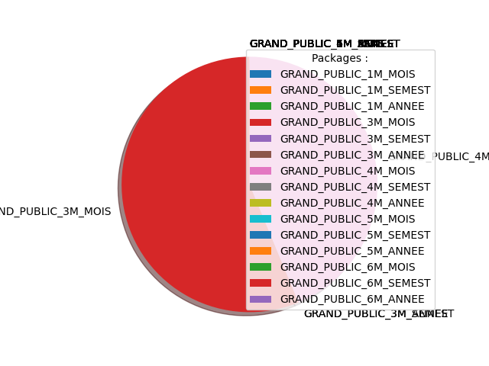
Graph

Slide 10
Les packages Employee
Package | Frais | Crm | Ussd | Total | Coût
EMPLOYE_2M | 2750 | 0 | 3 | 3 | 8250
EMPLOYE_4M | 9900 | 0 | 0 | 0 | 0
EMPLOYE_6M | 15400 | 0 | 0 | 0 | 0
EMPLOYE_8M | 19800 | 0 | 0 | 0 | 0
EMPLOYE_10M | 27500 | 0 | 0 | 0 | 0

Slide 11
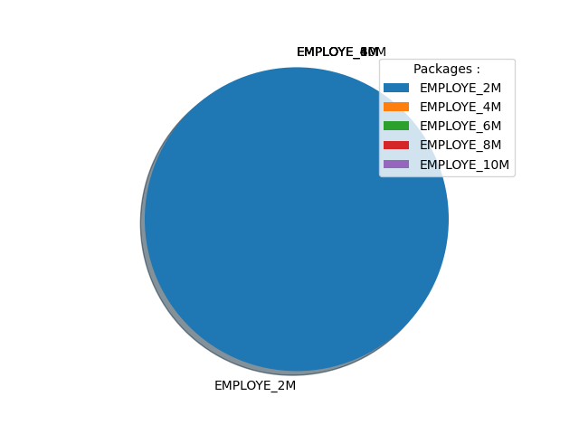
Graph

Slide 12
Packages Frais de Rétablissement
Package | Frais | Crm | Ussd | Total | Coût
FRAIS_RETABLISSEMENT | 1100 | 14 | 1 | 15 | 16500

Slide 13
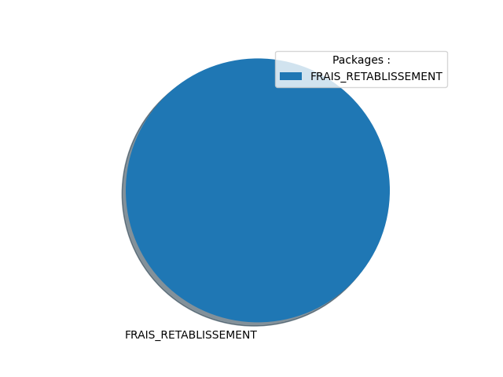
Graph

Slide 14
Les packages Voix
Package | Frais | Crm | Ussd | Total | Coût
VOIX_MOIS | 1595 | 3 | 3 | 6 | 9570
VOIX_SEMESTRE | 9092 | 0 | 0 | 0 | 0
VOIX_ANNEE | 16269 | 0 | 0 | 0 | 0

Slide 15
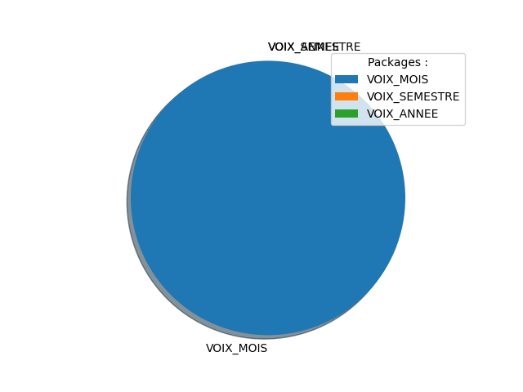
Graph

Slide 16
Les packages Giga Sup
Package | Frais | Crm | Ussd | Total | Coût
GIGASUP_10GO | 550 | 49 | 121 | 170 | 93500
GIGASUP_30GO | 1650 | 14 | 11 | 25 | 41250
GIGASUP_50GO | 2750 | 16 | 5 | 21 | 57750
GIGASUP_100GO | 4400 | 5 | 7 | 12 | 52800
GIGASUP_200GO | 6600 | 24 | 2 | 26 | 171600

Slide 17
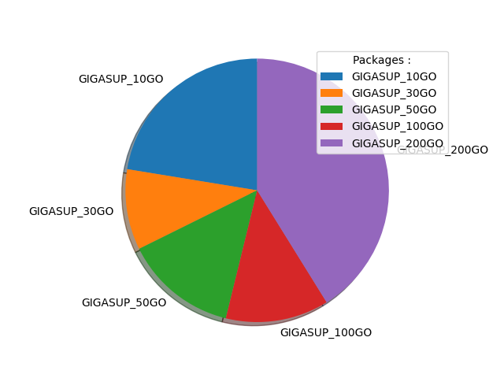
Graph

Slide 18
Les packages Voix Sup
Package | Frais | Crm | Ussd | Total | Coût
VOIXSUP_60MINS | 250 | 0 | 4 | 4 | 1000
VOIXSUP_150MINS | 500 | 0 | 3 | 3 | 1500
VOIXSUP_330MINS | 1000 | 2 | 0 | 2 | 2000

Slide 19
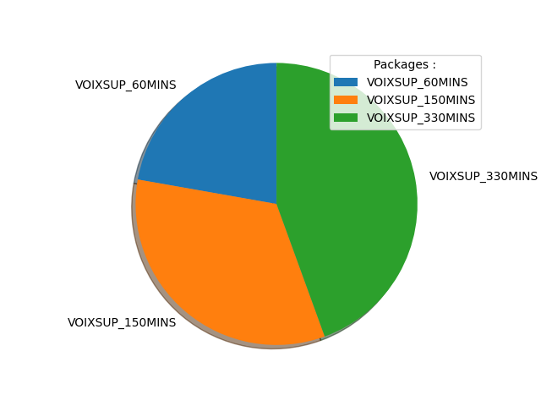
Graph

