Slide 1



Running Linux in Azure and other cool things
Alexey Bokov
Windows Azure evangelist
abokov@microsoft.com
azure_cee

Slide 2
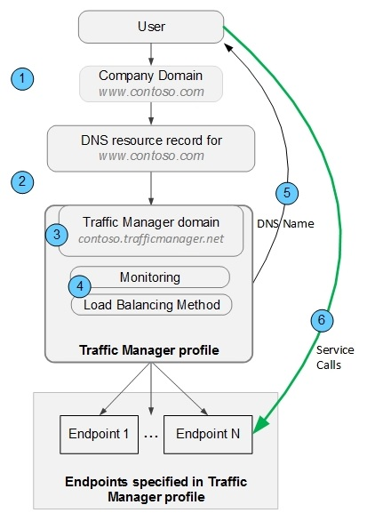
Traffic Manager – how it works ?
Notes:
1,000 new customers per day
1,000,000 cores milestone achieved September last year
1.6 Hexabyte milestones achieved at the end of last year

Slide 3

Use Azure to load
Balancing (round robin)
www.cloudtechnologies.org
ou.gs (198.12.153.248 )
GoDaddy hosting
topconf.trafficmanager.net
Mode: roundrobin
topconf2.cloudapp.net
Microsoft Azure hosting
Notes:
1,000 new customers per day
1,000,000 cores milestone achieved September last year
1.6 Hexabyte milestones achieved at the end of last year

Slide 4

Use Azure as disaster recovery for your site
cloudtechnologies.org
ou.gs (198.12.153.248 )
GoDaddy hosting
topconf.trafficmanager.net
Mode: Failover
topconf2.cloudapp.net
Microsoft Azure hosting
Notes:
1,000 new customers per day
1,000,000 cores milestone achieved September last year
1.6 Hexabyte milestones achieved at the end of last year

Slide 5

Yes, it works!!!!

Slide 6

Traffic Manager - pricing model
First 1 billion DNS queries /month | $0.75 per million queries
Over 1 billion DNS queries / month | $0.375 per million queries
Health Checks (Azure) | $0.50 per Azure endpoint / month
Health Checks (External) | $0.75 per External endpoint / month

