Slide 1
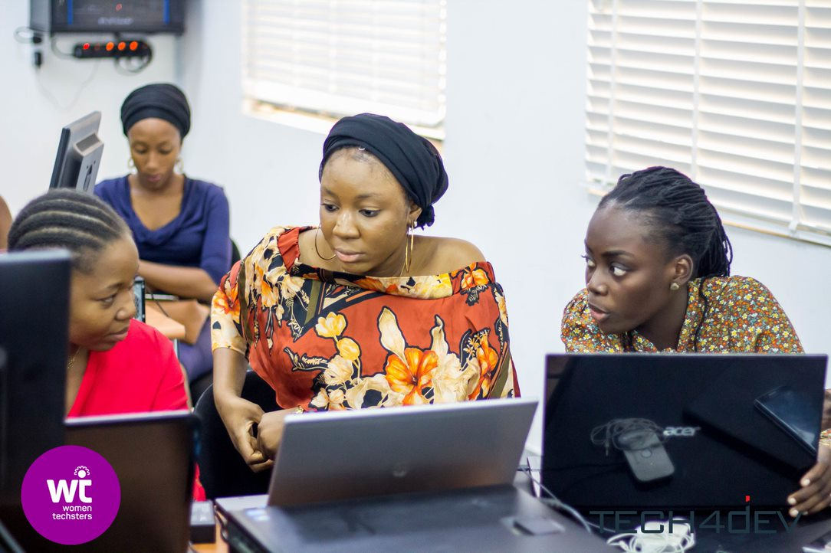



Data Science Projects
Women Techsters May/June 2021 Bootcamp
In partnership with

Slide 2
Group 1 & 4
Financial Inclusion in Africa – SDG #1 – No poverty
Info
Data
Submissions

Slide 3
Group 2
Sustainable Development Goals (SDGs): Text Classification Challenge - SDG #3 (Health and Well-Being)
Info
Data
Submissions

Slide 4
Group 3 & 5
Life Expectancy - SDG #3 (Health and Well-Being)
Info
Data
Submissions

