Slide 1

FOR PUPOSES OF FORAGE VIRTUAL WORK EXPERIENCE PROGRAM
Web scraping

Slide 2
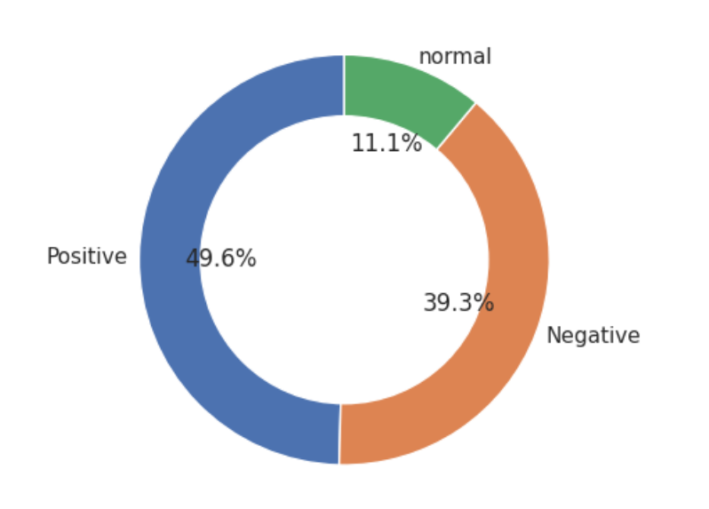
INSIGHTS FROM CUSTOMER REVIEWS
From cleaning 1000 reviews given by the customers, we obtained
POSITIVE REVIEWS: 496
NEGATIVE REVIEWS: 393
NORAM REVIEWS:111

