Slide 1

FOR PUPOSES OF FORAGE VIRTUAL WORK EXPERIENCE PROGRAM
Predicting customer buying behaviour

Slide 2
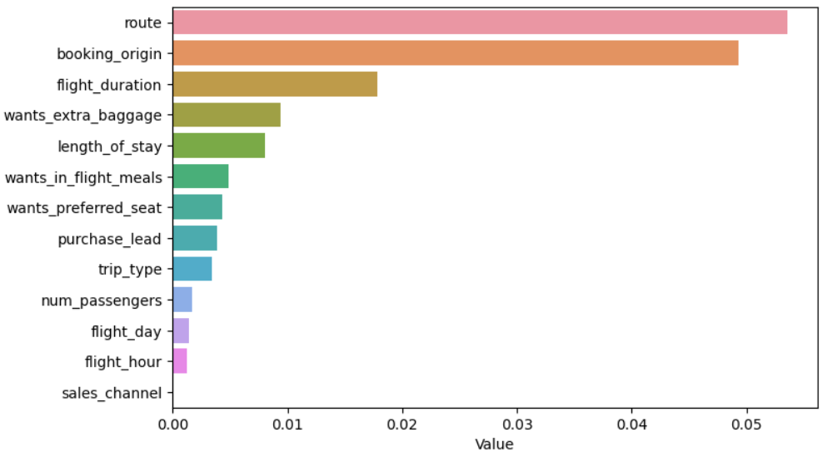
Results
The best accuracy is 85.2
for XGBoost model by using all features of our data set
You can watch the top 5 features which influence
Customer buying behavior
By: Abolfazl Aghdaee

