Slide 1


Framingham Heart Study Analysis
Presenter:
Abolfazl Ghandi Arani
Student ID:
810104229
Winter 2026

Slide 2
Project Overview & Methodology
01
Objective
Identify and quantify risk factors associated with 10-year coronary heart disease risk
02
Dataset
Framingham Heart Study with 4,240 participants including demographic, behavioral, and medical markers
03
Data Handling
Missing values imputed: Glucose (mean), Education (mode) to preserve sample size
04
Analysis
Data visualization, hypothesis testing, and regression modeling using Logistic and Lasso regression

Slide 3
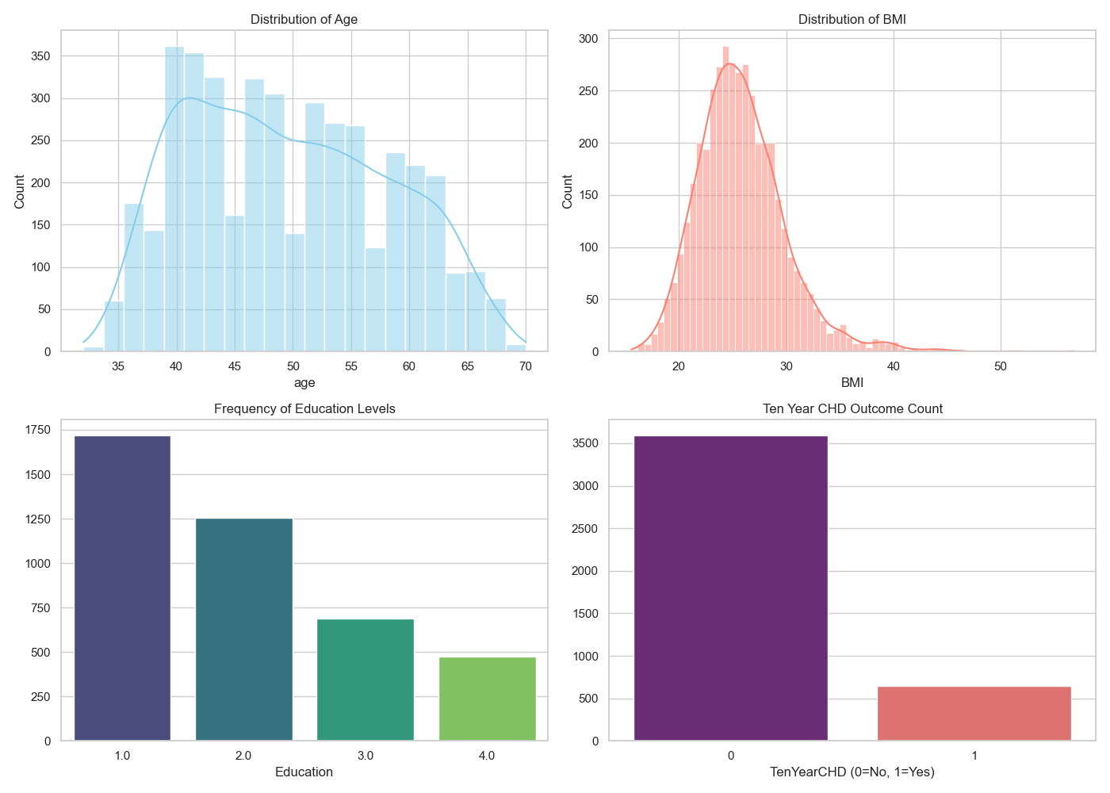
Demographics & Class Imbalance
Age Distribution
High concentration of middle-aged individuals representing at-risk demographic
BMI Profile
Right-skewed distribution with significant portion in overweight/obese range (BMI > 25)
Outcome Imbalance
Participants without CHD vastly outnumber those who developed it (0 vs 1)

Slide 4
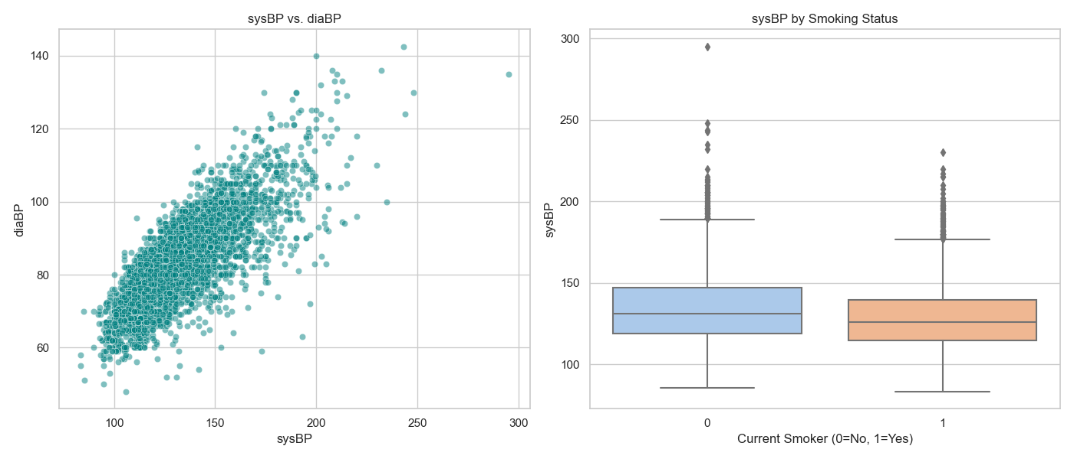
Bivariate Analysis: Blood Pressure & Smoking
Correlation Pattern
Smoking Effect
Outlier Pattern
Strong positive linear relationship between Systolic and Diastolic BP (collinearity expected)
Median blood pressure is similar between smokers and non-smokers
Smokers exhibit wider spread of outliers, prompting further statistical testing on heart rate

Slide 5
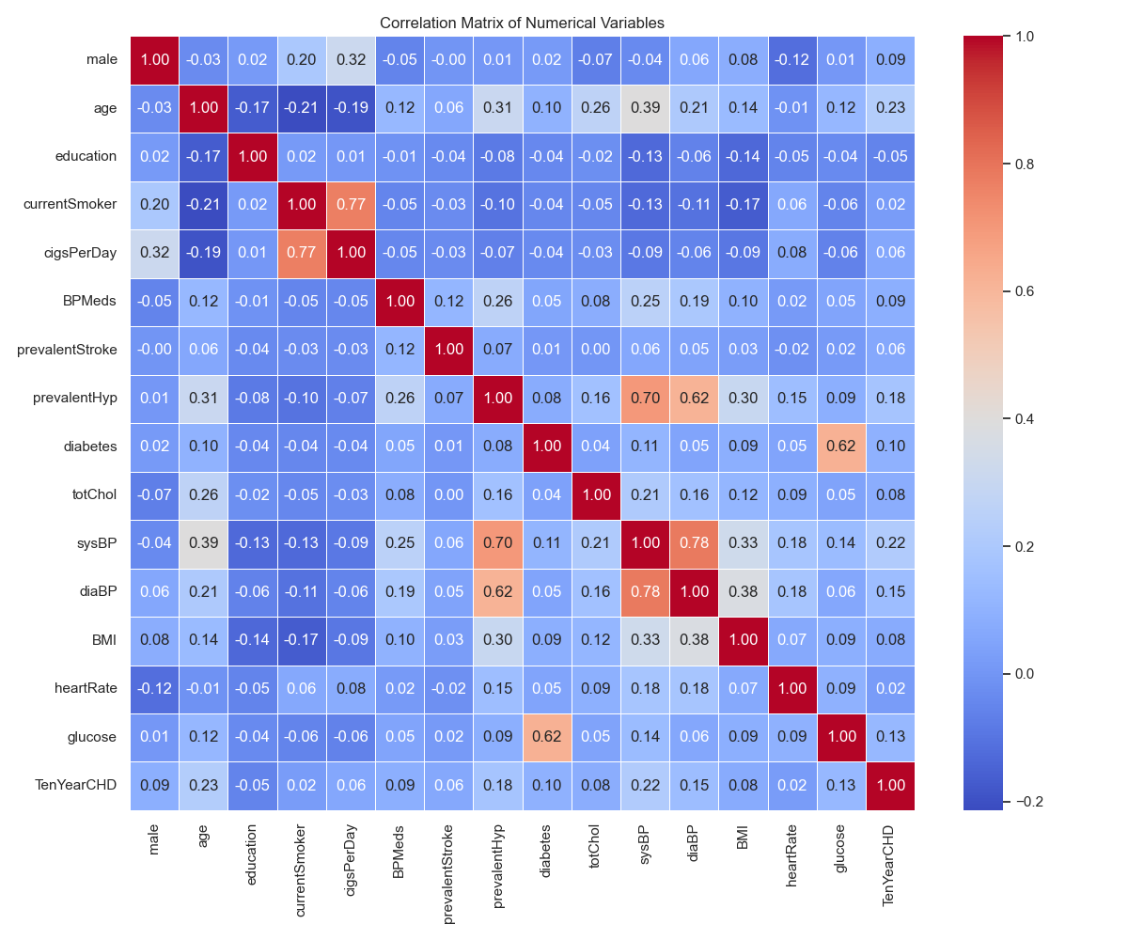

Correlation Analysis
Blood Pressure
Strongest correlation found between Systolic and Diastolic BP
Age Association
Moderate positive correlation with blood pressure (consistent with arterial stiffening)
Smoking & Heart Rate
Spearman's Rho shows statistically significant positive relationship (p < 0.05)
Physiological Effect: Confirms nicotine acts as a sympathomimetic, increasing heart rate

Slide 6
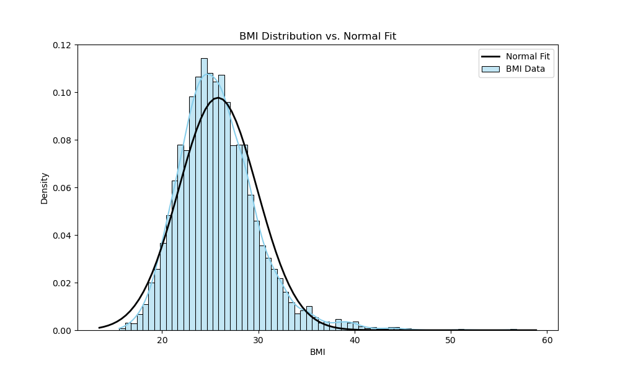
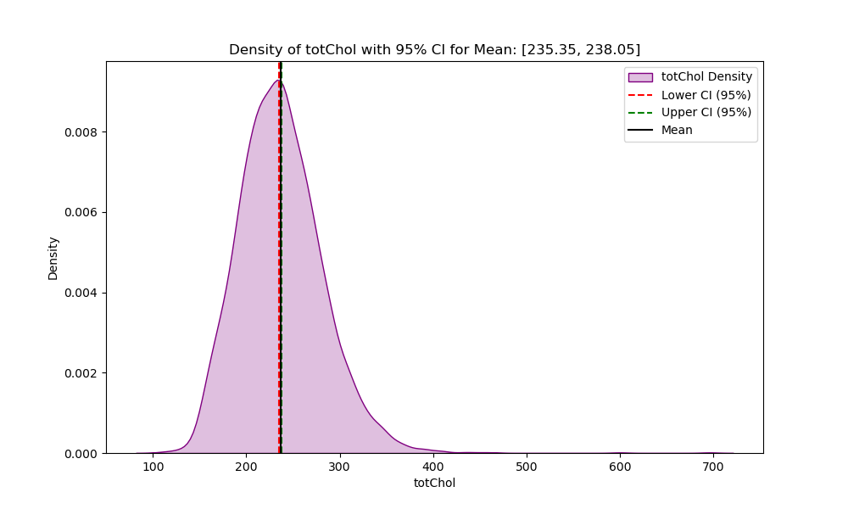
Statistical Estimation & Distributions
≈0
BMI Normality Test
Shapiro-Wilk test rejects normality; distribution is right-skewed
[235.35, 238.05]
Cholesterol CI
95% Confidence Interval for mean cholesterol (mg/dL)
Clinical Context
The population baseline is elevated compared to the desirable level (<200 mg/dL)

Slide 7



Hypothesis Testing Results
T-Test (Heart Rate)
Mann-Whitney U (Glucose)
Power Analysis
Reject Null Hypothesisp = 2.21e-5
Smokers have significantly higher heart rates
Sample size (N > 4000) provides >80% power to detect even small effect sizes
Reject Null Hypothesisp ≈ 0
Glucose levels differ significantly by diabetes status

Slide 8
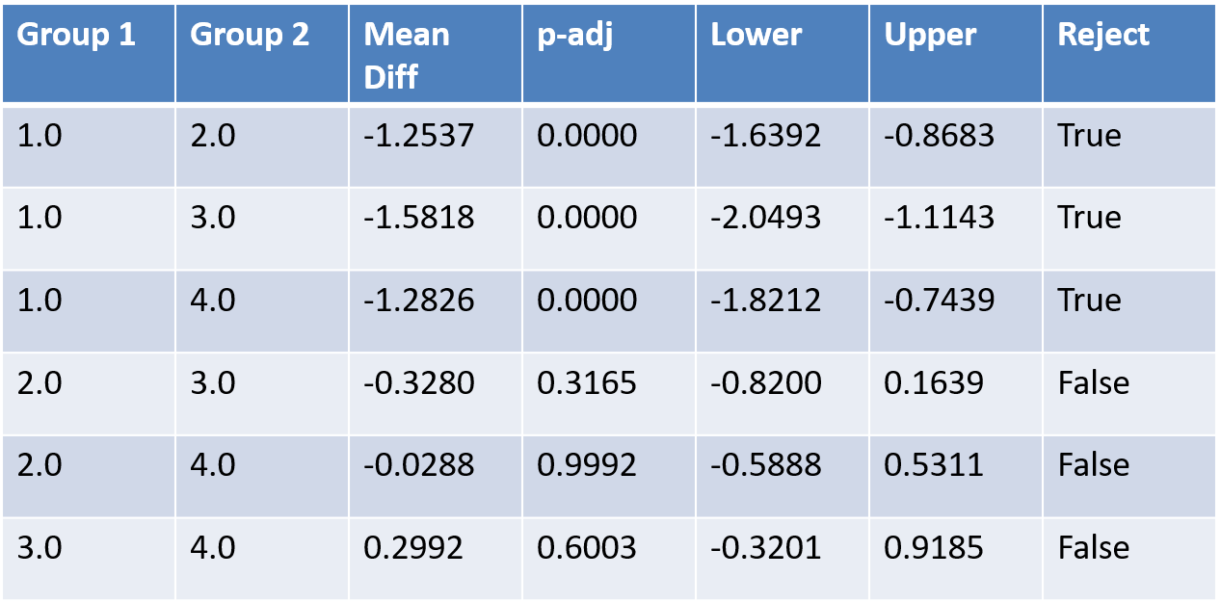




ANOVA: Socioeconomics & Obesity
Test Design
Result
Tukey's HSD
Comparing mean BMI across 4 Education Levels
Significant difference found (F=38.66, p ≈ 0)
Group 1 (Lowest Education) has significantly higher BMI than all other groups
Conclusion: Lower educational attainment is a strong indicator for obesity risk in this cohort

Slide 9
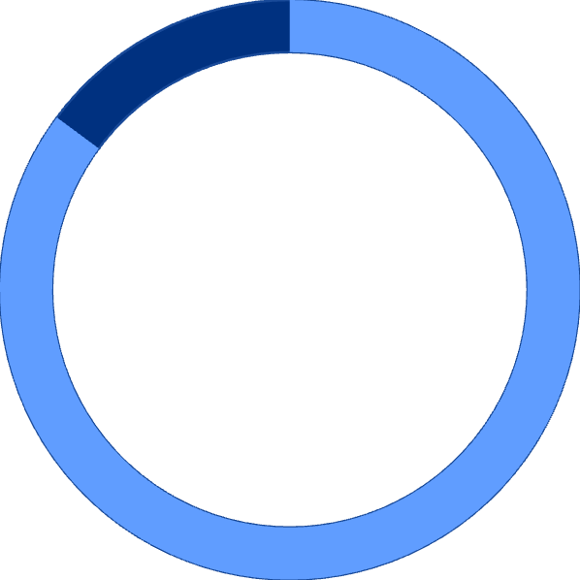




Logistic Regression: CHD Prediction
85.14%
Model Accuracy
In predicting 10-Year CHD risk
Top Predictor: Age
Key Predictor: SysBP
β = 0.57
Strongest driver of risk
β = 0.39
Major independent risk factor
Behavioral: CigsPerDay
Cholesterol Note
β = 0.25
Quantity matters distinct from smoker status
Showed weak predictive power when controlling for other factors

Slide 10




Lasso Regression: Determinants of SysBP
Methodology
Identify predictors of Systolic Blood Pressure using L1 Regularization
Diastolic BP
β = 15.72
Dominant feature
Age
β = 5.08
Secondary feature due to arterial stiffening
CigsPerDay
Coefficient shrunk to zero
Not a direct linear predictor when DiaBP is included

Slide 11



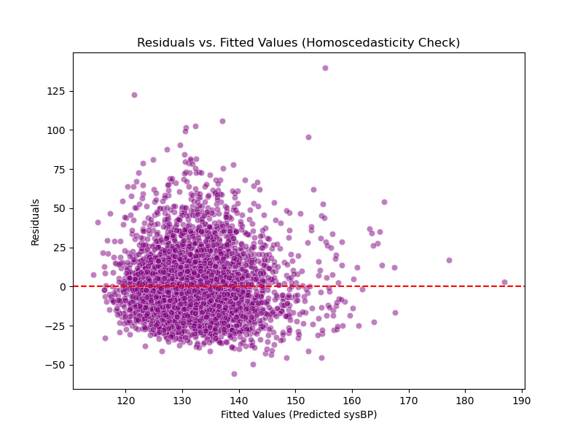
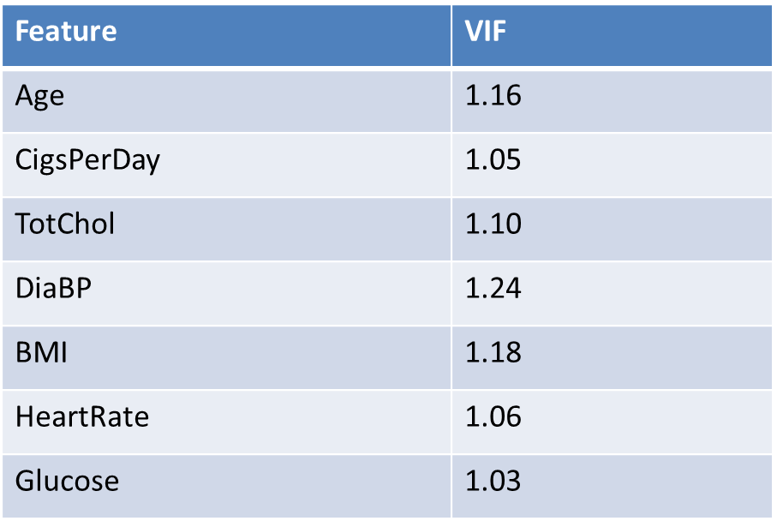
Model Diagnostics
Homoscedasticity
Multicollinearity
Conclusion
Residuals vs. Fitted plot shows random scatter (no funnel shape), validating linear assumptions.
All Variance Inflation Factors (VIF) are < 1.3, well below the threshold of 5.
Regression coefficients are stable, ensuring reliable statistical inference.

Slide 12
Final Conclusion
Primary Risks
Socioeconomic Link
Age and Systolic Blood Pressure are identified as the dominant drivers of 10-Year Coronary Heart Disease risk.
Lower educational attainment shows a clear statistical link to higher BMI, highlighting a crucial target for public health interventions.
Behavioral Impact
Analysis Summary
Smoking significantly elevates heart rate and is confirmed as a critical independent risk factor for CHD.
This comprehensive analysis successfully quantifies key cardiovascular risk factors using robust statistical inference methods, providing actionable insights for prevention.

