Slide 1

Machine Learning Operations (MLOps) Roadmap
Abolfazl Yarian
Summer 2023

Slide 2
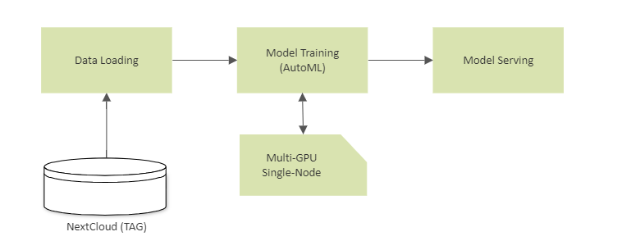
Step 1

Slide 3
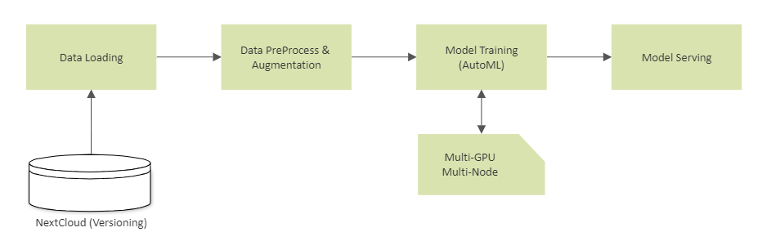
Step 2

Slide 4
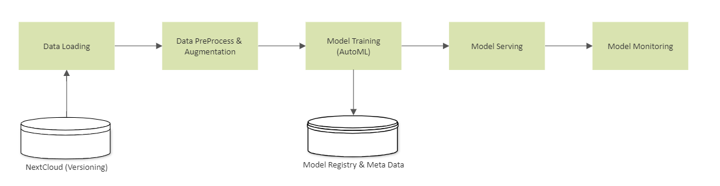
Step 3

Slide 5
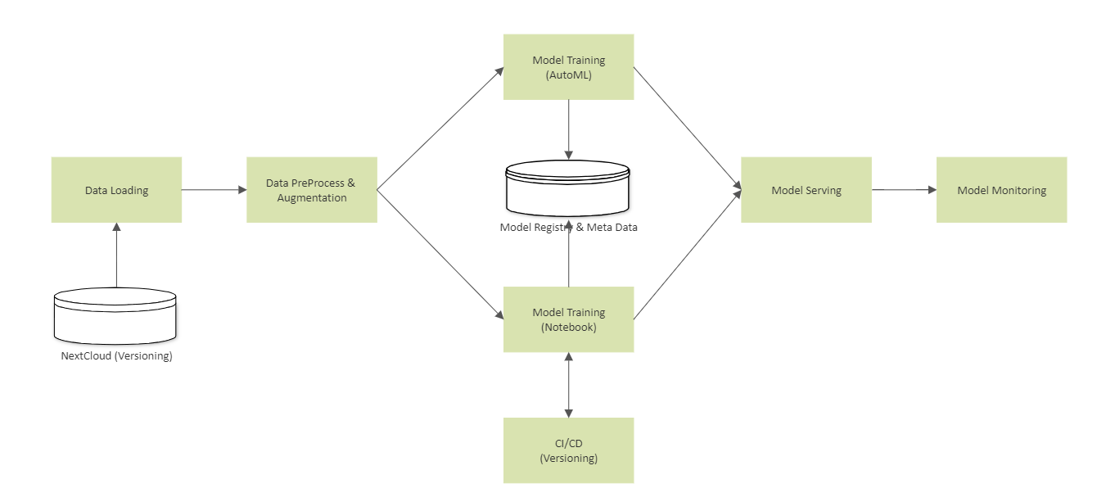
Step 4

Slide 6
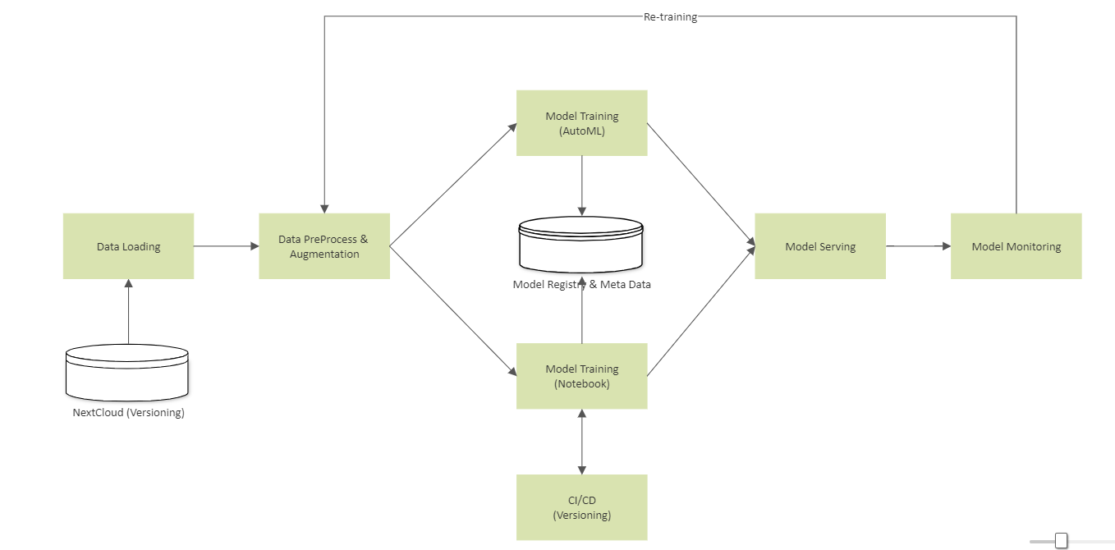
Step 5

