Slide 2
Case study On E-commerce website
Presented by-Aboli S. Vyawahare
Batch-E2E-Novelvista-.NET Core with Azure 17th May Batch3

Slide 3








Ecommerce Web API using ASP .Net & Angular
Implementation of Angular for the e-commerce application
Creation of ASP.Net core web API
Implementation of Controllers
& Models for Backend
SQL query commands for storing the data into database
Implementation of Login & Register part
Implementation of Authentication part for user & admin
Implementation of add products & edit products for the admin
Implementation of add to cart for the user

Slide 4
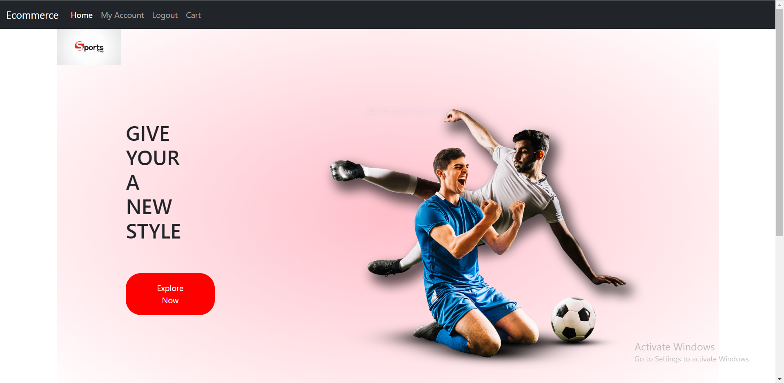
Home Page

Slide 5
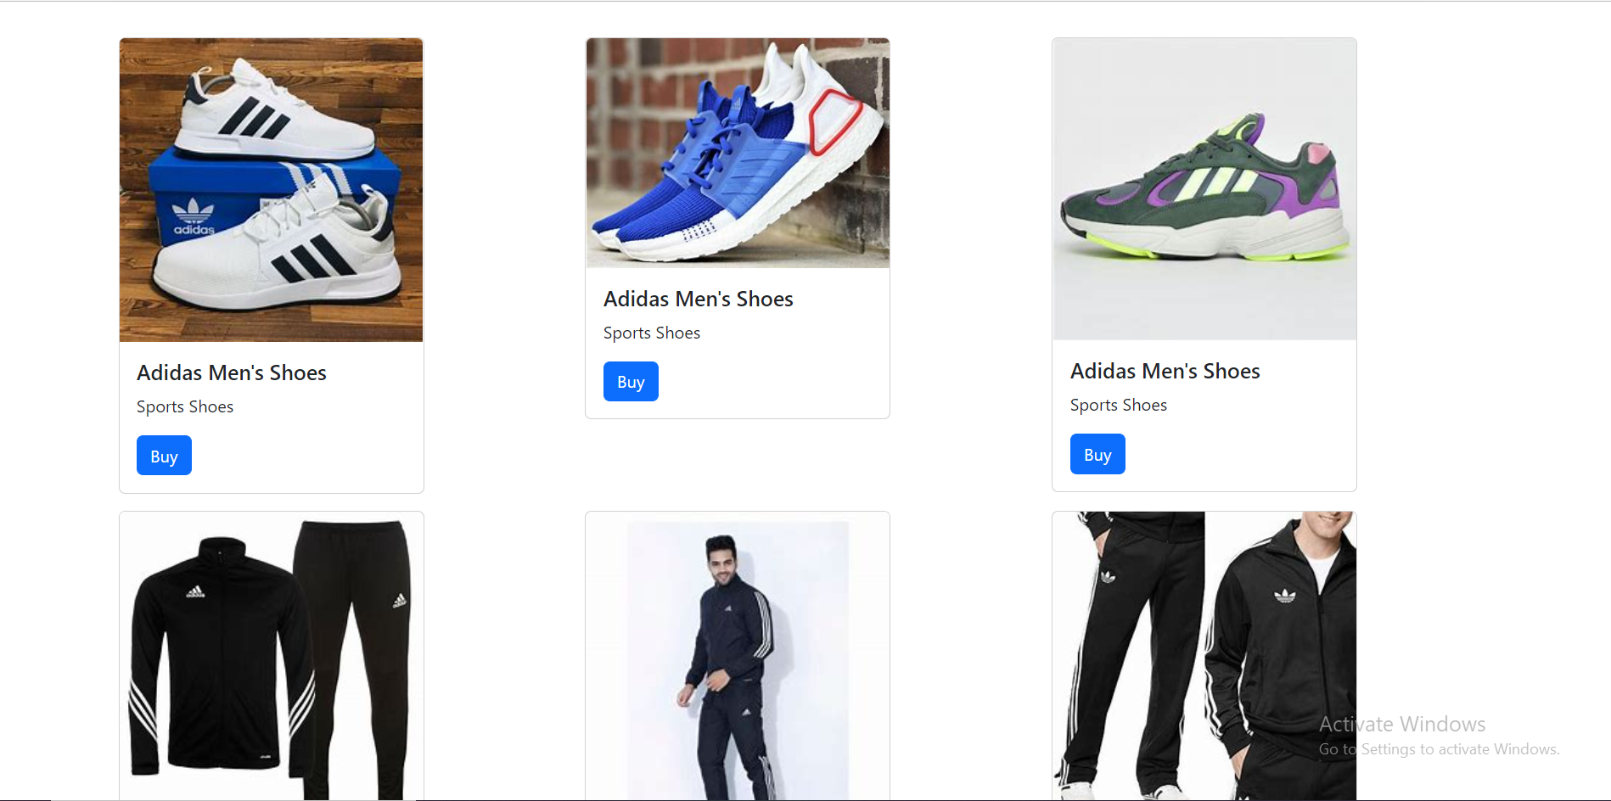
Product Page

Slide 6
THANK YOU

