Slide 1
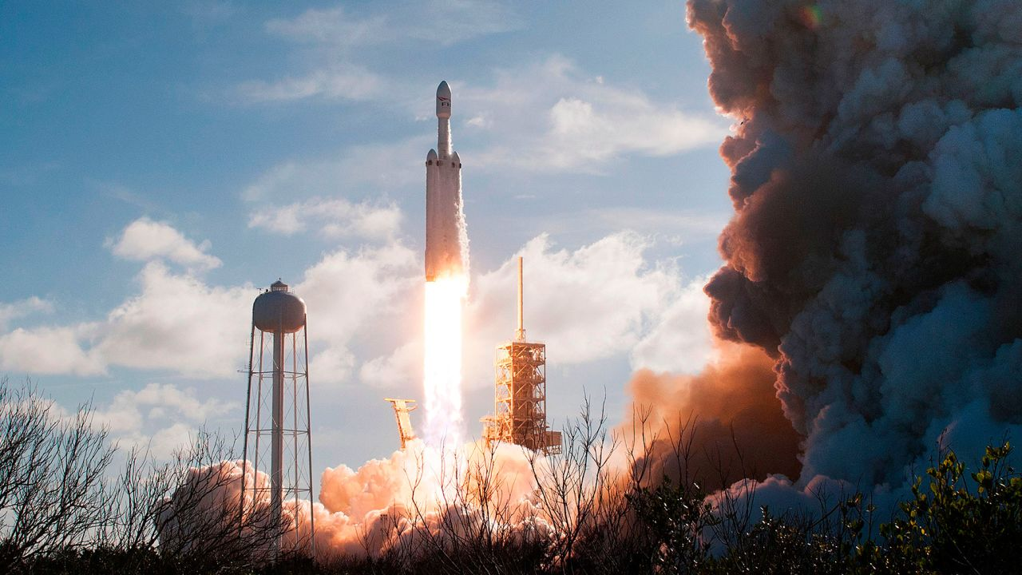






SpaceX Data Science Analysis
A. Bolzonello
25th August 2023

Slide 2


Contents
Executive Summary
Introduction
Methodology
Data Collection and Data Wrangling
Results
Visualization – Charts
Dashboard
Summary
Conclusion
Further Research

Slide 3
EXECUTIVE SUMMARY
The following report determines the success rate and factors of a successful SpaceX rocket launch by using data science models and tools to conduct the following steps to reach our results :
Data collection
Exploratory data analysis
Visualizations; and
Predictive analytics

Slide 4
INTRODUCTION
SpaceX's cost-effective Falcon 9 launches, priced at $62 million due to reusability, stand out against competitors' $165 million rates. Their 2010 achievement of recovering a spacecraft from low-earth orbit is historic. This capstone project aims to predict Falcon 9 first-stage landings, crucial for competitors, using available data.
By the end of this report, we will answer the following questions:
How payload mass, launch site, number of flights, and orbits affect first-stage landing success
Rate of successful landings over time
Best predictive model for successful landing

Slide 5
Methodologies
Data collection
SpaceX API
Falcon 9 historical launch records via Wikipedia and (https://en.wikipedia.org/wiki/List_of_Falcon/_9/_and_Falcon_Heavy_launches)
Data Wrangling
Prepare the data by cleaning and transforming it to uncover data patterns.
Perform exploratory data analysis (EDA)
Used visualization and SQL, to determine: total payload, payload range for successful launches, and total number of successful and failed outcomes
Create visual analytics using Folium and Plotly Dash
To explore factors to contributed to launch site success rates and to visualize launch sites that were the most successful.
Predictive analysis using classification models
To determine the best predictive model for landing outcomes we used logistic regression, support vector machine (SVM), decision tree and K-nearest neighbor (KNN)

Slide 6
Data Collection and Data Wrangling
Data Collection - API
Request data from SpaceX API (rocket launch data)
Decode response and create data frame
Filter data frame to contain only Falcon 9 launches
Replace missing values with average Payload Mass
Request data (Falcon 9 launch data) from Wikipedia
Create BeautifulSoup object from HTML response
Extract all column names for HTML tables
Create data frame through parsing the launch HTML tables
Data Wrangling
Summaries launch sites by site, orbit and mission outcome
Convert outcomes into 1 for a successful landing and 0 for an unsuccessful landing
Create landing outcome table
Data Collection – Web Scrapping

Slide 7
Results

Slide 8
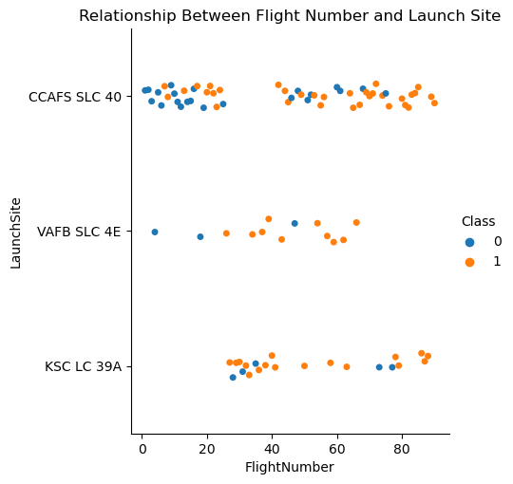
Flight Number vs. Launch Site
Observations:
VAFB SLC 4E and KSC LC 39A have higher success rates
The most frequent launches came from CCAFS SLC 40 launch site
Later flight in orange has a higher success rate than earlier flights in blue.

Slide 9
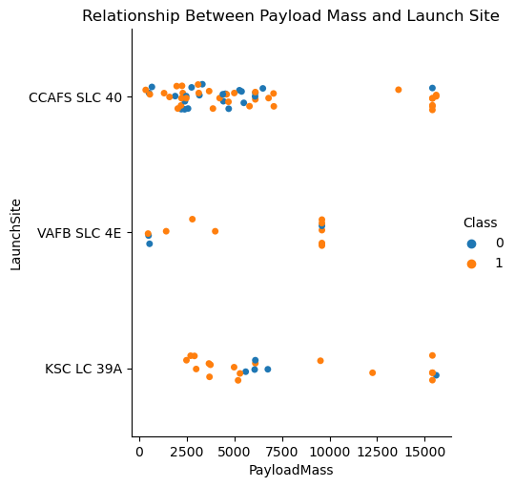
Payload vs Launch Site
Observations:
Typically, the higher the payload mass (kg), the higher the success rate
Most launches have a payload of less than 7500kg , however, launches over 7500 were a majority successful
KSC LC 39A has a 100% success rate for launches less than 5,500 kg

Slide 10
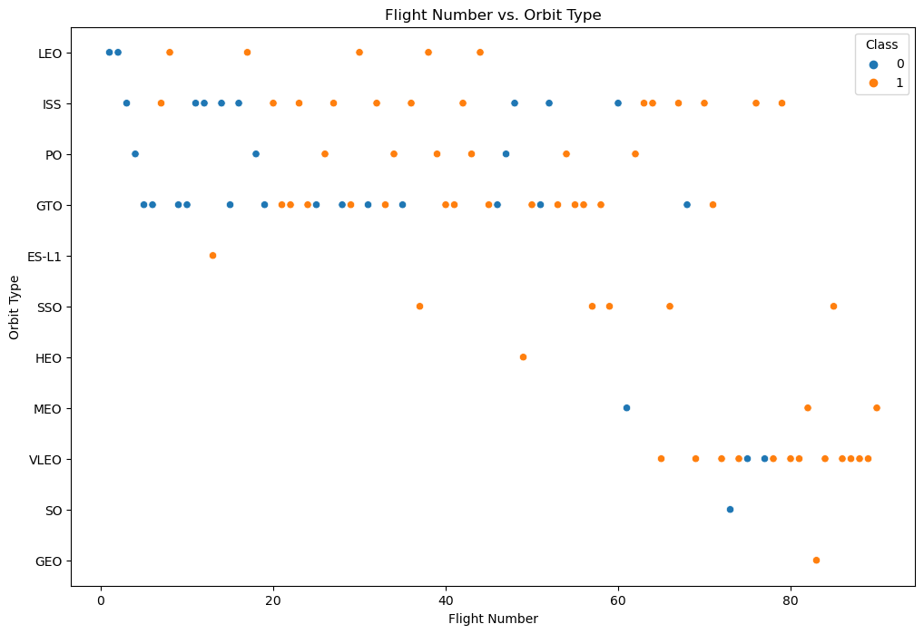
Flight Number vs. Orbit
Observations:
Success rate increases with the number of flights for each orbit except for GTO orbit

Slide 11
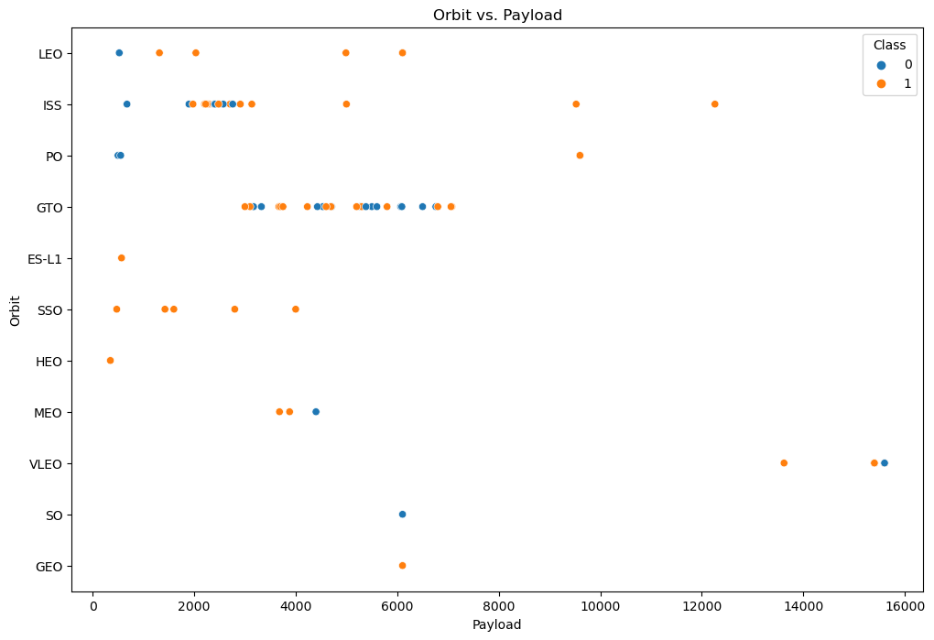
Payload vs. Orbit
Observations:
Heavier payload mass for PO, LEO and ISS orbits results in higher landing success

Slide 12
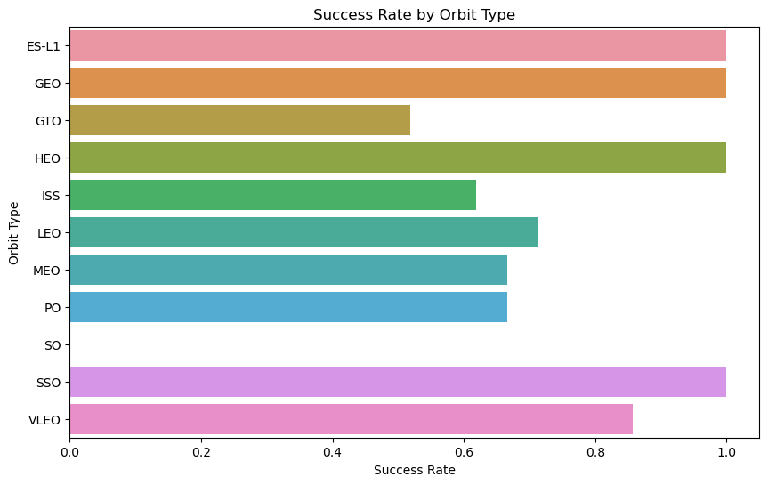
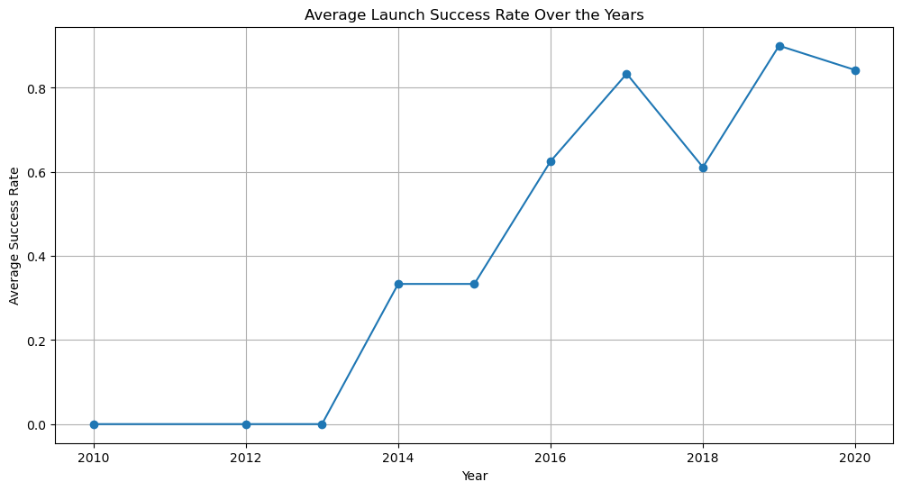
Success Rate
Success rate by Orbit type
ES-L1, GEO, HEO and SSO
100% Success Rate
GTO, ISS, LEO, MEO, PO
50%-80% Success Rate
SO
0% Success Rate
Yearly Trend
Over the past 10 years the average launch rates have continued to increase significantly with a drop in 2018

Slide 13
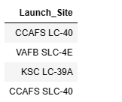

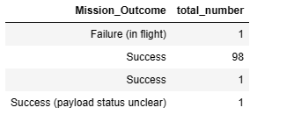
EDA with SQL - Findings
Names of launch sites:
Average payload mass carried by booster version F9 v1.1
Total number of successful and failure mission outcomes

Slide 14
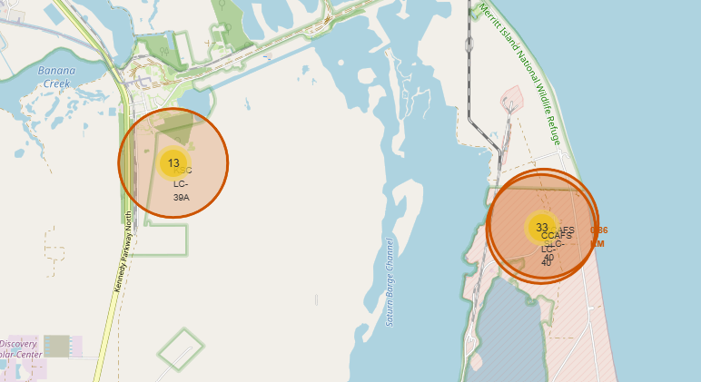
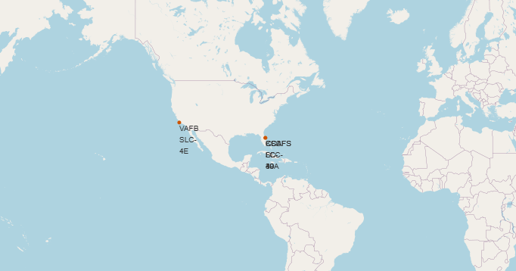
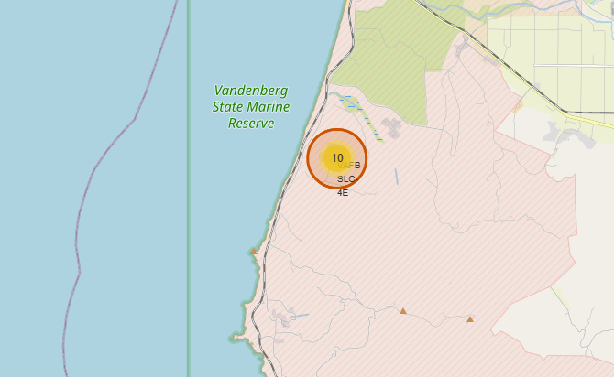
Launch Sites with Folium
Observations:
All launch sites are located on the equator
All launch site are in close proximity to coastlines

Slide 15
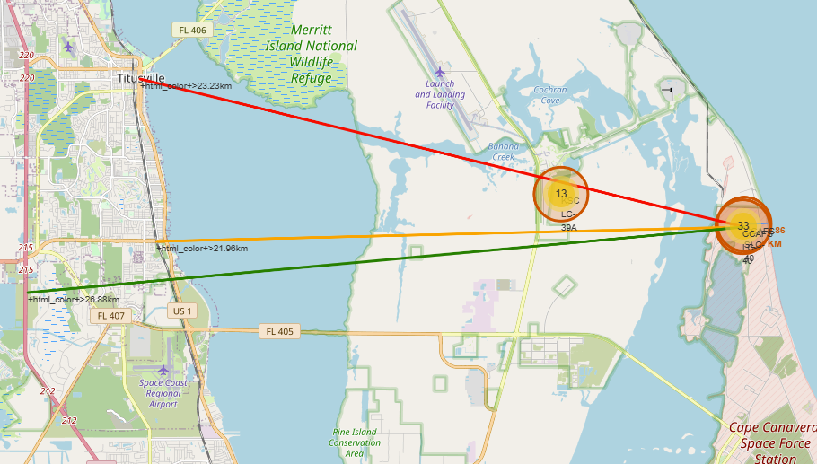

Launch Sites with Folium cont.
Launch sites are located far from cities to be safe but close enough to roads, rails and ports for the transport of people and material

Slide 16
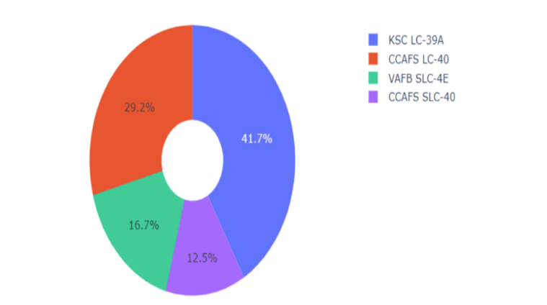
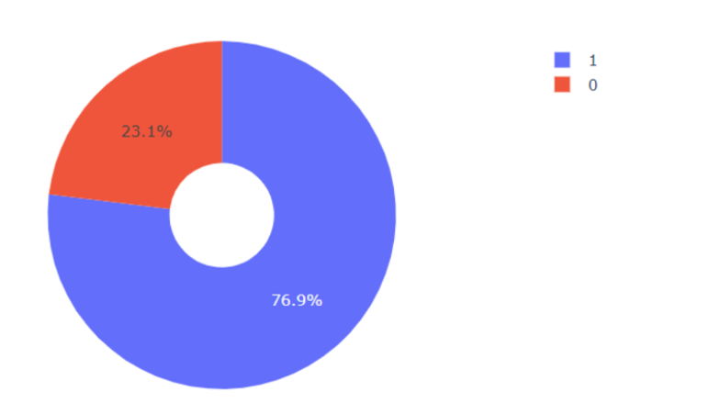
Launch Site with Plotly
KSC LC-39A have the most successful launches at a 76.9% success rate

Slide 17
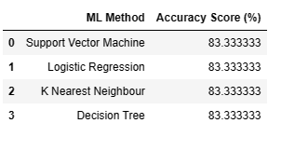
Machine Learning Prediction
All the models had the same accuracy scores possible due to the small sample size of 18
The Decision Tree slightly outperformed when we used GridSearchCV to determine the highest score (at 0.8892857142857145)

Slide 18
Summary

Slide 19
Conclusion
Component Success
Launch Site: KSC LC-39A had the highest success rate.
Orbits: ES-L1, GEO, HEO, SSO, VLEO had the highest success rates.
Successful landings over time
Launch success has improved over time from 2015 after the first successful outcome.
Best predictive model for successful landing.
The Decision tree classifier

Slide 20
Further Research
A large set would have determined a better predictive model.

