Slide 1
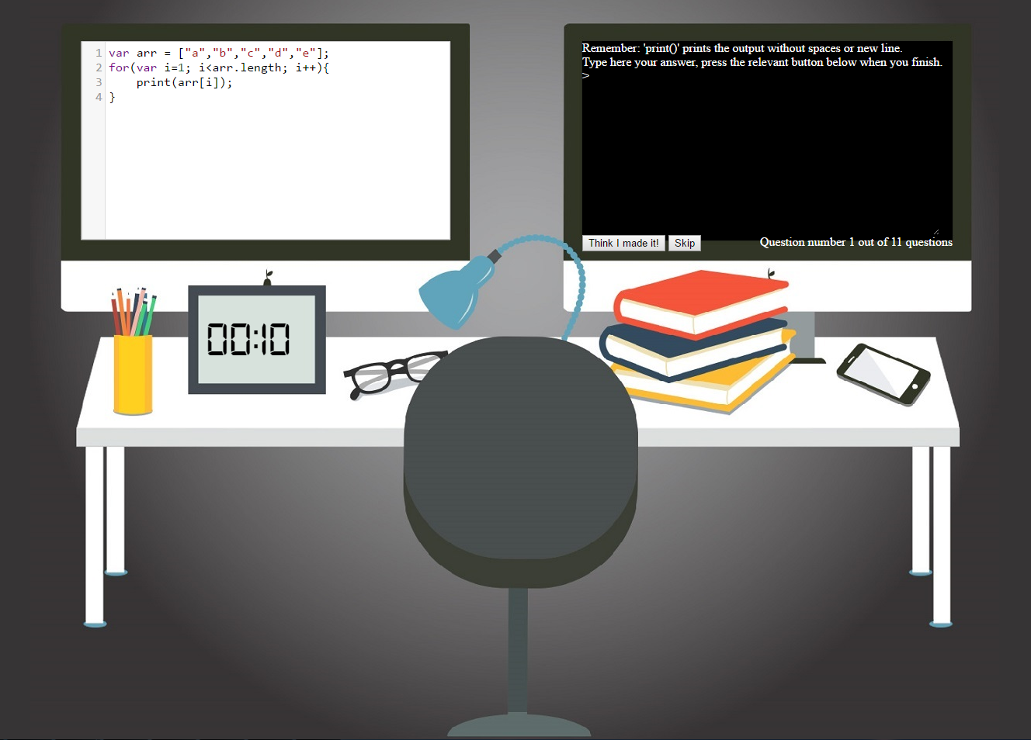
The code snippet is shown here
Type here the output of the code snippet shown on the left
'print()' prints the output without spaces or new line
Click here when you finish you
You can skip by clicking here
Remaining time for giving the output of the current code snippet
Your progress

