Slide 1

Steve Abonyo
DSF Phase 3 Project
24th May 2024

Slide 2

Overview
Classification model of Syria Tel Company on customer churn:
Aim:
Leading Reasons for high churn rate and how to mitigate them

Slide 3

Business Problem
To know if a customer will soon stop doing business with them.
This information is important to SyriaTel Company because the high churn rates have made them realise losses in their business

Slide 4

Implications of the Analysis
The company will eventually stop making losses due to the high churn rates
They will know the major reasons leading to high churn rates
They will improve their service/product delivery to reduce the customer churns

Slide 5

Data & Methodology
Data
Data provided was for SyriaTel Companyto solve a binary classification problem.
The target variable from this dataset is the customer churn rate.
Main factors affecting the customer churn are the total day charge/minutes and the customer service calls

Slide 6

Methodology
Data preview/cleaning: Check for missing, null values and data summary
EDA: Univariate and Bivariate Analysis
Preprocessing: Correlation, OHE, Multicolleniarity, scaling, handling imbalance
Classification models: Logistic regression, Decision Trees, Random Forests, Gradient Boosting, KNN, XGBoost and Cross Validation

Slide 7
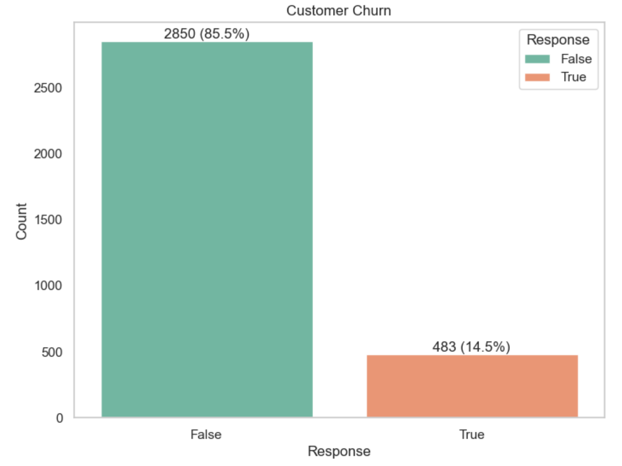
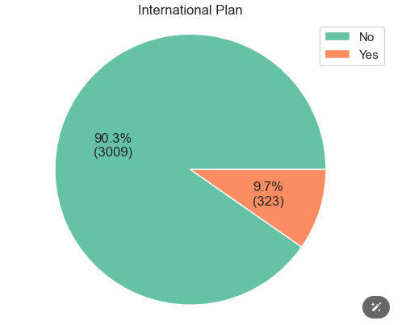
Results
Imbalance in the customer churn
Most customers are not in the international plan

Slide 8
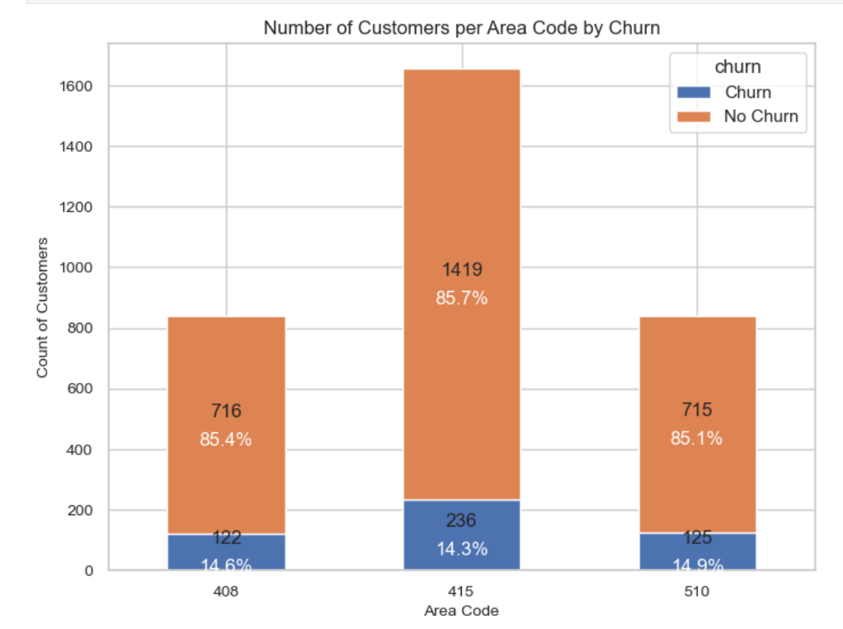
Results
The customer churn across all the 3 area codes is relatively the same, i.e., approximately 14%

Slide 9
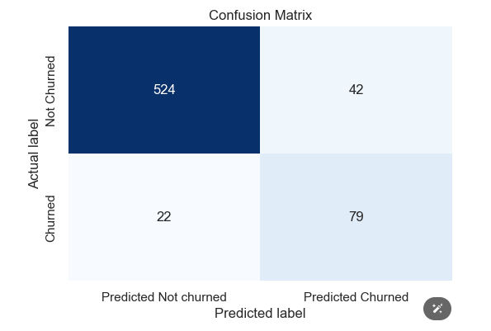
Results
Random Forest Model had the best performance with 524 customers correctly predicted as not churned

Slide 10
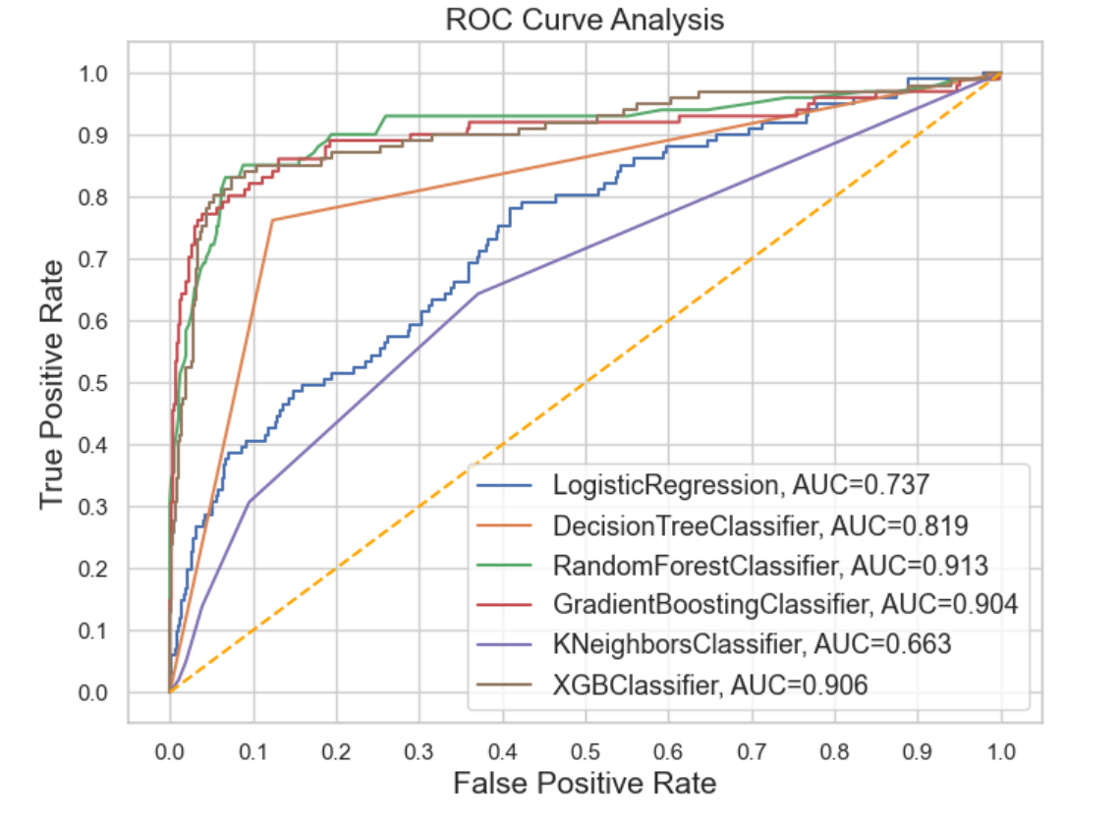
Results
The best performing model by checking the Area Under the ROC Curve (AUC) was the Random Forest

Slide 11


Conclusion
Key factors that influence customer churn
1. The total day charge/minutes
2. The Customer service calls

Slide 12
Recommendations
Offer better/impoved customer service techniques so as to reduce churn rate
Provide offers (better call rates, better data rates) to customers on their communication during daytime
Increase their international coverage/provide better options for their customers to make international calls.

Slide 13
Next Steps
Do more research on the which other Telecommunication company are shifting to and why so as to better their services.
After every specified duration, they should run an analysis to monitor customer churn rate so to mitigate losses do to high

