Slide 1
Honeypot Network System
Cybersecurity Project | Computer Networks | GNS3
By:
Abdulrahman abu Laila
Supervisor:
Dr.Jehad hamamreh
An-Najah National University

Slide 2
What is Honeypot?
Definition:
A Honeypot is a decoy system intentionally designed to look like a real target to lure attackers.
It records every action the attacker performs — without exposing real assets.
Used by: Microsoft, Cisco, financial institutions, government agencies.
How it works:
1. Attacker scans the network
2. Finds an easy-looking target
3. Connects to the Honeypot
4. Every action is logged silently
5. Real Server stays untouched

Slide 3
Main Goals of the Honeypot
Continuous Traffic Capture:
Logging all incoming network requests and packets directed at the isolated honeypot environment.
Threat Behavior Profiling:
Analyzing attacker techniques, such as port scanning, SSH brute-force attempts, and service exploitation.
Intelligence Gathering:
Collecting actionable security data, including attacker source IP addresses, timestamps, and targeted ports.
Log Review:
Producing and reviewing detailed system and firewall logs to understand the attack lifecycle without risking the actual network.

Slide 4

Tools and Technologies Used
GNS3(Graphical Network Simulator-3):
The core emulation platform used to build and design the virtual network topology.
FortiGate Firewall:
Used for network segmentation, traffic filtering, and securely routing the attacker to the honeypot environment.
Kali-Linux:
The attacker machine used to perform simulated cyber threats and penetration testing scenarios.
Ubuntu Server (Producion/Real Host):
Represents the actual internal server that needs protection, hosting legitimate services.
Ubuntu Server (Honeypot):
A decoy system configured with intentional vulnerabilities to attract and monitor malicious activites.

Slide 5
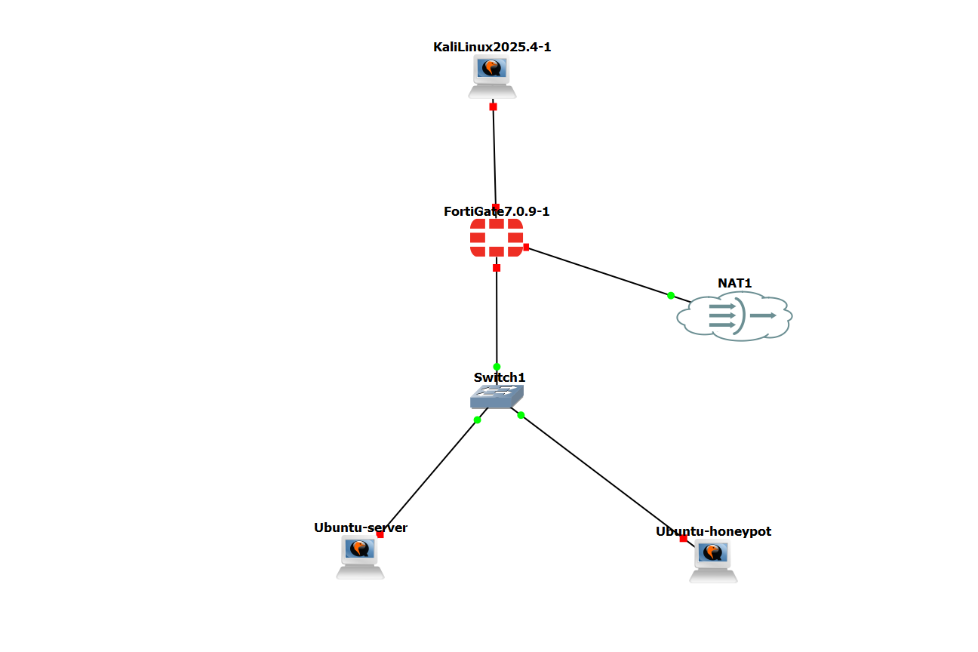
Network Topology & Architecture

Slide 6
IP Addressing & Connectivity Verification
Device | Interface | IP Address | Zone | Role
Kali linux | eth0 | 192.168.1.10 | WAN | Attacker
FortiGate | Port1 WAN | 192.168.1.1 | WAN | Gateway
FortiGate | Port2 LAN | 10.0.0.1 | LAN | Gateway
FortiGate | Port3 Wan | 192.168.122.1 | WAN | Internet
Honeypot | ens3 | 10.0.0.10 | LAN | Decoy
Real Server | ens3 | 10.0.0.20 | LAN | Protected

Slide 7
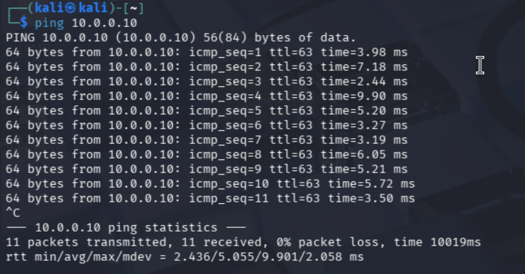
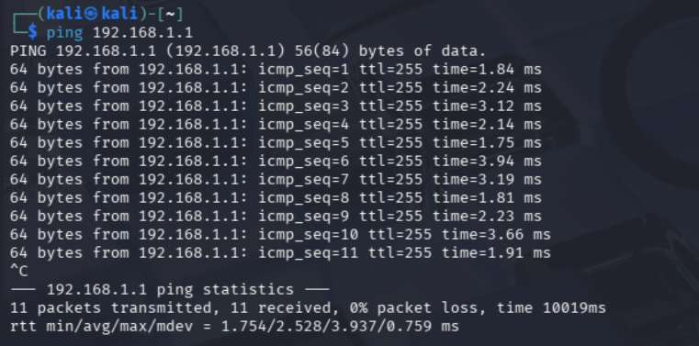
IP Addressing & Connectivity Verification
Ping to Honeypot From Kali-Linux
Ping to FortiGate From Kali-Linux

Slide 8
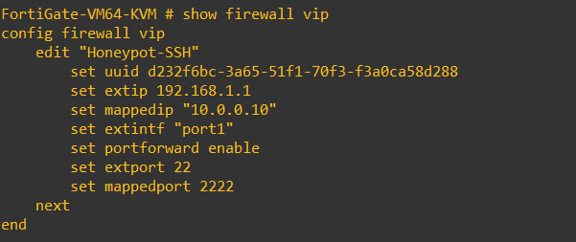
FortiGate Configuration:
Traffic Control & Port Forwarding
1.Virtual IP & Destination NAT (The Trap)
Action: Configured a Virtual IP (VIP) to map the external firewall address (192.168.1.134) to the internal Honeypot IP (10.0.0.2) on Port 2222.
Purpose: To transparently redirect all external SSH connection attempts directly into the Cowrie Honeypot service, which listens on Port 2222.

Slide 9
FortiGate Configuration:
Traffic Control & Port Forwarding
2.Security Policy Enforcement
Action: Implemented a specific IPv4 policy to allow traffic from the Attacker (WAN) to the Honeypot (DMZ) using the defined VIP.
Purpose: To ensure that any external interaction is strictly contained within the decoy system, leaving the production network completely invisible.
3.Outbound Connectivity (NAT Policy)
Action: Enabled a NAT-based policy for the Honeypot zone to access the internet (Port 3).
Purpose: To allow the system to fetch necessary updates, Cowrie dependencies, and Python libraries for the real-time dashboard.

Slide 10
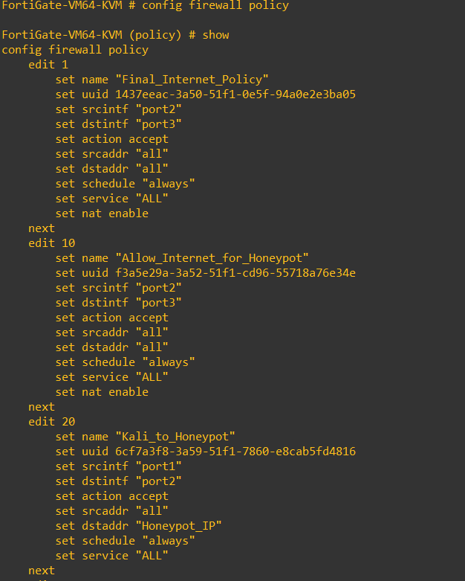
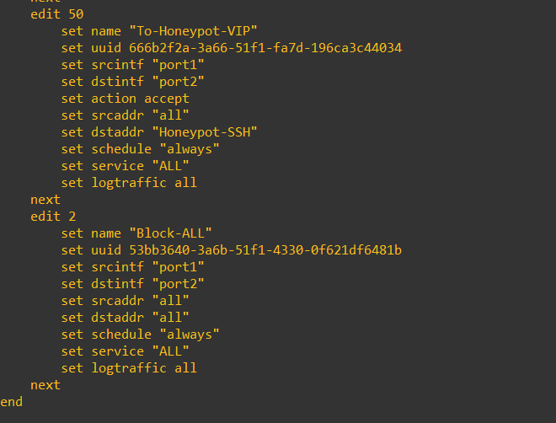
FortiGate Configuration:
Traffic Control & Port Forwarding

Slide 11
It provides a fake filesystem and shell environment that mimics a real Linux system to deceive attackers.
Honeypot Core:
Introduction to Cowrie
Definition:
Cowrie is a medium-to-high interaction SSH and Telnet honeypot designed to log brute force attacks and shell interaction.
Deception Mechanism:
Cowrie is a medium-to-high interaction SSH and Telnet honeypot designed to log brute force attacks and shell interaction.
Key Features:
Saves sessions in a format that can be replayed later.
Captures downloaded files and malware for analysis.
Detailed logging of every command executed by the attacker.

Slide 12
Why Cowrie? & Project Objectives
Medium Interaction Advantage:
It offers more than just an open port; it allows the attacker to log in and interact, providing deeper insights into their behavior.
Safe Isolation:
Combined with FortiGate, Cowrie ensures the attacker is trapped in a controlled environment without any risk to the real network.
Threat Intelligence:
It helps in identifying the common passwords, usernames, and tools used by attackers in real-time.
Customization:
Its Python-based architecture allowed for easy integration with our custom monitoring dashboard

Slide 13
Implementation: Cowrie Installation & Configuration
Environment Prepatation:
Installed essential Python dependencies and cloned the Cowrie repository to the Honeypot server.
Service Customization:
Configured cowrie.cfg to simulate a real server environment and set the service to listen on Port 2222
Exicution:
Started the service within an isolated virtual environment to capture redirected SSH traffic safely.
This is how it would look like when you successfully installed it.

Slide 14
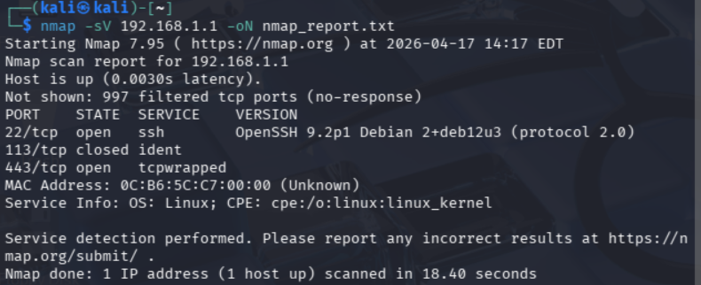
Attack Phase 1: Reconnaissance & Scanning
Tool Used: Nmap (Network Mapper).
Action: The attacker scans the target external IP (192.168.1.1) for open ports.
Result: Port 22 (SSH) is discovered open.
Impact: The attacker is successfully deceived into targeting the honeypot instead of the real production server, Thanks to FortiGate VIP rules.

Slide 15
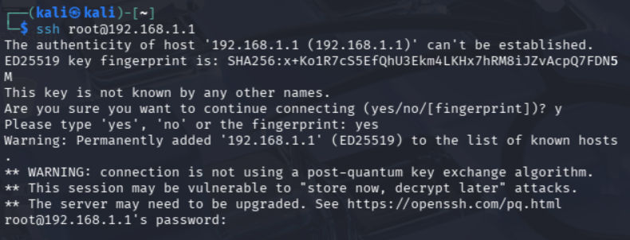
Attack Phase 2: Exploitation
(Manual &Automated)
Attack vector 1: Manual SSH Access
Action: The attacker attempts direct manual login using default administrative credentials(e.g. ssh root@target ).
Conclusion: The FortiGate VIP rule successfully intercepted the external SSH request and forwarded it silently to the Honeypot environment.
The appearance of the password: prompt confirms that the attacker is now directly interacting with the Cowrie service, completely isolated from the real network.

Slide 16
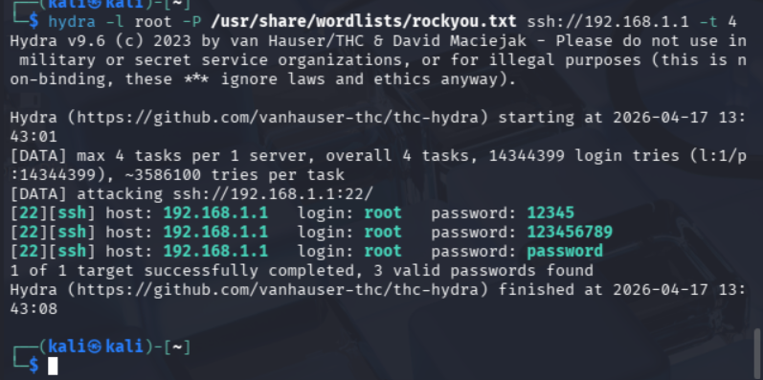
Attack Phase 2: Exploitation
(Manual &Automated)
Attack vector 2: Automated Brute-Force
Action: Lunching a dictionary attack against the SSH service using the Hydra tool and rockyou wordlist.
What is ‘Rockyou’?: The rockyou.txt is a famous wordlist containing over 14 million real-world leaked passwords. It is heavily used in penetration testing to simulate realistic dictionary attacks
Result:
Hydra successfully identified valid passwords,
Cowrie intentionally accepts these to let the attacker in.

Slide 17
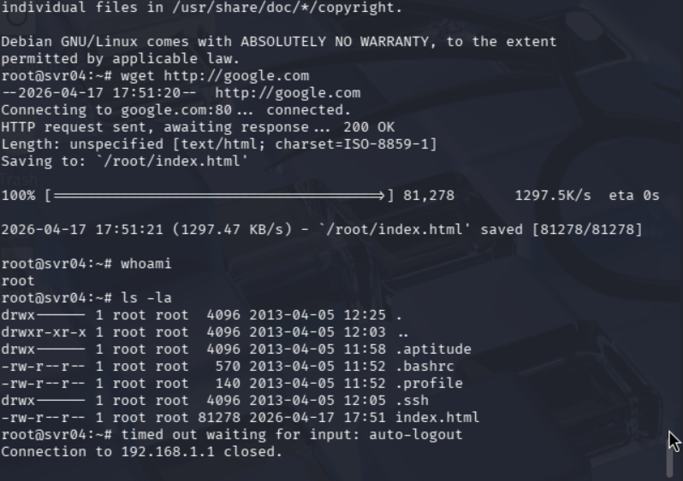
Attack Phase 3:
Post-Exploitation & Honeypot Interaction
The illusion of Success:
Once the attacker logs in, Cowrie provides a fully interactive “Fake Shell” that perfectly mimics a real ubuntu server

Slide 18
Attack Phase 3:
Post-Exploitation & Honeypot Interaction
Attacker Activity (Simulated):
System Reconnaissance: The attacker runs whoami (returns 'root') and ls -la to explore the file system
Malware Downloading: The attacker executes wget http://google.com to test internet connectivity and download files
The Trap in Action:
The attacker believes they have full control over the production server, but all actions are sandboxed, isolated, and safely recorded by the honeypot

Slide 19
Attack Phase 4:
Raw Data Collection & Logging
Session Capture: Cowrie successfully logs every incoming connection, recording the attacker’s source IP (192.168.1.10) and port.
Credential Harvesting: The logs explicity show the captured brute-force login attempts and the exact passwords used (e.g. 123456789, password).
Command Tracking: Every executed command (like wget, ls –la, and whoami)
Is recorded in real-time, providing the effectiveness of the interactive fake shell.
The Challenge: While comprehensive, analyzing thousands of lines of raw terminal logs is highly inefficient for rapid threat response.
IN THE NEXT PAGE YOU’LL SEE COWRIE LOGS

Slide 20
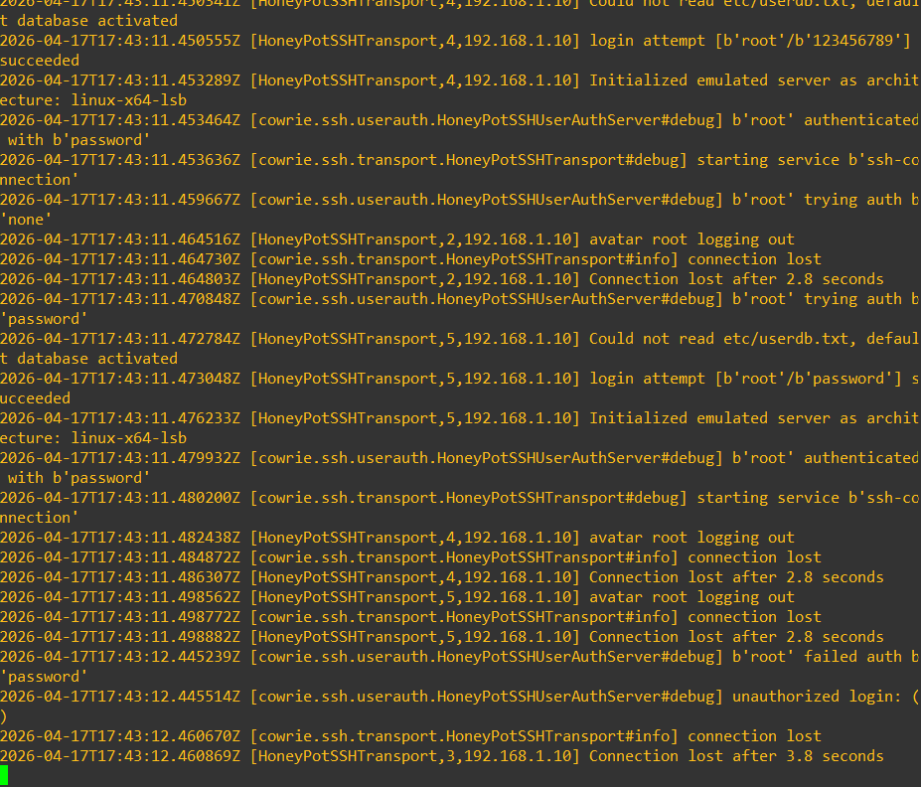
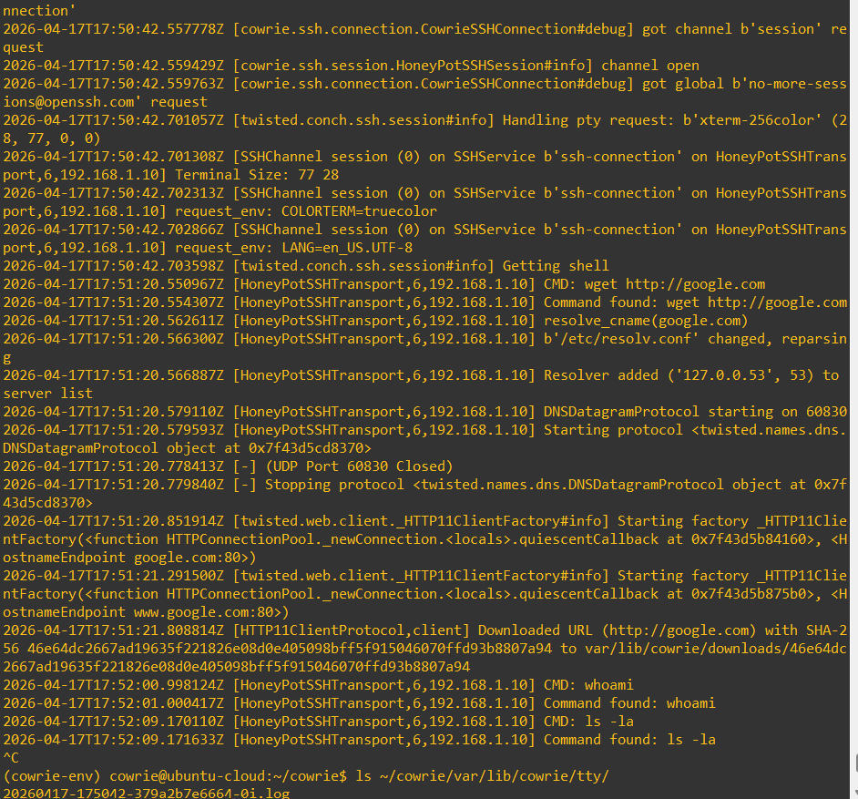
Attack Phase 4:
Raw Data Collection & Logging

Slide 21
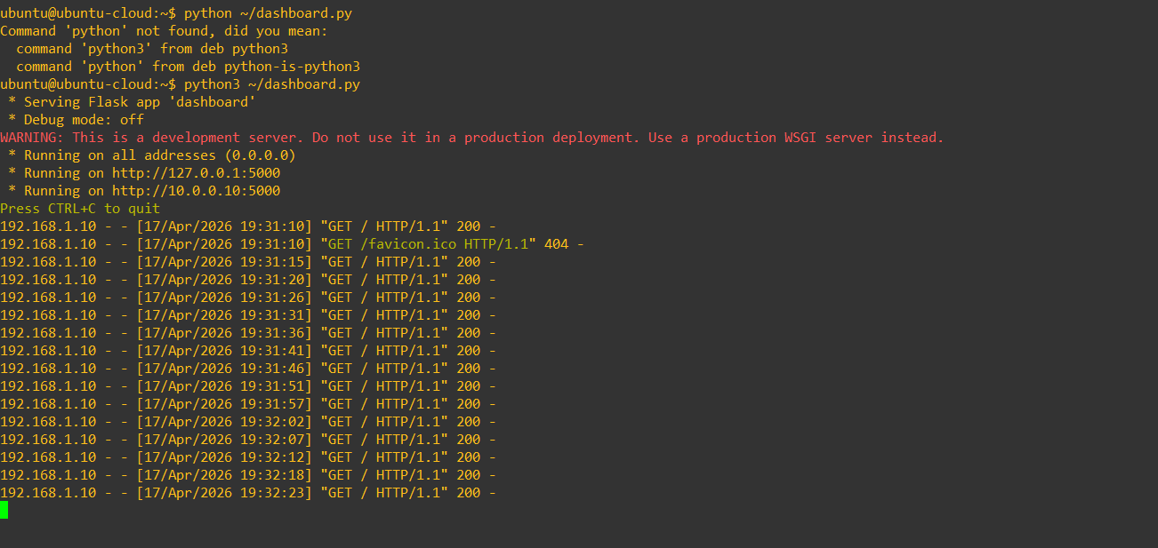
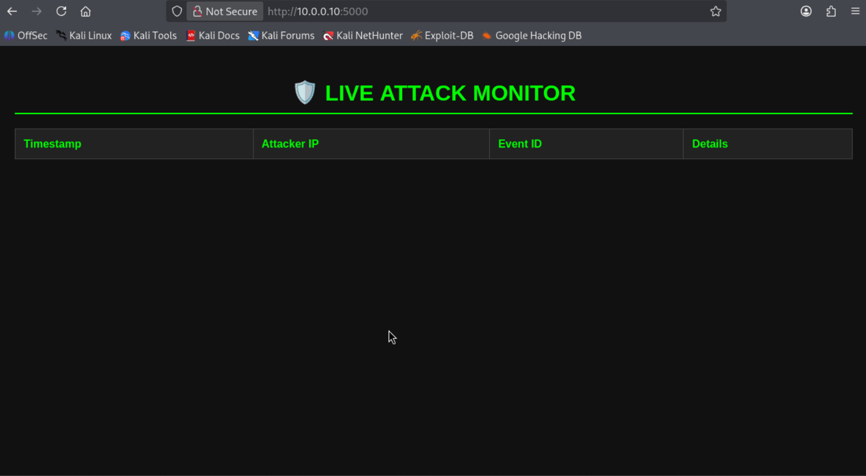
Phase 5: The Solution
Custom Web Dashboard
The Concept: Develpoed a Custom Python-based web application to bridge the gap between raw terminal logs and human alalysis.
The Mechanism: The dashboard automatically parses the complex Cowrie JSON log files and presents the data in a structured, easy-to-read graphical interface.
The Goal: To provide security administrators with a clear, real-time overview of the threat landscape, enabling faster inicident response.

Slide 22
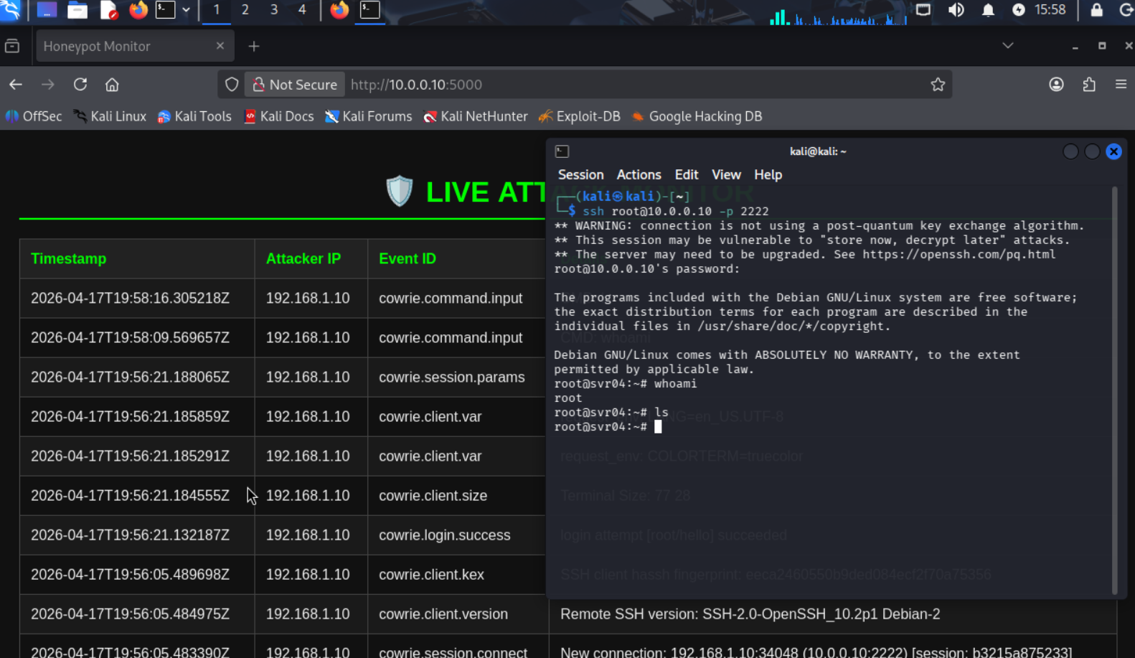
Phase 5: The Solution
Custom Web Dashboard
Here is a real-time test for the website

Slide 23
Conclusion & Project Imapct
Network Isolation: Successfully secured the production network by isolating threats inside a controlled DMZ using FortiGate VIP rules.
Active Deception: Cowrie effectively trapped attackers, capturing real-time brute-force attempts, IP addresses, and post-exploitation behavior.
Actionable Intelligence: Successfully transformed raw, complex terminal logs into a clear, visual web dashboard for rapid threat analysis.
End-to-End Security: Demonstrated a complete lifecycle from network design (GNS3) and firewall defense, to active monitoring and data visualization.
Thank you!

